Slide 1

The Global Economy
Production
(Where Output Comes From)
© NYU Stern School of Business
Notes:
Talk about issue: 3 questions, all the same, examples
Open Gapminder (x 2)
Fast pace
Hand signals
Two hands = important point
Point up = louder
Faster, Timeout, Facepalm

Slide 2
Country reports
International students
  What has your country done to encourage growth?
  What else should it do?
  Aim for 20 seconds so others have time to contribute
  15 minutes total
Others
  Feel free to ask questions
Notes:
15 minutes total
Consolidate at the end: what have we learned?

Slide 3
Country reports
What have we learned?

Slide 4
Plan of attack
Country reports ✓
Reminders, about the course
The idea
Pictures
World history [executive summary]
Theory: the production function
  Capital and labor inputs
  Productivity (the infamous “TFP”)
High wages: good or bad?

Slide 5
Reminder: participation
Goal: 100% participation
Don’t panic – if you’re not comfortable, say so
Contributions to discussion board count, too
Be brief – no more than 20 seconds
Once you’ve made a comment, give others their turn
Use your nameplate
Hand signals
Notes:
Aim for 100% participation – 40% last week.
Hand signals
Louder
Faster
Time!
Face palm

Slide 6
Reminder: slides
Available Monday afternoon [link in BB]

Slide 7
Reminder: current events
I’ll try to work them in
If there’s one of special interest, email me ahead of time (and post it on BB)

Slide 8
Reminder: GDP
GDP: Gross Domestic Product
  Total value of production in a given geographic area
Nominal GDP [value = price x quantity]
  GDP at current prices
  Changes over time reflect both quantities and prices
Real GDP (today’s focus) [quantity]
  GDP at constant prices (eg, 2000 US dollars)
  Measure of quantity: impact of price changes taken out
GDP price deflator [price]
  = Nominal GDP / Real GDP

Slide 9
About the course
First half: long-run country performance
  Why is GDP per capita lower in Brazil than Japan?
  Why are China and India growing so rapidly?
  What are the business opportunities and challenges?
Second half: short-run country performance
  Business cycles (short-term fluctuations)
  Economic and financial crises (disasters)
  What are the business opportunities and challenges?

Slide 10

About the course: long-term checklist
Courtesy wordle.net.

Slide 11
The idea
This week and next
  Good economic performance generally reflects effective markets backed by institutions that keep them honest.
The next hour
  Output reflects inputs (capital and labor) and how efficiently they are used (productivity). Simple idea, but we’ll get a lot of mileage out of it.

Slide 12
The idea
GDP
Capital & Labor
Productivity
Political Process
“Institutions”

Slide 13
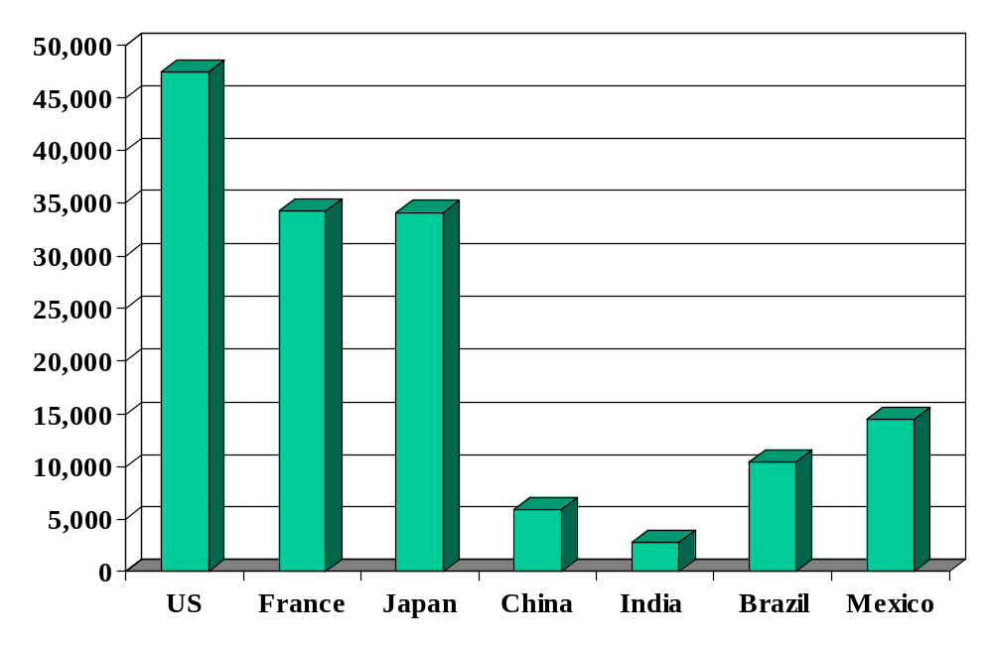
GDP per capita (2008, US dollars, PPP adj)
How did we get here?
Source: IMF, WEO; also Wikipedia.

Slide 14
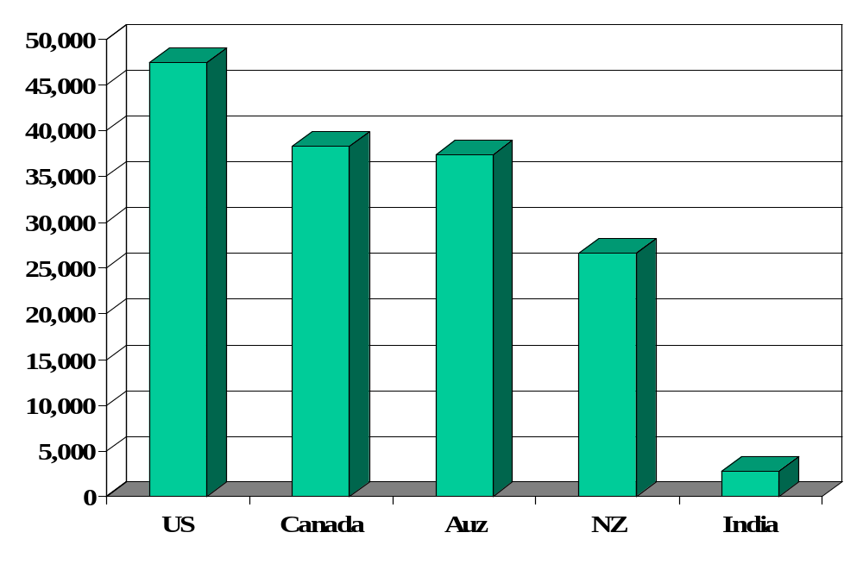
GDP per capita (2008, US dollars, PPP adj)
Source: IMF, WEO; also Wikipedia.

Slide 15
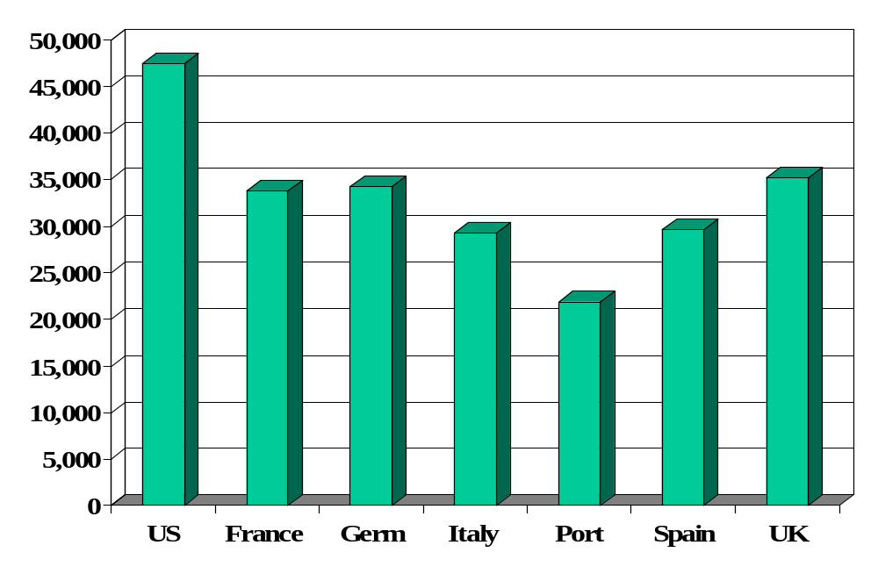
GDP per capita (2008, US dollars, PPP adj)
Source: IMF, WEO; also Wikipedia.

Slide 16
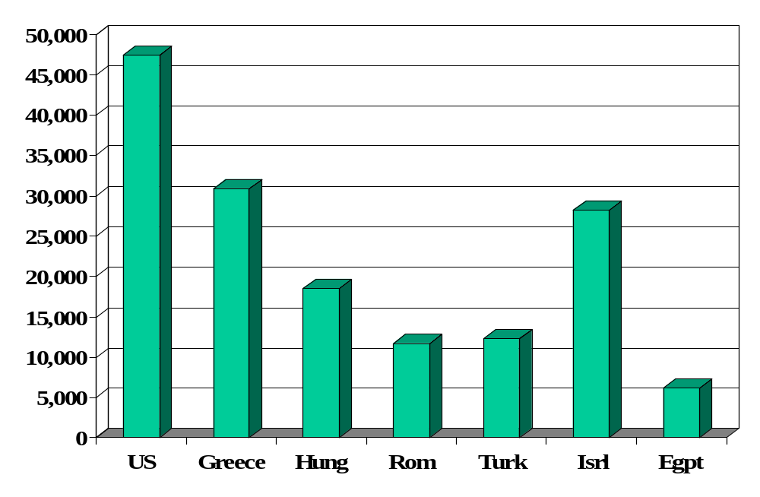
GDP per capita (2008, US dollars, PPP adj)
Source: IMF, WEO; also Wikipedia.

Slide 17
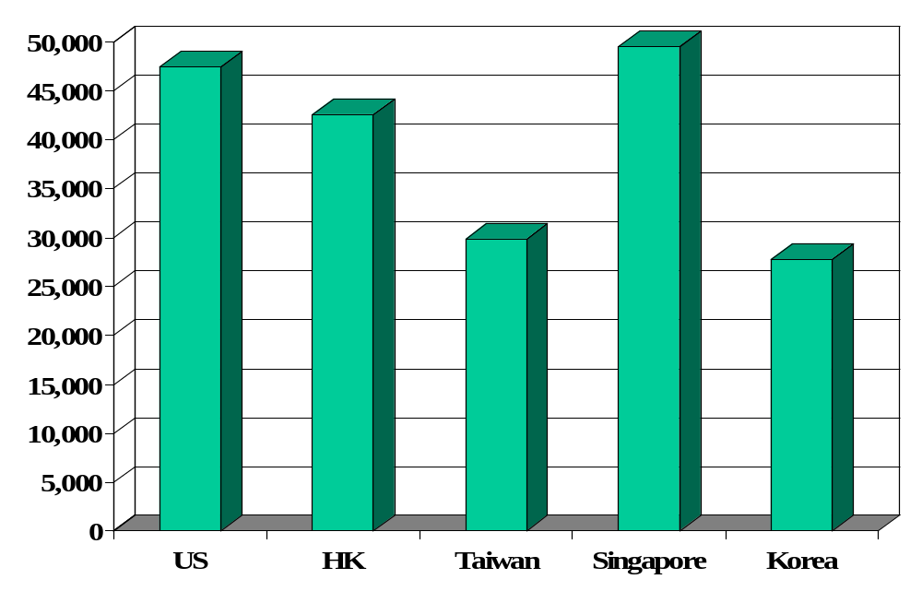
GDP per capita (2008, US dollars, PPP adj)
Source: IMF, WEO; also Wikipedia.

Slide 18
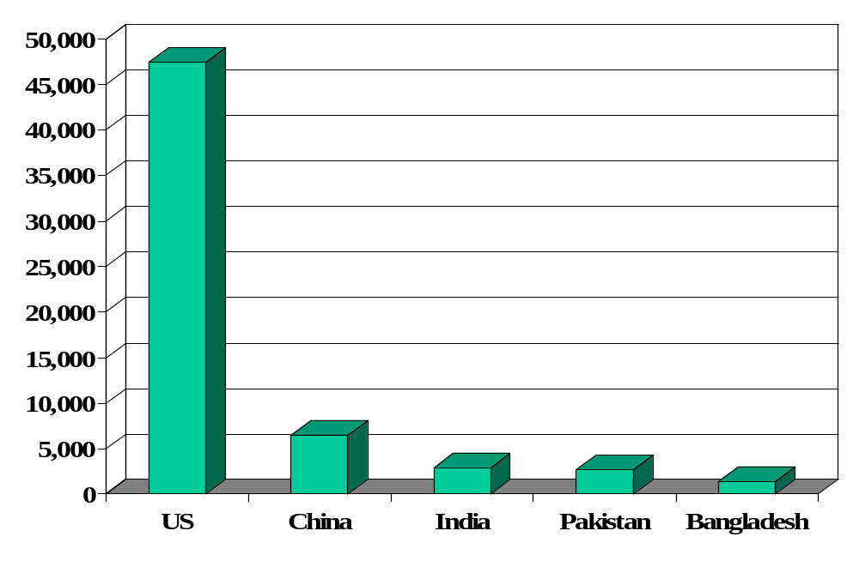
GDP per capita (2008, US dollars, PPP adj)
Source: IMF, WEO; also Wikipedia.

Slide 19
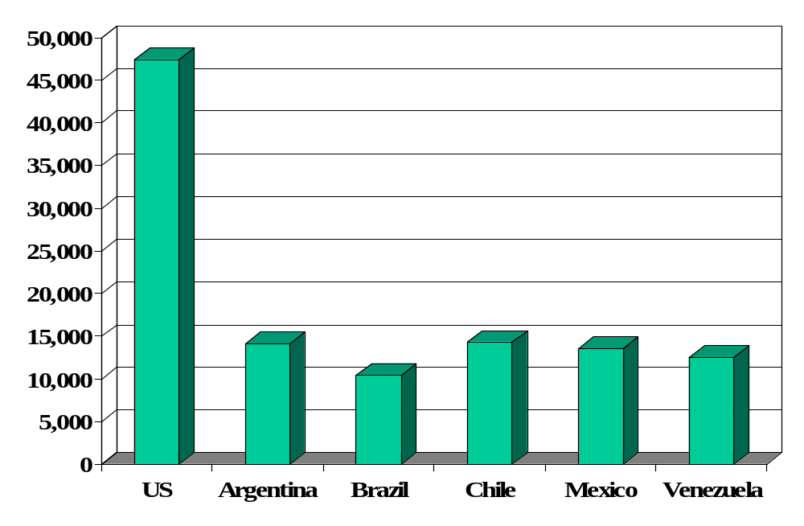
GDP per capita (2008, US dollars, PPP adj)
Source: IMF, WEO; also Wikipedia.

Slide 20
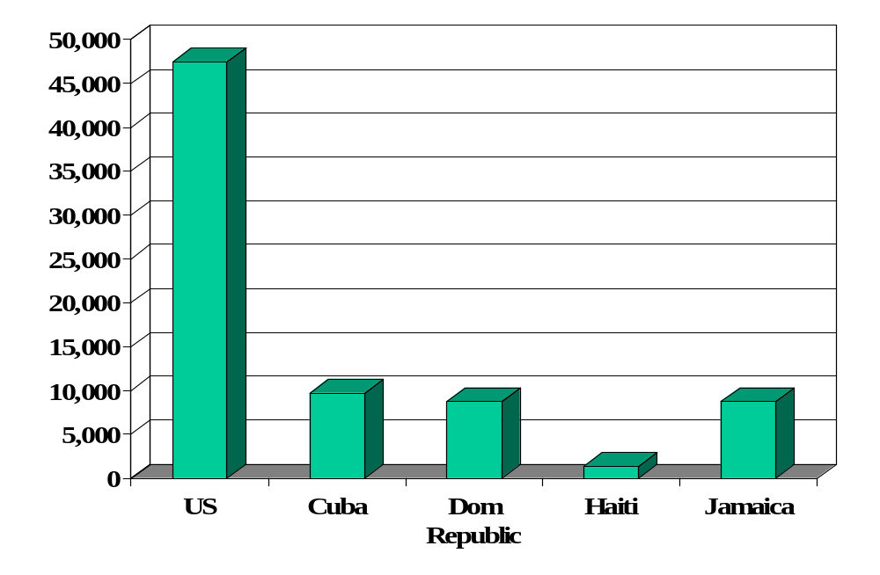
GDP per capita (2008, US dollars, PPP adj)
Source: IMF, WEO; also Wikipedia.

Slide 21
GDP per capita
How did we get here? What does it tell us about the local business environment?

Slide 22
World history
One-minute history of the world
Why Western Europe?
Why not China, India, Arab world?
What will the future bring?

Slide 23
World history: math
From Wikipedia on “Babylonian mathematics”
  Babylonian mathematics refers to mathematics of the people of Mesopotamia, from the days of the early Sumerians to the fall of Babylon in 539 BC. Our knowledge of [it] is derived from some 400 clay tablets written in Cuneiform script. They cover fractions, algebra, quadratic and cubic equations, and the Pythagorean theorem. The “base-60” convention of measuring time (seconds) and location (360 degrees in a circle) stem from this period.

Slide 24
World history: math
From Wikipedia on “Guassian elimination”
  The method of Gaussian elimination appears in Chapter Eight of the important Chinese mathematical text Jiuzhang suanshu or The Nine Chapters on the Mathematical Art. The first reference to the book by this title is dated to 179 CE, but parts of it were written as early as approximately 150 BCE.
  The method was invented in Europe independently by Carl Friedrich Gauss when developing the method of least squares in his 1809 publication Theory of Motion of Heavenly Bodies.

Slide 25
World history: math
From Wikipedia on “Indian mathematics”
  In the classical period of Indian mathematics (400 AD to 1200 AD), important contributions included the concept of zero as a number, negative numbers, arithmetic, decimal notation, and algebra. In addition, trigonometry, having evolved in the Hellenistic world and introduced into ancient India, was further advanced in India. In particular, the modern definitions of sine and cosine were developed there. These mathematical concepts were transmitted to the Middle East, China, and Europe.

Slide 26
World history: math
From Wikipedia on “Islamic mathematics”
  During the Islamic Golden Age, between 622 and 1600, mathematics flourished. Islamic activity in mathematics was largely centered around modern-day Iraq and Persia, but at its greatest extent stretched from North Africa and Spain in the west to India in the east. Greek, Indian and Babylonian mathematics all played important roles in this development, which included advances in trigonometry, geometry, algebra, and arithmetic, including properties of prime numbers. Practical issues like inheritance led to the modern symbolic notation now commonly used throughout the world.

Slide 27
World history: math
How important was mastery of mathematics to economic performance?
If not math, what?

Slide 28
World history
Gapminder again
Notes:
Prior to 1500 or so: life was “poor, nasty, brutish, and short” (Thomas Hobbes, Leviathan, 1651)
Draw pix on board
Temporary ups and downs from natural disasters, war…

Slide 29
Catch your breath
Why large differences in GDP per capita?
What do they mean for Bono or Bill Gates?
What do they mean for someone running a business?
Notes:
Stretch…. SAME QUESTION!!!

Slide 30
Production function
How are things produced?
What are the inputs? The outputs?
Production function
  A theoretical concept to organize our thoughts

Slide 31
Production function: picture
GDP
Capital & Labor
Productivity

Slide 32
Production function: math
Idea: relate output to inputs
Mathematical version:
Y = A F(K,L)
= A K^{α} L^{1-α} (“Cobb-Douglas”)
Definitions:
  K = quantity of physical capital used in production (plant and equipment)
  L = quantity of labor used in production
  A = total factor productivity (everything else)
  α = 1/3 (take my word for it)

Slide 33
Production function: properties
More inputs lead to more output
  Positive marginal products of capital and labor
Diminishing marginal products
  If we increase one input, holding the other input constant, each increase leads to less additional output
Constant returns to scale
  If we double both inputs, we double output
Notes:
Write out MPL …

Slide 34
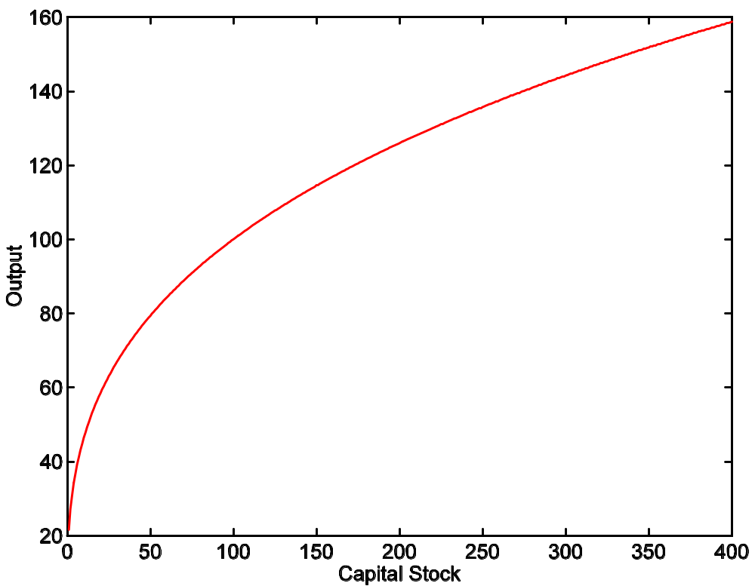
Production function: properties
A = 1
L = 100
α = 1/3

Slide 35
Capital
Meaning: physical capital used in production (plant and equipment)
Why does it change?
  Depreciation/destruction
  New investment (“capex”)
Mathematical version:
K_{t+1} = K_{t} – δ_{t}K_{t} + I_{t}
= (1 – δ_{t})K_{t} + I_{t}
Adjustments for quality?

Slide 36
Capital measurement
Option #1: direct surveys of plant and equipment
Option #2: perpetual inventory method
  Pick an initial value K₀ (survey?)
  Pick a depreciation rate (or measure depreciation directly)
  Measure K like this:
K_{t+1} = (1 – δ_{t})K_{t} + I_{t}
In practice, #2 is the norm:
  Get I from NIPA
  Set δ = 0.06 [ballpark number]
  Example: K₂₀₀₄ = 100, δ = 0.06, I = 12 → K₂₀₀₅ = 106

Slide 37
Labor
Meaning: units of labor used in production (labor input)
Why does it change?
  Population growth
  Age distribution
  Participation: fraction of population working
Notes:
Gapminder: fertilility v income per person

Slide 38
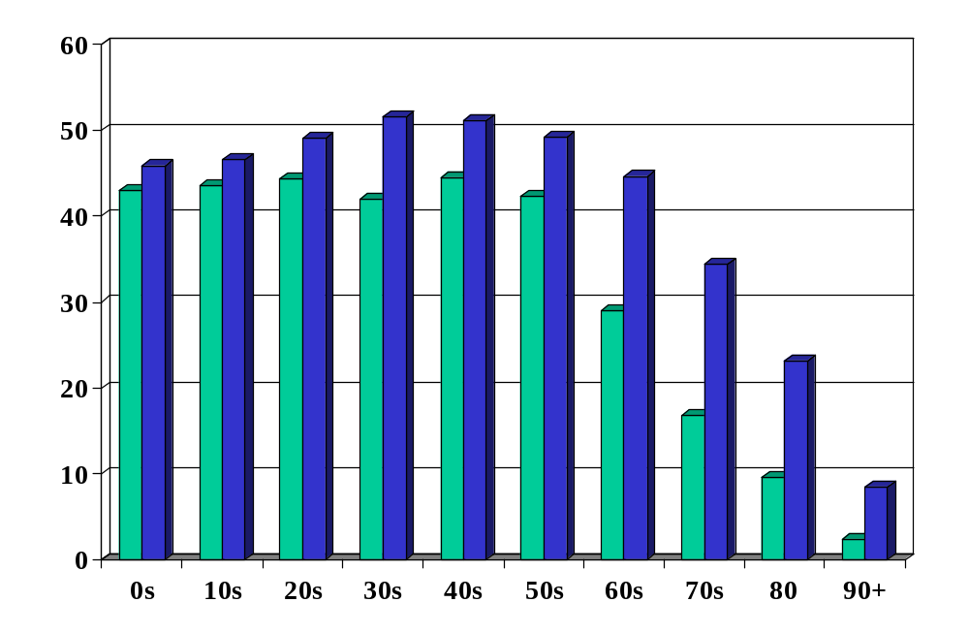
Population by age: US (millions)
Source: UN (link); green=2010, blue=2050.

Slide 39
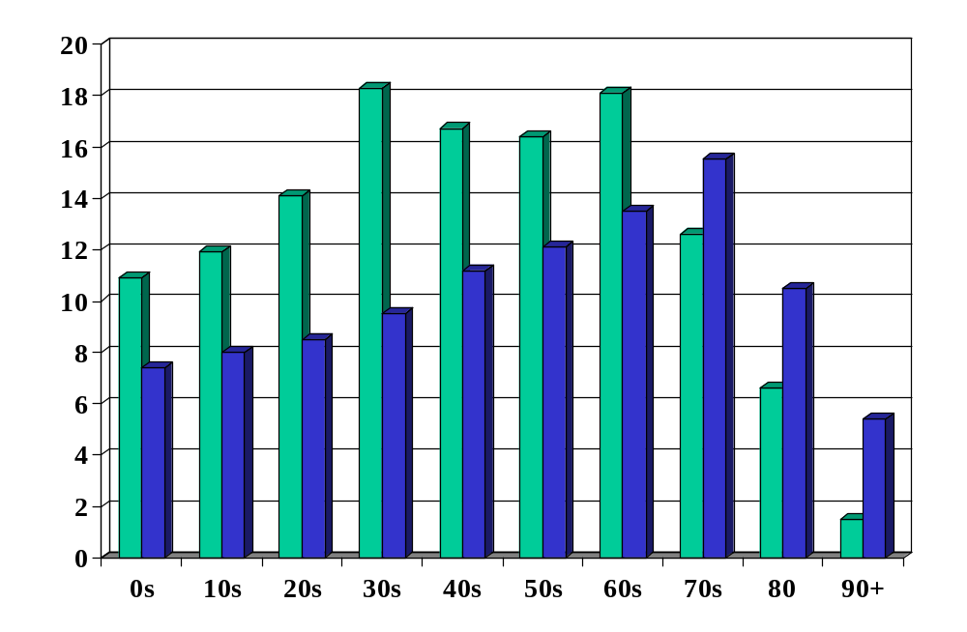
Population by age: Japan (millions)
Source: UN (link); green=2010, blue=2050.

Slide 40
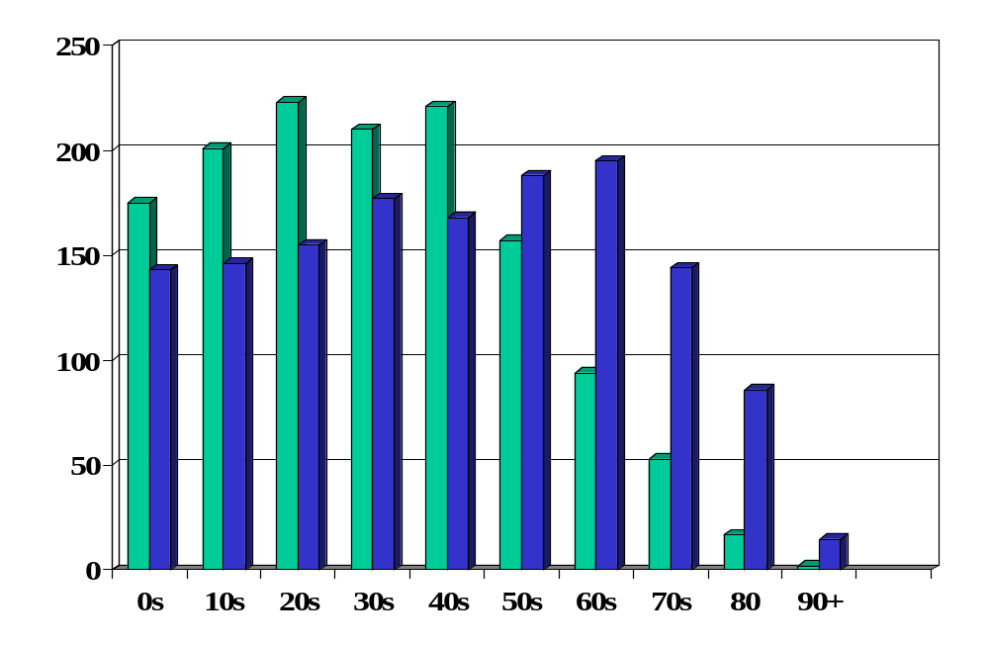
Population by age: China (millions)
Source: UN (link); green=2010, blue=2050.

Slide 41
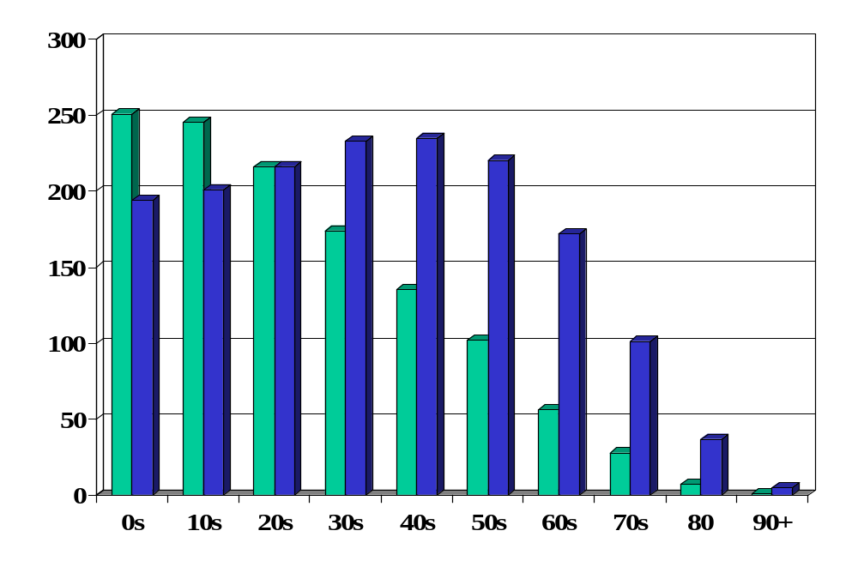
Population by age: India (millions)
Source: UN (link); green=2010, blue=2050.

Slide 42
Labor measurement
Basic measure: L = number of workers (employment)
  Government surveys of employers and people
Adjustments for quality? Hours?
  Skill: education? other? [H = “human capital”]
  Hours: if you know them [h = hours]
  Leads to an “augmented production function”:
Y = A F(K,hHL) = A K^{α} (hHL)^{1-α}

Slide 43
Productivity
The last component of the production function is “A”
  Y = A F(K,L) = A K^{α} L^{1-α}
Really important: higher A makes everyone better off
“Total Factor Productivity” or TFP
Why this mouthful?

Slide 44
Productivity
Simple labor productivity
  Average product of labor: Y/L = A (K/L)^{α}
Marginal product of labor
  Differentiate with respect to L:
  ∂Y/∂L = A K^{α} (1-α) L^{-α} = (1-α) A (K/L)^{α}
  What a firm would be willing to pay workers
Our number:
  Total Factor Productivity: A = Y/F(K,L) = Y/[K^{α} L^{1-α}]

Slide 45
Productivity measurement
We “measure” it indirectly
Solve the production function for A:
  Y = A K^{α} L^{1-α}
  A = Y/[K^{α} L^{1-α}] = (Y/L)/(K/L)^{α}
Example (US): Y/L = 33, K/L = 65:
A = 33/65^{1/3} = 8.21
Comments
  Any mistakes will be absorbed in A
  Solow: “a measure of our ignorance”

Slide 46
Production function summary
Remember: Y = A F(K,L)
What changes in this equation if
  A firm builds a new factory?
  The US reinstitutes a mandatory retirement age of 65
  Nintendo designs and produces a superior Wii?
  Workers shift from agriculture to industry in Viet Nam?
  Competition drives inefficient firms out of business?
  France makes employment more attractive to employers?
  China invests in massive infrastructure projects?
  Venture capital fund identifies good unfunded projects?
  Alaska builds a bridge to nowhere?

Slide 47
High wages
Good or bad? (For whom?)

Slide 48
Takeaways
The production function links output to inputs and productivity:
Y = A K^{α} L^{1-α}
Capital input (K)
  Plant and equipment, a consequence of investment (I)
Labor input (L)
  Population growth, age distribution, participation
  Could add skill (H) or hours per person (h)
TFP (A) is everything else
  can be inferred from data on output and inputs

Slide 49
After the break
Be prepared to discuss
  Problem 3 of Group Project #1

Slide 50
The Global Economy
Capital Accumulation
© NYU Stern School of Business
Notes:
Start gapminder: growth v GDP per capita
Start spreadsheet (Solow)
Write Solow eqs on board?
Use China and India as the examples. Is s a big deal?

Slide 51
Plan of attack
Group Projects
Where we’ve been, where we’re headed
The Solow model
  How important are saving and investment?
  In India?
What’s coming up

Slide 52
Group Project #2
Treat as the business problem it claims to be
Result should be a professional business document
Does not use what we’ve done in class – but I think you’ll find it both doable and interesting
Use the materials suggested [see links in project]
Stop by or email me if you have questions
Get started!
Notes:
Questions?

Slide 53
Group Project #2
Builds useful career skills: business judgment and communication
5-page limit intended to force you to prioritize
More of this coming
Notes:
Questions?

Slide 54
Group Project #1
Applies concepts covered in first class and notes
Answers will be posted shortly
Notes:
Questions?

Slide 55
Group Project #1
Problem 3
  Why difference in net exports?
  What does this tell you about where “capital” is flowing?
  Why difference in saving/investment rates?
Notes:
Foreshadows this class

Slide 56
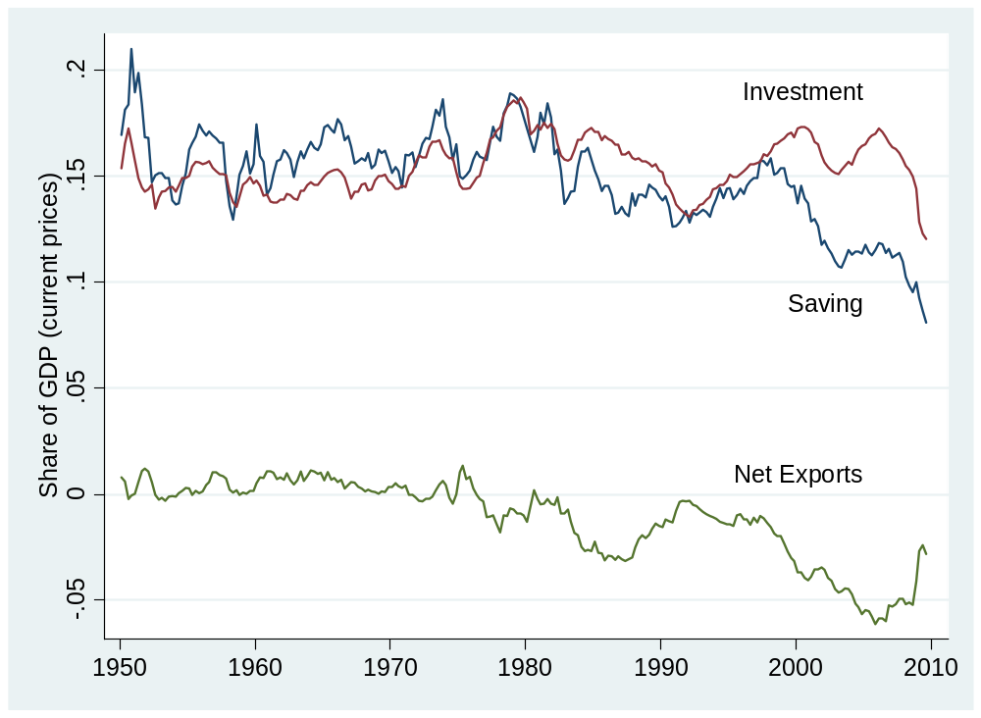
Group Project #1 (US)

Slide 57
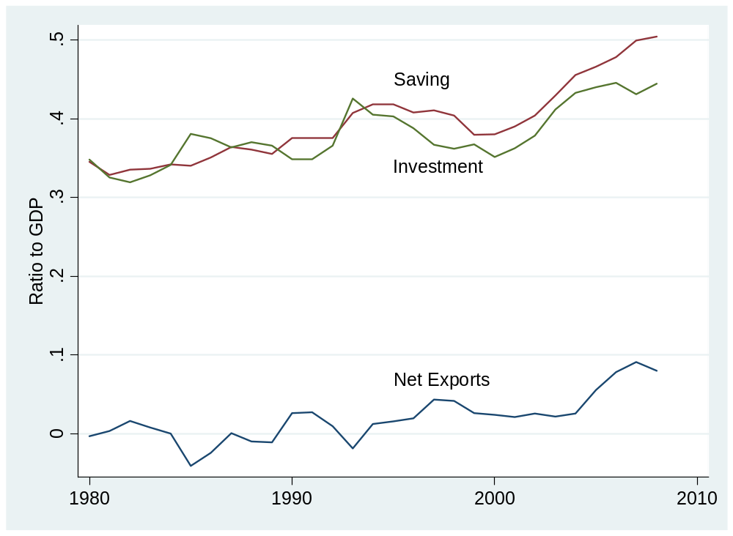
Group Project #1 (China)

Slide 58
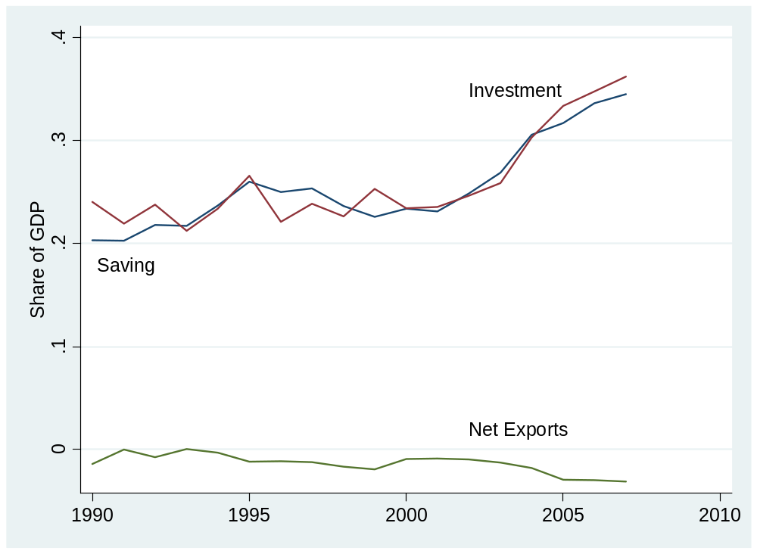
Group Project #1 (India)

Slide 59
Group Project #1
Why are saving rates so different? Investment rates? Net exports?
Is any of this central to economic growth?

Slide 60
Where we’ve been
Production function
Y = A K^{α} L^{1-α}
  Y is GDP
  A is “total factor productivity” or TFP
  K is capital (plant and equipment)
  L is number of workers (or perhaps a more refined measure of the “labor input”)
All measurable, either directly (Y,K,L) or indirectly (A)

Slide 61
Where we’re headed
GDP
Capital & Labor
Productivity
Political Process
“Institutions”

Slide 62
Where we’re headed
How important are saving and investment to growth?
Notes:
Solow stories

Slide 63
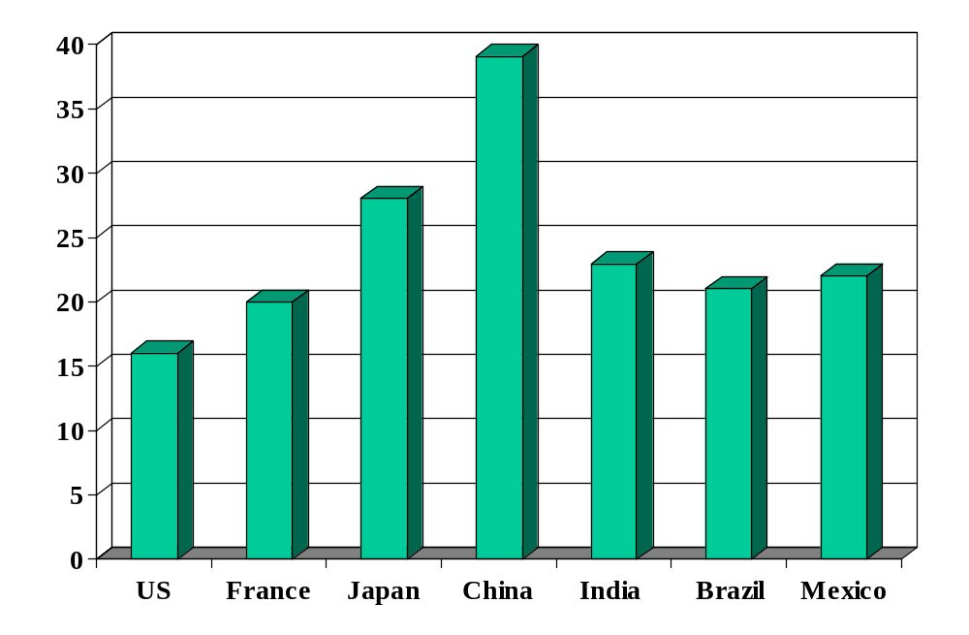
Investment rates (% of GDP)
Source: International Financial Statistics, averages for 1990-present.

Slide 64
Solow model: overview
Quantitative tool for thinking about growth
Used to extrapolate current trends in a sensible way
  How large will China and India be in 2050?
Focus on saving and investment
Conclusion: adding capital can’t produce high growth on its own
  Diminishing returns to capital in production function
Don’t sweat the details

Slide 65
Solow model
Production function:
Y = A K^{α} L^{1-α}
Flow identity:
I = S
Saving:
S = sY
Capital stock:
ΔK = I – δK
Notes:
Write on board, look at spreadsheet

Slide 66
Solow model
Dynamic structure works like this
K_{t+1} depends on K_{t}
Use this to generate path of K
Y follows, since it depends on K
Notes:
Write on board, look at spreadsheet

Slide 67
Solow model: India
Inputs:
  GDP in 2003: 3139b (2000 USD)
  Capital: 3683b [Note: this is low, K/Y = 2 or 3 more common]
  Labor force: 467m
  TFP: compute from above
  Saving and investment rate: 0.20
  Depreciation rate: 0.06
  Labor force growth: 0.00 (for comparison purposes)
  TFP growth: 0.05
Notes:
Lack of capital evident in India

Slide 68
Solow model: India
Comparisons
  No labor or TFP growth
  Higher saving/investment rate [how large an impact?]
  Higher TFP growth [how large an impact?]

Slide 69
Solow model: India
Scenario | GDP
2003 | 3,139
2050: no-growth benchmark | 5,030
2050: higher saving (+5%) | 5,591
2050: TFP growth (2%) | 17,188
2050: TFP growth (+1%) | 31,851
Notes:
US in 2050: 27 trillion (ballpark)

Slide 70
India
Is relative shortage of capital important?

Slide 71
What have we learned today?

Slide 72
What’s coming up
A moderately technical class
Also an important one
Please read notes beforehand
  Make sure you understand how we compute growth rates
  You’ll be lost if you don’t
  Major input to midterm exam

Slide 73
What’s coming up
I’ll be out of town Friday (conference at SF Fed)
Limited email availability Thursday noon to Saturday noon
Jason and Caitlin willing and able to answer any and all questions

Slide 74
Takeaways
Solow model
  Growth comes from saving-financed increases in capital
  Conclusion: capital can’t be the key to growth
What are we missing?
  TFP growth
Group Project #2
  Get started!
  Come prepared to discuss next class

Slide 75
Extra slides
I didn’t have the heart to kill them off

Slide 76
GDP per capita revisited
GDP per worker
    Y/L = A (K/L)^{α}
GDP per capita
    Y/POP = (L/POP) (Y/L)
    = (L/POP) A (K/L)^{α}
Reasons for high GDP per capita:
  More work: L/POP
  More productivity: A
  More capital: K/L
  Not present but could be added: skill H or hours worked h

Slide 77
World history
Statistic | Year 0 | 1000 | 1820 | 1998
Population (millions) | 231 | 268 | 1,041 | 5,908
GDP Per Capita | 444 | 435 | 667 | 5,709
Life expectancy | 24 | 24 | 26 | 66
Source: Maddison, Millennial Perspective, OECD, 2001, Tables 1-2, 1-5a.
Notes:
Prior to 1500 or so: life was “poor, nasty, brutish, and short” (Thomas Hobbes, Leviathan, 1651)
Draw pix on board
Temporary ups and downs from natural disasters, war…

Slide 78
GDP per capita (1990 US$)
Region | Year 0 | 1000 | 1820 | 1998
Western Europe | 450 | 400 | 1,232 | 17,921
Western offshoots | 400 | 400 | 1,201 | 26,146
Japan | 400 | 425 | 669 | 20,413
Latin America | 400 | 400 | 665 | 5,795
E Europe + “USSR” | 400 | 400 | 667 | 4,354
Asia (excl Japan) | 450 | 450 | 575 | 2,936
Africa | 425 | 416 | 418 | 1,368
World Average | 444 | 435 | 667 | 5,709
Source: Maddison, Millennial Perspective, OECD, 2001, Table 1-2.
Notes:
Offshoots = US + Canada + Australia + NZ
Note: Some grew, others didn’t. But it’s not true that growth by some was associated with shrinkage by others.

Slide 79
Share of world GDP (%)
Region | 1000 | 1820 | 1950 | 1998
Western Europe | 8.7 | 23.6 | 26.3 | 20.6
Western offshoots | 0.7 | 1.9 | 30.6 | 25.1
Japan | 2.7 | 3.0 | 3.0 | 7.7
Latin America | 3.9 | 2.0 | 7.9 | 8.7
E Europe + “USSR” | 4.6 | 8.8 | 13.1 | 5.3
Asia (excl Japan) | 67.6 | 56.2 | 15.5 | 29.5
Africa | 11.8 | 4.5 | 3.6 | 3.1
World | 100.0 | 100.0 | 100.0 | 100.0
Source: Maddison, Millennial Perspective, OECD, 2001, Table 3-1c.
Notes:
Offshoots = US + Canada + Australia + NZ

Slide 80
Does China save/invest too much?
How would we judge that?
What investment rate is needed to maintain K/Y?
  K and Y grow at rate g
  Given depreciation, how must investment rate vary with g?
Numbers
  Target: K/Y = 2 (typical number)
  Set δ = 0.06 (ditto)
  Compare: g = 0.03 and g = 0.08
In words: a fast-growing country needs a high investment rate just to keep up

