Slide 1

The Global Economy
Sources of Growth
© NYU Stern School of Business
Notes:
Open spreadsheet for calculations
Left brain, right brain
Business (+ life) is a combination of quant and qualitative – the trick is to integrate them.

Slide 2
US government deficit
Huge, no sign of going away
Subject of Group Project #7
NY Times editorial, Feb 7 10:
  At a time of high unemployment and fragile growth, the last thing the government should do is slash spending. That will only drive the economy into deeper trouble.
Does that sound right to you? Why or why not?

Slide 3
Plan of attack
US government deficit ✓
Where we’re headed
Pictures (more history) [too many, we’ll have to skip some]
Growth accounting
  A tool for quantifying sources of growth
  What we find: it’s mostly productivity
What’s happening in US, Japan, France, China, etc

Slide 4
Where we’re headed
Economic performance differs widely across countries. Why? Where do these differences come from?

Slide 5
Where we’re headed
GDP
Capital & Labor
Productivity
Political Process
“Institutions”

Slide 6
Pictures
100+ year perspective
“1990 US dollars, PPP adjusted” [what is this?]
What’s going on?

Slide 7
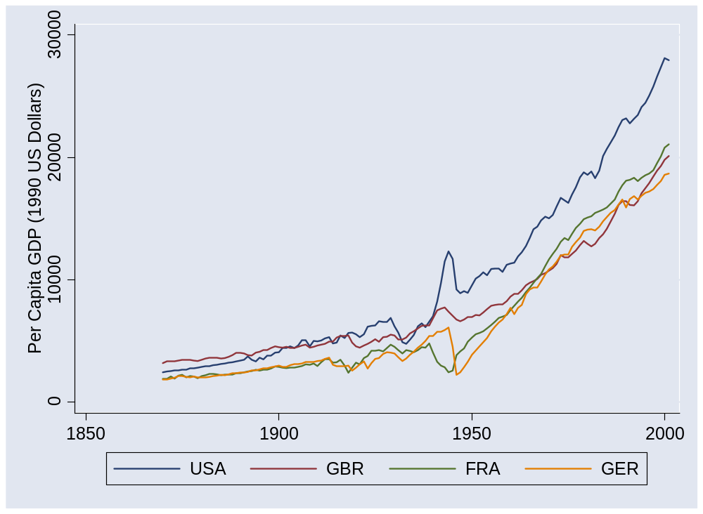
US and Europe
Source: Maddison, Historical Statistics, OECD.

Slide 8
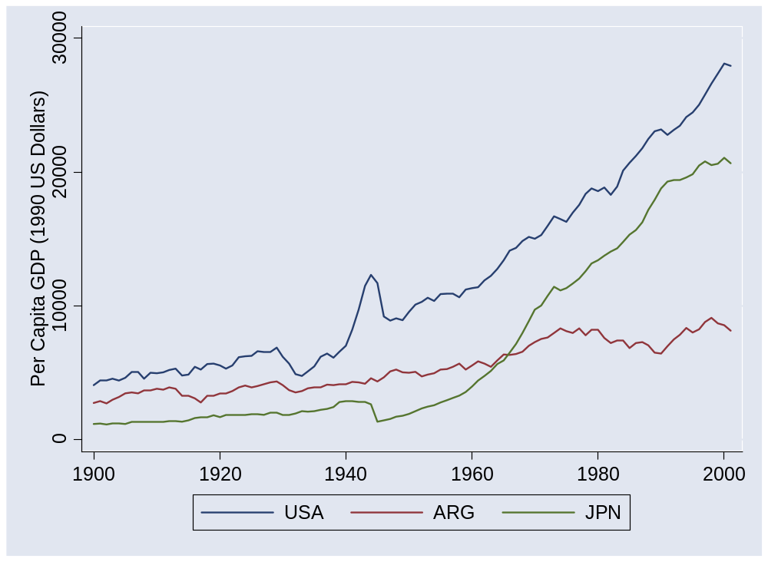
Argentina and Japan
Source: Maddison, Historical Statistics, OECD.

Slide 9
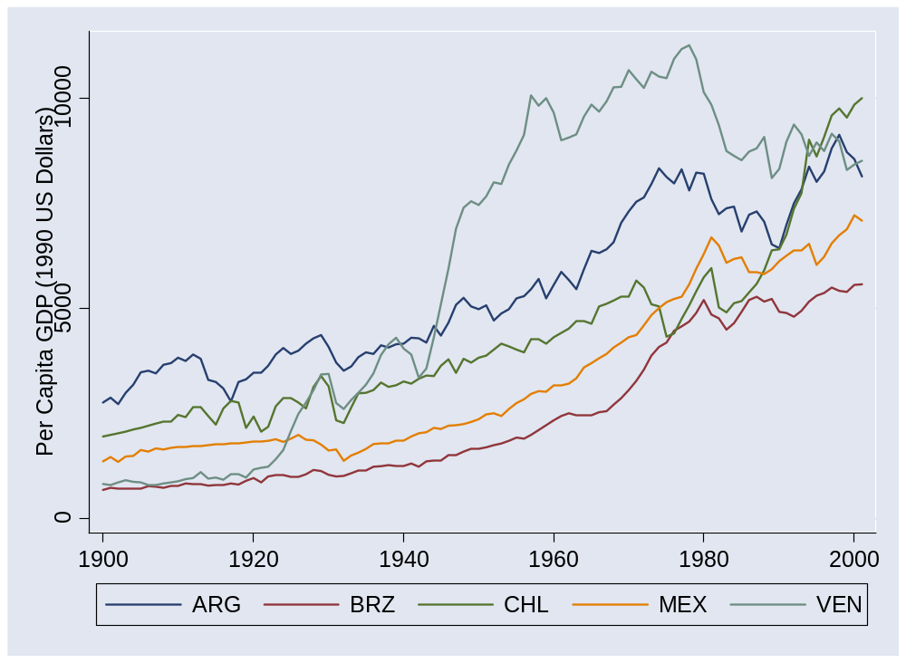
Latin America
Source: Maddison, Historical Statistics, OECD.

Slide 10
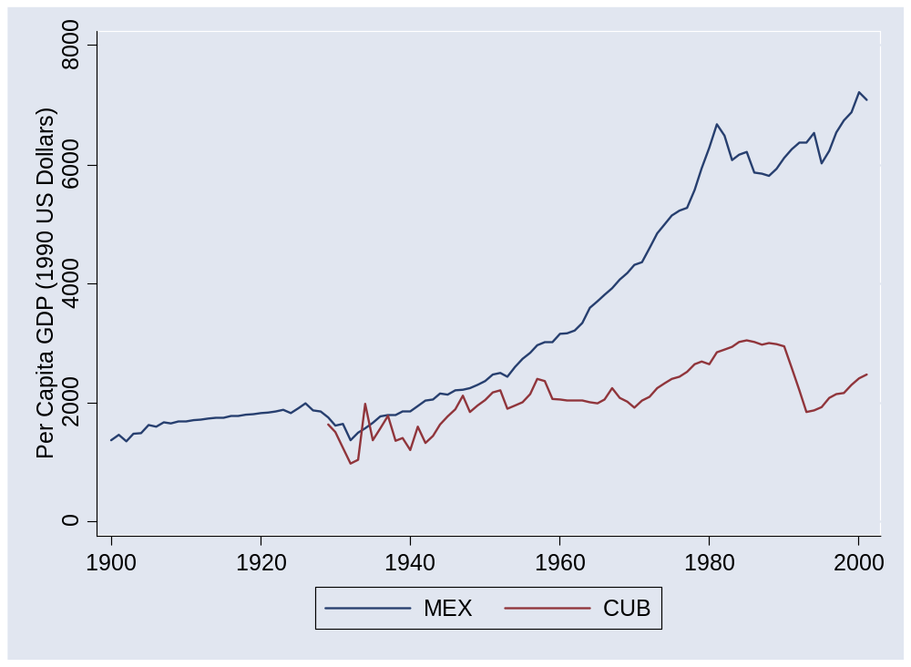
Mexico and Cuba
Source: Maddison, Historical Statistics, OECD.

Slide 11
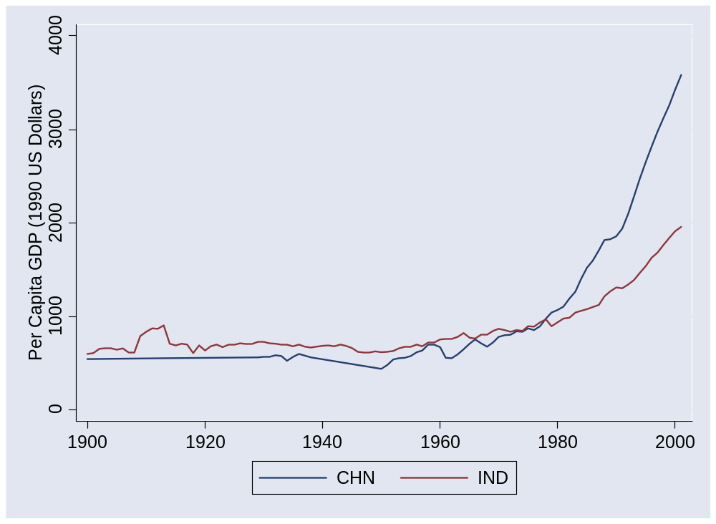
China and India
Source: Maddison, Historical Statistics, OECD.

Slide 12
Pictures
50+ year perspective
What’s going on?

Slide 13
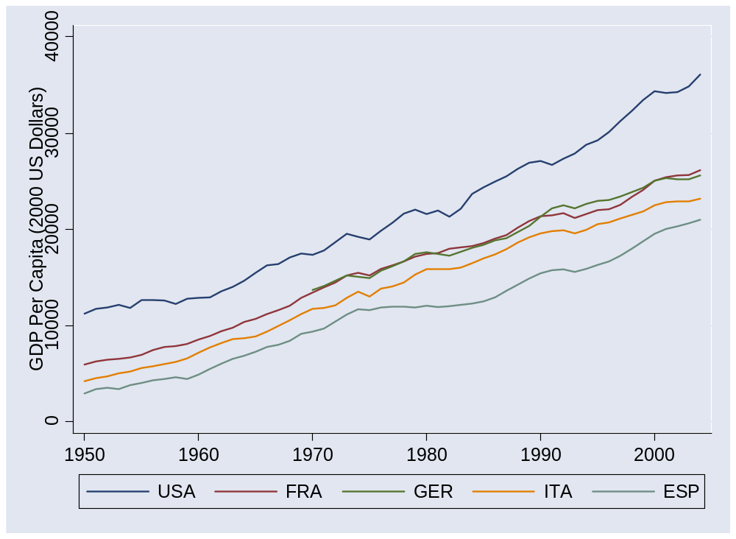
Europe (post 1950)
Source: Penn World Tables, version 6.2.

Slide 14
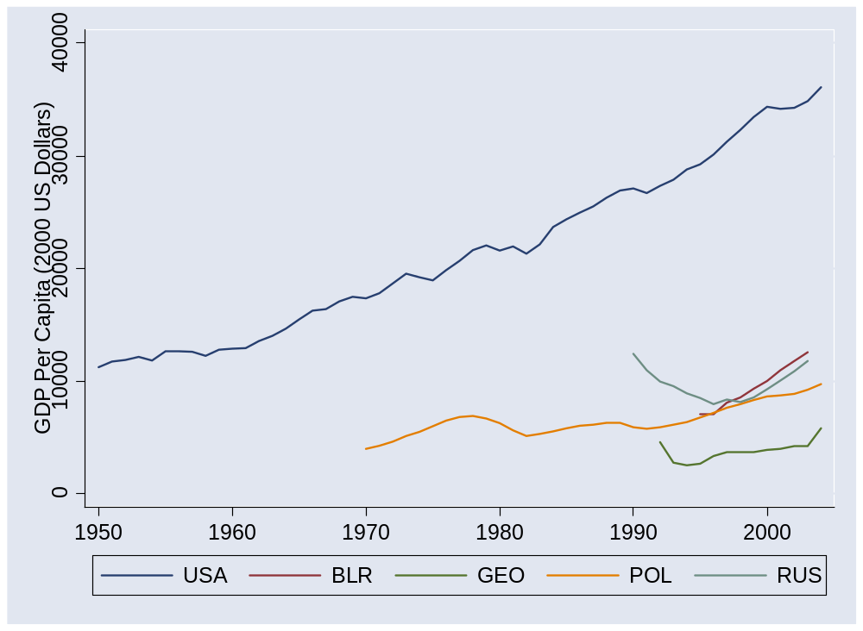
Former Soviet bloc
Source: Penn World Tables, version 6.2.

Slide 15
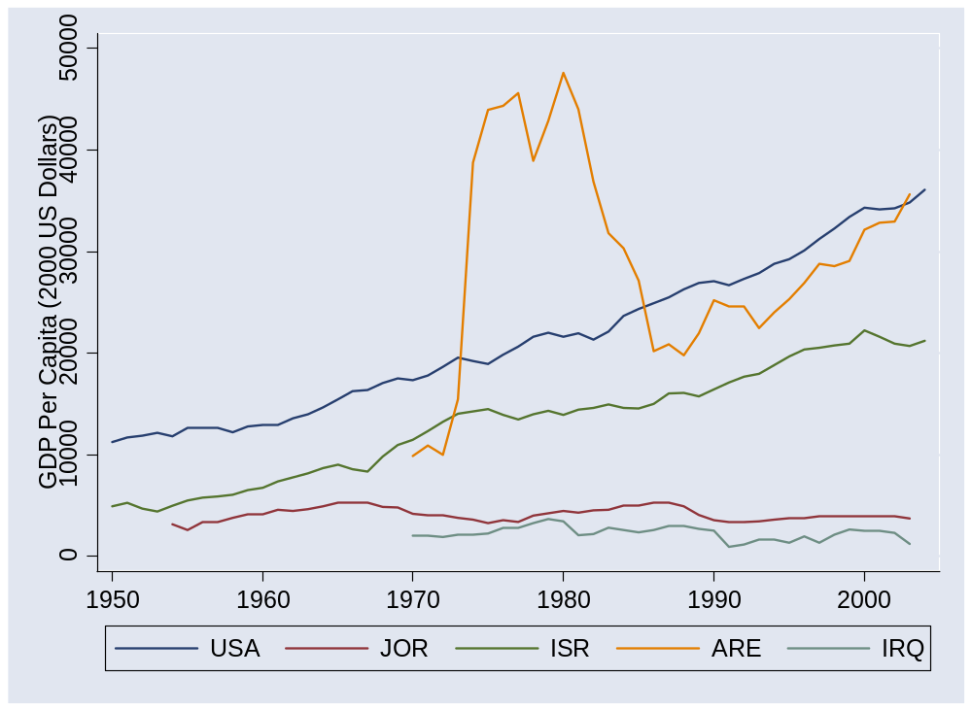
Middle East
Source: Penn World Tables, version 6.2.

Slide 16
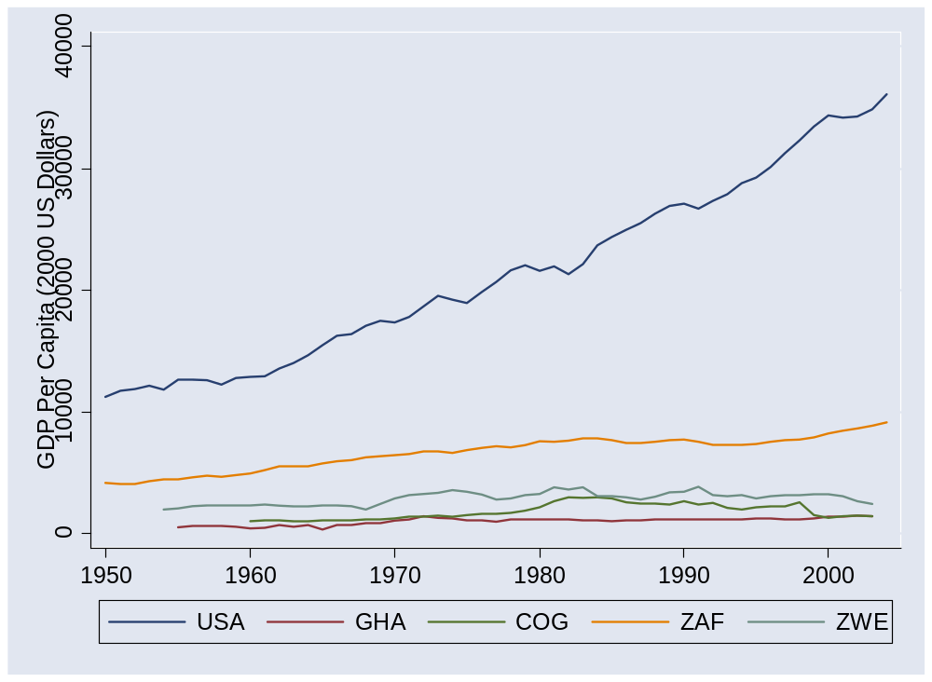
Africa 1
Source: Penn World Tables, version 6.2.

Slide 17
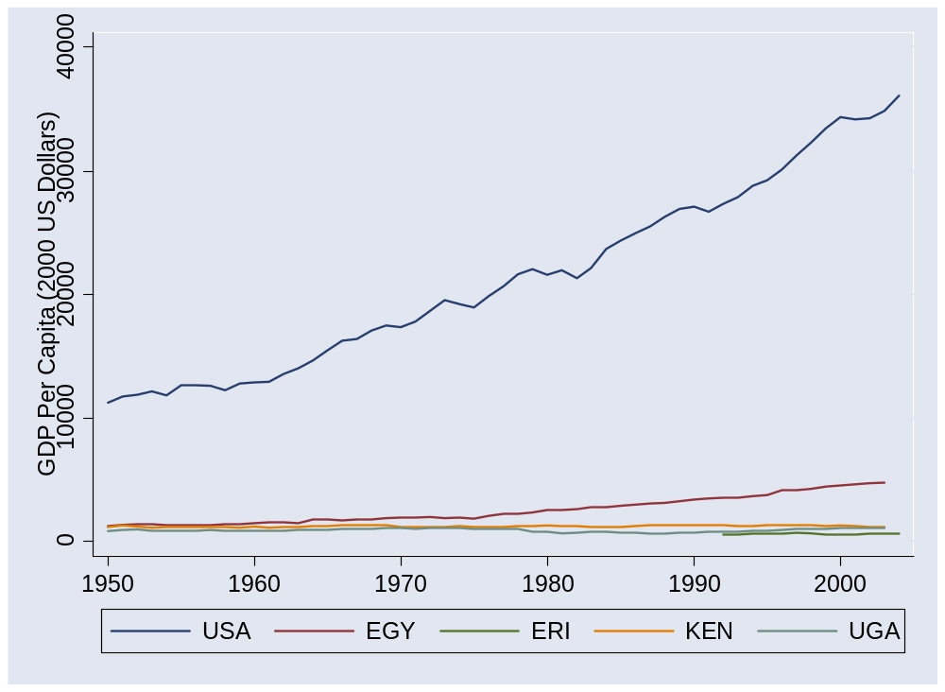
Africa 2
Source: Penn World Tables, version 6.2.

Slide 18
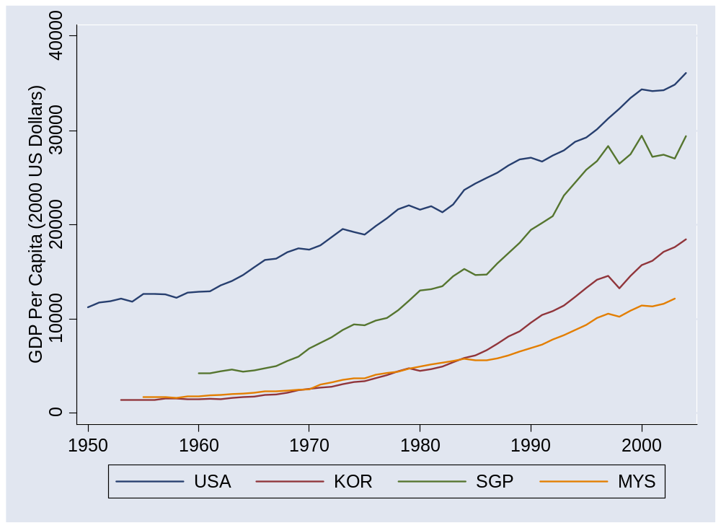
Asia 1
Source: Penn World Tables, version 6.2.

Slide 19
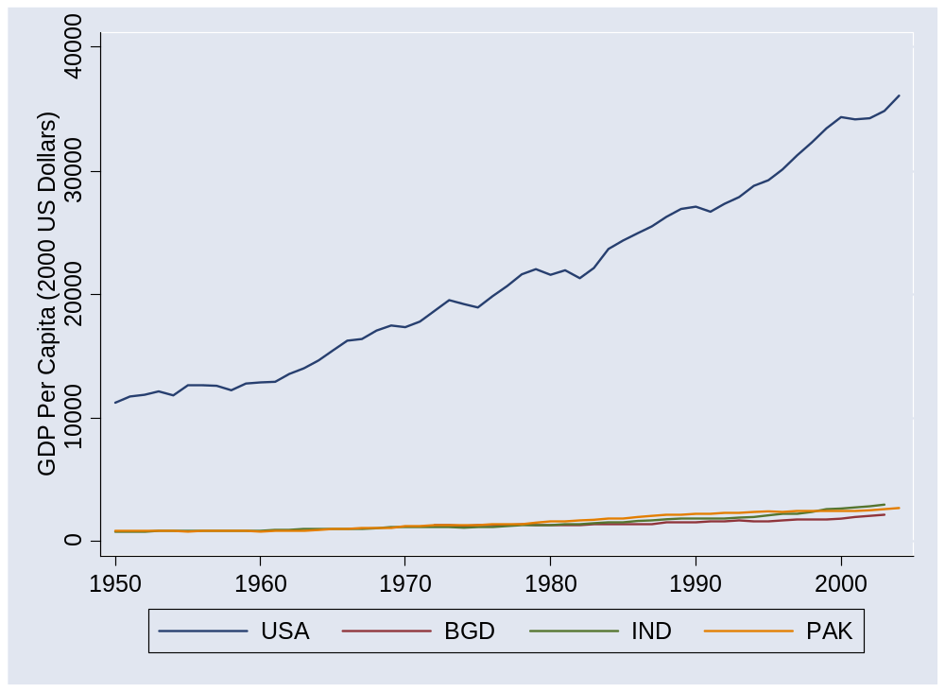
Asia 2
Source: Penn World Tables, version 6.2.

Slide 20
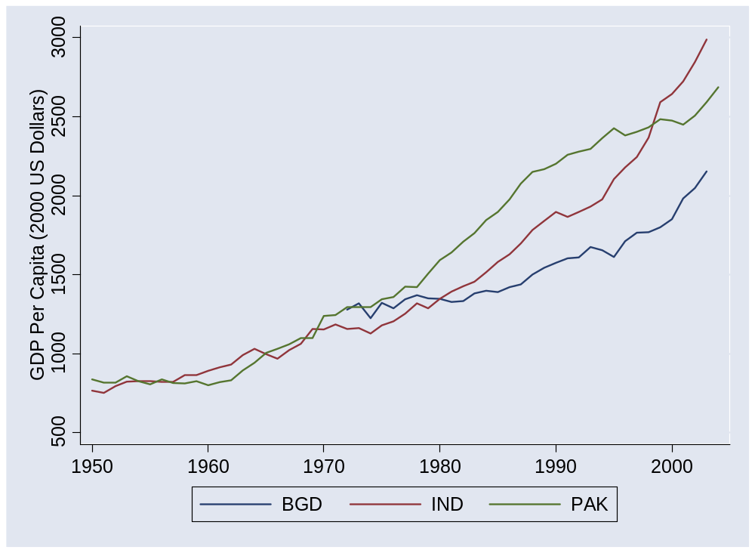
Asia 2 (without US)
Source: Penn World Tables, version 6.2.

Slide 21
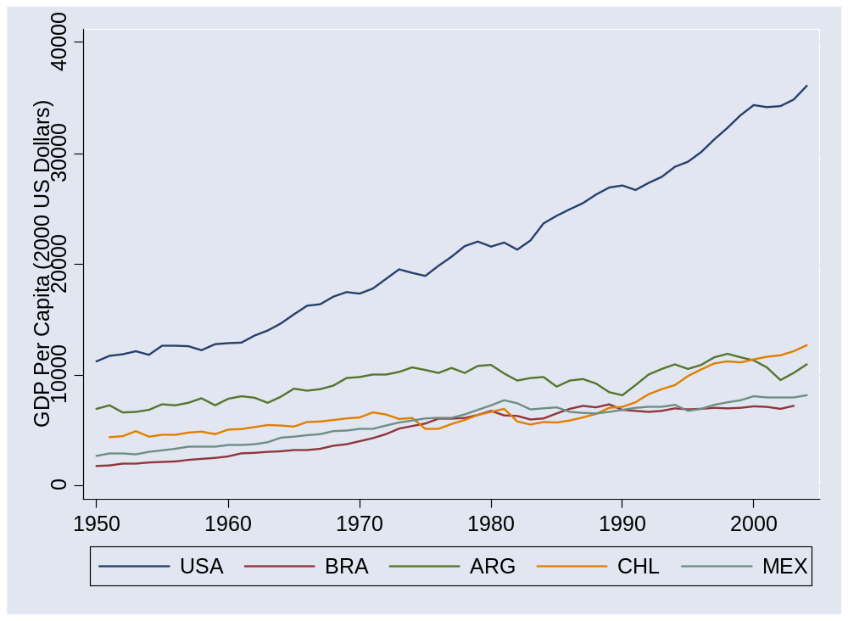
Latin America
Source: Penn World Tables, version 6.2.

Slide 22
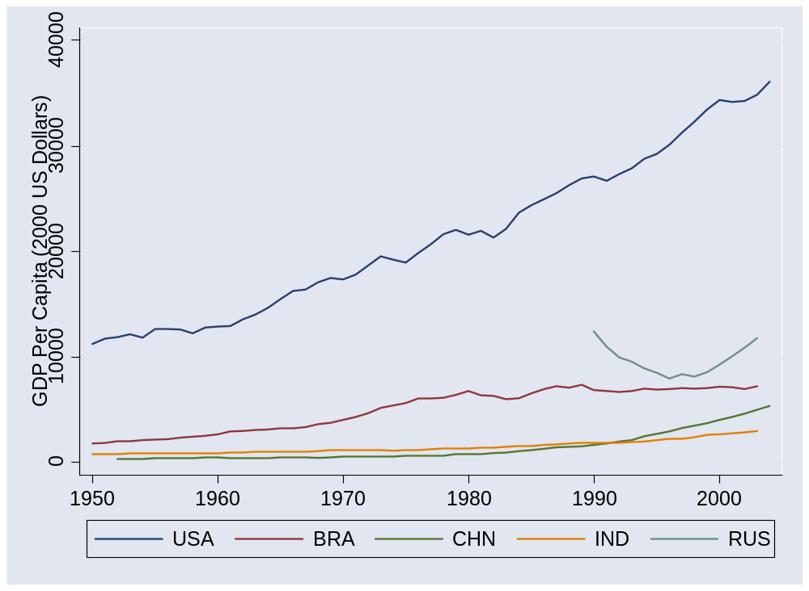
BRICs
Source: Penn World Tables, version 6.2.

Slide 23
Pictures: highlights
US, Europe: steady growth for two centuries
Japan: one century plus of amazing progress
Argentina, Cuba: not so much
China and India: amazing growth in recent past
Emerging markets overall: now more than half of world GDP
Poor countries: opportunities?

Slide 24
Catch your breath
Where do these differences come from?
Let’s put the production function to work

Slide 25
GDP per capita and per worker
GDP per worker
    Y = A K^{α} L^{1– α}
    Y/L = A (K/L)^{α}
GDP per capita
    Y/POP = (L/POP) (Y/L)
    = (L/POP) A (K/L)^{α}
Reasons for high GDP per capita:
  More work: L/POP
  More productivity: A
  More capital: K/L

Slide 26
Accounting for GDP per worker
Why are there differences in output per worker?
Production function
Y = A K^{α} L^{1-α}
Y/L = A (K/L)^{α}
Comparison of two countries
(Y/L)₁/(Y/L)₂ = (A₁/A₂) [(K/L)₁/(K/L)₂]^{α}
Bottom line: a clue to economic performance

Slide 27
Computing growth rates
Traditional growth rate
(1+g)^{n} = x_{t+n}/x_{t}
Continuously-compounded growth rate
e^{nγ} = x_{t+n}/x_{t}
Computing the growth rate
γ = log(x_{t+n}/x_{t})/n
See
  “Math review”
  “Sources of growth”
My advice:
Just memorize this.

Slide 28
Accounting for growth
Why differences in growth in output per worker?
Production function
Y = A K^{α} L^{1-α}
Y/L = A (K/L)^{α}
Additive in growth rates
γ_{Y/L} = γ_{A} + α γ_{K/L}
[γ_{x} means “growth rate of X”]
γ_{K/L} is growth rate of K/L
α γ_{K/L} is “contribution to growth”
Bottom line: a clue to economic performance

Slide 29
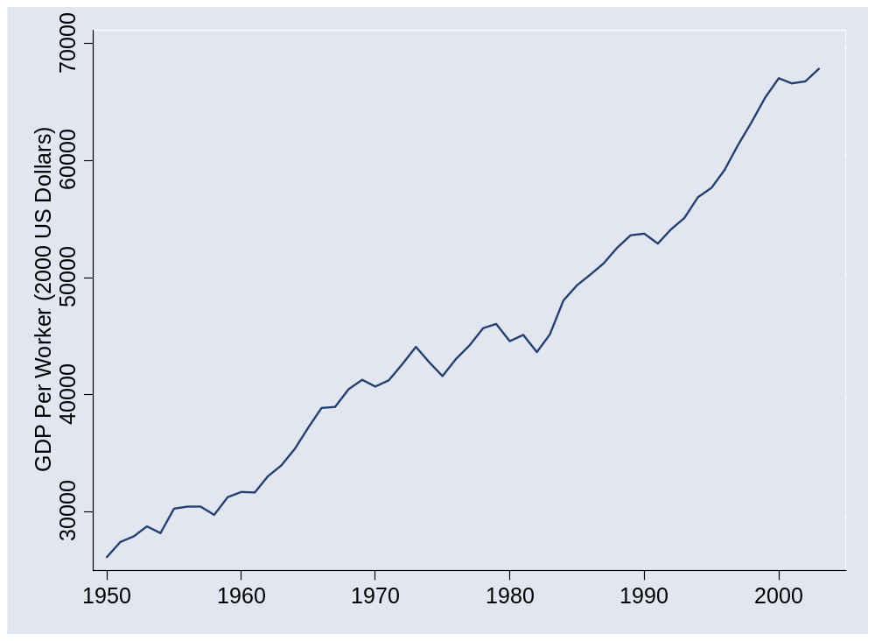
What happened in the US?
Source: Penn World Tables, version 6.2.

Slide 30
What happened in the US?
 | Y/L | K/L | A
1950 | 26,130 | 57,394 | 677
2003 | 67,865 | 177,008 | 1209
Growth rate (annual %) | 1.80 | 2.13 | 1.09
Contribution to growth | 1.80 | 0.71 | 1.09
Make sure you can calculate every number in italics

Slide 31
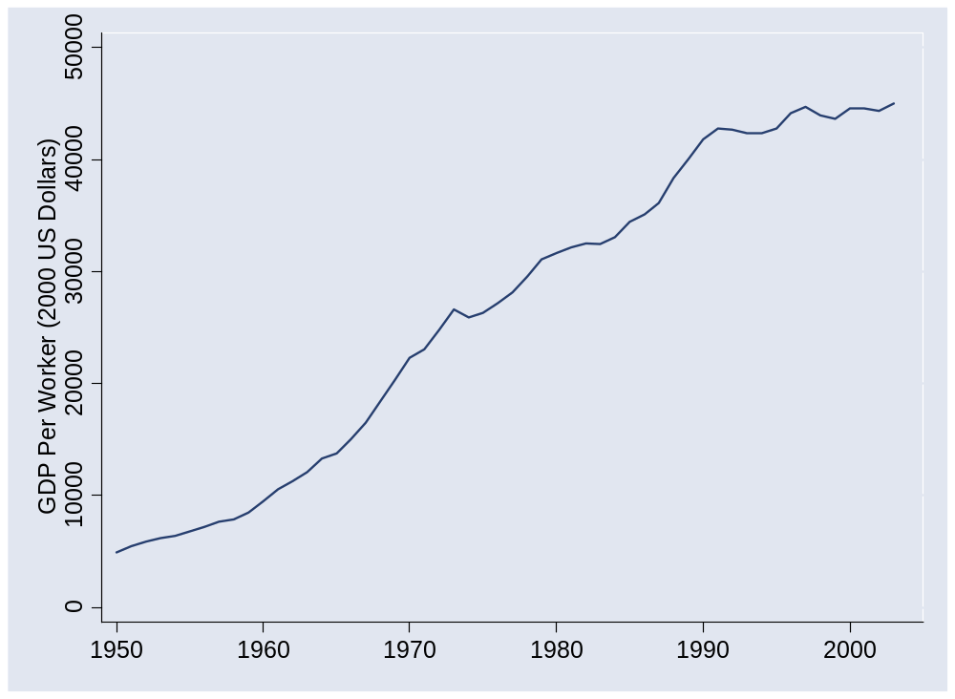
What happened in Japan?
Source: Penn World Tables, version 6.2.

Slide 32
What happened in Japan?
 | Y/L | K/L | A
1950 | 4,936 | 5,104 | 287
1973 | 26,642 | 61,119 | 676
1990 | 41,810 | 133,656 | 818
2003 | 45,030 | 180,284 | 797
Contribution 1950-73 | 7.33 | 3.60 | 3.73
Contribution 1973-90 | 2.65 | 1.53 | 1.12
Contribution 1990-2003 | 0.57 | 0.77 | (0.20)

Slide 33
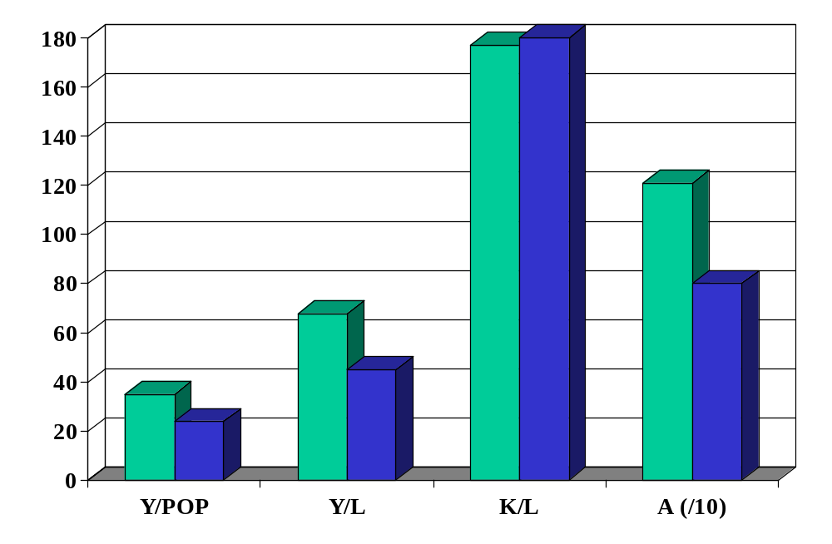
What happened in US & Japan?
Source: Penn World Tables, version 6.2. green=US, blue=Japan.

Slide 34
What happened in Japan?
Huge postwar success story
Capital played a larger role than in US, productivity a smaller role
1990s malaise
  Widespread financial crisis
  Many banks insolvent but allowed to linger
  Massive stimulus program apparently failed
Lessons?
Notes:
Summary: they stopped messing up

Slide 35
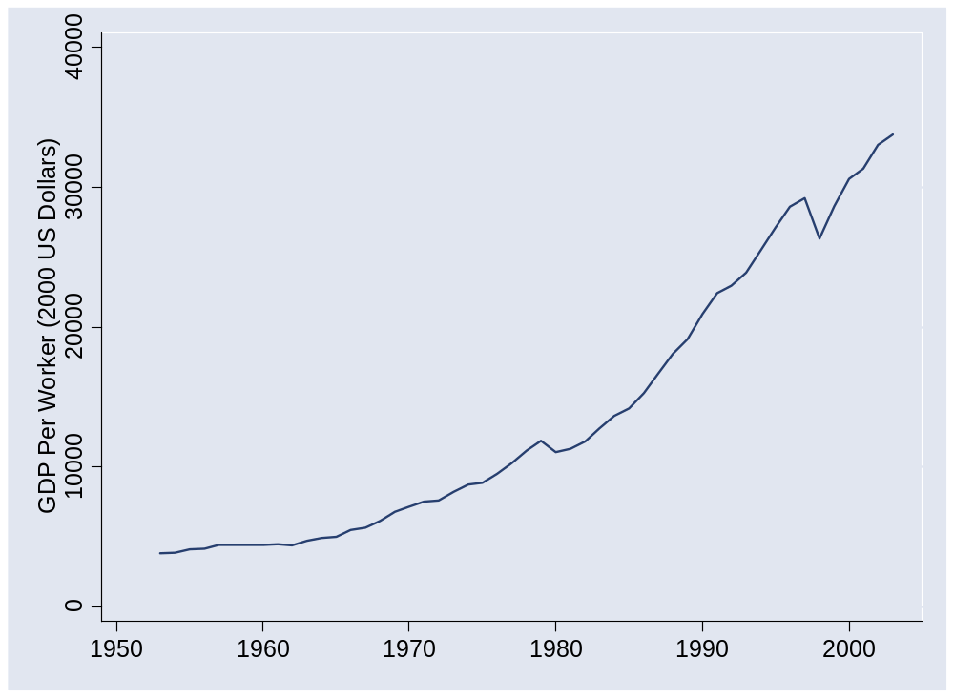
What happened in Korea?
Source: Penn World Tables, version 6.2.

Slide 36
What happened in Korea?
 | Y/L | K/L | A
1953 | 3,817 | 4,289 | 235
2003 | 33,784 | 113,720 | 697
Growth rate (annual %) | 4.36 | 6.56 | 2.18
Contribution to growth | 4.36 | 2.19 | 2.18

Slide 37
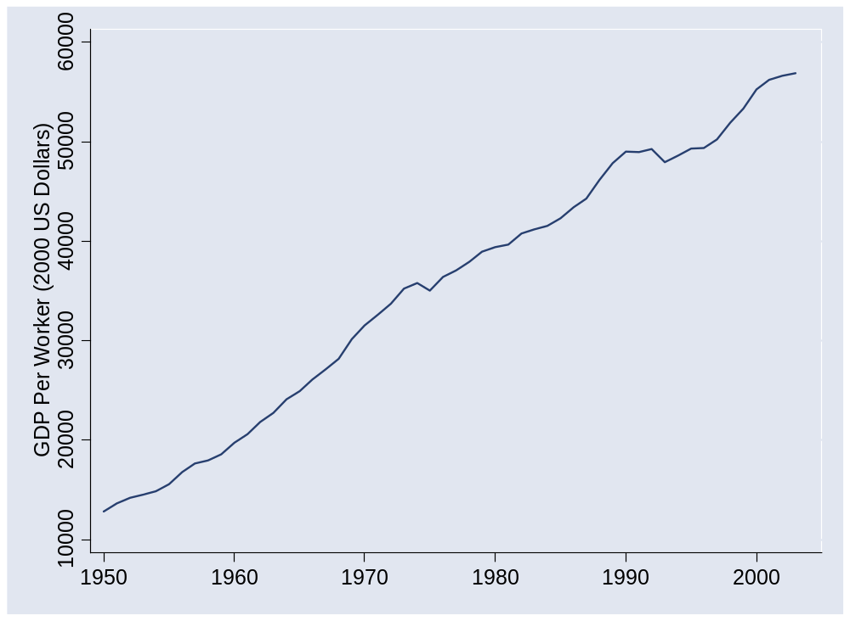
What happened in France?
Source: Penn World Tables, version 6.2.

Slide 38
What happened in France?
 | Y/L | K/L | A
1950 | 12,838 | 24,009 | 445
1973 | 35,236 | 82,298 | 810
2003 | 56,909 | 166,636 | 1,034
Contribution 1950-73 | 4.39 | 1.79 | 2.60
Contribution 1973-2003 | 1.60 | 0.79 | 0.81

Slide 39
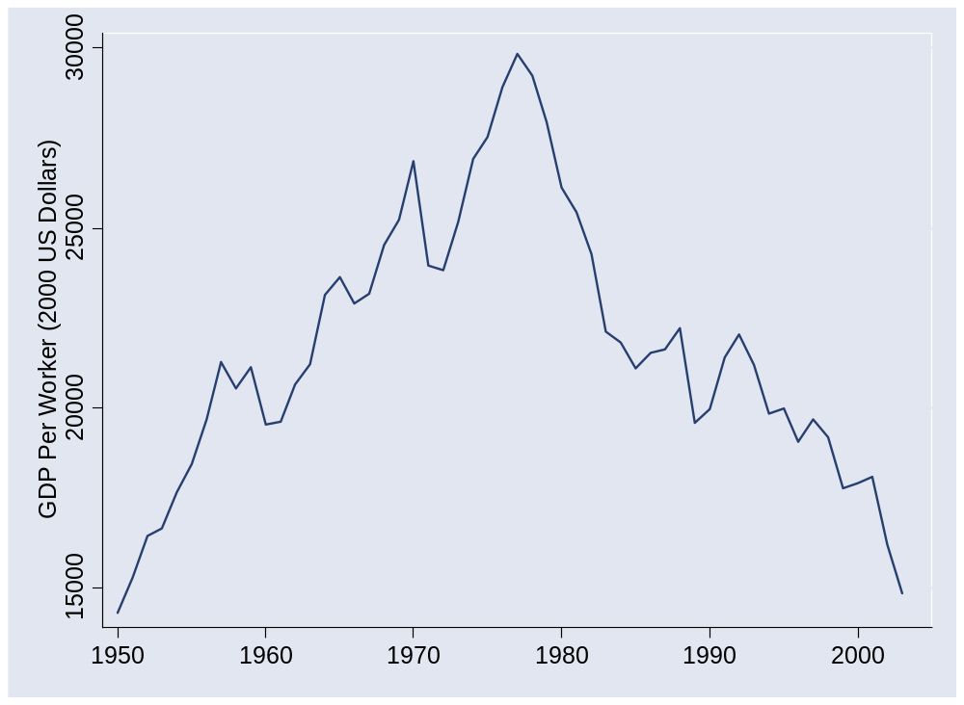
What happened in Venezuela?
Source: Penn World Tables, version 6.2.

Slide 40
What happened in Venezuela?
 | Y/L | K/L | A
1950 | 14,311 | 34,658 | 439
1977 | 29,853 | 81,303 | 689
2003 | 14,848 | 44,990 | 418
Contribution 1950-77 | 2.72 | 1.05 | 1.67
Contribution 1977-2003 | (2.69) | (0.76) | (1.92)

Slide 41
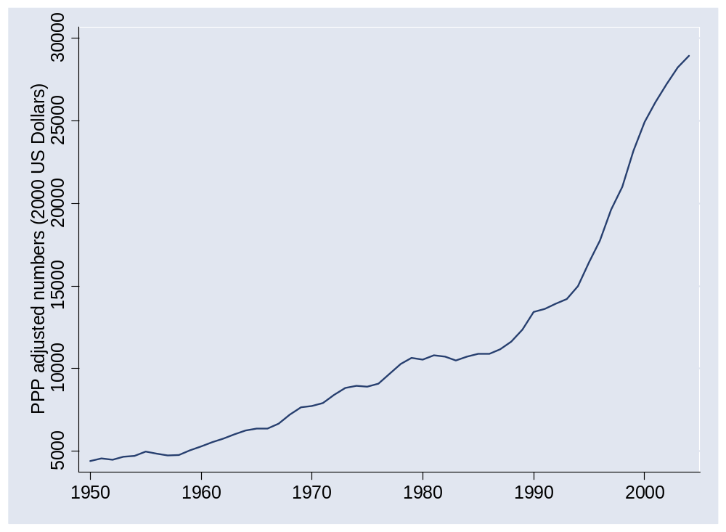
What happened in Ireland?

Slide 42
What happened in Ireland?
Why did growth accelerate in early 1990s?

Slide 43
What happened in Ireland?
 | Y/L | K/L | A
1950 | 10,227 | 21,074 | 370
1993 | 36,640 | 86,685 | 828
2003 | 65,925 | 131,131 | 1,298
Contribution 1950-93 | 2.97 | 1.10 | 1.87
Contribution 1993-2003 | 5.87 | 1.38 | 4.49

Slide 44
What happened in Ireland?
EU membership, aid recipient
Fiscal discipline (>1987)
  Government hiring frozen
  Personal and corporate tax rates slashed
  Government budget balanced
Peaceful labor relations
Attractive terms for foreign firms
  Lowest corporate tax rates in OECD
English speaking?
Notes:
Summary: they stopped messing up

Slide 45
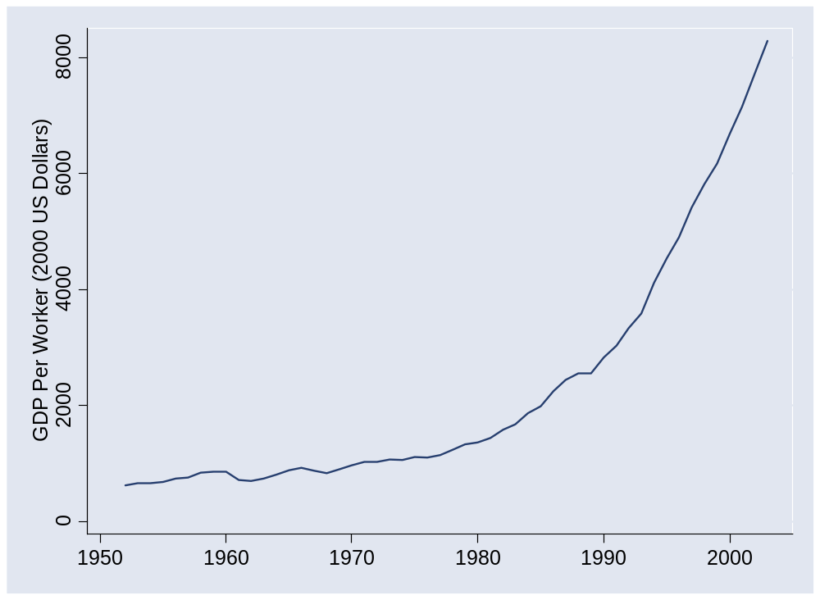
What happened in China?
Source: Penn World Tables, version 6.2.

Slide 46
What happened in China?
 | Y/L | K/L | A
1952 | 620 | 942 | 63
1978 | 1,234 | 3,070 | 85
2003 | 8,284 | 18,015 | 316
Contribution 1952-78 | 2.64 | 1.52 | 1.13
Contribution 1978-2003 | 7.62 | 2.36 | 5.26

Slide 47
What happened in China?
EIU, Country Finance Report:
  China’s financial sector is large but immature, with significant structural weaknesses. Risk-management techniques and the quality of bank lending have improved. However, the dominance of state-owned banks (the five large banks dominate the sector) suggests that savings are not used efficiently. Pressure from local governments means that lending decisions are still occasionally driven by political factors.
Notes:
Summary: they stopped messing up

Slide 48
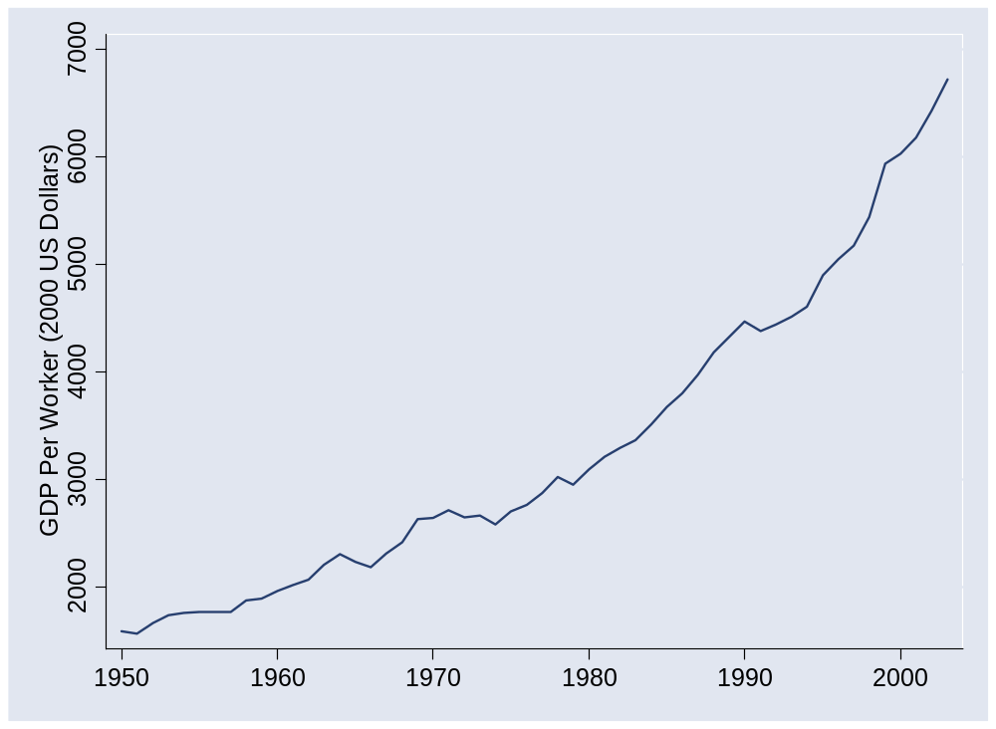
What happened in India?
Source: Penn World Tables, version 6.2.

Slide 49
What happened in India?
 | Y/L | K/L | A
1950 | 1,585 | 990 | 159
1980 | 3,094 | 3,714 | 200
2003 | 6,725 | 7,892 | 338
Contribution 1950-80 | 2.23 | 1.47 | 0.76
Contribution 1980-2003 | 3.38 | 1.09 | 2.28

Slide 50
What happened in India?
EIU, Country Finance Report:
  India is a difficult operating environment for foreign companies. Most economic activities are girded with restrictions, public services and infrastructure are poor, and the government continues to impede the free flow of capital across its borders. Tax rates are relatively high and the tax system is complicated.

Slide 51
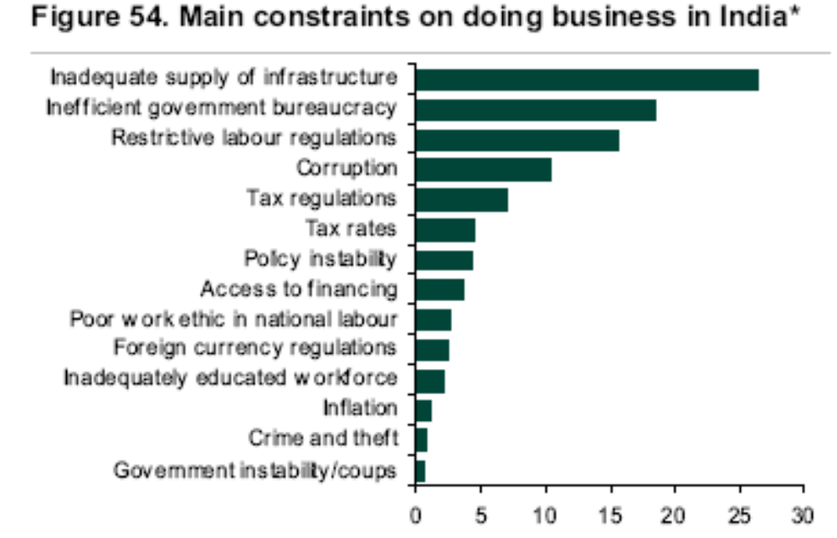
What happened in India?
Source: Lehman report, using data from World Economic Forum.

Slide 52
What happened in [country]?
Do your own calculations for any country you like
  Data online (link)
  Or through Blackboard (linked to this class)

Slide 53
Takeaways
Growth accounting quantifies sources of growth
Productivity (TFP) important in most cases
But… where does TFP come from? [up next]

Slide 54
After the break
Be prepared to discuss Group Project #2

Slide 55
At the break
Graded Group Project #1 to my right

Slide 56
The Global Economy
“Institutions”
© NYU Stern School of Business
Notes:
Spiel:
Modern society is a miracle – that hundreds of millions of people could interact and have things (more or less) work
All of this shows up in TFP
Where does it come from?
Not just math/science/tech
Bigger issue: Why aren’t people stealing from each other?
Some examples: Pirates (North), borrowing/lending game….
What do we need?
Security / Rule of Law
Property rights
Competition

Slide 57
The idea
Productivity (TFP) follows, in large part, from good economic and political institutions. Some institutions facilitate productivity and growth, others do not.
Notes:
But what are these institutions of which you speak?

Slide 58
Where we’re headed
GDP
Capital & Labor
Productivity
Political Process
“Institutions”

Slide 59
Group Project #2

Slide 60
Plan of attack
The idea, where we’re headed ✓
Group Project #2 ✓
Striking example: ocean shipping
More examples: what is this?
Governance
What have we learned?

Slide 61
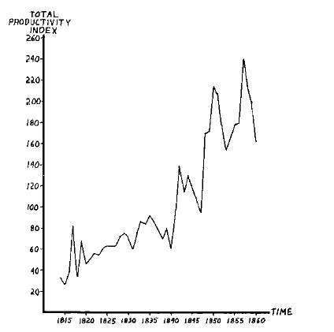
TFP in ocean shipping, 1600-1850
Source: Douglas North, 1993 Nobel prize
Why?

Slide 62
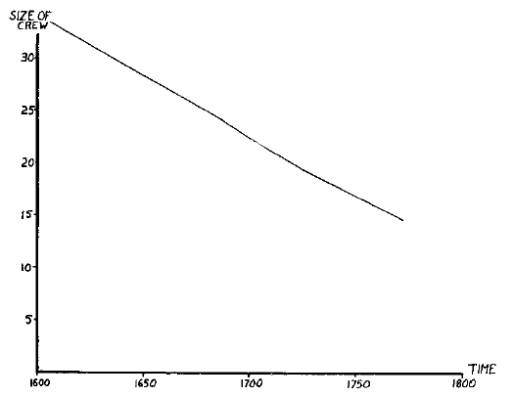
TFP in ocean shipping

Slide 63
TFP in ocean shipping
How important is technology?
How important are individual skills?

Slide 64
What is this?
Review of Winchester in The Economist Jun 5 08:
  The Chinese began printing 600 years before Gutenberg. They built the first chain drive 700 years before the Europeans. And they made use of a magnetic compass at least a century before anyone else. So why, in the middle of the 15th century, did this advanced civilisation suddenly cease its spectacular progress?
  Possible explanations: the stultifying pursuit of bureaucratic rank in the Middle Kingdom; the absence of a mercantile class to foster competition and self-improvement; the sheer size of China compared with the smaller states of Europe, whose fierce rivalries fostered technological competition.
Do you agree with any of these? Why or why not?

Slide 65
What is this?
Immigration
  Do (say) Mexican workers make more in the US or at home?
  What does that tell you about the source of productivity?
  Why do people immigrate?

Slide 66
Who’s the pirate?
Use this as a theme ??
  …

Slide 67
What is this?
How would each of these affect productivity?
  Tainted milk in China?
  Bernie Madoff’s Ponzi scheme?
  Satyam’s accounting fraud in India?
  Argentina’s takeover of private pensions?

Slide 68
What is this?
Argentina in 2002
  Facing inflation over 1000%, the government announced in 1991 that citizens could use either dollars or local currency and pegged the peso to the dollar. A decade later, the government converted all dollar assets into pesos (“pesification”) and devalued by 75%.

Slide 69
What is this?
Indicator | US | France | Ratio
GDP | 6,297b | 1,296b | 5:1
Biomedical researchers | 77,000 | 12,000 | 6:1
Public research funding | 15.8b | 1.8b | 9:1
Industry research funding | 18.6b | 2.8b | 7:1
Biotech patents | 13,982 | 1051 | 13:1
Biotech startups | 1,100 | 40 | 27:1
Publicly-traded biotechs | 315 | 5 | 63:1
Recombinant proteins | 97 | 0 | ∞:1
Source: Gittelman, 2003.

Slide 70
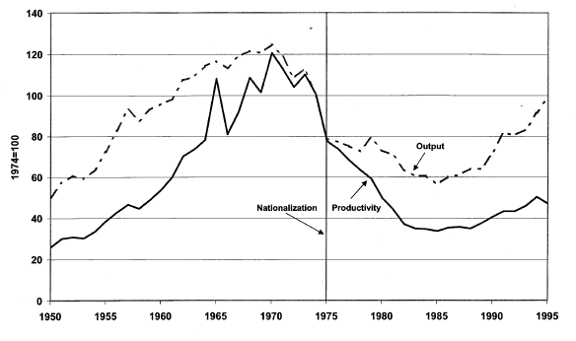
What is this?
Petroleum productivity in Venezuela
Light line is production, solid line is TFP.
Source: Schmitz and others.

Slide 71
What is this?
David Leonhardt, NY Times, Nov 8 09:
  If a hospital does a rigorous analysis of what actually works, it is likely to discover a fair amount of waste. When Intermountain standardized lung care for premature babies, it not only cut the number who went on a ventilator by more than 75 percent; it also reduced costs by hundreds of thousands of dollars a year. Perversely, Intermountain’s revenues were reduced by even more. Thanks to the fee-for-service system, the hospital had been making money off substandard care. By improving care it lost money.
What drives productivity here? What would “good institutions” look like?

Slide 72
What is this?
Lots of things go into building a system that facilitates productive economic activity

Slide 73
Measures of institutional quality
Broad categories
  Personal security and rule of law
  Clearly defined property rights
  Honest, open competitive markets (not “free”)
We have quantitative measures of these – and more

Slide 74
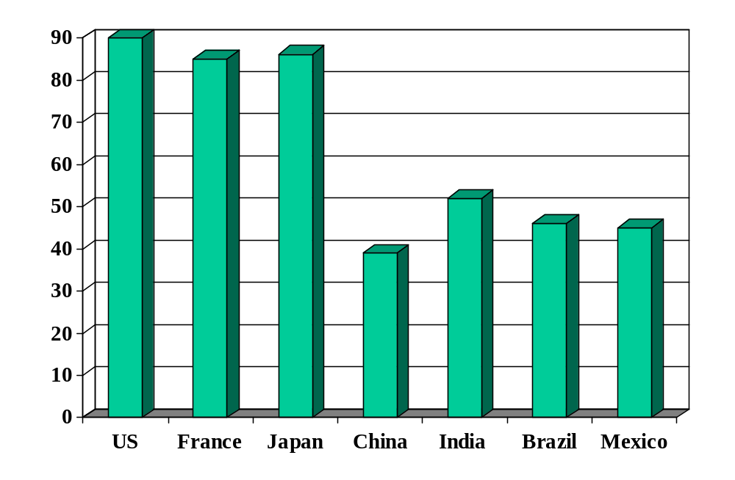
Rule of law (index)
Source: World Bank, Governance Indicators.

Slide 75
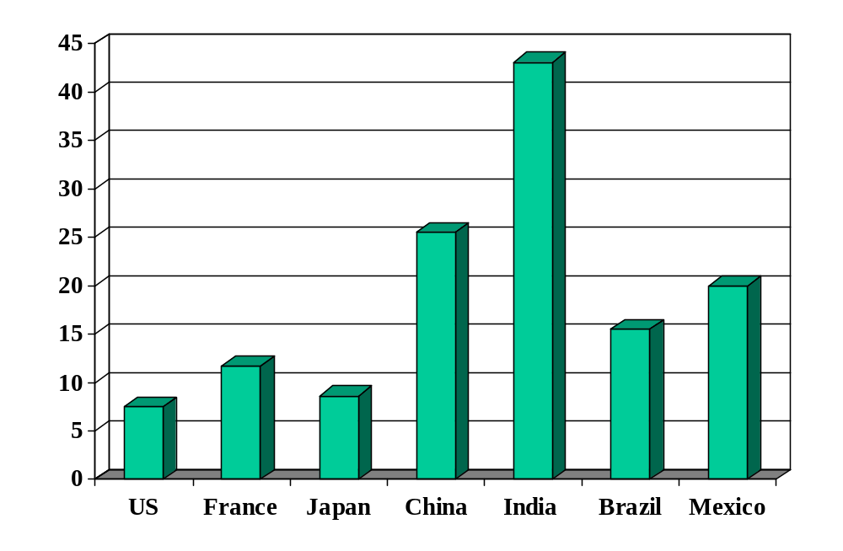
Cost of enforcing contracts (% of debt)
Source: World Bank, Doing Business.

Slide 76
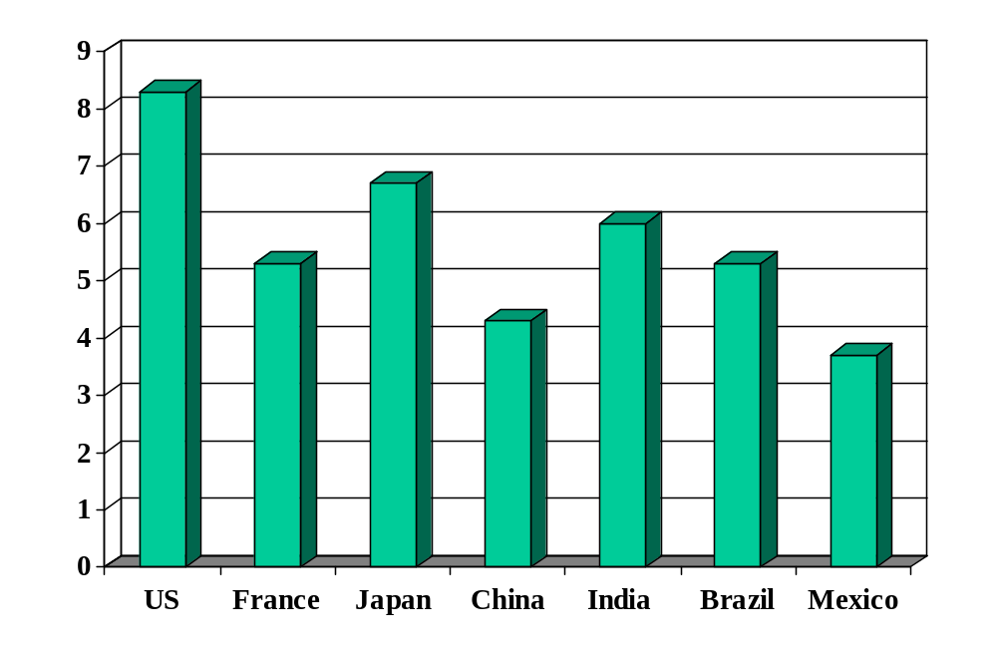
Investor protection (index)
Source: World Bank, Doing Business.

Slide 77
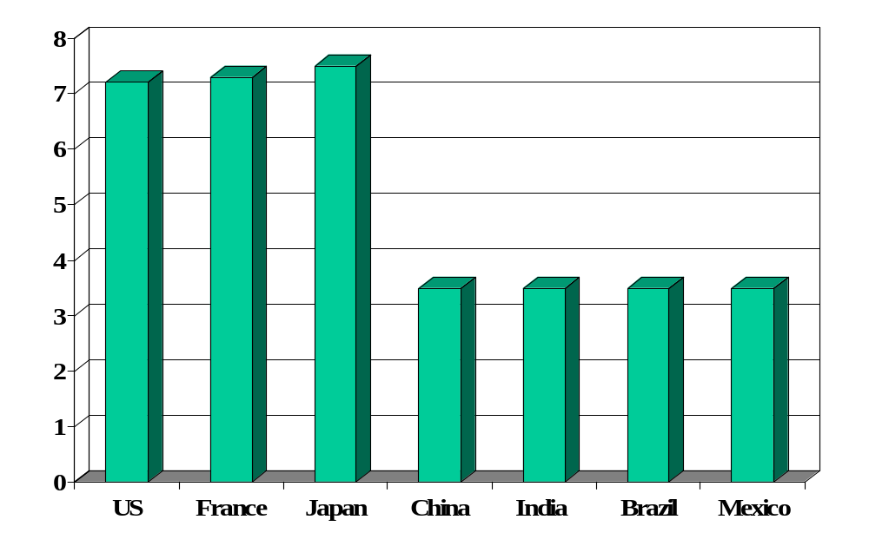
Absence of corruption (perceptions index)
Source: Transparency International.

Slide 78
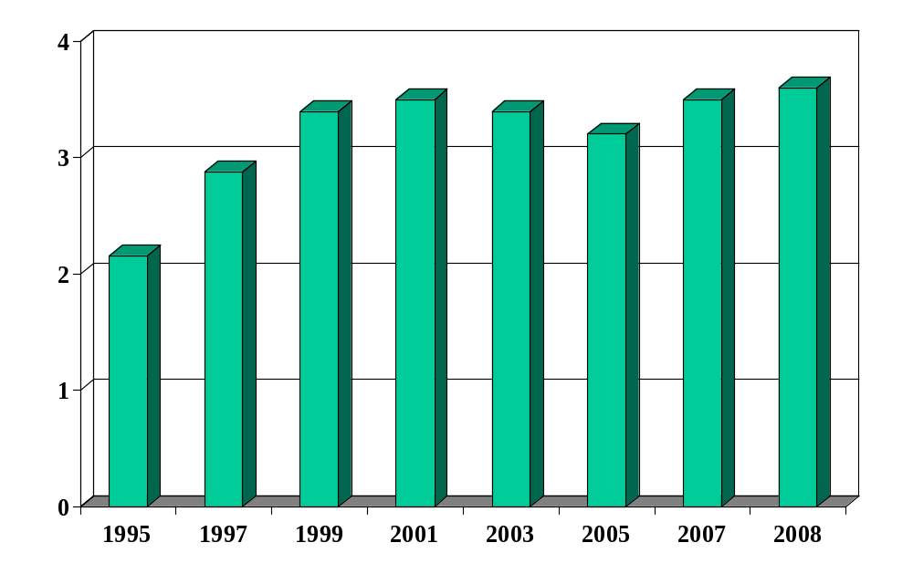
Absence of corruption in China
Source: Transparency International.

Slide 79
We started with
GDP
Capital & Labor
Productivity

Slide 80
Now we have
GDP
Capital & Labor
Productivity
“Institutions”

Slide 81
Governance
James Madison, Federalist Papers 51 (1788):
  If men were angels, no government would be necessary. If angels were to govern men, neither external nor internal controls on government would be necessary. In framing a government which is to be administered by men over men, the great difficulty lies in this: you must first enable the government to control the governed; and in the next place oblige it to control itself.

Slide 82
Governance
Mo Ibrahim, telecoms engineer and entrepreneur
Built African mobile telecom network
Supports improved governance in Africa
  “Nothing, simply nothing, is more important for Africa than good governance.”
  Ibrahim Index of African Governance intended to expose poor governance.
  Ibrahim Prize awarded to leader who rules fairly and turns power over to a successor.
FT interview, Feb 16 08
Good ideas?

Slide 83
Governance
Czech joke (circa 1968):
  The difference between capitalism and socialism? Under capitalism, Man oppresses Man. Under socialism it’s exactly the opposite.

Slide 84
Governance
James Surowiecki, The New Yorker:
  Regulation isn’t an obstacle to thriving free markets; it’s a vital part of them.
Link

Slide 85
And finally
GDP
Capital & Labor
Productivity
Political Process
“Institutions”

Slide 86
What have we learned?

Slide 87
Takeaways
Productivity (TFP) reflects “institutions” that facilitate economic activity
  Rule of law
  Property rights
  Honest, open competitive markets
Measures of institutional quality are useful inputs to business decisions.
Good institutions follow from good governance.

Slide 88
What’s coming up
Group Project #3
  Application of the tools developed in last two classes
  Good practice for the midterm

Slide 89
Extra slides
We don’t have time for these slides, but I don’t have the heart to delete them. If you find any of them interesting, feel free to ask questions next class.

Slide 90
The capital markets game
Parameters:
  Lender offers 100 to borrower for one year
  Lender’s cost of funds is 5%, charges 10%, the competitive risk-adjusted rate
  Borrower has project that generates 100 + 15
  If you default, you use up 50 (lawyers etc)
  Note: the deal generates value (115 – 105 = 10)
  What happens?

Slide 91
The capital markets game
Don’t lend
Payoffs = (0,0)
L
(+5,+5)
Repay
Lend
B
0
X
Default
(–105,+65)
What’s the outcome? What can we do about it?
Notes:
Note: economic activity creates value

Slide 92
What is this?
From Parkinson’s Law, published 1957, p 8:
Year | Ships | Men in Navy | Dock-workers | Dock officials | Naval Admin
1914 | 62 | 146,000 | 57,000 | 3249 | 2000
1928 | 20 | 100,000 | 62,439 | 4558 | 3569
What happened to productivity? Why?

Slide 93
The capital markets game
Note: creditor rights help borrowers!
  Making it easy to default simply kills off loan market, which hurts borrowers as well as lenders
  Result: positive NPV projects not funded, TFP lower than it could be
Evidence:
  States/countries with stronger creditor rights have more lending, lower rates
  Countries with strong creditor rights have more advanced financial systems and higher GDP per capita

Slide 94
The capital markets game
What does this suggest about institutions in general?

Slide 95
Islamic world
A puzzle
  Islamic countries around the Mediterranean in the middle ages were more advanced than Europe. Why has economic performance been worse?

Slide 96
Property rights
Hernando de Soto, Mystery of Capital:
  My summary: the absence of clear property rights is a major problem in many developing countries. This hits small businesses hardest, since lack of clear claim to (say) real estate makes it difficult for them to finance new or expanding businesses. An earlier book emphasized red tape: it would take a small business months to get the approvals needed to operate legally in Peru.
Notes:
http://www.pbs.org/wgbh/commandingheights/lo/story/ch_menu_03.html
Ch 19, 2:00

Slide 97
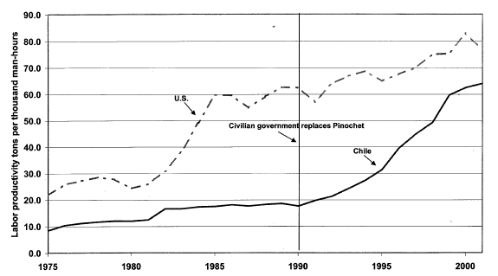
What is this?
Copper productivity in US and Chile
Light line is production, solid line is TFP.
Source: Schmitz and others.

Slide 98
Evidence
Good economic performance is associated with good institutions
How do we know this?
  Regressions: relate performance (growth and level of GDP per capita) to measures of institutional quality
  Micro studies
Causality?

