Slide 1

The Global Economy
Monetary Policy and (Big) Inflation
© NYU Stern School of Business
Notes:
Inflation
High inflation: has anyone lived through one? What was it like? [do this later]

Slide 2
Where we’re headed
Current Conditions
Indicators
Theory: AS & AD
Monetary Policy
Statistical Analysis
Future Conditions

Slide 3
The idea
Big inflations are generated by high growth rates in the supply of money, which in turn always have deeper roots.
Notes:
Reminder: P = price index (units?)
Inflation = rate of change of P
High inflation = fall in value of money
Theory : the more money there is, the less value each unit has

Slide 4
Plan of attack
Where we’re headed, the idea ✓
Costs of inflation
Pictures and quotes
Quantity theory of money
Money supply mechanics
Zimbabwe

Slide 5
Costs of inflation
Stable currency central to most transactions
  Bonds, salaries, prices, taxes…
Time spent adapting to inflation uses/wastes resources
Evidence suggests inflation above 10% is associated with poor economic performance

Slide 6
Highest inflation rates ever
Example | Highest Daily Inflation
Hungary, Jul 1946 | 207%
Zimbabwe, Nov 2008 | 98%
Yugoslavia, Jan 1994 | 65%
Germany, Oct 1923 | 21%
Source: Hanke, Cato: http://www.cato.org/zimbabwe.
Notes:
Have you lived through a big inflation? What was it like?

Slide 7
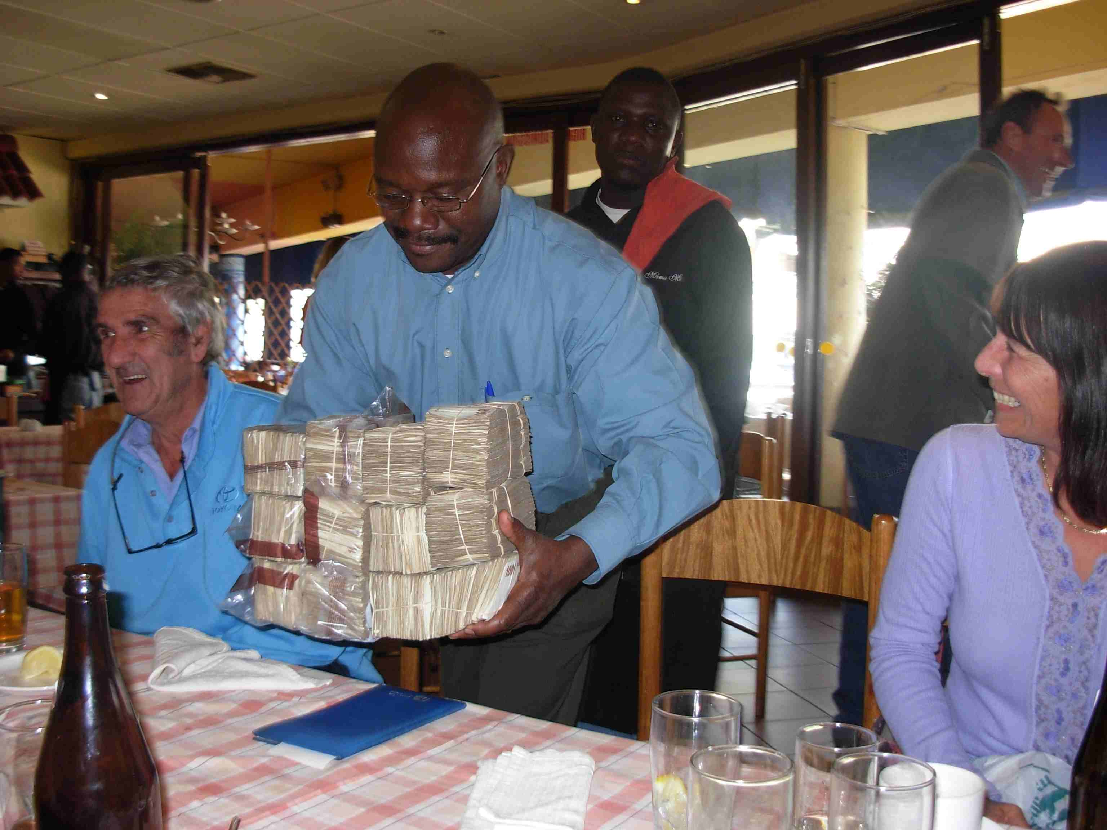
Buying lunch in Zimbabwe

Slide 8
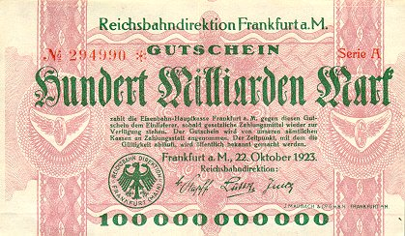
German currency
October 1923: 20 USD = 1 billion DM
Notes:
http://www.zum.de/whkmla/region/germany/turm2023.html

Slide 9
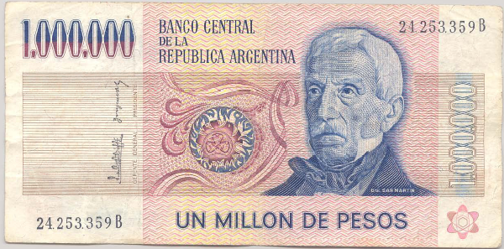
Argentine currency
This note dates from 1980s. What’s it worth now? Why?

Slide 10
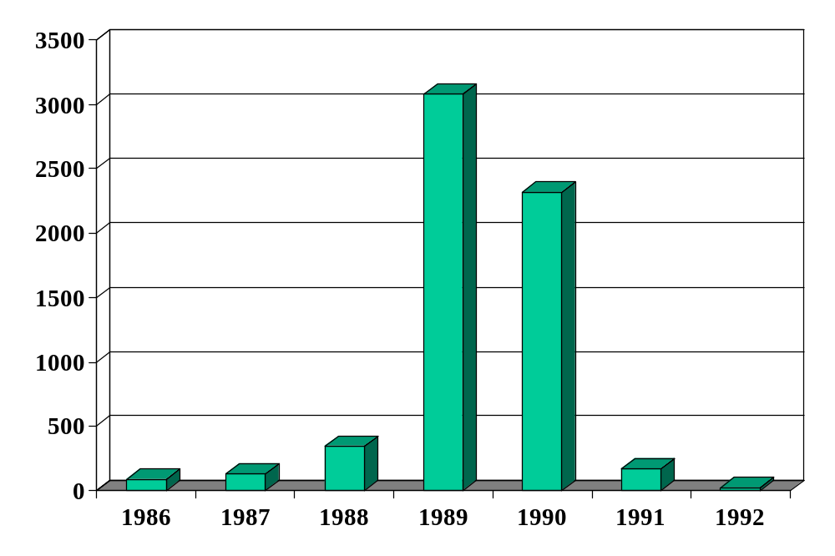
Inflation in Argentina (annual %)
Source: EIU database.

Slide 11
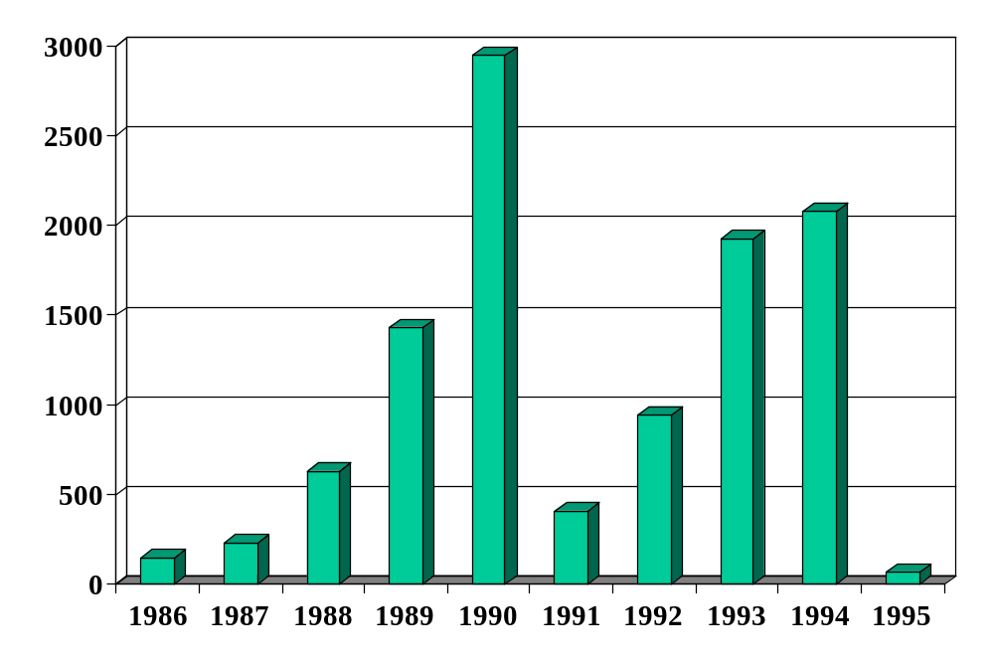
Inflation in Brazil (annual %)
Source: EIU database.

Slide 12
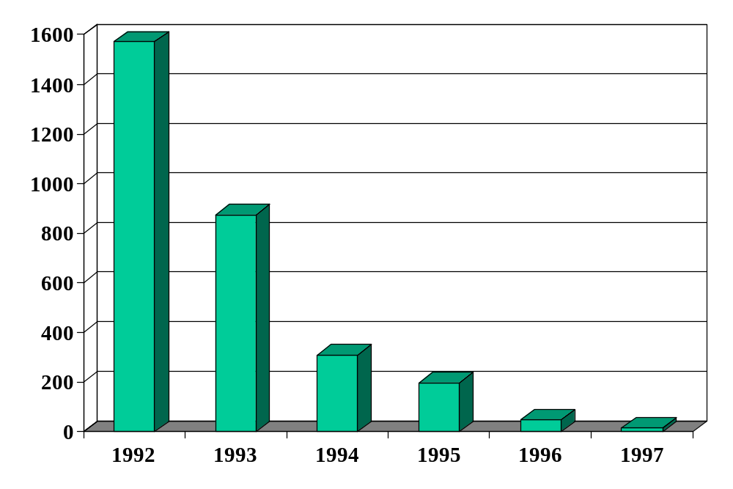
Inflation in Russia (annual %)
Source: EIU database.

Slide 13
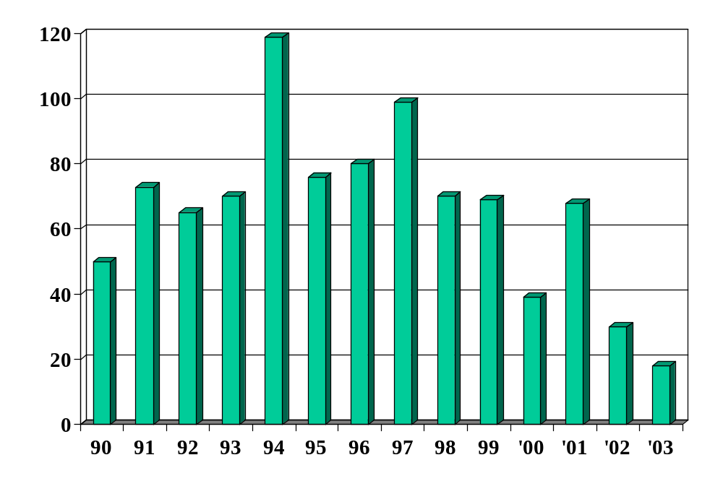
Inflation in Turkey (annual %)
Source: EIU database.

Slide 14
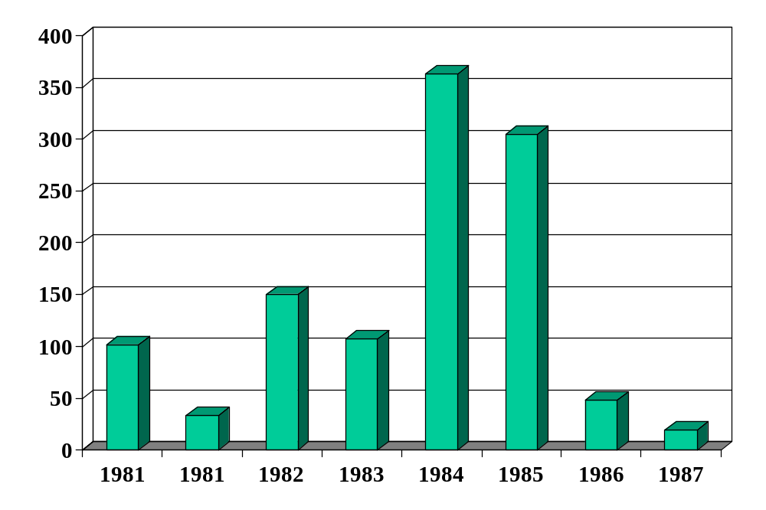
Inflation in Israel (annual %)
Source: EIU database.

Slide 15
Israel in the 1980s
American Rabbi visiting Israel:
  During Israel’s hyperinflation, I had a mortgage at a 5% fixed annual interest rate. In 1981, interest rates on mortgages were 39%, so it was a good deal. As inflation increased, fixed rate mortgage payments became laughably easy to make, because salaries more or less kept pace with inflation. Finally, I received a notice canceling my mortgage, because the cost of record-keeping had become more than the monthly payment.
Link

Slide 16
Quantity theory
Milton Friedman, 1976 Nobel Laureate:
  “Inflation is always and everywhere a monetary phenomenon. To control inflation, you need to control the money supply.”
Is he right?

Slide 17
Quantity theory
Money
Growth
Inflation

Slide 18
Quantity theory
One equation (technology for transactions)
M V = P Y
  M = stock of money in circulation (amount of currency)
  V = velocity (how often a unit of currency is used in a year)
  P = price level (the GDP deflator or other price index)
  Y = real GDP
In growth rates
γ_{M} + γ_{V} = γ_{P} + γ_{Y}
  γ_{M} = growth of money supply (think: currency in circulation)
  γ_{V} = growth of velocity
  γ_{P} = growth of price level (inflation rate)
  γ_{Y} = growth of real GDP

Slide 19
Quantity theory
Two hypotheses
  V is constant (γ_{V} = 0)
  Y not affected by changes in M [long-run approximation]
One conclusion
  Money growth causes inflation
γ_{P} = γ_{M} – γ_{Y}

Slide 20
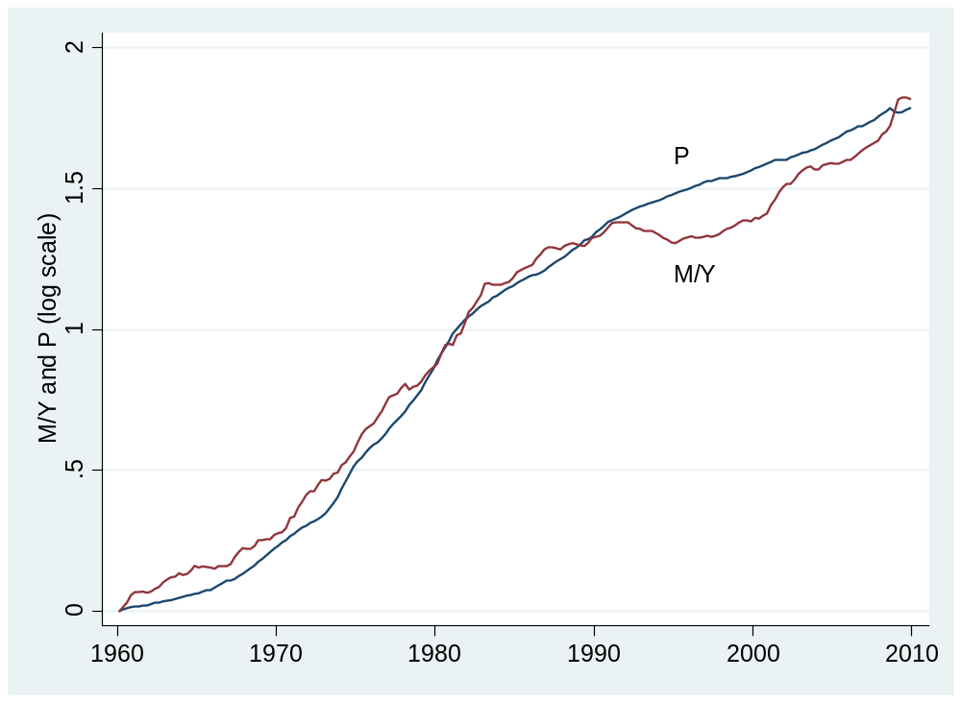
Quantity theory: long-run evidence
Source: FRED; M is M2 here.

Slide 21
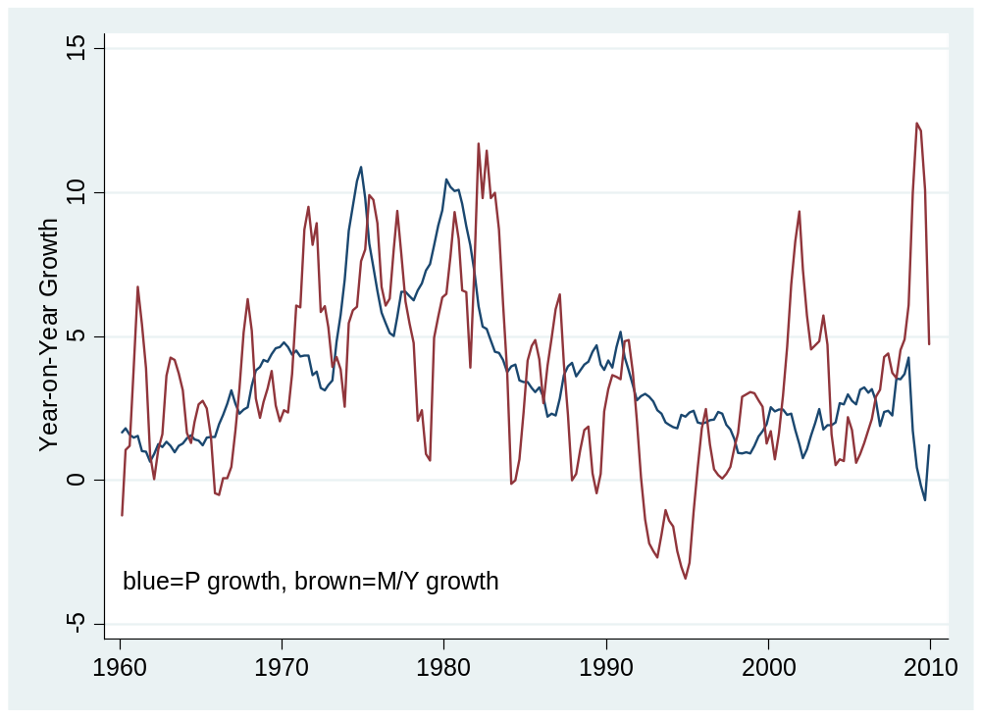
Quantity theory: short-run evidence

Slide 22
Money supply mechanics
How the central bank manages the money supply
  Money = currency for our purposes
Look at balance sheets for
  Treasury
  Central bank
  Private agents (households and firms)

Slide 23
Money supply mechanics
Treasury
Assets |  | Liabilities
 |  | Bonds | 200
Where does treasury debt come from?
How does central bank increase money supply?
Why do households go along?
Central bank
Assets |  | Liabilities
Bonds | 20 | Money | 20
Households and firms
Assets |  | Liabilities
Money | 20
Bonds | 180

Slide 24
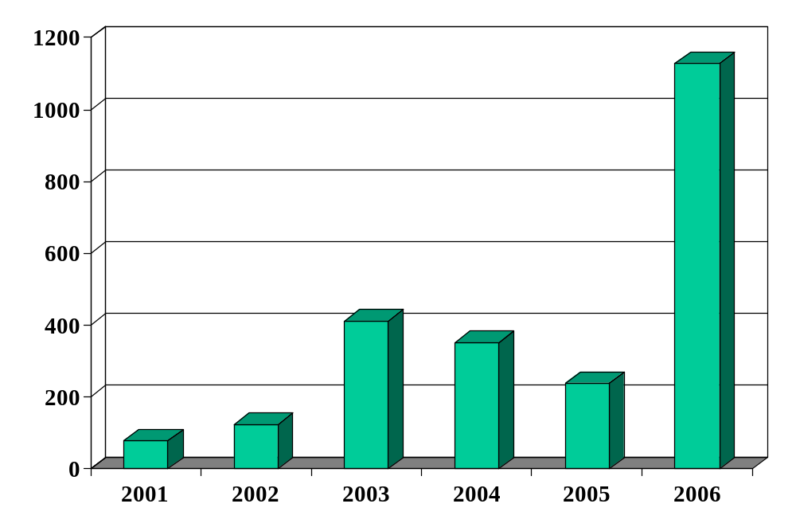
Zimbabwe (inflation rate, annual %)
Source: EIU database.

Slide 25
Zimbabwe
Dec 06: inflation over 1000 percent
Feb 07: inflation ruled “illegal”
Oct 08: inflation over 200 million percent (!)
Jan 09: transactions allowed in foreign currencies
  Soldiers and teachers to be paid in USD
Feb 09: 12 zeros knocked off currency
Apr 09: government abandons local currency
Notes:
http://www.cato.org/zimbabwe

Slide 26
Zimbabwe
What’s going on? Outline a chain of connections that generates inflation as the outcome. What is the underlying cause?

Slide 27
Money supply mechanics revisited
Treasury
Assets |  | Liabilities
 |  | Bonds | 200
What happened in Zimbabwe?
Central bank
Assets |  | Liabilities
Bonds | 20 | Money | 20
Households and firms
Assets |  | Liabilities
Money | 20
Bonds | 180

Slide 28
Quantity theory extended
Political
Instability
Fiscal
Deficit
Money
Growth
Inflation

Slide 29
What have we learned?
Was Friedman right?

Slide 30
Takeaways
Big inflations always reflect high money growth
Money growth typically follows from fiscal deficits …
… and fiscal deficits reflect political chaos
Modest inflations: up next

Slide 31
After the break
Be prepared to discuss
  Group Project #5
  Greenspan mini-case

Slide 32
North Korean fights inflation
New York Times, Mar 18 10:
  Faced with high inflation, North Korea announced in November that it would introduce new banknotes, which would chop two zeros off the currency. It also put a cap on how much old money they could swap for the new currency [around $40 by some reports].
  The shock measure was meant to arrest runaway inflation, but reportedly led to isolated highly unusual outbursts of protest in the totalitarian state.
  In March, North Korea executed its top financial official to quell public anger.
Notes:
http://www.nytimes.com/2010/03/19/world/asia/19korea.html
http://www.time.com/time/world/article/0,8599,1945251,00.html
http://wrongingrights.blogspot.com/2010/03/wtf-friday-31910.html

Slide 33
Deflation
Bad for economic performance?
Mechanism: debt more expensive in real terms
Examples:
  Bad performance: US in Depression, Japan in 1990s
  Good performance: US 1870-1900
My take: modest deflation not a big deal, the examples of bad performance reflect more basic problems
Notes:
http://www.nytimes.com/2010/03/19/world/asia/19korea.html
http://www.time.com/time/world/article/0,8599,1945251,00.html
http://wrongingrights.blogspot.com/2010/03/wtf-friday-31910.html

Slide 34
The Global Economy
Monetary Policy in AS/AD Model
© NYU Stern School of Business
Notes:
Board: GP5
Open IE, get Nasdaq chart
Mon policy: rates down 300bps with inflation rising
Generally mysterious?

Slide 35
Group Project #5
Useful indicators?
What do they tell us?
How do you see the US economy over next 6 months?

Slide 36
The idea
It’s a subtle issue, but monetary policy should in principle react differently to supply and demand “shocks.”

Slide 37
Plan of attack
Group Project #5 ✓
The idea ✓
Goals of monetary policy
Commodity and paper money [if time allows]
AS/AD review
AS/AD policy analysis
Greenspan mini-case [if time allows]

Slide 38
Goals of monetary policy
Typically these two
  Stable prices [translated as: inflation about 2% and stable]
  Output equal to long-run equilibrium [AS*, where the frictionless markets would put us]

Slide 39
Federal Reserve
Federal Reserve Act
  The Federal Reserve System and the Federal Open Market Committee should seek “to promote effectively the goals of maximum employment, stable prices, and moderate long-term interest rates.”

Slide 40
ECB
ECB = European Central Bank
Treaty establishing the European Community:
  The primary objective of [monetary policy] shall be to maintain price stability.
  Without prejudice to the objective of price stability, the ECB shall support the general economic policies in the Community with a view to contributing to the achievement of … a high level of employment and sustainable and non-inflationary growth.
Group Project #6 is an opportunity to explore this further

Slide 41
Banco Central de Argentina
BCRA Act (2003):
  The Argentine Central Bank is a National State self-governed institution, whose primary and fundamental mission is to preserve the value of the Argentine currency.

Slide 42
Commodity money
Gold standard
  Governments agree to tie money to gold (1 oz = $35)
  Money then controlled by availability of gold
  Guarantees stable prices?
  Limits policymakers?
  Waste of gold?

Slide 43
Paper money
David Ricardo, Proposals for a secure currency (1816)
  The introduction of precious metals [as money] may with truth be considered one of the most important steps towards the improvement of commerce; but it is no less true that, with the advance of knowledge and science, it would be another improvement to banish them altogether [in favor of paper money].

Slide 44
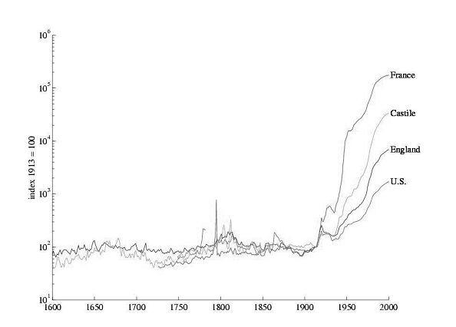
Prices over four centuries
Source: Sargent, “Evolution and intelligent design.”

Slide 45
AS/AD review
This section a little dense, think about pacing it differently ???

Slide 46
AS/AD review
P
AS*
AS
AD
Y*
Y

Slide 47
AS/AD review
What they are
  Aggregate supply concerns production of goods
  Aggregate demand concerns purchases of goods
What shifts them
  What shifts AD?
  What shifts AS & AS*?
How to use them
  Short-run equilibrium: where AS and AD cross
  Long-run equilibrium: where AS* and AD cross

Slide 48
AS/AD review
P
AS*
AS
Where is SR equilibrium?
Where is LR equilibrium?
C
A
B
AD
Y*
Y

Slide 49
AS/AD review
How can you tell supply shocks from demand shocks?
  Demand: P and Y move in same direction
  Supply: P and Y move in opposite directions
What are these?
  The financial crisis: Inflation fell from 3.5% in 2007 to about 0% in mid 2009. GDP growth fell from 2% to –4% over the same period. Does that sound like a shift in supply or demand? Which direction?
  1970s: GDP growth dropped from 4% in 1973 to –2% a year later, while inflation jumped from 6% to over 10%. Does that sound like a shift in supply or demand? Which direction?

Slide 50
AS/AD policy analysis
What are our goals?
  Low inflation [stable prices]
  Output near “potential output” Y* [invisible hand again]

Slide 51
AS/AD policy analysis
What’s coming
  How should we respond to demand shocks?
  How should we respond to supply shocks?

Slide 52
AS/AD policy analysis
P
AS*
AS
Is this good or bad?
A
AD
Y*
Y

Slide 53
AS/AD policy analysis
What happens when we increase the money supply?

Slide 54
AS/AD policy analysis
P
AS*
AS
Is this good or bad?
B
A
AD
AD'
Y*
Y

Slide 55
AS/AD policy analysis
What’s an example of an adverse demand shock?
What is its impact?
How should we respond?

Slide 56
AS/AD policy analysis
P
AS*
AS
What should policy do?
A
B
AD'
AD
Y*
Y

Slide 57
AS/AD policy analysis
What’s an example of an adverse supply shock?
What is its impact?
How should we respond?

Slide 58
AS/AD policy analysis
P
AS*
AS
B
What should policy do?
A
AD
Y*
Y

Slide 59
AS/AD policy analysis
P
AS*
AS
B
What happened in the 1970s?
A
AD
Y*
Y

Slide 60
What happened in the 1970s?
Krugman, NYT blog, Mar 18 10:
  The kind of inflation we had in the 1970s – high inflation combined with high unemployment – was quite different [from the typical hyperinflation]. [Government] deficits weren’t the issue – US deficits were much smaller in the inflationary 70s than in the disinflationary 80s. Instead, what you had was a combination of excessively expansionary monetary policies, based on an unrealistic view of how low the unemployment rate could be pushed.
Translation: AS* shifted left and Fed didn’t realize it
Notes:
http://krugman.blogs.nytimes.com/2010/03/18/stagflation-versus-hyperinflation/

Slide 61
Greenspan mini-case
How should we respond to demand shocks?
How should we respond to supply shocks?
How can we tell them apart?

Slide 62
Takeaways
Monetary policy affects
  Inflation
  Output in the short run
In theory, central banks should “resist” demand shocks and “accommodate” supply shocks
The challenge in practice is telling them apart

Slide 63
What’s coming up
Friday, “Employment Situation”
  Consensus +200k jobs [would be the first significant increase]

Slide 64
Special review session
Tuesday, April 6, 4:45-6:15 *** Note change ***
Additional session the following week if needed
Location TBA: probably Amity Hall
Come with questions, comments, stories

Slide 65
Extra slides

Slide 66
Hyperinflation
Krugman, NYT blog, Mar 18 10:
  Hyperinflation is actually quite well understood. It’s basically about revenue: when governments can’t raise taxes or borrow to pay for their spending, they sometimes turn to money creation. This leads to inflation.
Notes:
http://krugman.blogs.nytimes.com/2010/03/18/stagflation-versus-hyperinflation/

Slide 67
Real and nominal interest rates
Connection:
i = r + π
  i = nominal interest rate (what we usually see quoted)
  r = real interest rate (rate on basket of goods)
  π = expected inflation [why “expected”?]
Comment
  Movements in i reflect both r and π
  Which is more important? [It depends!]

Slide 68
Ben Bernanke
Testimony to Congress, Nov 05:
  Middle-income living standards, and poverty for that matter, are best addressed through employment growth. By maintaining low inflation and low expectations of inflation, you can create new employment.
Do this make sense to you?

