Slide 1

The Global Economy
Input Markets
© NYU Stern School of Business
Notes:
Institutions vary
Stories
Trading stocks in London
Buying groceries in France
Seminar in Lisbon
Pizza in Norway
Easy to tell stories of dumb policies, are there good ones?

Slide 2
The idea
Recall
  Good economic performance follows from good institutions, which typically require government intervention. The challenge is to do this in a way that generates more benefits than costs.
Today
  Experience suggests that some intervention is essential in financial markets, but often counterproductive in labor markets.
Notes:
Pragmatic issue: getting institutions right

Slide 3
Plan of attack
The idea ✓
Financial market institutions
  What’s going on in Greece?
  Financial market institutions
  Crisis prevention
Labor market institutions
  Quotes and pictures
  What’s going on in France?
  Minimum wage: who wins, who loses?

Slide 4
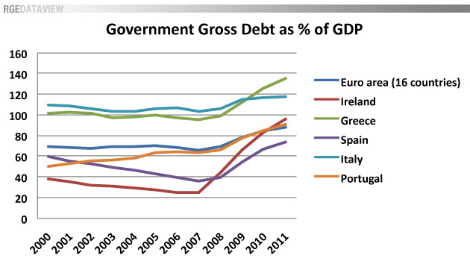
What’s going on in Greece?
Source: Roubini Global Economics, “Will PIGS fly?” Feb 11 2010.

Slide 5
What’s going on in Greece?
“Germany rescues Greece,” FT blog, Feb 11 10:
  Otmar Issing, the German former chief economist of the European Central Bank, was telling German television viewers that Greeks enjoyed “one of the most luxurious pensions systems in the world” and it was unreasonable to expect German taxpayers to fund it.

Slide 6
What’s going on in Greece?
Why is there a crisis?
Why would the Germans want to bail them out?
In what ways is California similar? Different?
[This is complicated and involves issues we haven’t covered yet, but it’s too interesting to ignore]

Slide 7
What’s going on in Greece?
General lessons
  There’s often a tradeoff being offering help and providing good incentives
  Federal systems exhibit this tension
  Fixed exchange rate systems are built on trust

Slide 8
What’s going on in Greece?
Professor Gian Luca Clementi, Feb 16 10:
  This is not a financial crisis.
  The sovereign debt crisis in Europe is a test of the Euro Zone. Since there are no rules in place, the decision will shape incentives for the future. Any guarantee of Greek debt must be accompanied by harsh terms: oust current government and demand EU approval of budgets.

Slide 9
Financial market institutions
Obvious: enforce property rights
  Protecting investors is good for borrowers
  Equity harder to do than debt
Less than obvious: manage financial crises?
  Why not let failures happen?
  “Capitalism without failure is like religion without sin”
The argument for intervention
  Financial crises hurt everyone
  An externality? Like pollution? [sounds right, but even experts are fuzzy about the details]

Slide 10
Financial crises happen
Common in emerging markets
  Mexican crisis: 1994-95
  Asian crisis: 1997
  US: 1907, 1891, …
Developed countries, too
  Japan: 1990s
  Scandanavia: 1990s
  All over: 2008-09
Bottom line
  Insolvent banking system bad for economic performance

Slide 11
Financial crises
Friedman and Schwartz on the 1930s
  The failure of one bank can produce “runs” on other banks that in turn may force even “sound” banks to suspend [payments].
  Federal deposit insurance has succeeded in achieving a major objective of banking reform, namely, the prevention of banking panics.
Do you agree?
  Is deposit insurance a “good institution”?
  Does it raise other problems?
Source: Monetary History of the United States

Slide 12
Financial crises
Arthur Levitt, WSJ, Feb 22 10
  There is now a high probability that the greatest financial crisis in three generations will yield not one meaningful financial reform.
  The policy bias against failure was regrettable but excusable in the fall of 2008. Now there is no reason for it. Too many regulators, politicians, bankers, credit rating agencies, and others have believed failure was not an option. In financial markets, when people take risks and don’t anticipate failure, they take greater risks and the resulting failure becomes far more damaging.

Slide 13
Financial crises: regulation basics
Insolvent banking system bad for the economy
Therefore: protect banks
  Require deposit insurance
  Limit risk-taking
  Close or merge insolvent banks
  Pay special attention to large banks (“systemic”)
  Thousands of details
Bailouts
  A sign we did something wrong?
  Or a fact of life?

Slide 14
Financial crises: open issues
Should we regulate banks, who benefit from deposit insurance, but leave other financial institutions alone?
What if crisis originates outside banking system?
  Bear, Lehman, AIG didn’t have deposit insurance
  Should the Fed have let AIG fail? Rescued Lehman?
Regulatory arbitrage
  Should we regulate financial firms by type? Product? Location?
  Should we have a “macro” regulator with authority to intervene whenever economy is threatened, regardless of the type of firm?
Should we manage “bubbles”?
This is inherently difficult to get right

Slide 15
Catch your breath
Labor market institutions
  Hiring workers is subject to a wide range of restrictions in many countries: minimum wages, unions, limits on layoffs and dismissals
  Often called “employment protection”
What’s the effect on employment? Business practice?

Slide 16
India
Shankar Acharya, “Ten myths about India,” FT Forum, Feb 1 10:
  Myth 4. Our labour laws protect labour. Quite the opposite. Present laws over-protect a tiny minority at the expense of the vast majority of workers. By making it extremely difficult to retrench workers in the organised sector, our existing laws massively discourage the employment of new workers. In effect, these laws are very anti-employment and lead to huge under-utilisation of our most abundant resource, low-skill labour.

Slide 17
Germany
“Daimler to boost flexibility,” FT, Mar 15 10:
  Daimler is seeking greater flexibility by hiring more temp workers and using external service Bodo Uebber also noted “a more cautious hiring policy for permanent staff.”

Slide 18
Brazil
EIU Country Commerce Report:
  The 1988 constitution legalises unions and the right to strike. The constitution also sets overtime rates, provides a monthly minimum wage and regulates working hours. It lists a variety of labour entitlements, including maternity leave, annual leave, worker’s compensation, social services, medical assistance and unemployment benefits.
  Labour costs are relatively high in Brazil because of the many mandatory charges and taxes attached to employment. Wages remain moderate but account for at most two-thirds of the total costs of hiring labour.

Slide 19
Spain
“Hard to bend,” The Economist, Feb 11 10:
  Spain has a rigid system for setting wages. Pay is set centrally through a complex system [in which] wages adjust only slowly to changes in business conditions. Despite a deep recession and zero inflation, pay growth averaged 3% last year, according to the OECD. That helps explain why Spain’s jobless rate shot up so quickly; it now stands at 19.5%.

Slide 20
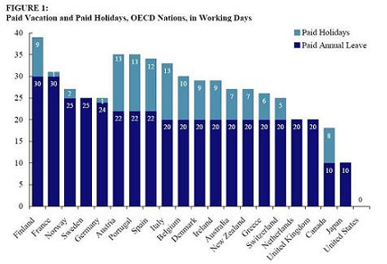
Mandated vacation and holidays

Slide 21
Mandated vacation and holidays
Sociological images, Feb 2010:
  The weak labor movement in the U.S. is partly to blame for the stingy federal policies around vacation and holidays. ... The quality of life of a typical American certainly suffers from our ignorance of life in other nations. If we were more aware of what a strong labor movement could offer, we might be more supportive of those movements.
Link.

Slide 22
What’s going on in France?
Christopher Caldwell, Financial Times, Feb 05:
  In early 2000, Martine Aubry, the Socialist labour minister, shepherded into law a bill that capped the work-week of most employees at 35 hours. She called it “a necessity for job creation.” Today French labour participation is rock-bottom among developed countries.

Slide 23
What’s going on in France?
The Economist, Feb 1 07:
  Smokers are fleeing the country's new anti-tobacco law. The country's strict working-time rules, though, add a particular French twist: should smoking breaks be counted as part of the 35-hour week?

Slide 24
What’s going on in France?
Financial Times, Feb 12 07:
  Presidential candidate Segolene Royal laid out her economic vision: increase the minimum wage, scrap laws that make it easier for small companies to hire and fire employees.

Slide 25
What’s going on in France?
Associated Press, Sep 09:
  French President Nicolas Sarkozy on Monday asked world leaders to join a “revolution” in the measurement of economic progress by dropping their obsession with gross domestic product to account for factors such as health care availability and leisure time. …
  His own country – known for its leisurely meals, long vacations and labor protections – could outshine more proﬁt–focused economies if nations act on new recommendations in a report commissioned 18 months ago.

Slide 26
What’s going on in France?
How would you guess France and US compare?
  Employment (fraction of working-age population)
  Hours worked per employed person

Slide 27
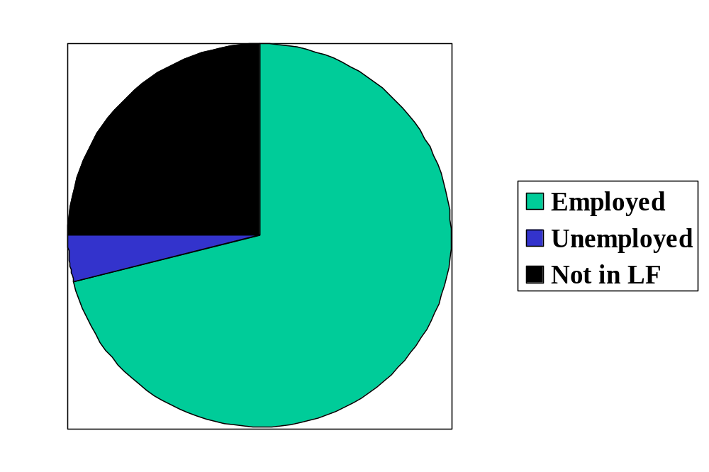
Labor market status in the US
Source: OECD, Employment Outlook, 2006. Numbers are percentages of the population 15-64.
Notes:
Draw this on board, show what universe and pieces are
Employment rate
Participation rate
Un rate

Slide 28
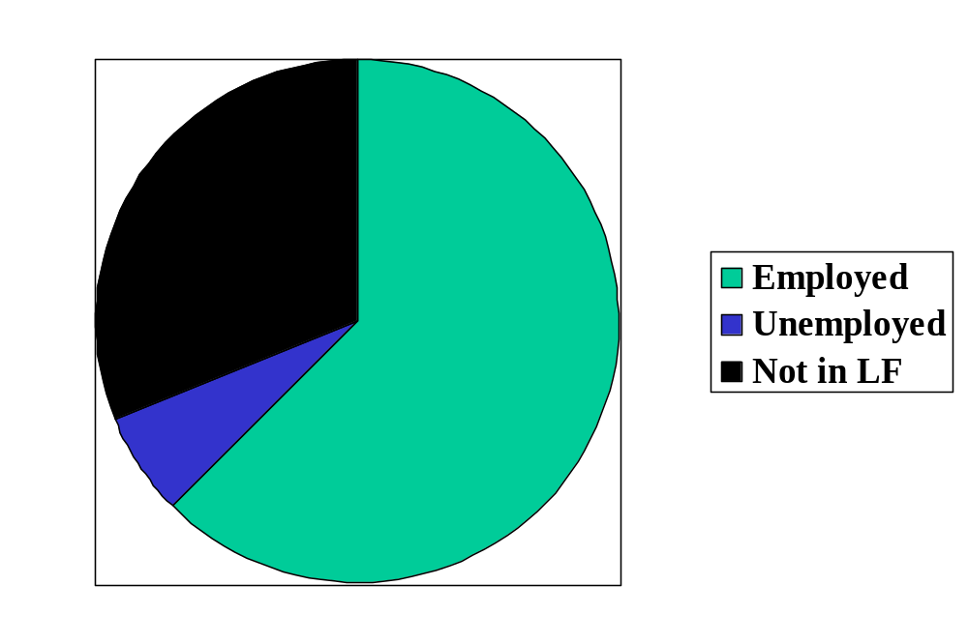
Labor market status in France
Source: OECD, Employment Outlook, 2006. Numbers are percentages of the population 15-64.

Slide 29
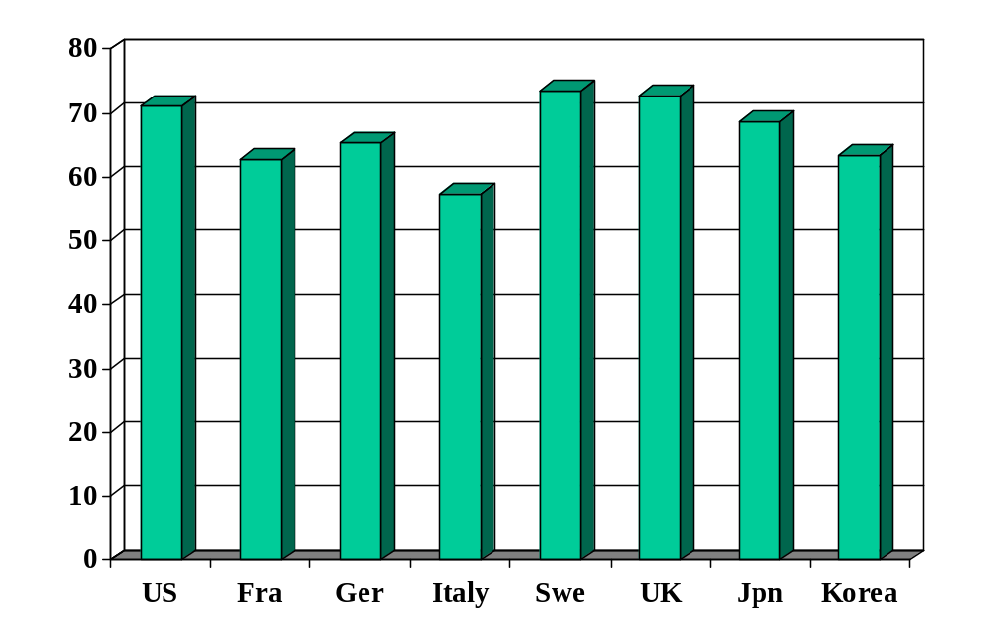
Employment rate (% of 15-64)
Source: OECD, Employment Outlook.

Slide 30
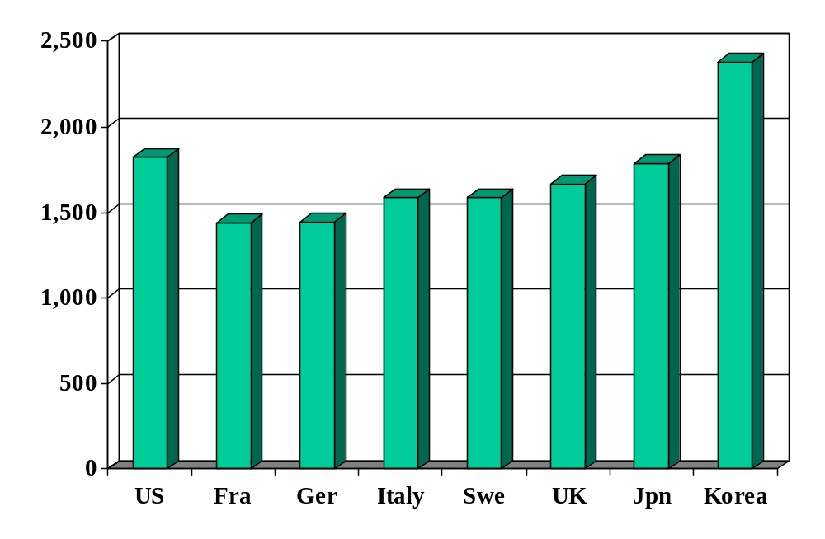
Hours worked (per worker per year)
Source: OECD, Employment Outlook.

Slide 31
GDP per hour worked
GDP per hour worked [h = hours per worker]
    Y/hL
Connection to GDP per capita
Y/POP = (L/POP) (Y/L) = (L/POP) h (Y/hL)
Comparison of two countries
(Y/POP)₁/(Y/POP)₂ =
(L/POP)₁/(L/POP)₂ (h₁/h₂) [(Y/hL)₁/(Y/hL)₂]

Slide 32
France and US
 | Y/POP | Y/L | Y/hL
US | 34,875 | 67,865 | 37.58
France | 25,664 | 56,909 | 37.12
Ratio | 1.36 | 1.19 | 1.012
Log of ratio (%) | 30.7 | 17.6 | 1.1
Source: Penn World Tables, version 6.2, and OECD, Employment Outlook.

Slide 33
France and US (2003)
 | Y/POP | L/POP | h
US | 34,875 | 0.514 | 1806
France | 25,664 | 0.451 | 1532
Ratio | 1.36 | 1.14 | 1.18
Log of ratio (%) | 30.7 | 13.1 | 16.5
Source: Penn World Tables, version 6.2, and OECD, Employment Outlook.

Slide 34
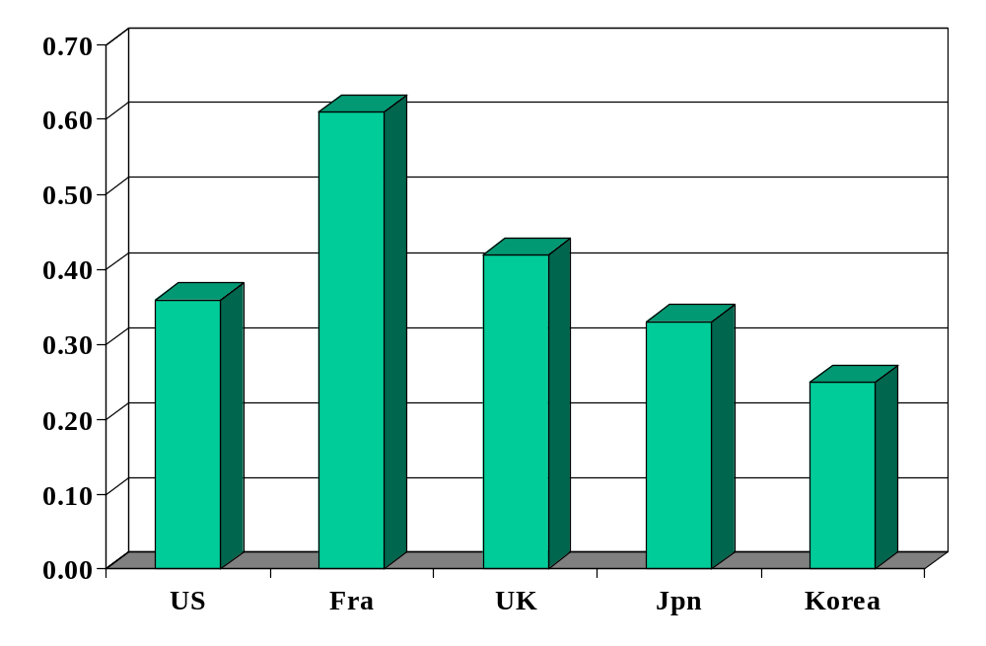
Minimum wage (ratio to median wage)
Source: OECD, employment database.

Slide 35
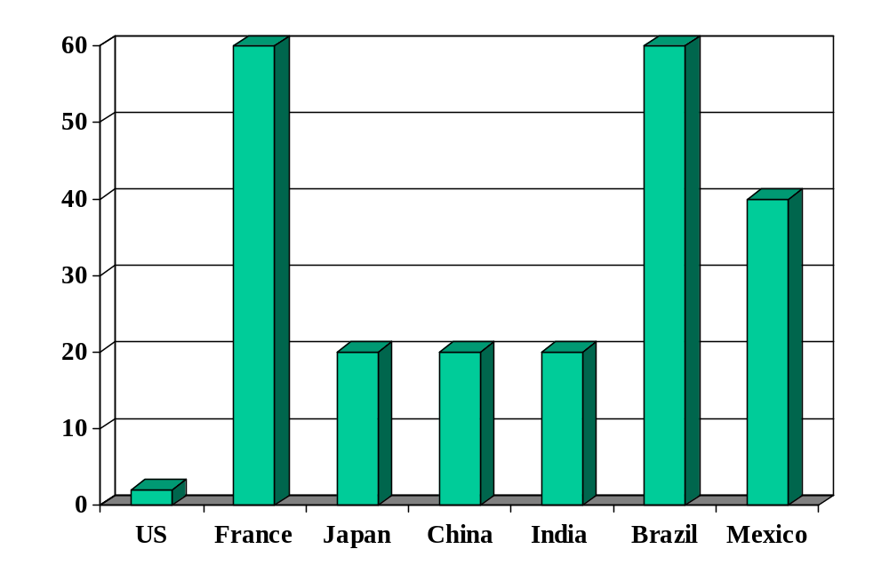
Rigidity of hours (index)
Source: World Bank, Doing Business.

Slide 36
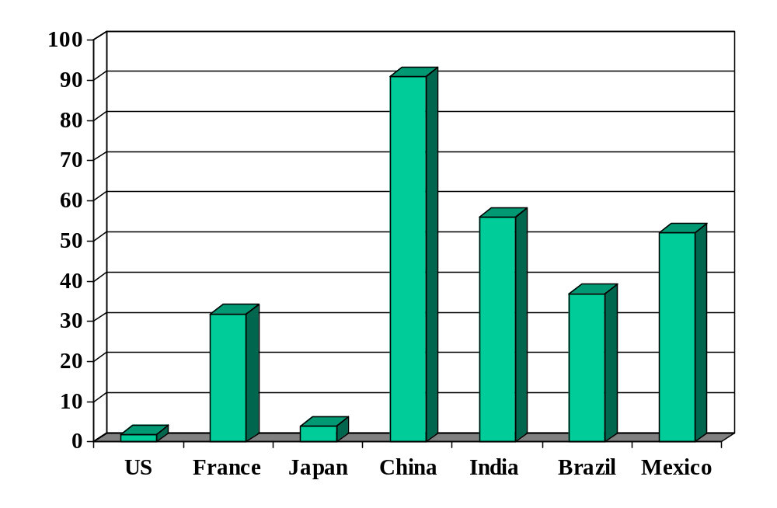
Firing costs (weeks of wages)
Source: World Bank, Doing Business.

Slide 37
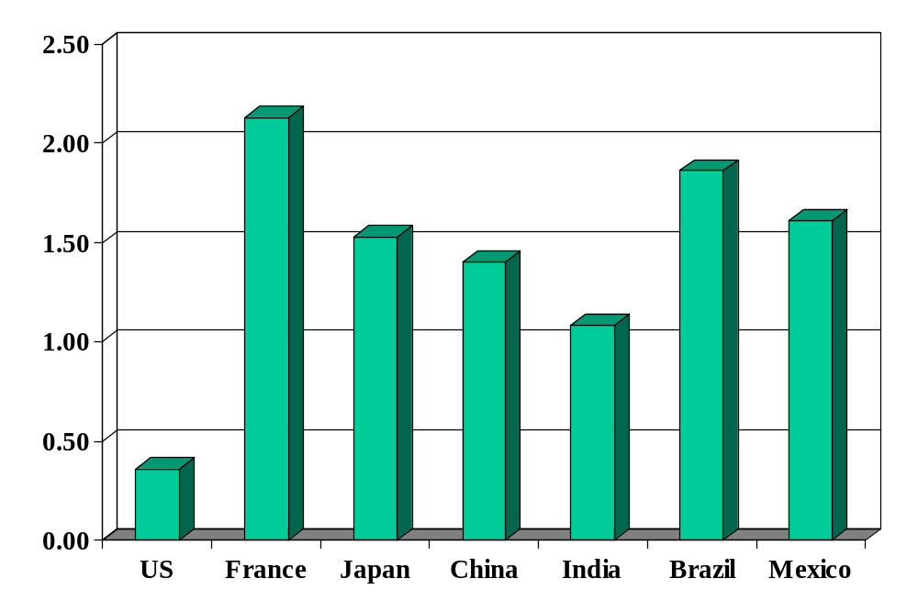
Union rights (index)
Source: Botero, Djankov, La Porta, Lopez-de-Silanes, Shleifer, Regulation of Labor.

Slide 38
France revisited
Why are employment and hours lower than in US?
Would you build a plant there? Locate a bank? Go on vacation?
Overall: lots of evidence that “employment protection” reduces employment and economic performance

Slide 39
Minimum wage
Good or bad? For whom?
An example of “employment protection” that’s relatively simply to study

Slide 40
Minimum wage
Reuters, Jan 19 2010:
  Gabon will almost double the minimum wage, its government said late on Monday. … The minimum monthly salary will rise to 150,000 CFA francs from 80,000 francs from the end of February.
  “Firstly, it will increase the purchasing power of men and women who work in Gabon, and secondly, as purchasing power increases, quality of life increases too,” said Prime Minister Paul Mba.
Link
Is this a good idea? Why or why not?

Slide 41
Minimum wage
Milton Friedman
  The minimum wage law is most properly described as saying employers must discriminate against people who have low skills.
Link
Notes:
http://www.youtube.com/watch?v=JfdRpyfEmBE
Start at 2:30

Slide 42
Labor market
Notes:
Do this on the board
Show: D is who? Supply? Willingness to hire? Work?

Slide 43
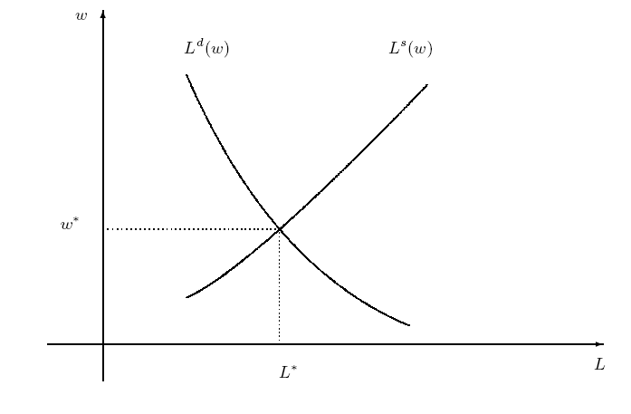
Labor market w/out min wage
Notes:
Do this on the board
Show: D is who? Supply? Willingness to hire? Work?

Slide 44
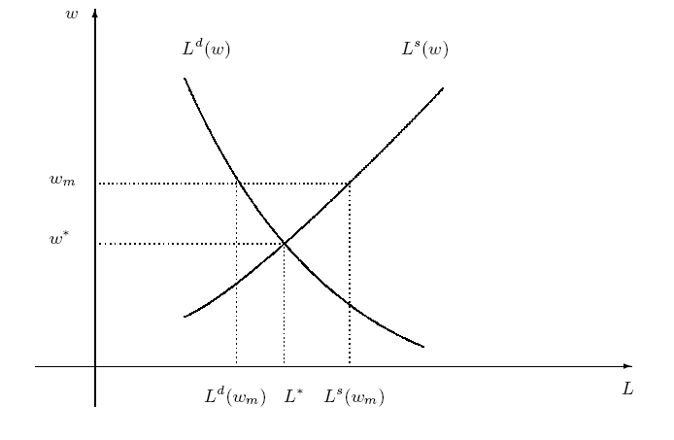
Labor market with min wage
Are we better off?
Who’s “we”?
Notes:
Is this a big deal in the US? Elsewhere?

Slide 45
Takeaways
Financial markets work best with effective government support
Financial crises are a challenge
  How do you balance the practical need for a functioning financial system with the bad incentives inherent in rescues, bailouts, and even deposit insurance?
Labor market regulations often raise the cost of hiring people and discourage employment
  This is a fact of life if you’re running a business

Slide 46
After the break
Be prepared to speak about Group Project #3
  How large will the US and China be in 2030?

Slide 47
The Global Economy
Labor Markets and Volatility
© NYU Stern School of Business
Notes:
Intro: call me when we reach “equil”
World is volatile place
Open Gapminder: shares

Slide 48
Group Project #3
How large will US and China be in 2030?
Which will be larger?
Which will have the more prosperous consumers?
What are the essential inputs to this conclusion?
Notes:
Why is this not extrapolation?
Because we understand the inputs and can change them

Slide 49
Plan of attack
Group Project #3 ✓
Pictures and quotes
Labor market volatility (“transitions”/“flows”)
Volatility and labor market flexibility
What have we learned?
What’s coming up

Slide 50
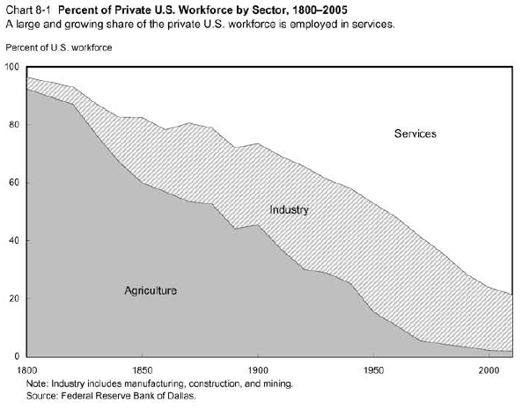
Output by sector in the US
Source: Dallas Fed.

Slide 51
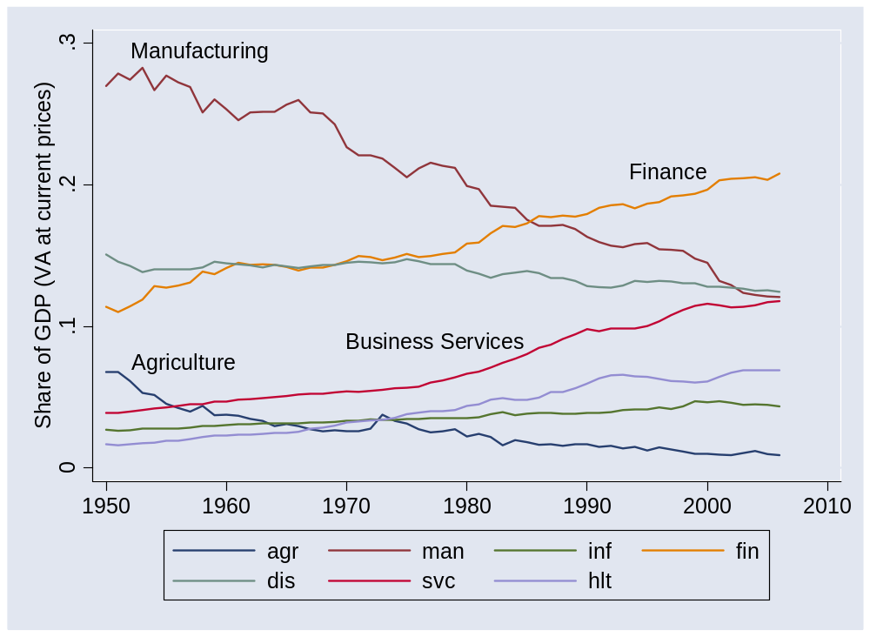
Output by sector in the US
Source: BEA.

Slide 52
Output by sector in the US
Millions of agricultural jobs lost
Millions of manufacturing jobs lost
Where did they go?

Slide 53
Output by sector worldwide
Gapminder again

Slide 54
Marx and Engels
Communist Manifesto (1848):
  Everlasting uncertainty and agitation distinguish the bourgeois epoch from all earlier ones. All fixed, fast frozen relations, with their train of ancient and venerable prejudices and opinions, are swept away, all new-formed ones become antiquated before they can ossify. All that is solid melts into air, all that is holy is profaned.
  All old-established national industries have been destroyed or are daily being destroyed. They are dislodged by new industries, whose introduction becomes a life and death question for all civilized nations.
Link
Notes:
http://www.marxist.net/marx/index.html

Slide 55
Joseph Schumpeter
Capitalism, Socialism and Democracy (1942):
  The fundamental impulse that sets and keeps the capitalist engine in motion comes from the new consumers, goods, the new methods of production or transportation, the new markets, the new forms of industrial organization that capitalist enterprise creates. This process of Creative Destruction is the essential fact about capitalism.
  In capitalist reality, competition … strikes not at the margins of the profits and the outputs of the existing firms but at their foundations and their very lives.
Link

Slide 56
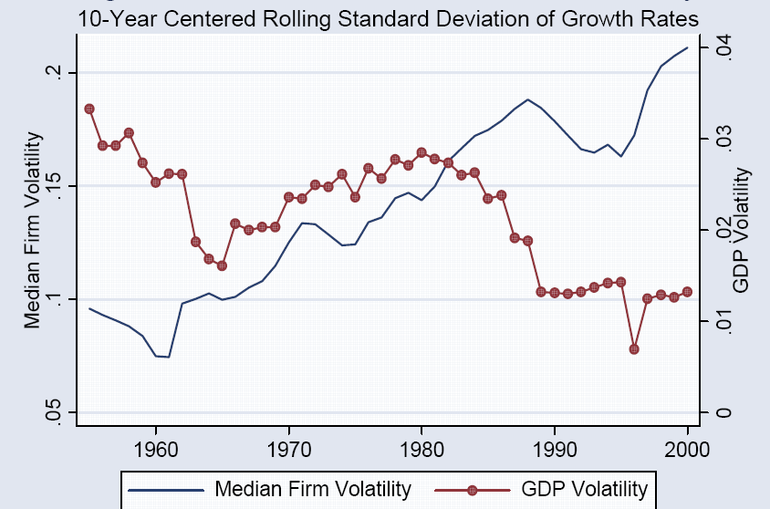
Sales volatility
Source: Comin and Philippon, NBER Macro Annual, 2006.

Slide 57
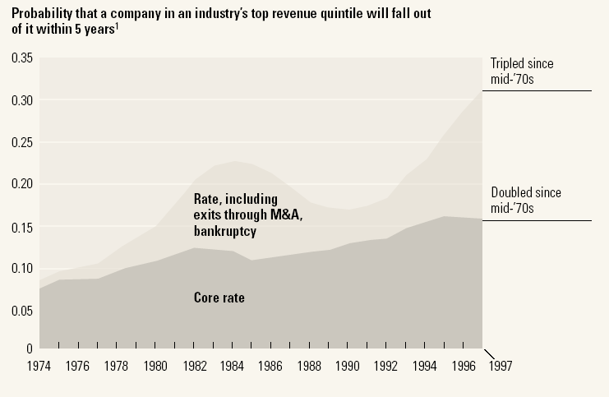
Market share volatility
Source: McKinsey Quarterly, “Extreme competition,” 2005.

Slide 58
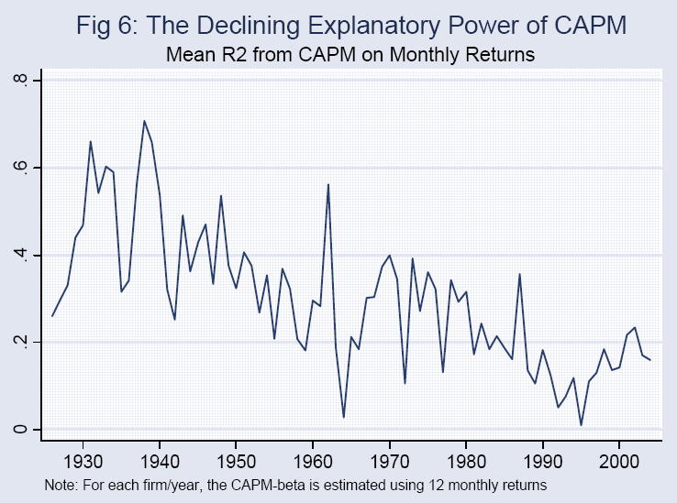
Stock return volatility
Source: Comin and Philippon; see also Morck, Yeung, Yu, JFE, 2000.

Slide 59
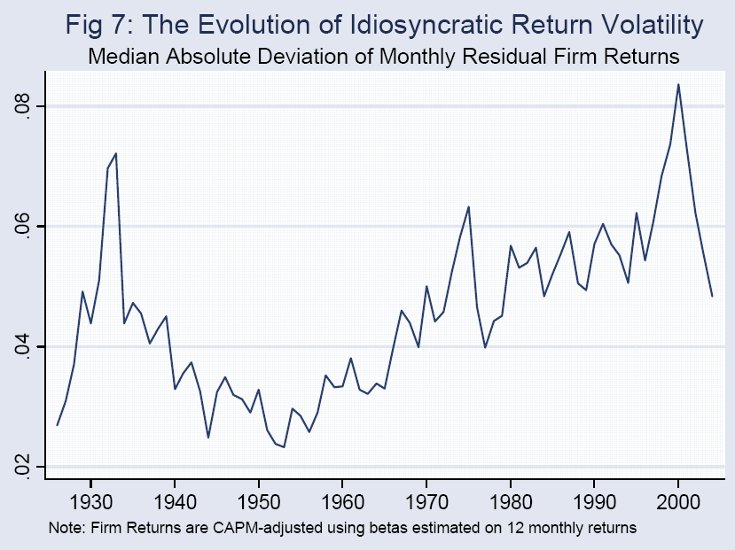
Stock return volatility
Source: Comin and Philippon; see also Morck, Yeung, Yu, JFE, 2000.

Slide 60
Why?
Why more micro volatility? Good or bad?

Slide 61
Labor market volatility
We measure people changing jobs in a variety of ways

Slide 62
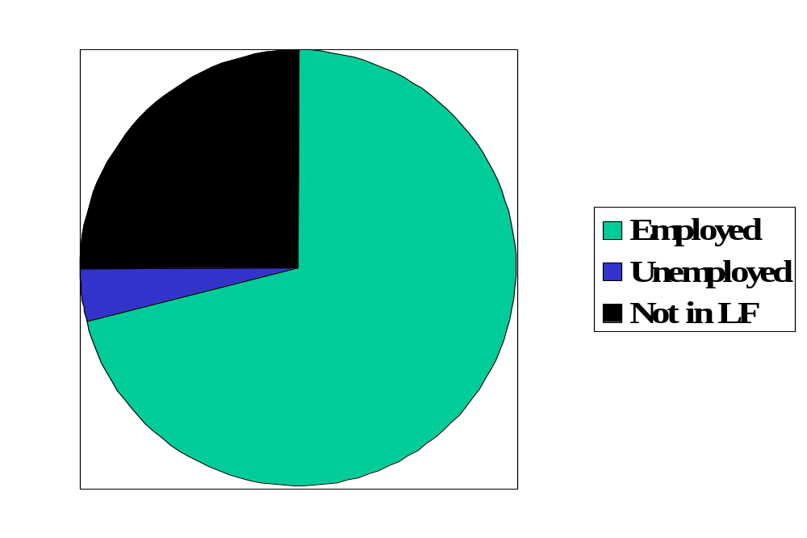
Reminder: labor market status (US)
Source: OECD, Employment Outlook, 2006. Numbers are percentages of the population 15-64.
Notes:
Draw this on board, show what universe and pieces are

Slide 63
Labor market “flows” (“transitions”)
Transitions
  How many people change “status” from month to month?
Aggregate measures of turnover
  Accessions: number of workers taking new jobs, whether their previous status was employed, unemployed, or not in labor force
  Separations: number of workers leaving current jobs, whether they become employed, unemployed, or leave labor force.
Bottom line: enormous turnover

Slide 64
Labor market flows (avg, 1993-2005)
Monthly!
Percentages apply to “source” of flow
2.6% “job-to-job”
Employment
122.0m
1.3%
4.8%
28.3%
2.7%
2.4%
Unemployment
6.2m
Out of labor force
59.3m
23.3%
Source: US data, monthly, reported in Davis, Faberman, and Haltiwanger, “Flow approach,” 2005.

Slide 65
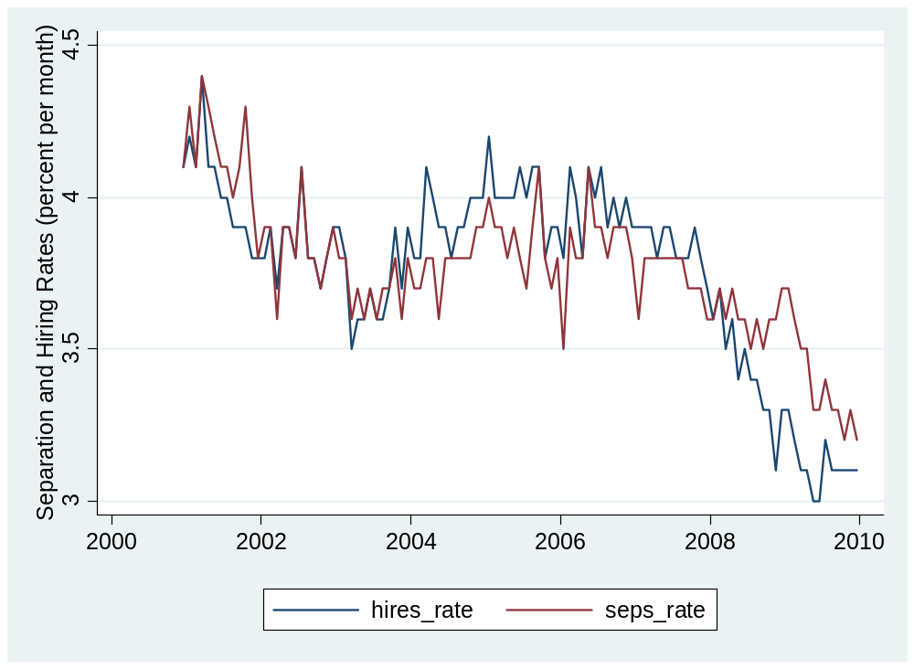
Hires and separations (monthly)
Notes:
See also: http://economix.blogs.nytimes.com/2009/12/23/another-look-at-hiring-and-layoffs/

Slide 66
Labor market flows in US and EU
 |  | Workers and Jobs
Country | EPL | Accessions | Separations | Reallocation
Denmark | 1.8 | 29.0 | 29.0 | 58.0
France | 2.8 | 28.9 | 30.7 | 59.6
Germany | 2.5 | 31.6 | 30.4 | 62.0
Italy | 2.5 | 34.5 | 33.6 | 68.1
Sweden | 2.6 | 16.8 | 17.8 | 34.6
UK | 1.2 | 37.2 | 37.6 | 74.8
USA | 0.7 | 45.2 | 46.0 | 91.2
Source: OECD, Employment Report, 1994; numbers are annual percentages of labor force.
Notes:
What do you see?

Slide 67
Labor market flows
New York Times, Oct 9 05:
  Some European experts say that French and German leaders are at least looking at the heart of the unemployment problem: that companies are not likely to hire more freely unless they can fire more freely. As economist Katinka Barysch put it, “the best place to lose your job is in a country where it's easiest to find a new job.”

Slide 68
Sources of micro volatility
Products come and go
Firms come and go
Industries come and go
Good or bad?
What does this mean for capital? Labor?

Slide 69
Micro volatility and labor markets
What happens when you mix
  employment rigidity
  and micro volatility?

Slide 70

Ljunqvist and Sargent
Volatile Economy
+
Inflexible Labor Market

Slide 71
Denmark’s “flexicurity”
Flexible labor market + strong social support
Generous unemployment insurance tied to compulsory training
Result:
  Flexible labor market: indicators look like US
  High cost: 2.7% of GDP [v 0.2% in US]

Slide 72
What have we learned?

Slide 73
Takeaways
Modern economies are volatile
  Companies, industries, sectors come and go
  Ditto capital and labor
Flexible markets improve aggregate performance …
…but individual firms and workers must deal with the uncertainty

Slide 74
What’s coming up
Read mini-cases before next week’s class
Group Project #4: not due for 2 weeks

Slide 75
Extra slides

Slide 76
Labor markets in Germany
Financial Times, Feb 13 06:
  Diether Klingelnberg knows what’s holding the German economy back: there is no incentive for (mid-sized) firms like his to hire new workers. Demand is good, we have more than enough orders, but without greater labor flexibility and predictability of social security and healthcare costs, companies are increasingly likely to move production abroad.

Slide 77
Labor markets in Hong Kong
Financial Times, February 2005:
  People routinely work Saturday mornings, have long work weeks (50-55 hours)
  Pressure on unskilled workers as jobs move to China
  Proposal: minimum wage, cap on hours
  Advocates: min wage would reduce unemployment by making work more attractive

Slide 78
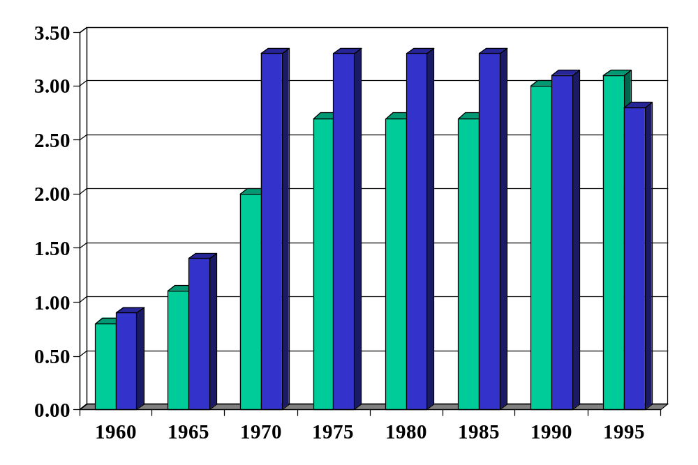
Employment protection in Europe
Green = FRA
Blue = DEU
Source: Blanchard and Wolfers.
Notes:
http://bpp.wharton.upenn.edu/jwolfers/research.shtml

Slide 79
Labor market indicators (“outcomes”)
Employment rate = employed/(working-age) population
Labor force = employed + unemployed
Unemployment rate = unemployed/labor force
Participation rate = labor force/working-age population
Inactivity rate = out of labor force/working-age population
Hours worked = average hours worked of employed people

Slide 80
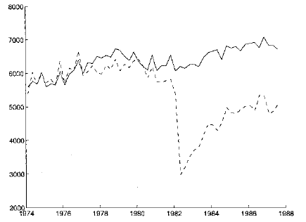
Displaced workers
Average quarterly earnings of “stayers” and “separators”
“stayers”
“separators”
Source: Ljungqvist and Sargent, JPE, 1999; adapted from Jacobson et al, AER, 1993.

Slide 81
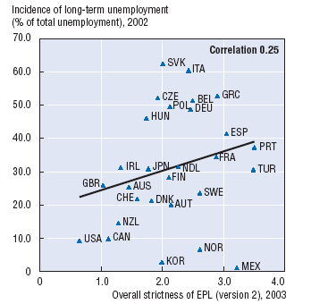
Protection and unemployment
Source: OECD, Employment Outlook, 2004.

Slide 82
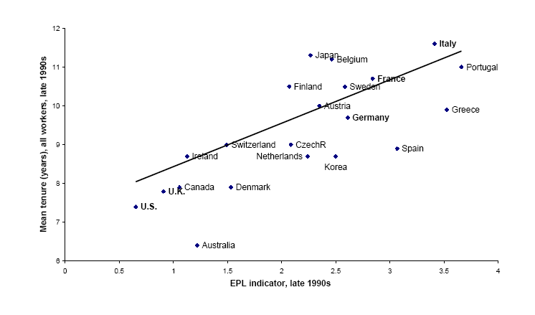
Employment protection and tenure
Source: Bertola, 2001.

Slide 83
Labor markets in the US
The Economist, Jan 18 07:
  NESTLED among the wooded Blue Ridge mountains in Virginia's far south-west, Galax is a town of bluegrass music, barbecue and hardscrabble living. Globalization has hit hard. Last year … three big [furniture] factories closed their doors within months.
  For some, the future looks bleak. At 59, Paul Rotan sees little chance of finding another job with health insurance. But other, mainly younger, workers are already better off.
  [This is the way trade and innovation work.] Displaced workers should find new jobs, but their wages will probably fall. Although the country overall gains handsomely, these people are often worse off.
Link

Slide 84
Demand-side theory of wages
You often hear
  Higher wages generate prosperity, because workers have more money to spend, which makes the economy grow faster.
Example
Do you agree? Why or why not?

Slide 85
Labor market institutions
Employment “protection” laws
Industrial relations / trade unions
Minimum wages

Slide 86
Employment protection laws (EPL)
What are they?
  Laws that govern employment contracts
Examples
  Duration of contract
  Overtime compensation
  Layoffs
  Dismissals

Slide 87
Portugal v New Zealand
Fixed-term contracts
PRT Fixed term contracts allowed only in special situations (such as seasonal activity)
NZL Fixed term contracts are unrestricted, with no maximum duration period

Slide 88
Portugal v New Zealand
Overtime
PRT Mandatory premium for overtime work ranges from 50% to 75%, additional restrictions on night work, and there are 24 days of paid leave per year
NZL No required premium for overtime work, no restrictions on night work, and the minimum paid leave is 15 days per year

Slide 89
Portugal v New Zealand
Dismissal
PRT Has a list of fair grounds for termination and stringent procedural limitations on dismissals, such as mandatory notification of the government and priority rules for re-employment of redundant workers.
NZL Allows “contracts at will,” which can be terminated with notice without cause
Source: Botero, Djankov, La Porta, Lopez-de-Silanes, Shleifer, 2003

Slide 90
Industrial relations laws
What are they?
  Laws that govern collective bargaining, enforcement of collective agreements, and the organization of trade unions
Examples:
  Employers’ duty to bargain with unions
  Extension of collective contracts to third parties
  Right to strike
  Right of unions to appoint company directors

Slide 91
Portugal v New Zealand
Collective bargaining
PRT Employers have a legal duty to bargain with unions, collective agreements are extended to third parties by law, workers councils are mandatory, and employer lockouts are prohibited.
NZL Employers have no legal obligation to bargain with unions, collective agreements are not legally extended, labor participation in management is not required by law, and employer lockouts are allowed.
Source: Botero, Djankov, La Porta, Lopez-de-Silanes, Shleifer, 2003

Slide 92
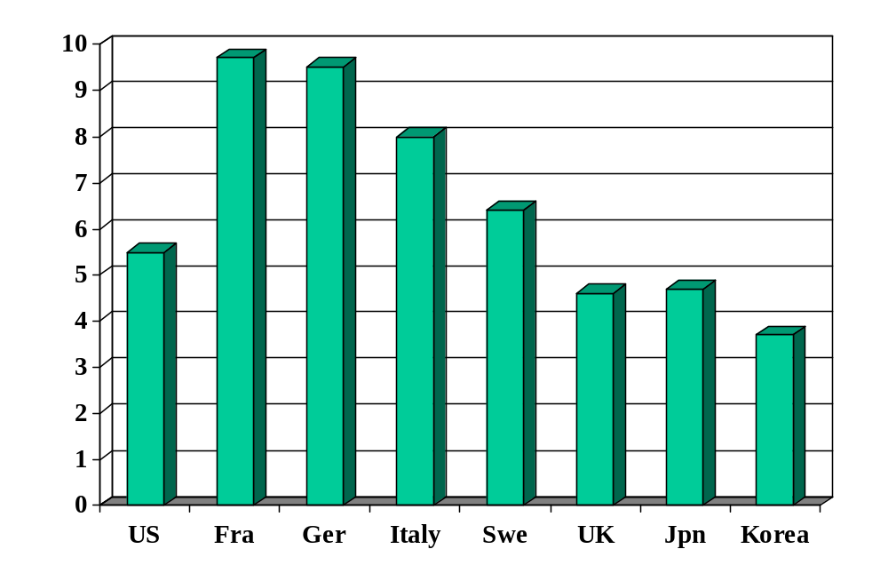
Unemployment rate (% of labor force)
Source: OECD, Employment Outlook; standardized rates intended to be comparable across countries.

Slide 93
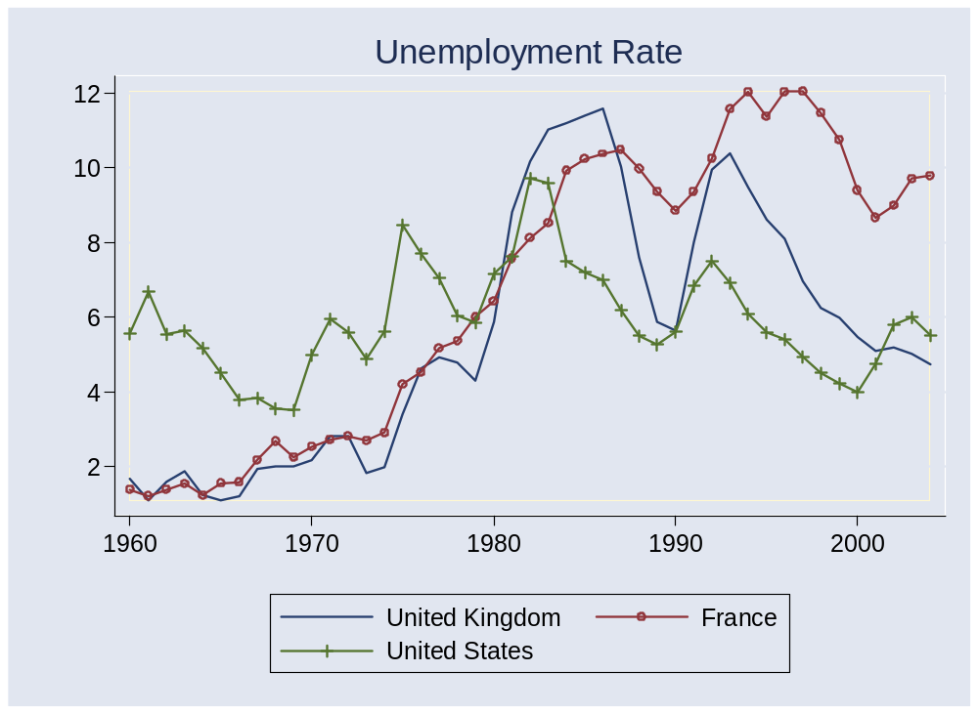
Unemployment rates
Source: OECD, Main Economic Indicators.

