Slide 1

The Global Economy
© NYU Stern School of Business
Notes:
Bring to class: Economist
Start Blackboard, GapMinder
On board: flow chart to pick up binders
Welcome to Global Economy
Goal: learn about the world, using economics as our tool
Start w/ evidence, over time get deeper understanding of why
Gapminder: share-pair
US economy: share-pair-square

Slide 2
The Global Economy
© NYU Stern School of Business

Slide 3
Gapminder
What do you see?
  Gapminder World
Notes:
Growth vs GDP per capita
What do you see?
Cold calls

Slide 4
Gapminder
What did we see?

Slide 5
About participation
Broad-based participation part of class design
  Demands discipline from both of us with large class
“Volunteers” intended to keep you involved
  Don’t panic
  Ask for help if you need it

Slide 6
About participation
If you’re stuck, here are some foolproof comments:
  It depends
  Fact of life
  P2C2E
  [Of course, each is better if you explain why]

Slide 7
About participation
We’ll use class to work through issues together
  Share your thoughts
  I’ll share mine
  Don’t be insulted if we disagree
  Feel free to prove me wrong

Slide 8
Plan of attack
Gapminder ✓
Current conditions in the US
About the course

Slide 9
About the course??
It’s about two things
  Facts
  Frameworks for interpreting them
Examples
  Pizza delivery in Norway
  Starbucks in Norway
  Bill Lewis at Carrefour in France
  Ikea in Russia
  (bus cycle example?)
  Matt Heyman in Mexico

Slide 10
Current conditions in the US
How do things look? How can you tell?

Slide 11
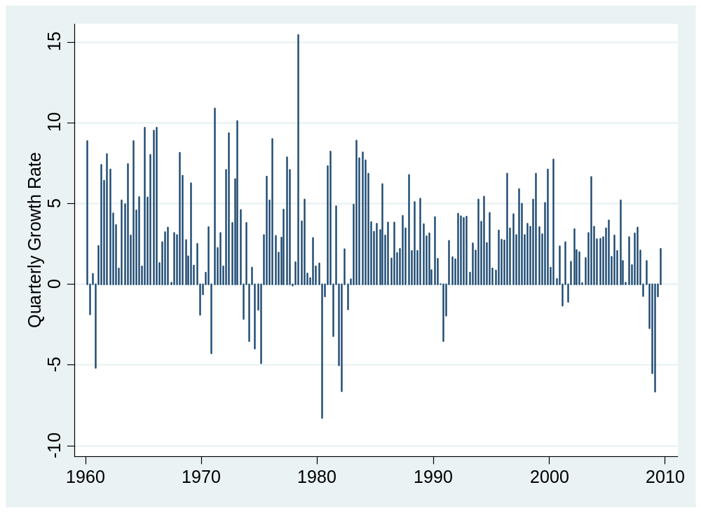
US GDP growth (annual rate, %)
What is this?
Source: US Bureau of Economic Analysis.
Notes:
Draw mean at 3.1%
Real (quantity), growth (annual rate)

Slide 12
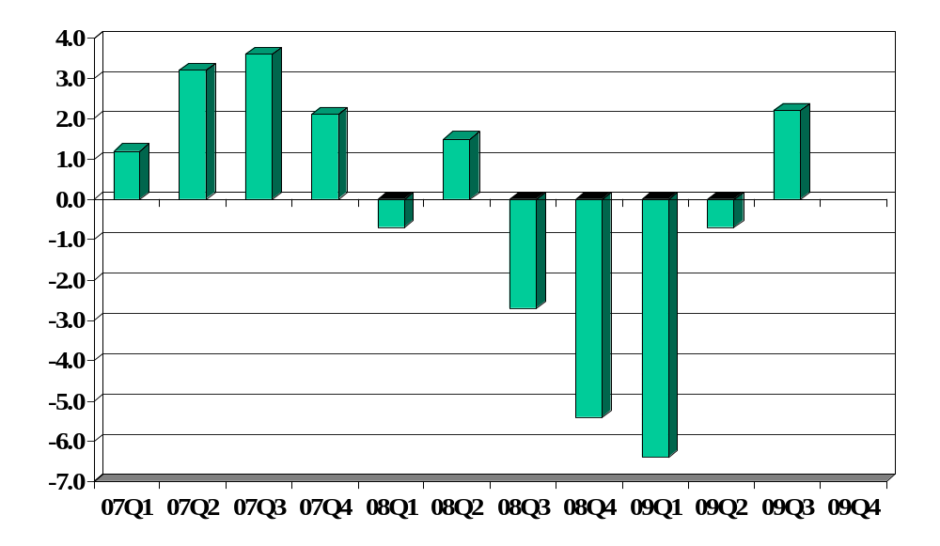
US GDP growth (annual rate, %)
Source: US Bureau of Economic Analysis.
Notes:
Real (quantity), growth (annual rate)

Slide 13
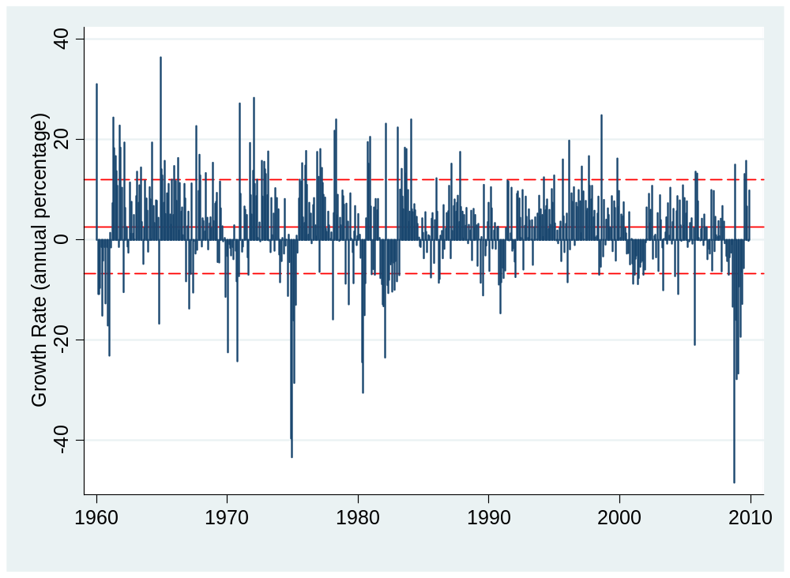
Industrial production (monthly, annual rate)
Source: Fed via FRED.

Slide 14
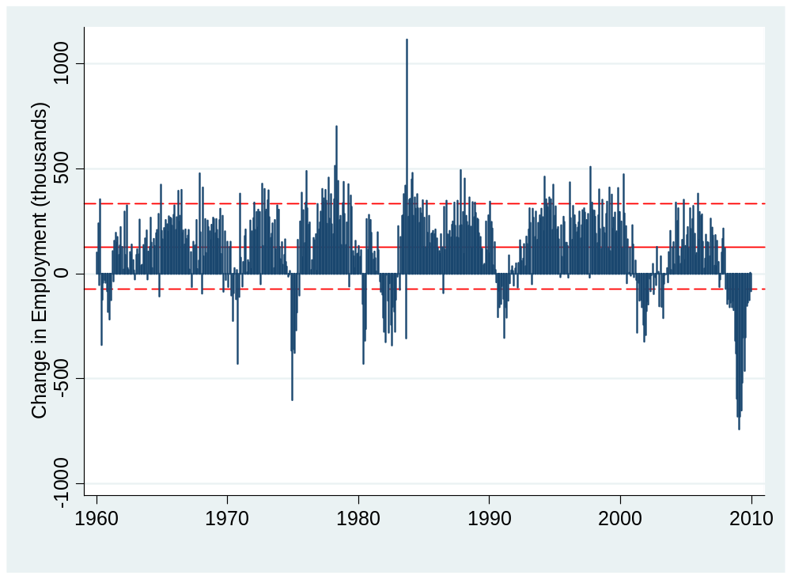
Employment (nonfarm payroll, monthly change)
Source: BLS via FRED.

Slide 15
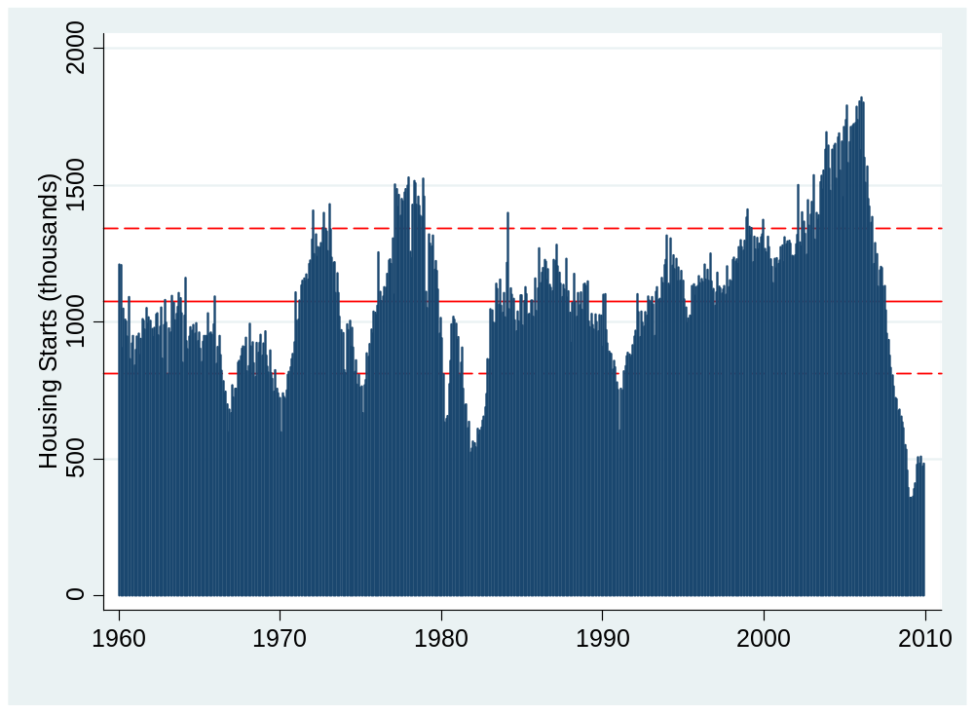
Housing starts
Source: Census via FRED.

Slide 16
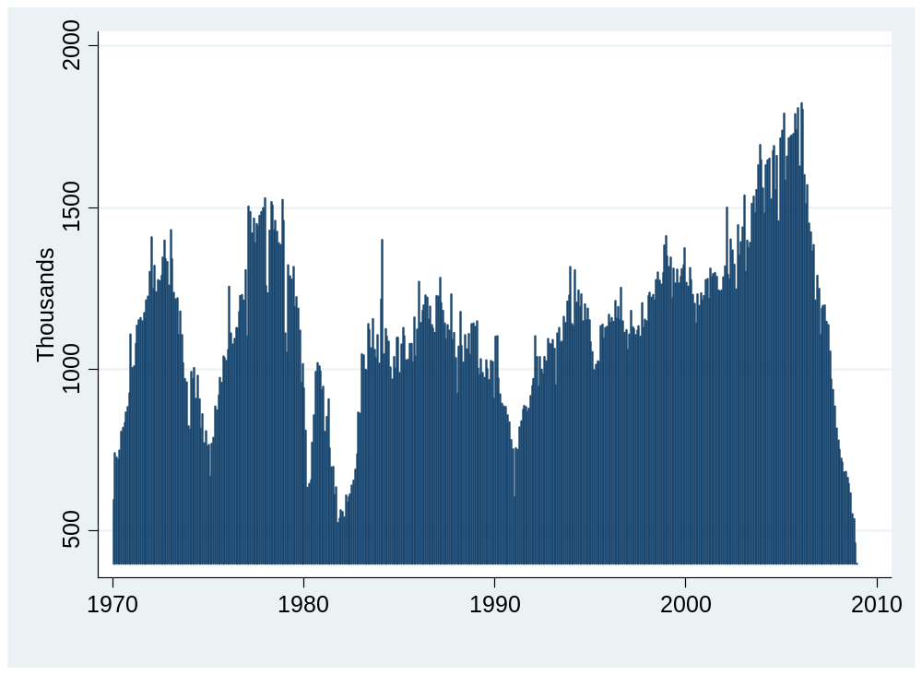
New claims for UI
Source: Census via FRED.

Slide 17
Anything else?

Slide 18
US prospects
Richard Berner and David Cho, MS, Jan 15 10:
  The Morgan Stanley Business Conditions Index prolonged its rousing finish to 2009 and kicked off the new year on a decisively positive note. The headline index increased 11 percentage points from 71% to 82% in early January – the sixth consecutive reading in expansionary territory. By every metric, this month’s canvass revealed the strength and durability of the current upturn. More importantly, each of the MSBCI’s forward-looking indicators exhibited marked improvement this month.

Slide 19
US prospects
Robert Mellman, JP Morgan, Jan 15 10:
  The forecast for 4Q09 real GDP growth has been raised to 5.7% (from 4.5%). Most of last quarter’s growth, and most of the forecast revision, reflects the fairly abrupt shift in the inventory cycle. Part reflects an upward adjustment to the forecast of real consumer spending in 4Q09. The forecast for real GDP growth in the current quarter is unchanged at 3.0%, and the forecast for all of 2010 is still 3.6% (4Q/4Q).

Slide 20
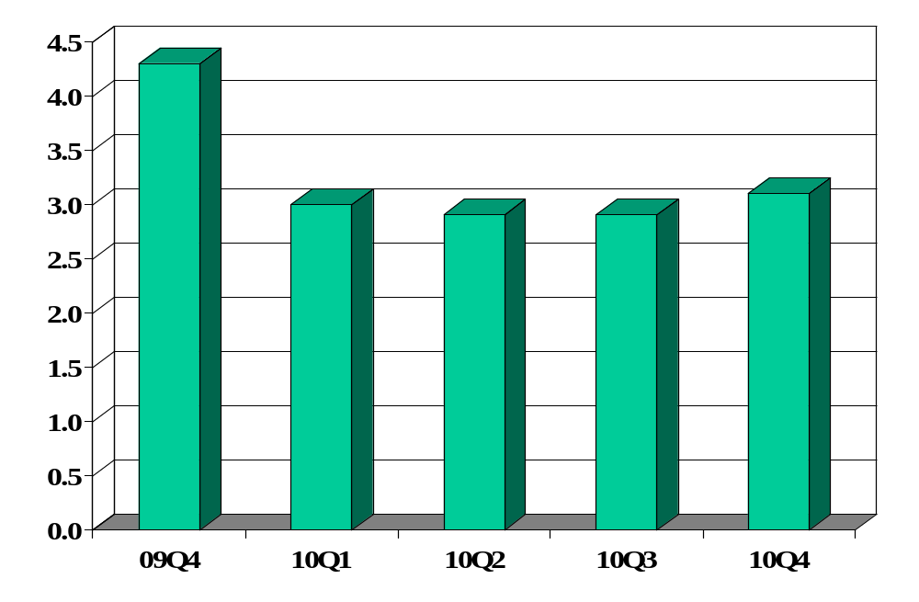
US growth forecasts (WSJ survey)
Source: WSJ (link)
Notes:
Draw mean – 3.1% for period 1960-present

Slide 21
About the course
We’ll cover these topics and more
Read the syllabus – please!

Slide 22
About the course
Mixture of quantitative and qualitative
  Neither is enough on its own
  Just like business
  All our quantitative tools are used in business

Slide 23
About the course
My biggest challenge
  Differences in student backgrounds
My goals
  Give you a new perspective on the world
  Keep things as simple as possible – but not simpler!
Our enemy
  P2C2E
Notes:
Questions?

Slide 24
About you
Target audience
  Know some economics, want to know more, comfortable with numbers and quantitative methods, willing to work
Consider another course if
  You dislike numbers and/or economics
  You didn’t find any of this interesting
Notes:
Questions?

Slide 25
About me
Grew up in Pittsburgh
PhD in Economics, Yale, 1981
Research interests
  International capital flows and markets
  Fixed income and currency derivatives
  Latin American and Asian economic history
Other interests
  Pittsburgh sports teams
  Basketball, biking, books, Buffy, beer
Notes:
Questions?

Slide 26
About class notes
Theoretical background to class discussion
Executive summaries: more concise than a textbook
Custom designed for this course
Read them – before class
Notes:
Questions?

Slide 27
About class notes
One view
  “The notes explained the concepts clearly and were easy to follow.”
Another
  “The notes were dense and difficult to follow.”
Notes:
Questions?

Slide 28
About the textbook
Optional
Most students prefer not to use one
But if you have little or no background in economics, or want to know more, you might buy
  Mankiw, Macroeconomics [concise, well-written]
Blackboard lists chapters for the 6th edition [buy used on Amazon or eBay]
  Editions 5 and 6 are effectively the same, 7 adds a few things
Order now so you’ll have it
Notes:
Questions?

Slide 29
About slides
Catalyst for discussion: not intended to be read on their own [See: Notes]
More than we need: don’t panic if we skip some
Available by mid-afternoon the day before class
Subject to modification without notice

Slide 30
About grades
Participation | 10%
Group Projects (best 5 of 7) | 30%
Midterm | 30%
Final | 30%

Slide 31
About grades
A/A– | 35%
B+/B/B– | the rest
Below B– | a few

Slide 32
About participation
Keeps things interesting – for you and me both
We’ll track
  Comments and articles posted on Blackboard
  Comments in class
Use your name plate so we know who you are

Slide 33
About participation
Keep it short
  20 seconds or less
Keep it simple
  I will duck complex questions to protect non-experts
  Ditto questions that we’ve already covered
Keep asking if your question isn’t answered in class
  After class
  Here between sessions (bring lunch)
  At the Half Pint over a beer
  Just let me know ahead of time
Notes:
This is a large class…

Slide 34
About mini-cases
Important part of the class
Essential that you -- at least -- skim them before class
Notes:
This is a large class…

Slide 35
About attendance
I don’t track attendance
But keep in mind: attendance and grade are correlated (I have years of evidence)
Notes:
Questions?

Slide 36
About group projects
Essential part of the course
I’ll tell you what’s coming the week before
Some are demanding, so plan ahead
Notes:
Questions?

Slide 37
About groups
Preset groups designed to have international diversity
You can change them
  Unlimited marriage and divorce
  Can include members from both sections
  No more than five
  Please tell your group if you leave
Make sure all names are listed on anything you submit

Slide 38
About groups
Preset groups of four can add one
If you need a group
  Contact one and ask to join
  Post a “personal” on Blackboard discussion
  Send an email to the class
Meet up front at the break if
  You need a group
  You want to add a member

Slide 39
About your seat
Join your classmates
  Please don’t sit in the section to my right
  Or in the back row

Slide 40
About laptops
Please turn them off
Ditto cell phones, Blackberries, etc

Slide 41
About the TFs
Jason Gilbertson
  From: Washington DC
  Concentrations: finance and accounting
  Career plans: investment banking
  Personal interests: hiking, reading
Caitlin Reidway
  From: Connecticut, Georgetown
  Concentrations: finance and strategy
  Career plans: strategic planning at PepsiCo
  Personal interests: international travel, running
Michele Rozzi (course development)
Notes:
Questions?
Jason Gilbertson
From: Washington, DC
Concentrations: Finance and Accounting
Job prospects: Investment Banking
Personal interests: Hiking, Reading
Caitlin Reidway
Here's my bio.
From Connecticut and completed my undergrad at Georgetown University. My concentrations are Finance and Strategy. After graduating from Stern, I will work in Strategic Planning for PepsiCo. My personal interests include international travel and running.

Slide 42
About help
If you get stuck, come see me
Or email me – I check email frequently
Or see either of the TFs
Notes:
Questions?

Slide 43
About feedback
If you have ideas, comments, questions, whatever:
  Come see me
  Send an email
  Speak to one of the TFs
  … whatever you prefer

Slide 44
About the start of class
We’ll start (and end) on time
[Morning session painful for all of us]
Suggestion: come early, bring coffee or snack, look through Economist for an interesting article

Slide 45
About Blackboard
Notes:
Show all pages
Overview
Sessions
Discussion
Resources

Slide 46
Takeaways
Read the syllabus
Look through the Blackboard site
Come to class prepared
Expect to participate
Have some fun

Slide 47
The Global Economy
Macroeconomic Data
© NYU Stern School of Business
Notes:
Set fast pace: lots to do
Notes + this session + GP1

Slide 48
The idea
Quick overview of macroeconomic data, including
  GDP
  Separating prices from quantities
  Connections between expenditures and financial flows
Do now at high speed, reinforce later through constant use

Slide 49
Question of the day
We’ll see lots of statements like:
  “Per Capita GDP in 2000 prices is 30% higher in the US than France”
What on earth are we talking about?

Slide 50
GDP
Bill Easterly, WSJ, Mar 07:
  Bill Gates expressed indifference to Africa’s stagnant GDP, since “you can’t eat GDP.” Mr Gates apparently missed the economics class that listed the components of GDP, such as food.

Slide 51

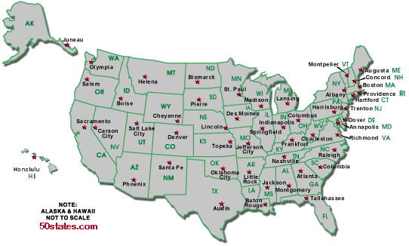
US and France (2008 numbers)
Per capita GDP: $47,440
Avg weekly hours: 35
Per capita GDP: $34,205 Avg weekly hours: 29

Slide 52
Plan of attack
Pictures
Measuring country performance:
  GDP
  Prices and quantities
  Flows of goods and assets (“identities”)
Do Americans save too little? [if time allows]
What’s coming up

Slide 53
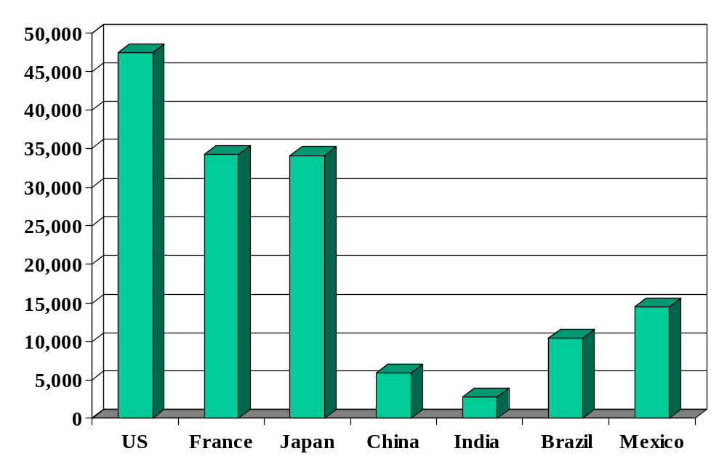
GDP per capita (2008, US dollars, PPP adj)
Source: IMF, WEO; also Wikipedia.

Slide 54
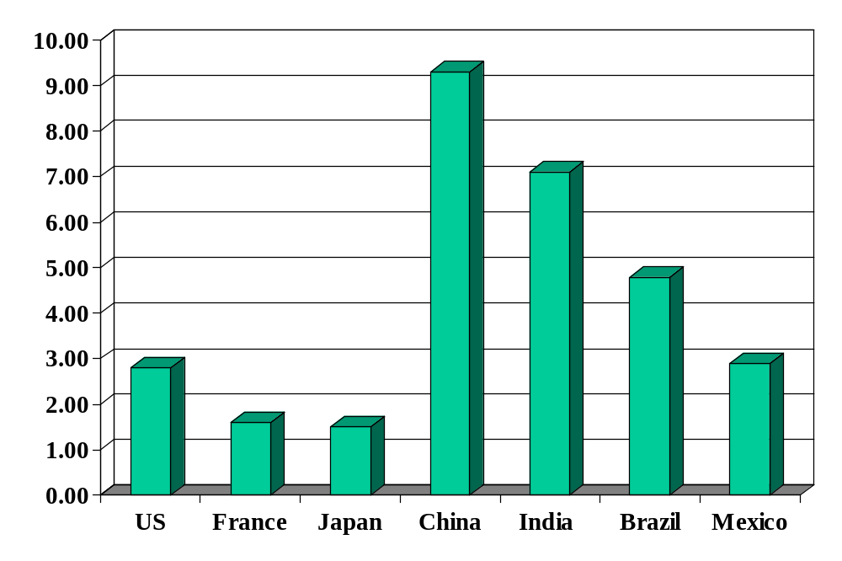
GDP growth (real, forecast for 2010, %)
Source: The Economist.

Slide 55
GDP
GDP = Gross Domestic Product
Three approaches
  Value added
  Income
  Final sales
Example: MBA education
  As value added [by NYU Stern]
  As income [my salary]
  As final sales [your tuition payment]
  All of these things are linked

Slide 56
GDP
GDP = Gross Domestic Product
Total value of production in an economy (“output”)
  Sum value-added by all production units
  Equals: sales minus material input costs (“COGS”)
  Equals: payments to labor and capital (owners)
  Equals (almost): income
  Equals: sales of final good (last stage of value chain)
Why gross?
  All of these numbers include depreciation

Slide 57
GDP as value added
Example:
  Farmer produces wheat, sells it for 100
  Miller buys wheat, produces flour, sells it for 175
  Baker buys flour, makes bread, sells it for 300
What is value added for each producer?
What is GDP?
Who eats the wheat?

Slide 58
GDP as value added
Producer | Value Added = Income | Final Sales
Farmer | 100 | 0
Miller | 75 | 0
Baker | 125 | 300
GDP (total) | 300 | 300
Notes:
VA = income

Slide 59
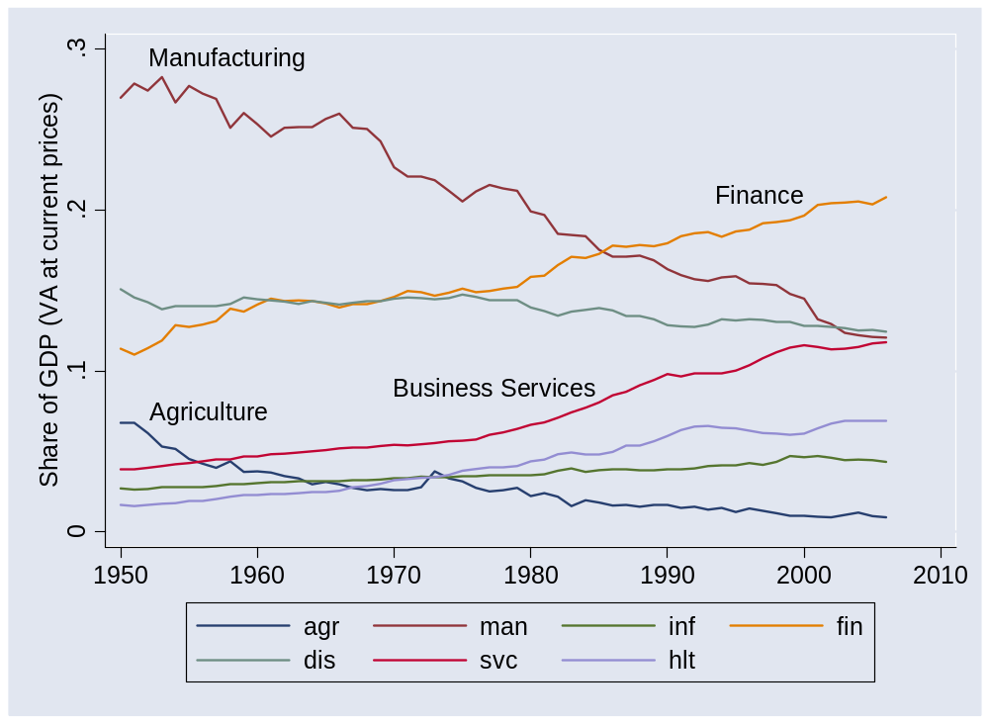
GDP by industry
Source: US NIPA.
Notes:
What does this mean? What does it tell us?

Slide 60
GDP as income
Recall: GDP = payments to labor and capital (“almost income”)
In income but not in GDP
  Capital gains
  Interest on government debt
  Net foreign income
In GDP but not in income
  Depreciation
Bottom line
  GDP ≈ income [“≈” means “almost equals”]
Notes:
Draw venn diagram?

Slide 61
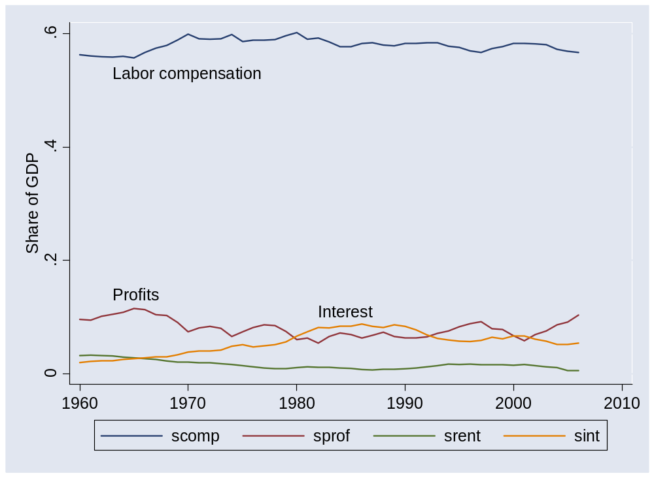
GDP by income component
Source: US NIPA.

Slide 62
GDP as final sales
Allocate GDP among purchasers of final goods:
Y = C + I + G + NX
  Y = GDP (“output”)
  C = sales to households (“consumption”)
  I = sales of capital goods to firms (“investment”)
  G = purchases of goods and services by government
  NX = net exports (exports minus imports)
  We call these: “expenditure components”
  Can be nominal (current prices) or real (base-year prices)

Slide 63
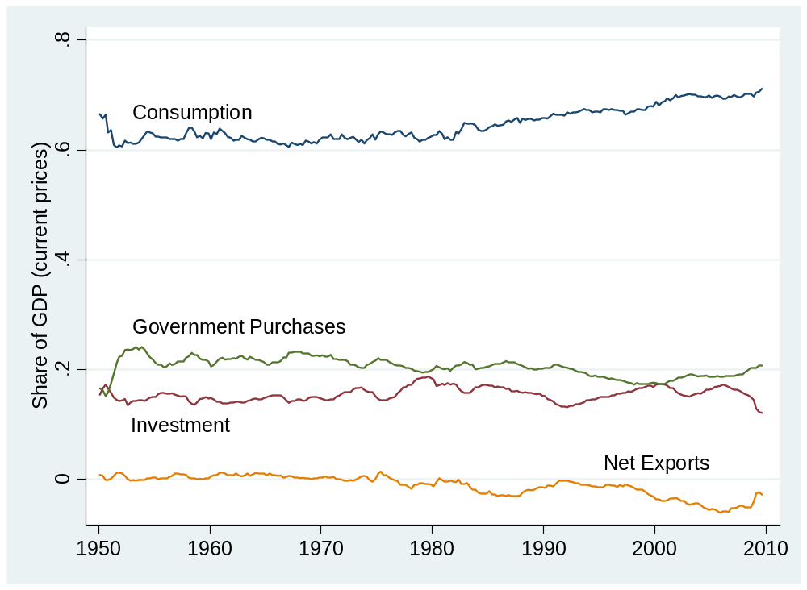
GDP by expenditure component
Source: US NIPA.

Slide 64
Price and quantities
Next topic, take a breath
Terminology
  GDP at current prices: “nominal” [value = price x quantity]
  GDP at base-year prices: “real” [quantity]
What is
  GDP at 2000 prices?
  GDP in 2005 US dollars?
  GDP in 2000 international prices?
  GDP in 2000 USD PPP adjusted?

Slide 65
Prices and quantities
Intel (say)
  Sales up 25% year-on-year [this is a value]
  How much is higher prices, how much greater quantities?
US economy
  Nominal GDP up 5% year-on-year [this is a value]
  How much is higher prices, how much more “stuff”?
What to remember
  Inflation is the “average” increase in prices
  “Real” growth is the “average” increase in quantities
  “Averaging” is trickier than it looks
  Several natural approaches produce different answers
  We muddle along and hope for the best

Slide 66
Prices and quantities
We measure values well
Value = p₁q₁ + p₂q₂ + …
We want to separate into price and quantity
Value (V) = Price Index (P) x Quantity Index (Q)
Problem: sums don’t factor nicely like that

Slide 67
Prices and quantities
What we do: muddle through
Approach 1: start with quantity index
  Compute GDP at current prices (“nominal”)
  Compute GDP at base-year prices (“real”) [quantity index]
  Find price “deflator” as ratio [price index]
Approach 2: start with price index
  Compute GDP at current prices (“nominal”)
  Compute price index of base-year quantities [price index]
  Find real GDP as ratio [quantity index]
But: they don’t give the same answer

Slide 68
Prices and quantities
Another degree of freedom: base year
That gives us many possible answers, all different
Base Year | Approach 1 | Approach 2
2001
2002
…
2009
Numerical illustration follows

Slide 69
Prices and quantities
Example:
 | Fish |  | Chips
Date | Price | Quantity | Price | Quantity
2004 | 0.50 | 10 | 0.25 | 10
2005 | 0.75 | 12 | 0.50 | 8
What’s “real” GDP growth? What’s the inflation rate?

Slide 70
Prices and quantities
Approach 1 (“GDP deflator”):
Date | Nominal GDP | Real GDP | Price Deflator
2004 | 7.50 | 7.50 | 1.000
2005 | 13.00 | 8.00 | 1.625
Growth rate | 73.3% | 6.7% | 62.5%
Base year: 2004.
Numbers in italics can be computed from the others.
Notes:
Where does this [pick one] number come from?

Slide 71
Prices and quantities
Approach 1 (“GDP deflator”):
Date | Nominal GDP | Real GDP | Price Deflator
2004 | 7.50 | 12.50 | 0.600
2005 | 13.00 | 13.00 | 1.000
Growth rate | 73.3% | 4.0% | 66.7%
Base year: 2005.

Slide 72
Prices and quantities
Approach 2 (“CPI”):
Date | Price Index (2004 Basket) | Price Index (2005 Basket)
2004 | 7.50 | 8.00
2005 | 12.50 | 13.00
Growth rate | 66.7% | 62.5%

Slide 73
Prices and quantities
We charge ahead anyway – not the last time we’ll run across dodgy numbers and survive

Slide 74
Flows of goods and assets
Next topic, take a breath
Examples linking spending to financing
  Firms invest (“capex”): how is it financed?
  Governments run deficits: how are they financed?
  Households save: where does it go?
Notes:
Expenditures: who we sell to
Financing: how are expenditures financed?

Slide 75
Flows of goods
Reminder: allocate GDP among buyers of final goods:
Y = C + I + G + NX
  Y = GDP (“output”)
  C = sales to households (“consumption”)
  I = sales of capital goods to firms (“investment”)
  G = purchases of goods and services by government
  NX = net exports (exports minus imports)
  We call these: “expenditure components”
  Can be nominal (current prices) or real (base-year prices)

Slide 76
Flows of assets (streamlined version)
Allocate flows of assets:
Y – C – G = I + NX
S = I + NX
  I = (gross) investment (new plant and equipment)
  S = (gross) national saving (purchases of assets)
  NX = net purchases of foreign assets
Why are these “flows of assets”?

Slide 77
Flows of assets (streamlined version)
Households+ Govt
S
Financial Markets
I
Firms
NX
Rest-of-World

Slide 78
Flows of assets
Allocate flows of assets:
(Y–C–T) + (T– G) = I + NX
S_{p} + S_{g} = I + NX
  T = taxes net of transfers paid by households to govt
Beware: many measures of saving
  Sometimes we subtract depreciation from both S and I (“net”)
  Useful for confusing amateurs
Later in the course
  We’ll include income and transfers with foreign countries and replace NX with the “current account”

Slide 79
Flows of assets
Households
S_{p}
Financial Markets
I
Firms
Government
S_{g}
NX
Rest-of-World

Slide 80
National accounts summary
Production
GDP
Income
Labor, Capital
Expenditures
C,I,G,NX
Think about setting up income statements for each sector: households + govt, firms, ROW
Financial Flows
S = I + NX

Slide 81
Do Americans save too little?
Notes:
Write down the list

Slide 82
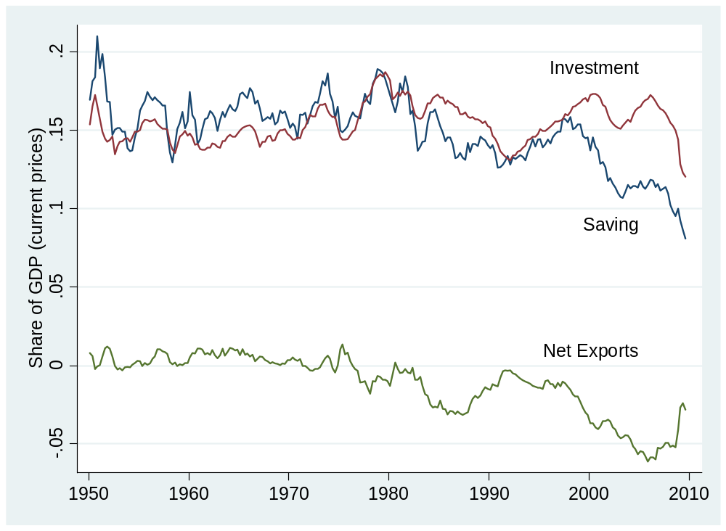
US saving rate
Source: US NIPA via FRED.

Slide 83
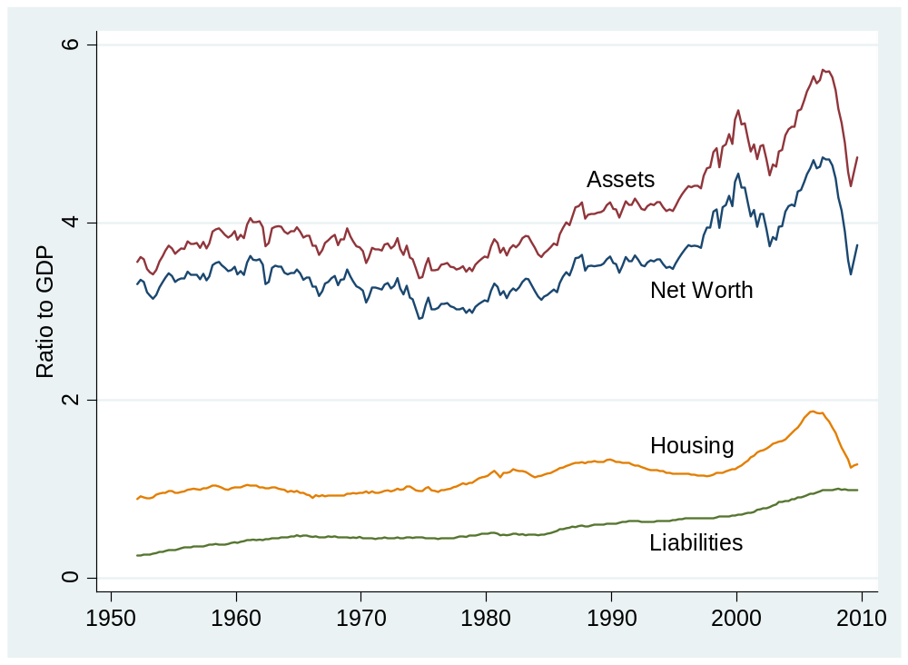
US household net worth
Source: US, Federal Reserve, Flow of Funds Accounts.

Slide 84
Do Americans save too little?
Notes:
Write down the list

Slide 85
What’s coming up

Slide 86
Tomorrow
FOMC meeting tomorrow
  Statement released at 2:15 pm tomorrow
  What do we expect?
  Impact on markets?
  http://www.federalreserve.gov/FOMC/
GDP release Friday
  Fourth quarter “advance” estimate
  Released at 8:30 am
  What do we expect?
  Impact on markets?
  http://bea.gov/bea/newsrel/gdpnewsrelease.htm

Slide 87
Group Project #1
Due before next class
  Submit by 9am via Blackboard
Based on this class + notes
Stop by or email if you have questions
Don’t panic
Get started!

Slide 88
International students
Write 100 words [max] about your country
  What has it done to encourage economic growth?
  What else could it do?
  Post on Blackboard by Monday noon
  Be prepared to speak next week [20 seconds]
  Thank you!
Other students
  Read postings
  Be prepared to ask questions next week

Slide 89
Takeaways
Economic data are like sausages
GDP ≈ output, income, economic performance
Separating prices and quantities is tricky: we do our best
Flows of goods and assets
  Goods: Y = C + I + G + NX
  Assets: S = I + NX
Get to work: Group Project #1 due next week

