Slide 1

The Global Economy
Monetary Policy and Interest Rates
© NYU Stern School of Business
Notes:
Where do interest rates come from?
Summers joke
Open http://www.frbsf.org/econanswers/response.htm

Slide 2
The idea
Interest rates reflect many things, but the short-term focus of bond traders in most countries is monetary policy.

Slide 3
Plan of attack
Where do interest rates come from?
  Interest rates
  Interest rates and inflation
  Interest rates and the business cycle
  Short- and long-term interest rates
Monetary policy and interest rates
The Taylor rule (bond traders’ guide)
“Quantitative easing” and other topical jargon
Is inflation on the way?

Slide 4
Where do interest rates come from?
Ideas?

Slide 5
Interest rates
Interest rates are a way of quoting bond prices
Simplest for “zeros”: bonds with no coupons
  Consider a bond that pays you 100 in n years
Bond Price = 100/(1+i)^{n}
  100 is face value or principal
  i is the interest rate or “yield to maturity”
  n is maturity of bond
Real-life interest rate conventions are more complicated, but this is the idea

Slide 6
Interest rates and inflation
Interest rates are typically quoted in currency units
  Most bonds are trades of money now for money later
  Call i the nominal interest rate
Return includes inflation
i = r + π
  i = nominal interest rate (what we usually see quoted)
  r = real interest rate (rate on basket of goods)
  π = expected inflation (over the life of the bond)

Slide 7
Interest rates and inflation
Questions
  Why expected inflation?
  Where does real rate come from?
  How does this apply to longer maturities?
  How do inflation-indexed bonds work?

Slide 8
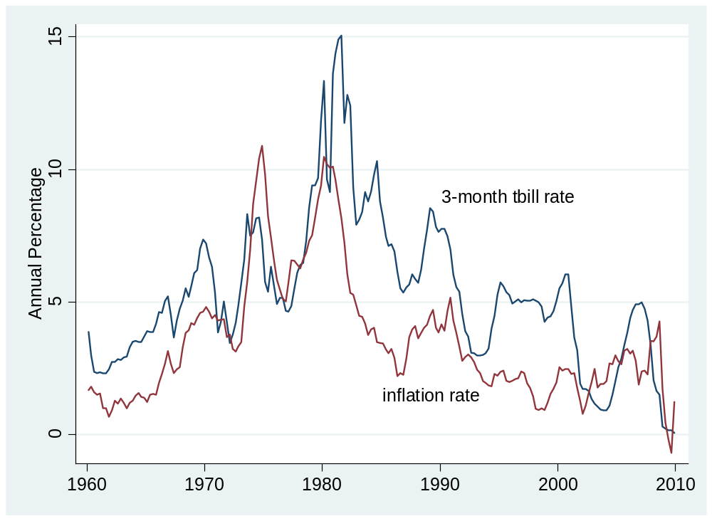
Interest rates and inflation
Source: FRED.

Slide 9
Interest rates and growth
Fact: short-term real and nominal interest rates go up in booms and down in recessions
Why?

Slide 10
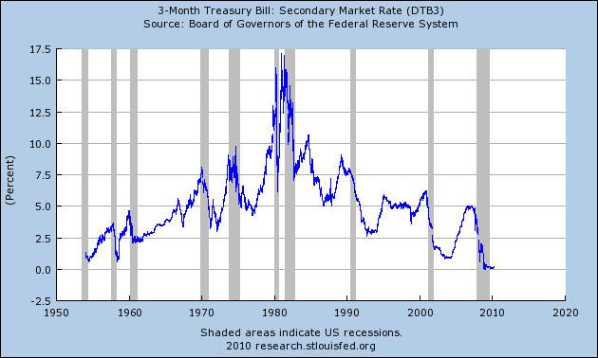
Interest rates and growth
Source: FRED.

Slide 11
Interest rates and growth
r
S
What happens to I in a boom?
What happens to r?
I
S,I

Slide 12
Short- and long-term interest rates
Rule of thumb:
  Long-term interest rates incorporate expectations of future real short-term interest rates and inflation
What’s missing?
  Risk premium: we can make this as complicated as you want – but not in this class

Slide 13
Interest rates and money supply
Most discussions of monetary policy focus on the short-term interest rate rather than the money supply
The Economist, Mar 06:
  A quarter of a century ago, control of the money supply was seen as both necessary and sufficient to curb inflation – so most central banks set monetary targets. Financial deregulation and innovation have made the money supply harder to interpret, let alone control.
Result: most central banks “manage” interest rates rather than money supplies

Slide 14
Interest rates and money supply
Rule of thumb:
  An increase in the money supply corresponds to a lower interest rate
Mechanics
  Central bank adjusts supply of money to hit whatever interest rate it thinks appropriate

Slide 15
Interest rate review
What does it mean if
  Short-term interest rate rises sharply?
  Long-term interest rate rises sharply?
  Yield curve is downward sloping (long rate < short rate)?

Slide 16
Take a breath
What do central banks do?
As much art as science, but here’s a good place to start

Slide 17
Taylor rule: overview
The bond traders’ guide to monetary policy
  Inflation up ⇨ raise short rate
  GDP growth up ⇨ raise short rate
Why is a “rule” valuable?

Slide 18
Taylor rule: the rule
Rule for setting short-term interest rate
i = r* + π + a₁(π –π*) + a₂(y–y*)
  i = short term interest rate (fed funds rate)
  r* = “equilibrium” real interest rate [2%?]
  π = inflation rate
  π* = target inflation [2%?]
  y = growth rate of real GDP
  y* = target growth rate [3%?]
  a₁, a₂ = (positive) parameters [1/2?]

Slide 19
Taylor rule: the rule
What does it suggest on now? On average?
i = r* + π + 0.5 (π –π*) + 0.5 (y–y*)
What happens if inflation rises 1%?
Why does interest rate rise more than inflation?
Notes:
I = 2 + 0 -1 – (1/2) (-3-3) = -2 !

Slide 20
Taylor rule: using it
What does a bond trader expect if
  CPI number shows uptick in inflation?
  Employment report shows sharp increase in jobs?
  Fed announces it sees economic growth picking up?

Slide 21
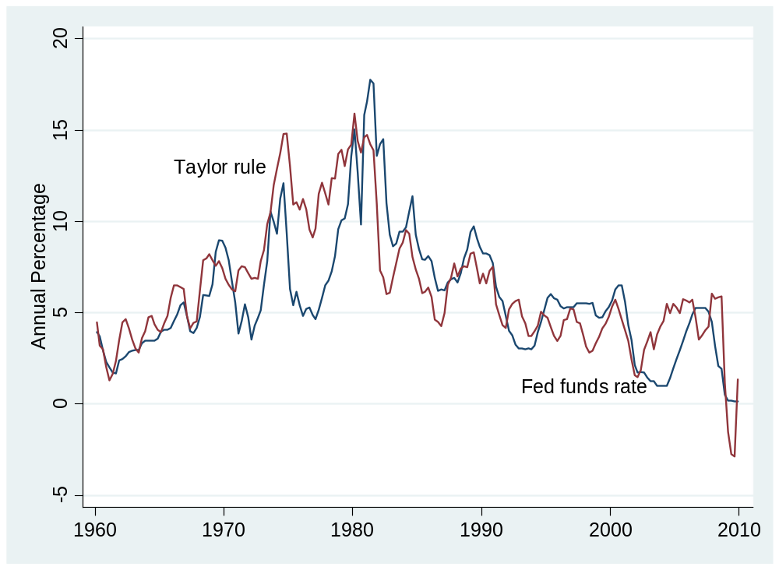
Taylor rule: interpreting the past
What’s going on here?
Here?
Here?
Source: FRED (red=Taylor rule, blue=actual).

Slide 22
Taylor rule: interpreting the past
1970s:
  interest rate too low, inflation exploded
2002-2005:
  low rates intended to avoid deflation (a mistake?)
2008-2010:
  when interest rate hits zero, what can you do?

Slide 23
“Quantitative easing”
Interest rate can’t go below zero
  Why not?
But: you can still expand the money supply
  Money supply has grown rapidly in recent past
  We call this “quantitative easing” because we’re changing the quantity of money
  “Credit easing” and “unconventional monetary policy” refer to central bank buying private assets

Slide 24
“Quantitative easing”
Treasury
Assets |  | Liabilities
 |  | Bonds | 200
QE = expand money supply
How?
What else now?
Central bank
Assets |  | Liabilities
Bonds | 20 | Money | 20
Households and firms
Assets |  | Liabilities
Money | 20
Bonds | 180

Slide 25
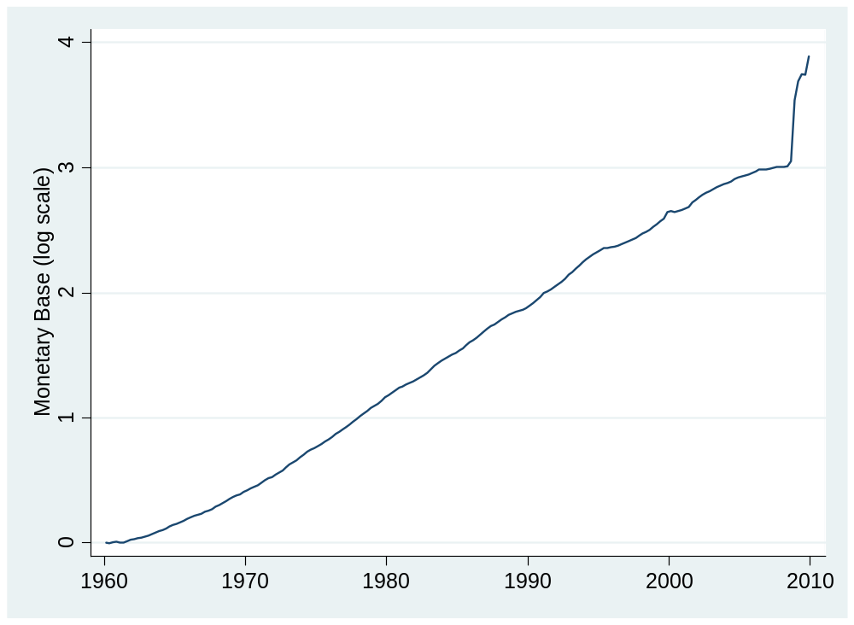
“Quantitative easing”
Source: FRED.

Slide 26
“Credit easing”
http://www.frbsf.org/econanswers/response.htm
Source: SF Fed.

Slide 27
Inflation on the way?
Do you see inflation rising sharply in the near future?
Why or why not?

Slide 28
Inflation on the way?
Morgan Stanley, Global Monetary Analyst, Mar 31 10:
  We expect public debt to be an important constraint on central banks’ ability to deliver price stability. The temptation to inflate away debt depends on several factors. We find the temptation to be higher in the US and the UK than in the euro-zone and lowest in Japan.
Do you agree?

Slide 29
Where do interest rates come from?
Monetary Policy
Inflation & Growth
Interest Rates

Slide 30
What have we learned?

Slide 31
Takeaways
Most central banks focus on short-term interest rates
  Increase in rate corresponds to fall in money supply
Taylor rule ties interest rate to inflation and output
  Policy is predictable
  Strong output growth and high inflation trigger increases in interest rate
When interest rate hits zero, you can still expand the money supply [“quantitative easing”]

Slide 32
The Global Economy
Principles of Tax Policy
© NYU Stern School of Business
Notes:
Many of the recent disasters/crises stemmed from fiscal policy mistakes

Slide 33
Changing gears
We’re starting a new module, organized roughly around the idea of economic crises
More on that next week
First topic: government finance, part 1

Slide 34
Definition
Fiscal policy: government expenses, revenues, and debt
Fiscal policy has these components
  How much to spend (% of GDP)
  How to collect taxes [we’ll do this today]
  How to manage debt (= deferred taxes) [next week]

Slide 35
The ideas
Countries differ – a lot – in the magnitude and composition of government spending, the complexity and burden of their tax systems, and in how they manage their debt.
Good tax systems are (i) easy to comply with and (ii) apply low rates to a broad base.

Slide 36
Plan of attack
Changing gears, definition, ideas ✓
Quotes and pictures
What should governments do?
Principles of tax policy
Examples

Slide 37
France
The Economist, Survey France, Oct 26 06:
  An employer who pays a worker twice the minimum wage, or €2,400 a month, has to shell out nearly half as much again to the state in social-security contributions; the employee, for his part, has to hand over 22% of his pay in social-security contributions, on top of income tax. A French pay slip typically runs to over 40 itemised lines.
Notes:
http://online.wsj.com/article/SB117500805386350446-email.html?

Slide 38
Slovakia
Ivan Miklos, Deputy Prime Minister of Slovakia, Financial Times:
  I am convinced that the reforms of new EU member states could serve as inspiration for the older member states as well. One such reform is the flat tax. … We now have one of the simplest, most transparent tax systems in the world. … And our tax revenues have not decreased at all, partly because the reform eliminated most of the incentives and opportunities for tax avoidance. The new system has been particularly popular with German companies.
Notes:
March 23 2005 p 15

Slide 39
India
EIU, Country Commerce Report:
  Corporate tax rates have come down in recent years to fairly reasonable levels, in keeping with the government’s aim to widen the tax base and ensure greater compliance. But the underground economy, with its untaxed transactions and incomes, remains large.
  The system remains complicated, however, and is the subject of frequent litigation.

Slide 40
US
Tom Friedman, NYT, Mar 2 10:
  Intel’s CEO Paul Otellini: “The things that are not conducive to investments here are [corporate] taxes. A new semiconductor factory at world scale built from scratch is about $4.5 billion – in the United States. If I build that factory in almost any other country in the world, where they have significant incentive programs, I could save $1 billion. [We built our new plant in China] and it wasn’t because the labor costs are lower. Yeah, the construction costs were a little bit lower, but the cost of operating when you look at it after tax was substantially lower – and you have local market access.”

Slide 41
US
Mehir Desai, “Taxing foreign profits”:
  The United States operates a mishmash of a [corporate tax] system that taxes worldwide income, provides partial relief for foreign taxes paid, and imposes those taxes only upon repatriation. The ability to defer US taxation until profits are repatriated is often framed as providing an incentive to ship jobs overseas. The current worldwide system is often derided as making American firms uncompetitive relative to their foreign competition. So, there are easy ways to take political potshots at the current system from both sides.

Slide 42
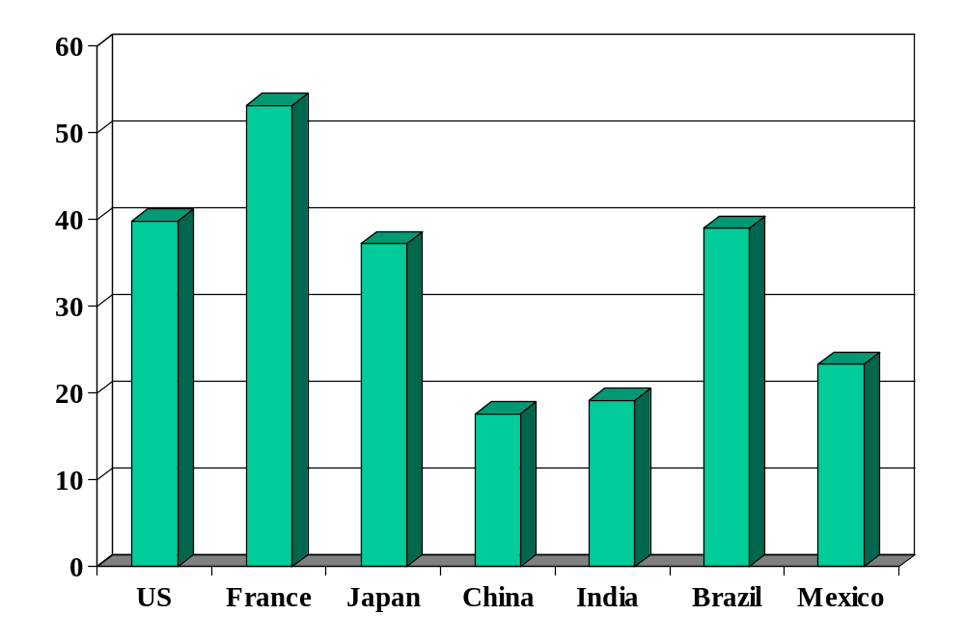
Government spending (% of GDP)
Source: OECD fiscal database, EIU country data.
Notes:
OECD countries: 2009 numbers, Economic Outlook, Annex Table 25.
China, India, Brazil, Mexico: EIU

Slide 43
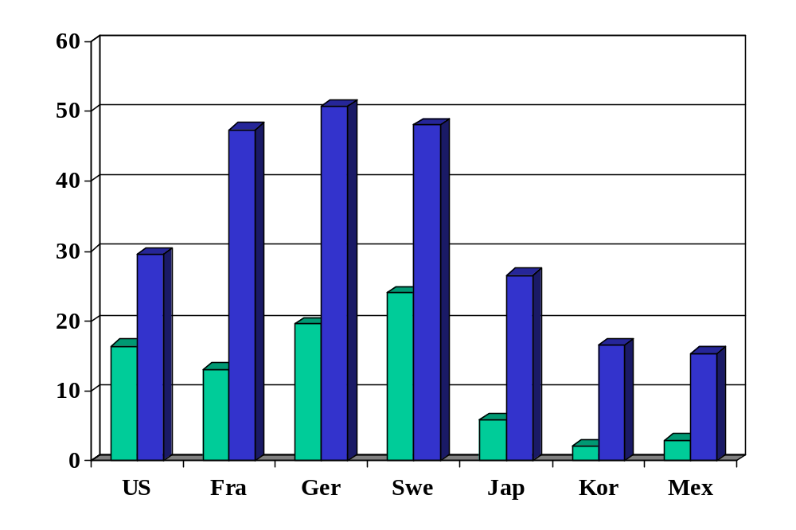
Personal tax rates (%, at average wage)
Source: OECD tax database. Green=direct tax. Blue=total incl soc ins payments by employee/er.

Slide 44
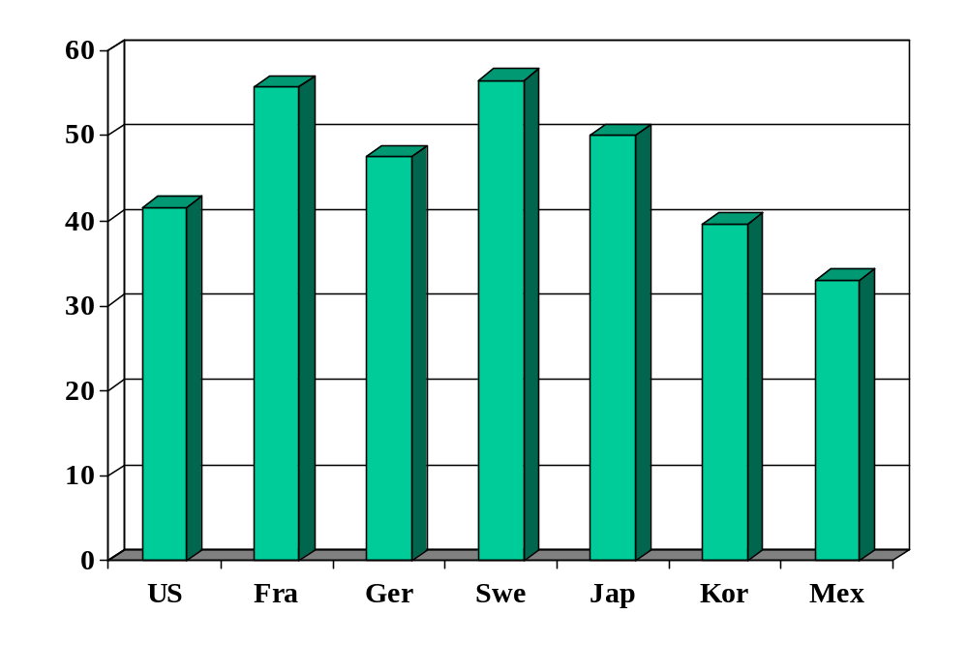
Top personal tax rates (%)
Source: OECD tax database.

Slide 45
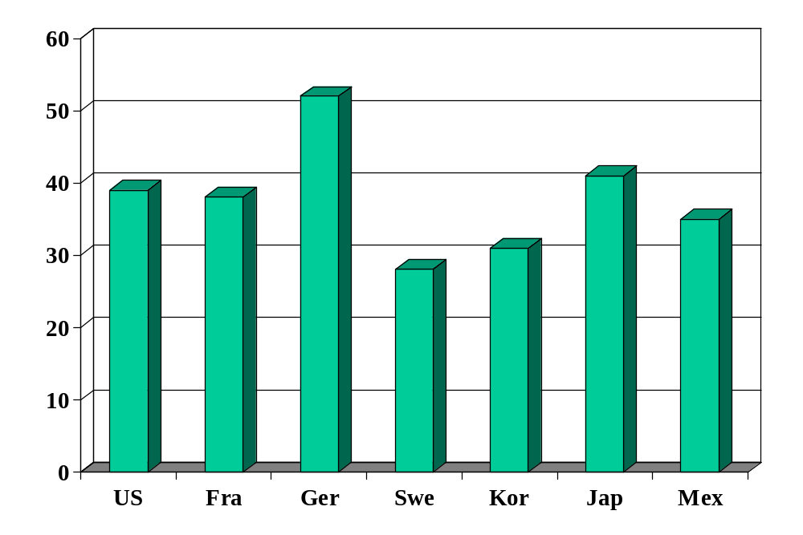
Corporate tax rates (official rate, %)
Source: KPMG Tax Survey.

Slide 46
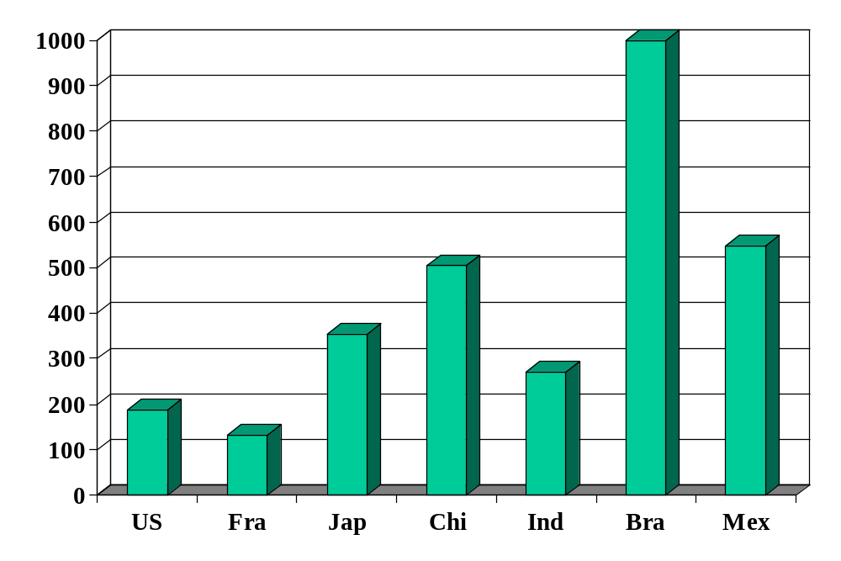
Complexity of business taxes (hours)
Source: Doing Business.

Slide 47
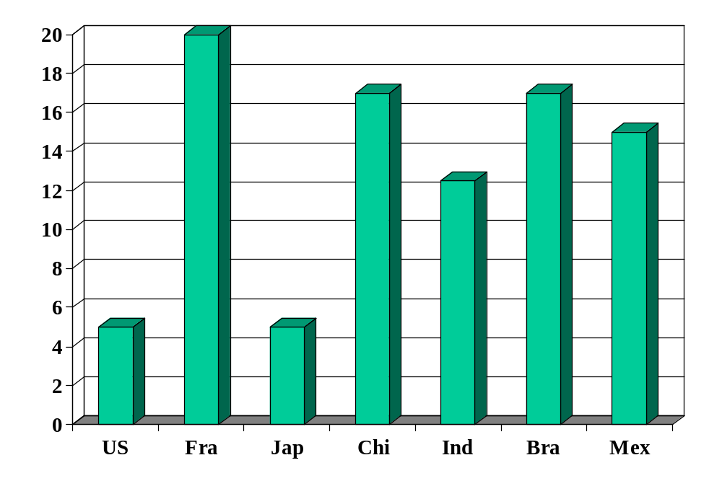
Value added tax (%)
Source: Doing Business.
Notes:
http://www.deloitte.com/dtt/article/0,1002,cid%253D5028,00.html

Slide 48
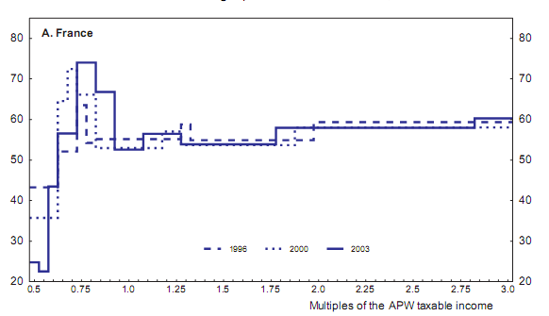
French marginal tax rates by income
Source: OECD working paper 439, “The French tax system.”

Slide 49
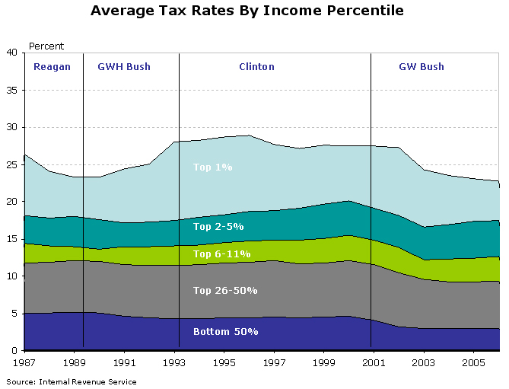
US average tax rates by income
Source: Macroblog, Aug 24 08.

Slide 50
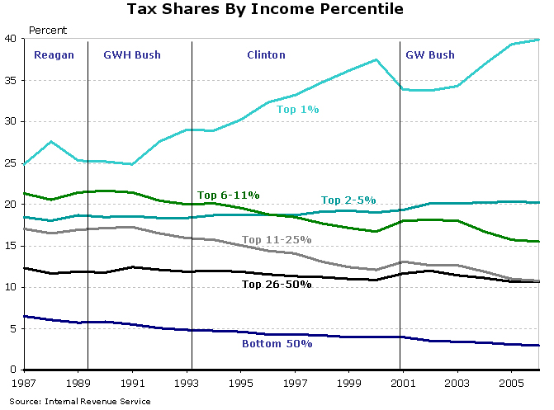
US tax shares by income
Source: Macroblog, Aug 24 08.

Slide 51
What should governments do?
Spending? Next.
Taxes? After that.

Slide 52
What should governments do?
Traditional arguments about spending
Provide public goods
  Non-excludable: hard to keep people from consuming ii [national defense, personal security, clean air]
  Non-rival: my consumption does not affect your consumption [national defense, etc]
Insurance and redistribution
  Protect the unfortunate and unlucky [disability, major medical issues, …]
Claim: hard to provide these services privately [is it?]

Slide 53

What should governments do?
Libertarian Reluctantly Calls Fire Department
April 21, 2004 | Issue 40•16
CHEYENNE, WY—After attempting to contain a living-room blaze started by a cigarette, card-carrying Libertarian Trent Jacobs reluctantly called the Cheyenne Fire Department Monday. “Although the community would do better to rely on an efficient, free-market fire-fighting service, the fact is that expensive, unnecessary public fire departments do exist,” Jacobs said. “Also, my house was burning down.” Jacobs did not offer to pay firefighters for their service.
© Copyright 2006, Onion, Inc. All rights reserved.
The Onion is not intended for readers under 18 years of age.

Slide 54
What should governments do?
How should they finance spending?
Is there a down side to high tax rates?

Slide 55
Tax principles
Principle #1: Taxes must finance spending
  High government spending requires high taxes
  More on this next week
Principle #2: Apply low rates to a broad base
  Exceptions implicitly raise taxes for others

Slide 56
Tax principles
Principle #2: Apply low rates to a broad base
Why?
  Taxes “distort” economic decisions
  High taxes distort more
Our logic
  Tax two markets equally
  Tax one market twice as much
  Which is better? [the first one]

Slide 57
Taxes and loss of surplus
P
consumer
surplus
S
P*
producer surplus
D
Q*
Q

Slide 58
Taxes and loss of surplus
P
“Deadweight loss”
S'
consumer
surplus
S
P_{c}
t
P*
tax revenue
P_{f}
producer surplus
D
Q'
Q*
Q

Slide 59
Taxes and loss of surplus
P
S''
S'
S
2t
t
D
Q

Slide 60
Tax rates
Applications of Principle #2
Should we
  Make food and clothing exempt from tax?
  Internet sales?
  Medical care?
  Education supplied by nonprofits?
Value-added taxes
Taxes on interest income

Slide 61
What have we learned?

Slide 62
Takeaways
Countries differ in government spending and taxation
Taxes change incentives to work and save/invest
Good tax systems
  Easy to comply with (transparent, administratively simple0
  Low rates on broad base

Slide 63
Group Project #6
Note links in online pdf
Guideline: no more than 5 pages or 10 slides
Come see me if you have questions
Aim for a professional business document
  Options: report or slides, whatever you prefer
Two wonderful examples from Group Project #5
  Report: Chiao-Feng Hung, Matthew Cedergren, Linlin Yu, Pei-Yu Lu, Jianyun Feng
  Slides: Daniel Haykin, Jil Shah, and Dennis Snopkowski

Slide 64
Special review session
Today, 4:45-6:15 *** Note change ***
Location: Amity Hall, downstairs (80 West 3rd)
Additional session next week if there’s interest
Come with questions, comments, stories

Slide 65
Mankiw’s taxes
If he earns an extra dollar, saves and invests it, and gives the proceeds to his kids in 35 years, how much do they get?
Inputs
  Income tax rate: 35%
  Return on investment: 10%
  Corporate tax rate: 25%
  Dividend and capital gains rate: 15%
  Estate tax rate: 15%
Answers: $28 with no taxes, $1.85 with given tax rates
What are his incentives to work and save?
Link
Notes:
http://gregmankiw.blogspot.com/2008/10/blog-post.html
http://macroblog.typepad.com/macroblog/2008/11/saving-and-taxe.html

