Slide 1

The Global Economy
Monetary Policy
© NYU Stern School of Business
Notes:
Board: GP5
Open IE, get Nasdaq chart
Mon policy: rates down 300bps with inflation rising
Generally mysterious?

Slide 2
LAHBA
Latin America in a turbulent environment
Friday April 3
Joint with Columbia
All-star lineup
Link

Slide 3
Group Project #5
What’s your forecast for employment in 1 month? 6?
What indicators did you find most useful?

Slide 4
Where we’re headed
Current Conditions
Indicators
Theory: AS & AD
Monetary Policy
Statistical Analysis
Future Conditions

Slide 5
Where we’re headed
Money
Growth
Inflation & Growth

Slide 6
Plan of attack
Group Project #5 ✓
Where we’re headed ✓
Questions of the day
Philosophies of monetary policy
Mechanics of monetary policy
Aggregate supply and demand

Slide 7
Questions of the day
What should monetary policy do?
What can it do? What does it do?

Slide 8
Reminder: quantity theory
More money ⇨ higher prices
M V = P Y
  M = stock of money in circulation (currency)
  V = velocity (how often a unit of currency is used in a year)
  P = price level (average price of goods in currency units)
  Y = real GDP
Money
Growth
Inflation
Notes:
How fast should money grow?

Slide 9
Mysteries of money
Milton Friedman, “Stone money,” in Money Mischief
Notes:
Starting point: green pieces of paper have no impact on economic performance

Slide 10
Metaphors for monetary policy
It’s a string: you can pull, but you can’t push
It’s a drug: works only in controlled doses

Slide 11
Commodity money
Gold standard
  Governments agree to tie money to gold (1 oz = $35)
  Money then controlled by availability of gold
  Guarantees stable prices?
  Limits policymakers?
  Waste of gold?

Slide 12
David Ricardo
Proposals for a secure currency (1816)
  The introduction of precious metals [as money] may with truth be considered one of the most important steps towards the improvement of commerce; but it is no less true that, with the advance of knowledge and science, it would be another improvement to banish them altogether [in favor of paper money].

Slide 13
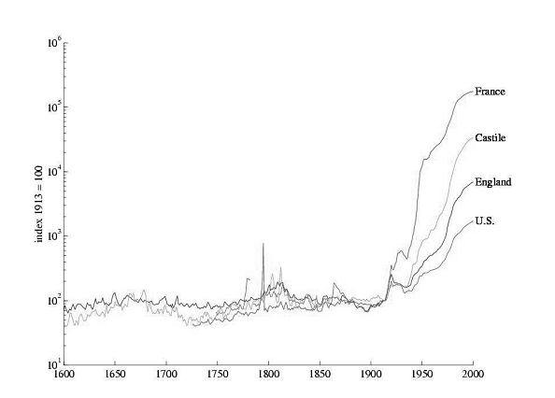
Centuries of prices
Source: Sargent, “Evolution and intelligent design.”

Slide 14
Federal Reserve
Federal Reserve Act
  The Federal Reserve System and the Federal Open Market Committee should seek “to promote effectively the goals of maximum employment, stable prices, and moderate long-term interest rates.”

Slide 15
ECB
ECB = European Central Bank
Treaty establishing the European Community:
  The primary objective of [monetary policy] shall be to maintain price stability.
  Without prejudice to the objective of price stability, the ECB shall support the general economic policies in the Community with a view to contributing to the achievement of … a high level of employment and sustainable and non-inflationary growth.

Slide 16
Banco Central de Argentina
BCRA Act (2003):
  The Argentine Central Bank is a National State self-governed institution, whose primary and fundamental mission is to preserve the value of the Argentine currency.

Slide 17
Ben Bernanke
Testimony to Congress, November 2005:
  Middle-income living standards, and poverty for that matter, are best addressed through employment growth. By maintaining low inflation and low expectations of inflation, you can create new employment.
Do this make sense to you?

Slide 18
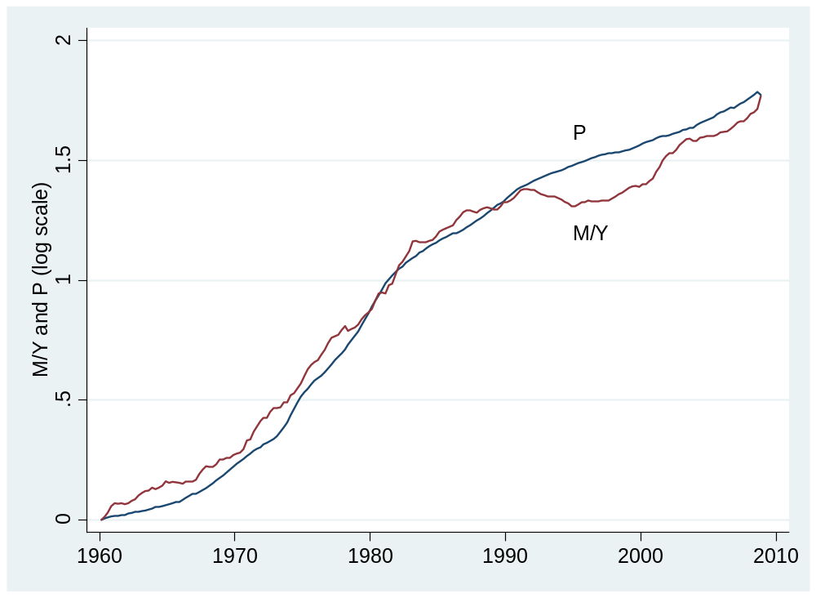
Money and prices in the US
Source: FRED.

Slide 19
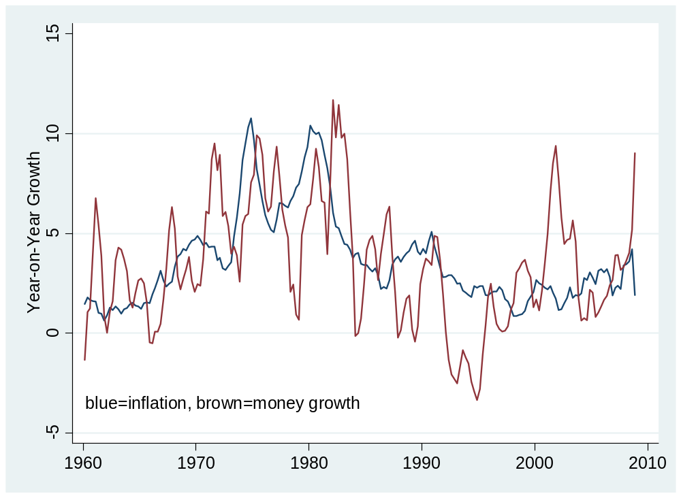
Money and prices in the US
Source: FRED.

Slide 20
Mechanics of monetary policy
How does the Central Bank control the money supply?

Slide 21
Mechanics of monetary policy
Treasury
Assets |  | Liabilities
 |  | Bonds | 200
Where does treasury debt come from?
How does central bank increase money supply?
Why do households go along?
Central bank
Assets |  | Liabilities
Bonds | 20 | Money | 20
Households and firms
Assets |  | Liabilities
Money | 20
Bonds | 180

Slide 22
Mechanics of monetary policy
What happened in Zimbabwe?
Why doesn’t it happen more often?

Slide 23
Aggregate supply and demand
What they are
  Aggregate supply concerns production of goods
  Aggregate demand concerns purchases of goods
How to use them
  Short-run equilibrium: where AS and AD cross
  Long-run equilibrium: where AS* and AD cross
What shifts them
  What shifts AD?
  What shifts AS & AS*?

Slide 24
Aggregate supply and demand
What are our goals?
  Low inflation [stable prices]
  Output near “potential output” Y* [invisible hand again]

Slide 25
Aggregate supply and demand
What’s coming
  How should we respond to demand shocks?
  How should we respond to supply shocks?

Slide 26
Aggregate supply and demand
P
AS*
AS
Is this good or bad?
A
AD
Y

Slide 27
Aggregate supply and demand
What happens when we increase the money supply?

Slide 28
Aggregate supply and demand
P
AS*
AS
Is this good or bad?
B
A
AD
AD'
Y

Slide 29
Aggregate supply and demand
What’s an example of an adverse demand shock?
What is its impact?
How should we respond?

Slide 30
Aggregate supply and demand
P
AS*
AS
What should policy do?
A
B
AD'
AD
Y

Slide 31
Aggregate supply and demand
What’s an example of an adverse supply shock?
What is its impact?
How should we respond?

Slide 32
Aggregate supply and demand
P
AS*
AS
B
What should policy do?
A
AD
Y

Slide 33
Aggregate supply and demand
How should we respond to demand shocks?
How should we respond to supply shocks?
How can we tell them apart?

Slide 34
Aggregate supply and demand
Money
Growth
Inflation & Growth

Slide 35
Takeaways
Monetary policy affects
  Inflation
  Output in the short run
Central banks change the money supply with purchases and sales of government bonds
In theory, central banks should resist demand shocks and accommodate supply shocks [if you can tell them apart!]

Slide 36
After the break
Be prepared to discuss the Greenspan mini-case

Slide 37
Midterm
A: 87 and up
B: 70 and up
Mean and median: 83

Slide 38
The Global Economy
Monetary Policy and Interest Rates
© NYU Stern School of Business
Notes:
Where do interest rates come from?
Are they too low, too high, or just right now?

Slide 39
Greenspan mini-case
Indicators of GDP growth?
Indicators of inflation?
Are we facing supply or demand shocks?
What should we do?

Slide 40
Plan of attack
Greenspan mini-case ✓
Where do interest rates come from?
The Taylor rule (bond traders’ guide to monetary policy)
Where do interest rates come from?
What’s going on now?
Group Project #6

Slide 41
Where do interest rates come from?
Short-term interest rates?
Long rates?

Slide 42
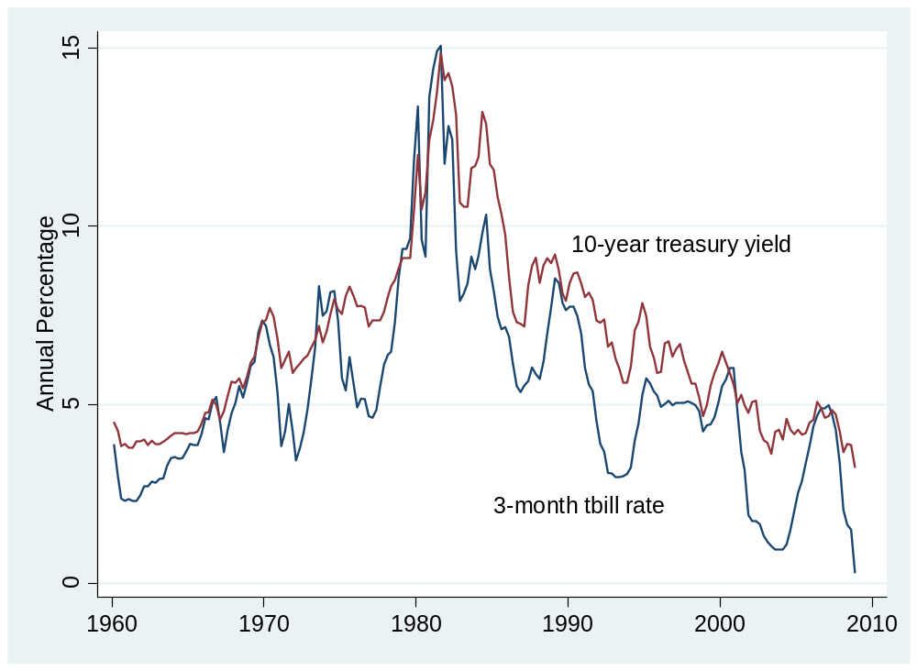
Where do interest rates come from?
Source: FRED.

Slide 43
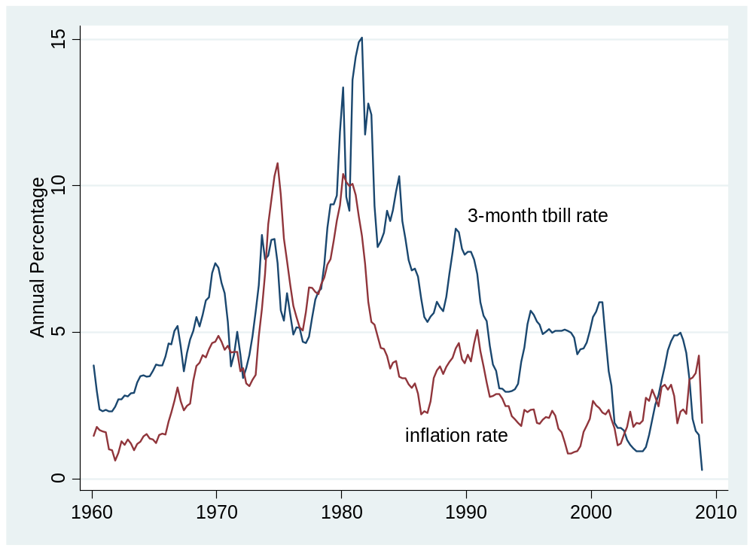
Where do interest rates come from?
Source: FRED.

Slide 44
Interest rates and money supply
Most discussions of monetary policy are focused on short-term interest rate
  In US: Fed Funds rate
More money, lower interest rate

Slide 45
Taylor rule
Bond traders’ guide to monetary policy
  Inflation up ⇨ raise short rate
  GDP growth up ⇨ raise short rate
Why is a “rule” valuable?

Slide 46
Taylor rule
Rule for setting short-term interest rate
i = r* + π + a₁(π –π*) + a₂(y–y*)
  i = short term interest rate (fed funds rate)
  r* = “equilibrium” real interest rate [2%?]
  π = inflation rate
  π* = target inflation [2%?]
  y = growth rate of real GDP
  y* = target growth rate [3%?]
  a₁, a₂ = (positive) parameters [1/2?]

Slide 47
Taylor rule
What does it suggest on average? Now?
i = r* + π + 0.5 (π –π*) + 0.5 (y–y*)
What happens if inflation rises 1%? Growth?
Why does interest rate rise more than inflation?
Notes:
I = 2 + 0 -1 – (1/2) (-3-3) = -2 !

Slide 48
Taylor rule
What does a bond trader expect if
  Inflation rises 1%?
  Growth rises 1%?
Optional:
  How should long rates respond?

Slide 49
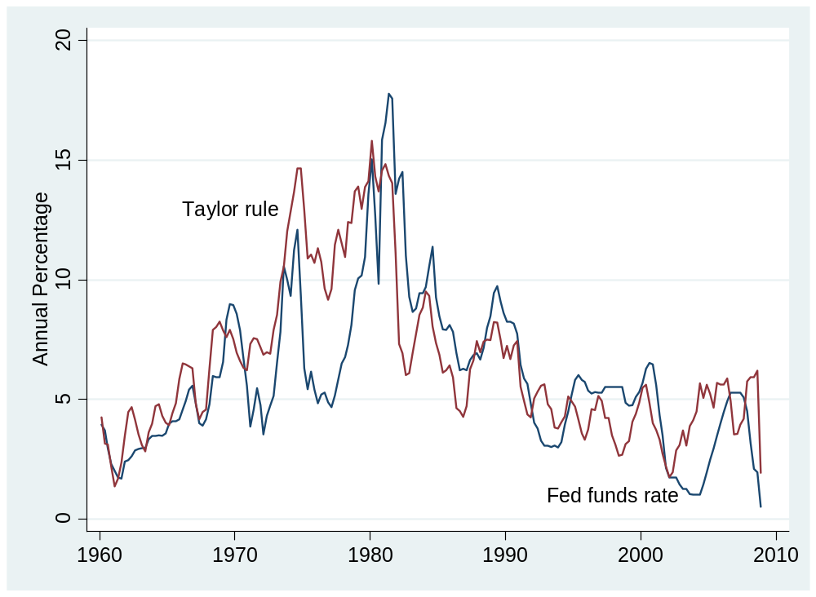
Taylor rule
What’s going on here?
Here?
Source: FRED.

Slide 50
Taylor rule
How does interest rate respond to
  Positive demand shock? [what changes?]
  Positive supply shock? [what changes?]

Slide 51
What’s going on now?
What’s the Fed up to?
What do you do if interest rate hits zero?

Slide 52
“Quantitative easing”
Interest rate can’t go below zero
  Why not?
But: you can still expand the money supply
  Money supply has grown rapidly in recent past
  We call this “quantitative easing” because we’re changing the quantity of money

Slide 53
“Quantitative easing”
Treasury
Assets |  | Liabilities
 |  | Bonds | 200
QE = expand money supply
How?
What else now?
Central bank
Assets |  | Liabilities
Bonds | 20 | Money | 20
Households and firms
Assets |  | Liabilities
Money | 20
Bonds | 180

Slide 54
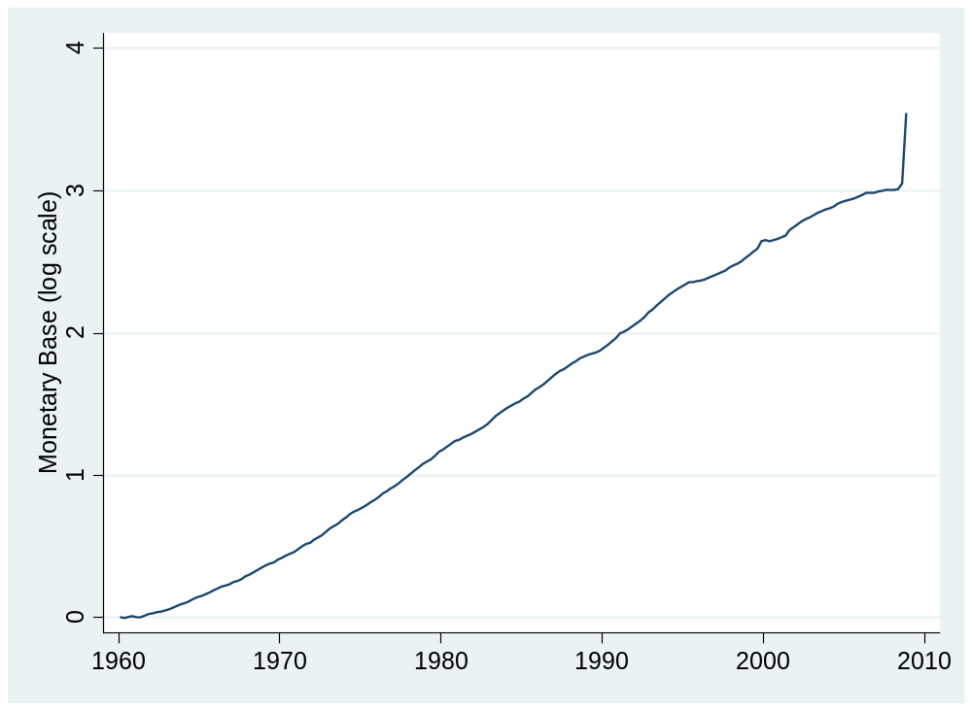
“Quantitative easing”
Source: FRED.

Slide 55
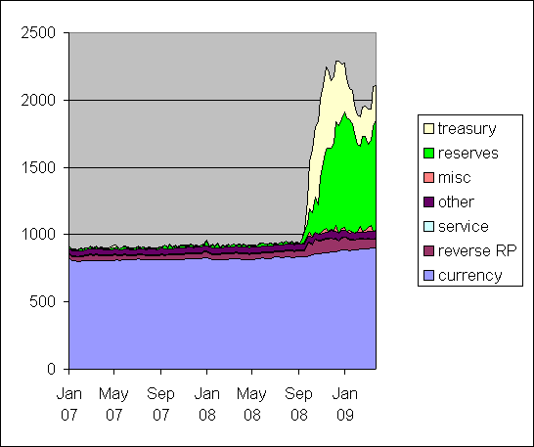
“Quantitative easing”
Source: Jim Hamilton’s blog

Slide 56
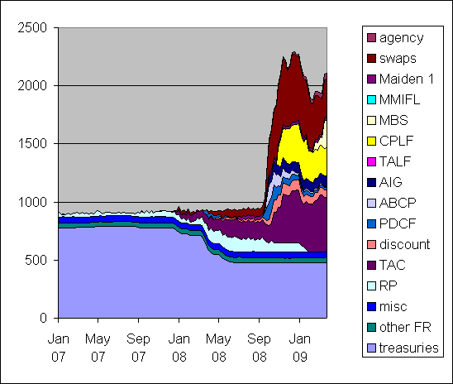
“Quantitative easing”
Source: Jim Hamilton’s blog

Slide 57
Where do interest rates come from?
Monetary Policy
Inflation & Growth
Interest Rates

Slide 58
What have we learned?

Slide 59
Group Project #6
Note links in online version
Aim for a professional business document
  Options: report or slides, whatever you prefer
Guideline: no more than 5 pages or 10 slides
Do not do any of your own statistical analysis!
Option: focus on current use of balance sheet rather than Taylor rule
Come see me if you have questions

Slide 60
Takeaways
Most central banks focus on short-term interest rates
  Increase in rate corresponds to fall in money supply
Taylor rule ties interest rate to inflation and output
  Policy is predictable
  Strong output growth and high inflation trigger increases in interest rate
When interest rate hits zero, you can still expand the money supply [“quantitative easing”]

