Slide 1

The Global Economy
Macroeconomic Crises
© NYU Stern School of Business

Slide 2
Crises
Crises are unusually large recessions, typically accompanied by a collapse of government debt markets, foreign exchange markets, and/or the financial system.
They’re a regular feature of the world we live in
Significant business risk, esp in emerging markets – also opportunity.

Slide 3
Crises
Walter Wriston, CEO of Citibank, 1980 or so:
  Countries don't go out of business.... The infrastructure doesn't go away, the productivity of the people doesn't go away, the natural resources don’t go away. And so their assets always exceed their liabilities, which is the technical reason for bankruptcy. And that's very different from a company.
What he meant: default is a political choice
Notes:
http://www.imf.org/external/np/exr/center/mm/eng/mm_dt_01.htm

Slide 4
Question for later
Are open global capital markets good or bad for emerging market economies?

Slide 5
The idea
Crises are not easy to predict, but there are a number of common “signs of trouble.”

Slide 6
Signs of trouble
What would you look at to detect trouble?

Slide 7
Signs of trouble
Fiscal indicators
  Government debt more than 50% of GDP?
  Deficit more than 5% of GDP?
  Signs that deficit is a long-term issue? [pensions, healthcare, banks…]
  Tighter restrictions on emerging markets [why?]

Slide 8
Signs of trouble
Exchange rate
  Real exchange rate overvalued? [more than 30% above PPP or 20% above 3-year average]
  Fixed or “managed”?
  Low reserves?

Slide 9
Signs of trouble
Capital inflows: not necessarily a problem [it depends!]
Signs of trouble [maybe: you’ll want to think about these]
  Foreign debt more than 50% of GDP?
  Capital inflows more than 5% of GDP? [=current account deficit]
  Public or private? [Lawson]
  Debt or equity? [debt is riskier]
  Short-term or long-term? [short is riskier]
  Denominated in foreign currency? [riskier]

Slide 10
Signs of trouble
Banking system
  Signs of weakness?
  Cause or effect?

Slide 11
Signs of trouble
Politics and institutions
  Could the government decide default is attractive?
  Are “institutions” weak?

Slide 12
Signs of trouble checklist
Government debt and deficits
Exchange rate and reserves
Current account and net foreign assets
Banking system
Politics and institutions

Slide 13
Signs of trouble
Govt Deficit
print money
Inflation
Govt Debt
Trade Deficit
overvaluation
FX
fear of default
Bank Failures
Crisis
devaluation

Slide 14
Plan of attack
The idea, signs of trouble ✓
Volatility and crises
Examples: Mexico, Argentina, Korea
“Free markets” revisited

Slide 15
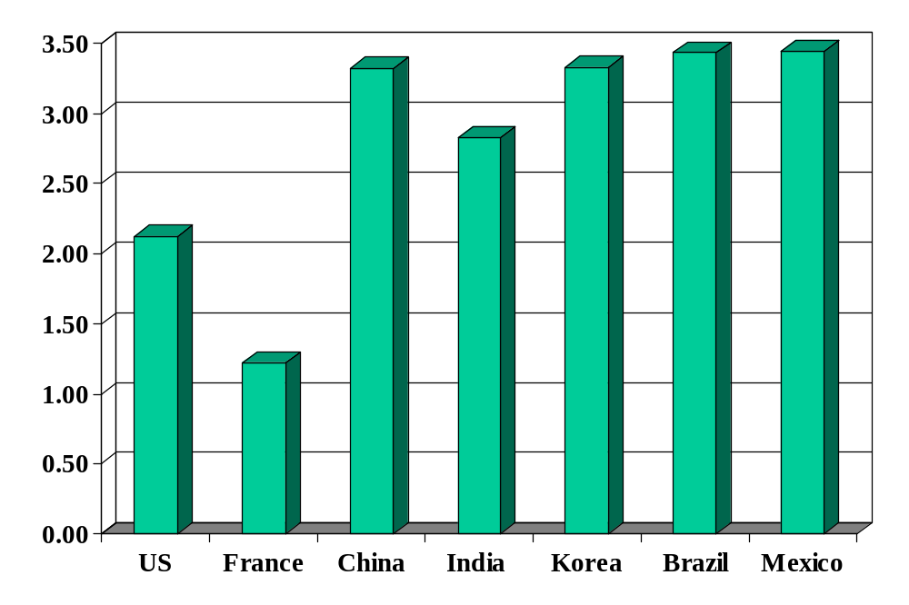
Volatility (std dev of annual growth rate %)
Source: World Bank, World Development Indicators, GDP per capita, 1975-2005.

Slide 16
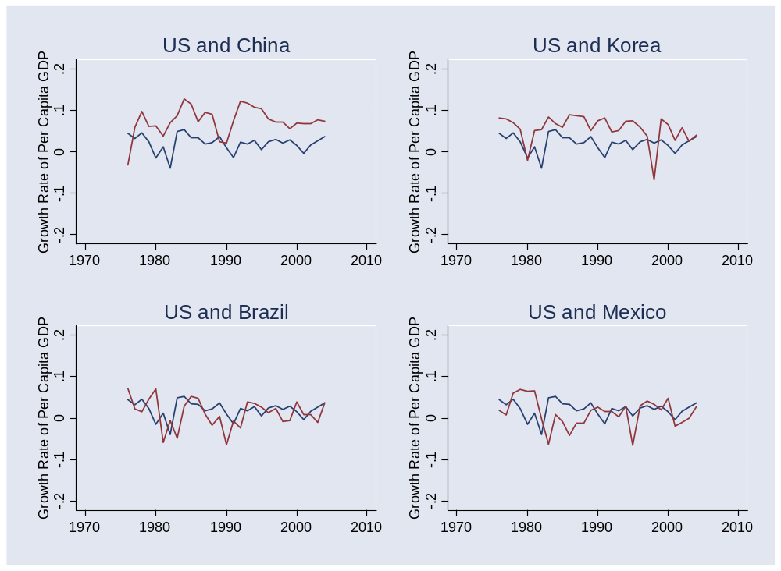
Volatility
Source: World Bank, World Development Indicators, GDP per capita, 1975-2005. Blue=US.

Slide 17
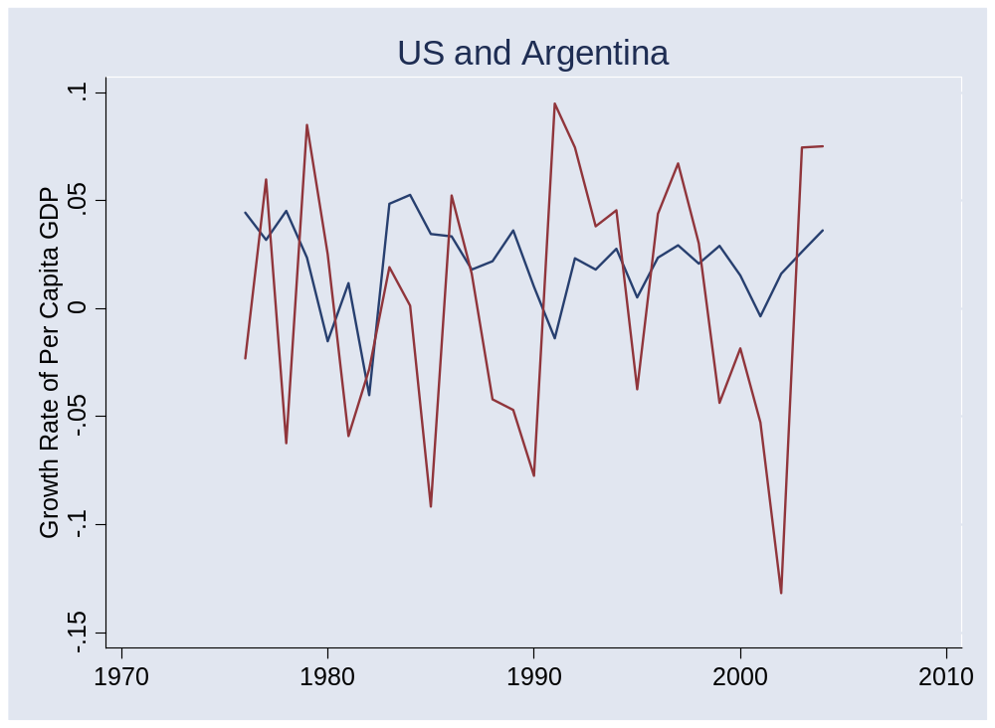
Volatility
Source: World Bank, World Development Indicators, GDP per capita, 1975-2005.

Slide 18
Crises (a fact of life)
Australia 1891-93 (“Barings crisis”)
  GDP fell 18%
United States 1907-08
  GDP fell 10%
Mexico 1994-95
  GDP fell 9%, peso fell almost 50%
Korea 1997-98
  GDP fell 9%, won fell 30%
Argentina 1999-2002
  GDP fell 20%, peso fell 65%
Many others

Slide 19
Mexico 1994-95
High growth in early 1990s
Economic liberalization and NAFTA (1994)
Modest government debt [27%] and deficit [1%]
Exchange rate “managed”
Higher inflation than US led to “real appreciation” [what does this mean?]
Current account deficit 5-7% of GDP
Net foreign borrower [NFA/Y ≈ –30%]
Political turmoil during 1994 election campaign [Chiapas, Colosio, …]

Slide 20
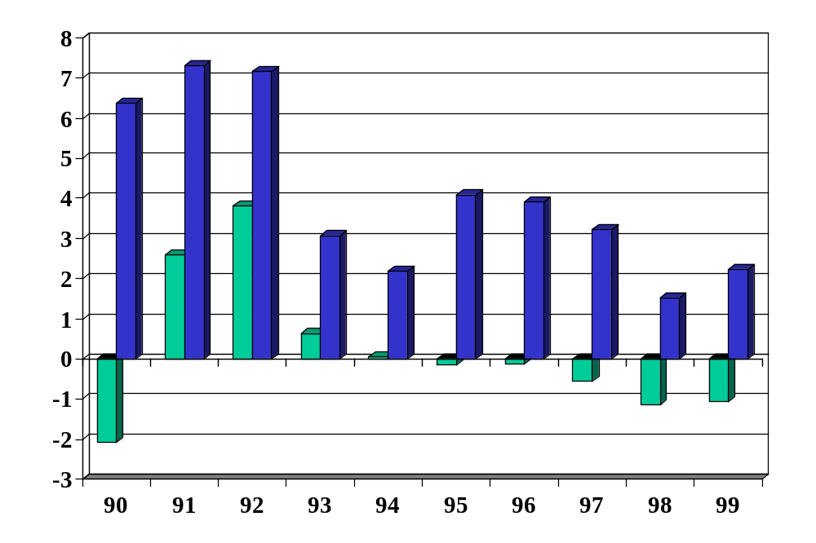
Mexico: government budget (% of GDP)
Positive numbers are surpluses
green=total, blue=primary
Source: EIU Country Data, green=deficit, blue=primary.

Slide 21
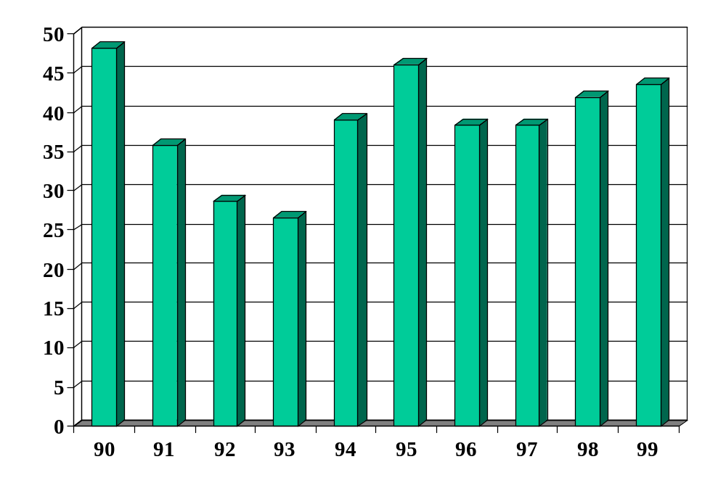
Mexico: government debt (% of GDP)
Source: EIU Country Data.

Slide 22
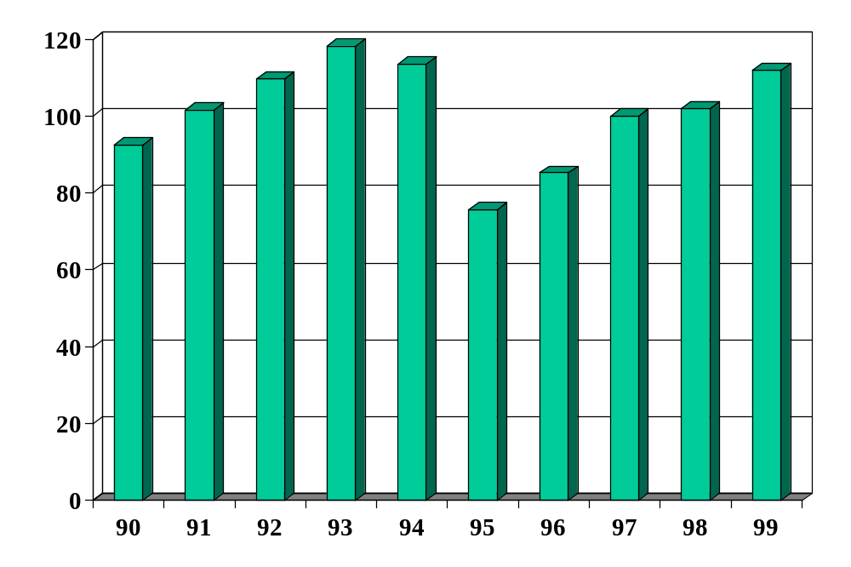
Mexico: real exchange rate
Source: EIU Country Data, trade-weighted relative price of Mexican to foreign goods.

Slide 23
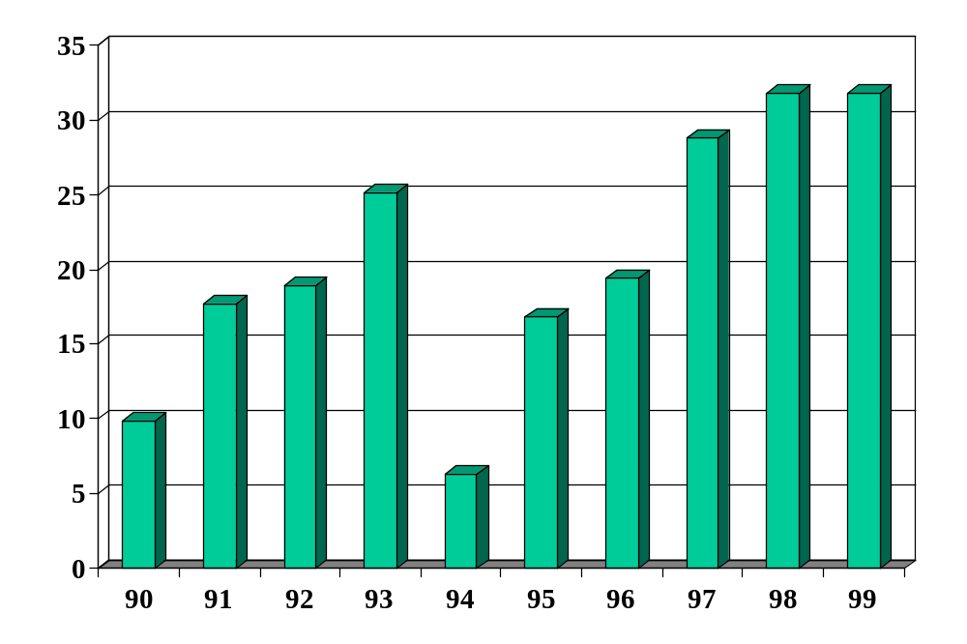
Mexico: fx reserves (USD billions)
Source: EIU Country Data.

Slide 24
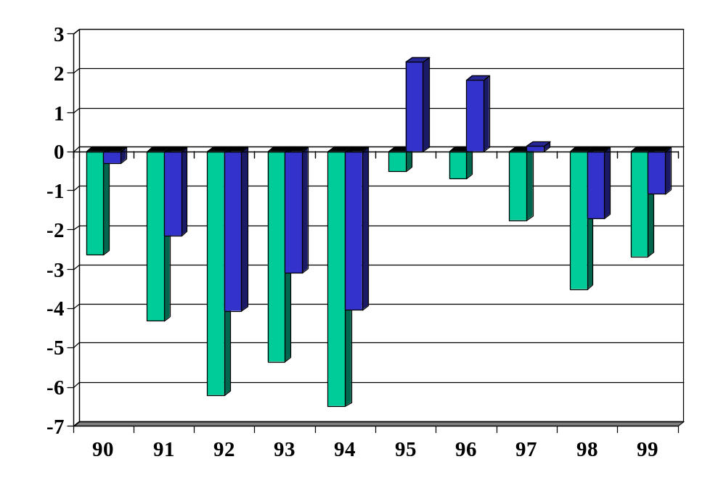
Mexico: external “balances” (% of GDP)
Source: EIU Country Data, green=current account, blue=trade balance.

Slide 25
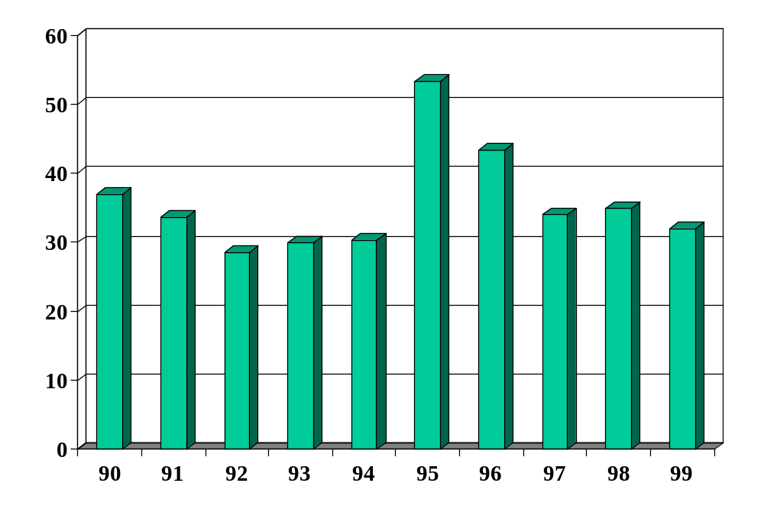
Mexico: external debt (% of GDP)
Source: EIU Country Data.

Slide 26
Mexico: assessment
Checklist
  Government debt and deficits
  Exchange rate and reserves
  Current account and net foreign assets
  Banking system
  Politics and institutions
Does it look risky to you? Would you have taken your money out of the country?

Slide 27
Mexico 1994-95
More
  Government borrowed short-term, in dollars
  Many firms also borrowed in dollars [why?]
  Reserves not reported at the time
  Banks turned out to be in serious trouble

Slide 28
Argentina 1999-2002
1991: currency board established to maintain parity with USD, hyperinflation ends
Early 1990s: rapid growth, capital inflows
Late 1990s: slower growth, political unrest
Late 1990s: strong currency raises prices v Brazil
Dec 01: government defaults
Jan 02: parity with USD broken, peso falls

Slide 29
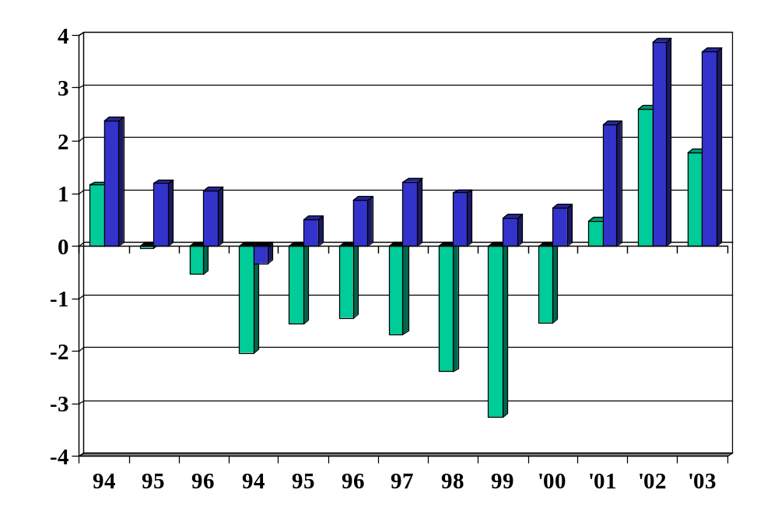
Argentina: government budget
Source: EIU Country Data, green=deficit, blue=primary.

Slide 30
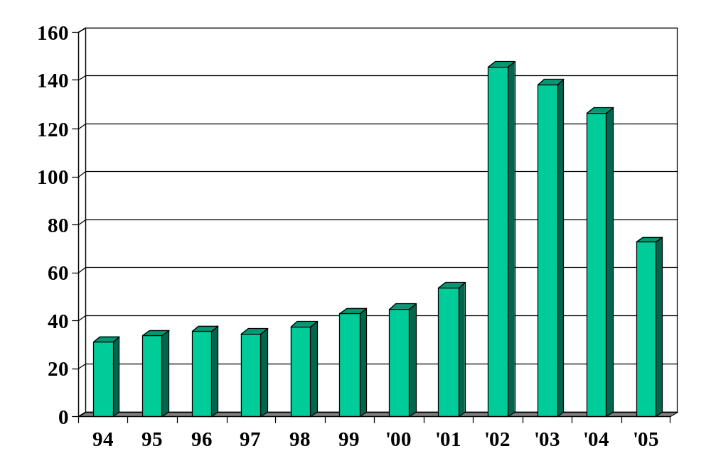
Argentina: government debt
Source: EIU Country Data.

Slide 31
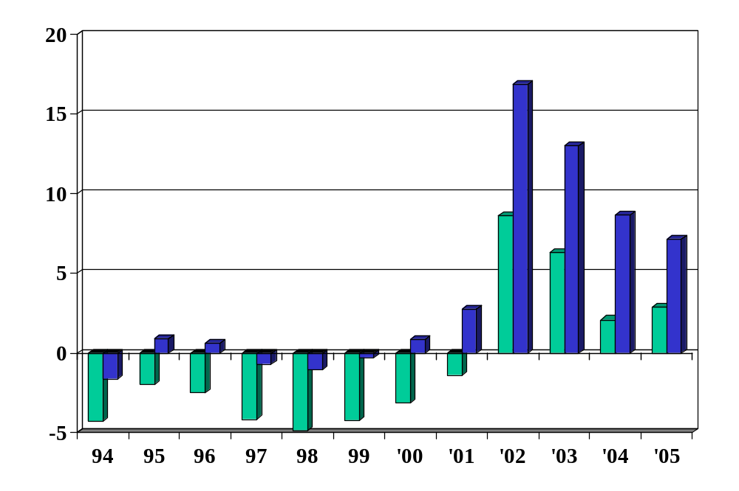
Argentina: external “balances”
Source: EIU Country Data, green=current account, blue=trade balance.

Slide 32
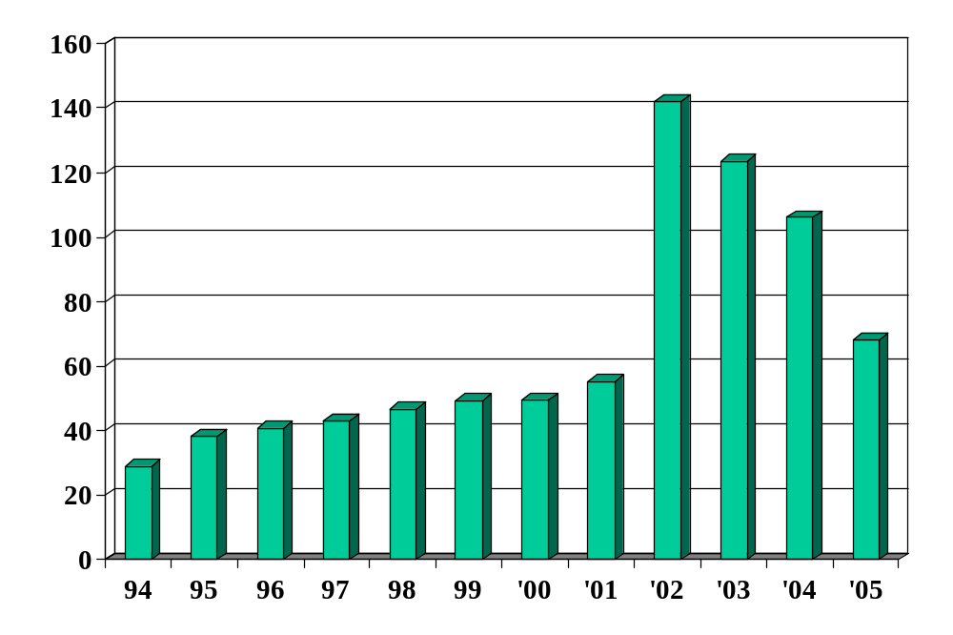
Argentina: external debt
Source: EIU Country Data.

Slide 33
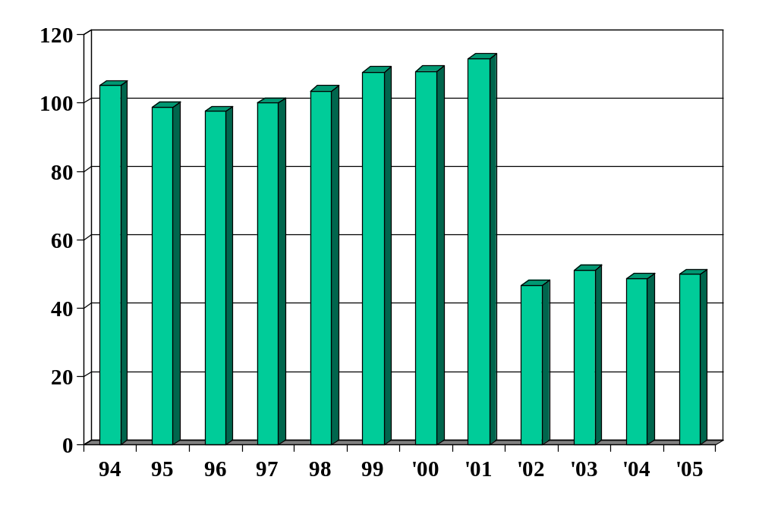
Argentina: real exchange rate
Source: EIU Country Data.

Slide 34
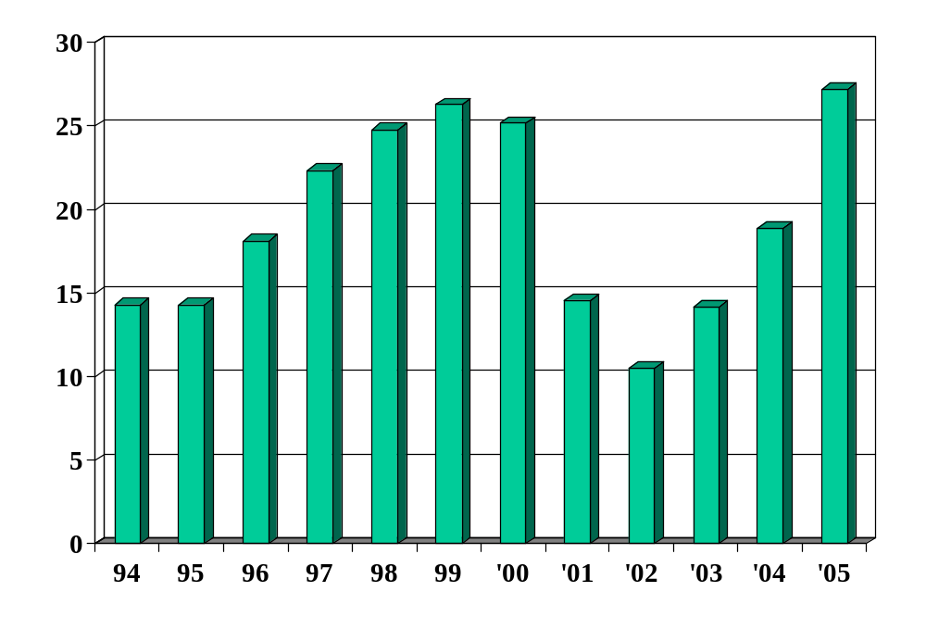
Argentina: fx reserves (USD billions)
Source: EIU Country Data.

Slide 35
Argentina: assessment
Checklist
  Government debt and deficits
  Exchange rate and reserves
  Current account and net foreign assets
  Banking system
  Politics and institutions
Does it look risky to you? Would you have taken your money out of the country?

Slide 36
US: assessment
What caused the crisis?
Checklist as of July 2007
  Government debt and deficits
  Exchange rate and reserves
  Current account and net foreign assets
  Banking system
  Politics and institutions
Does it look risky to you? Would you have taken your money out of the country?

Slide 37
Crisis assessment
Crises hard to predict
Checklist gives you a first cut
Politics almost always central [recall: Wriston]

Slide 38
Catch your breath

Slide 39
Open capital markets
Money moves around the world in seconds
  Is that a good thing?
  A source of crises?
Is China wrong to limit international capital flows?

Slide 40
India
India’s central banker, D. Subbarao, pointed to the volatility of capital flows to emerging markets and the problems they can create:
  They never come in at the precise time or in the exact quantity you want them. … India has, in response, limited the amount foreigners can invest in bonds, an attempt to limit India’s borrowing from abroad. He noted that the IMF, in a change of view, has said that capital controls can be “desirable and effective” in managing capital flows in select circumstances.
Notes:
http://blogs.wsj.com/economics/2010/04/27/secondary-sources-slashing-state-budgets-capital-flows-alan-greenspan/

Slide 41
Takeaways
Developing countries are volatile
Signs of trouble checklist
  Government debt and deficits
  Exchange rate and reserves
  Current account and net foreign assets
  Banking system
  Politics and institutions

Slide 42
The Global Economy
Final Review
© NYU Stern School of Business

Slide 43
Plan of attack
About the final exam
Review of topics – with applications

Slide 44
About the final exam
Thursday, May 6, 1:30–3:30, KMC 2-60
Same format and content as practice exams
You can use one page of notes
Bring a calculator
Wireless devices prohibited
Covers second half only
Mixture of qualitative and quantitative
Anything from the notes, slides, or projects is fair game, but the exam is not an attempt to stump you with obscure issues

Slide 45
About the final
Recommended study plan
  Skim “checklist” to get big picture
  Review course materials slides, notes, projects
  Draft summary page
  Work through practice exams
  Review topics you have difficulty with
  Come see me if you have questions

Slide 46
About office hours
Wed May 5, 12n – 5pm
Other times: make an appointment or stop by

Slide 47
About the “cheat sheet”
For each topic, I suggest you ask:
  What are the quantitative tools?
  What are the takeaways?

Slide 48
About today
Two collections of topics
  Business cycles
  Crises
Ask questions at any time

Slide 49
Business cycle overview
Current Conditions
Indicators
Theory: AS & AD
Monetary Policy
Statistical Analysis
Future Conditions

Slide 50
Business cycle checklist
Macroeconomic conditions
  GDP growth, inflation, interest rates
Business cycle indicators
  Hints about future conditions
AS and AD
  Which is shifting?
Monetary policy
  How do we expect the central bank to respond?
  How will this affect interest rates? Inflation and GDP?

Slide 51
Business cycle properties
Cyclicality
  Most indicators of economic activity move up/down with GDP
  We say they are procyclical if they go up/down with GDP does, countercyclical if the opposite
Volatility
  Volatility = standard deviation of (say) growth rate
  Consumption is less volatile than GDP, investment more
Leads and lags
  Unemployment lags GDP [what else?]
  Housing starts, stock market, term spread lead GDP [what else?]

Slide 52
Business cycle indicators
Big picture
  Economic activity is “stochastic” [random]
  But the randomness has patterns
  The patterns allow prediction
Tools
  Statistical analysis of macroeconomic data [“time series”]
  Cross-correlation function
  Regressions
Relevance
  Reminder: unpredictable things can happen to the economy, your business, and even your career

Slide 53
Business cycle indicators
Suppose current indicators include
  Unemployment remains near its peak
  New claims for unemployment insurance down sharply
  Housing starts up from trough but below norm
  Yield curve steep
What does that suggest to you about economic conditions in the near future?

Slide 54
Inflation
Big picture
  Q: Where does high inflation come from?
  A: Money growth [<= fiscal deficits <= political chaos]
Tools
  Quantity theory ties inflation to money growth:
M V = P Y
γ_{P} = γ_{M} – γ_{Y} (V constant)
  Monetary mechanics: use central bank balance sheet to show how it changes the supply of money/currency
Relevance
  High inflation destroys bond values and makes day-to-day business difficult.

Slide 55
Monetary policy mechanics
Treasury
Assets |  | Liabilities
 |  | Bonds | 200
Where does treasury debt come from?
How does central bank increase money supply?
Why do households go along?
What happened in Zimbabwe?
Central bank
Assets |  | Liabilities
Bonds | 20 | Money | 20
Households and firms
Assets |  | Liabilities
Money | 20
Bonds | 180

Slide 56
Aggregate supply and demand
Big picture
  Q: Where do business cycles come from?
  A: Shocks to aggregate supply and demand.
Tools
  AS/AD framework: supply and demand affect output and prices
  Shocks to supply and demand have different consequences [more on this soon]
Relevance
  Standard tool for analysts and business press

Slide 57
Aggregate supply and demand
What they are
  Aggregate supply concerns production of goods
  Aggregate demand concerns purchases of goods
What shifts them
  What shifts AD?
  What shifts AS & AS*?
How to use them
  Short-run equilibrium: where AS and AD cross
  Long-run equilibrium: where AS* and AD cross
Goals of policy
  Stable prices, output = AS*

Slide 58
Aggregate supply and demand
P
AS*
AS
AD
Y

Slide 59
Aggregate supply and demand
In the spring of 2009, the ECB faced
  Declining prices (deflation)
  Sharp drop in output
Questions
  Was this a shift of supply or demand?
  How should a central bank respond to such a shift?
  How would you expect the ECB to respond?
  What would you expect to happen to EZ interest rates?

Slide 60
2010 final Q1
???In the spring of 2009, the ECB faced
  Declining prices (deflation)
  Sharp drop in output
Questions
  Was this a shift of supply or demand?
  How should a central bank respond to such a shift?
  How would you expect the ECB to respond?
  What would you expect to happen to EZ interest rates?

Slide 61
Monetary policy
Big picture
  Q: How do central banks manage interest rates? [why “manage”?]
  A1: Offset demand shocks, accommodate supply shocks
  A2: Carefully, often approximated by Taylor rule.
Principles of good policy
  Stable prices, predictable policy, independent central bank?
Taylor rule approximates policy in many countries:
i = r* + π + a₁(π –π*) + a₂(y–y*)
Relevance
  Summarizes impact of GDP growth, inflation on interest rates
  Helps to identify unusual policy episodes [like now]

Slide 62
Interest rate analysis
Reminder: Taylor rule is
i = r* + π + a₁(π –π*) + a₂(y–y*)
What interest rate does it suggest now?

Slide 63
Interest rate analysis
You observe
  Modest increase in 3-month yield
  Larger increase in 10-year bond yield
  Inflation about 1%
  Slowly increasing economic growth
What kinds of things would lead bond yields to change this way?

Slide 64
Crisis overview
Govt Deficit
print money
Inflation
Govt Debt
Trade Deficit
overvaluation
FX
fear of default
Bank Failures
Crisis
devaluation

Slide 65
Crisis checklist
Government debt and deficits
Exchange rate and reserves
Current account and net foreign assets
Banking system
Politics and institutions

Slide 66
Fiscal policy
Big picture
  Q: How do taxes affect performance? Deficits?
  A1: Taxes discourage some activities (working and saving?)
  A2: Deficits can indicate future problems, esp in emerging markets
Tools
  Principle: apply low rates to broad tax base [incentives]
  Deficits: you can’t run them forever
  Debt dynamics: how is debt/GDP evolving?
Relevance
  Taxes central to many business decisions
  Deficits are a common indicator of trouble [what kind?]

Slide 67
Fiscal policy
Government debt dynamics
B_{t}/Y_{t} = [(1+i)/(1+g)] (B_{t-1}/Y_{t-1}) + D_{t}/Y_{t}
Germany in 2009 (Dec 08 estimates)
  B/Y = 64.4%
  D/Y = –2.3%
  iB/Y = 3.4%
  i = 5%
  g = 0% (inflation + real growth)
How does B/Y change?

Slide 68
Exchange rates
Big picture
  Q: Where do exchange rates come from?
  A: Long run: prices/inflation. Short run: who knows?
Tools
  Purchasing power parity: prices of goods tend to equalize across countries
s P* = P
  OK if large price changes, typically irrelevant otherwise
  Interest rates: currencies with high interest rates generally appreciate (increase in value) [but: modest R²]
  Other predictors: 50-50 bet is often the best you can do
Relevance
  Exchange rates central to international transactions
  If you can’t predict them, think about mitigating their impact

Slide 69
Exchange rate regimes
Big picture
  Q: How do fixed exchange rates work?
  A: Central bank buys and sells to support the price
Tools
  Central bank balance sheet
Relevance
  Fixed exchange rate systems periodically blow up
  Reserves are a common indicator of stability

Slide 70
Foreign exchange reserve mechanics
Treasury
Assets |  | Liabilities
 |  | Bonds | 200
What are foreign exchange reserves?
How does bank fix exchange rate?
What if people buy foreign currency?
What if central bank runs out?
Central bank
Assets |  | Liabilities
Bonds | 10 | Money | 20
FX reserves | 10
Households & firms (everyone else)
Assets |  | Liabilities
Money | 20
FX | 50
Bonds | 190

Slide 71
Balance of payments
Big picture
  Q: Are trade and current account deficits signs of trouble?
  A: Maybe, depends how the money is used
Tools
  Balance of payments: net exports, trade balance, current account, capital flows, net foreign assets
  Net foreign asset dynamics
Relevance
  Current account is fundamental indicator – but of what?

Slide 72
Net foreign asset dynamics
Change in NFA/Y
NFA_{t}/Y_{t} = [(1+i)/(1+g)] (NFA_{t-1}/Y_{t-1}) + NX_{t}/Y_{t}
Current numbers for US
  NFA/Y = –20% (rough guess)
  NX/Y = –4% (EIU forecast)
  i = 0%
  g = – 1% (–2+1)
How is NFA/Y changing? Why?

Slide 73
Macroeconomic crises
Big picture
  Q: Why do we see periodic crises, esp in emerging markets?
  A: Government finance, fixed exchange rates, bank problems. Also: Fact of life.
Checklist of indicators
  Government debt and deficits, exchange rate and reserves, current account and net foreign assets, banking weakness, politics and institutions
Relevance
  Emerging markets: risk high – also reward?

Slide 74
Crisis checklist
Government debt and deficits
Exchange rate and reserves
Current account and net foreign assets
Banking system
Politics and institutions

Slide 75
Asian crisis
Crisis hit many Asian countries in July 1997
Overall picture
  Modest government debt, no deficits
  Exchange rates fixed or managed
  Reserves modest
  Banks had serious bad loan problems
  Banks and firms borrowed short-term in foreign currency
  Countries with weakest institutions had worst crises
  Korea is striking because of its strong performance otherwise

Slide 76
Korea
Mid-1990s:
  Chaebols struggling
  Ditto major banks that loaned to them, some of the loans financed by foreign borrowing
  Line between government and business unclear to lenders
July 1997: Kia Motors asks for emergency loans
Nov-Dec 1997: Moody’s downgrades sovereign debt
Currency fell sharply

Slide 77
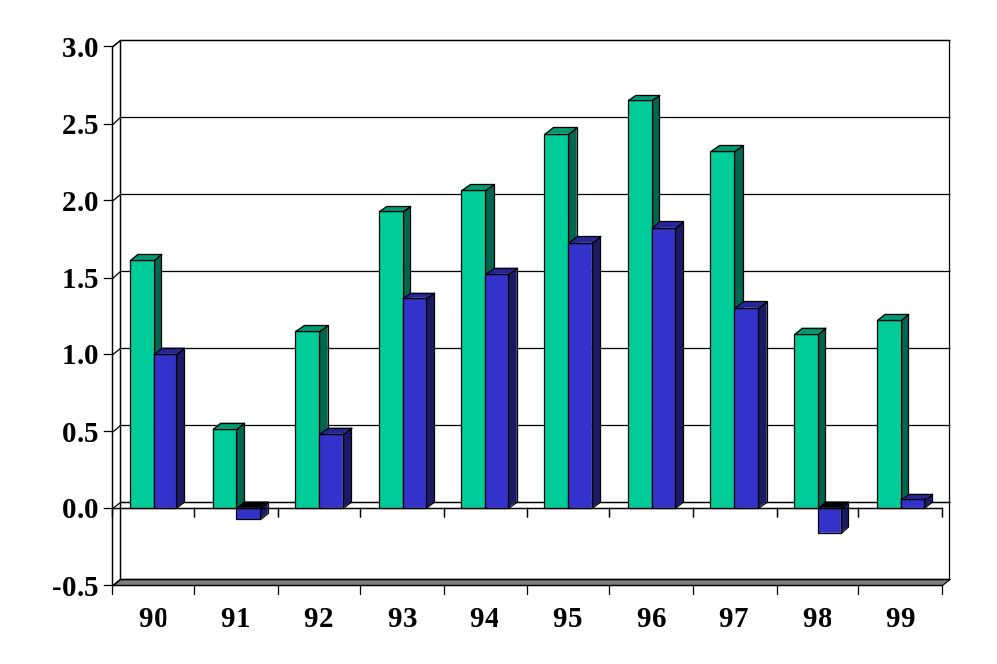
Korea: government budget
Source: EIU Country Data, green=deficit, blue=primary.

Slide 78
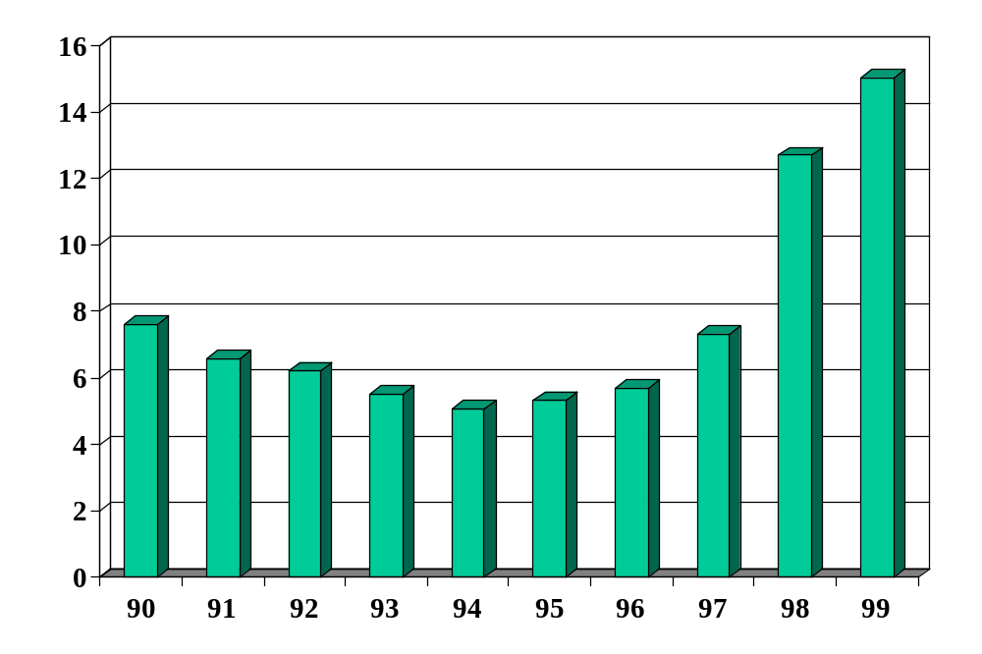
Korea: government debt
Source: EIU Country Data.

Slide 79
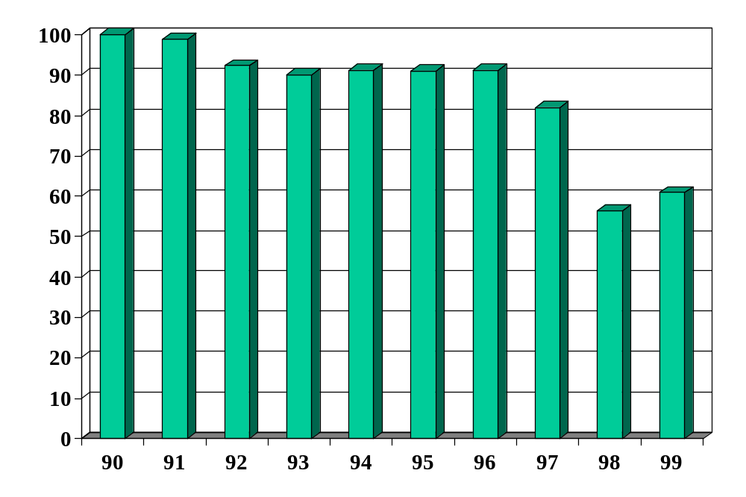
Korea: real exchange rate
Source: EIU Country Data.

Slide 80
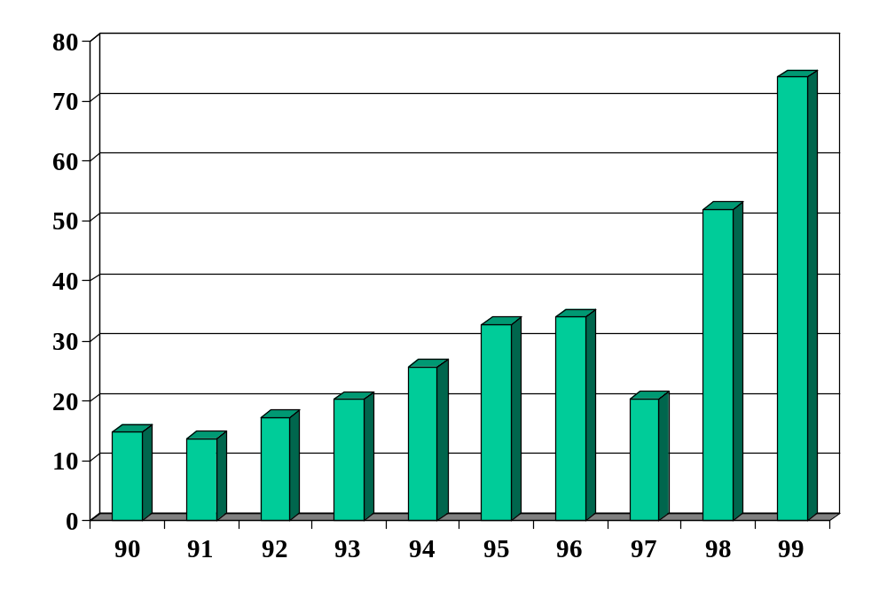
Korea: fx reserves (USD billions)
Source: EIU Country Data.

Slide 81
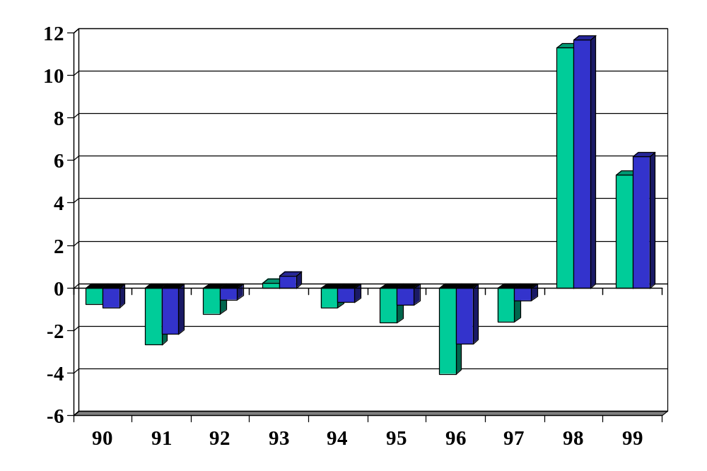
Korea: external “balances”
Source: EIU Country Data, green=current account, blue=trade balance.

Slide 82
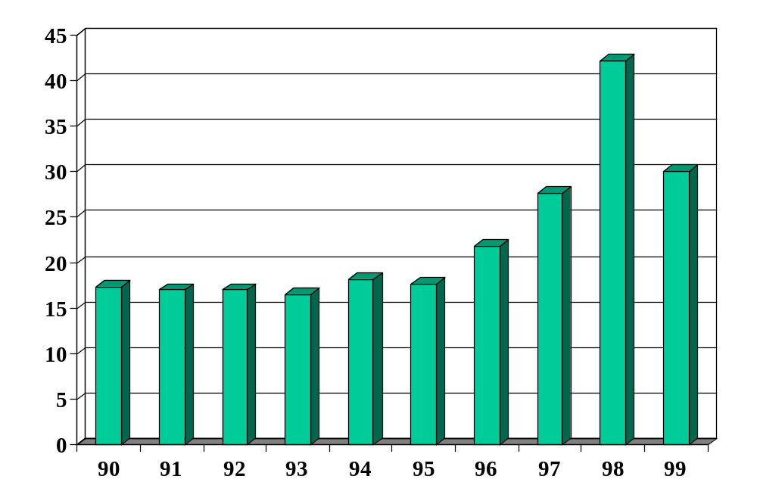
Korea: external debt
Source: EIU Country Data.

Slide 83
Korea: assessment
Checklist
  Government debt and deficits
  Exchange rate and reserves
  Current account and net foreign assets
  Banking system
  Politics and institutions
Does it look risky to you? Would you have taken your money out of the country?

Slide 84
Korea: after the crisis
From MBA ’11 Boon Young Lee:
  I had a chance to observe the changes made after the crisis. Many Chaebols went bankrupt, and some companies were bought by foreign capital (Lone Star, for example). Many other corporations went through restructuring (e.g. Samsung sold its auto business to Renault; GM bought Daewoo Auto company), and more strict regulations have made for companies and banks. To look at the bright side, the crisis helped (or forced) Korean companies to become more transparent and healthy.

Slide 85
Good luck
Good luck on the exam
Have a great summer
Report back in the fall

Slide 86
Course recommendations 1
Economics
  International macroeconomic policy, Roubini (Fall)
  Advanced macroeconomics, Ljungqvist and Sargent (Fall)
  Developing financial institutions and markets, Sylla
  Game theory, Brandenburger (Spring).

Slide 87
Course recommendations 2
Quant tools
  Regression and multivariate analysis, Simonoff
  Forecasting time series, Hurvich or Deo
Other recommended courses
  Financial statement analysis, various
  Decision models, Juran
  Collaboration, conflict, and negotiation, various

Slide 88
Beach and airplane reading
Adam Hall, Quiller. Cold war spy novel moves at breakneck pace. Called Northlight in Britain.
Walter Mosley, Cinnamon kiss. LA noir from a master.
Ian Rankin, Resurrection man. Edinburgh noir. Wonderfully anti-social protagonist.
Brian Haig, The Kingmaker. Funny books about a military lawyer, light tone.
Carol O’Connor, Find me. Most recent Mallory mystery, maybe the best one yet.

Slide 89
Global economy nonfiction
Andres Oppenheimer, Bordering on chaos: Mexico's roller-coaster journey toward prosperity. A page-turner – really.
Ron Chernow, Alexander Hamilton. Great story of one of the founders of the American economic and political system, esp its financial system.
William Lewis, The power of productivity. Studies of country performance by a McKinsey partner. A little slow, but the content is fascinating. Should be called: the power of competition.
Jonathan Spence, The search for modern China. China since 1400 by a leading China scholar.

