Slide 1
Coming event
Social Enterprise Association presents
  Think Social, Drink Local
  Friday, March 5, 8pm-12m
  Altman Building (135 W 18th)
  Buy tickets on campus

Slide 2

The Global Economy
Midterm Review
© NYU Stern School of Business
Notes:
Review to consolidate learning
Long-term bus relationship: what do you look for?
Big picture “checklist,” but we’ll work through the components
Your job: ask a question if there’s anything you don’t follow

Slide 3
Where we’ve been
You’re considering a business opportunity in another country
  Manufacturing plant in Brazil
  Mutual fund in India
  Retail operation in Russia
What issues will you face?

Slide 4
Where we’ve been
GDP
Capital & Labor
Productivity
Political Process
“Institutions”

Slide 5
Plan of attack
Where we’ve been ✓
About the midterm
Review of topics: ask questions if you don’t follow
Beach and airplane reading [reference only]

Slide 6
About the midterm
Same format and content as practice exams
You can use one page of notes: std size, both sides
Bring a calculator that does “logs” and “exponents”
Wireless devices prohibited
Covers long-run performance only
Some questions will be quantitative
Anything from the notes, slides, or projects is fair game, but the exam is not an attempt to stump you with obscure issues

Slide 7
About the midterm: study plan
Skim “checklist” to get big picture
Review course materials: slides, notes, projects
Draft one-page “cheat sheet”
Work through practice exams
Review topics you have difficulty with
Keep a list of terms and concepts you don’t understand
Stop by or email if you have questions

Slide 8
About the midterm: grading
I target an average of ~75–80
Don’t panic, average is still a solid B
Gives you an opportunity to show what you know
And reduces impact of questions you miss completely

Slide 9
About the midterm: “cheat sheet”
For each topic, you should ask yourself:
  What are the big picture takeaways?
  What are the quantitative tools?

Slide 10
Measuring performance
Big picture
  Q: Why do we care about National Accounts? A: They’re the basic data on country performance.
  Q: Does GDP measure performance? A: There are other things we might care about, but most of them are closely related to GDP.
Tools:
  Price and quantity indexes are used to separate changes in quantities from changes in prices.
  Identities connect expenditure components and financial flows
Relevance
  Common indicators of performance and market size

Slide 11
Measuring performance
Production
GDP
Income
Labor, Capital
Expenditures
C,I,G,NX
Financial Flows
S = I + NX

Slide 12
Measuring performance
GDP
  Gross domestic product
  Gross of depreciation [ie, includes depreciation]
  Equals: sum of value-added for all production units
  Equals: payments to capital and labor by the same units
  Almost equals: income

Slide 13
Measuring performance
Real (quantities) and nominal (values)
  Not so easy to separate changes in nominal GDP into price and quantity components: we do our best.
  GDP and components measured at current market prices and constant prices: What’s the difference?
  Cross-country comparisons often done at constant international prices: Why do we call this PPP adjusted?

Slide 14
Measuring performance
Recall:
Y = C + I + G + NX
What does this mean?
We commonly take ratios to Y
  Eg, NX/Y, expressed at current prices [why?]
Saving
  Warning: has many definitions!
  We use: S = Y – C – G [“gross” “national” saving]
  And sometimes: S = S_{p} + S_{g} [S_{p} = Y – C – T, S_{g} = T – G]

Slide 15
Measuring performance
Recall:
S = I + NX
What does this mean?
If S (domestic source of new funds) ≠ I (domestic use of new funds), where does the difference go?
  In the US?
  In China?
It is better to give or receive?
  Goods or funds?

Slide 16
Production function
Big picture
  Q: Where does GDP come from? A: Inputs of capital and labor, total factor productivity
Tools
  The production function [simplify by setting h=H=1]
  Y = A K^{α} (hHL)^{1-α}
  Y/L = A (K/L)^{α} (hH)^{1-α}
  Y/POP = (L/POP) A (K/L)^{α} (hH)^{1-α}
Relevance
  Fundamental to country analysis. (Why is per capita GDP higher in the US than Argentina?)

Slide 17
Production function
Function
  Y/L = A (K/L)^{α} [for example]
India, 2000
  Y/L = 6216
  K/L = 6413
What is A?
  A = (Y/L)/(K/L)^{α} = ??
  “Whatever’s left”

Slide 18
Production function
What changes if
  A firm builds a new factory?
  France makes employment more attractive to firms?
  India invests in infrastructure?
  Dubai overbuilds?
  Students learn a lot in their Global Economy course?
  The US imports more cotton from Brazil and Africa?
  [put your own example here]?

Slide 19
Solow model
Big picture
  Q: Can saving and capital formation lead to continuing growth? A: No, diminishing returns to capital limits the impact, so saving-based growth will eventually stop
Tools
  Dynamics: connects “t” to “t+1”
Relevance
  Basic tool for studying economic dynamics. (How large will China’s economy be in 20 years?)
  Superior to extrapolating trends: builds in information on the economy, clarifies assumptions.

Slide 20
Solow model
How important is a high saving rate to India’s economic growth?
Is low saving a central issue for the US economy?

Slide 21
Level accounting
Why are there differences in output per worker?
Production function
Y = A K^{α} (hHL)^{1-α}
Y/L = A (K/L)^{α} (hH)^{1-α}
Comparison of two countries
(Y/L)₁/(Y/L)₂ = (A₁/A₂) [(K/L)₁/(K/L)₂]^{α}
x [(hH)₁/(hH)₂]^{1-α}
Bottom line: a clue to economic performance

Slide 22
Growth accounting
Big picture
  Q: Why do some countries grow faster than others? A: It depends, but often the most important factor is TFP.
Tools
  Continuously-compounded growth rates:
  γ_{x} = log(x_{t+n}/x_{t})/n [“log” = “LN” in Excel]
  Growth accounting
  γ_{Y/L} = γ_{A} + α γ_{K/L} + (1–α) (γ_{H} +γ_{h})
Relevance
  Basic tool for country analysis. (Why have China and India grown so fast? Why has growth slowed in Japan?)

Slide 23
Growth accounting for China
 | Y/L | K/L | A
1952 | 620 | 942 | 63
1978 | 1,234 | 3,070 | 85
2003 | 8,284 | 18,015 | 316
Contribution 1952-78 | 2.64 | 1.52 | 1.13
Contribution 1978-2003 | 7.62 | 2.36 | 5.26
You should be able to compute all the numbers in italics

Slide 24
Growth accounting
How does a high saving rate show up?
Why is TFP growth so important?
  Would its absence worry you?
Where does TFP come from?

Slide 25
Institutions
Big picture
  Q: Where does TFP come from? A: Much of it is tied to “institutions”
Tools
  Measures of institutional quality
Relevance
  The institutional environment is probably the most important factor in decisions to produce or invest in a country. (Is an Argentine winery a good bet?)

Slide 26
Institutions
High-performance institutions
  Rule of law
  Property rights
  Honest, competitive markets for products, capital, and labor
Practice
  Name five useful measures of institutional quality

Slide 27
Labor markets
Big picture
  Q: Why do employment and unemployment rates differ so much across countries? A: Largely because local labor laws differ.
Tools
  Outcomes: participation, employment, unemployment rates
  Institutions: “employment protection,” flexibility
Relevance
  Labor laws can be a major source of difficulty when doing business abroad. If you’re American, you’d make a big mistake thinking other countries are like the US. (Should Toyota open a plant in France?)

Slide 28
Labor markets
Group Project #4, question 1
Compare labor markets in Brazil, Poland, and Singapore

Slide 29
Labor markets
Practice question from Professor Clementi
  OECD data show that in Denmark, 85% of women between 25 and 54 work, but in Greece only 69%. Fertility rates are also different: women in Denmark have 1.8 children each, on average, and women in Greece have 1.4. Given this evidence, why do you think “female labor force participation” differs between the two countries?

Slide 30
International trade
Big picture
  Q: Who are the winners and losers from trade? A: On average, people in all countries gain, but it is nevertheless politically appealing to protect local workers and businesses from foreign competition.
Tools
  Ricardo’s model of trade is based on comparative advantage: consumers get products from cheapest source, production is more efficient.
Relevance
  International business has opportunities, but you can expect local competitors to use the political process against you. (UPS in Mexico, Chinese furniture makers in the US)

Slide 31
International trade
Trade is like TFP
Wages
  Why do wages differ across countries?
  Are high-wage countries uncompetitive?
  Would you expect trade to increase or reduce differences?
What is dumping? Why is it illegal?

Slide 32
International trade
Group Project #4, question 2
How has Mexico performed since NAFTA?
Why?

Slide 33
International trade
Professor Ed Leamer on countries trading with the US:
  International trade hurts both
  We get their wages and they get our culture

Slide 34
Long-run “big picture”
GDP
Capital & Labor
Productivity
Political Process
“Institutions”

Slide 35
The challenge of good government
Madison (Federalist Papers 51):
  The great difficulty [of good government] lies in this: you must first enable the government to control the governed; and in the next place oblige it to control itself.
Mo Ibrahim, telecoms engineer and entrepreneur
  Nothing, simply nothing, is more important for Africa than good governance.
Czech joke (circa 1968):
  The difference between capitalism and socialism? Under capitalism, Man oppresses Man. Under socialism it’s exactly the opposite.

Slide 36
Practice midterm
Questions and answers posted
Come see me if you have questions
Extended office hours next Monday: 12-5:45
Also most afternoons this week (email me)

Slide 37
Beach and airplane reading
Andrea Camilleri, The terra-cotta dog. Delightful series about a Sicilian detective.
Alan Furst, Dark star. Great spy novel about Europe prior to World War II.
Cheryl Benard, Moghul buffet. Wry mystery set in Peshawar Pakistan.
Carol O'Connell, Dead famous. Her Mallory series has an amazingly complex protagonist.
Richard Russo, Straight man. If you're not laughing out loud in 5 pages, I'll buy the book from you.
James Church, Corpse in the Koryo. Another good mystery set in an exotic location – in this case, North Korea.
Dan Fesperman, Warlord’s Son and Lie in the Dark. Good mysteries about Afghanistan and Sarjevo, resp, by former reporter.

Slide 38
Global economy nonfiction
Andres Oppenheimer, Bordering on chaos. US journalist reports on Mexico in the 1990s. Good read, good insights.
Norman Cantor, In the wake of the plague. How the black plague killed one-third of the people in Europe, but led to huge improvements in property rights. Short!
Peter Hessler, Oracle bones. Best book I’ve read on China.
William Dalrymple, City of Djinns. Well-written book about the author’s year in Dehli, a combination of personal experiences and history.
William Easterly, The elusive quest for growth. Great stories about the developing world from prominent NYU professor.
Ryszard Kapuscinski, Imperium. Fascinating take on the Soviet Union from a Polish journalist. Old, but worth reading.

Slide 39
The Global Economy
Business Cycles
© NYU Stern School of Business
Notes:
Before we start
* Open Bloomberg calendar
Board: case
Board: line from less cyclical to more cyclical

Slide 40
The idea
Economic growth isn’t smooth, it varies a lot. We refer to fluctuations in GDP growth as “business cycles.” For a business, they’re a fact of life.

Slide 41
Plan of attack
The idea ✓
Pictures
Expenditure components of GDP
Mercedes-Benz USA
Managing business cycles [if we have time]
Where we’re headed

Slide 42
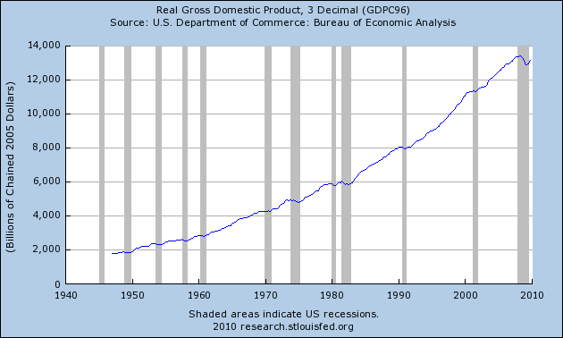
US GDP
Source: FRED.

Slide 43
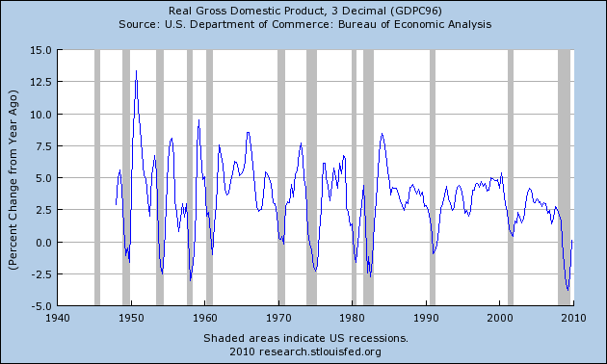
US GDP growth (YOY)
Source: FRED.

Slide 44
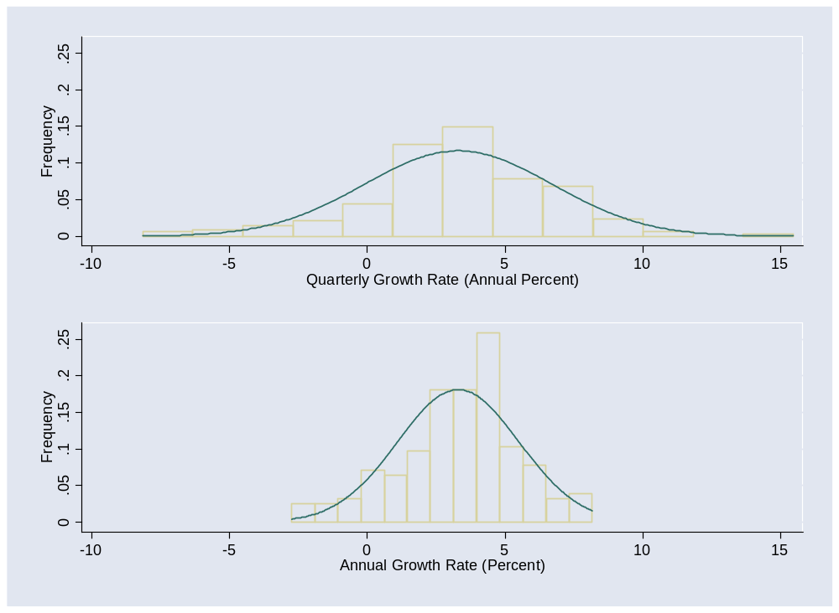
US GDP growth
Notes:
g = 3.5 +/- 7!

Slide 45
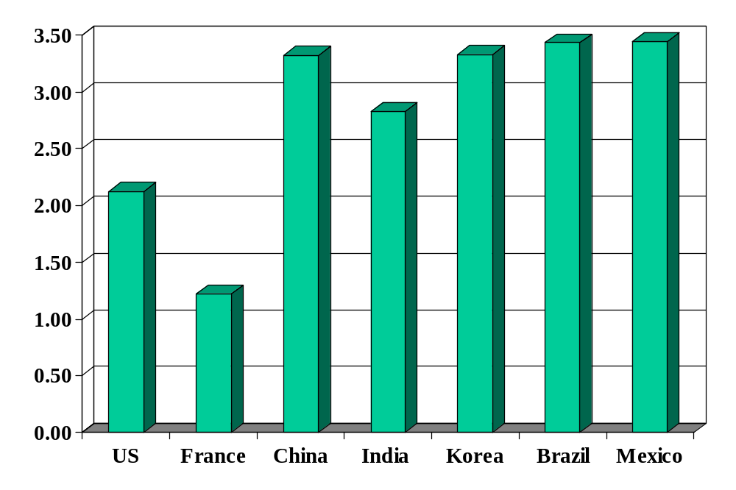
Volatility (std dev of annual growth rate %)
Source: World Bank, World Development Indicators, GDP per capita, 1975-2005.

Slide 46
Expenditure components of GDP
Which is more cyclical? Why?
  Toothpaste?
  Beer?
  Restaurant meals?
  Computer hardware?
  Furniture?
  New homes?

Slide 47
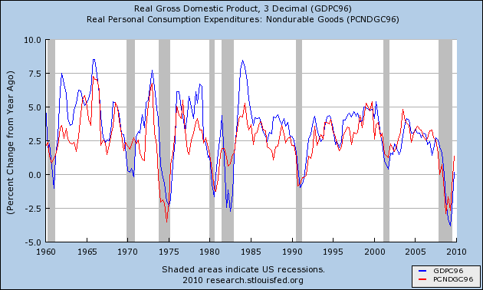
Consumption of nondurables
Source: FRED.

Slide 48
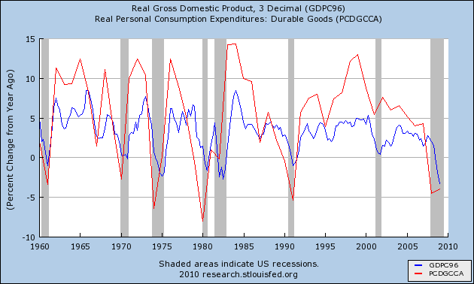
Consumption of durables
Source: FRED.

Slide 49
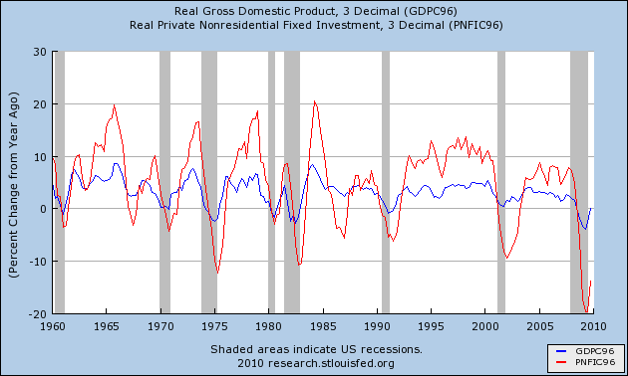
Investment (“producer durables”)
Source: FRED.

Slide 50
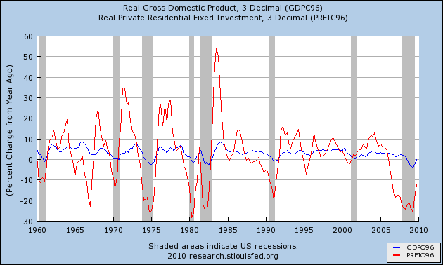
Investment (“housing”)
Source: FRED.

Slide 51
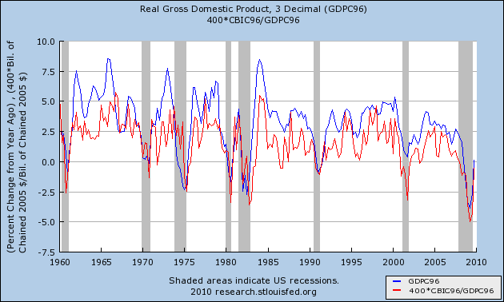
Change in inventories (ratio to GDP)
Source: FRED.

Slide 52
Mercedes-Benz USA
Indicators
  Which ones do you like?
  What do they indicate?
Production and sales targets for 2011?
Which segments look strongest?
Continue or eliminate financing offers?

Slide 53
Managing the business cycle
If you’re in a cyclical business, what would you do?
Notes:
Capital structure
Information feedback
Temp workers?

Slide 54
Where we’re headed
Current Conditions
Indicators
Theory: AS & AD
Monetary Policy
Statistical Analysis
Future Conditions

Slide 55
Next week
After the midterm
Morning: Tobias Levkovich, Chief US equity strategist, Citi
Afternoon: Dick Berner, Chief US economist, Morgan Stanley

Slide 56
Takeaways
GDP growth is volatile
Durable goods production is more volatile than nondurable goods
Businesses need to manage this source of risk
More coming…

