Slide 1

The Global Economy
Trade Theory
© NYU Stern School of Business
Notes:
Start quickly – full class
Note: students should argue – no need for unquestioned market religion
When we get to trade:
Samuelson: nontrivial result
Nobel laureate Paul Samuelson (1969) was once challenged by the mathematician Stanislaw Ulam to "name me one proposition in all of the social sciences which is both true and non-trivial." It was several years later than he thought of the correct response: comparative advantage. "That it is logically true need not be argued before a mathematician; that is is not trivial is attested by the thousands of important and intelligent men who have never been able to grasp the doctrine for themselves or to believe it after it was explained to them."
http://www.wto.org/english/res_e/reser_e/cadv_e.htm

Slide 2
Are markets moral?
Examples in which markets work well, poorly
Do markets contribute to global prosperity?
Are markets moral?

Slide 3
Video
Cato’s Sallie James
  What arguments does she make?
  Do you agree?
http://www.youtube.com/watch?v=J0twuU6aUj4

Slide 4
Are markets moral?

Slide 5
The idea
First half
  International trade, and markets in general, are win-win: both sides of a trade benefit, or (presumably) they wouldn’t do it. This is mathematical logic, not opinion, but remains controversial.
Second half
  A fact of life in international business situations is that locals use their knowledge and political connections to hamper foreign competitors.

Slide 6
Plan of attack
Are markets moral? ✓
The idea ✓
Where we’re headed
Picture and quotations
The logic of markets and trade
Ricardo’s model
Trade = Productivity?

Slide 7
Where we’re headed
GDP
Capital & Labor
Productivity
Political Process
“Institutions”

Slide 8
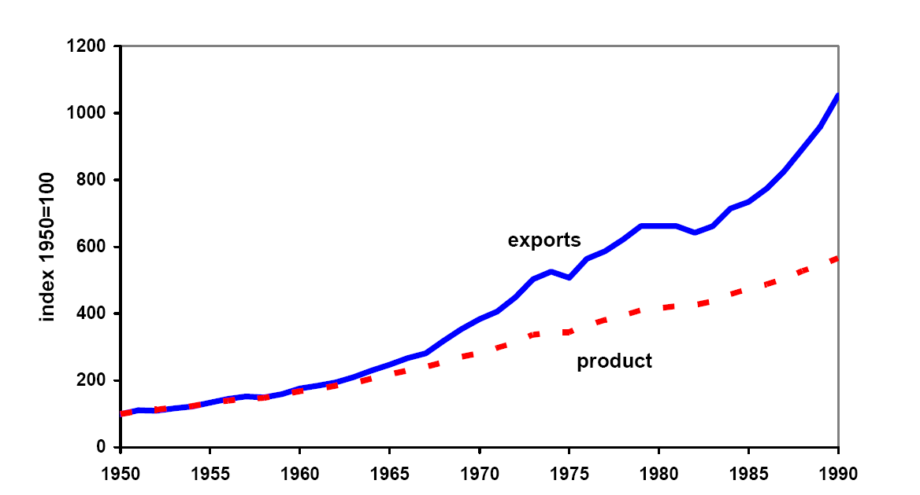
World trade and output since 1950
Source: Kehoe and Boergoing.
Notes:
What do you see here? Why?

Slide 9
Lou Dobbs
Television host and critic of “exporting jobs”
  The shipment of American jobs to cheap foreign labor markets threatens not only millions of workers and their families, but also the American way of life. Corporate raiders are breaking down our borders in search of the lowest-price labor available anywhere in the world. For the first time in history, corporations are laying off Americans from well-paying jobs and replacing them with low-paid foreign workers. … Corporate America isn’t doing all this alone: Big business and Washington are in cahoots, trading our nation’s livelihood for short-term gain.
Notes:
From blurb for his book, Exporting America.

Slide 10
Global Trade Watch
Anti-globalization group on NAFTA:
  The data are in and they clearly show the damage NAFTA has wrought for millions of people in the US, Mexico, and Canada. As we predicted: a race-to-the-bottom in wages, destruction of hundreds of thousands of good US jobs, undermining of democratic control of domestic policy-making, and threats to health, environmental and food safety standards. … Millions of campesinos throughout Mexico have lost a significant source of income and left their small corn farms.

Slide 11
Ernesto Zedillo
Former president of Mexico:
  Half of the world’s population lives on less than $2 a day. I say to you, with all conviction, that a vital part of the solution consists of promoting more globalization. More international trade, more investment flowing across countries, more knowledge diffused internationally among communities and individuals … will do much to defeat the evil of poverty during this new century.

Slide 12
Adam Smith
Wealth of Nations, 1776:
  All political writers since the time of Charles II had been prophesying “that in a few years we would be reduced to an absolute state of poverty” [by international trade], but “we find ourselves far richer than before.”
Notes:
http://www.econlib.org/library/Smith/smWN.html

Slide 13
Greg Mankiw
Reflections on trade policy, 2006:
  The prevailing view in the nation’s capital is precisely the view that Adam Smith campaigned against two centuries ago: exports are good because they create jobs, and imports are bad because they take jobs away from Americans. Economists understand that [this] has things almost exactly backwards: imports are good because they expand our consumption opportunities, and exports are the price we have to pay because foreigners want payment for the goods they sell us.

Slide 14
Winston Churchill
Free Trade Hall, Manchester, 1904
  Will the shutting out of foreign goods increase the total amount of wealth in this country? Can foreign nations grow rich at our expense by selling us goods under cost price? Can a people tax themselves into prosperity? Can a man stand in a bucket and lift himself up by the handle?

Slide 15
Dave Barry
Q: You are a large US car maker. You have been losing sales to Japanese producers, whose cars tend to be extremely well made. You should:
  Have Congress restrict Japanese imports
  Have Congress give you money
  Have Congress allow you to kidnap consumers’ children unless they buy your cars.
  Remind everyone about Pearl Harbor.
A: These are all pretty good.
Source: Dave Barry, Claw Your Way to the Top.

Slide 16
Reinhart
http://economix.blogs.nytimes.com/2011/02/18/how-convincing-is-the-case-for-free-trade/
Source: Dave Barry, Claw Your Way to the Top.

Slide 17
Take a breath
How should we think about international trade?
Is it different from other economic activity?

Slide 18
The logic of markets
Adam Smith, Wealth of Nations (1776)
  By pursuing his own interest, [an individual] is led by an invisible hand to promote the interest of the society more effectively than when he really intends to promote it.
  Logic: if two people voluntarily exchange products, it suggests both find it advantageous. It’s “win-win.” Economic activity is a positive sum game.

Slide 19
The logic of markets
First theorem of welfare economics
  Under certain conditions, competitive markets produce a good allocation of resources.
  This follows from mathematical logic, not opinion
What conditions?
  Clearly defined property rights
  Competitive buyers and sellers
What do we mean by a “good allocation”?
  No one can be made better off without someone else being made worse off (“pareto optimal”)

Slide 20
The logic of trade
Voluntary exchange is “win-win”
  Suppose two people or firms value a product or asset differently
  Trade can benefit both
  What price?
  Who benefits? Who loses?
Notes:
http://www.econlib.org/library/Smith/smWN.html

Slide 21
The logic of trade
Airlines, October 2001
  Too many planes, too little cash
General Electric
  Lots of cash, major player in plane leasing business
Solution: trade!
What price?
Who benefits? Who loses?

Slide 22
The logic of trade
Green Bay Packers, Summer 08
  Had 2 good quarterbacks
  Can only use one at a time
NY Jets
  No good quarterbacks
Solution: trade!
Who benefits? Who loses?

Slide 23
The logic of trade
Goldman Sachs, September 08
  Wanted cash
Berkshire Hathaway
  Lots of cash on hand, earning low returns
Solution: trade!
What price?
Who benefits? Who loses?

Slide 24
Ricardo’s model of trade
Why a model?
  Simpler than the real world
  Allows us to see exactly what’s going on
Ricardo’s insight (1817)
  Trade based on relative productivity
  Produce the good at which you’re relatively more productive, import the others
  Both countries benefit!
We’ll run through this quickly, but the notes go through the mechanics
Notes:
Talk about abstract logic

Slide 25
Ricardo: setup
Two countries (US, Mexico), two goods (apples, bananas), one input (labor)
  Our production function: Y = AL (no K)
Productivities A (output from one unit of labor):
 | Apples | Bananas | Labor
US | 20 | 10 | 100
Mexico | 5 | 5 | 100
Notes:
What would Americans say? Mexicans? Wages and productivity…

Slide 26
Ricardo: consumption possibilities

Slide 27
Ricardo: consumption possibilities
Mexico
Compare: TFP, trade
b
500
Shown for: q = p_{b}/p_{a} > 1
500
a
Notes:
Talk about this in class, show that opportunities expand with trade
For extra work: do the US case…
In a sense, we’re done…

Slide 28
Ricardo: details
We’ll compare free trade (no tariffs) with no trade (prohibitive tariffs = no international markets)
  Extreme, but makes the point
Utility is a composite of the two goods:
u(a,b) = a^{0.75} b^{0.25}
  Translation: consumers spend 75% of income on apples, 25% on bananas
Producers maximize profit
Competitive markets

Slide 29
Ricardo: numbers
 | Free Trade | No Trade
 | US
Price of apples (p_{a}) | 0.05 | 0.05 dollars
Price of bananas (p_{b}) | 0.0667 | 0.10 dollars
Consumption of apples (a) | 1500 | 1500
Consumption of bananas (b) | 375 | 250
Utility (u) | 1061 | 958
 | Mexico
Price of apples (p_{a}) | 0.05 | 0.2 pesos
Price of bananas (p_{b}) | 0.0667 | 0.2 pesos
Consumption of apples (a) | 500 | 375
Consumption of bananas (b) | 125 | 125
Utility (u) | 354 | 285
Notes:
Note change in relative prices:
No trade: US q = 2, Mex q = 1
Free trade: q = 4/3 in both cases (in between)
Pick a number and show where it comes from
Comment on shift in production
Contrast consumption baskets in Mexico (draw on previous diagram)

Slide 30
Ricardo: impact of trade
Consumption and utility up in both countries
Production changes
  US shifted to apples
  Mexico shifted to bananas
  No change in labor (“jobs”) by assumption
Trade shows up as increase in productivity
  Real GDP = consumption at world prices
  GDP rises in both countries
  Y = AL: rise in Y shows up as rise in A

Slide 31
Ricardo: summary
Mexican consumers are better off
  Consumption possibilities set is strictly larger
Mexican production is more efficient
  Shift production to bananas, at which it is relatively more productive than the US
Similar arguments for the US
  Both sides benefit

Slide 32
Trade and productivity
Free trade works like an increase in TFP
Are they the same?

Slide 33
Automobile TFP
Consider new technology for making cars:
  Technology breakthrough reduces labor requirement per car
  Thousands thrown out of work
Is this a good thing for the economy as a whole?

Slide 34
Automobile TFP
Consider new technology for making cars:
  We grow soybeans in Iowa
  Ship them to Japan, where they are “transformed” into cars
  Thousands thrown out of work
Is this a good thing for the economy as a whole?

Slide 35
After the break
Be prepared to discuss the “UPS” and “Dumping” mini-cases

Slide 36
The Global Economy
Trade Reality
© NYU Stern School of Business
Notes:
http://www.pbs.org/wgbh/commandingheights/lo/story/ch_menu_03.html
NAFTA
3:50?

Slide 37
Chinese dumping
What is “dumping”?
How could dumping suits affect your business?
What should you do?

Slide 38
Chinese dumping
US firms file dumping suit against Chinese producers
  Legitimate complaint or strategic attack on competitors?
US industry divided
  Retailers fight suit, favor low prices
Chinese firms hire US lawyers
  They’re the winners! (the lawyers, that is)
Some producers head elsewhere
  Vietnam, Brazil, etc
  Not to US!

Slide 39
UPS in Mexico
What are Dadoo’s problems?
How do they affect his costs?
What should he do?

Slide 40
UPS in Mexico
UPS enters Mexico to take part in NAFTA boom
Mexicans protect local truckers
UPS asks US government for help
US drags feet when Teamsters protest Mexican truckers entering US
Mexico drags its feet in return
>15 years later little has changed

Slide 41
Plan of attack
Chinese dumping ✓
UPS in Mexico ✓
Trade and wages
Fallacies
What have we learned?

Slide 42
Trade and wages
Can US workers compete with cheaper Mexican workers? [Or Chinese, Indian, …]
Can Mexican workers compete with more productive Americans? [Or German, Japanese, …]

Slide 43
Trade and wages in Ricardo’s model
In the “free trade” equilibrium
  Why are Mexican wages lower?
  What if Mexican wages increased?
US wage (w₁) | 1
Mexican wage (w₂) | 1/3
Apple price (p_{a}) | 0.05
Banana price (p_{b}) | 0.0667

Slide 44
Fallacies
Use our numerical example and your own insight
It’s ok to disagree

Slide 45
Fallacy #1
Trade costs us jobs
Why a fallacy?
  Trade is about what the jobs are, not how many
  What they’re really saying: “I lost my job, and I’m mad”
  In most countries, trade is a small factor in job creation and destruction [in US, replace “small” with “tiny”]

Slide 46
Fallacy #2
Our tariffs are good for us
Why a fallacy?
  Higher prices for consumers
  Inefficient production
  Note: true even if other countries have tariffs

Slide 47
Argentina in the 1930s
Export-oriented agriculture
  Wheat
  Beef (refrigerated and canned)
  Major markets: US and UK
During the Depression, both the US and UK raised tariffs on Argentine beef to protect their own farmers
Argentina responded with its own protection of manufactures
First step in 60-year decline in performance
Notes:
Argentina: think Canada in the Southern hemisphere
This isn’t all due to trade!

Slide 48
Voluntary export restraints
In 1980s, US “persuaded” Japanese carmakers to limit exports to US
Similar to a tariff, but
  “Voluntary” (hence ok with trade law)
  US got no revenue (Japanese carmakers did)
Limits on numbers benefited Japanese:
  Reduced competition among them in US (profits up)
  Instigated increase in quality
What were we thinking of?

Slide 49
Fallacy #3
We should subsidize local producers to help them compete with foreign producers
Why a fallacy?
  Costs us money
  Encourages inefficient production

Slide 50
Agriculture
Farmers are subsidized in all developed countries:
Country | Subsidy per Farmer
Norway | $33,000
Switzerland | $32,000
Japan | $26,000
US | $21,000
EU | $17,000
Plus: health and safety regulations keep out imports
Local milk in Norway?
Notes:
Data: The Economist, “From bad to worse,” May 5, 2001

Slide 51
Brazil v US
Brazil filed suit against US cotton subsidies
  US agreed to $1.6b cap on subsidies in 1995
  Current subsidies >$2b
  WTO ruled in 2004 that these subsidies violate trade rules
  Resolution still pending
If Brazil wins
  Is this good for Brazil?
  Bad for the US?

Slide 52
Fallacy #4
Free trade creates trade deficits
Why a fallacy?
  My deficit is someone else’s surplus: can’t cause deficits for everyone
  Trade deficits are about international financial flows [more later]

Slide 53
Fallacy #5
Outsourcing costs us jobs
Why a fallacy?
  It’s an issue of which jobs, not how many.
  Countries should do jobs at which they have comparative advantage
  Krugman’s example
Notes:
Goldman Sachs: you hire the Indian, or they do.

Slide 54
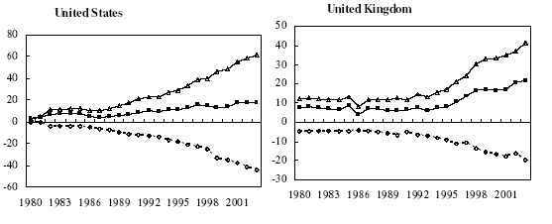
Outsourcing: business services
Billions of dollars: Δ = in, o = out, ■ = net

Slide 55
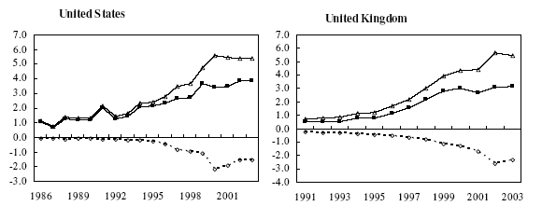
Outsourcing: IT services
Billions of dollars: Δ = in, o = out, ■ = net
Source: Amiti and Wei, NBER 10808.

Slide 56
Fallacy #6
High wages hurt competitiveness
Why a fallacy?
  Competitiveness depends on relation between wage and productivity
  If wages reflect productivity, a sign of competitive strength

Slide 57
Why protection?
High-performance “institutions” include
  Rule of law
  Property rights
  Open, honest competitive markets
What political process leads to good institutions?
  Democratic leaders often protect supporters from competition
  Dictators often protect friends
Trade adds:
  Protect us from “unfair” foreign competition (remember: foreigners don’t vote)

Slide 58
What have we learned?

Slide 59
Takeaways
Globalization is a fact of life
I believe there is clear logic for markets and trade
  Consumers benefit from lower prices
  Production more efficient
Political opposition also a fact
Trade reality
  International business remains a challenge

Slide 60
What’s coming up
We’ve finished “long-run country performance”
Midterm in 2 weeks (practice exams posted)
Review next week + start of next module
Group Project #4 reviews labor markets and trade

Slide 61
Extra slides

Slide 62
Bill Gross
PIMCO’s Investment Outlook, Nov 04:
  It’s really quite simple you know. Asia has hollowed out our manufacturing base and is now making inroads into services. … We can’t really educate or innovate ourselves out of this. 250 million Americans sitting around thinking up ways for the rest of the world to support us is not my idea of a real world outcome.

Slide 63
Was NAFTA good for Mexico?
Mexican auto manufacturing is booming
  Many old factories shut down, new ones opened aimed at full North American market
Mexican garment manufacturing booming
  Clothes made with US cloth, shipped back to US
  Rules of origin work against Asian textiles
Mexican corn farmers wiped out
  Corn is US comparative advantage
  Many small farmers displaced

Slide 64
The logic of international trade
Adam Smith, Wealth of Nations
  What is prudence in the conduct of every private family, can scarce be folly in that of a great kingdom. If a foreign country can supply us with a commodity cheaper than we ourselves can make it, better buy it of them with some part of the produce of our own industry, employed in a way in which we have some advantage. The general industry of the country, being always in proportion to the capital which employs it, will not therby be diminished... but only left to find out the way in which it can be employed with the greatest advantage.
Notes:
http://www.wto.org/english/res_e/reser_e/cadv_e.htm

Slide 65
The logic of international trade
Paul Samuelson, when asked for an example of a proposition from the social sciences that was true but not trivial, mentioned comparative advantage:
  That it is logically true need not be argued before a mathematician; that it is not trivial is attested by the thousands of important and intelligent men who have never been able to grasp the doctrine for themselves or to believe it after it was explained to them.
Notes:
http://www.wto.org/english/res_e/reser_e/cadv_e.htm

Slide 66
Ricardo revisited
Two countries (US, Mexico), two goods (apples, bananas), one input (labor)
  Our production function: Y = AL (no K)
Productivities A (output from one unit of labor):
 | Apples | Bananas | Labor
US (country 1) | α₁ = 20 | β₁ = 10 | 100
Mexico (country 2) | α₂ = 5 | β₂ = 5 | 100

Slide 67
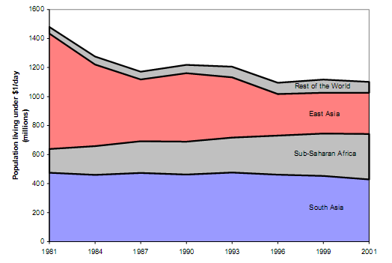
Global poverty
Source: World Bank, How Have the World's Poorest Fared Since the Early 1980s?
Notes:
How many believe it?

Slide 68
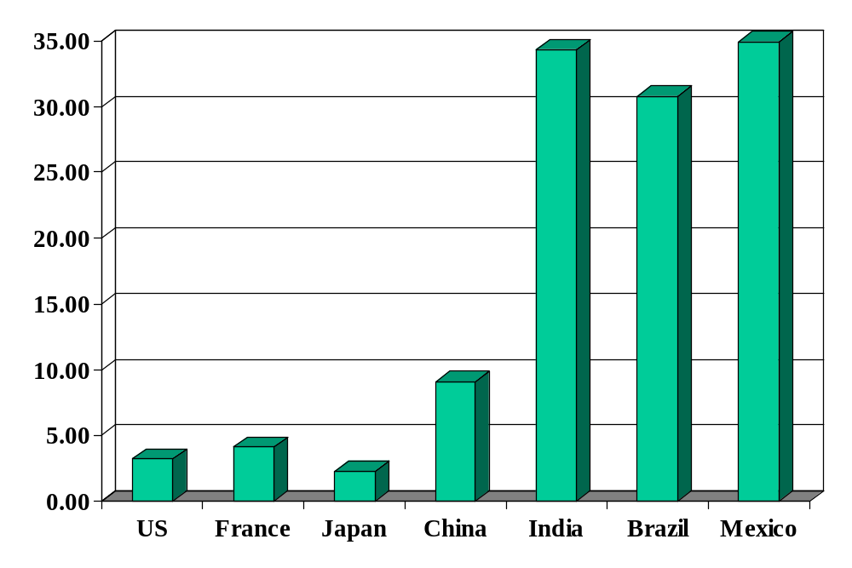
Average tariffs (non-agriculture)
Source: World Trade Organization, World Trade Report, 2004.

