Slide 1
INFLATION HALL of FAME
Subtitle: Clearly Turks, Argentineans and Brazilians were wimps when it came to printing money.
Prof. Yeltekin

Slide 2
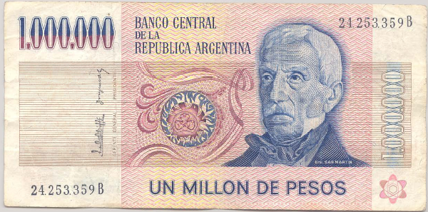
Argentine currency
This note dates from 1980s. What’s it worth now?
Prof. Yeltekin

Slide 3
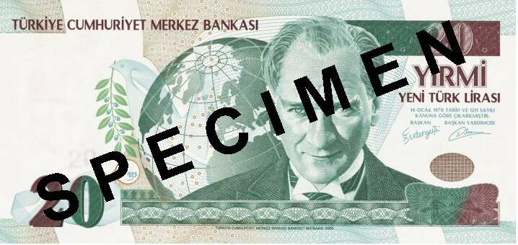
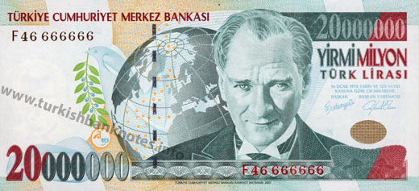
Turkish Currency (i.e. the conversion rate between my mother’s prices and my prices)
After 2008
Before 2008
Prof. Yeltekin

Slide 4
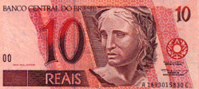
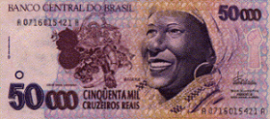
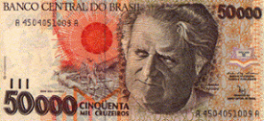
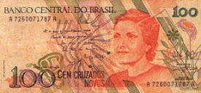
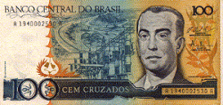
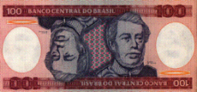
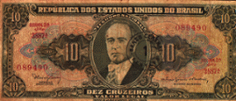
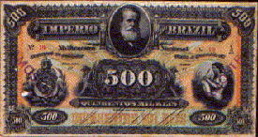
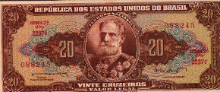
Brazilian currencies
REAL, Jun 1994 – present
CRUZEIRO REAL, Aug 1993 - Jun 1994
CRUZEIRO, Mar 1990 – Aug 1993
CRUZADO, Feb 1986 – Jan 1989
CRUZADO NOVO, Jan 1989 – Mar 1990
CRUZEIRO, May 1970 – Feb 1986
CRUZEIRO NOVO, Feb 1967 – May 1970
MIL-RÉIS, Oct 1833 – Oct 1942
CRUZEIRO, Oct 1942 – Feb 1967
Prof. Yeltekin

Slide 5
Inflation in Argentina (annual %)
Source: EIU database.
Prof. Yeltekin

Slide 6
Inflation in Brazil (annual %)
Source: EIU database.
Prof. Yeltekin

Slide 7
Inflation in Russia (annual %)
Source: EIU database.
Prof. Yeltekin

Slide 8
Israel in the 1980s
American Rabbi visiting Israel:
  During Israel’s hyperinflation of the early 1980s, the name of the game was to part with currency as quickly as possible. I invested some money with an Israeli mortgage bank, which gave me the option of receiving at a later date a secondary mortgage at a 5% fixed annual interest rate. When my wife and I purchased a condominium in 1981, interest rates on mortgages were 39%, a very high rate one might think. We took the secondary mortgage. Fixed rate mortgage payments became laughably easy to make as inflation shot up to 800% a year, because salaries more or less kept pace with inflation, a typical phenomenon in high inflation economies. The coup de grace came when I received a notice canceling my mortgage, because the cost of record-keeping had become more costly than the value of our monthly payment.
Prof. Yeltekin

Slide 9
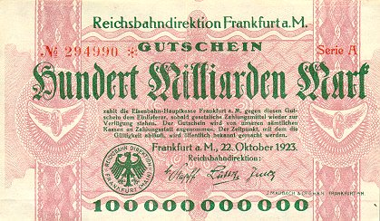
German currency
October 1923: 20 USD = 1 billion DM
Prof. Yeltekin
Notes:
http://www.zum.de/whkmla/region/germany/turm2023.html

Slide 10
And the small print says…
“pays the Eisenbahn-Hauptkasse (Railroad bank) Frankfurt am Main to the owner of this certificate, as soon as lawful means of payment (currency/instruments of payment) are available again. The certificate will be accepted by all our cashiers in place of/as payment. The date of expiration will be announced publicly.”
Actual translation: Hang onto this worthless piece of about-to-expire paper until we give you something better if possible. Don’t hold your breath though.
Prof. Yeltekin

Slide 11
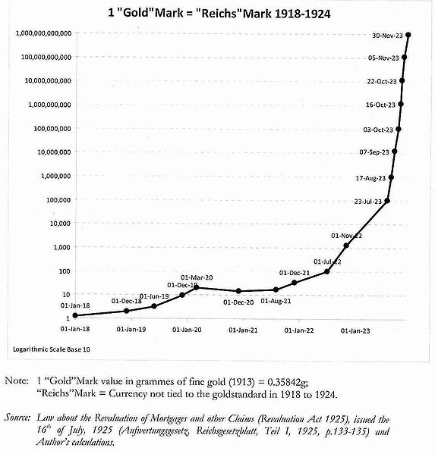
Ouch.
Prof. Yeltekin

Slide 12
The silver medal goes to..
Zimbabwe
  Inflation peaked at an annual rate of 89.7 sextillion percent (89,700,000,000,000,000,000,000%) in mid-November 2008.
  The peak monthly rate was 79.6 billion percent. At that rate, prices were doubling every 24.7 hours.
  Zimbabwe abandoned its own currency in 2009. No LCU anymore, only foreign currency is used.
  The more important question is: How did Mugabe survive this mess?
Prof. Yeltekin

Slide 13
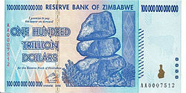
Zimbabwe
Guess how much this was worth!
Prof. Yeltekin

Slide 14
And the gold medal goes to……
HUNGARY (1946)
  Monthly inflation rate 4.19 × 10¹⁶ %
  Daily inflation rate 207.19%
  It took 15 hours for prices to double.
Prof. Yeltekin

Slide 15
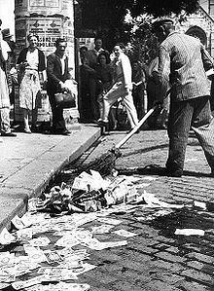
The pengo finds it rightful place…
In the trash!
Prof. Yeltekin

Slide 16
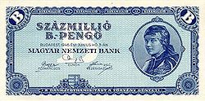
Hungary, you deserve a medal for ingenuity
No numbers! B-pengo! Equal to 10²⁰ or 100 quintillion Hungarian pengő
Prof. Yeltekin

Slide 17
Takeaway
Clearly the Hungarians and Zimbabweans had the best and fastest printers. And they were not wimpy with those printers.
The first person to tell me the number of zeros in quintillion and octillion gets an A+.
Prof. Yeltekin

