Slide 1

The Global Economy Business Cycle Properties

Slide 2
The idea
Economic growth is volatile
We’re not sure why, but we did come up with a name: business cycles

Slide 3
Roadmap
In the news
Business cycles
Volatility
Mercedes-Benz USA
Business cycle properties (some things are more “cyclical” than others)
What’s more cyclical?

Slide 4
In the news
“Kazakhstan spoof anthem played,” AP, March 23, 2012:
At the Arab shooting championships in Kuwait yesterday, the organizers played the anthem from “Borat” in place of the real one. Apparently they downloaded anthems from the internet and got the wrong one.

Slide 5
In the news
“China's $22 trillion time-bomb,” Business Standard, March 2, 2012, via Neel Sheth:
China's growth model is based on the oldest rapid economic growth hormone available: debt.
What’s the idea? Serious problem or not?

Slide 6
In the news
Robert Mellman, JP Morgan Chase, March 16, 2012
Our forecast still looks for GDP growth to average 2% (SAAR) in the first half of the year, with 1.5% this quarter and 2.5% next quarter. This week’s reports on retail sales and inventories came in stronger than expected, and tilt the risk to the upside.
What is he talking about? Good news or bad?

Slide 7
In the news
Neil Shah, “Vital signs,” WSJ RealTime Economics, March 22, 2012
Builders broke ground on fewer homes in February than in January, but overall housing starts are on the rise. January’s rate was revised up to 706,000 — the best reading since October 2008. Permits for new construction climbed to their highest level since October 2008.
What is he talking about? Good news or bad?

Slide 8
In the news
Jon Hilsenrath, WSJ, March 22, 2012
Charles Evans, president of the Chicago Fed, called for a stronger commitment to low interest rates.
What is he talking about? Do you agree?

Slide 9
Business cycles

Slide 10
Business cycles: what are they?
Burns and Mitchell
Fluctuations in aggregate economic activity. Expansions occur in many economic activities, followed by similarly general recessions, which merge into the next “cycle.”
That is: short-term fluctuations in growth rates

Slide 11
Business cycles: terminology
peak
trough
expansion
recession/ contraction
11 months
59 months

Slide 12
US business cycle duration in months
Period | Contraction | Expansion | Total
1854-2009 (33 cycles) | 16 | 42 | 56
1854-1919 (16 cycles) | 22 | 27 | 48
1919-45 (6 cycles) | 18 | 35 | 53
1945-2009 (11 cycles) | 11 | 59 | 73
Great Recession (2007-09) | 18 | 73 | 91

Slide 13
Great Depression still great
 | How Long? | How Deep?
 | Duration | Real GDP | Ind. Prod | Emp.
Great Depression (1933) | 43 | ₋33% | ₋53% | ₋32%
Major depressions (1921, 1938) | 16 | -13 | -32 | -11
Sharp recessions (1924, 1949, 1954, 1958, 1975, 1982) | 13 | -3 | -12 | -4
Mild recessions (1927, 1945, 1961, 1970, 1980, 1991, 2001) | 9 | -2 | -7 | -2
Great Recession (2009) | 18 | -5 | -15 | -5
Sources: BEA, BLS, Citi, FRB, and Geoffrey Moore.

Slide 14
Business cycles: who cares?
Finance
Fixed income
Currencies
Asset management
Equities, esp emerging markets
Media and marketing
Not a focus, but they’re unusually cyclical businesses
Everyone else
Fact of life you’ll have to deal with

Slide 15
Volatility

Slide 16
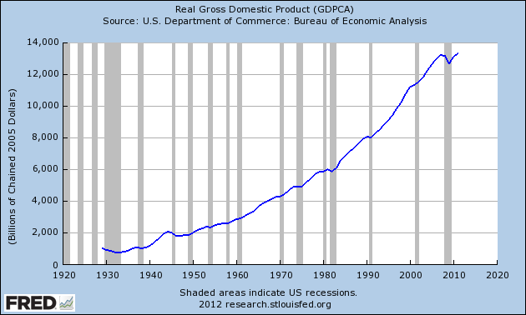
US GDP

Slide 17
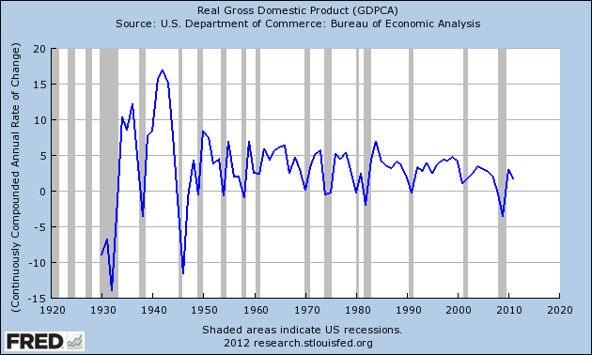
US GDP annual growth

Slide 18
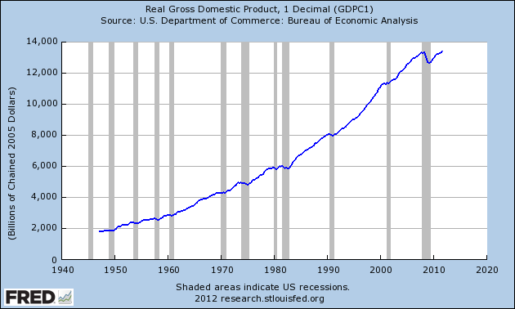
US GDP

Slide 19
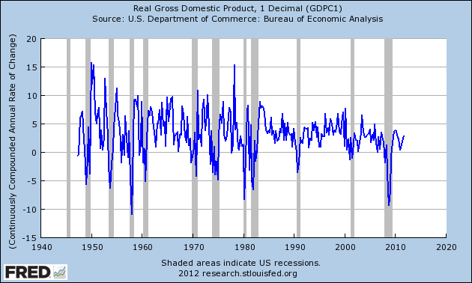
US GDP quarterly growth

Slide 20
Mean annual GDP growth, 1980-2011
Source: EIU CountryData

Slide 21
Std dev annual GDP growth, 1980-2011
Source: EIU CountryData

Slide 22
Mercedes-Benz USA

Slide 23
Mercedes-Benz USA
How should they respond to expansions? Contractions?
What aspects of their business are important?
How do conditions look now?

Slide 24
Business cycle properties

Slide 25
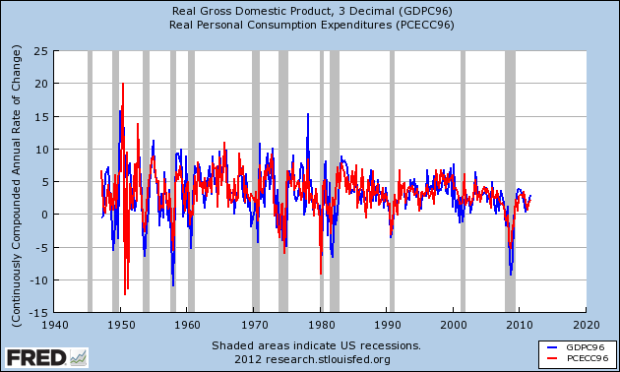
Consumption

Slide 26
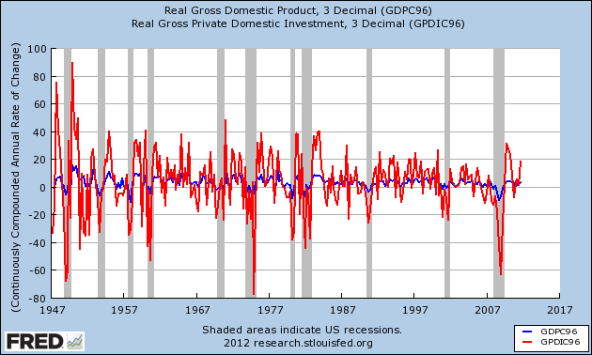
Private investment

Slide 27
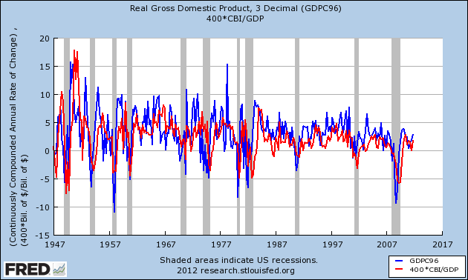
Change in inventories

Slide 28
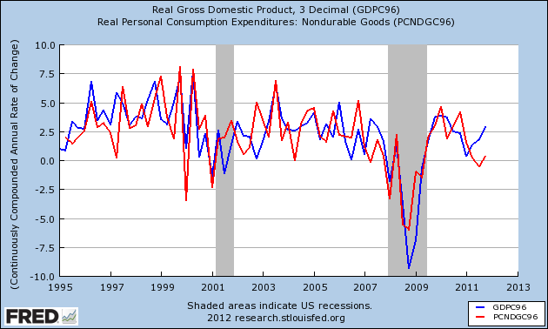
Consumption: nondurable goods

Slide 29
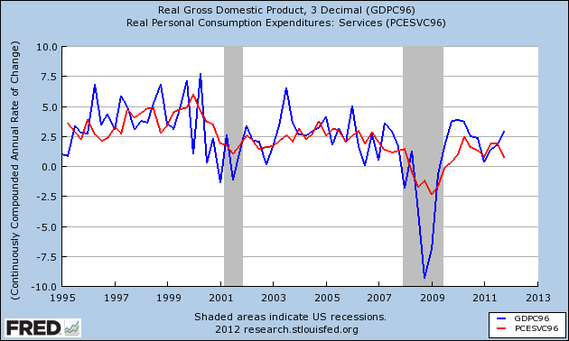
Consumption: services

Slide 30
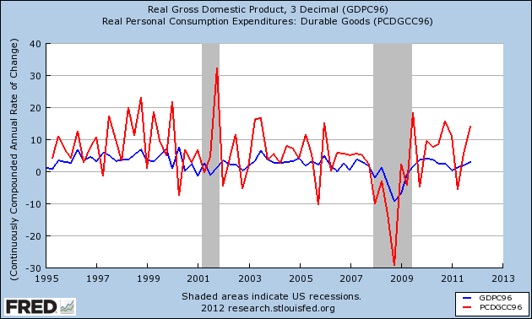
Consumption: durable goods

Slide 31
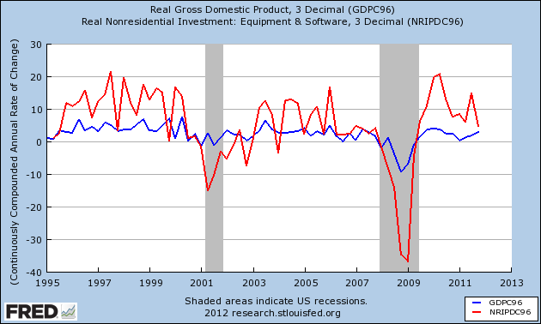
Investment: equipment & software

Slide 32
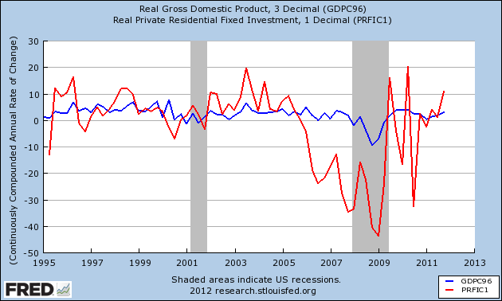
Investment: housing

Slide 33
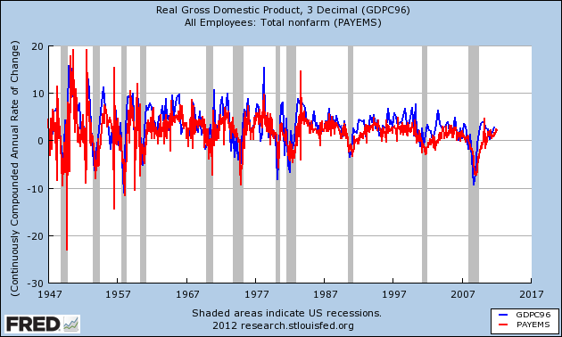
Employment

Slide 34
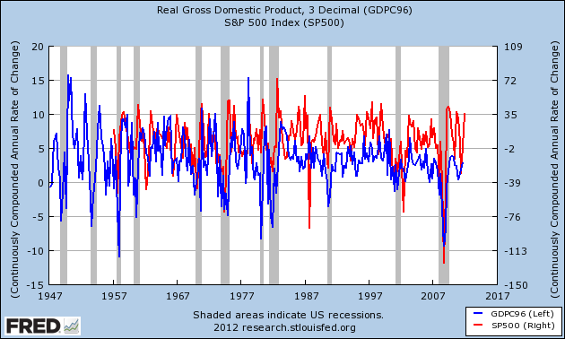
S&P 500

Slide 35
What’s more cyclical?

Slide 36
What’s more cyclical?
General Motors
Proctor & Gamble
Pfizer
Johnson & Johnson

Slide 37
What’s more cyclical?
Walmart
Richemont
New York Times
Google
American Airlines
McKinsey

Slide 38
What have we learned?
Economic growth is volatile
Lots of things move up and down together
[Like what?]
Some of them move more than others
[Which ones?]

Slide 39
For the ride home
The economy
How does it look to you?
How would you get a clearer picture?

