Slide 1

The Global Economy Government Debt & Deficits

Slide 2
The idea
Governments issue debt when spending exceeds revenue. When they issue too much debt, investors bail out, possibly triggering a crisis.
Open question: how much is “too much”?

Slide 3
Roadmap
Macroeconomic crises
Words and pictures
Debt arithmetic
Debt dynamics
What’s missing?
Is the US in trouble?

Slide 4
Macroeconomic crises

Slide 5
Macroeconomic crises
New module
The classic crisis triggers
Sovereign debt (“debt crisis”)
Financial fragility (“financial crisis”)
Fixed exchange rates (“exchange rate crisis”)
What was/is the trigger in
The US in 2008?
Mexico in 1994?
Europe today? (Greece, Ireland, Spain, …)

Slide 6
Words & pictures

Slide 7
Words
Alexander Hamilton, Second Report on Public Credit, 1795
Every system of Public Credit must assume as a fundamental principle the ability to pay the debt which it contracts. With the creation of debt should be incorporated the means of extinguishment.
What is he saying? Do you agree?

Slide 8
Words
Angela Merkel, Financial Times, March 2009
The German chancellor warns world leaders against pumping too much money into reviving global growth, saying such action would create and “unsustainable” recovery. She rejected calls to spend more public money in Germany as part of a coordinated stimulus program.
What is she saying? Do you agree?

Slide 9
Words
Thomas Sargent, October 2011:
Here’s a phrase that you hear. You hear that US fiscal policy is unsustainable. You hear it from both parties. What they mean is that certain promises people have made -- taxes, entitlements, medicare, medicaid -- those are incredible, they’re not going to fit together. So US fiscal policy is very uncertain. It’s uncertain because it’s not clear which of these incredible promises is going to be broken first.
What is he saying? Do you agree?

Slide 10
Government deficits (2011, % of GDP)
Source: EIU CountryData.

Slide 11
Government debt (2000, 2011, % of GDP)
Source: EIU CountryData.

Slide 12
Debt arithmetic

Slide 13
Government budget: Principle #1
Principle #1 of fiscal policy
Government spending must be financed with tax revenue, either now or in the future

Slide 14
Government budget: ingredients
Government spending in year t
G_{t} + V_{t} + i_{t}B_{t-1}
G = government purchases of goods and services
V = government spending on transfers
i = interest rate on debt B
Government tax revenue in year t
T_{t}
Government debt at end of year t-1, start of year t
B_{t-1}

Slide 15
Government budget
Budget (cash flow out = cash flow in)
G_{t} + V_{t} + i_{t}B_{t-1} = T_{t} + B_{t} − B_{t-1}
Spending = Tax Revenue + Change in Debt
Government deficit
( G_{t} + V_{t} + i_{t} B_{t-1} ) − T_{t}
Primary deficit (excl interest)
D_{t} = (G_{t} + V_{t} ) − T_{t}
(replace three symbols with one)

Slide 16
Government budget: US, 2011, $b
Revenue |  | 4,120
 | Tax revenue | 3,230
 | Social insurance contributions | 931
Expenses |  | 5,410
 | Goods, services, and employee comp | 2,611
 | Transfer payments | 2,371
 | Interest on debt | 428
Surplus |  | −1,249
For reference: GDP = 15,094
Source: BEA, Table 3.1, aggregated.

Slide 17
Government budget
Reminder
G_{t} + V_{t} + i_{t}B_{t-1} = T_{t} + B_{t} − B_{t-1}
Spending = Tax Revenue + Change in Debt
How can spending be financed?
Tax revenue
Debt [but is there a limit?]

Slide 18
Government budget arithmetic
Primary deficit (excl interest)
D_{t} = (G_{t} + V_{t} ) − T_{t}
Budget becomes
G_{t} + V_{t} + i_{t}B_{t-1} = T_{t} + B_{t} − B_{t-1}
D_{t} + i_{t}B_{t-1} = B_{t} − B_{t-1}
The point: this is how debt is connected to deficits
Past debt incurs interest expense
Current deficits lead to increases in debt

Slide 19
Government budget arithmetic
Looking back in time
Where does debt come from?
D_{t} + i_{t} B_{t-1} = B_{t} − B_{t-1}
B_{t} = D_{t} + (1+i_{t}) B_{t-1}
= D_{t} + (1+i_{t}) D_{t-1} + B_{t-2}
Answer: debt = past primary deficits plus interest

Slide 20
Government budget arithmetic
Looking forward in time
Where does debt lead? [kill t on i_{t} for simplicity]
D_{t} + iB_{t-1} = B_{t} − B_{t-1}
B_{t-1} = − D_{t}/(1+i) + B_{t-1}/(1+i)
= − D_{t}/(1+i) − D_{t+1}/(1+i)² + B_{t+2} /(1+i)²
Answer: debt = present value of future primary surpluses
Debt today is a promise to run surpluses in the future

Slide 21
Government budget: Principle #1
Principle #1 of fiscal policy
Government spending must be financed with tax revenue, either now or in the future
That’s what the arithmetic says

Slide 22
Debt dynamics

Slide 23
Debt dynamics
What makes ratio of debt B to GDP Y change over time?
Both numerator and denominator can change
Two ways to reduce B/Y
Decrease debt
Increase output
Here’s how that works …

Slide 24
Debt dynamics
We usually look at debt and deficits as ratios to GDP
How do they change over time?
Growth of (nominal) debt
[1] B_{t} = (1+i) B_{t-1} + D_{t}
= (1+r+π) B_{t-1} + D_{t}
Growth of (nominal) GDP
[2] Y_{t} = (1+g+π) Y_{t-1}
Both numerator and denominator of B/Y change

Slide 25
Debt dynamics
Reminder:
[1] B_{t} = (1+r+π) B_{t-1} + D_{t}
[2] Y_{t} = (1+g+π) Y_{t-1}
Summary
B_{t}/Y_{t} = [(1+r+π)/(1+g+π)] B_{t-1}/Y_{t-1} + D_{t}/Y_{t}
≈ (1+r−g) B_{t-1}/Y_{t-1} + D_{t}/Y_{t}
≈ B_{t-1}/Y_{t-1} + r B_{t-1}/Y_{t-1} − g B_{t-1}/Y_{t-1} + D_{t}/Y_{t}
Δ(B_{t}/Y_{t}) = r B_{t-1}/Y_{t-1} − g B_{t-1}/Y_{t-1} + D_{t}/Y_{t}

Slide 26
Debt dynamics
Ok, what are we left with?
Δ(B_{t}/Y_{t}) = r B_{t-1}/Y_{t-1} − g B_{t-1}/Y_{t-1} + D_{t}/Y_{t}
(A) (B) (C)
(A): interest on debt
(B): growth in the economy
(C): (primary) deficit

Slide 27
Debt dynamics in Brazil
Primary deficit (% GDP) | −2.9
Interest on debt (%) | 5.4
Interest rate (money market, %) | 9.4
Inflation rate (%) | 5.5
Real GDP growth rate (%) | 3.3
Public debt (% GDP, 2010 year end) | 53.2
Is B/Y going up or down? Why?
Source: EIU, Country Report.

Slide 28
Debt dynamics in Ireland
Debt
Primary Deficit
Source: EIU, Country Report.

Slide 29
Debt dynamics in Ireland
Primary deficit (% GDP) | 7.0
Interest on debt (%) | 2.1
Interest rate (money market, %) | 1.1
Inflation rate (%) | 1.1
Real GDP growth rate (%) | −1.0
Public debt (% GDP, 2010 year end) | 105.4
Is B/Y going up or down? Why?
Source: EIU, Country Report.

Slide 30
??Save one for in-class practice
Primary deficit (% GDP) | 7.0
Interest on debt (%) | 2.1
Interest rate (money market, %) | 1.1
Inflation rate (%) | 1.1
Real GDP growth rate (%) | −1.0
Public debt (% GDP, 2010 year end) | 105.4
Is B/Y going up or down? Why?
Source: EIU, Country Report.

Slide 31
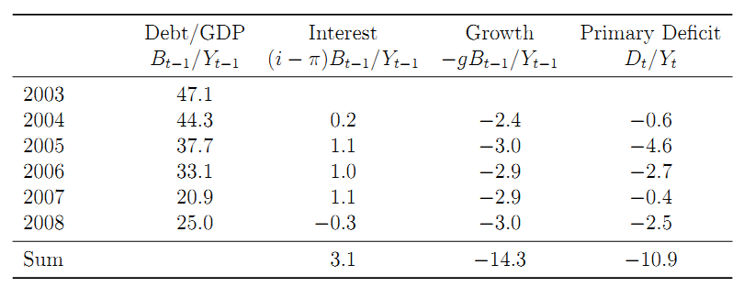
What happened to Peru’s debt?
Debt-to-GDP fell from 47.1% to 25.0%
Why?

Slide 32
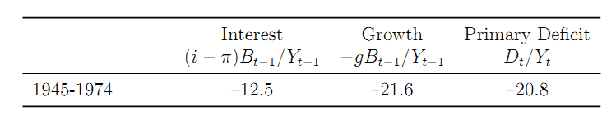
What happened to US WW II debt?
Debt-to-GDP fell from 66% in 1945 to 11% in 1974
Why?
Source: Hall and Sargent.

Slide 33
What’s missing?

Slide 34
What’s missing?
The impact of growth on tax revenue
GDP growth
Affects B/Y directly
Also raises tax revenue, reduces primary deficit
The best cure for debt problems (and reverse)
Examples?

Slide 35
What’s missing?
The impact of debt in the interest rate
Interest rate can rise sharply if investors become concerned with repayment
Direct impact on changes in debt through r = i – π
When does it happen?
Examples?

Slide 36
What’s missing?
Hidden liabilities
Like what?
Unfunded pensions
Financial bailouts
Implicit guarantees of business or regional governments
Examples?

Slide 37
What’s missing?
Maturity of debt
Short debt needs to be rolled over
Interest rate could rise quickly
Or you could be shut out of markets altogether
Examples?

Slide 38
Is the US in trouble?

Slide 39
Is the US in trouble
Large current deficits
Growing debt
Significant increases in future spending in the pipeline
Blinder and Hubbard, Wash Post, Sept 19, 2011
The (total) deficit is forecast by the CBO to reach 15.5% of GDP by 2035. By then, the national debt would be 187% of GDP. The main culprit is increased health care spending, which CBO projects to rise from 5.6% of GDP now to 10.4% by 2035.

Slide 40
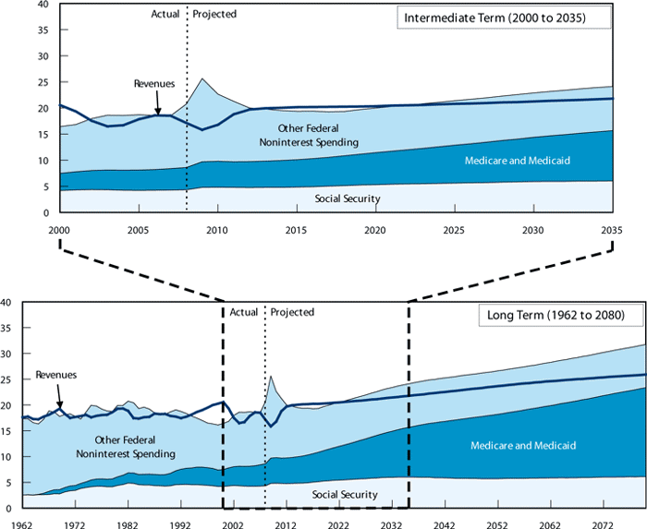
US government expenses & revenues
Source: CBO.

Slide 41
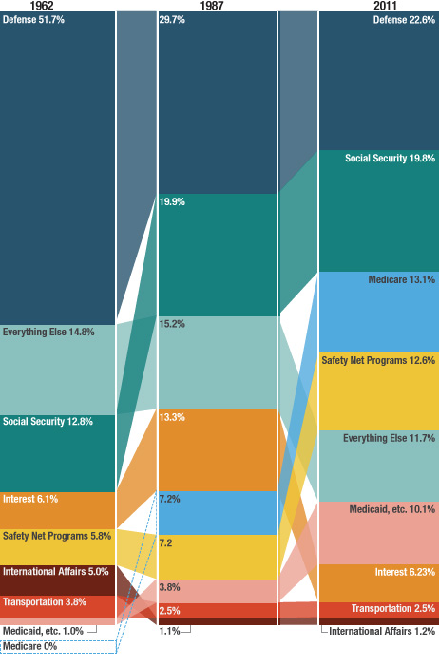
US government expenses (NPR)
Source: CBO.

Slide 42
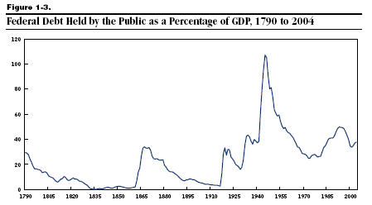
US government debt
Source: CBO.

Slide 43
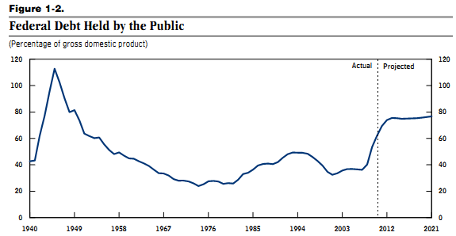
US government debt
Source: CBO.

Slide 44
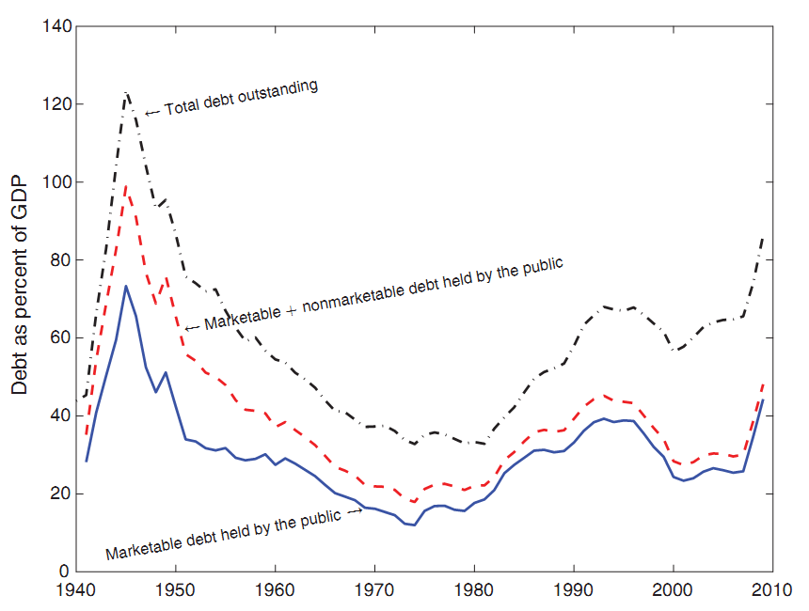
US government debt
Source: Hall and Sargent.

Slide 45
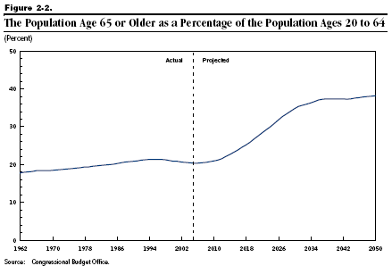
Demographics

Slide 46
Social Security outlays and receipts
Scheduled Outlays
Scheduled Receipts
Feasible Outlays
Trust Fund Growing
Trust Fund Shrinking

Slide 47
Social Security “fixes”
Solutions
Increase the payroll tax – or other taxes
Reduce benefits
Raise retirement age
Reduce cost-of-living adjustments
Congressional Budget Office analysis (2010)
http://www.cbo.gov/doc.cfm?index=11580

Slide 48
Medicare and Medicaid
Medicare: age 65 and older
Parts A&B cover hospital and physician care
Part D (2006) covers drugs
Funded by payroll tax and general revenues
Medicaid: poor (joint state-federal program)
Federal government share about 57%
States set rules subject to federal approval

Slide 49
Medicare and Medicaid
Medicaid
Medicare
Source: CBO, http://www.cbo.gov/ftpdocs/87xx/doc8758/11-13-LT-Health.pdf

Slide 50
Medicare and Medicaid
Ageing population
Healthcare spending per insured rising faster than GDP
Holding fixed demographics and spending
Source: CBO, http://www.cbo.gov/ftpdocs/87xx/doc8758/11-13-LT-Health.pdf

Slide 51
Medicare and Medicaid
All other medical spending
Medicaid
Medicare
source: http://www.cbo.gov/ftpdocs/87xx/doc8758/11-13-LT-Health.pdf

Slide 52
Medicare and Medicaid “fixes”
Health care system as a whole is a mess
What can be done for Medicare and Medicaid?
Spending needs to be paid for
Either raise taxes: by a lot!
Or reduce benefits: but how?
The central budget issue of our time

Slide 53
What have we learned?
Government budgets: deficits are financed by
By issuing debt today
And running (primary) surpluses in the future
Signs of trouble
Too much debt
Continuing deficits
Weak political system
US faces questions about future healthcare spending

Slide 54
The Global Economy Foreign Exchange

Slide 55
The ideas
Exchange rates are …
Relative prices of currencies [dollar price of one euro]
Source of variation in costs, revenues, etc
Where sensible theories come to die

Slide 56
Roadmap
Announcement and reminder
In the news
Heineken USA
Words and pictures
Exchange rates and prices (“PPP anchor”)
Exchange rates and interest rates (“carry trade”)

Slide 57
Announcement
Special class meetings at Amity Hall
Saturday class: April 28, after class
Monday class: May 7, after the exam
Amity Hall, 80 West 3rd Street, probably downstairs

Slide 58
Reminder
Problem Set #4 due next class
Email questions
We’ll post answers to all on the announcements page

Slide 59
In the news
“Yuan band widening,” WSJ, April 16, 2012
The People's Bank of China said Saturday it was widening the yuan's daily trading band against the US dollar to 1.0% above and below a daily reference exchange rate, up from a previous band of 0.5%. It last expanded the dollar/yuan trading band from 0.3% in May 2007.
China's move to widen the yuan trading band is a key step in its exchange rate reform, the Ministry of Commerce said Tuesday. Commerce ministry spokesman Shen Danyang said the yuan's trend is set to become less predictable.
What’s going on here? Why?

Slide 60
In the news
“Real rallies, Dow Jones, April 20, 2012
Brazil's currency opened stronger Friday. The real appeared poised to bounce back from Thursday's steep sell-off, when the currency market reacted strongly to indications that the Brazilian Central Bank could cut interest rates further. On Wednesday, central bankers reduced the benchmark Selic base interest rate to 9.0%, as expected.
What’s going on here? Why?

Slide 61
Heineken USA
What’s your margin at the current exchange rate?
How likely is a rise in the euro of 10-15%? A fall?
What happens to your margin if the euro rises 15%?
What response do you recommend?

Slide 62
Words & pictures

Slide 63
Words
Alan Greenspan, “The euro as an international currency,” November 2001
Having endeavored to forecast exchange rates for more than half a century, I have developed significant humility about my ability in this area, a sentiment I suspect many in this room share.

Slide 64
Words
Warren Buffett, Letter to Shareholders, 2005
Berkshire owned about $21.4 billion of foreign exchange contracts at yearend, spread among 12 currencies. Holding of this kind are a change for us. But the evidence grows that our trade [deficit] will put unremitting pressure on the dollar for many years to come.
Positions closed 2 years later at a loss.

Slide 65
Words
Jean-Paul Villain, head of strategy, ADIA, 2010
We came to a very firm conclusion: we simply don’t know how to trade currencies.

Slide 66
Words
Anonymous hedge fund trader, n+1, 2008:
From time to time, the dollar’s been very weak; from time to time it’s strong. … Over the very long term, currency prices tend to be fairly stable and mean reverting. So the dollar’s weak today, but that’s no reason to believe it’s going to be weak forever. It’s amazing how many brilliant investors have gotten egg on their faces trading G-7 crosses.
What is he saying? Does it make sense?

Slide 67
Yen per dollar
Source: Fed via FRED.

Slide 68
Dollars per euro
Source: Fed via FRED.

Slide 69
Pesos per dollar
Source: Fed via FRED.

Slide 70
Yuan per dollar
Source: Fed via FRED.

Slide 71
Exchange rates & prices

Slide 72
Exchange rates
Exchange rate terminology
e = exchange rate : dollar price of one unit of euro
If e rises, we say the dollar has depreciated (declined in value)
If e falls, we say the dollar has appreciated (increased in value)
The reverse, of course, for the euro
The facts
e’s for many currencies move around a lot
Annual std dev of stock market ~18%, dollar/euro ~12%
Why?

Slide 73
Exchange rates and prices
The idea
Exchange rates reflect differences in prices of goods
Prices look high in Paris, but if we convert them to dollars using the exchange rate, they should be about the same as New York
We call this “purchasing power parity” (PPP)
What we’ll find
Crude approximation, but useful as long-term anchor

Slide 74
Exchange rates and prices
Define
P = domestic price (measured in dollars)
P* = foreign price (measured in euros)
e = exchange rate (dollar price of one euro)
Compare P with eP*
P ?=? e P*
e ?=? P/P*
RER = e P*/P ?=? 1

Slide 75
Exchange rates and prices
Region | USD Price of Big Mac (Jan 2012)
US | 4.20
Euro area | 4.43
Japan | 4.16
China | 2.44
India | 1.62
Brazil | 5.68
Mexico | 2.70
Source: The Economist.

Slide 76
Exchange rates and prices
Big Macs
Why are prices so low in China?
Ditto India?
Why so high in Brazil?
How would you expect exchange rates to change?
How fast?
Are Big Macs typical?

Slide 77
Exchange rates and prices
Suppose we used price indexes instead of Big Macs
Do we see
e = P/P*?

Slide 78
Yen per dollar
Source: Fed via FRED.

Slide 79
Dollars per euro
Source: Fed via FRED.

Slide 80
Pesos per dollar
Source: Fed via FRED.

Slide 81
Yuan per dollar
Source: Fed via FRED.

Slide 82
Exchange rates and prices
Summary
Dollar v peso
Large movements in P/P* reflected in e
Still lots of variation in RER
Dollar v euro
Little variation in P/P*
Movements in e therefore similar to movements in RER

Slide 83
Exchange rates and prices
One last try
PPP says
e = P/P*
Rate of Change of e = Rate of Change of P/P*
Let’s look at this over different time intervals

Slide 84
Exchange rates and prices
Source: Deutsche Bank FX Guide.

Slide 85
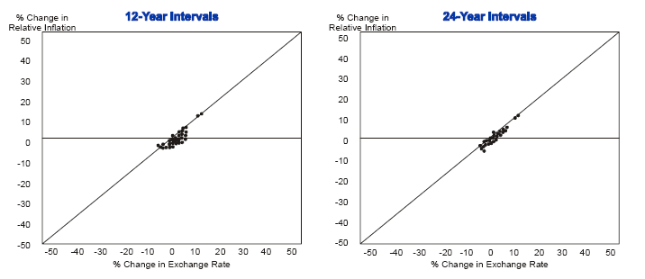
Exchange rates and prices

Slide 86
Exchange rates and prices
Summary of PPP
Approximation that works best
When there are large differences in inflation rates
And over long periods of time

Slide 87
Exchange rates & interest rates

Slide 88
Exchange rates and interest rates
If two countries have different interest rates, the one with the higher rate will tend to appreciate
R2 small (<0.05) but that’s enough to make money from
More coming …

Slide 89
Exchange rates and interest rates
Region | Money market rate (local currency)
US | 0.47
Euro area | 0.74
Japan | 0.20
China | 4.78
India | 8.35
Brazil | 8.74
Mexico | 4.73
Source: The Economist.

Slide 90
Exchange rates and interest rates
The “carry trade”
Long position in high interest rate currency
Short position in low interest rate currency
Carry: collect difference in interest rates
Risk: the low-rate currency will rise
Does it work?
Most of the time, yes

Slide 91
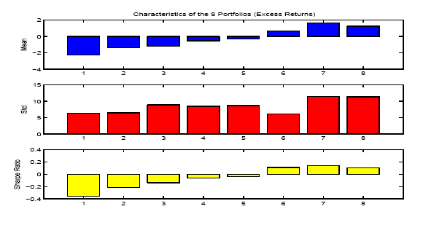
Exchange rates and interest rates
Source: Lustig and Verdelhan.

Slide 92
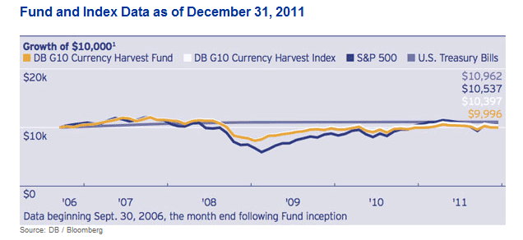
Exchange rates and interest rates
Source: Deutsche Bank G10 Currency Harvest Fund.

Slide 93
Exchange rates & anything else?

Slide 94
Exchange rates and …
Trade balance?
GDP growth?
Stock market?

Slide 95
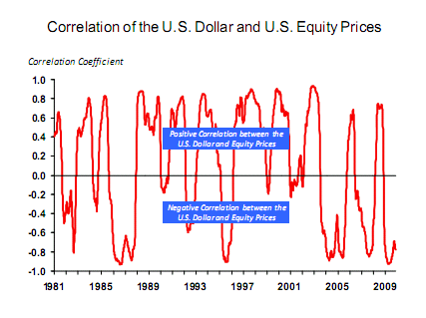
Exchange rates and stock prices
Source: Michael Rosenberg, Bloomberg.

Slide 96
What have we learned
Exchange rates are variable, affect costs, revenues, etc, in international transactions
In the short run, most of this variation is unpredictable, even inexplicable
In the long run, exchange rates roughly mirror ratios of prices (PPP)

Slide 97
For the ride home
Is China’s currency “too cheap”?
What does that mean?
How could we tell?

