Slide 1

The Global Economy The Production Function
Notes:
Open spreadsheet, Solow
Also website

Slide 2
Roadmap
Discussion
Problem Set #0
Reminders
Facts: GDP and GDP growth
Theory: the production function
Inputs: capital and labor
Productivity

Slide 3
Discussion: inflation
Linpei Zhang
My father in law just came from Beijing. His biggest complaint was inflation in China. Although overall inflation is not high, the price of the food has increased substantially.
Questions
What is inflation?
Why are people concerned about it?
Where does it come from?

Slide 4
Problem Set #0
Math and spreadsheet skills
Spreadsheets: essential life skill
Exponents and logarithms: used extensively in first half [LN]
Calculus: used sparingly, not on exams
Answers will be posted Saturday afternoon
Question 3 makes two points that will come up later
GDP, C, and I move up and down together (correlations)
I moves a lot more than the others (standard deviation)

Slide 5
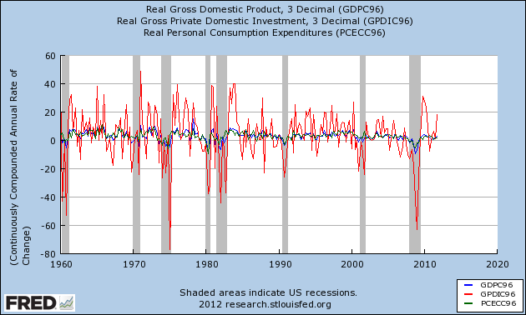
Problem Set #0

Slide 6
Reminder: Problem Set #1
Due next class
Do in groups of one to five
Send questions to me or TF (I’ll post answers in announcements)
Start with the data download step of Question 3 (Any problems, let me know)

Slide 7
Reminder: Announcements/Discussion
Links on course website
Optional signups for email delivery

Slide 8
Reminder: real and nominal GDP
Real GDP (“quantity”)
GDP in constant dollars
GDP in 2005 USD
GDP in 1990 international prices
GDP in LCU
GDP chain-weighted in 2010 USD
Nominal GDP (“value = price times quantity”)
GDP at current prices

Slide 9
Reminder: where are we headed?
Module 1: long-term economic performance
Why are some countries rich, and others poor?
Where are the economic and business opportunities?
Our proposed answer (developed over several weeks)
Business opportunities and economic performance generally reflect effective markets backed by institutions that keep them honest.

Slide 10
Reminder: where are we headed?
Factory in Indonesia or Kaz?
Why are some countries rich, and others poor?
Where are the economic and business opportunities?
Four Seasons would like to expand
Etc ??

Slide 11
Facts: GDP per capita

Slide 12
Economic history of the world
Statistic | Year
 | 1 | 1000 | 1820 | 2008
Population (millions) | 225 | 267 | 1,042 | 6,694
GDP Per Capita (1990 USD) | 467 | 425 | 666 | 7,614
Life expectancy (years) | 24 | 24 | 26 | 66
Source: Angus Maddison, Millenial Perspective.

Slide 13
Economic history of the world

Slide 14
GDP per capita (1990 international USD)
Region | Year
 | 0 | 1000 | 1820 | 2008
Western Europe | 599 | 425 | 1,218 | 21,672
Western “offshoots” | 400 | 400 | 1,202 | 30,152
Japan | 400 | 425 | 669 | 22,816
Latin America | 400 | 400 | 691 | 6,973
Former USSR | 400 | 400 | 688 | 7,904
China | 450 | 466 | 600 | 6,725
Africa | 472 | 425 | 420 | 1,760
World Average | 467 | 453 | 666 | 7,614
Source: Angus Maddison, website.

Slide 15
More history
Notes:
2^8=256, 2^9=512, 2^10=1024, 2^11=2048,2^12=4096, 2^13=8192, 2^14=16384, 2^15=32768
Log2 scale: each number represents a doubling, Arg<13, Ger>14, Germany GDP/capita (19,144) almost double Argentina(7,666)
Germany, US, most of Western Europe: 2% growth over last 100 years
Argentina: used to be as rich as Germany

Slide 16
Recent history
Source: World Bank, World Development Indicators.

Slide 17
Facts: summary
Several centuries ago, we were all poor
Now there’s enormous variation across countries
Also variation in growth rates
Modest variation among rich countries
Greater variation among poor countries

Slide 18
Questions
What separates successes from others?
What factors facilitate good performance?
What factors generate business opportunities?
Why?
Why did Western Europe do so well?
Why not the Greeks and Romans?
Why not China, India, the Islamic World?
Could the future be different?

Slide 19
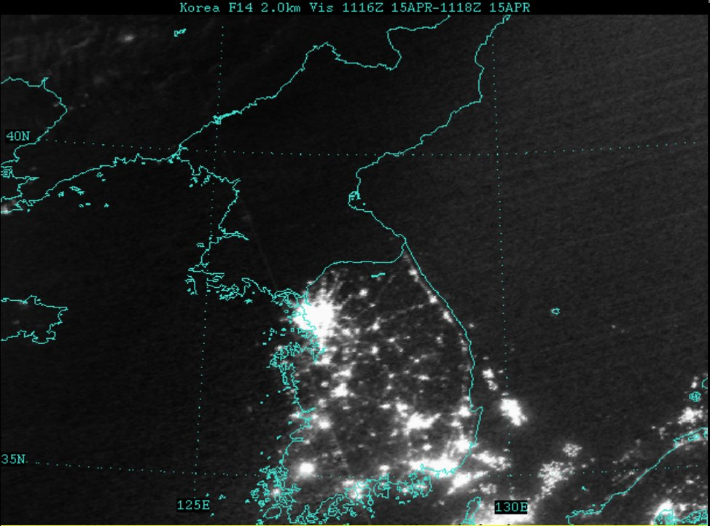
A controlled experiment
What separates the successes from the others?
What roleAlso variation in growth rates
Modest variation among rich countries
More variation among poor countries

Slide 20
Theory: The Production Function

Slide 21
Why theory?
A tool to help us organize our thoughts
What separates successes from others?
What factors facilitate good performance?
What factors offer attractive business opportunities?

Slide 22
Theory: the picture
GDP
Capital & Labor
Productivity
Political Process
“Institutions”

Slide 23
Theory: the math
The idea: relate output to inputs
Mathematical version (“production function”):
Y = A F(K,L) = A K^{α} L^{1-α}
A formula we can compute in a spreadsheet
Definitions:
K = quantity of physical capital used in production (plant and equipment)
L = quantity of labor used in production
A = total factor productivity (everything else)
α = a parameter we set equal to 1/3 (more soon)

Slide 24
Production function properties
More inputs lead to more output
Positive marginal products of capital and labor
Diminishing marginal products
If we increase one input at a time, each increase leads to less additional output
Marginal product = partial derivative of production function
Constant returns to scale
If we double **both** inputs, we double output (no inherent advantage or disadvantage to size)

Slide 25
Production function properties

Slide 26
Where does α come from?
Capital’s share of value-added
If you know calculus, this is how we show it
Profit is
Profit = pY – rK – wL = pAK^{α}L^{1-α} – rK – wL
Maximize profit by setting derivative wrt K equal to zero
dProfit/dK = αpAK^{α-1}L^{1-α} – r = 0
Multiply by K
α pAK^{α}L^{1-α} = rK
α = rK / pAK^{α}L^{1-α}
Evidence (last week): about 1/3

Slide 27
Capital (K)
What we mean: plant and equipment, physical capital
Why does it change?
Depreciation/destruction
New investment (“capex”)
Mathematical version:
K_{t+1} = K_{t} – δ_{t}K_{t} + I_{t}
= (1 – δ_{t})K_{t} + I_{t}
Adjustments for quality?

Slide 28
Measuring capital
Option #1: direct surveys of plant and equipment
Option #2: perpetual inventory method
Pick an initial value K₀
Pick a depreciation rate (or measure depreciation directly)
Measure K like this:
K_{t+1} = (1 – δ_{t})K_{t} + I_{t}
In practice, #2 is the norm:
Get I from “NIPA”
Set δ = 0.06 [ballpark number]
Example: K₂₀₁₀ = 100, δ = 0.06, I = 12 → K₂₀₁₁ = ??

Slide 29
Investment composition

Slide 30
Labor (L)
What we mean: units of work effort
Why does it change?
Population growth
Fraction of population employed (extensive margin)
Hours worked per worker (intensive margin)
Our starting point: number of people working

Slide 31
Measuring labor
Our starting point
L = number of people working
Adjustments for hours worked
Replace L with hL (h = hours per worker)
Adjustments for skill, education
Replace L with HL (H = “human capital”)
H commonly connected to years of school

Slide 32
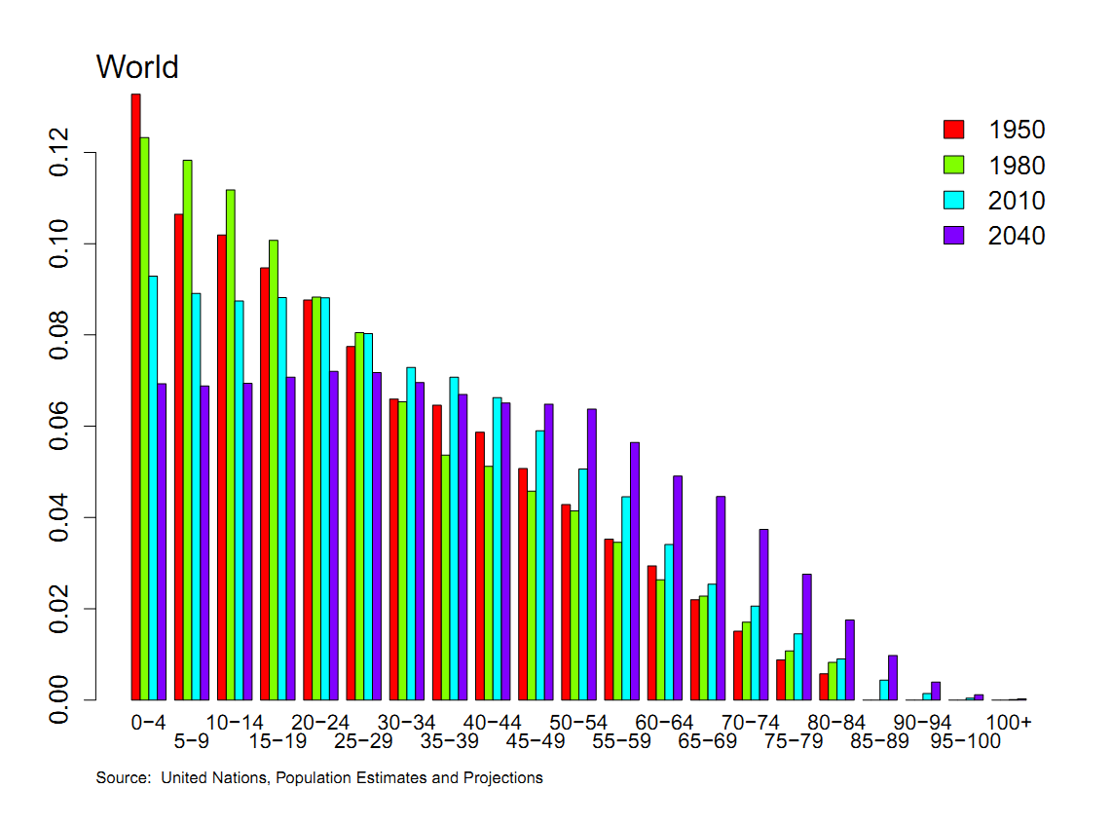
Population by age

Slide 33
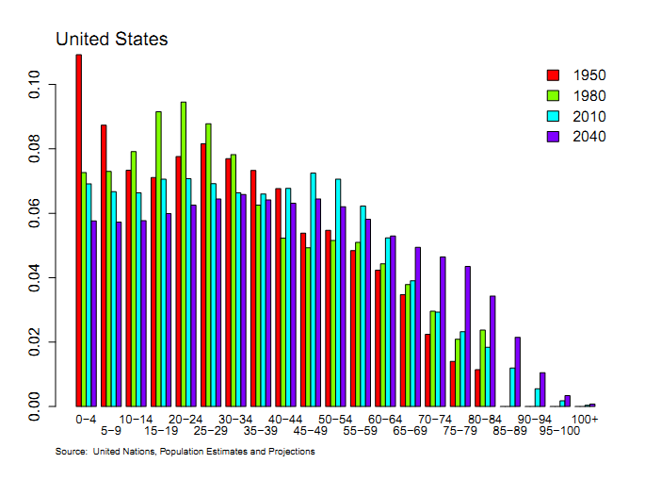
Population by age

Slide 34
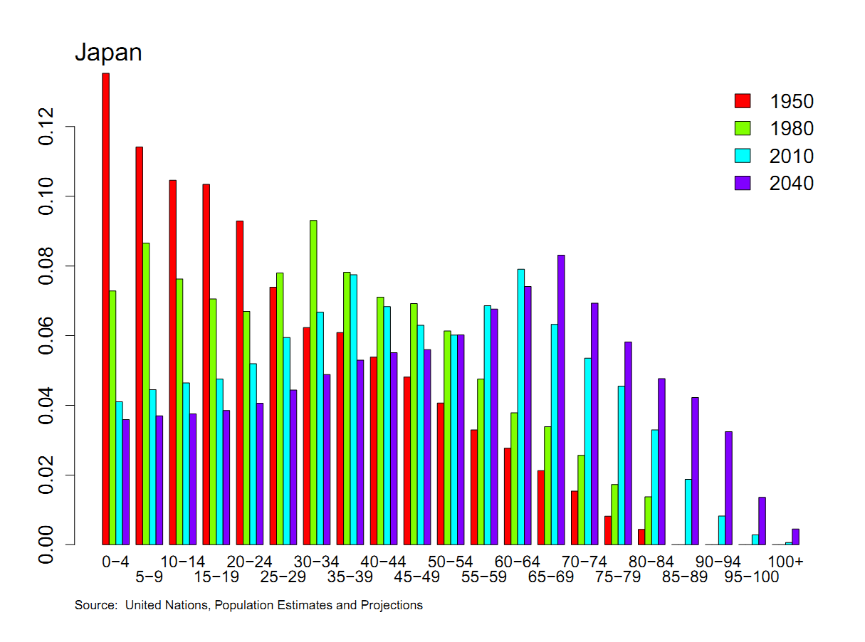
Population by age

Slide 35
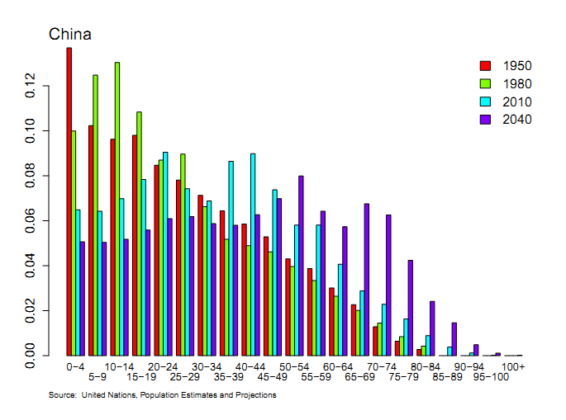
Population by age

Slide 36
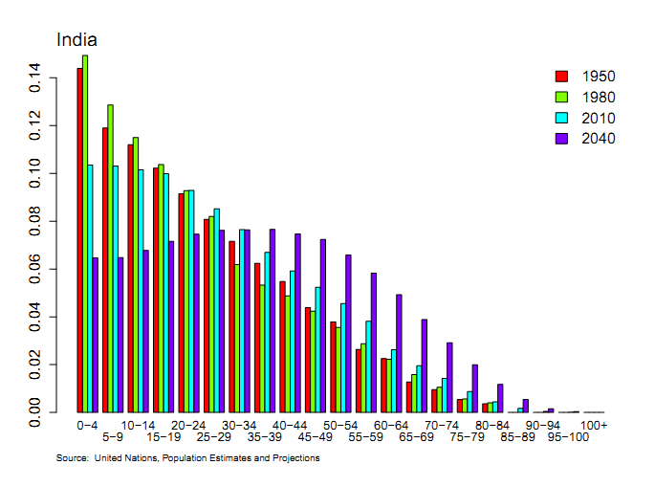
Population by age

Slide 37
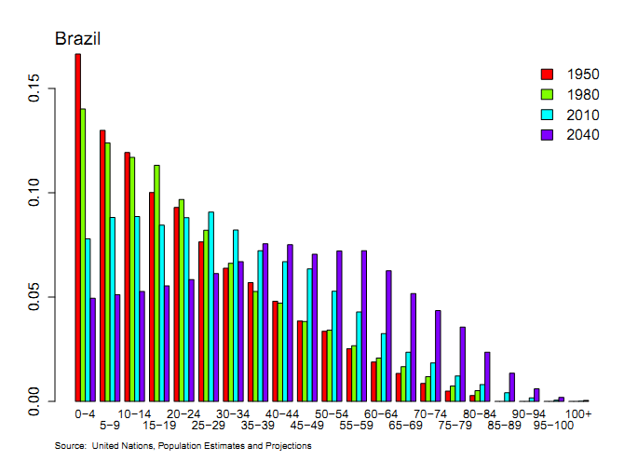
Population by age

Slide 38
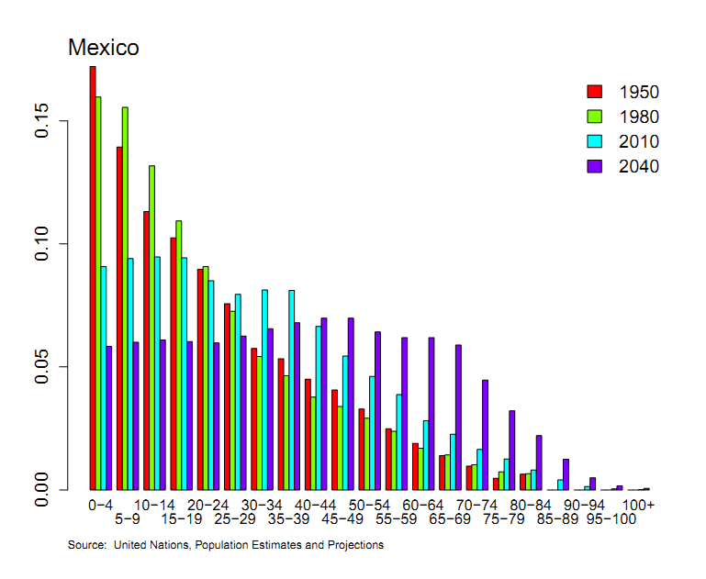
Population by age

Slide 39
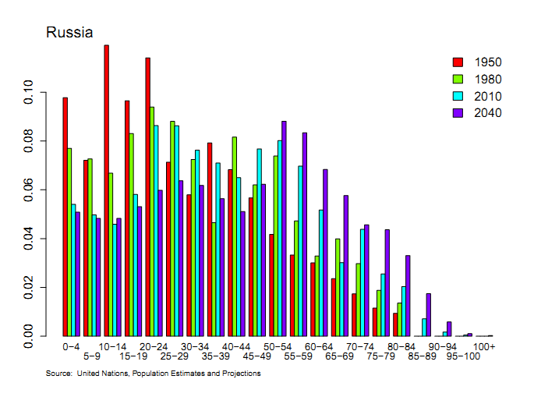
Population by age

Slide 40
Comparing China and Mexico
Different “demographics”
China has had “one child” rule since 1979, low birth rate
Mexico has high birth rate
How does that show up in (say) GDP per capita?
If kids don’t work, then having lots of them reduces the ratio of workers to population
Ditto having lots of retired people

Slide 41
GDP per working age person
Mexico
China
Notes:
41

Slide 42
GDP
Mexico GDP per Working Age Person
Mexico GDP per Capita
China GDP per Working Age Person
China GDP per Capita
Notes:
42

Slide 43
Productivity (A)
Standard number
Average product of labor: Y/L
How do we measure it?
Measure output and input, take the ratio
Our number
Total Factor Productivity (TFP): A = Y/F(K,L)
How do we measure it?
Same idea, but “input” combines capital and labor

Slide 44
Productivity
Solve the production function for A
Y = A K^{α} L^{1-α}
A = Y/[K^{α} L^{1-α}] = (Y/L)/(K/L)^{α}
Example: Y/L = 33, K/L = 65:
A = 33/65^{1/3} = 8.21
Note: units meaningless, but comparisons across time or countries are useful

Slide 45
Production function review
Remember: Y = A F(K,L)
What changes in this equation if
A firm builds a new factory?
Fewer people retire at 65
Workers shift from agriculture to industry in Viet Nam?
Competition drives inefficient firms out of business?
Venture capital fund identifies good unfunded projects?
Alaska builds a bridge to nowhere?
China invests in massive infrastructure projects?

Slide 46
What have we learned?
The production function links output to inputs and productivity:
Y = A K^{α} L^{1-α}
Capital input (K)
Plant and equipment, a consequence of investment (I)
Labor input (L)
Population growth, age distribution, participation, hours (h), skill (H)
TFP (A) can be inferred from data on output and inputs

Slide 47
The Global Economy Solow’s Growth Model

Slide 48
Roadmap
In the news
Saving and growth
Solow’s model and convergence
India

Slide 49
In the news: Greece
Joachim Fels, Morgan Stanley
Events around Greece underscored our concerns. Following the Eurogroup’s ultimatum, the Greek government – hit by a slew of resignations – now has to pass the reform and austerity measures in Parliament. More uncertainties lie ahead, including whether the deal will be approved by German parliament and whether a sufficient number of investors participates in the debt swap.
What is he saying?
Do you agree?

Slide 50
In the news: inflation
Joachim Fels, Morgan Stanley
With central banks around the world opening the monetary floodgates, it is only a question of time until markets start to worry about the consequences for inflation. Our Asia (ex-Japan) and Latin America teams are looking for inflation rates to creep higher after the middle of the year.
What is he saying?
Do you agree?

Slide 51
Saving and growth
JFK in 1960, height of Cold War
Rapid growth in USSR, also high saving and investment rates
Cause and effect?
US analysts in 1985
Rapid growth in Asian “tigers,” lots of saving
Cause and effect?
China in 2010
Rapid growth, saving close to 50% of GDP
Does India need to do the same?

Slide 52
Saving and growth
How does saving generate growth?
Critical to long-run performance?

Slide 53
Solow’s Model

Slide 54
Solow model
How it works
Saving finances capital accumulation
More capital leads to greater output
Impact eventually tails off: diminishing marginal product of capital

Slide 55
Solow model: equations
Production function:
Y = A K^{α} L^{1-α}
Flow identity:
I = S
Saving:
S = sY
Capital stock:
ΔK = I – δK

Slide 56
Solow model: analysis
“Analysis” here means we substitute like crazy
ΔK = sY – δK
= sAK^{α} L^{1-α} – δK
For the time being, A, L don’t change
Two competing forces on K
Depreciation drives K down
Saving drives K up
Which is stronger?
Where does diminishing returns show up?

Slide 57
Solow model: dynamics
output
saving
depreciation

Slide 58
Solow model: convergence
Eventually the two forces balance
Capital stock eventually stops changing
Output does, too
Solow’s answer to JFK
USSR won’t catch up through saving alone
Do we see convergence in the data?

Slide 59
Convergence? Log of Real Per Capita GDP (PPP, 2005 Chained US$)
Source: Penn World Tables 7.0

Slide 60
Convergence? Log of Real Per Capita GDP (PPP, 2005 Chained US$)
Source: Penn World Tables 7.0

Slide 61
Convergence summary
Worked reasonably well for rich countries after WW II
Countries bounced back from the destruction of capital
Not so well for other countries
Something else must be going on
But what?

Slide 62
Level effects v. growth effects
Level effect: change in GDP level
Temporary change in growth rate
Growth effect: permanent change in growth rate
Level or growth effect?
Saving rate
Population growth

Slide 63
Saving?
output
high saving
low saving
depreciation

Slide 64
Population growth?
How does it work?
Increases GDP
Decreases GDP per capita if K is fixed
Capital per worker falls
Increases share of young, who don’t work
Doesn’t vary enough to account for growth experiences

Slide 65
India

Slide 66
India
Saving and investment rates well below China’s
How important is this to India’s future?

Slide 67
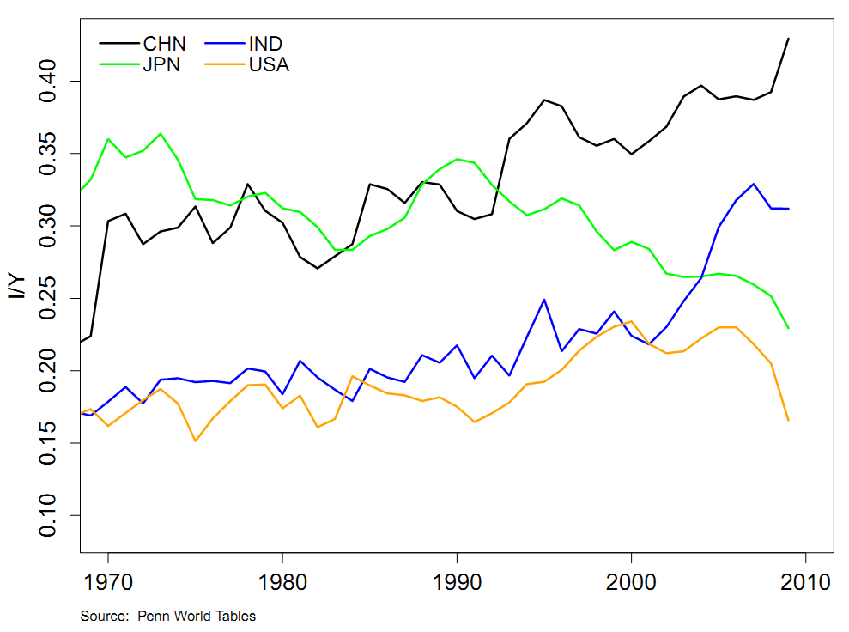
Investment rates

Slide 68
India
Experiments with Solow model
Benchmark: start model in 2010 and see what happens
Raise saving rate
Introduce productivity growth
What has the biggest impact?

Slide 69
India
Solow model inputs (estimates for 2010)
Output Y=GDP: 3.87 trillion 2005 USD
Capital K: 5.78 trillion 2005 USD
Labor L: 0.450 billion people
Productivity A: how do we compute this?
Saving/investment rate s: 0.25
Depreciation rate delta: 0.06
Experiments
Raise saving rate
Add productivity growth

Slide 70
India
Solow model experiments
Raise saving rate
Add labor force growth
Add productivity growth
Increase productivity growth

Slide 71
India
Scenario | GDP
2010 | 3.87
2050: no-growth benchmark
2050: higher saving (+5%)
2050: population growth (1%)
2050: TFP growth (2%)
2050: TFP growth (+1%)

Slide 72
India
Scenario | GDP
2010 | 3.87
2050: no-growth benchmark | 6.08
2050: higher saving (+5%) | 6.61
2050: population growth (1%) | 8.72
2050: TFP growth (2%) | 18.02
2050: TFP growth (+1%) | 31.09

Slide 73
What have we learned?
Solow model
Growth comes from saving and capital accumulation
Diminishing returns kills this off quickly
Conclusion: saving and capital formation can’t be the keys to prosperity (in the US, in China, in India, etc)
Still a useful forecasting tool
If not capital, what?
TFP growth

Slide 74
For the ride home
US healthcare
What’s the biggest problem you see?
How would you solve it?

