Slide 1

The Global Economy Sources of Growth

Slide 2
Roadmap
In the news
Reminders
GDP per capita, GDP per worker, and data on both
Level comparisons
Growth rates and growth accounting

Slide 3
In the news
“Reform in China,” WSJ, Feb 23, 2012, via Ming Dong:
“China 2030,” a report set to be released Monday by the World Bank and a Chinese government think tank, argues that China should implement deep reforms, including scaling back its vast state-owned enterprises and making them operate more like commercial firms. It also urges China to overhaul local government finances and promote competition and entrepreneurship.

Slide 4
Reminder: our plan
GDP
Capital & Labor
Productivity
Political Process
“Institutions”

Slide 5
Reminder: production function
Production function
Y = A K^{α} L^{1– α}
[a formula in a spreadsheet]
Ingredients
Y: real GDP (output)
K: quantity of physical capital (plant and equipment)
L: quantity of labor (number of workers)
A: total factor productivity (TFP) (“productivity” for short)

Slide 6
Reminder: productivity
Production function in per worker form
Y = A K^{α} L^{1– α}
Y/L = A (K/L)^{α}
Productivity
A = (Y/L)/(K/L)^{α}
What is α?

Slide 7
GDP per capita and per worker
GDP per worker
Y = A K^{α} L^{1– α}
Y/L = A (K/L)^{α}
GDP per capita
Y/POP = (Y/L) (L/POP)
= A (K/L)^{α} (L/POP)
Where do differences come from?

Slide 8
Data
Penn World Tables provides
Y: real GDP (2005 USD)
L: employment
Pop: population
I: investment
We compute
K: capital stock
How? Perpetual inventory method using I
Comparable across countries, 1950-2007

Slide 9
Level comparisons

Slide 10
Comparing output per worker
Why do countries have different output per worker?
GDP per worker
Y/L = A (K/L)^{α}
Comparison of countries 1 and 2
(Y/L)₁/(Y/L)₂ = (A₁/A₂) [(K/L)₁/(K/L)₂]^{α}
Bottom line: a clue to economic performance

Slide 11
Level comparison: US & Mexico
Why is Y/L larger in the US than Mexico (2007)?
 | Y/L | K/L | A
US | 84.34 | 274.59
Mexico | 26.91 | 86.59
Ratio
“Contribution”
Numbers in bold are data, what are the others?

Slide 12
Level comparison: US & Mexico
Why is Y/L larger in the US than Mexico (2007)?
 | Y/L | K/L | A
US | 84.34 | 274.59 | 12.98
Mexico | 26.91 | 86.59 | 6.08
Ratio | 3.13 | 3.17 | 2.13
“Contribution” | 3.13 | 1.47 | 2.13
Numbers in bold are data, the others are computed

Slide 13
Level comparison: China & India
How do China and India compare?
 | Y/L | K/L | A
China | 13.20 | 30.98
India | 9.61 | 17.49
Ratio
“Contribution”
Numbers in bold are data, what are the others?

Slide 14
Level comparison: China & India
How do China and India compare?
 | Y/L | K/L | A
China | 13.20 | 30.98 | 4.20
India | 9.61 | 17.49 | 3.70
Ratio | 1.37 | 1.77 | 1.14
“Contribution” | 1.37 | 1.21 | 1.14
Numbers in bold are data, the others are computed

Slide 15
Growth rates & growth accounting

Slide 16
Growth rate review
Traditional growth rate g
(1+g)^{n} = x_{t+n}/x_{t}
Continuously-compounded growth rate γ
e^{nγ} = x_{t+n}/x_{t}
How to compute it
γ = [log(x_{t+n}) – log(x_{t})]/n = [log(x_{t+n}/x_{t})]/n
See
“Math review” and “Sources of growth”

Slide 17
Growth accounting
Why differences in growth in output per worker?
Production function
Y/L = A (K/L)^{α}
Additive in growth rates
γ_{Y/L} = γ_{A} + α γ_{K/L}
[γ_{x} means “growth rate of X”]
γ_{K/L} is growth rate of K/L
α γ_{K/L} is “contribution” to growth
Bottom line: a clue to economic performance

Slide 18
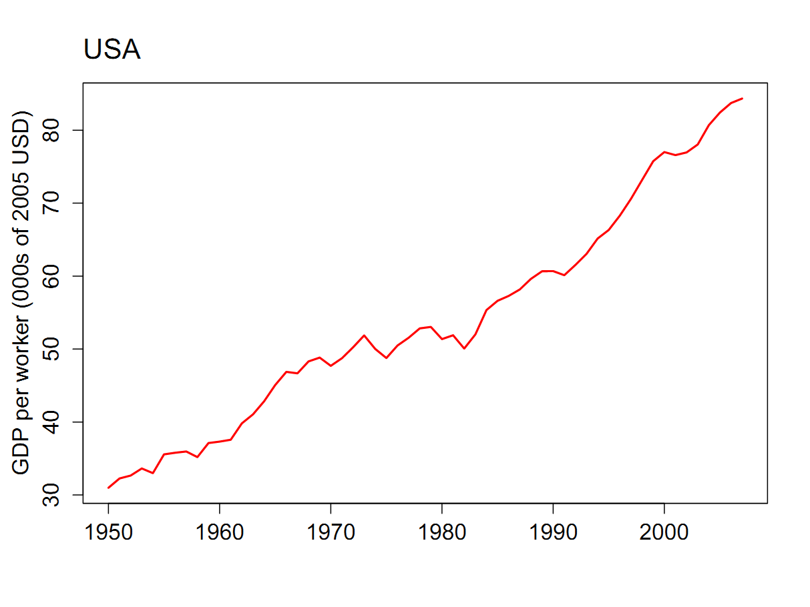
What happened in the US?

Slide 19
What happened in the US?
γ_{Y/L} = γ_{A} + α γ_{K/L}
 | Y/L | K/L | A
1950 | 30.99 | 82.83
2007 | 84.34 | 274.59
Growth rate (annual %)
Contribution to growth
Numbers in bold are data, the rest are computed
“Contribution” means we multiply γ_{K/L} by 1/3

Slide 20
What happened in the US?
γ_{Y/L} = γ_{A} + α γ_{K/L}
 | Y/L | K/L | A
1950 | 30.99 | 82.83 | 7.11
2007 | 84.34 | 274.59 | 12.98
Growth rate (annual %) | 1.76 | 2.10 | 1.06
Contribution to growth | 1.76 | 0.70 | 1.06
Numbers in bold are data, the rest are computed
“Contribution” means we multiply γ_{K/L} by 1/3

Slide 21
What happened in the US?
World Economic Forum
While many structural features continue to make its economy extremely productive, a number of escalating weaknesses have lowered the US ranking. Compared to last year, policymaking is felt by business to be less transparent (ranked 50th of 141 countries) and regulation more burdensome (58th). Lack of macroeconomic stability continues to be the greatest area of weakness (90th), particularly repeated fiscal deficits and burgeoning levels of public indebtedness.

Slide 22
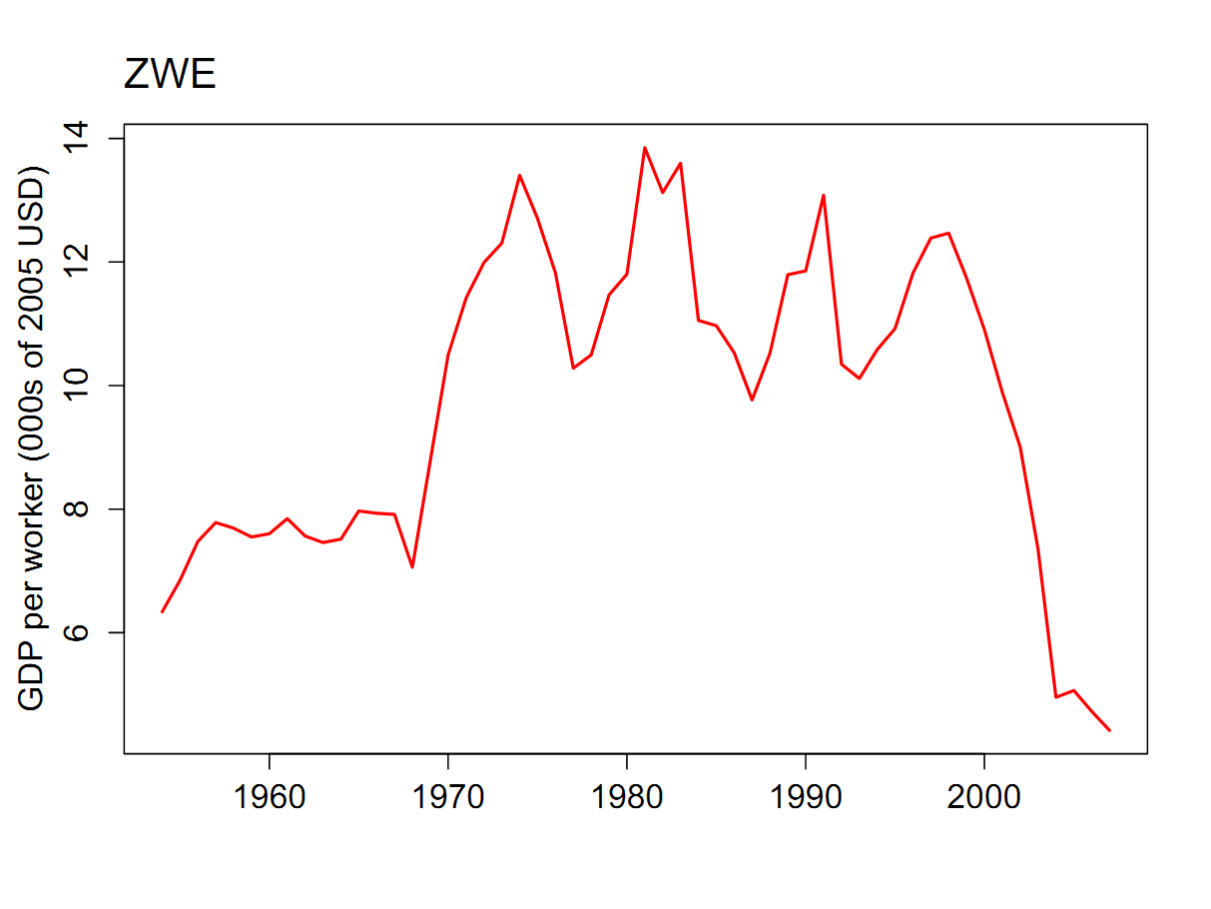
What happened in Zimbabwe?

Slide 23
What happened in Zimbabwe?
γ_{Y/L} = γ_{A} + α γ_{K/L}
 | Y/L | K/L | A
1998 | 12.47 | 34.17
2007 | 4.42 | 26.51
Growth rate (annual %)
Contribution to growth
Numbers in bold are data, the rest are computed
“Contribution” means we multiply γ_{K/L} by 1/3

Slide 24
What happened in Zimbabwe?
γ_{Y/L} = γ_{A} + α γ_{K/L}
 | Y/L | K/L | A
1998 | 12.47 | 34.17 | 3.84
2007 | 4.42 | 26.51 | 1.48
Growth rate (annual %) | (11.52) | (2.83) | (10.58)
Contribution to growth | (11.52) | (0.94) | (10.58)
Numbers in bold are data, the rest are computed
“Contribution” means we multiply γ_{K/L} by 1/3

Slide 25
What happened in Zimbabwe?
Fertile farm land with abundant resources
History
European immigration in late 19th century
British colony 1888-1965
Independent 1980
Led by Robert Mugabe since then
1997 “land reform” led to sharp drop in agricultural output, loss of tax revenue, hyperinflation, economic chaos

Slide 26
What happened in Zimbabwe?
World Economic Forum
Zimbabwe tentatively reverses its adverse trend. The assessment of public institutions, while still weak, has improved measurably, increasing from 125th two years ago to 107th. Specific areas of improvement are ethics and corruption and government inefficiency, although significant room for improvement remains. On the other hand, major concerns linger with regard to the protection of property rights, where Zimbabwe is second-to-last.

Slide 27
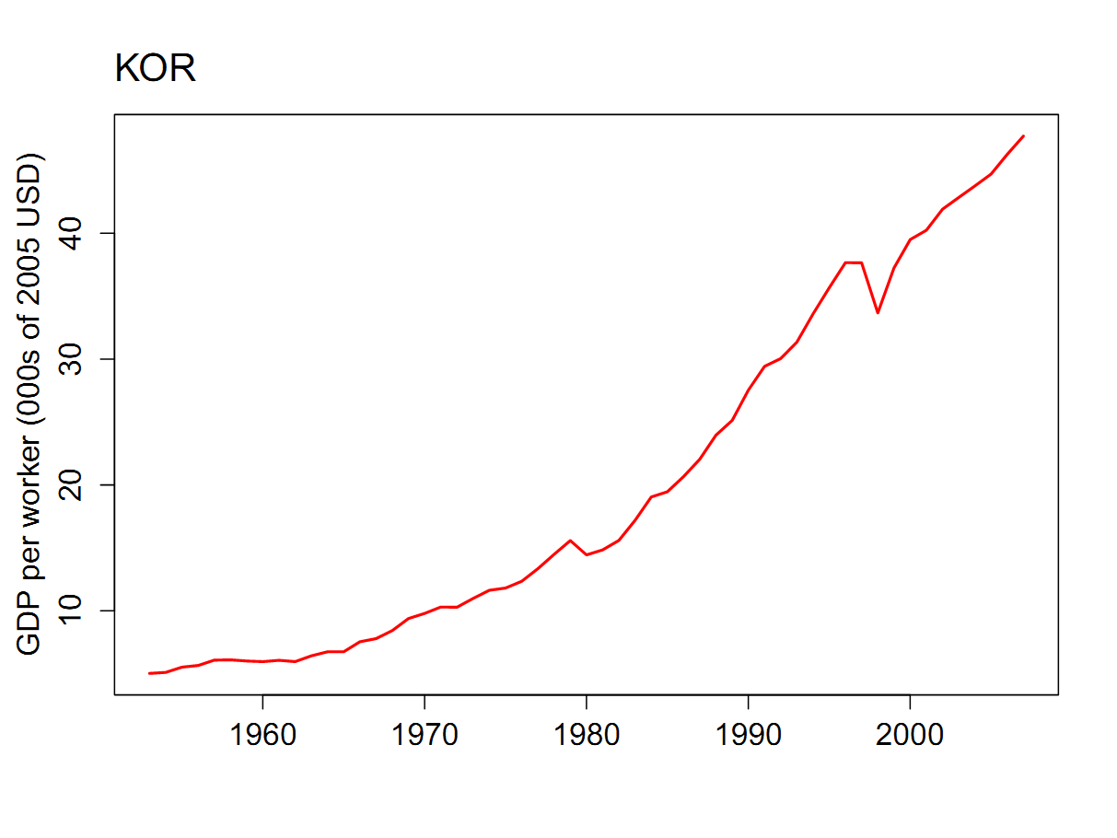
What happened in Korea?

Slide 28
What happened in Korea?
γ_{Y/L} = γ_{A} + α γ_{K/L}
 | Y/L | K/L | A
1953 | 5.03 | 7.68 | 2.55
2007 | 47.72 | 210.43 | 8.02
Growth rate (annual %) | 4.25 | 6.05 | 2.16
Contribution to growth | 4.25 | 2.08 | 2.16
Numbers in bold are data, the rest are computed
“Contribution” means we multiply γ_{K/L} by 1/3

Slide 29
What happened in Korea?
Huge economic success
Characteristics
Massive early investments from US
Strong government role in the economy early on
Encouraged large conglomerates (“chaebols”)
Greater role for investment than we see in US
Which of these matters?

Slide 30
What happened in Korea?
World Economic Forum
Korea’s performance is very uneven. The country’s outstanding infrastructure (9th) and stable macroeconomic environment (6th) are among its key competitive strengths. Furthermore, education is accessible and of high quality. On the other hand, considerable room for improvement remains with respect to the quality of its institutions (65th) and its rigid labor market (76th), as well as its largely inefficient financial market (80th).

Slide 31
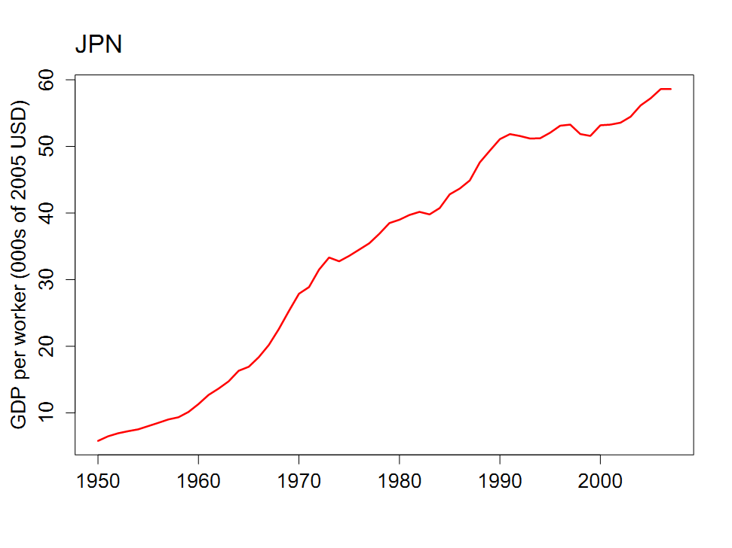
What happened in Japan?

Slide 32
What happened in Japan?
 | Y/L | K/L | A
1950 | 5.82 | 7.67 | 2.95
1990 | 51.09 | 196.28 | 8.79
2007 | 58.60 | 273.71 | 9.03
Contribution, 1950-1990 | 5.43 | 2.70 | 2.73
Contribution, 1990-2007 | 0.81 | 0.28 | 0.15
Numbers in bold are data, the rest are computed

Slide 33
What happened in Japan?
Huge postwar success story
Capital played larger role than in US
1990s malaise
Widespread financial crisis
Many banks insolvent but allowed to linger (“Zombies”)
Massive stimulus program apparently failed
Challenging demographics
Lessons?

Slide 34
What happened in Japan?
World Economic Forum
Japan continues to enjoy a major competitive edge in business sophistication and innovation. Overall competitive performance, however, continues to be dragged down by severe macroeconomic weaknesses, with high budget deficits and the highest public debt levels in the entire sample.
Hmmmm….

Slide 35
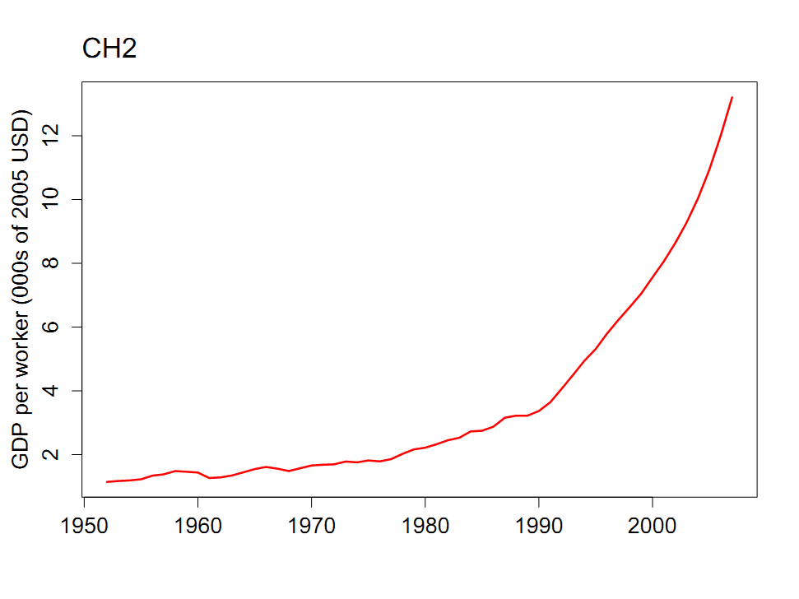
What happened in China?

Slide 36
What happened in China?
 | Y/L | K/L | A
1952 | 1.14 | 1.95 | 0.91
1978 | 2.02 | 4.60 | 1.22
2007 | 13.20 | 30.98 | 4.20
Contribution, 1952-1978 | 2.20 | 1.10 | 1.10
Contribution, 1978-2007 | 6.47 | 2.45 | 4.28
Numbers in bold are data, the rest are computed

Slide 37
What happened in China?
Modest reforms in late 1970s led to huge gains
Ongoing development of market economy
Economic structure remains unusual
“Socialism with Chinese characteristics”
Central role for Communist Party
Do banks support the Party or the business?

Slide 38
What happened in China?
World Economic Forum
China leads the BRICs by a significant margin. Challenges persist in the areas of corruption and judicial independence. Moreover, businesses feel that the country has become less safe, resulting in higher costs for protection. Finally, standards of business ethics and corporate accountability are below those found in a number of other economies. [There are also] poor results in financial market development.

Slide 39
What happened in China?
EIU, Country Finance Report:
China’s financial sector is large but immature, with significant structural weaknesses. Risk-management techniques and the quality of bank lending have improved. However, the dominance of state-owned banks (the five large banks dominate the sector) suggests that savings are not used efficiently. Pressure from local governments means that lending decisions are still occasionally driven by political factors.

Slide 40
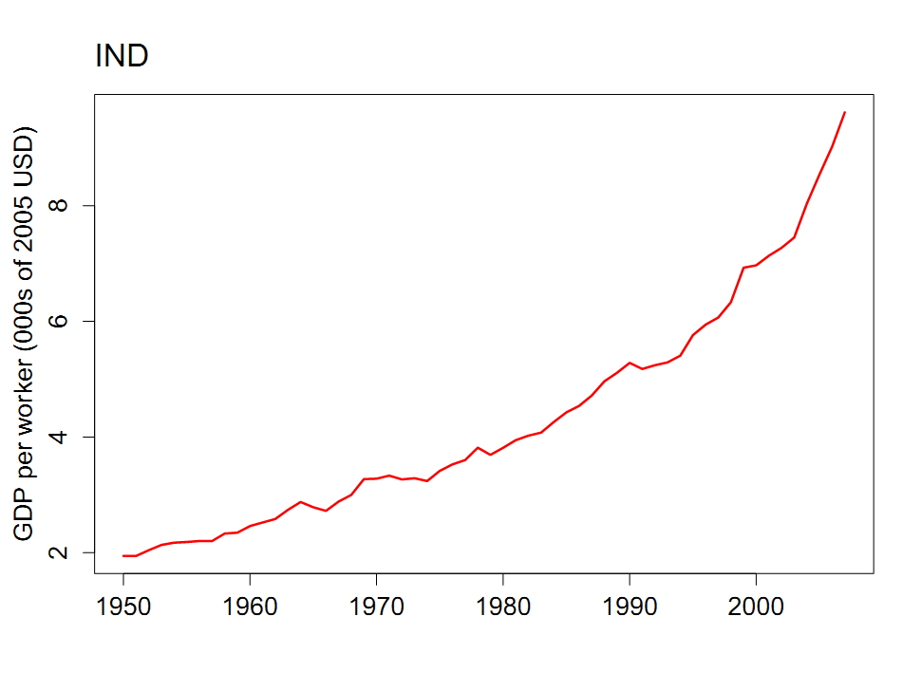
What happened in India?

Slide 41
What happened in India?
 | Y/L | K/L | A
1950 | 1.95 | 1.70 | 1.63
1980 | 3.81 | 6.50 | 2.04
2007 | 9.61 | 17.49 | 3.70
Contribution, 1950-1980 | 2.58 | 1.72 | 0.86
Contribution, 1980-2007 | 3.19 | 1.14 | 2.05
Numbers in bold are data, the rest are computed

Slide 42
What happened in India?
British colony, independent 1947
Active democracy
British and successors built bureaucratic planned economy
Modest liberalization under Rajiv Ghandi in 1980s
More liberalization during 1990 crisis
Dramatic improvement in economic performance

Slide 43
What happened in India?
World Economic Forum
The country’s supply of infrastructure remains largely insufficient. In health and education, quality remains a concern. Discontent in the business community about the inability of the government to provide a more conducive environment for business has been growing. Corruption (99th) and burdensome regulation (96th) fuel this discontent. Despite these considerable challenges, India has a well-developed and sophisticated financial market.

Slide 44
What happened in India?
EIU, Country Finance Report:
India is a difficult operating environment for foreign companies. Most economic activities are girded with restrictions, public services and infrastructure are poor, and the government continues to impede the free flow of capital across its borders. Tax rates are relatively high and the tax system is complicated.

Slide 45
What happened in India?

Slide 46
What have we learned?
Production function is a clue about performance
Why output per worker differs across countries
Why countries grow
[Also a good source of exam questions]
Productivity invariably central to good performance
Up next: the foundations of high productivity

Slide 47
The Global Economy Institutions

Slide 48
Roadmap
Problem Set #1
Productivity in nineteenth-century ocean shipping
Institutions
What is this?

Slide 49
Problem Set #1
Answers will be posted Tuesday
Figures from Question 3 follow
Remaining question
Why are saving and investment rates so different?

Slide 50
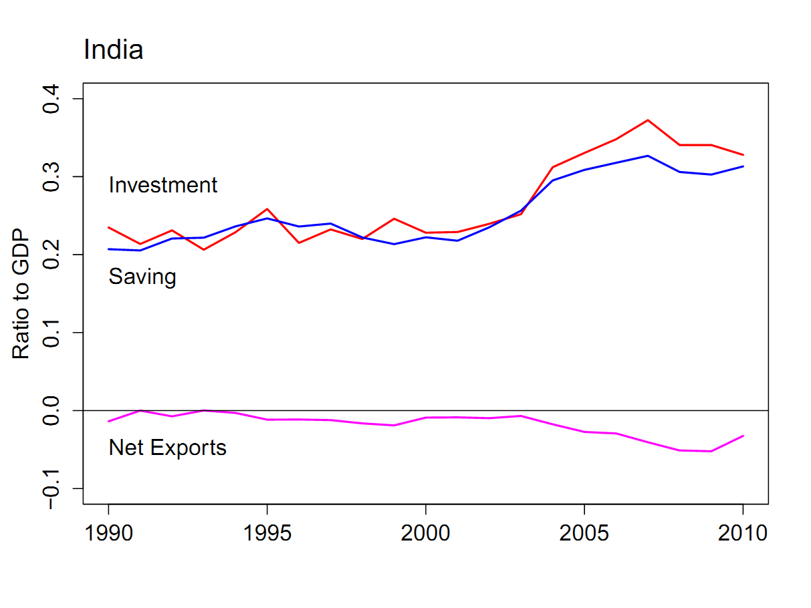
Problem Set #1: India

Slide 51
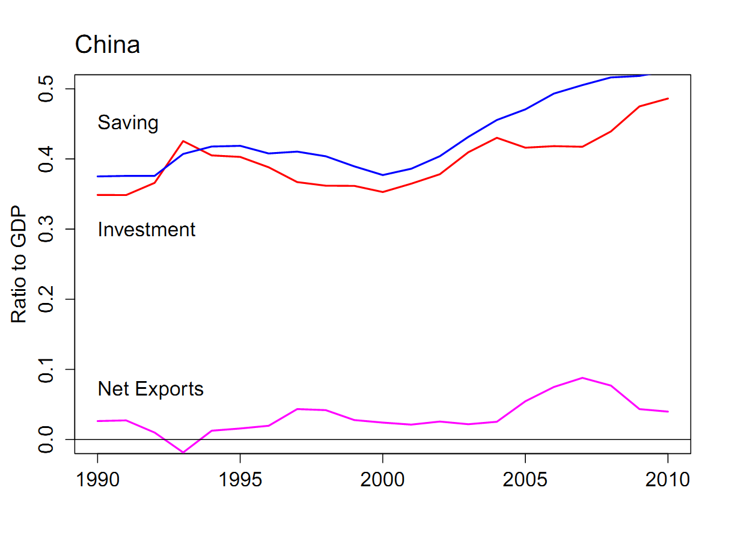
Problem Set #1: China

Slide 52
Nineteenth-century ocean shipping

Slide 53
Ocean shipping
Massive improvements in productivity
Not due to technology
Why?

Slide 54
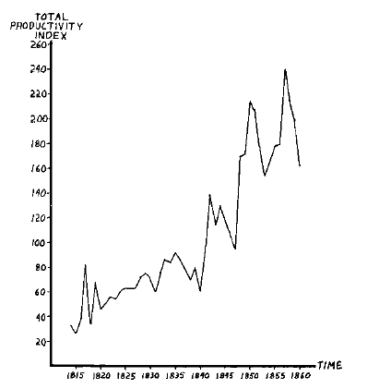
Ocean shipping
Source: Douglas North, Journal of Political Economy, 1968.

Slide 55
Ocean shipping
What’s the takeaway?
Productivity is in the environment, not the individual
Steve Jobs? Immigration?

Slide 56
Ocean shipping
Immigration?
http://marginalrevolution.com/marginalrevolution/2012/07/immigration-to-australian-jail.html

Slide 57
Institutions

Slide 58
What are “institutions”?
Social mechanisms that facilitate good economic performance
They should favor production over piracy
Like what?
What’s important in your business or industry?

Slide 59
Institutions
Governance
Rule of law
Clearly defined property rights
Open, honest, competitive markets

Slide 60
Institutions
Governance
Governments should be strong enough to deliver security and enforce rules
But not so strong that they can rob their own citizens
They should facilitate economic performance

Slide 61
Institutions
James Madison, Federalist Papers 51 (1788):
If men were angels, no government would be necessary. If angels were to govern men, neither external nor internal controls on government would be necessary. In framing a government which is to be administered by men over men, the great difficulty lies in this: you must first enable the government to control the governed; and in the next place oblige it to control itself.

Slide 62
Institutions
Old Soviet joke:
Here’s how things work under Communism. We pretend to work, and they pretend to pay us.

Slide 63
Institutions
Old Czech joke (circa 1968):
The difference between capitalism and socialism? Under capitalism, Man oppresses Man. Under socialism it’s exactly the opposite.

Slide 64
Institutions
Rule of law
Legal system must enforce the law
Honest police and judiciary

Slide 65
Institutions
Property rights
Should be clearly defined
And enforced

Slide 66
Institutions
Open, honest, competitive markets
Not “free” markets
Competitive, not monopolies
Free entry

Slide 67
Measuring institutions
Measures of institutional quality
Attempts to quantify inherently qualitative features of the economic and business environment
Lord Kelvin
If you can’t measure it, you can’t improve it

Slide 68
Measures of institutional quality
Good sources
World Bank, World Governance Indicators
World Bank, Doing Business
Transparency International, corruption indexes
Useful aggregators
Economist Intelligence Unit, various reports
World Economic Forum, Global Competitiveness Report
Links to these and more on the “resources” page

Slide 69
Government effectiveness
Source: World Bank, Governance Indicators.

Slide 70
Regulatory quality
Source: World Bank, Governance Indicators.

Slide 71
Rule of law
Source: World Bank, Governance Indicators.

Slide 72
Control of corruption
Source: World Bank, Governance Indicators.

Slide 73
Days to enforce a contract
Source: World Bank, Doing Business.

Slide 74
Cost of enforcing a contract
Source: World Bank, Doing Business.

Slide 75
Procedures required to start a business
Source: World Bank, Doing Business.

Slide 76
Cost of starting a business
Source: World Bank, Doing Business.

Slide 77
What is this?

Slide 78
What is this?
Rules of the game
Assess problem
Decide which institutions are involved
Bonus points: Who’s the pirate?

Slide 79
What is this?
Sandeep Kohli, “Long live license Raj,” WSJ, Feb 13 09:
When I set up restaurants in Dehli, I found the License Raj was alive and well. First, you need a "No Objection" certificate from the Fire Department. That’s followed by a Health license from the Municipal Corporation of Delhi. Then you need three different police clearances – one from the police station in the area where the restaurant is located, the next from the police station in the area where the restaurant manager lives, and then another one from the police licensing department. Next, you apply for Tourism & Excise licenses. Inspectors check out the premises and paste a notice at the restaurant inviting objections from the neighborhood regarding the sale of alcohol.

Slide 80
What is this?
Hernando de Soto, The Other Path
Researchers tried to set up a factory in Lima – legally
Steps required: 11
Time: 289 days
Bribes requested: 10 (2 paid)
Cost: $1,231 (32 times the monthly min wage)

Slide 81
What is this?
Bill Lewis, McKinsey, The Power of Productivity
The Japan we don’t see is the small farmer, the small shopkeeper, and the small milk plant. Small isn’t beautiful, it’s inefficient and unproductive. A string of land restrictions, tax policies, loan subsidies, and regulations prop up the small while stifling the enterprising and efficient. As a result, Japan is 40% more productive than the US in autos but 50% less productive in retail.

Slide 82
What is this?
“Africa’s Singapore?” The Economist, Feb 25 2012, via Aaron Butler:
Rwanda is best known for the genocide of 1994. It has been peaceful since then, but lacks nearly all of Singapore’s advantages. Yet Rwanda has one huge advantage: the rule of law. No African country has done more to curb corruption. Transparency International reckons Rwanda is less graft-ridden than Greece or Italy. The country is blessedly free of red tape, too. Property rights are strengthening, as well—the government is giving peasants formal title to their land.

Slide 83
What is this?
Andrew Kramer, New York Times, May 16, 2006:
Mike Matthews, a sound-effects designer and one-time promoter of Jimi Hendrix, bought a moribund Russian factory and converted it to making vacuum tubes for high-end guitar amplifiers. Now he’s facing a hostile takeover. A company called Russian Business Estates offered $400k for his firm, which has a monthly turnover of $600k. When Mr Matthews refused, the electricity went off. Then he was accused of “security violations.”
Notes:
http://www.nytimes.com/2006/05/16/business/worldbusiness/16cheat.html?sq=russia%20vacuum%20tubes%20amplifier%20guitar&st=cse&scp=1&pagewanted=all

Slide 84
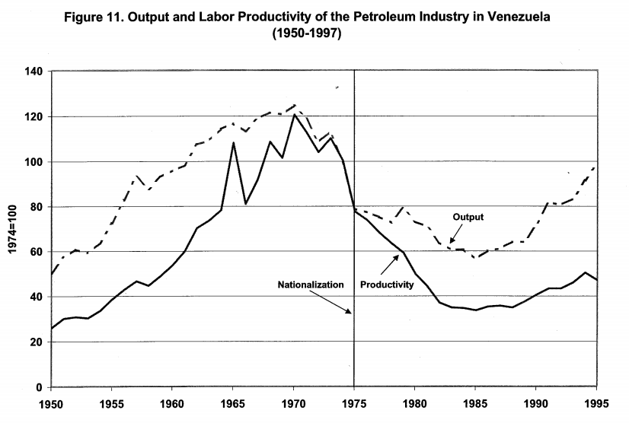
What is this?
Source: Cole, Ohanian, Riascos, and Schmitz, “Latin America in the rearview mirror.”

Slide 85
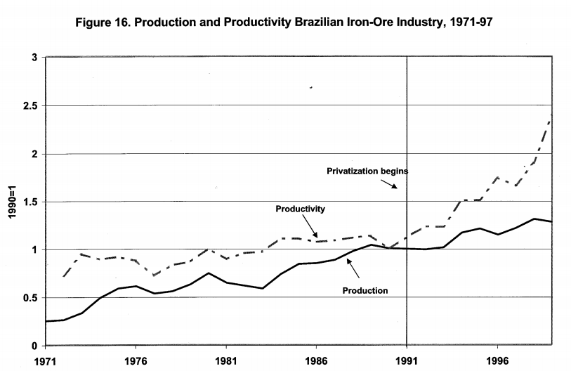
What is this?
Source: Cole, Ohanian, Riascos, and Schmitz, “Latin America in the rearview mirror.”

Slide 86
What is this?
Cole et al, “Latin America in the rearview mirror”:
In 1977, Brazil embarked on a zero-quota policy that meant that only PCs and minicomputers produced by Brazilian-owned firms could be sold in Brazil. Moreover, the black market was not a practical choice for large firms. The policy insulated Brazilian computer producers from foreign competition and featured entry barriers to new Brazilian producers through a maze of bureaucratic requirements. As a result, computer prices were 70-100 percent above international prices.

Slide 87
What is this?
Carlos Slim in Mexico
Most reports see him as using influence with the Mexican government to eliminate competition in his businesses, including telecoms.
Is this “capitalism”?

Slide 88
What is this?
Argentina in 2002
Facing inflation over 1000%, the government announced in 1991 that citizens could use dollars and pegged the peso to the dollar. A decade later, they forcibly converted dollar deposits to pesos (“pesification”) and devalued 75%.

Slide 89
What is this?
Argentina in 2008 (WSJ, Oct 28 08)
Argentina’s government pressed forward with its controversial plan to nationalize private pension plans. President Kirchner said her move is designed to protect private pension funds from mismanagement amid the global financial crisis.

Slide 90
What is this?
Joe Nocera, NY Times, Aug 22 11:
In April, the National Labor Relations Board filed a complaint against Boeing, accusing it of opening its new non-union South Carolina plant to retaliate against the union, which has a history of striking at contract time. The NLRB’s proposed solution is to move all its Dreamliner production back to Puget Sound.

Slide 91
What is this?
David Leonhardt, NY Times, Nov 8 09:
When Intermountain standardized lung care for premature babies, it not only cut the number who went on a ventilator by more than 75 percent; it also reduced costs by hundreds of thousands of dollars a year. Perversely, Intermountain’s revenues were reduced by even more. Thanks to the fee-for-service system, the hospital had been making money off substandard care. By improving care it lost money.

Slide 92
What is this?
What examples come to mind?

Slide 93
Cases
Come back to them ??

Slide 94
Summary
GDP
Capital & Labor
Productivity
Political Process
“Institutions”

Slide 95
What have we learned?
Good institutions support productivity and economic performance
A short list includes
Governance
Rule of law
Property rights
Competitive markets
Macroeconomic policies matter, too [later]

Slide 96
Something for the ride home
James Surowiecki, New Yorker, June 10, 2010
Regulation isn’t an obstacle to thriving markets, it’s a vital part of them.
Do you agree? Disagree? Both?
Come to class next week with examples for discussion

