Slide 1

The Global Economy Business Cycle Indicators

Slide 2
Investors’ guide to business cycles
?? Add something like this
Equity investors
Equity moves with the economy – with a lead
Forecasts could help you – if you do it better than others
Bond investors
Bond prices fall when interest rates rise (definition)
More so for long bonds
If you expect rates to rise, hold short bonds

Slide 3
The idea
We use patterns in the data to assess
Current economic conditions
Near-term future economic conditions
If (say) a jump in housing starts has been associated with good economic performance in the past…
What if this time is different?

Slide 4
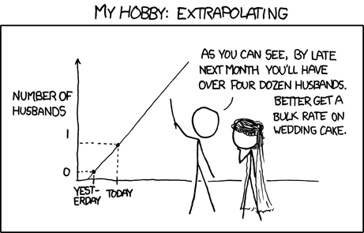
The idea (xkcd version)

Slide 5
Joke of the day
Why do economists add a digit after the decimal point to their forecasts?
To show they have a sense of humor

Slide 6
Roadmap
Indicators
The cross-correlation function
The business cycle scorecard

Slide 7
Indicators

Slide 8
Indicators of economic activity
Hundreds of them, more all the time
Bloomberg and WSJ calendars
What’s your sense of current economic conditions? What indicators would you use to make your case?

Slide 9
Indicators: terminology
A variable is procyclical if it moves up and down with the economy, countercyclical if it moves in the opposite direction
A variable leads the economy if its ups and downs precede, lags if its movements come after, coincident if they happen at the same time
“The economy” = GDP growth

Slide 10
Indicators: plan
Look at monthly data (mostly yoy growth rates)
Shift from GDP to industrial production
For each one
Is it procyclical? Countercyclical?
Does it lead? Lag?
What does it suggest about current and future conditions?

Slide 11
Indicators: FRED
Plot and download data

Slide 12
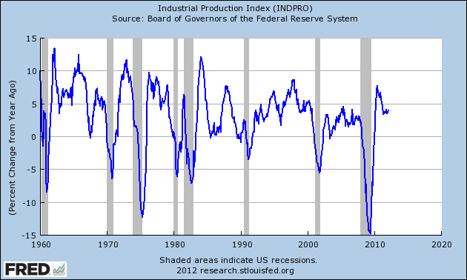
Industrial production (yoy growth)

Slide 13
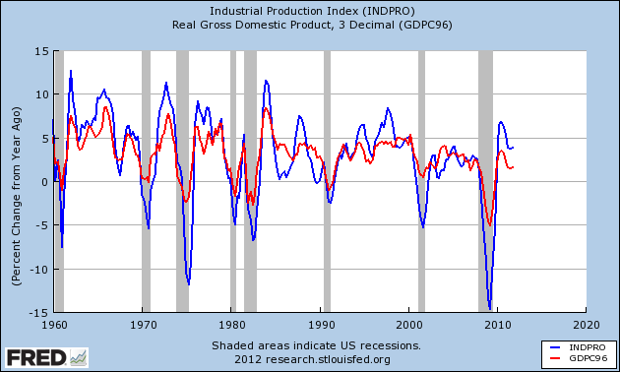
Industrial production and GDP (yoy)

Slide 14
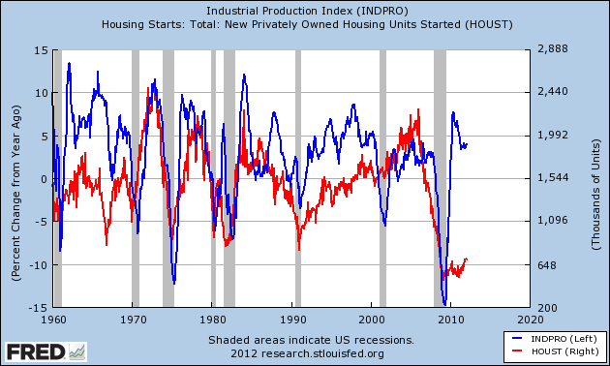
Housing starts

Slide 15
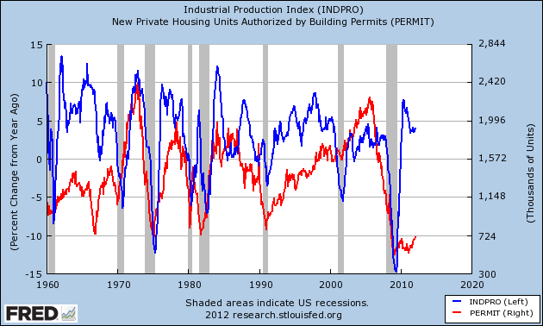
Building permits

Slide 16
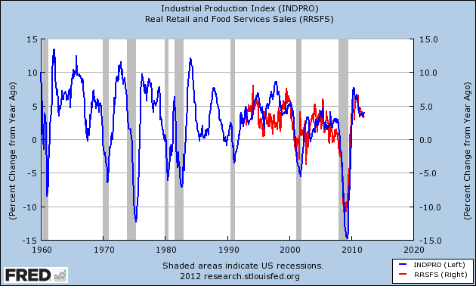
Retail sales (yoy growth)

Slide 17
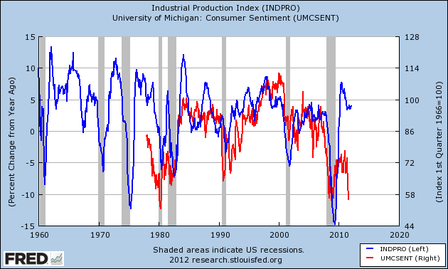
Consumer sentiment

Slide 18
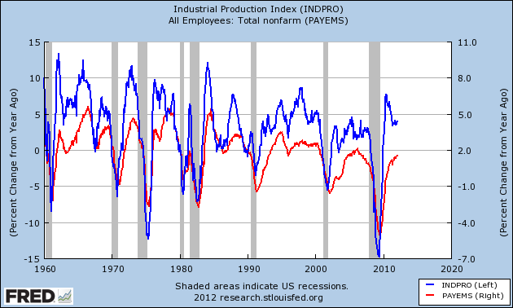
Employment (yoy growth)

Slide 19
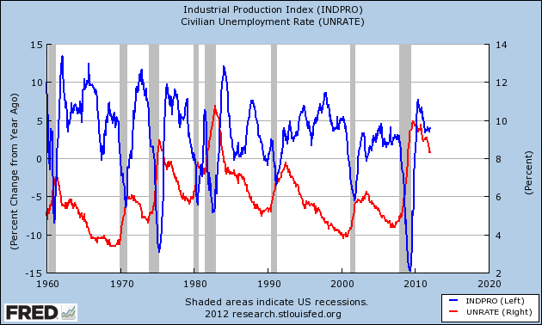
Unemployment rate

Slide 20
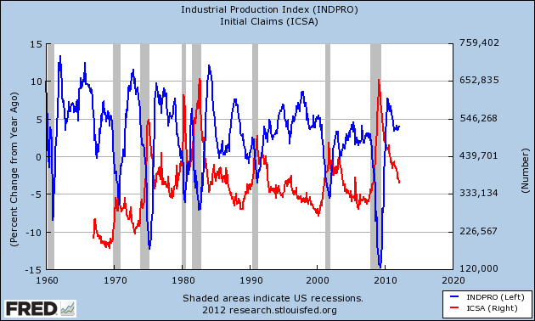
Initial claims for UI

Slide 21
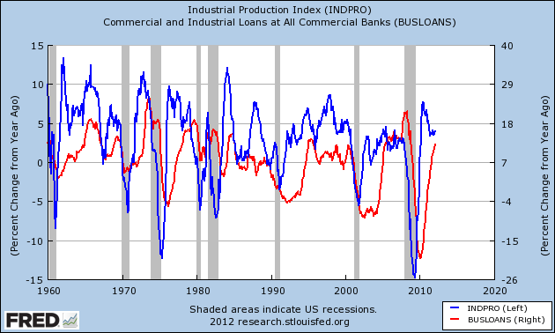
C & I loans (yoy growth)

Slide 22
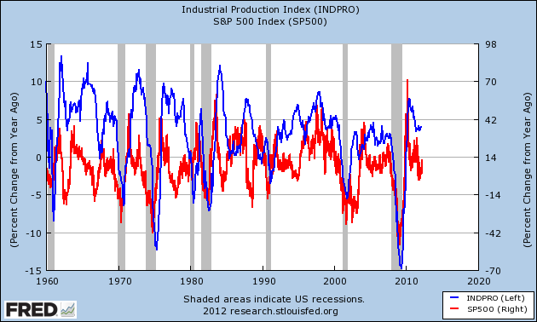
S&P 500 (yoy growth)

Slide 23
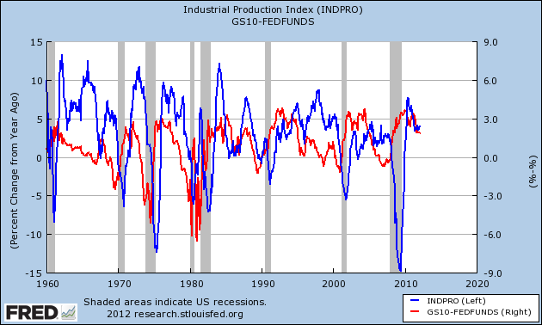
Term spread (10y – fed funds)

Slide 24
Indicator summary
Think about which indicators are
Procyclical
Countercyclical
Leading
Lagging
Coincident
Which ones do you like best?

Slide 25
Cross-correlations

Slide 26
Review: correlations
Correlations: a measure of (linear) association between two variables
Conveniently scaled between –1 and +1
The farther from zero, the stronger the association

Slide 27
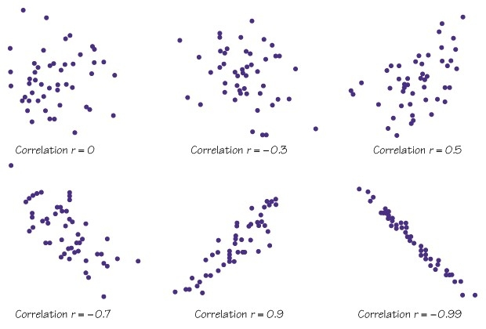
Review: correlations

Slide 28
The cross-correlation function
Look at the correlation between x and y
Plus: shift y back and forth in time (to see leads and lags)
Formally
ccf(k) = corr[x(t),y(t-k)]
If k<0: x leads y [or y lags x]
If k>0: x lags y [or y leads x]
Why? Makes a great picture

Slide 29
Cross correlation graphs
Pictures: plot ccf(k) against k
y = IP growth
x = indicator
Sample period: 1960 to present
Does indicator lead or lag IP growth?

Slide 30
Does employment lead or lag?

Slide 31
Contemporaneous correlation
Date | x(t) | y(t)
1 | 2.43 | 8.47
2 | 1.19 | 2.29
3 | 0.13 | 7.36
4 | 0.56 | 6.39
5 | 0.38 | 6.02
6 | 0.96 | 0.22
7 | 1.87 | 3.60
Reminder:
ccf(k) = corr[x(t),y(t-k)]
For k = 0:
ccf(0) = corr[x(t),y(t)]
Use data marked
Red for x
Blue for y

Slide 32
Lagging indicator
Date | x(t) | y(t)
1 | 2.43 | 8.47
2 | 1.19 | 2.29
3 | 0.13 | 7.36
4 | 0.56 | 6.39
5 | 0.38 | 6.02
6 | 0.96 | 0.22
7 | 1.87 | 3.60
Reminder:
ccf(k) = corr[x(t),y(t-k)]
For k = +1:
ccf(1) = corr[x(t),y(t-1)]
Means: x lags y
Use data marked
Red for x
Blue for y

Slide 33
Leading indicator
Date | x(t) | y(t)
1 | 2.43 | 8.47
2 | 1.19 | 2.29
3 | 0.13 | 7.36
4 | 0.56 | 6.39
5 | 0.38 | 6.02
6 | 0.96 | 0.22
7 | 1.87 | 3.60
Reminder:
ccf(k) = corr[x(t),y(t-k)]
For k = -1:
ccf(1) = corr[x(t),y(t+1)]
Means: x leads y
Use data marked
Red for x
Blue for y

Slide 34
Initial (“new”) claims (yoy)

Slide 35
Housing starts

Slide 36
Consumer sentiment (yoy)

Slide 37
S&P 500 (yoy)

Slide 38
Yield spread

Slide 39
The Conference Board indicators
Indicator
Average weekly hours, manufacturing
Average weekly initial claims for unemployment insurance
Manufacturers new orders, consumer goods
Vendor performance, slower deliveries index
Manufacturers new orders, non-defense capital goods
Building permits, new private housing units
Stock prices, 500 common stocks
Money supply, M2
Interest spread, 10 year T-bond less Federal Funds rate
Index of consumer expectations

Slide 40
Good indicators
Which ones have high correlations?
Which ones lead?
Which ones do you like best?
Warning: even the best indicators forecast the future poorly

Slide 41
Business cycle scorecard

Slide 42
Business cycle scorecard
Useful summary of lots of indicators
For each one:
Graph over time
Add lines for mean, +/- one std deviation
Rate indicator as strong positive, positive, negative, strong negative

Slide 43
Scorecard example

Slide 44
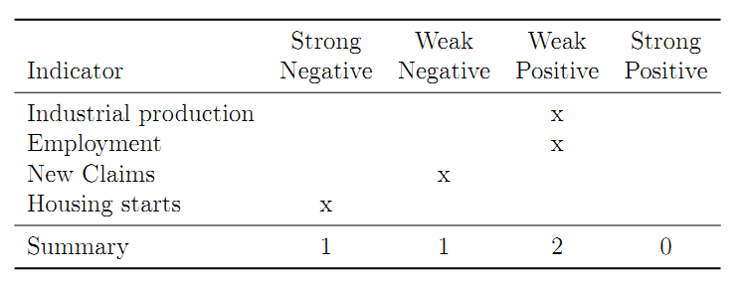
Business cycle scorecard

Slide 45
Business cycle scorecard
Coming up: Problem Set #3
Download indicators (FRED recommended)
Compute cross-correlation functions
Construct business cycle scorecard
Start soon!

Slide 46
What have we learned?
Lots of things move up and down with the economy
We can use these patterns to assess current and even future conditions
Useful tools
Cross-correlation function
Business cycle scorecard
Where can I learn more?
Forecasting course: B90.2302, Deo and Hurvich

Slide 47
The Global Economy Hyperinflation

Slide 48
The idea
Tom Sargent, interview, October 2011
The way to start a hyperinflation is run sustained government deficits and then have the monetary authority print money to pay for it. That always works. How do you stop a hyperinflation? You stop doing it. This isn’t high economic theory.
What is he saying? Does it make sense to you?

Slide 49
Roadmap
In the news
Inflation
Hyperinflation show and tell
Quantity theory
Money supply mechanics
How deficits enter the picture

Slide 50
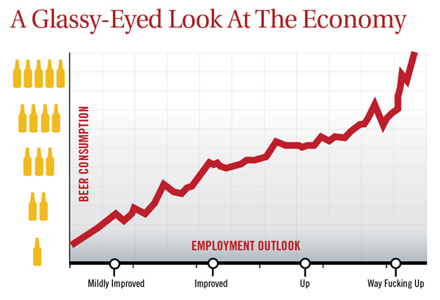
In the news
“Nation's Unemployment Outlook Improves Drastically After Fifth Beer,” The Onion.
Notes:
50
http://www.theonion.com/articles/nations-unemployment-outlook-improves-drastically,2792/

Slide 51
In the news
“Revolution in retreat,” The Economist, March 24, 2012, via Mike Morand:
Raúl Castro, who formally took over as Cuba’s president in February 2008 and as first secretary of the Communist Party in April 2011, is trying to revive the island’s moribund economy by transferring a substantial chunk of it from state to private hands, with profound social and political implications.
What’s going on? Good or bad?

Slide 52
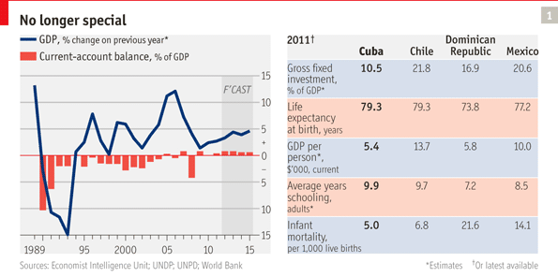
In the news
“Revolution in retreat,” The Economist, March 24, 2012, via Mike Morand:
What’s going on? Good or bad?

Slide 53
In the news
La Nacion, via Google translate, March 25, 2012
[Argentina's] Central Bank president, Mercedes Marco del Pont, said it “is totally false to say that the issue [of money] generates inflation.” She continued: ”only in Argentina does the idea remain that the expansion of the money [supply] generates inflation.”
What is she saying? Does it make sense to you?

Slide 54
Inflation
The price level P is the quantity of currency you need to buy a representative basket of goods and services
Inflation = increases in P
Goods cost more currency
Or: currency buys less (same thing, of course)
Deflation = decreases in P
Hyperinflation = annual inflation > 100%

Slide 55
Hyperinflation show and tell

Slide 56
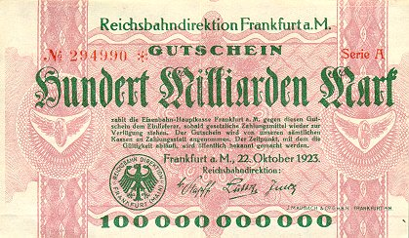
German currency
October 1923: 20 USD = 1 billion RM
Notes:
http://www.zum.de/whkmla/region/germany/turm2023.html

Slide 57
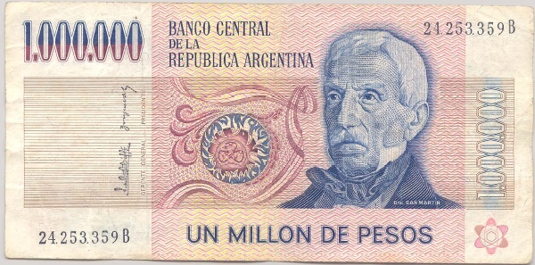
Argentine currency
This note dates from 1980s. What’s it worth now?

Slide 58

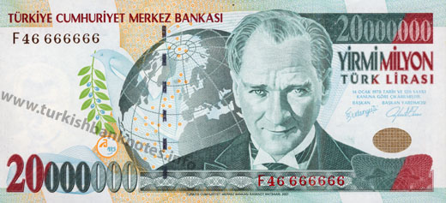
Turkish currencies
After 2008
Before 2008

Slide 59
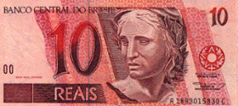
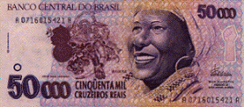
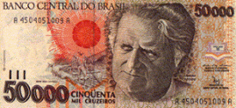
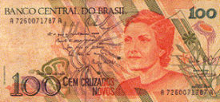
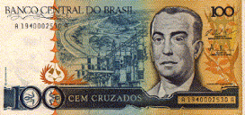
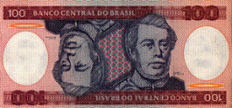

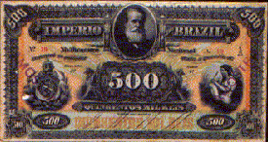
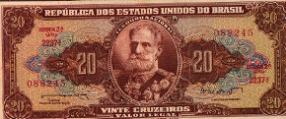
Brazilian currencies
REAL, Jun 1994 – present
CRUZEIRO REAL, Aug 1993 - Jun 1994
CRUZEIRO, Mar 1990 – Aug 1993
CRUZADO, Feb 1986 – Jan 1989
CRUZADO NOVO, Jan 1989 – Mar 1990
CRUZEIRO, May 1970 – Feb 1986
CRUZEIRO NOVO, Feb 1967 – May 1970
MIL-RÉIS, Oct 1833 – Oct 1942
CRUZEIRO, Oct 1942 – Feb 1967

Slide 60
Inflation in Argentina (annual %)
Source: EIU database.

Slide 61
Inflation in Brazil (annual %)
Source: EIU database.

Slide 62
Inflation in Russia (annual %)
Source: EIU database.

Slide 63
Inflation in Turkey (annual %)
Source: EIU database.

Slide 64
Inflation in Israel (annual %)
Source: EIU database.
Notes:
64

Slide 65
Israel in the 1980s
American Rabbi visiting Israel:
During Israel’s hyperinflation, I had a mortgage at a 5% fixed annual interest rate. As inflation increased, fixed rate mortgage payments became laughably easy to make, because salaries more or less kept pace with inflation. Finally, I received a notice canceling my mortgage, because the cost of record-keeping had become more than the monthly payment.

Slide 66
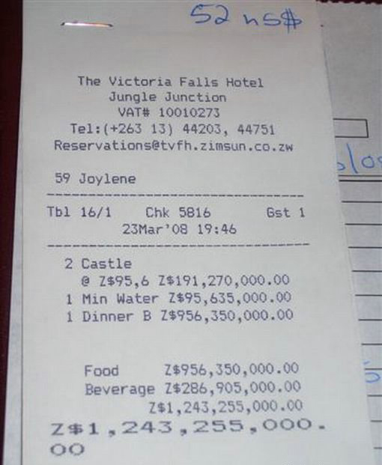

Buying lunch in Zimbabwe

Slide 67
Zimbabwe timeline
December 2006: inflation over 1000%
February 2007: inflation ruled illegal
October 2008: inflation over 200 million percent!
January 2009:
Transactions permitted in foreign currency
Soldiers and teachers to be paid in USD
February 2009: 12 zeros knocked off
April 2009: government abandons currency, people use USD (also South African rand – ZAR)

Slide 68
Highest inflation rates ever
Example | Highest Daily Inflation
Hungary, Jul 1946 | 207%
Zimbabwe, Nov 2008 | 98%
Yugoslavia, Jan 1994 | 65%
Germany, Oct 1923 | 21%
Notes:
68
Have you lived through a big inflation? What was it like?

Slide 69
The quantity theory of money

Slide 70
Quantity theory: picture
Money
Growth
Inflation

Slide 71
Quantity theory: words
The more currency (money) in circulation, the less each unit is worth

Slide 72
Quantity theory: math
One equation (technology for transactions)
M V = P Y
M = stock of money in circulation (amount of currency)
V = velocity (how often a unit of currency is used in a year)
P = price level (the GDP deflator or other price index)
Y = real GDP

Slide 73
Quantity theory: math
One equation (technology for transactions)
M V = P Y
In growth rates
γ_{M} + γ_{V} = γ_{P} + γ_{Y}
γ_{M} = growth of money supply (think: currency)
γ_{V} = growth of velocity
γ_{P} = growth of price level (inflation rate)
γ_{Y} = growth of real GDP

Slide 74
Quantity theory
Two hypotheses
V is constant (γ_{V} = 0)
Y not affected by changes in M [long-run approximation]
One conclusion
Money growth causes inflation
γ_{P} = γ_{M} – γ_{Y}
Notes:
74

Slide 75
Quantity theory: long-run evidence

Slide 76
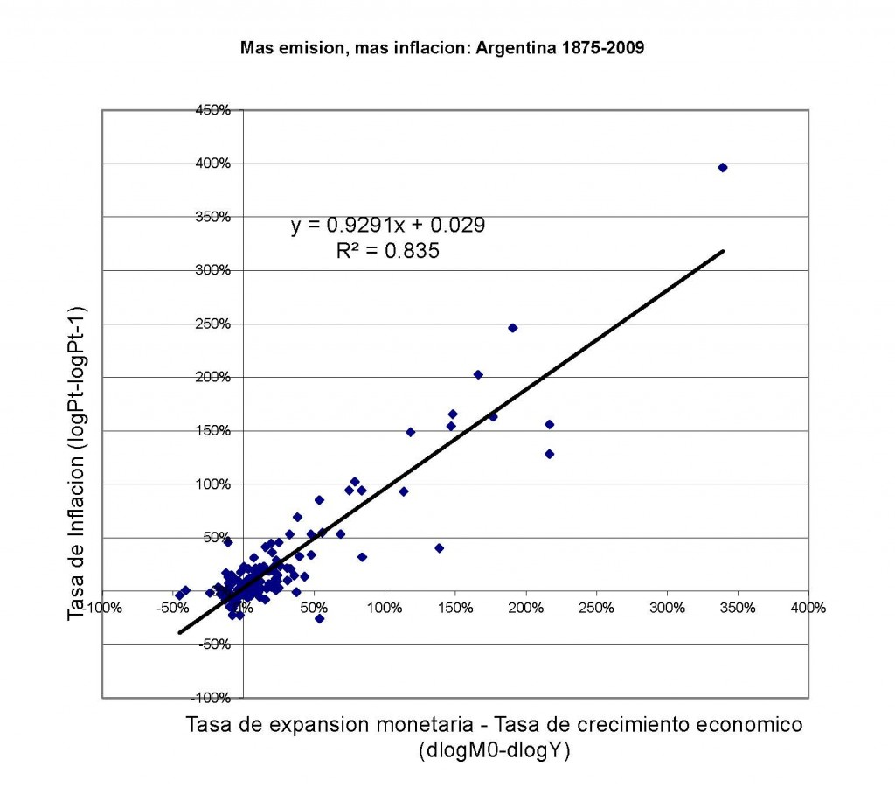
Quantity theory: long-run evidence

Slide 77
Quantity theory: short-run evidence

Slide 78
Quantity theory: small inflations
Lots of other things relevant in small inflations
Link between money and prices not as tight
More on this next week

Slide 79
Money supply mechanics

Slide 80
Money supply mechanics
How the central bank manages the money supply
Money = currency for our purposes
Look at balance sheets for
Treasury
Central bank
Private agents (households and firms)

Slide 81
Money supply mechanics
Treasury
Assets |  | Liabilities
 |  | Bonds | 200
Where does treasury debt come from?
How does central bank increase money supply?
Why do households go along?
Central bank
Assets |  | Liabilities
Bonds | 20 | Money | 20
Households and firms
Assets |  | Liabilities
Money | 20
Bonds | 180

Slide 82
Money supply mechanics
Treasury
Assets |  | Liabilities
 |  | Bonds | 200
Where do deficits come in?
Does there need to be a connection with money growth?
Why so in hyperinflations?
Central bank
Assets |  | Liabilities
Bonds | 20 | Money | 20
Households and firms
Assets |  | Liabilities
Money | 20
Bonds | 180

Slide 83
Quantity theory: revised picture
Government
Deficit
Money
Growth
Inflation

Slide 84
Hyperinflation recap
Hyper inflations stem from
Lack of fiscal discipline
Accommodation by central bank
How to stop them: stop doing it
Balance government budget
Make central bank independent, prohibit it from buying debt directly from Treasury

Slide 85
What have we learned?
Big inflation comes from
Big increases in money supply
Triggered by government deficits that can’t be financed any other way
Solution: Stop doing it.
Essential tools
Quantity theory
Central bank balance sheet

Slide 86
For the ride home
Would Argentina be better off using USD? Would the US be better off with gold?
Bonus topic: Google trends as indicators
Can search popularity be used to make better forecasts?
See (or search “ny fed search data”) http://libertystreeteconomics.newyorkfed.org/2012/01/forecasting-with-internet-search-data.html

