Slide 1

The Global Economy Introduction & Overview
Notes:
Open Gapminder (growth, corruption, mortality)
Also: course website

Slide 2
Roadmap
Gapminder
What’s happening this week?
What’s happening in the US?
What’s happening in Europe?
About the course

Slide 3
Gapminder
What do you see?
http://www.gapminder.org/world/
(growth, corruption, life expectancy, child mortality)

Slide 4
About participation
An important part of the class
And more fun for all of us
Ways to participate
Make a comment
Ask a question
Share an experience
Email current events for next class

Slide 5
About participation
Guidelines
Be courteous of others
But feel free to disagree politely – esp with me
Facts are always good
Experts: keep it short
Non-expert: don’t panic

Slide 6
What’s happening this week?

Slide 7
What’s happening this week?
Regular feature
Bring ideas, I’ll bring mine
Read The Economist
Order now if you haven’t already
Check Bloomberg and WSJ economic calendars

Slide 8
What’s happening this week?
Slow week?
Probably Wednesday: Euro meeting re Greece
Thursday: ECB & BOE policy announcements

Slide 9
What’s happening in the US?

Slide 10
Current conditions in the US
How’s the economy doing?
Where is it headed?
How can you tell?

Slide 11
Business questions
Start with a case or two? ??

Slide 12
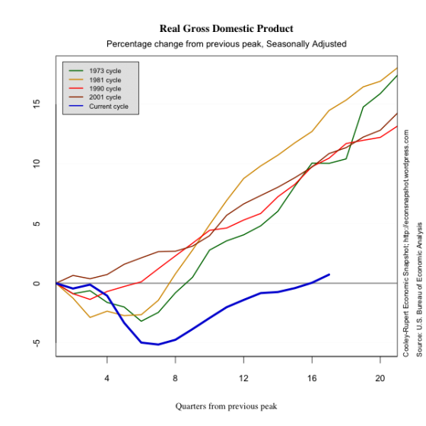
Real GDP
Source: Cooley-Rupert Snapshot

Slide 13
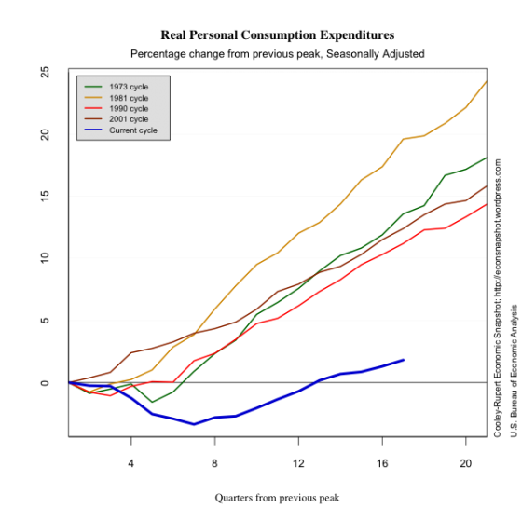
Consumption

Slide 14
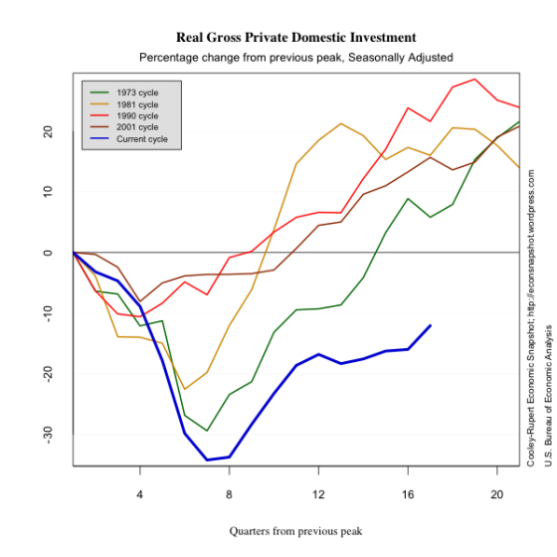
Investment

Slide 15
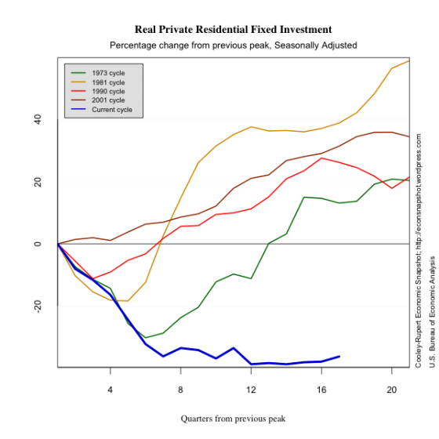
Housing

Slide 16
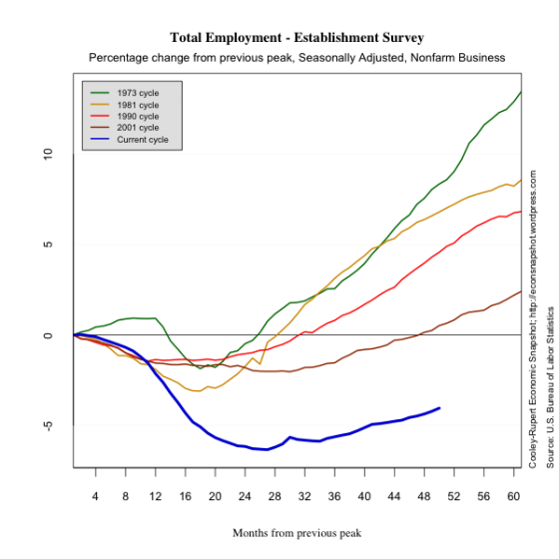
Employment

Slide 17
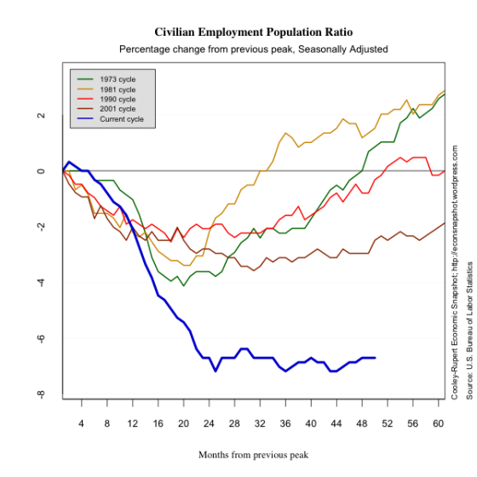
Employment rate

Slide 18
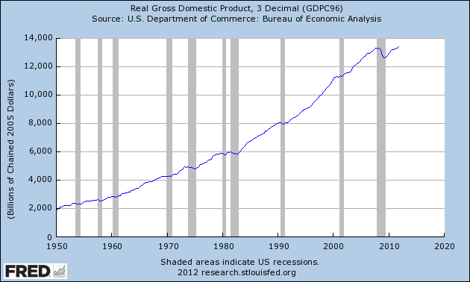
Real GDP (output)

Slide 19
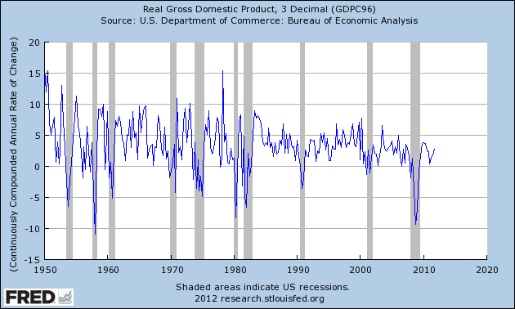
Real GDP growth (annual rate)
Source: FRED

Slide 20
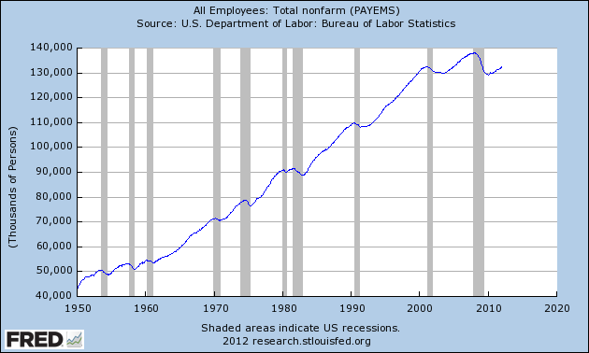
Employment (“nonfarm payroll”)

Slide 21
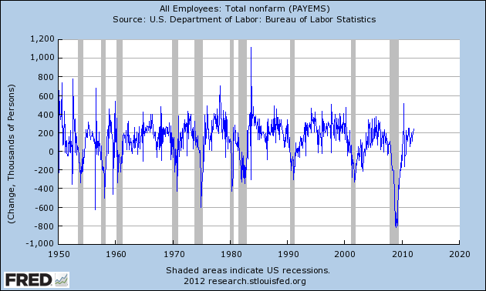
Employment (monthly change)

Slide 22
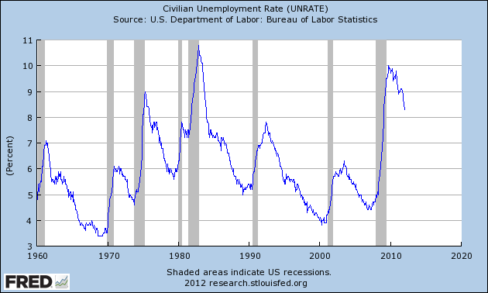
Unemployment

Slide 23
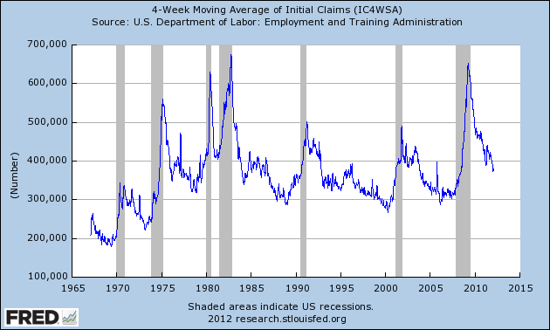
New claims for UI

Slide 24
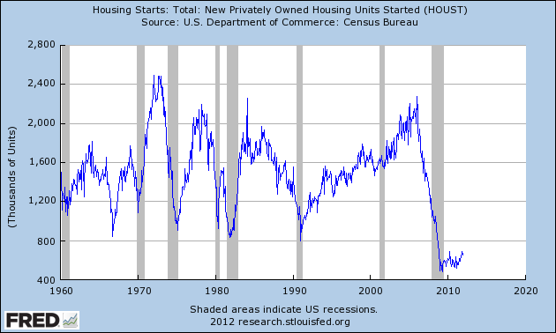
Housing starts

Slide 25
What’s happening in Europe?

Slide 26
Europe
What countries are in trouble?
What are the signs? The causes?

Slide 27
Europe
What are the classic crisis triggers?
Does Europe fit the pattern?

Slide 28
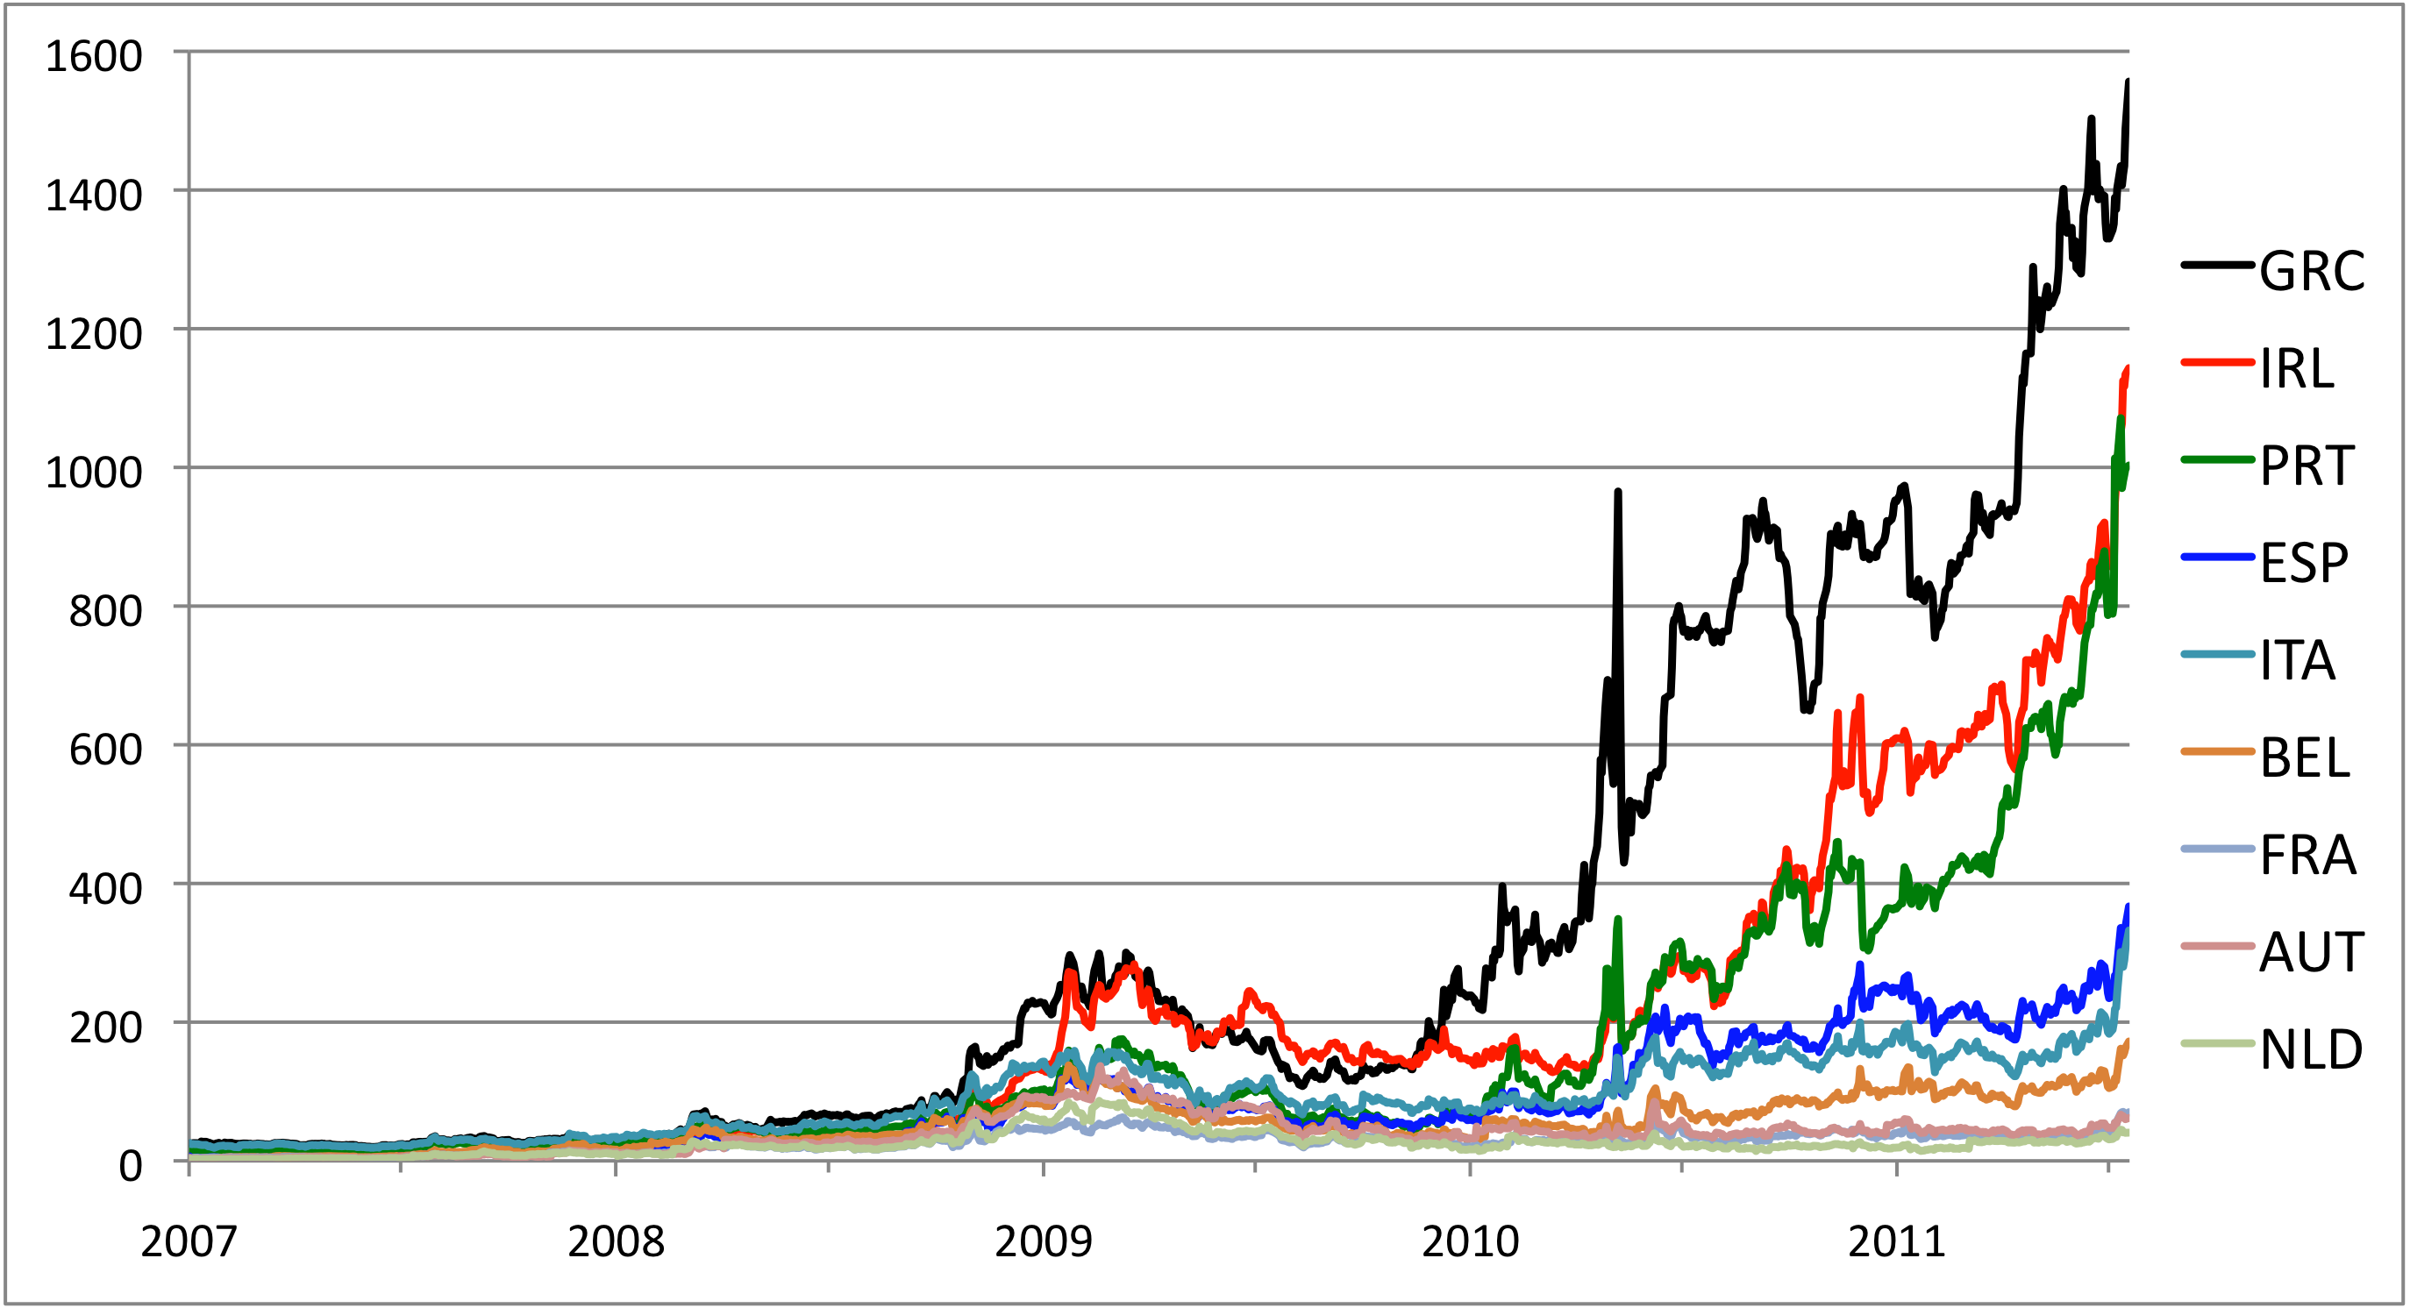
Sovereign yield spreads (bps)
Source: European Community, AMECO

Slide 29
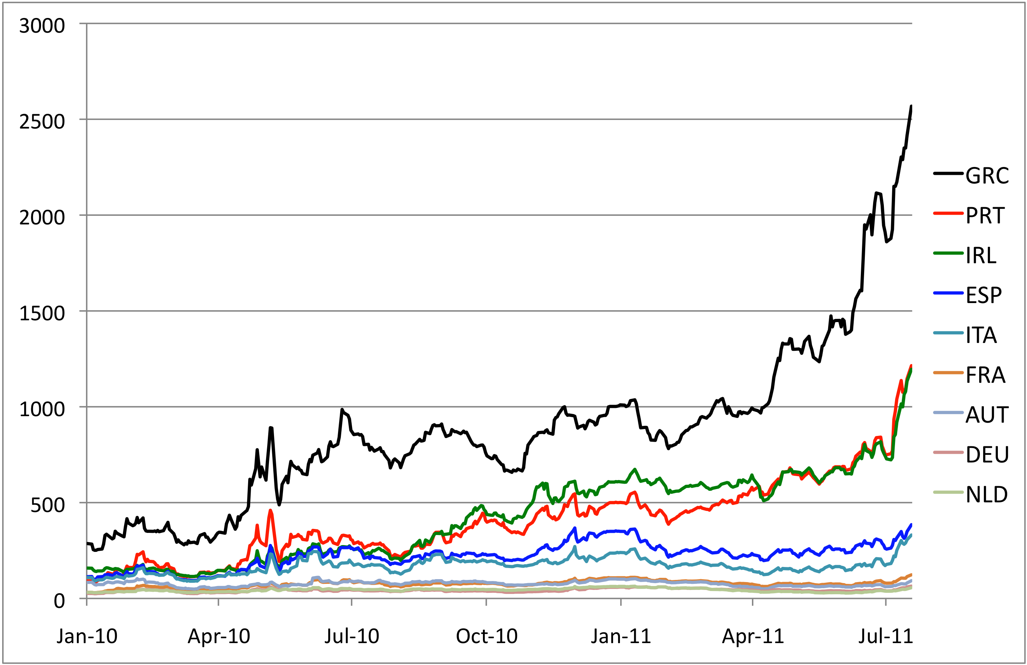
Five-year CDS premia (bps)
Source: Bloomberg

Slide 30
Govt debt (% of GDP)

Slide 31
Govt budget balance: total
Source: AMECO

Slide 32
Govt budget balance: primary
Source: AMECO

Slide 33
Real exchange rates (index, 1999=100)

Slide 34
Europe
What about the financial system? Cause or effect?
What about the exchange rate?
More later in the term

Slide 35
About the course

Slide 36
About the course
Long-term economic performance
Why are some countries richer than others?
Are low-wage countries attractive business opportunities?
Business cycles
Why does economic growth fluctuate?
Is now a good time to buy stocks?
Macroeconomic crises
Why do they happen?
Where are the opportunities?

Slide 37
About the website
Everything’s on the website: https://sites.google.com/site/nyusternglobal/
Outline contains
Notes
Assignments
Links to slides and video
Announcements, too
Sign up for email delivery (updates?)
Answers to questions about assignments – look there first
This is an experiment, suggestions welcome
[Discussion facility?]

Slide 38
About slides
Catalyst for class
Not intended to be read on their own (see notes instead)
More than we need: don’t panic if we skip some
Subject to change without notice

Slide 39
About assignments
Problem Set #0
Individual – everyone must do it
Due next week, start of class
Math and spreadsheet review
Problem Sets #1 to #4
Do in groups of up to five people
Unlimited marriage and divorce
Due dates noted in red on website
Practice Problems A to D
Not graded
Useful preparation for exams

Slide 40
About quantitative content
Spreadsheets
Used extensively (essential life skill)
Read “Math Review” to get up to speed
Exponents and logarithms
Used extensively in first half
Read “Math Review” to get up to speed
Calculus
Used a little
Not required for exams
Read “Math Review” to get up to speed

Slide 41
About the notes
Theoretical background for class
Executive summaries: more concise than a textbook
Custom designed for this course (“bespoke”)
Read them – preferably before class
No textbook! Save money!
If you’d like one, see Syllabus and Outline
Readings posted
Both good, fit with course 50 to 75%

Slide 42
About me
Grew up in Pittsburgh
PhD Yale, 1981
Research interests
International capital flows
Fixed income and currency markets
Emerging economies
Other interests
The Steelers
Basketball, biking, Buffy, beer

Slide 43
About the teaching fellows
Saturday: Olenna Tysiak, ogt202@stern.nyu.edu
Monday: Varun Bahl, vb680@stern.nyu.edu

Slide 44
About help
With problem sets
Check Announcements: I’ll post comments there
Email me: I’ll respond directly AND update Announcements
With anything else
Email me
Stop by any afternoon
See teaching fellow

Slide 45
About helping me
Course works best if communication goes both ways
If you have ideas, comments, whatever
Email me
Speak to the teaching fellow
Anything else that crosses your mind

Slide 46
About grades
Participation | Outliers & Tiebreakers
Problem Sets | 20%
Midterm Exam | 35%
Final Exam | 45%

Slide 47
About class videos
Available roughly an hour after class
Links on course website

Slide 48
What have we learned?
As Haiku
Read notes before class
If you need help ask for it
Website is knowledge

Slide 49
The Global Economy Macroeconomic Data

Slide 50
Objective
Know what these headline numbers are
Real GDP: how much stuff did we produce? growth rate?
Inflation: how much did average prices change?
Why do we need this?
Common vocabulary (like financial statements for businesses)
Small differences often important
Do at high speed now, reinforce with constant use

Slide 51
US GDP growth
Source: FRED

Slide 52
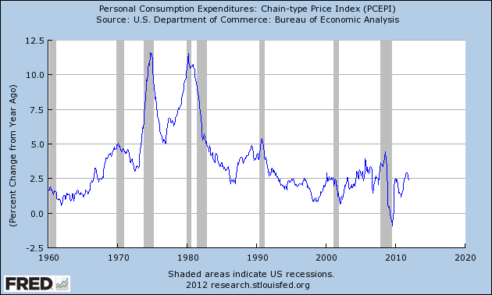
US inflation
Source: FRED

Slide 53
GDP per capita (USD, PPP adj)
Source: World Bank, World Development Indicators

Slide 54
Growth in GDP per capita (20-year avg)
Source: Penn World Tables.

Slide 55
Growth in GDP per capita (2012 forecast)
Source: OECD.

Slide 56
Roadmap
GDP: Gross Domestic Product
Expenditures and financial flows (“identities”)
Prices and quantities
Second thoughts

Slide 57
GDP

Slide 58
GDP
GDP: = Gross Domestic Product
Total value of production in a geographic area
Sum value-added across all production units
By convention we include depreciation (“gross”)
Three approaches to the same answer
Value-added
Income
Final sales (the end of the value chain)

Slide 59
GDP: example 1
Example
Farmer produces wheat, sells it for 100
Miller buys wheat, produces flour, sells it for 175
Baker buys flour, makes bread, sells it for 300
What is value-added for each producer?
What is GDP?
What is total income for the economy?
What is final sales?

Slide 60
GDP example 1
Producer | Value Added = Income | Final Sales
Farmer
Miller
Baker
GDP (total)

Slide 61
GDP: more examples ??
Do examples with investment and government
Add one for them to do in class

Slide 62
GDP example 2
Brewer
Sales = $110
Rent = $30
Wages = $70
Barley = $10
Value Added = ??
Barley Farmer
Sales = $10
Rent = $3
Income = $7
Value Added = ??
Value added farming + value added brewing = ??
Landlord’s income + wages + profits = ??
Final sales farming + final sales brewing = ??

Slide 63
GDP as value added by industry
mfg
FIRE
bus. services
agriculture
Source: BEA
Notes:
Agriculture, Manufacturing, FIRE, Business Services

Slide 64
GDP as income by type
labor comp.
rental income
corp. profits
interest

Slide 65
GDP as final sales by expenditure
private cons
gov. cons
investment
net exports

Slide 66
Expenditures & financial flows

Slide 67
Expenditure flows
Allocate GDP among purchasers of final goods:
Y = C + I + G + NX
Y = GDP
C = sales to households (“consumption”)
I = sales of capital goods to firms (“investment”)
G = purchases of goods and services by government
NX = net exports (net sales to other countries)

Slide 68
Saving flows 1
Allocate flows of assets
Y – C – G = I + NX
S = I + NX
S = gross domestic saving (purchases of assets)
NX = net purchases of foreign assets

Slide 69
Saving flows 2
Separate household and government
(Y – C – T) + (T – G) = I + NX
S_{p} + S_{g} = I + NX
T = taxes net of transfers paid by households to govt
Warning: many measures of saving, all different

Slide 70
Saving flows 3
Do Americans save too little?

Slide 71
US saving and investment
investment
saving
net exports

Slide 72
Household net worth
Source: Flow of Funds Accounts
Notes:
Table L.10

Slide 73
Prices & quantities

Slide 74
Prices and quantities
GDP measures output at market prices
What if prices change?
If GDP rises, how much is higher quantity, how much higher prices?
Problem: no clear answer, we do muddle through

Slide 75
Prices and quantities
Our problem: find Q and P such that
Y = PQ = p₁q₁ + p₂q₂ + etc
Y = GDP in dollars (“nominal GDP”)
p,q = price and quantity of a product
P,Q = “average” price (“price level”) or quantity (“real GDP”)
How do we compute P and Q?

Slide 76
Prices and quantities
Method 1 (“fixed price method”)
Find average quantity Q using “base-year” prices
Find “average” price from P = Y/Q (“deflator”)
Method 2 (“fixed quantity method”)
Find average price P using “base-year” quantities
Find “average” quantity from Q = Y/P
Problems
Both make sense, but answers are different
Choice of base year matters too

Slide 77
Example
 | Fish |  | Chips
Date | Price | Quantity | Price | Quantity
2004 | 0.50 | 10 | 0.25 | 10
2005 | 0.75 | 12 | 0.50 | 8
What is the inflation rate?
What is real output growth?

Slide 78
Fixed price method (GDP deflator)
 | Fish |  | Chips
Date | Price | Quantity | Price | Quantity
2004 | 0.50 | 10 | 0.25 | 10
2005 | 0.75 | 12 | 0.50 | 8
Date | Nominal GDP | Real GDP | Price Deflator
2004
2005
Growth rate
Base year: 2004

Slide 79
Fixed price method (GDP deflator)
 | Fish |  | Chips
Date | Price | Quantity | Price | Quantity
2004 | 0.50 | 10 | 0.25 | 10
2005 | 0.75 | 12 | 0.50 | 8
Date | Nominal GDP | Real GDP | Price Deflator
2004 | 7.50 | 7.50 | 1.000
2005 | 13.00 | 8.00 | 1.625
Growth rate | 73.3% | 6.7% | 62.5%
Base year: 2004

Slide 80
Fixed price method (GDP deflator)
 | Fish |  | Chips
Date | Price | Quantity | Price | Quantity
2004 | 0.50 | 10 | 0.25 | 10
2005 | 0.75 | 12 | 0.50 | 8
Date | Nominal GDP | Real GDP | Price Deflator
2004
2005
Growth rate
Base year: 2005

Slide 81
Fixed price method (GDP deflator)
 | Fish |  | Chips
Date | Price | Quantity | Price | Quantity
2004 | 0.50 | 10 | 0.25 | 10
2005 | 0.75 | 12 | 0.50 | 8
Date | Nominal GDP | Real GDP | Price Deflator
2004 | 7.50 | 12.50 | 0.600
2005 | 13.00 | 13.00 | 1.000
Growth rate | 73.3% | 4.0% | 66.7%
Base year: 2005

Slide 82
Fixed quantity method (CPI)
 | Fish |  | Chips
Date | Price | Quantity | Price | Quantity
2004 | 0.50 | 10 | 0.25 | 10
2005 | 0.75 | 12 | 0.50 | 8
Date | Price Index (2004 Basket) | Price Index (2005 Basket)
2004
2005
Growth rate

Slide 83
Fixed quantity method (CPI)
 | Fish |  | Chips
Date | Price | Quantity | Price | Quantity
2004 | 0.50 | 10 | 0.25 | 10
2005 | 0.75 | 12 | 0.50 | 8
Date | Price Index (2004 Basket) | Price Index (2005 Basket)
2004 | 7.50/7.50*100=100.0 | 8.00/8.00*100=100.0
2005 | 12.50/7.50*100=166.7 | 13.00/8.00*100=162.5
Growth rate | 66.7% | 62.5%

Slide 84
Prices in Argentina
Former president instituted “new methodology”
Only certain products are in the official price index
Prices of those products subject to “persuasion”
Inflation lower with new method
What happened next
Official products cheap, but not available (why?)
Unofficial estimates of inflation more than double official rate
Economists arrested for producing private inflation estimates
[Google: “inflation Argentina”]

Slide 85
Second thoughts

Slide 86
Do we care about GDP?
Bill Gates
“You can’t eat GDP.”
Bill Easterly
“Mr Gates apparently missed the economics lecture that listed the components of GDP, such as food.”
WSJ, March 2007

Slide 87
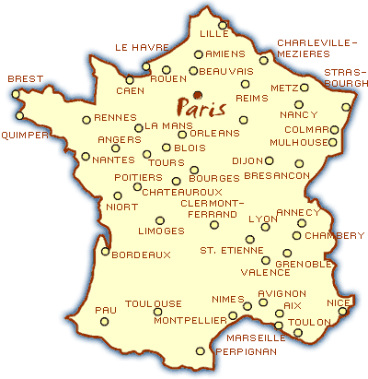
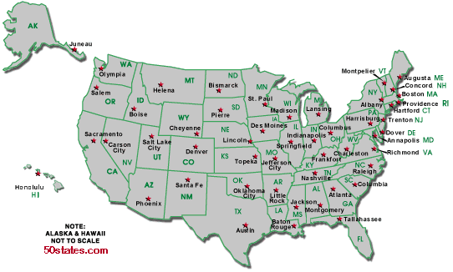
Do we care about GDP?
Per capita GDP: $47k
Per capita GDP: $34k
Avg weekly hours: 35
Avg weekly hours: 29

Slide 88
Do we care about GDP?
The obvious
GDP reflects income and standard of living
The less obvious
Correlated with many other things we care about: life expectancy, child mortality, poverty
Recall Gapminder
It’s one number, not the answer to all questions

Slide 89
Details, details
Home production not counted in GDP
Black market transactions not counted either
Government services are valued at cost
Some “income” not in GDP
Capital gains (houses, equity)
Interest on government debt
Net return from owning foreign assets
Need to adjust prices for new and different products

Slide 90
Macroeconomic data
Caption for old New Yorker cartoon:
“Final, revised government figures for the fourth quarter of 1981 now indicate that the Yankees, not the Dodgers, won the World Series.”

Slide 91
What have we learned?
GDP measures output and income
Per capita GDP wildly different across countries
Composition always changing (where did those factory jobs go?)
Labor gets about 2/3, “capital” 1/3
Real GDP measures the quantity of output
Inflation measures the change in average prices
Macroeconomic data are like sausages

Slide 92
Something for the ride home
Is aid good for developing countries?
Why or why not?

