Slide 1

The Global Economy Labor Markets

Slide 2
The idea
Regulation can be good or bad
Can facilitate productive activity
Can also be an obstacle to it
Needed: balance
Today’s examples
Labor markets (first half)
Financial markets (second half)
Both essential to economic performance

Slide 3
Roadmap
In the news
Discussion: regulation good and bad
What’s going on in France?
Labor market indicators
Labor market analysis
Labor market institutions: “protection” v “flexibility”
What’s going on in Denmark?

Slide 4
In the news
“Protected and inefficient,” The Economist, Feb 18, 2012
Regulation of professional services is stricter in Germany than in all but 5 of the 27 countries ranked by the OECD. Only qualified pharmacists can own a pharmacy. Mario Monti notes that there is “still lots of room to liberalize” law and medicine, too.
What’s going on here? Who wins? Who loses?

Slide 5
In the news
ISDA, Mar 1, 2012 (rough paraphrase)
We were asked whether any agreements to date on restructuring Greek debt constitute Restructuring Credit Events. The Committee determined that it had not received any evidence of such an agreement and therefore unanimously determine that a Restructuring Credit Event has not occurred.
What’s going on here? Who wins? Who loses?

Slide 6
In the news
“China’s Billionaire Congress,” Bloomberg, Feb 27 2012
The net worth of the 70 richest delegates in China’s National People’s Congress, which opens its annual session on March 5, rose to 565.8 billion yuan ($89.8 billion) in 2011, a gain of $11.5 billion from 2010, according to figures from the Hurun Report.
[The wealthiest member of the US Congress is Darrell Issa, who had a maximum wealth of $700 million in 2010.]
What’s going on here? Who wins? Who loses?

Slide 7
In the news
“Dangermen,” The Economist, Feb 18, 2012:
A plaque markets the spot in Rome where Professor D’Antona was assassinated in 1999 by the Red Brigades. He was killed because he was working on plans for greater flexibility of Italy’s labor market. Marco Biagi, who took up his standard, was murdered by the same group three years later. The two killings testify to the resistance to reform in a country where jobs-for-life is the culture and youth unemployment is over 30%.
What’s going on here? Who wins? Who loses?

Slide 8
In the news
Adam Davidson, “London and New York,” NY Times, Feb 29, 2012
Every month, some young bureaucrat in the Chinese State Administration of Foreign Exchange reaches out to a trader in London and buys or sells billions of dollars’ worth of U.S. Treasury bonds. You’ve heard the overblown fears that China owns too much U.S. debt, but you might not realize that it’s a British firm that regularly gets the commission. That’s because London is the world’s largest market for dollars.
What’s going on here? Who wins? Who loses?

Slide 9
In the news
France …. http://www.businessweek.com/articles/2012-05-03/why-france-has-so-many-49-employee-companies
What’s going on here? Who wins? Who loses?

Slide 10
Regulation good and bad
James Surowiecki, New Yorker, June 10, 2010
Regulation isn’t an obstacle to thriving markets, it’s a vital part of them.
Examples of good regulation? Bad?

Slide 11
Cases
You run a software company in France
Expand in France or move elsewhere?
What are the issues? ??

Slide 12
What’s going on in France?

Slide 13
What’s going on in France?
Christopher Caldwell, Financial Times, Feb 05:
In early 2000, when the French unemployment rate was 9.6%, Martine Aubry, the Socialist labour minister, shepherded into law a bill that capped the work-week of most employees at 35 hours. She called it “a necessity for job creation.” Today, the unemployment rate stands at 9.9% … and French labour participation is rock-bottom among developed countries.
What’s going on here? Who wins? Who loses?

Slide 14
What’s going on in France?
Financial Times, Feb 12 07:
Presidential candidate Segolene Royal laid out her economic vision: increase the minimum wage, scrap laws that make it easier for small companies to hire and fire employees.
What’s going on here? Who wins? Who loses?

Slide 15
What’s going on in France?
The Economist, Feb 1 07:
France’s Nicolas Sarkozy took his campaign to London, calling it “one of the biggest French cities.” London is thought to have at least 300,000 French citizens – and voters. Journalists noted that France’s unemployment rate is 8.6%, compared with 5.5% in Britain, and has not dipped below 8% for nearly 25 years.
What’s going on here? Who wins? Who loses?

Slide 16
What’s going on in France?
How do France and the US compare?
Unemployment?
Employment?
Hours worked?
GDP per capita?

Slide 17
Unemployment rate
France
US
Source: OECD.

Slide 18
Employment rate
US
France
Source: OECD.

Slide 19
Hours worked
US
France
Source: OECD.

Slide 20
What’s going on in France?
Why is GDP per capita lower in France?
 | Y/POP | L/POP | h
US | 34,875 | 0.514 | 1806
France | 25,664 | 0.451 | 1532
Ratio | 1.36 | 1.14 | 1.18
Log of ratio (%) | 30.7 | 13.1 | 16.5
Source: OECD and Penn World Tables, 2005.

Slide 21
What’s going on in France?
Compare to GDP per hour worked:
Y/POP = (Y/hL) (L/POP) h
 | Y/POP | Y/L | Y/hL
US | 34,875 | 67,865 | 37.58
France | 25,664 | 56,909 | 37.12
Ratio | 1.36 | 1.19 | 1.012
Log of ratio (%) | 30.7 | 17.6 | 1.1
Source: OECD and Penn World Tables, 2005.

Slide 22
What’s going on in France?
How would you summarize the evidence?
Explain it?

Slide 23
Labor Market Indicators

Slide 24
Employment “status” in the US
Noninstitutional, civilian population
Source: BLS, Jan 2012.

Slide 25
Standard indicators
Employment rate = employed/working-age population
Labor force = employed + unemployed
Unemployment rate = unemployed/labor force
Participation rate = labor force/working-age population
Inactivity rate = out of labor force/working-age population
Hours worked = average hours worked of employed people

Slide 26
Employment status in the US
Labor force =
Employment rate =
Unemployment rate =
Participation rate =
Source: BLS, Jan 2012.

Slide 27
Employment status in the US
Labor force = 154.395
Employment rate = 54.5% [??]
Unemployment rate = 8.3%
Participation rate = 63.7%
Source: BLS, Jan 2012.

Slide 28
Ways to reduce unemployment
Unemployed get jobs
Raises employment rate
Unemployed leave labor force
Employment rate doesn’t change
Unemployment rate falls
Which is more informative
Employment or unemployment?

Slide 29
Unemployment rates
Source: OECD.

Slide 30
Unemployment rates, youths
Source: OECD.

Slide 31
Employment rates
Source: OECD.

Slide 32
Hours worked
Source: OECD.

Slide 33
Labor Market Analysis

Slide 34
Why unemployment?
What would you suggest?
Are jobs like apples? hotel rooms? something else?

Slide 35
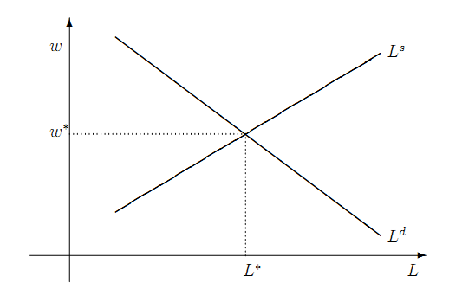
Frictionless labor market model

Slide 36
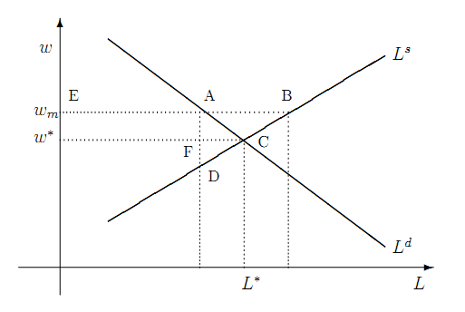
Institution: minimum wage

Slide 37
Institution: minimum wage
What happens to unemployment? Why?
Who wins in the model? Who loses?
Who wins in the real world? Who loses?

Slide 38
Minimum wage (fraction of median)
Source: OECD.

Slide 39
Institution: minimum wage
Milton Friedman (paraphrase)
The minimum wage is discrimination against people with low skills, because it forces firms to pay a wage greater than their skill supports. As a result, many of them are unemployed, rather than working and developing skills that would improve their prospects.
Do you agree or disagree? Why?

Slide 40
Institution: minimum wage
Gary Becker, Becker-Posner blog:
Generous minimum wages and other rigidities of the French labor market caused unemployment rates that have remained stubbornly high. Immigrants, youths, and other new entrants into the labor market have been hurt the most.
Do you agree or disagree? Why?

Slide 41
Labor Market Institutions

Slide 42
“Protection” v “flexibility”
Doing Business, 2006
Least flexible labor market = Portugal
Most flexible labor market = New Zealand
Use them as examples
Employment protection law (EPL) governs
Fixed term contracts
Overtime compensation
Dismissal
Collective bargaining

Slide 43
“Protection” v “flexibility”
Fixed-term contracts
PRT Fixed term contracts allowed only in special situations (such as seasonal activity)
NZL Fixed term contracts are unrestricted, with no maximum duration period
Source: Botero, Djankov, La Porta, Lopez-de-Silanes, Shleifer, Regulation of Labor.

Slide 44
“Protection” v “flexibility”
Overtime
PRT Mandatory premium for overtime ranges from 50% to 75%, additional restrictions on night work, and there are 24 days of paid leave per year.
NZL No required premium for overtime, no restrictions on night work, and the minimum paid leave is 15 days per year.
Source: Botero, Djankov, La Porta, Lopez-de-Silanes, Shleifer, Regulation of Labor.

Slide 45
Rigidity of hours (index)
Source: World Bank, Doing Business.
Notes:
45

Slide 46
“Protection” v “flexibility”
Dismissal
PRT List of fair grounds for terminations and stringent procedures for dismissals, such as mandatory notification of the government and priority rules for re-employment of redundant workers.
NZL Allows “contracts at will,” which can be terminated without notice without cause.
Source: Botero, Djankov, La Porta, Lopez-de-Silanes, Shleifer, Regulation of Labor.

Slide 47
Firing costs (weeks of wages)
Source: World Bank, Doing Business.
Notes:
47

Slide 48
“Protection” v “flexibility”
Collective bargaining
PRT Employers have a legal duty to bargain with unions, collective agreements are extended to third parties by law, workers councils are mandatory, and employer lockouts are prohibited.
NZL Employers have no legal obligation to bargain with unions, collective agreements are not extended, labor participation in management is not required, and employer lockouts are allowed.
Source: Botero, Djankov, La Porta, Lopez-de-Silanes, Shleifer, Regulation of Labor.

Slide 49
Union rights (index)
Source: Botero, Djankov, La Porta, Lopez-de-Silanes, Shleifer, Regulation of Labor.

Slide 50
Employment protection overall (index)
Source: OECD.

Slide 51
Employment protection over time
Source: Blanchard and Wolfers.

Slide 52
France revisited
What happened?
Would you build a plant there? Locate a bank?

Slide 53
France
New York Times, Oct 9, 2005
The French government is trying to make it easier for small companies to lay off workers. … Some European experts say that French and German leaders are at least looking at the heart of the unemployment problem: that companies are not likely to hire more freely unless they can fire more freely. As economist Katinka Barysch put it, “the best place to lose your job is in a country where it's easiest to find a new job.”
What’s going on here? Who wins? Who loses?

Slide 54
India
Shankar Acharya, “Ten myths about India,” FT Forum, Feb 1, 2010
Myth 4. Our labor laws protect labor. Quite the opposite. Present laws overprotect a tiny minority at the expense of the mast majority of workers. By making it extremely difficult to fire workers, our laws massively discourage the employment of new workers. They lead to huge under-utilization of our most abundant resource, low-skill labor.
What’s going on here? Who wins? Who loses?

Slide 55
Brazil
EIU, Country Commerce Report
The 1988 federal constitution contains several important labour provisions: it legalises unions, collective bargaining negotiations, and the right to strike in both the public and private sectors. The constitution also sets overtime rates, provides a monthly minimum wage and regulates working hours. It lists a variety of labour entitlements, including the following: maternity leave, annual leave, workers’ compensation, social services, medical assistance and unemployment benefits.
What’s going on here? Who wins? Who loses?

Slide 56
Japan
EIU, Country Commerce Report
Japan’s labour system traditionally featured lifetime employment, elaborate fringe benefits, and wages based on length of service rather than performance. Most Japanese companies are finding this system increasingly difficult to sustain. But changing the social contract of lifetime employment has been difficult. The result is a massive number of unneeded workers in virtually every industry. The rigidity of the job market is partly offset by the growing presence of non-regular and part-time workers willing to work for less pay with no job security at all.
What’s going on here? Who wins? Who loses?

Slide 57
Italy
http://johnhcochrane.blogspot.com/2012/06/sand-in-gears.html

Slide 58
What’s going on in Denmark?

Slide 59
Denmark’s “flexicurity” model
Flexible labor markets
Flexible hours, easy to fire people
Strong support for unemployed
Training programs
Subsidies to employers
Results
Flexible labor market
Security for unemployed
Cost is 4-5% of GDP [OECD average 0.5%]

Slide 60
Denmark’s “flexicurity” model
World Economic Forum
Denmark continues to distinguish itself as having one of the most efficient labor markets internationally, with more flexibility in setting wages, firing, and therefore hiring workers than in the other Nordics and in most countries more generally.
Who wins? Who loses?

Slide 61
What have we learned?
Wide variation in labor market institutions
Something to keep in mind when you’re operating in another country
Also variation in “outcomes”
Employment, unemployment, hours …
In flexible labor markets
Easier to lose a job
Easier to get one
Who wins? Who loses?

Slide 62
After the break
Be prepared to discuss Ghana

Slide 63
The Global Economy Volatility & Financial Markets

Slide 64
Roadmap
Ghana mini-case
Volatility
The capital markets “game”
Financial market institutions
Crisis management

Slide 65
Ghana mini-case
What features do you need in this business?
How does Ghana stack up?
Good idea – or not?

Slide 66
The idea
Good economic performance requires effective labor and financial markets
Especially in a volatile economic environment
Financial markets are harder to get right
They require lots of “infrastructure”
“That where the money is”
Periodic financial crises

Slide 67
Volatility

Slide 68
Volatility
Marx and Engels, Communist Manifesto, 1848
Everlasting uncertainty and agitation distinguish the bourgeois epoch from all earlier ones. All fixed, fast frozen relations … are swept away, all new-formed ones become antiquated before they can ossify. All that is solid melts into air, all that is holy is profaned, and man is at last compelled to face with sober senses his real condition of life and his relations with his kind. All old-established national industries have been destroyed or are daily being destroyed. They are dislodged by new industries, whose introduction becomes a life and death question for all civilized nations.
Does this sound right to you?

Slide 69
Volatility
Joseph Schumpeter, Capitalism, Socialism and Democracy
The fundamental impulse that sets and keeps the capitalist engine in motion comes from the new consumers, goods, the new methods of production or transportation, the new markets, the new forms of industrial organization that capitalist enterprise creates. This process of Creative Destruction is the essential fact about capitalism. In capitalist reality, competition … strikes not at the margins of the profits and the outputs of the existing firms but at their foundations and their very lives.
Does this sound right to you?

Slide 70
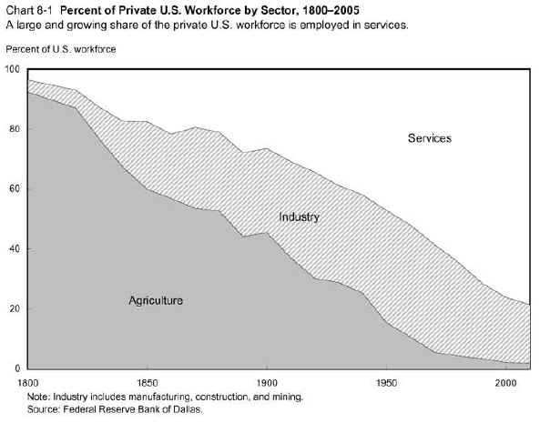
Volatility

Slide 71
Volatility
Millions of farm jobs lost
Millions of industrial jobs lost
Where did they go?

Slide 72
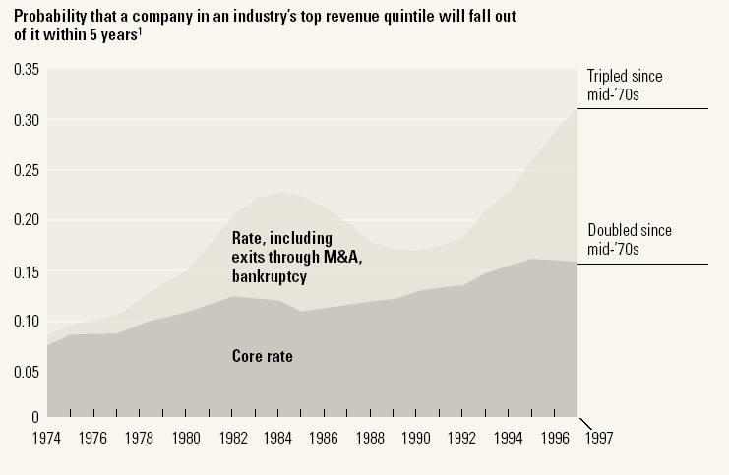
Volatility
Source: McKinsey Quarterly, “Extreme competition,” 2005.

Slide 73
Volatility
Products come and go
Firms come and go
Industries come and go
Good or bad?
What does this mean for labor and capital?

Slide 74
Volatility
If the world is volatile, do you want
“Fixed, fast relations”?
“Creative destruction”?
Why?

Slide 75
Capital markets game

Slide 76
Capital markets game
A bit of game theory…
Parameters:
Borrower has project that generates 100 + 15
Lender offers 100 to borrower for one year
Lender’s cost of funds is 5%, charges 10%, the competitive risk-adjusted rate
In default, borrower uses up 50, keeps the rest
Where’s the value in this game?
Who gets it?

Slide 77
Capital markets game
Don’t lend
Payoffs = (0,0)
L
(+5,+5)
Repay
Lend
B
Default
(–105,+65)
What’s the outcome? What can we do about it?
Notes:
77
Note: economic activity creates value

Slide 78
Capital markets game
Don’t lend
Payoffs = (0,0)
L
(+5,+5)
Repay
Lend
B
0
X
Default
(–105,+65)
What’s the outcome? What can we do about it?
Notes:
78
Note: economic activity creates value

Slide 79
Capital markets game
Note: creditor rights are good for borrowers
If default is attractive, lenders don’t lend
Result: projects not funded, TFP lower than it could be
Evidence
States/countries with stronger creditor rights have more lending, lower rates
Also higher GDP per capita

Slide 80
Financial market institutions

Slide 81
Financial market institutions
Obvious: enforce property rights
Protect creditors
Governance of firms
Disclosure
Less than obvious: manage financial crises
Why not let failures happen?
Meltzer: “Capitalism without failure is like religion without sin”
But: they cause collateral damage
More shortly

Slide 82
Days to enforce contracts
Source: World Bank, Doing Business.

Slide 83
Cost of enforcing contracts
Source: World Bank Group, Doing Business

Slide 84
Investor protection (index)
Source: World Bank Group, Doing Business

Slide 85
Financial markets in action
Indicator | US | France | Ratio
GDP | 6,297b | 1,296b | 5:1
Biomedical researchers | 77,000 | 12,000 | 6:1
Public research funding | 15.8b | 1.8b | 9:1
Industry research funding | 18.6b | 2.8b | 7:1
Biotech patents | 13,982 | 1051 | 13:1
Biotech startups | 1,100 | 40 | 27:1
Publicly-traded biotechs | 315 | 5 | 63:1
Recombinant proteins | 97 | 0 | ∞:1

Slide 86
Managing crises

Slide 87
Financial crises happen
Common in emerging markets
Mexico: 1982, 1994
Asian crisis: 1997
US: 1891, 1907, …
Developed countries too
Japan: 1990s
Scandinavia: 1990s
All over: 2008-09

Slide 88
Financial crises as “runs”
Friedman and Schwartz on the 1930s
The failure of one bank can produce “runs” on other banks that in turn might force even “sound” banks to close
Federal deposit insurance has succeeded in achieving a major objective of reform, namely, the prevention of runs
What are they saying? Do you agree? Disagree?

Slide 89
Financial crises: regulation basics
Insolvent banking system bad for the economy
Therefore: protect the banks through regulation
Deposit insurance
Limits on risk
Close or merge insolvent banks
Look closely at large banks (“systemic”)
Central bank lending when needed
Mind-numbing detail

Slide 90
Financial crises: open issues
Are governments capable of doing this well?
Complex rules invite arbitrage
Should failure be an option?
Let failures fail, deal with consequences
Just banks?
Commercial paper? Money market funds?

Slide 91
What have we learned
The world’s a volatile place
Products, companies, and industries come and go
Financial markets facilitate the reallocation of capital
With good institutions, this works better
But they’re subject to crises
A fact of life or something we can manage?

Slide 92
Something for the ride home
Tyler Cowen, New York Times, Feb 11, 2012
Bailing out financial institutions deemed “too big to fail” has become wildly unpopular, but breaking them up is probably not the best way forward, because it penalizes size instead of failure.
But why not make shareholders liable for the first $1.50 — or more — of losses as insolvency approaches? We would be making the shareholders liable for the costs that bank failures impose on society, and making the banks sort out the right mixes of activities and risks.
Good idea or bad? Explain.

