Slide 1

The Global Economy Business Cycle Properties
Notes:
Open FRED, Bloomberg Calendar

Slide 2
The idea
Economic growth is volatile
We’re not sure why, but we did come up with a name: business cycles

Slide 3
Roadmap
What’s happening?
Business cycles
Volatility
Mercedes-Benz USA
Business cycle properties (some things are more “cyclical” than others)
What’s more cyclical?

Slide 4
What’s happening?
Cyprus summary
Large banking sector targeting Russian money
Banks insolvent, partly from buying Greek debt
Depositors insured by government, which is short of money
After prolonged debate, covered small depositors, others took haircuts
Financed in part by EU money
New restrictions on moving money out of the country
Prospects bleak for banks, economy
What would you have done? How would this have worked in the US?

Slide 5
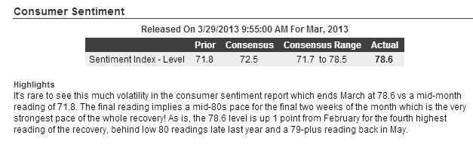
What’s happening?
Consumer sentiment up Friday:
What does this tell us?
Source: Bloomberg, Economic Calendar.

Slide 6
Business cycles

Slide 7
Business cycles: what are they?
Burns and Mitchell
“Business cycles” are fluctuations in aggregate economic activity. Expansions occur in many economic activities, followed by similarly general recessions, which merge into the next “cycle.”
That is: short-term fluctuations in growth rates

Slide 8
Business cycles: terminology
peak
trough
expansion
recession/ contraction
11 months
59 months

Slide 9
Business cycles: who cares?
Finance
Fixed income
Currencies
Asset management
Equities, esp emerging markets
Media and marketing
Not a focus, but they’re unusually cyclical businesses
Everyone else
Fact of life you’ll have to deal with

Slide 10
Volatility

Slide 11
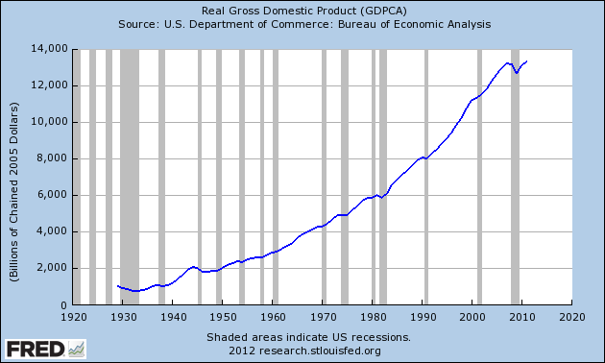
US GDP

Slide 12
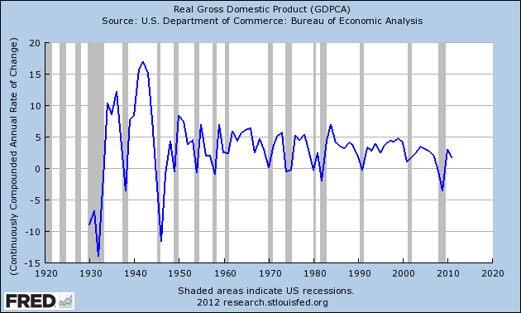
US GDP annual growth

Slide 13
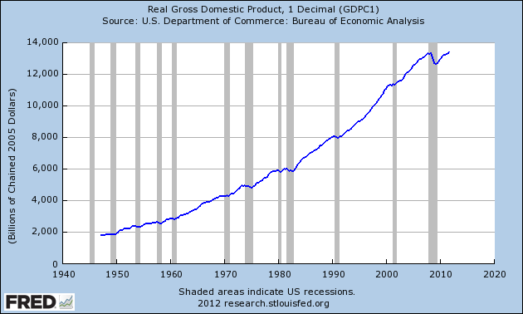
US GDP

Slide 14
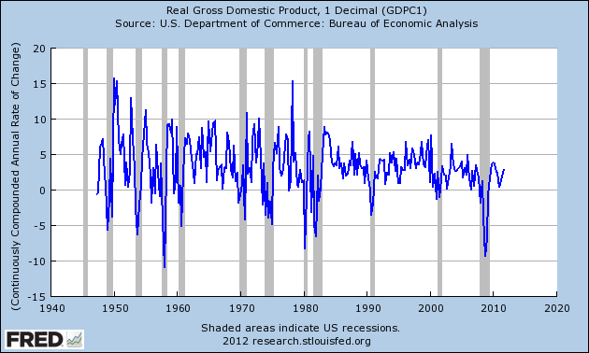
US GDP quarterly growth

Slide 15
Mean annual GDP growth, 1980-2011
Source: EIU CountryData

Slide 16
Std dev annual GDP growth, 1980-2011
Source: EIU CountryData

Slide 17
Mercedes-Benz USA

Slide 18
Mercedes-Benz USA
How cyclical is their business?
Why?
What should they do to deal with it?

Slide 19
Business cycle properties

Slide 20
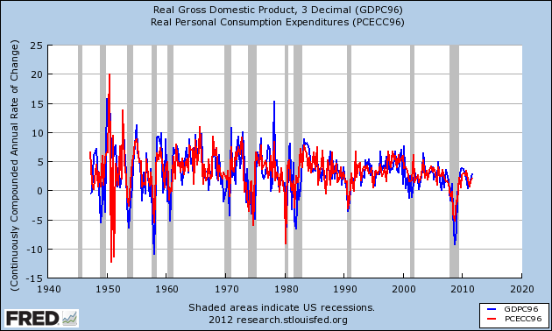
Consumption

Slide 21
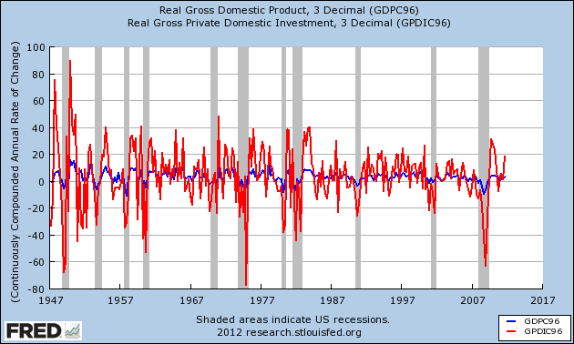
Private investment

Slide 22
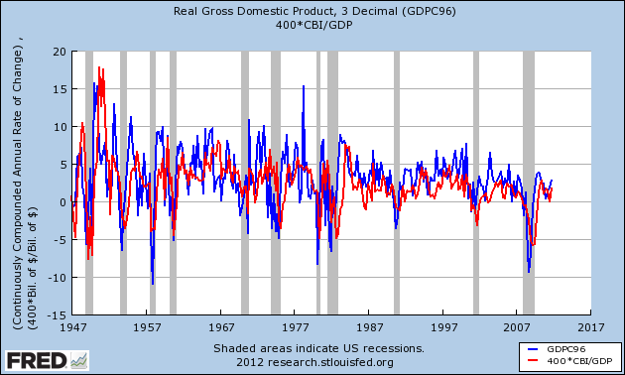
Change in inventories

Slide 23
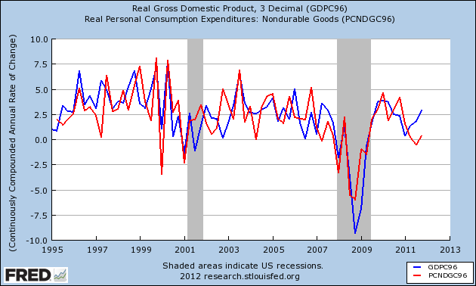
Consumption: nondurable goods

Slide 24
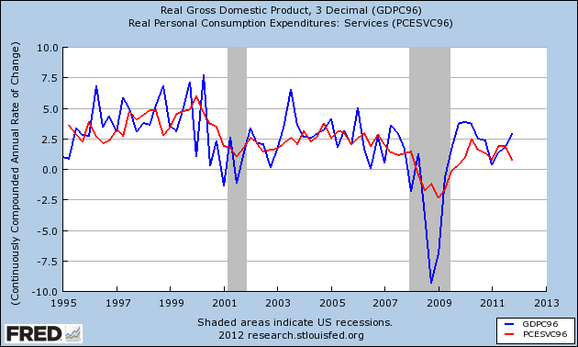
Consumption: services

Slide 25
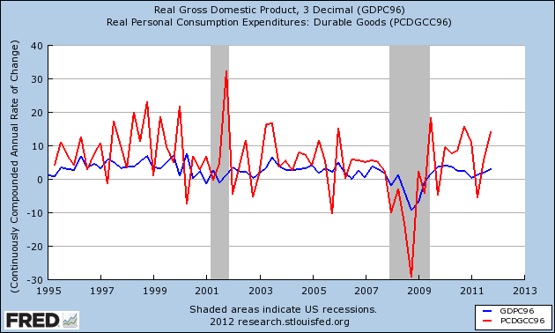
Consumption: durable goods

Slide 26
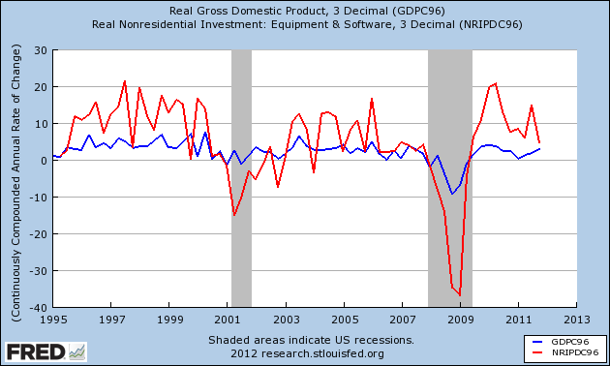
Investment: equipment & software

Slide 27
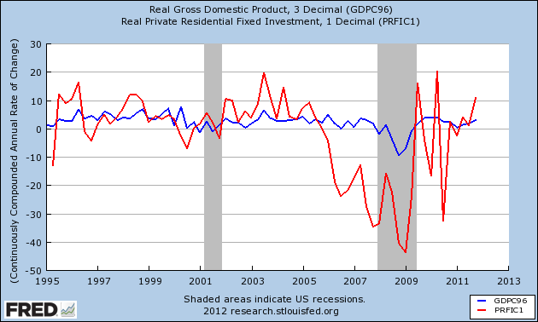
Investment: housing

Slide 28
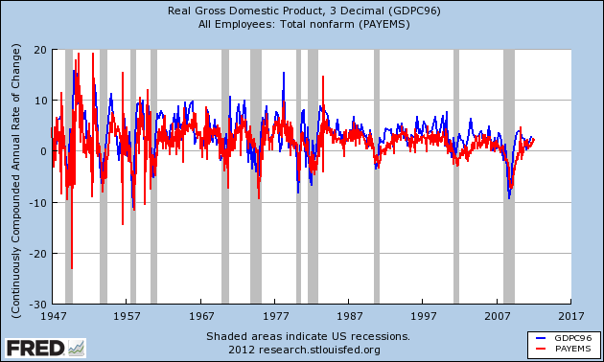
Employment

Slide 29
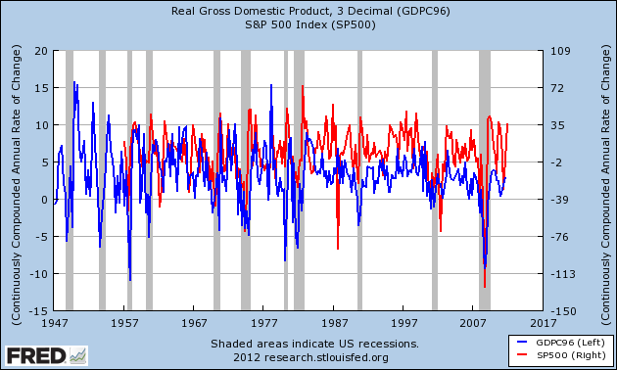
S&P 500

Slide 30
What’s more cyclical?

Slide 31
What’s more cyclical?
General Motors
Proctor & Gamble
Pfizer
Johnson & Johnson

Slide 32
What’s more cyclical?
Walmart
Richemont
New York Times
Google
American Airlines
McKinsey

Slide 33
What have we learned?
Economic growth is volatile
Lots of things move up and down together
[Like what?]
Some of them move more than others
[Which ones?]

Slide 34
For the ride home
The economy
How does it look to you?
How would you get a clearer picture?
As an example, skim the attached JP Morgan report

