Slide 1

The Global Economy Government Debt & Deficits

Slide 2
The idea
Governments issue debt when spending exceeds revenue. When they issue too much debt, investors bail out, possibly triggering a crisis.
Open question: how much is “too much”?

Slide 3
??
Streamline this
Do calc in more depth
Then go on to look at a country

Slide 4
The US
Do we have budget problems?
How would you make a case either way?
What evidence would you point to?

Slide 5
The US
“Krugman declares bankruptcy,” Daily Currant, March 2013
Economist and columnist Paul Krugman declared personal bankruptcy today following a failed attempt to spend his way out of debt. … Rather than tighten his belt, the economist decided to "stimulate" his way to a personal recovery by investing in expenses he hoped would one day boost his income.
What are they saying? Do you agree?

Slide 6
Roadmap
Macroeconomic crises
Words and pictures
Debt arithmetic
Debt dynamics
What’s missing?
Is the US in trouble?

Slide 7
Macroeconomic crises

Slide 8
Macroeconomic crises
New module
The classic crisis triggers
Sovereign debt (“debt crisis”)
Financial fragility (“financial crisis”)
Fixed exchange rates (“exchange rate crisis”)
What was/is the trigger in
Japan in the 1990s?
Mexico in 1994?
The US in 2008?
Europe today? (Greece, Ireland, Portugal, Spain, Italy…)

Slide 9
Words & pictures

Slide 10
Words
Alexander Hamilton, Second Report on Public Credit, 1795
Every system of Public Credit must assume as a fundamental principle the ability to pay the debt which it contracts. With the creation of debt should be incorporated the means of extinguishment.
What is he saying? Do you agree?

Slide 11
Words
Thomas Sargent, October 2011:
Here’s a phrase that you hear. You hear that US fiscal policy is unsustainable. You hear it from both parties. What they mean is that certain promises people have made – taxes, entitlements, medicare, medicaid – those are incredible, they don’t fit together. So US fiscal policy is very uncertain. It’s uncertain because it’s not clear which of these promises is going to be broken first.
What is he saying? Do you agree?

Slide 12
Words
Walter Wriston, 1987:
Countries don't go out of business. ... The infrastructure doesn't go away, the productivity of the people doesn't go away, the natural resources don’t go away. And so their assets always exceed their liabilities, which is the technical reason for bankruptcy. And that's very different from a company.
What is he saying? Do you agree?

Slide 13

Libertad
October 2012
The ARA Libertad, a training ship owned by the Argentine navy, was detained in Ghana at the request of Elliott Capital Management, a hedge fund run by Paul Singer.
What’s going on here?

Slide 14
Government deficits (% of GDP, 2013)
Source: EIU CountryData.

Slide 15
Government debt (% of GDP)
Source: EIU CountryData.

Slide 16
Debt arithmetic

Slide 17
Government budget: Principle #1
Principle #1 of fiscal policy
Government spending must be financed with tax revenue, either now or in the future

Slide 18
Government budget: ingredients
Government spending in year t
G_{t} + V_{t} + i_{t}B_{t-1}
G = government purchases of goods and services
V = government spending on transfers
i = interest rate on debt B
Government tax revenue in year t
T_{t}
Government debt at end of year t-1, start of year t
B_{t-1}

Slide 19
Government budget: US, $b, 2011
Revenue |  | 4,120
 | Tax revenue | 3,230
 | Social insurance contributions | 931
Expenses |  | 5,410
 | Goods, services, and employee comp | 2,611
 | Transfer payments | 2,371
 | Interest on debt | 428
Surplus |  | −1,249
For reference: GDP = 15,094
Source: BEA, Table 3.1, aggregated.

Slide 20
Government budget
Budget (cash flow out = cash flow in)
G_{t} + V_{t} + i_{t}B_{t-1} = T_{t} + B_{t} − B_{t-1}
Spending = Tax Revenue + Change in Debt
Government deficit
( G_{t} + V_{t} + i_{t} B_{t-1}) − T_{t}
Primary deficit (excl interest)
D_{t} = G_{t} + V_{t} − T_{t}
(replace three symbols with one)

Slide 21
Government budget arithmetic
Primary deficit (excl interest)
D_{t} = (G_{t} + V_{t}) − T_{t}
Budget becomes
G_{t} + V_{t} + i_{t}B_{t-1} − T_{t} = B_{t} − B_{t-1}
D_{t} + i_{t}B_{t-1} = B_{t} − B_{t-1}
The point: this is how debt is connected to deficits
Past debt incurs interest expense
Current deficits lead to increases in debt

Slide 22
Government budget arithmetic
Looking back in time
Where does debt come from?
D_{t} + i_{t}B_{t-1} = B_{t} − B_{t-1}
B_{t} = D_{t} + (1+i_{t})B_{t-1}
= D_{t} + (1+i_{t}) D_{t-1} + (1+i_{t})(1+i_{t-1})D_{t-2} …
Answer: debt = past primary deficits plus interest

Slide 23
Government budget arithmetic
Looking forward in time
Where does debt lead? [kill t on i_{t} for simplicity]
D_{t} + iB_{t-1} = B_{t} − B_{t-1}
B_{t-1} = − D_{t}/(1+i) + B_{t-1}/(1+i)
= − D_{t}/(1+i) − D_{t+1}/(1+i)² − D_{t+2} /(1+i)² …
Answer: debt = present value of future primary surpluses
Debt today is a promise to run surpluses in the future

Slide 24
Government budget: Principle #1
Principle #1 of fiscal policy
Government spending must be financed with tax revenue, either now or in the future.
That’s what the arithmetic says

Slide 25
Debt dynamics

Slide 26
Debt dynamics
Focus: ratio of debt to GDP – B/Y
What makes B/Y change over time?
Two ways to reduce B/Y
Decrease debt
Increase output
Here’s how that works …

Slide 27
Debt dynamics
We usually look at debt and deficits as ratios to GDP
How do they change over time?
Growth of (nominal) debt
[1] B_{t} = (1+i_{t})B_{t-1} + D_{t}
Growth of (nominal) GDP
[2] Y_{t} = (1+g_{t}+π_{t}) Y_{t-1}
Both numerator and denominator of B/Y change

Slide 28
Debt dynamics
Reminder:
[1] B_{t} = (1+i_{t})B_{t-1} + D_{t}
[2] Y_{t} = (1+g_{t}+π_{t})Y_{t-1}
Summary [1]/[2]
B_{t}/Y_{t} = [(1+i_{t})/(1+g_{t}+π_{t})] B_{t-1}/Y_{t-1} + D_{t}/Y_{t}
≈ [1+i_{t}−(g_{t}+π_{t})] B_{t-1}/Y_{t-1} + D_{t}/Y_{t}
≈ B_{t-1}/Y_{t-1} + (i_{t}−π_{t})B_{t-1}/Y_{t-1} − g_{t}B_{t-1}/Y_{t-1} + D_{t}/Y_{t}
Δ(B_{t}/Y_{t}) = (i_{t}−π_{t})B_{t-1}/Y_{t-1} − g_{t}B_{t-1}/Y_{t-1} + D_{t}/Y_{t}

Slide 29
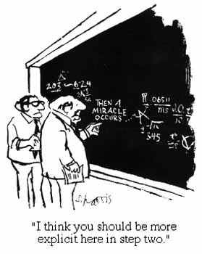
Debt dynamics
More on that last step

Slide 30
Debt dynamics
Ok, what are we left with?
Δ(B_{t}/Y_{t}) = (i_{t}−π_{t})B_{t-1}/Y_{t-1} − g_{t}B_{t-1}/Y_{t-1} + D_{t}/Y_{t}
(A) (B) (C)
(A): interest on debt at (real) interest rate r = i−π
(B): real GDP growth at rate g
(C): (primary) deficit D

Slide 31
Debt dynamics
In case you forgot
Δ(B_{t}/Y_{t}) = (i_{t}−π_{t})B_{t-1}/Y_{t-1} − g_{t}B_{t-1}/Y_{t-1} + D_{t}/Y_{t}
Dealing with percentages
We need to convert (i, π, g) to numbers: 0.05, not 5\%
But it’s convenient to keep (B/Y) and (D/Y) as percentages of GDP

Slide 32
Debt dynamics in Brazil
Total deficit (% GDP) | 2.5
Primary deficit (% GDP) | −2.9
Interest rate (money market, %) | 9.4
Inflation rate (%) | 5.5
Real GDP growth rate (%) | 3.3
Public debt (% GDP, previous year end) | 53.2
Is B/Y going up or down? Why?
Source: EIU, Country Report.

Slide 33
Debt dynamics in Brazil
Δ(B_{t}/Y_{t}) = (i_{t}−π_{t})B_{t-1}/Y_{t-1} − g_{t}B_{t-1}/Y_{t-1} + D_{t}/Y_{t}
Add answers here *****

Slide 34
Debt dynamics in Ireland
Debt
Primary Deficit
Source: EIU, Country Report.

Slide 35
Debt dynamics in Ireland
Total deficit (% GDP) | 9.1
Primary deficit (% GDP) | 7.0
Interest rate (money market, %) | 1.1
Inflation rate (%) | 1.1
Real GDP growth rate (%) | −1.0
Public debt (% GDP, previous year end) | 105.4
Is B/Y going up or down? Why?
Source: EIU, Country Report.

Slide 36
Debt dynamics in Ireland
Δ(B_{t}/Y_{t}) = (i_{t}−π_{t}) B_{t-1}/Y_{t-1} − g_{t} B_{t-1}/Y_{t-1} + D_{t}/Y_{t}

Slide 37
Debt dynamics in Portugal
Total deficit (% GDP) | 6.4
Primary deficit (% GDP) | 2.3
Interest rate (money market, %) | 0.6
Inflation rate (%) | 2.8
Real GDP growth rate (%) | −3.2
Public debt (% GDP, 2012 year end) | 108.1
Is B/Y going up or down? Why?
Source: EIU, Country Report.

Slide 38
Debt dynamics in Portugal
Δ(B_{t}/Y_{t}) = (i_{t}−π_{t}) B_{t-1}/Y_{t-1} − g_{t} B_{t-1}/Y_{t-1} + D_{t}/Y_{t}

Slide 39
Debt dynamics in Portugal
From the EIU report
Portugal faces a severe economic adjustment. Its bail-out via the EU/IMF/European Central Bank (ECB) (“Troika”) entails tough fiscal consolidation and structural reforms, which could threaten political stability.
A decision by the Constitutional Court in April 2013 to strike down public-sector wage and pension cuts will force the government to find new expenditure savings, jeopardising budget targets.
Despite a substantial hike in taxes, the deficit is likely to remain around 6% of GDP in 2013, above the agreed target of 5% of GDP.

Slide 40
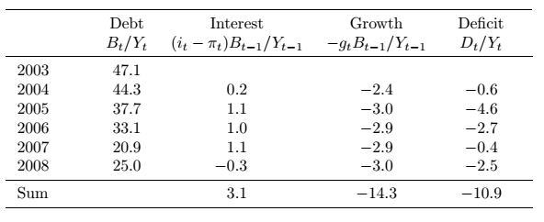
What happened to Peru’s debt?
Debt-to-GDP fell from 47.1% to 25.0% [total change in B/Y = −22.1%]
Why?
Source: Global Economy book.

Slide 41
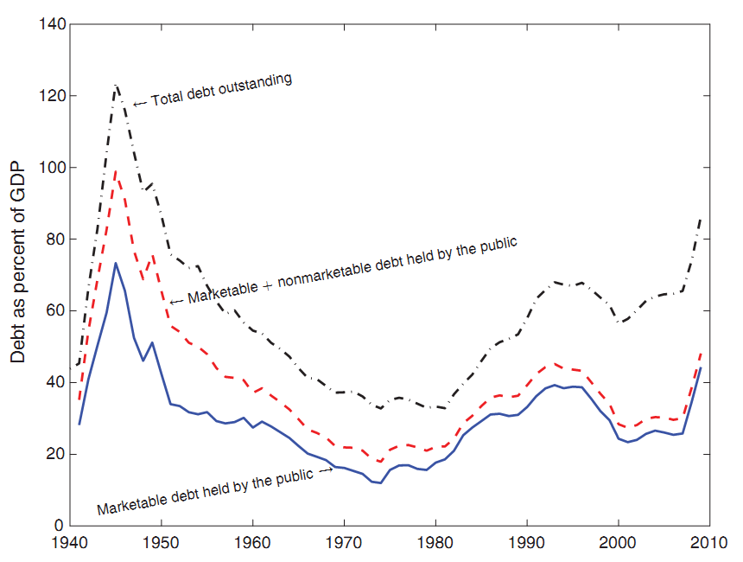
What happened to US WW II debt?
Source: Hall and Sargent.

Slide 42
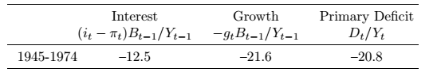
What happened to US WW II debt?
Debt-to-GDP fell from 66% in 1945 to 11% in 1974 [a change of –55%]
Why?
Source: Hall and Sargent.

Slide 43
What’s missing?

Slide 44
What’s missing?
Hidden liabilities
Like what?
Unfunded pensions
Financial bailouts
Implicit guarantees of businesses or regional governments
Examples?

Slide 45
What’s missing?
The impact of growth on tax revenue
GDP growth
Affects B/Y directly
Also raises tax revenue, reduces primary deficit
Overall: the best cure for debt problems (also the converse)
Examples?

Slide 46
What’s missing?
The impact of debt in the interest rate
Interest rate can rise sharply if investors become concerned with repayment
Direct impact on changes in debt through r = i – π
When does it happen?
Examples?

Slide 47
What’s missing?
Maturity of debt
Short debt needs to be rolled over
Interest rate could rise quickly
Or you could be shut out of markets altogether
Examples?

Slide 48
Is the US in trouble?

Slide 49
Is the US in trouble?
Large current deficits
Growing debt
Significant increases in future spending in pipeline
Blinder and Hubbard, Wash Post, Sept 19, 2011
The (total) deficit is forecast by the CBO to reach 15.5% of GDP by 2035. By then, the national debt would be 187% of GDP. The main culprit is increased health care spending, which CBO projects to rise from 5.6% of GDP now to 10.4% by 2035.

Slide 50
Is the US in trouble?
Helpful resource: CBO reports
http://www.cbo.gov/publication/43288

Slide 51
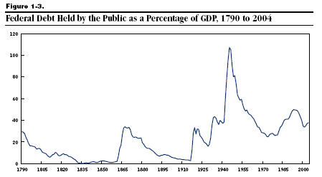
US government debt
Source: CBO.

Slide 52
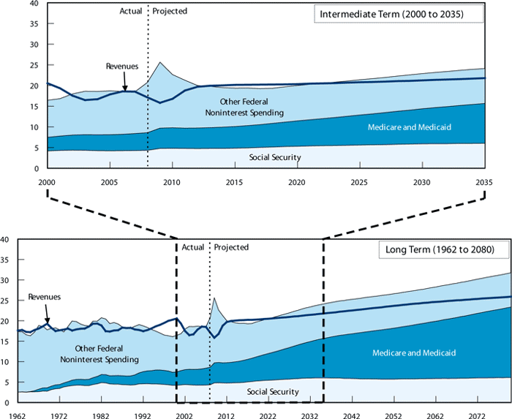
US government expenses & revenues
Source: CBO.

Slide 53
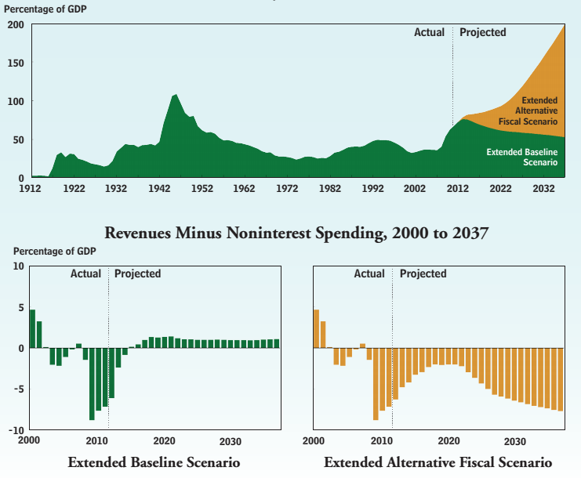
US government expenses & revenues
Source: CBO.

Slide 54
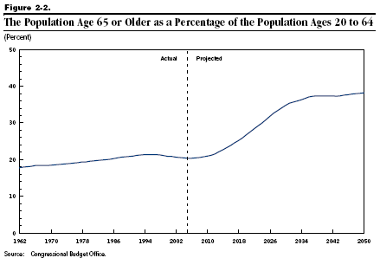
Demographics
Source: CBO.

Slide 55
Social Security outlays and receipts
Scheduled Outlays
Scheduled Receipts
Feasible Outlays
Trust Fund Growing
Trust Fund Shrinking
Source: CBO.

Slide 56
Social Security “fixes”
Solutions
Increase the payroll tax – or other taxes
Reduce benefits
Raise retirement age
Reduce cost-of-living adjustments
Congressional Budget Office analysis (2010)
http://www.cbo.gov/doc.cfm?index=11580

Slide 57
Medicare and Medicaid
Medicare: age 65 and older
Parts A&B cover hospital and physician care
Part D (2006) covers drugs
Funded by payroll tax and general revenues
Medicaid: poor (joint state-federal program)
Federal government share about 57%
States set rules subject to federal approval

Slide 58
Medicare and Medicaid
Medicaid
Medicare
Source: CBO, http://www.cbo.gov/ftpdocs/87xx/doc8758/11-13-LT-Health.pdf

Slide 59
Medicare and Medicaid
Ageing population
Healthcare spending per insured rising faster than GDP
Holding fixed demographics and spending
Source: CBO, http://www.cbo.gov/ftpdocs/87xx/doc8758/11-13-LT-Health.pdf

Slide 60
Medicare and Medicaid
All other medical spending
Medicaid
Medicare
source: http://www.cbo.gov/ftpdocs/87xx/doc8758/11-13-LT-Health.pdf

Slide 61
Medicare and Medicaid “fixes”
Health care system as a whole is a mess
What can be done for Medicare and Medicaid?
Spending needs to be paid for
Either raise taxes: by a lot!
Or reduce benefits: but how?
The central budget issue of our time

Slide 62
What have we learned?
Government budgets: deficits are financed by
By issuing debt today
And running (primary) surpluses in the future
Standard tool
Debt dynamics equation (look for red box)
Signs of trouble
Too much debt
Continuing deficits
Weak political system
US faces questions about future healthcare spending

Slide 63
The Global Economy Foreign Exchange

Slide 64
The ideas
Exchange rates are …
Relative prices of currencies [dollar price of one euro]
Source of variation in costs, revenues, etc
Where sensible theories come to die

Slide 65
The question
What do you think will happen to the euro over the next six months?

Slide 66
Announcement
Special class meetings
Right after final exam
Malt House, 206 Thompson, just north of Bleecker

Slide 67
What’s happening?
Vincent Reinhart, Adam Parker, and Neil McLeish of Morgan Stanley”
Key takeaways from Morgan Stanley’s 13th annual DC Macro Forum, include: As long as Global Monetary Expansion rules, we stick with our strategic preference for equities over credit over government bonds.
What’s going on here? Do you agree?

Slide 68
Roadmap
Heineken USA
Words and pictures
Exchange rates and prices (“PPP anchor”)
Exchange rates and interest rates (“carry trade”)

Slide 69
Heineken USA
What’s your margin at the current exchange rate?
How likely is a rise in the euro of 10-15%? A fall?
What happens to your margin if the euro rises 15%?
What response do you recommend?

Slide 70
Words & pictures

Slide 71
Words
Alan Greenspan, “The euro as an international currency,” November 2001
Having endeavored to forecast exchange rates for more than half a century, I have developed significant humility about my ability in this area, a sentiment I suspect many in this room share.

Slide 72
Words
Warren Buffett, Letter to Shareholders, 2005
Berkshire owned about $21.4 billion of foreign exchange contracts at yearend, spread among 12 currencies. Holding of this kind are a change for us. But the evidence grows that our trade [deficit] will put unremitting pressure on the dollar for many years to come.
Positions closed 2 years later at a loss.

Slide 73
Words
Jean-Paul Villain, head of strategy, ADIA, 2010
We came to a very firm conclusion: we simply don’t know how to trade currencies.

Slide 74
Words
Anonymous hedge fund trader, n+1, 2008:
From time to time, the dollar’s been very weak; from time to time it’s strong. … Over the very long term, currency prices tend to be fairly stable and mean reverting. So the dollar’s weak today, but that’s no reason to believe it’s going to be weak forever. It’s amazing how many brilliant investors have gotten egg on their faces trading G-7 crosses.
What is he saying? Does it make sense?

Slide 75
Words
Michael Feroli, Chief US Economist, JP Morgan Chase
No framework works very well. Currency prices remain somewhat of a mystery.
What is he saying? Does it make sense?

Slide 76
Yen per dollar
Source: Fed via FRED.

Slide 77
Dollars per euro
Source: Fed via FRED.

Slide 78
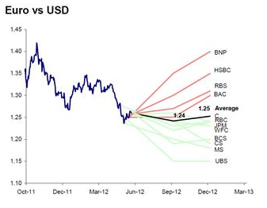
Dollars per euro
Source: Ticker sense.

Slide 79
Pesos per dollar
Source: Fed via FRED.

Slide 80
Yuan per dollar
Source: Fed via FRED.

Slide 81
Exchange rates & prices

Slide 82
Exchange rates
Exchange rate terminology
e = exchange rate : dollar price of one unit of euro
If e rises, we say the dollar has depreciated (declined in value)
If e falls, we say the dollar has appreciated (increased in value)
The reverse, of course, for the euro
The facts
e’s for many currencies move around a lot
Annual std dev of stock market ~18%, dollar/euro ~12%
Why?

Slide 83
Exchange rates and prices
The idea
Exchange rates reflect differences in prices of goods
Prices look high in Paris, but if we convert them to dollars using the exchange rate, they should be about the same as New York
We call this “purchasing power parity” (PPP)
What we’ll find
Crude approximation, but useful as long-term anchor
What we say
If prices are high in Paris, we say the euro is overvalued [it’s all relative: we also say dollar is undervalued]

Slide 84
Exchange rates and prices
Define
P = domestic price (measured in dollars)
P* = foreign price (measured in euros)
e = exchange rate (dollar price of one euro)
Compare P with eP*
P ?=? e P*
e ?=? P/P*
RER = e P*/P ?=? 1

Slide 85
Exchange rates and prices
Region | USD Price of Big Mac (Jan 2013)
US | 4.37
Euro area | 4.88
Japan | 3.51
China | 2.57
India | 1.67
Brazil | 5.64
Mexico | 2.90
Source: The Economist.

Slide 86
Exchange rates and prices
Big Macs
Why are prices so low in China?
Ditto India?
Why so high in Brazil?
How would you expect exchange rates to change?
How fast?
Are Big Macs typical?

Slide 87
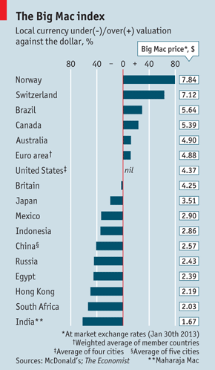
Exchange rates and prices
Which currencies are “overvalued”?
Which currencies are “undervalued”?
Why?
Source: The Economist.

Slide 88
Exchange rates and prices
http://www.economist.com/content/big-mac-index
Which currencies are “overvalued”?
Which currencies are “undervalued”?
Why?
Source: The Economist.

Slide 89
Exchange rates and prices
Suppose we used price indexes instead of Big Macs
Do we see
e = P/P*?

Slide 90
Exchange rates and prices
Convention: home is country fx is quoted in
Dollars per pound: home=US, foreign=UK
Yen per dollar: home=Japan, foreign=US

Slide 91
Pesos per dollar
Source: Fed via FRED.

Slide 92
Yuan per dollar
Source: Fed via FRED.

Slide 93
Yen per dollar
Source: Fed via FRED.

Slide 94
Dollars per euro
Source: Fed via FRED.

Slide 95
Exchange rates and prices
Summary
Dollar v peso
Large movements in P/P* reflected in e
Still lots of variation in RER
Dollar v euro
Little variation in P/P*
Movements in e therefore similar to movements in RER

Slide 96
Exchange rates and prices
One last try
PPP says
e = P/P*
Rate of Change of e = Rate of Change of P/P*
Let’s look at this over different time intervals

Slide 97
Exchange rates and prices
Source: Deutsche Bank FX Guide.

Slide 98
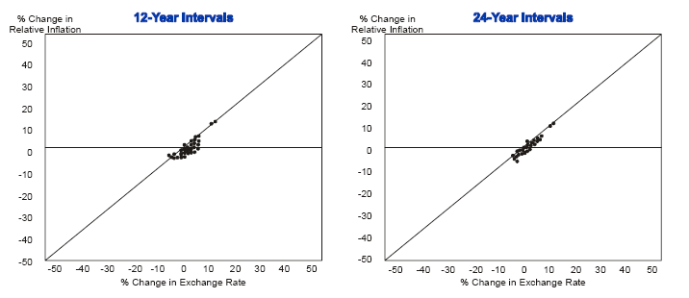
Exchange rates and prices

Slide 99
Exchange rates and prices
Summary of PPP
An approximation that works best
When there are large differences in inflation rates
And over long periods of time

Slide 100
Exchange rates & interest rates

Slide 101
Exchange rates and interest rates
If two countries have different interest rates, the one with the higher rate will tend to appreciate
R² small (<0.05) but that’s enough to make money
More coming …

Slide 102
Exchange rates and interest rates
Region | Money market rate (local currency)
US | 0.28
Euro area | 0.21
Japan | 0.16
China | 3.89
India | 7.68
Brazil | 7.47
Mexico | 4.33
Source: The Economist.

Slide 103
Exchange rates and interest rates
Why do interest rates differ across countries/currencies?
Do global capital markets equate expected returns?

Slide 104
Exchange rates and interest rates
The “carry trade”
Long position in high interest rate currency
Short position in low interest rate currency
Carry: collect difference in interest rates
Risk: the low-rate currency will rise
Does it work?
Most of the time, yes
Why?

Slide 105
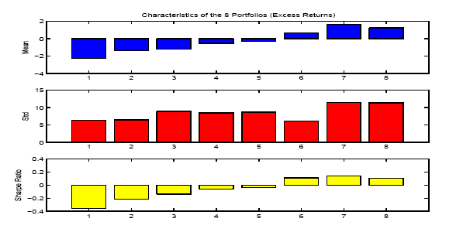
Exchange rates and interest rates
Source: Lustig and Verdelhan.

Slide 106
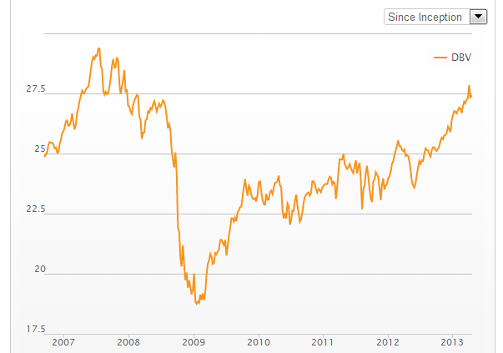
Exchange rates and interest rates
Source: Deutsche Bank G10 Currency Harvest Fund.

Slide 107
Exchange rates & anything else?

Slide 108
Exchange rates and …
Trade balance?
GDP growth?
Stock market?

Slide 109
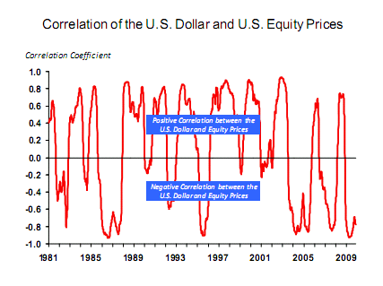
Exchange rates and stock prices
Source: Michael Rosenberg, Bloomberg.

Slide 110
What have we learned?
Exchange rates are variable, affect costs, revenues, etc, in international transactions
In the short run, most of this variation is unpredictable, even inexplicable
In the long run, exchange rates roughly mirror ratios of prices (PPP)

Slide 111
For the ride home
Is China’s currency “too cheap”?
What does that mean?
What evidence would tell us one way or the other?

