Slide 1

The Global Economy Introduction & Overview
Notes:
Open Gapminder (growth, corruption, mortality)
Also: course website, FRED

Slide 2
Roadmap
Gapminder
What’s happening this week?
What’s happening in the US?
What’s happening in Europe?
About the course

Slide 3
Gapminder
What do you see?
http://www.gapminder.org/world/
(growth, corruption, life expectancy)
Questions that might cross your mind
What striking features do you see?
Where are the business opportunities?
Other thoughts?

Slide 4
About participation
An important part of the class
And more fun for all of us
Ways to participate
Make a comment
Ask a question
Share an experience
Post a comment on Announcements & Discussion

Slide 5
About participation
Guidelines
Feel free to disagree --- politely, please!
Also with me
Facts are always good
Experts: try to keep it short
Non-experts: don’t panic, speak up if you’re lost

Slide 6
What’s happening this week?

Slide 7
What’s happening this week?
Regular feature
Bring your ideas, I’ll bring mine
Read The Economist
Order now if you haven’t already

Slide 8
What’s happening this week?
Joachim Fels, “Sunday Start,” Morgan Stanley, Feb 10, 2013:
I’ve been telling the Spain-becomes-Germany story for quite some time now, but on my visit to Madrid this past week I felt it resonated for the first time. Several of my most bearish contacts now think that the worst for the Spanish economy may soon be behind us.
What is he saying? Do you agree? Why or why not?

Slide 9
What’s happening this week?
“Is a Grexit off the table?” The Economist, Feb 9, 2013:
Greece is still grappling with a record recession that has shrunk output by more than a fifth (!), but the mood in Greek business circles is brightening.
What are they saying? Do you agree? Why or why not?

Slide 10
What’s happening this week?
“Yuan for the money,” The Economist, Feb 9, 2013:
[Until 2009, China did not allow use of its currency outside the country.] Since then, the government has allowed Chinese importers and exporters to settle their trades in yuan.
For the Chinese, the issue is financial liberalisation. The regime likes its capital controls. But the yuan will not become a successful international currency unless outsiders can use it.
What are they saying? Do you agree? Why or why not?

Slide 11
What’s happening in the US?

Slide 12
Current conditions in the US
How’s the economy doing?
Where is it headed?
What does that mean for your business?

Slide 13
Current conditions in the US
What do conditions mean for
General Motors?
Google?
Morgan Stanley?
NYU?
John Paulson’s hedge fund?

Slide 14
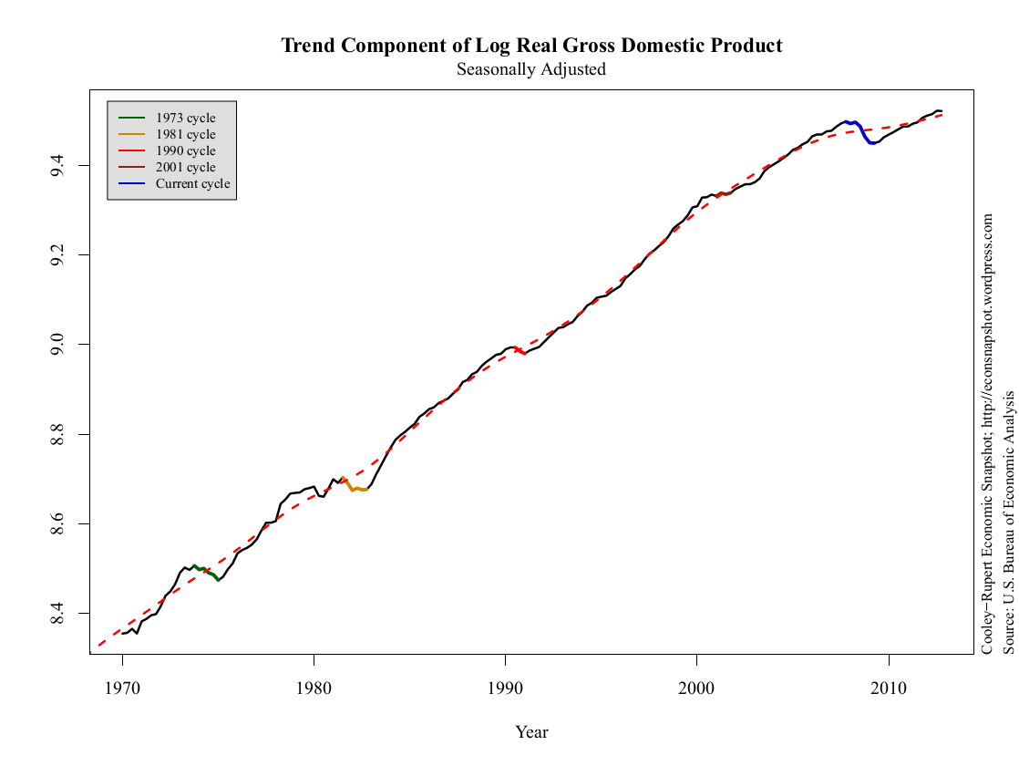
Real GDP
Source: Cooley-Rupert Snapshot

Slide 15
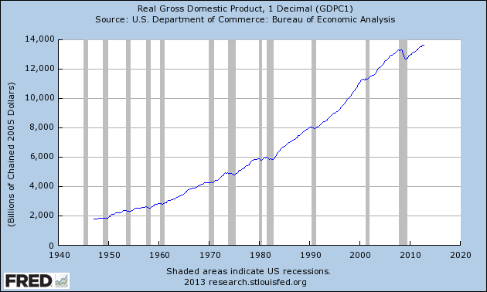
Real GDP
Source: FRED.

Slide 16
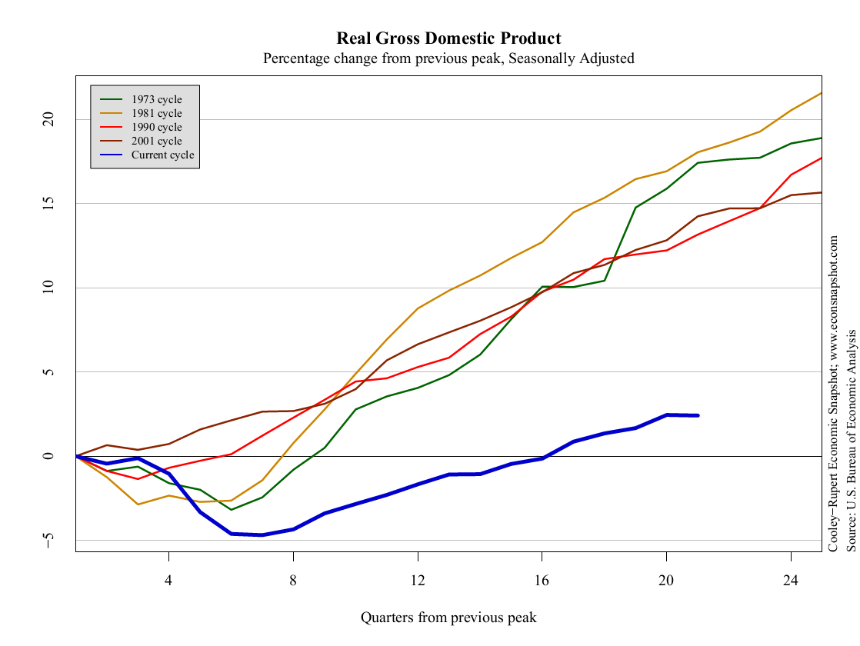
Real GDP
Source: Cooley-Rupert Snapshot

Slide 17
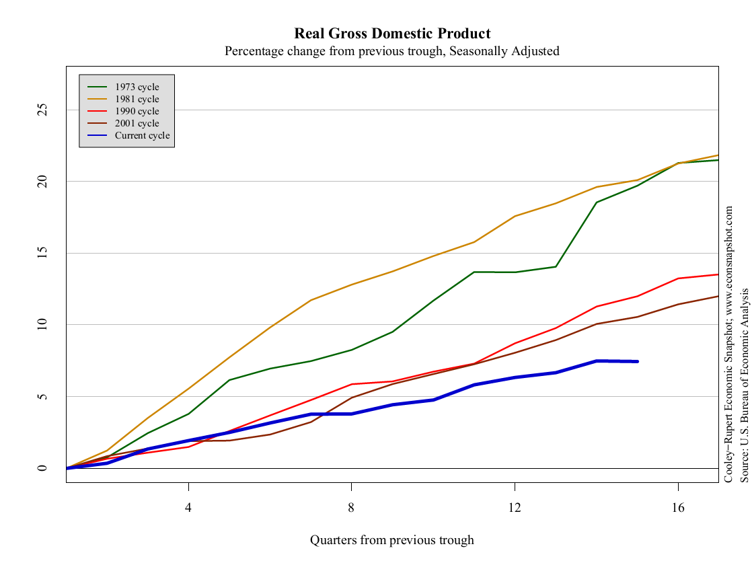
Real GDP
Source: Cooley-Rupert Snapshot

Slide 18
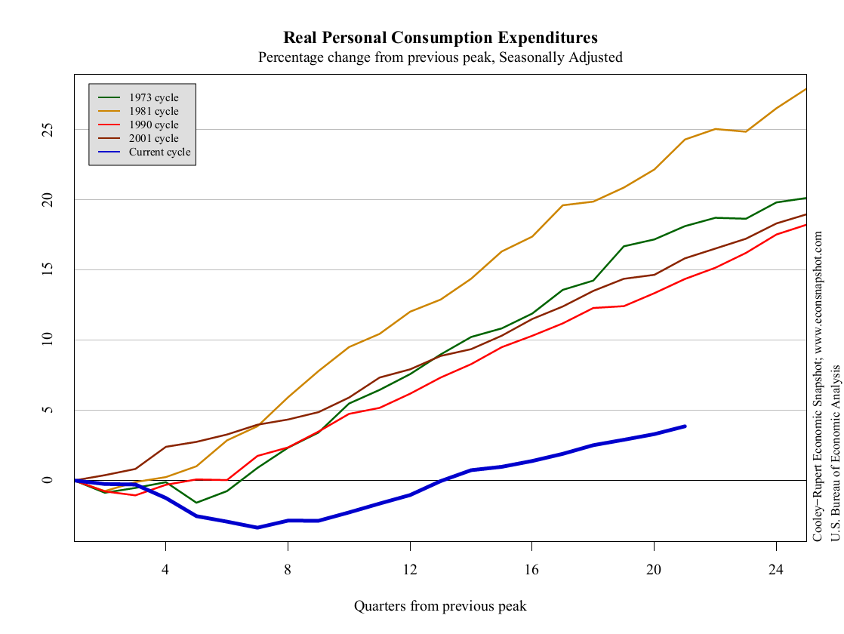
Consumption
Source: Cooley-Rupert Snapshot

Slide 19
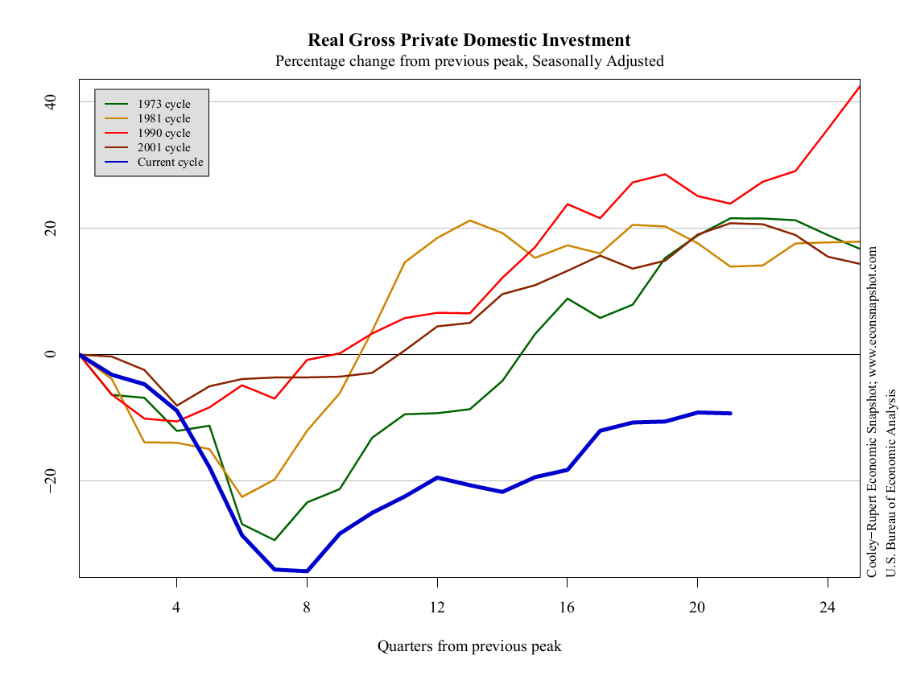
Investment
Source: Cooley-Rupert Snapshot

Slide 20
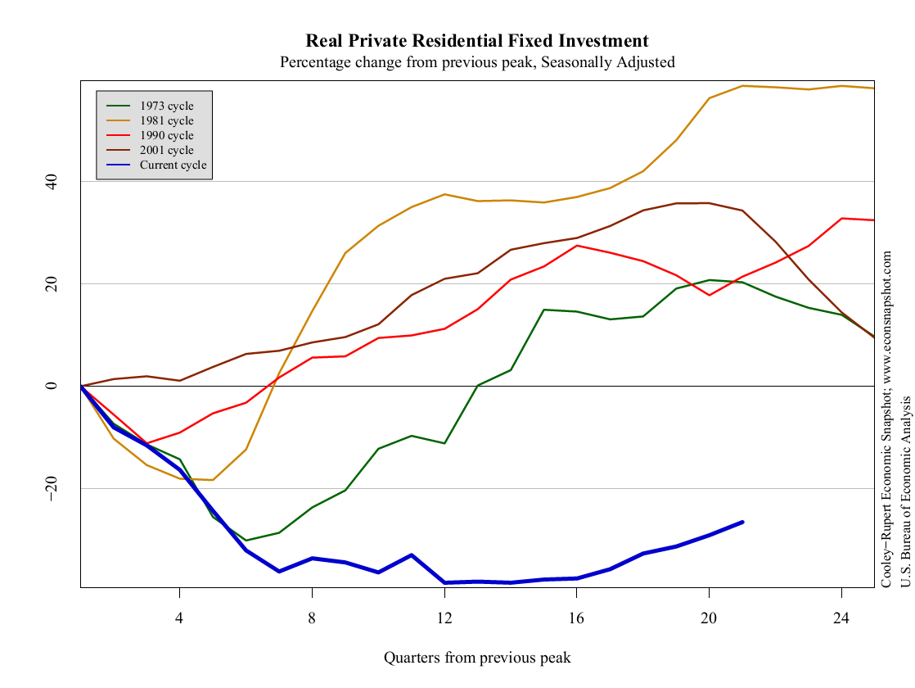
Residential investment
Source: Cooley-Rupert Snapshot

Slide 21
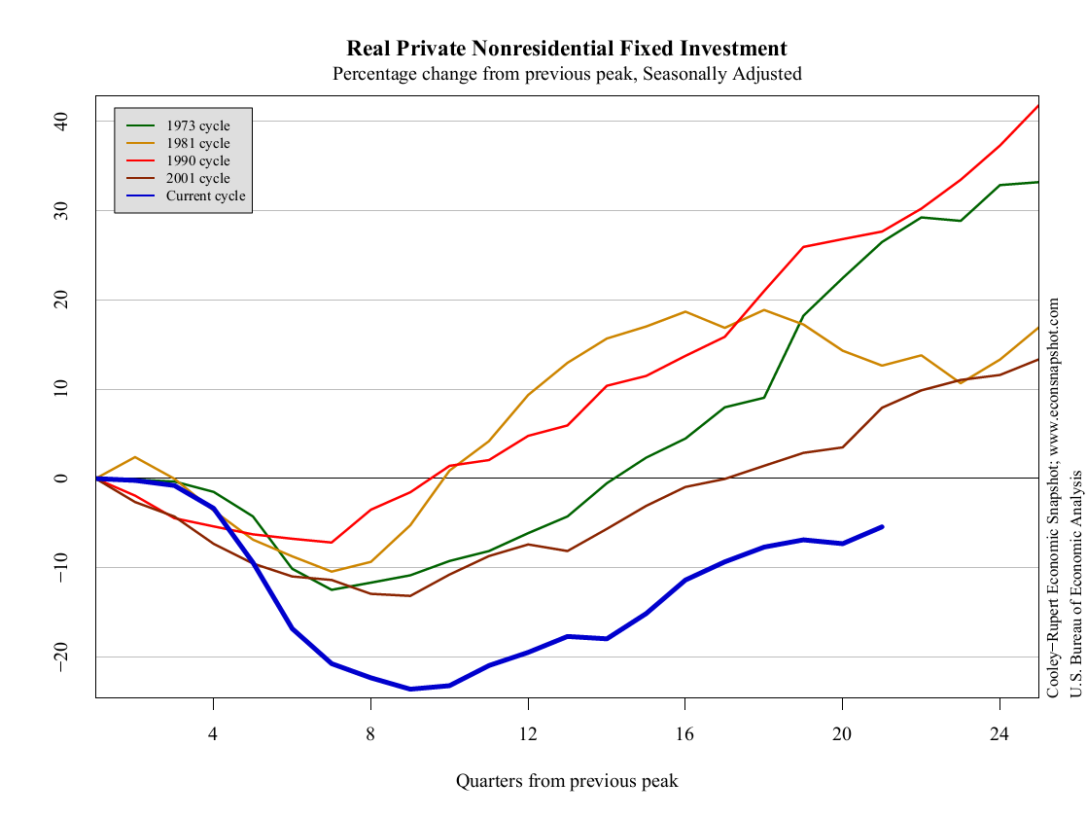
Nonresidential investment
Source: Cooley-Rupert Snapshot

Slide 22
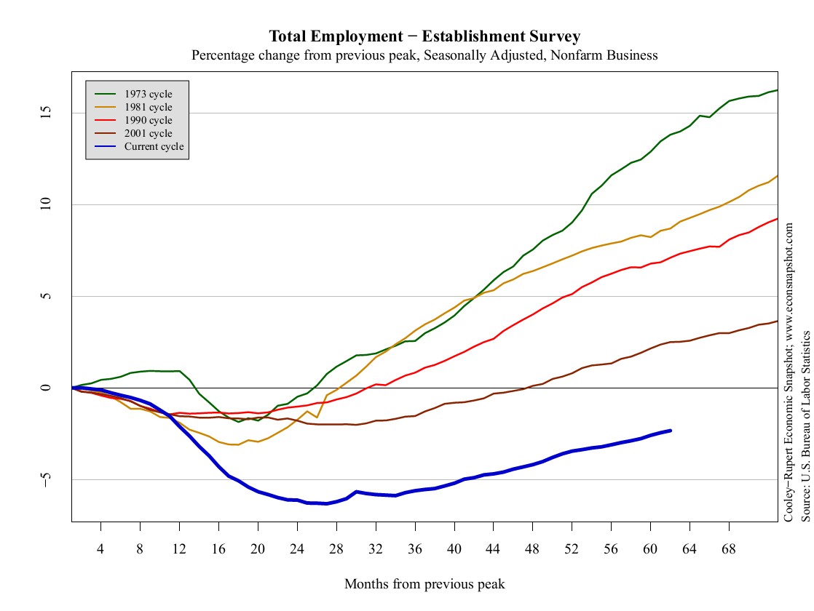
Employment
Source: Cooley-Rupert Snapshot

Slide 23
Current conditions revisited
How’s the economy doing?
Where is it headed?
What does that mean for your business?
Do we need households to spend more?

Slide 24
What’s happening in Europe?

Slide 25
Europe
What countries are in trouble?
Why?
How long till things turn around?

Slide 26
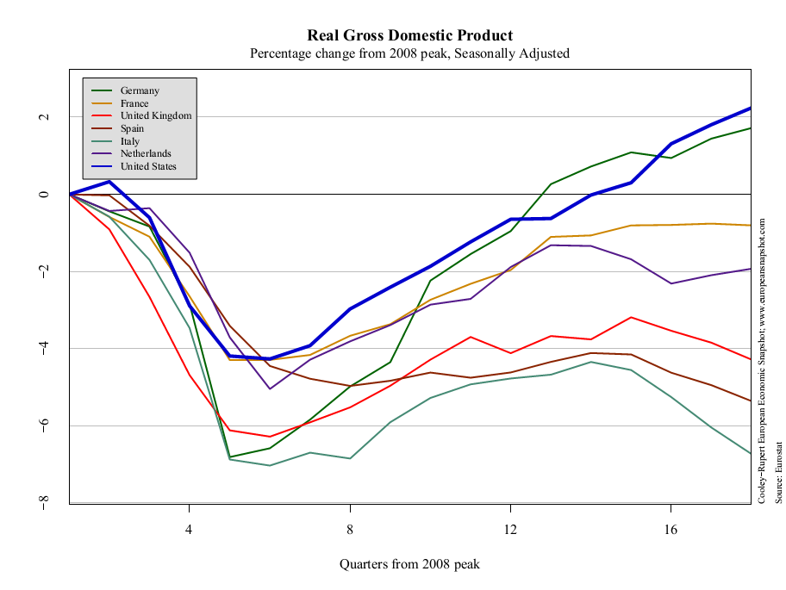
European GDP
Source: Cooley-Rupert European Snapshot

Slide 27
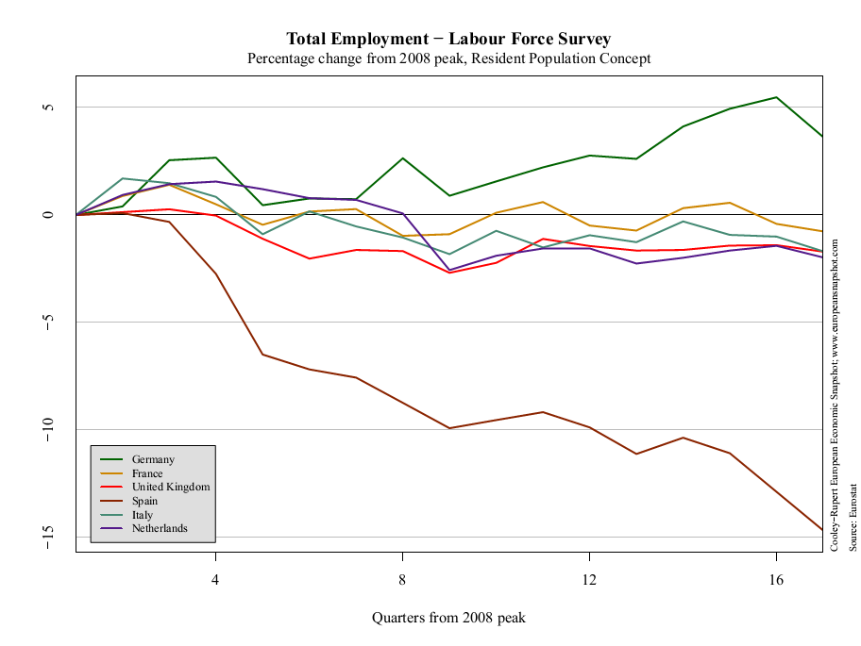
European employment
Source: Cooley-Rupert European Snapshot

Slide 28
About the course

Slide 29
About the course
It’s about economic performance
Of countries
And the businesses in them

Slide 30
About the course
Long-term economic performance
Why are some countries richer than others?
Are low-wage countries attractive business opportunities?
Short-term performance: Business cycles
Why do growth rates fluctuate?
Is now a good time to buy stocks? Bonds?
Short-term performance: Crises
Why do they happen?
Where are the opportunities?

Slide 31
About the course website
Everything’s on the website: https://sites.google.com/site/nyusternglobal/
Outline contains
Topic summaries
Assignments (with links!)
Slides, video, and more

Slide 32
About Announcements & Discussion
Access by
Signing up for email delivery
Or viewing online
You can use it to
Find a group
Post comments and articles
Ask questions about assignments
Answer questions asked by others
I’ll use it to
Post updates about the course
Answer questions

Slide 33
About slides
Catalyst for class discussion
Not intended to be read on their own
More than we need: don’t panic if we skip some
Subject to change without notice

Slide 34
About assignments
Problem Set #0
Individual – everyone must do it
Math and spreadsheet review
Due at the start of our next class
Problem Sets #1 to #4
Do in groups of up to four people [five in special cases]
Unlimited marriage and divorce
Due dates noted in red on website
Practice Problems A to D
Not graded
Useful review and preparation for exams

Slide 35
About quantitative content
Course is a mixture of quantitative and qualitative
Like business
Like life?

Slide 36
About quantitative content
Spreadsheets
Used extensively (essential life skill)
Read “Math Review” to get up to speed
Exponents and logarithms
Used extensively in first half
Read “Math Review” to get up to speed
Calculus
Used a little
Not required for exams
Read “Math Review” to get up to speed

Slide 37
About the book
Custom designed for this course (“bespoke”)
More focused and concise than most
Free online and cheap on Amazon
[Write a good review?]
Skim before class, read again afterwards

Slide 38
About me
Grew up in Pittsburgh
PhD Yale, 1981
Research interests
International capital flows
Fixed income and currency markets
Emerging economies
Other interests
The Steelers
Basketball, biking, Buffy, books, beer

Slide 39
About getting help
With problem sets
Post questions on Announcements & Discussion
Check same to see what others have asked
Email me: I’ll respond directly AND update Announcements
With anything else
Post a question on Announcements & Discussion
Email me
Stop by any afternoon
Buy me a beer or coffee after class

Slide 40
About grades
Participation | Outliers & Tiebreakers
Problem Sets | 20%
Midterm Exam | 35%
Final Exam | 45%

Slide 41
About class videos
Available roughly an hour after class
Link on course website (when I track it down)

Slide 42
About the syllabus
Read it, it’s a contract between us

Slide 43
What have we learned?
As Haiku
Read notes before class
If you need help ask for it
Website is knowledge

Slide 44
The Global Economy Macroeconomic Data

Slide 45
?? Streamline this set
Bill Gates, Wall Street Journal, January 2013:
I have been struck by how important measurement is to improving the human condition. You can achieve incredible progress if you set a clear goal and find a measure that will drive progress toward that goal.
Is that true in your world? Examples?
Notes:
http://online.wsj.com/article/SB10001424127887323539804578261780648285770.html

Slide 46
Measurement
Bill Gates, Wall Street Journal, January 2013:
I have been struck by how important measurement is to improving the human condition. You can achieve incredible progress if you set a clear goal and find a measure that will drive progress toward that goal.
Is that true in your world? Examples?
Notes:
http://online.wsj.com/article/SB10001424127887323539804578261780648285770.html

Slide 47
Objective
Know what these headline numbers are
(Real) GDP: how much stuff did we produce? growth rate?
Inflation: how much did average prices change?
Why do we need this?
Common vocabulary (like financial statements for businesses)
Do at high speed now, reinforce with constant use

Slide 48
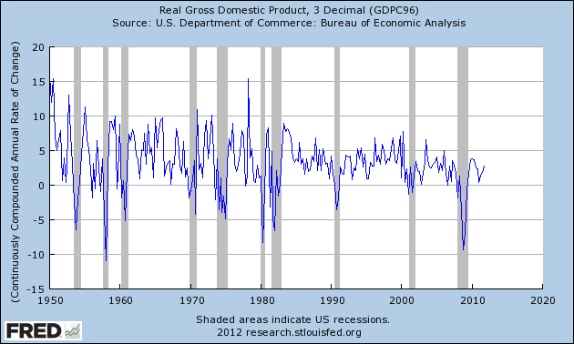
US (real) GDP growth
Source: FRED

Slide 49
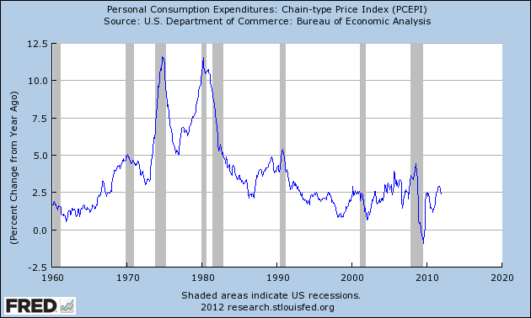
US inflation
Source: FRED

Slide 50
GDP per capita (USD, PPP adj)
Source: World Bank, World Development Indicators

Slide 51
Growth in GDP per capita (20-year avg)
Source: Penn World Tables.

Slide 52
Growth in GDP per capita (2013 est)
Source: OECD.

Slide 53
Roadmap
GDP: Gross Domestic Product
Expenditures and financial flows (“identities”)
Prices and quantities
Second thoughts

Slide 54
GDP

Slide 55
GDP
GDP = Gross Domestic Product
Total value of production in a geographic area
Sum value-added across all production units
By convention we don’t subtract depreciation (“gross”)
Three approaches to the same answer
Value-added
Income
Final sales (the end of the value chain)

Slide 56
GDP: example 1
Example
Farmer produces wheat, sells it for 100
Miller buys the wheat, produces flour, sells it for 175
Baker buys the flour, makes bread, sells it for 300
What is value-added for each producer?
What is GDP?
What is total income for the economy?
What is final sales?
Who eats the bread?

Slide 57
GDP: example 1
Producer | Farmer | Miller | Baker | GDP
Value-added
Final sales

Slide 58
GDP: example 1
Producer | Farmer | Miller | Baker | GDP
Value-added | 100 | 75 | 125 | 300
Final sales | 0 | 0 | 300 | 300

Slide 59
GDP: example 2
Barley farmer
Sales = 10
Rent = 3
Farmer’s profit = 7
Brewer
Sales = 110
Rent = 30
Wages = 70
Barley input = 10 (COGS)

Slide 60
GDP: example 2
Producer | Farmer | Brewer | Total
Value-added
Income
Final sales

Slide 61
GDP: example 2
Producer | Farmer | Brewer | Total
Value-added | 10 | 100 | 110
Income | 10 | 100 | 110
Final sales | 0 | 110 | 110

Slide 62
GDP: fine points
Investment not an input cost
Like corporate financial statements
Except: we never do subtract depreciation
Government purchases valued at cost
If the government produces goods and services, we value the output at whatever the input cost is
Imports are negative final sales
Exports are final sales outside the country
Imports final sales for the other country, negative final sales for us

Slide 63
GDP: example 3
Computer maker
Sales = 100
Wages = 65
Materials = 10
Owners’ income = 25
New building = 15
What is value added?
What is income?
What is final sales?
Concept | Total
Value-added
Income
Final sales

Slide 64
GDP: example 3
Computer maker
Sales = 100
Wages = 65
Materials = 10
Owners’ income = 25
New building = 15
What is value added?
What is income?
What is final sales?
Concept | Total
Value-added | 90
Income | 90
Final sales | 100*
* Includes 10 from materials producer

Slide 65
GDP: example 4
Government
Wages = 75
Rent = 25
What is value added?
What is income?
What is final sales?
Concept | Total
Value-added
Income
Final sales

Slide 66
GDP: example 4
Government
Wages = 75
Rent = 25
What is value added?
What is income?
What is final sales?
Concept | Total
Value-added | 100
Income | 100
Final sales | 100

Slide 67
GDP: example 5
Import-export firm
Sales = 140
Of which: 120 local, 20 abroad
Inputs = 25 from abroad
What is value added?
Income?
Final sales?
Concept | Total
Value-added
Income
Final sales

Slide 68
GDP: example 5
Import-export firm
Sales = 140
Of which: 120 local, 20 abroad
Inputs = 25 from abroad
What is value added?
Income?
Final sales?
Concept | Total
Value-added | 115
Income | 115
Final sales | 115*
* Note that we subtract imports here

Slide 69
GDP as value added by industry
mfg
FIRE
bus. services
agriculture
Source: BEA
Notes:
Agriculture, Manufacturing, FIRE, Business Services

Slide 70
GDP as income by type
labor comp.
rental income
corp. profits
interest
Source: BEA

Slide 71
Expenditures & financial flows

Slide 72
Expenditure flows
Allocate GDP among purchasers of final goods:
Y = C + I + G + NX
Y = GDP
C = sales to households (“consumption”)
I = sales of capital goods to firms (“investment” = “capex”)
G = purchases of goods and services by government
NX = net exports (exports minus imports)

Slide 73
GDP as final sales by expenditure
private cons
gov. cons
investment
net exports

Slide 74
Saving flows 1
Allocate flows of assets
Y – C – G = I + NX
S = I + NX
S = gross domestic saving (purchases of assets)
NX = net purchases of foreign assets

Slide 75
Saving flows 2
Separate household and government
(Y – C – T) + (T – G) = I + NX
S_{p} + S_{g} = I + NX
T = taxes net of transfers paid by households to govt
Warning: many measures of saving, all different
Call me is this ever comes up

Slide 76
Saving flows 3
Do Americans save too little?

Slide 77
US saving and investment
investment
saving
net exports

Slide 78
Household net worth
Source: Flow of Funds Accounts
Notes:
Table L.10

Slide 79
Prices & quantities

Slide 80
Prices and quantities
What we’ve seen so far is “nominal GDP”
GDP measured at current prices, in local currency units
If nominal GDP goes up
How much is more stuff? (more “real GDP”)
And how much higher prices? (“inflation”)
[We could ask the same of a firm’s sales]
Problem
There’s no clear answer
Or rather: several answers, equally sensible but different

Slide 81
Prices and quantities
Our problem: find P and Q so that
Nominal GDP = PQ = p₁q₁ + p₂q₂ + etc
Nominal GDP = GDP at current prices
p,q = price and quantity of a specific product
P,Q = “average” price (“price level”) or quantity (“real GDP”)
Growth rates
Of Q: real GDP growth
Of P: inflation
How do we compute P and Q?

Slide 82
Prices and quantities
Method 1 (“fixed price method”)
Find average quantity Q using “base-year” prices
Find “average” price from P = Y??/Q (“deflator”)
Method 2 (“fixed quantity method”)
Find average price P using “base-year” quantities
Find “average” quantity from Q = Y??/P
Problems
Both make sense, but answers are different
Choice of base year matters too

Slide 83
Example
 | Fish |  | Chips
Date | Price | Quantity | Price | Quantity
2004 | 0.50 | 10 | 0.25 | 10
2005 | 0.75 | 12 | 0.50 | 8
What is the inflation rate?
What is real output growth?

Slide 84
Fixed price method (GDP deflator)
 | Fish |  | Chips
Date | Price | Quantity | Price | Quantity
2004 | 0.50 | 10 | 0.25 | 10
2005 | 0.75 | 12 | 0.50 | 8
Date | Nominal GDP | Real GDP | Price Deflator
2004
2005
Growth rate
Base year: 2004

Slide 85
Fixed price method (GDP deflator)
 | Fish |  | Chips
Date | Price | Quantity | Price | Quantity
2004 | 0.50 | 10 | 0.25 | 10
2005 | 0.75 | 12 | 0.50 | 8
Date | Nominal GDP | Real GDP | Price Deflator
2004 | 7.50 | 7.50 | 1.000
2005 | 13.00 | 8.00 | 1.625
Growth rate | 73.3% | 6.7% | 62.5%
Base year: 2004

Slide 86
Fixed price method (GDP deflator)
 | Fish |  | Chips
Date | Price | Quantity | Price | Quantity
2004 | 0.50 | 10 | 0.25 | 10
2005 | 0.75 | 12 | 0.50 | 8
Date | Nominal GDP | Real GDP | Price Deflator
2004
2005
Growth rate
Base year: 2005

Slide 87
Fixed price method (GDP deflator)
 | Fish |  | Chips
Date | Price | Quantity | Price | Quantity
2004 | 0.50 | 10 | 0.25 | 10
2005 | 0.75 | 12 | 0.50 | 8
Date | Nominal GDP | Real GDP | Price Deflator
2004 | 7.50 | 12.50 | 0.600
2005 | 13.00 | 13.00 | 1.000
Growth rate | 73.3% | 4.0% | 66.7%
Base year: 2005

Slide 88
Fixed quantity method (CPI)
 | Fish |  | Chips
Date | Price | Quantity | Price | Quantity
2004 | 0.50 | 10 | 0.25 | 10
2005 | 0.75 | 12 | 0.50 | 8
Date | Price Index (2004 Basket) | Price Index (2005 Basket)
2004
2005
Growth rate

Slide 89
Fixed quantity method (CPI)
 | Fish |  | Chips
Date | Price | Quantity | Price | Quantity
2004 | 0.50 | 10 | 0.25 | 10
2005 | 0.75 | 12 | 0.50 | 8
Date | Price Index (2004 Basket) | Price Index (2005 Basket)
2004 | 7.50/7.50*100=100.0 | 8.00/8.00*100=100.0
2005 | 12.50/7.50*100=166.7 | 13.00/8.00*100=162.5
Growth rate | 66.7% | 62.5%

Slide 90
Prices in Argentina
Former president instituted “new methodology”
Only certain products are in the official price index
Prices of those products subject to “persuasion”
Inflation lower with new method
What happened next
Official products cheap, but not available (why?)
Unofficial estimates of inflation more than double official rate
Economists arrested for producing private inflation estimates
[Search: “inflation Argentina”]

Slide 91
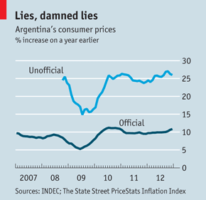
Prices in Argentina
“The IMF and Argentina,” The Economist, Feb 9, 2013:

Slide 92
Second thoughts

Slide 93
Do we care about GDP?
Bill Gates
“You can’t eat GDP.”
Bill Easterly
“Mr Gates apparently missed the economics lecture that listed the components of GDP, such as food.”
WSJ, March 2007

Slide 94

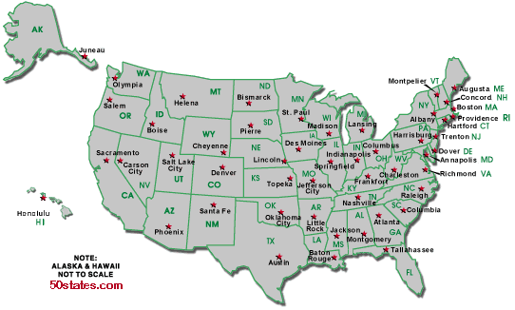
Do we care about GDP?
Per capita GDP: $47k
Per capita GDP: $34k
Avg weekly hours: 35
Avg weekly hours: 29

Slide 95
Do we care about GDP?
The obvious
GDP per person reflects income and standard of living
The less obvious
Correlated with many other things we care about: life expectancy, child mortality, poverty
Recall Gapminder
But it’s one number, not the answer to all questions

Slide 96
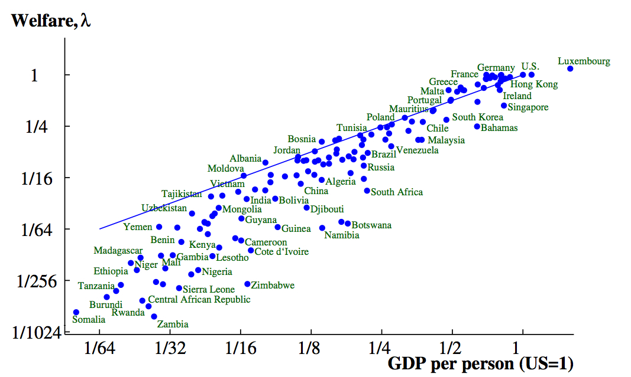
Do we care about GDP? (2000)
Source: Jones and Klenow, “Beyond GDP”

Slide 97
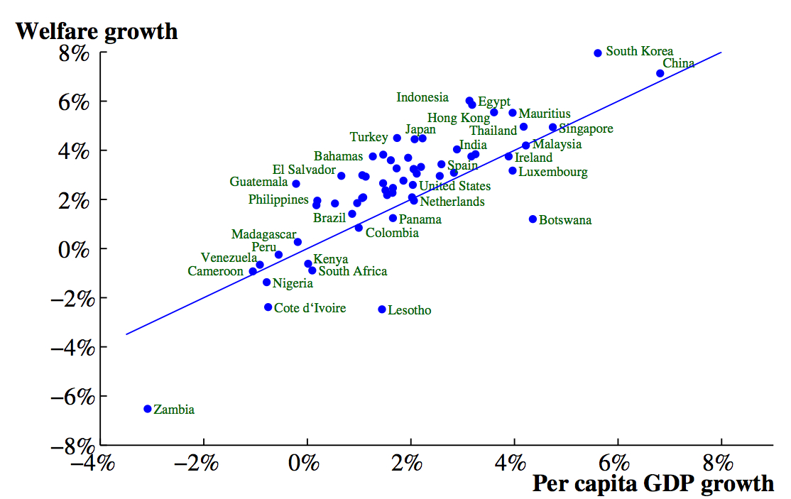
Do we care about GDP? (1980-2000)
Source: Jones and Klenow, “Beyond GDP”

Slide 98
More fine points
Home production not counted in GDP
Black market transactions not counted either
Some “income” not in GDP
Capital gains (houses, equity)
Interest on government debt
Returns on foreign assets
Call me if you ever have to deal with this

Slide 99
Macroeconomic data
Caption for old New Yorker cartoon:
“Final, revised government figures for the fourth quarter of 1981 now indicate that the Yankees, not the Dodgers, won the World Series.”

Slide 100
What have we learned?
GDP measures output , income, and expenditure
Per capita GDP wildly different across countries
Labor gets about 2/3, “capital” 1/3
Expenditures: Y = C + I + G + NX
Real GDP measures the quantity of output
Inflation measures the change in average prices
Macroeconomic data are like sausages

Slide 101
Problem Set #0
Due at start of next class
Start now!

Slide 102
Something for the ride home
Are natural resources critical to economic growth?
Why? Or why not?
Examples?
Add your comments on the discussion page

