Slide 1

The Global Economy Labor Markets

Slide 2
What’s happening?
Friday at 8:30am, the Bureau of Labor Statistics (BLS) released employment numbers for February:
The unemployment rate fell to 7.7%
Nonfarm employment (“jobs”) rose 236k
What does this mean? Which is more informative?

Slide 3
Roadmap
What’s happening?
Regulation good and bad
What’s going on in France?
Labor market indicators
Labor market analysis
Labor market “protection” and “flexibility”
What’s going on in Denmark?

Slide 4
Regulation good and bad
James Surowiecki, New Yorker, June 10, 2010
Regulation isn’t an obstacle to thriving markets, it’s a vital part of them.
Examples of good regulation? Bad?

Slide 5
Regulation good and bad
Limerick version
The market's a clever creation And a hallmark of civilization. Though it's good to be free, I-ron-i-cal-ly, It isn't, without regulation.
http://www.limericksecon.com/2013/01/free-markets.html

Slide 6
Regulation good and bad
Kenneth Arrow, “Gifts and exchange”
The price system must involve the concept of property. [But] property systems are not self-enforcing, they depend upon a constellation of legal procedures. The judges and police may indeed be paid, but the system itself would disappear if on each occasion they were to sell their services and decisions. Thus the definition of property rights depends precisely on the lack of universality of private property and of the price system.
Examples of good regulation? Bad?
Move to previous class ??

Slide 7
The idea for the day
Regulation can be good or bad
Can facilitate productive activity
Can also be an obstacle to it
Needed: balance
Today’s examples
Labor markets (first half)
Financial markets (second half)
Both essential to economic performance

Slide 8
What’s going on in France?

Slide 9
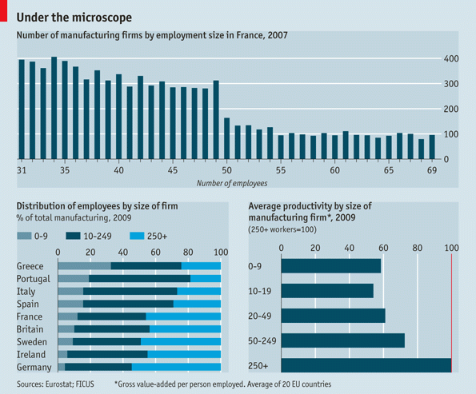
What’s going on in France?
Source: The Economist, March 3, 2012.

Slide 10
What’s going on in France?
Bloomberg Business Week, May 3, 2012 France
Here’s a curious fact about the French economy: The country has 2.4 times as many companies with 49 employees as with 50. What difference does one employee make? Plenty, according to the French labor code. Once a company has at least 50 employees inside France, management must create three worker councils, introduce profit sharing, and submit restructuring plans to the councils if the company decides to fire workers for economic reasons.
What’s going on here? Who wins? Who loses?

Slide 11
What’s going on in France?
Christopher Caldwell, Financial Times, Feb 05:
In early 2000, when the French unemployment rate was 9.6%, Martine Aubry, the Socialist labour minister, shepherded into law a bill that capped the work-week of most employees at 35 hours. She called it “a necessity for job creation.” Today, the unemployment rate stands at 9.9% … and French labour participation is rock-bottom among developed countries.
What’s going on here? Who wins? Who loses?

Slide 12
What’s going on in France?
Financial Times, Feb 12 07:
Presidential candidate Segolene Royal laid out her economic vision: increase the minimum wage, scrap laws that make it easier for small companies to hire and fire employees.
What’s going on here? Who wins? Who loses?

Slide 13
What’s going on in France?
Liz Alderman, NYT, February 20, 2013
“How stupid do you think we are?” wrote Titan CEO Maurice Taylor, an American. “The French work force gets paid high wages but works only three hours. They have one hour for their breaks and lunch, talk for three and work for three.” He was roundly condemned in France for his “predatory” American corporate culture. Others said that France’s 35-hour workweek, its rigid labor market and the influence that labor unions hold over the workplace have long been a source of aggravation for businesses.
What’s going on here? Who wins? Who loses?

Slide 14
What’s going on in France?
Jacqui Cheng, “Sacre bleu!” Ars Technica, March 13, 2013
It's a rule of retail life that you often have to work long past closing time while you clean up or do inventory for the following day. But Apple Store employees in France won't have to do this anymore. Apple has been ordered to stop asking its retail employees to work past 9pm and must now pay €10,000 in damages. French labor laws forbid requiring employees to work between 9pm and 6am (as well as Sundays, all day).
What’s going on here? Who wins? Who loses?

Slide 15
What’s going on in France?
How do France and the US compare?
Unemployment?
Employment?
Hours worked?
GDP per capita?

Slide 16
Unemployment rate
France
US
Source: OECD.

Slide 17
Employment rate
US
France
Source: OECD.

Slide 18
Hours worked
US
France
Source: OECD.

Slide 19
What’s going on in France?
Why is GDP per capita lower in France?
 | Y/POP | L/POP | h
US | 34,875 | 0.514 | 1806
France | 25,664 | 0.451 | 1532
Ratio | 1.36 | 1.14 | 1.18
Log of ratio (%) | 30.7 | 13.1 | 16.5
Source: OECD and Penn World Tables, 2005.

Slide 20
What’s going on in France?
GDP per capita and GDP per hour worked
 | Y/POP | Y/L | Y/hL
US | 34,875 | 67,865 | 37.58
France | 25,664 | 56,909 | 37.12
Ratio | 1.36 | 1.19 | 1.012
Source: OECD and Penn World Tables, 2005.

Slide 21
What’s going on in France?
How would you summarize the evidence?
Explain it?

Slide 22
Labor Market Indicators

Slide 23
Labor market indicators
What the numbers mean
Why experts prefer employment to unemployment

Slide 24
Employment “status” in the US
Noninstitutional, civilian population, 16 and over
Source: BLS, Jan 2012.

Slide 25
Standard indicators
Employment rate = employed/working-age population
Labor force = employed + unemployed
Unemployment rate = unemployed/labor force
Participation rate = labor force/working-age population
Inactivity rate = out of labor force/working-age population
Hours worked = average hours worked of employed people

Slide 26
Employment status in the US
Population 16+:
Labor force :
Employment rate:
Unemployment rate:
Participation rate:
Source: BLS, Jan 2012.

Slide 27
Employment status in the US
Population 16+: 242.268
Labor force : 154.395
Employment rate: 58.5%
Unemployment rate: 8.3%
Participation rate: 63.7%
Source: BLS, Jan 2012.

Slide 28
Ways to reduce unemployment
Unemployed get jobs
Raises employment rate
Unemployed leave labor force
Employment rate doesn’t change
Unemployment rate falls
Which is more informative
Employment or unemployment?

Slide 29
Unemployment rates
Source: OECD.

Slide 30
Unemployment rates, youths
Source: OECD.

Slide 31
Employment rates
Source: OECD.

Slide 32
Hours worked
Source: OECD.

Slide 33
Labor Market Analysis

Slide 34
Why unemployment?
Are jobs like donuts? hotel rooms? something else?
Evidence overwhelming that the number of jobs isn’t fixed, it responds to circumstances

Slide 35
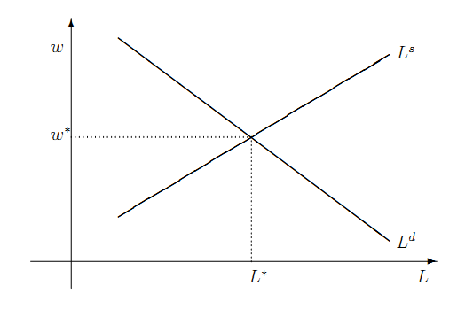
Frictionless labor market model
Where’s the unemployment?

Slide 36
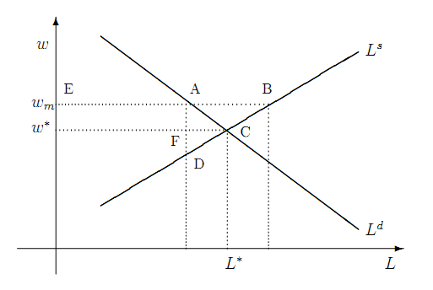
Institution: minimum wage
Where’s the unemployment?

Slide 37
Institution: minimum wage
What happens to unemployment? Why?
Is this a big effect or a small one?
Who wins in the model? Who loses? Which is bigger?
Who wins in the real world? Who loses? Which is bigger?

Slide 38
Minimum wage (fraction of median)
Source: OECD.

Slide 39
Institution: minimum wage
Milton Friedman (paraphrase)
The minimum wage is discrimination against people with low skills, because it forces firms to pay a wage greater than their skill supports. As a result, many of them are unemployed, rather than working and developing skills that would improve their prospects.
Do you agree or disagree? Why?

Slide 40
Institution: minimum wage
Gary Becker, Becker-Posner blog:
Generous minimum wages and other rigidities of the French labor market caused unemployment rates that have remained stubbornly high. Immigrants, youths, and other new entrants into the labor market have been hurt the most.
Do you agree or disagree? Why?

Slide 41
Labor Market Institutions

Slide 42
“Protection” v “flexibility”
What you’ll be dealing with in other countries
Doing Business, 2006
Least flexible labor market = Portugal
Most flexible labor market = New Zealand
Use them as examples
Employment protection law (EPL) governs
Fixed term contracts
Overtime compensation
Dismissal
Collective bargaining

Slide 43
“Protection” v “flexibility”
Fixed-term contracts
PRT Fixed term contracts allowed only in special situations (such as seasonal activity)
NZL Fixed term contracts are unrestricted, with no maximum duration period
Source: Botero, Djankov, La Porta, Lopez-de-Silanes, Shleifer, Regulation of Labor.

Slide 44
“Protection” v “flexibility”
Overtime
PRT Mandatory premium for overtime ranges from 50% to 75%, additional restrictions on night work, and there are 24 days of paid leave per year.
NZL No required premium for overtime, no restrictions on night work, and the minimum paid leave is 15 days per year.
Source: Botero, Djankov, La Porta, Lopez-de-Silanes, Shleifer, Regulation of Labor.

Slide 45
Rigidity of hours (index)
Source: World Bank, Doing Business.
Notes:
45

Slide 46
“Protection” v “flexibility”
Dismissal
PRT List of fair grounds for terminations and stringent procedures for dismissals, such as mandatory notification of the government and priority rules for re-employment of redundant workers.
NZL Allows “contracts at will,” which can be terminated without notice without cause.
Source: Botero, Djankov, La Porta, Lopez-de-Silanes, Shleifer, Regulation of Labor.

Slide 47
Firing costs (weeks of wages)
Source: World Bank, Doing Business.
Notes:
47

Slide 48
“Protection” v “flexibility”
Collective bargaining
PRT Employers have a legal duty to bargain with unions, collective agreements are extended to third parties by law, workers councils are mandatory, and employer lockouts are prohibited.
NZL Employers have no legal obligation to bargain with unions, collective agreements are not extended, labor participation in management is not required, and employer lockouts are allowed.
Source: Botero, Djankov, La Porta, Lopez-de-Silanes, Shleifer, Regulation of Labor.

Slide 49
Union rights (index)
Source: Botero, Djankov, La Porta, Lopez-de-Silanes, Shleifer, Regulation of Labor.

Slide 50
Employment protection overall (index)
Source: OECD.

Slide 51
Employment protection over time
Source: Blanchard and Wolfers.

Slide 52
France revisited
What happened?
Would you build a plant there? Locate a bank?

Slide 53
India
Shankar Acharya, “Ten myths about India,” FT Forum, Feb 1, 2010
Myth 4. Our labor laws protect labor. Quite the opposite. Present laws overprotect a tiny minority at the expense of the mast majority of workers. By making it extremely difficult to fire workers, our laws massively discourage the employment of new workers. They lead to huge under-utilization of our most abundant resource, low-skill labor.
What’s going on here? Who wins? Who loses?

Slide 54
Brazil
EIU, Country Commerce Report
The 1988 federal constitution contains several important labour provisions: it legalises unions, collective bargaining negotiations, and the right to strike in both the public and private sectors. The constitution also sets overtime rates, provides a monthly minimum wage and regulates working hours. It lists a variety of labour entitlements, including the following: maternity leave, annual leave, workers’ compensation, social services, medical assistance and unemployment benefits.
What’s going on here? Who wins? Who loses?

Slide 55
Italy
“Employment, Italian style,” WSJ, June 25, 2012
Once you hire employee 11, you must submit an annual self-assessment to the national authorities outlining every possible health and safety hazard to which your employees might be subject.
Once you hire your 16th employee, national unions can set up shop.
Hire No. 16 also means that your next recruit must qualify as disabled. By the time your firm hires its 51st worker, 7% of the payroll must be handicapped in some way.
What’s going on here? Who wins? Who loses?
Notes:
http://johnhcochrane.blogspot.com/2012/06/sand-in-gears.html

Slide 56
Italy
“Dangermen,” The Economist, Feb 18, 2012:
A plaque marks the spot in Rome where Professor D’Antona was assassinated in 1999 by the Red Brigades. He was killed because he was working on plans for greater flexibility of Italy’s labor market. Marco Biagi, who took up his standard, was murdered by the same group three years later. The two killings testify to the resistance to reform in a country where jobs-for-life is the culture and youth unemployment is over 30%.
What’s going on here? Who wins? Who loses?

Slide 57
Japan
EIU, Country Commerce Report
Japan’s labour system traditionally featured lifetime employment, elaborate fringe benefits, and wages based on length of service rather than performance. Most Japanese companies are finding this system increasingly difficult to sustain. But changing the social contract of lifetime employment has been difficult. The result is a massive number of unneeded workers in virtually every industry. The rigidity of the job market is partly offset by the growing presence of non-regular and part-time workers willing to work for less pay with no job security at all.
What’s going on here? Who wins? Who loses?

Slide 58
Japan
“Misfire,” The Economist, June 15, 2013:
Many were left disappointed by Abe’s “third arrow,” seeking to boost long-term economic performance. One area reformers hoped for progress was Japan’s labour market. Unless they are going out of business, firms are barred from firing employees. Companies hang on to their excess workers, so their costs are inflated, leaving them unwilling to take on new employees or raise salaries.
What’s going on here? Who wins? Who loses?

Slide 59
US
Econbrowser, November 2012
The recent health care legislation requires that that large companies either provide health insurance for full-time workers or pay a fee. But the Wall Street Journal reports that some are taking a third route-- shifting to more part-time workers.
What’s going on here? Who wins? Who loses?
Notes:
http://www.econbrowser.com/archives/2012/11/links_for_20121.html

Slide 60
What’s going on in Denmark?

Slide 61
Denmark’s “flexicurity” model
Flexible labor markets
Flexible hours, easy to fire people
Strong support for unemployed
Training programs
Subsidies to employers
Results
Flexible labor market
Security for unemployed
Cost is 4-5% of GDP [OECD average 0.5%]

Slide 62
Denmark’s “flexicurity” model
World Economic Forum
Denmark continues to distinguish itself as having one of the most efficient labor markets internationally, with more flexibility in setting wages, firing, and therefore hiring workers than in the other Nordics and in most countries more generally.
Who wins? Who loses?

Slide 63
What have we learned?
Wide variation in labor market institutions/regulations
Something to keep in mind when you’re operating in another country
Also variation in “outcomes”
Employment, unemployment, hours …
In flexible labor markets
Easier to lose a job
Easier to get one
Who wins? Who loses?

Slide 64
After the break
Be prepared to discuss Ghana

Slide 65
The Global Economy Volatility & Financial Markets

Slide 66
Roadmap
Ghana mini-case
What’s happening?
Volatility
The capital markets “game”
Financial market institutions
Crisis management

Slide 67
Ghana mini-case
What features do you need in this business?
How does Ghana stack up?
Good idea – or not?

Slide 68
What’s happening?
Simon Romero, “A polarizing figure,” NYT, March 5, 2013
Hugo Chávez, who died on Tuesday at 58, rose from poverty in a dirt-floor adobe house to unrivaled influence in Venezuela as its president, consolidating power and wielding the country’s oil reserves as a tool for his Socialist-inspired change. … He was a man of mixed ancestry — African, indigenous and Spanish — who despised a power structure dominated by Europeanized elites.
Was he good or bad for Venezuela? Why?

Slide 69
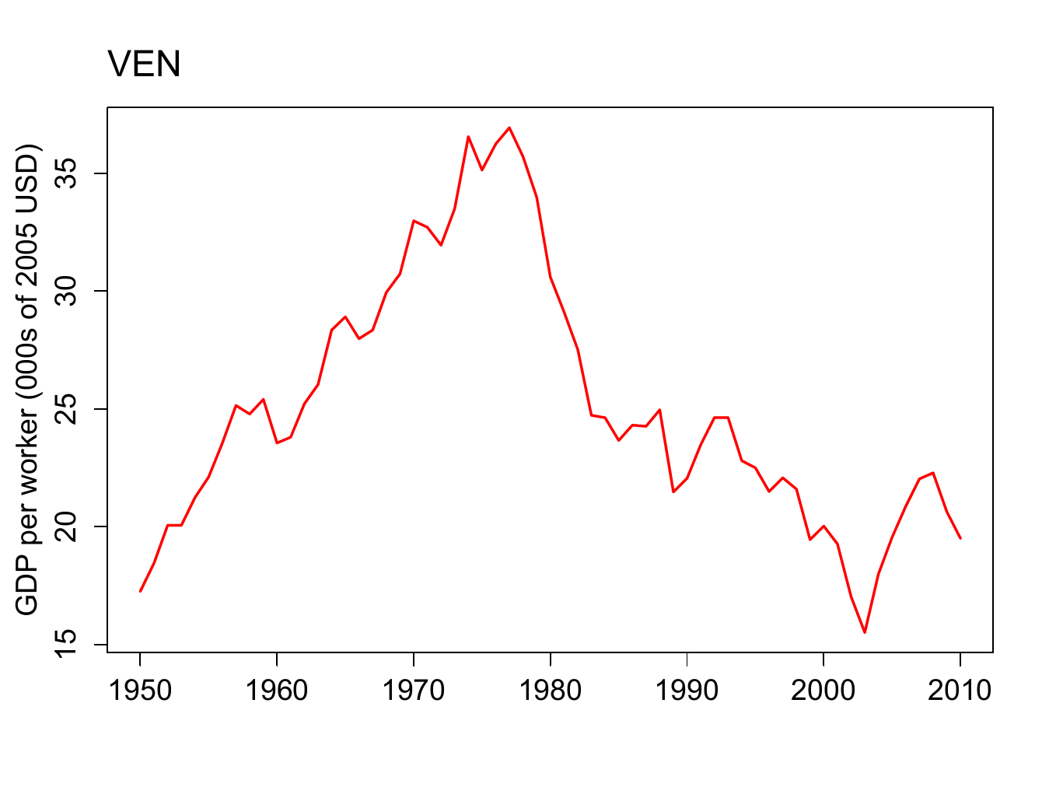
What’s happening?

Slide 70
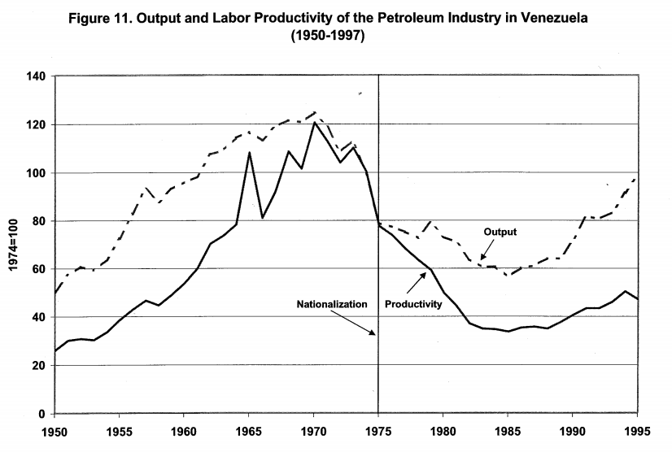
What’s happening?
Source: Cole, Ohanian, Riascos, and Schmitz, “Latin America in the rearview mirror.”

Slide 71
The idea
Good economic performance requires effective labor and financial markets
Especially in a volatile economic environment
Financial markets are hard to get right
They require lots of “infrastructure”
“That’s where the money is”
They sometimes blow up

Slide 72
Volatility

Slide 73
Equilibrium
Call me when we get there

Slide 74
Volatility
Marx and Engels, Communist Manifesto, 1848
Everlasting uncertainty and agitation distinguish the bourgeois epoch from all earlier ones. All fixed, fast frozen relations … are swept away, all new-formed ones become antiquated before they can ossify. All that is solid melts into air, all that is holy is profaned, and man is at last compelled to face with sober senses his real condition of life and his relations with his kind. All old-established national industries have been destroyed or are daily being destroyed. They are dislodged by new industries, whose introduction becomes a life and death question for all civilized nations.
Does this sound right to you?

Slide 75
Volatility
Joseph Schumpeter, Capitalism, Socialism and Democracy
The process of Creative Destruction is the essential fact about capitalism. In capitalist reality, competition … strikes not at the margins of the profits and the outputs of the existing firms but at their foundations and their very lives.
Does this sound right to you?

Slide 76
Volatility
Adam Davidson, Planet Money, March 2013
In January, 4.2 million were hired. And 4.1 million quit or were fired. In other words, every 1.6 seconds, someone got a job and someone else left a job. Even in good economic times, new jobs are constantly being created and old jobs are constantly being destroyed. There's a little-known jobs report that shows all this creation and destruction. It's called the Job Openings and Labor Turnover Survey, though it typically goes by the catchy acronym JOLTS.
What’s going on here?

Slide 77
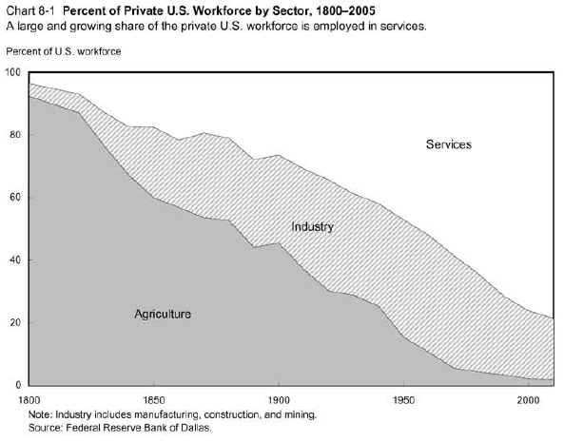
Volatility

Slide 78
Volatility
Millions of farm jobs lost
Millions of industrial jobs lost
Where did they go?

Slide 79
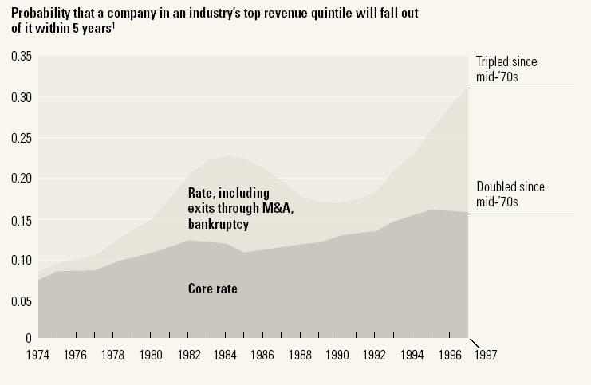
Volatility
Source: McKinsey Quarterly, “Extreme competition,” 2005.

Slide 80
Volatility
Products come and go
Firms come and go
Industries come and go
Good or bad?
What does this mean for labor and capital markets?

Slide 81
Volatility
If the world is volatile, do you want
“Fixed, fast relations”?
“Creative destruction”?
Why?

Slide 82
Capital markets game

Slide 83
Capital markets game
A bit of game theory…
Parameters:
Borrower has project that generates 100 + 15
Lender offers 100 to borrower for one year
Lender’s cost of funds is 5%, charges 10%
In default, borrower uses up 50, keeps the rest [Hmmm…]
Where’s the value in this game?
Who gets it?

Slide 84
Capital markets game
Don’t lend
Payoffs = (0,0)
L
(+5,+5)
Repay
Lend
B
Default
(–105,+65)
What’s the outcome? What can we do about it?
Notes:
84
Note: economic activity creates value

Slide 85
Capital markets game
Don’t lend
Payoffs = (0,0)
L
(+5,+5)
Repay
Lend
B
0
X
Default
(–105,+65)
What’s the outcome? What can we do about it?
Notes:
85
Note: economic activity creates value

Slide 86
Capital markets game
Note: creditor rights are good for borrowers
If default is attractive, lenders don’t lend
Result: projects not funded, TFP lower than it could be
Evidence
States/countries with stronger creditor rights have more lending, lower rates
Also higher GDP per capita

Slide 87
Financial market institutions

Slide 88
Financial market institutions
Obvious: enforce property rights
Protect creditors
Governance of firms
Disclosure
Less than obvious: manage financial crises
Why not let failures happen?
Meltzer: “Capitalism without failure is like religion without sin”
But: they cause collateral damage
How do we balance these concerns?

Slide 89
Days to enforce contracts
Source: World Bank, Doing Business.

Slide 90
Cost of enforcing contracts
Source: World Bank, Doing Business.

Slide 91
Investor protection (index)
Source: World Bank, Doing Business.

Slide 92
Financial markets in action
Indicator | US | France | Ratio
GDP | 6,297b | 1,296b | 5:1
Biomedical researchers | 77,000 | 12,000 | 6:1
Public research funding | 15.8b | 1.8b | 9:1
Industry research funding | 18.6b | 2.8b | 7:1
Biotech patents | 13,982 | 1051 | 13:1
Biotech startups | 1,100 | 40 | 27:1
Publicly-traded biotechs | 315 | 5 | 63:1
Recombinant proteins | 97 | 0 | ∞:1
Source: Michelle Gittelman.

Slide 93
Managing crises

Slide 94
Financial crises happen
Common in emerging markets
Mexico: 1982, 1994
Asian crisis: 1997
US: 1891, 1907, …
Developed countries too
Japan: 1990s
Scandinavia: 1990s
All over: 2008-09

Slide 95
Financial crises as “runs”
Friedman and Schwartz on the 1930s
The failure of one bank can produce “runs” on other banks that in turn might force even “sound” banks to close
Federal deposit insurance has succeeded in achieving a major objective of reform, namely, the prevention of runs
What are they saying? Do you agree? Disagree?

Slide 96
Financial crises: regulation basics
Insolvent banking system bad for the economy
Therefore: protect the banks through regulation
Deposit insurance
Limits on risk
Close or merge insolvent banks
Look closely at large banks (“systemic”)
Central bank lending when needed
Mind-numbing detail

Slide 97
Financial crises: open issues
Are governments capable of doing this well?
Complex rules invite arbitrage
Should failure be an option?
Let failures fail, deal with consequences
Just banks?
Commercial paper? Money market funds?

Slide 98
What have we learned
The world’s a volatile place
Products, companies, and industries come and go
Financial markets facilitate the reallocation of capital
With good institutions, they work better
But they’re subject to crises
A fact of life or something we can manage?

Slide 99
Problem Set #2
Due next class
Post questions on Announcements & Discussion
Or email me

Slide 100
Something for the ride home
Are markets “moral”?
Would you use them to
Set wages and salaries?
Buy and sell goods from other countries?
Allocate kidneys for transplants?
Be prepared to discuss next class
Read mini-case posted on course website

