Slide 1

The Global Economy Introduction & Overview
Notes:
Open Gapminder (growth, corruption, mortality)
Ask students about china, india – what’s happening? Differences?
Also: course website, FRED

Slide 2
This course is about countries
Their economic and business environments
Featuring
Data
Economics

Slide 3
Three modules
Long-term economic performance
What are the challenges of running a business in [Argentina | France | Brazil | China | India]?
Short-term economic performance
How’s the economy doing?
How does it affect my business?
Economic crises
Are there signs of serious trouble on the horizon?
What can I do about it?

Slide 4
Long-term economic conditions

Slide 5
Gapminder
What do you see?
http://www.gapminder.org/world/
(growth, human development index, etc)
Questions that might cross your mind
What do you see?
Where are the business opportunities? The “challenges”?
What’s going on in [China | India | Argentina | Brazil | …]?
Other thoughts?

Slide 6
About participation
An important part of the class
More fun for all of us if you pitch in
Ways to participate
Make a comment
Ask a question
Share an experience
Post a comment or link on Announcements & Discussion

Slide 7
About participation
Guidelines
Feel free to disagree --- politely, please!
Also with me (I was wrong once)
Facts are always good
Novices: please ask questions, it helps everyone
Experts: don’t scare your classmates

Slide 8
What’s happening?

Slide 9
What’s happening?
Regular feature
Bring your ideas, I’ll bring mine
Read The Economist
Order now if you haven’t already

Slide 10
What’s happening?
Fed decided not to “taper”
Fed has been purchasing lots of long-term assets
Suggested earlier it would slow down – “taper”
Announced last week it would keep buying for now
Stock market soared
Also emerging market currencies
What’s going on here? Does it make any sense to you?
Tyler Cowen:
“None of [us] understand what is going on here.”

Slide 11
What’s happening?
Anything else cross your mind?

Slide 12
Short-term economic conditions

Slide 13
Current conditions in the US
How’s the economy doing?
How can you tell?
What does that mean for your business?

Slide 14
Current conditions in the US
What do conditions mean for
Johnson & Johnson?
Google?
Morgan Stanley’s fixed income trading desk?
Your company?

Slide 15
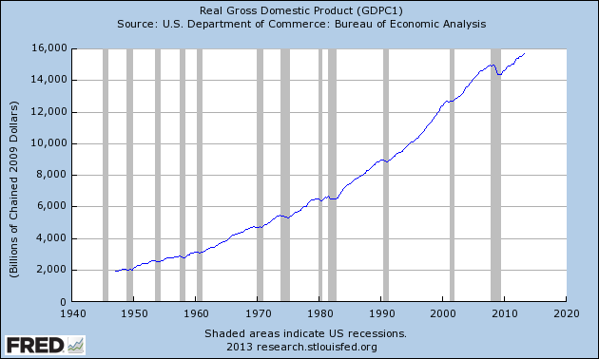
Real GDP
Source: FRED.

Slide 16
Real GDP
Source: Cooley-Rupert Snapshot

Slide 17
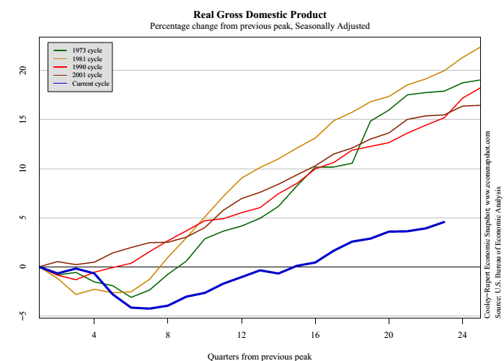
Real GDP
Source: Cooley-Rupert Snapshot

Slide 18
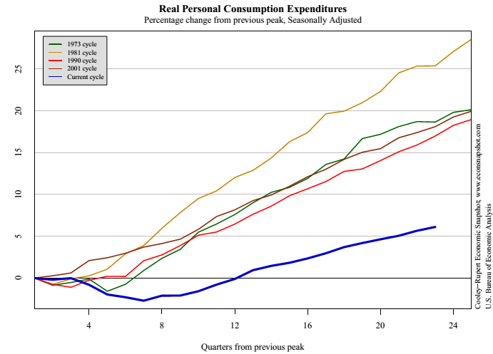
Consumption
Source: Cooley-Rupert Snapshot

Slide 19
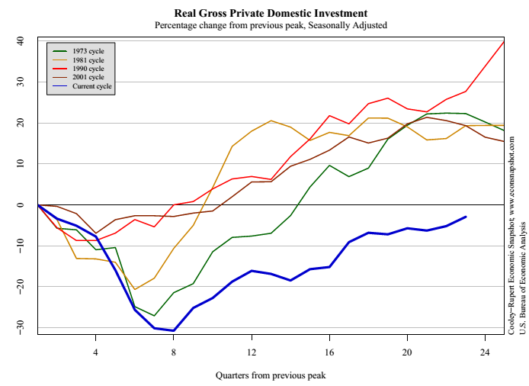
Investment
Source: Cooley-Rupert Snapshot

Slide 20
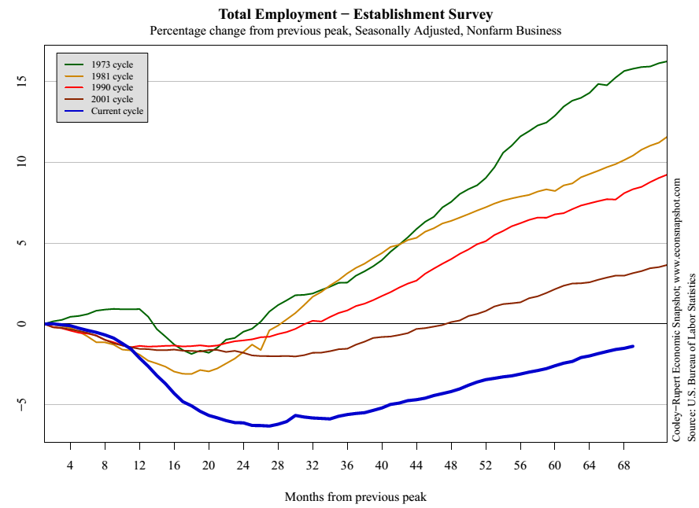
Employment
Source: Cooley-Rupert Snapshot

Slide 21
Current conditions revisited
How’s the economy doing?
Where is it headed?
What does that mean for your business?

Slide 22
Economic crises

Slide 23
Crises ***
What countries are in trouble?
How can you tell?
How did they get that way?

Slide 24
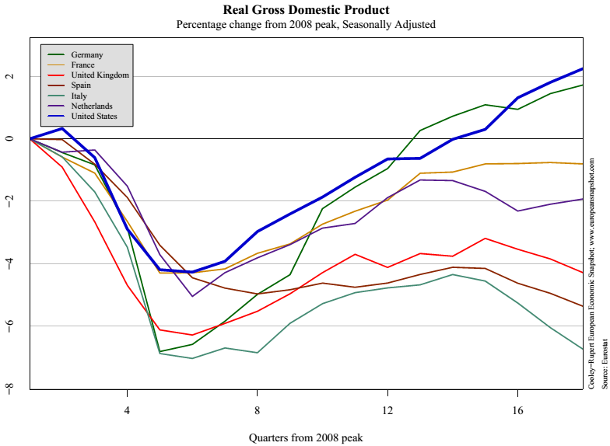
European GDP
Source: Cooley-Rupert European Snapshot

Slide 25
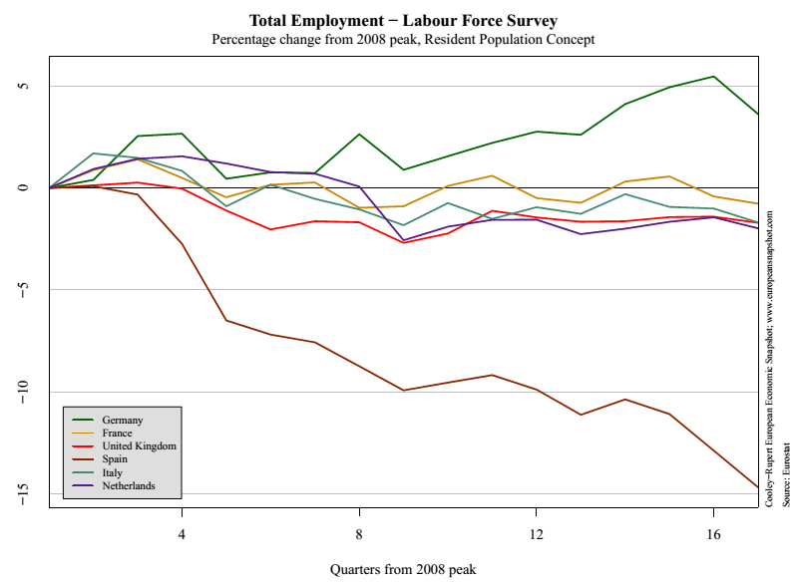
European employment
Source: Cooley-Rupert European Snapshot

Slide 26
About the course

Slide 27
About the course
It’s about economic performance
Of countries
And the businesses in them

Slide 28
About the course website
Everything’s on the website:
https://sites.google.com/site/nyusternglobal/
Or search: #nyuecon global
The outline contains
Topic summaries
Assignments (with links!)
Slides, video, and more

Slide 29
About Announcements & Discussion
Access by
Signing up for email delivery
Or viewing online
You can use it to
Find a group
Post comments and links
Ask questions about assignments
Answer questions asked by others
I’ll use it to
Post announcements about the course
Answer questions

Slide 30
About slides
Catalyst for class discussion
Not intended to be read on their own
More than we need: don’t panic if we skip some
Subject to change without notice

Slide 31
About slides
Catalyst for class discussion
Not intended to be read on their own
More than we need: don’t panic if we skip some
Subject to change without notice

Slide 32
About assignments
Problem Set #0
Individual – everyone must do it
Math and spreadsheet review
Due at the start of our next class
Problem Sets #1 to #4
Do in groups of up to four people
Unlimited marriage and divorce
Due dates noted in red on website
Practice Problems A to D
Not graded
Useful review and preparation for exams

Slide 33
About quantitative content
Course is a mixture of quantitative and qualitative
Like business
Like life?

Slide 34
About quantitative content
Spreadsheets
Used extensively (essential life skill)
Read “Math Review” to get up to speed
Exponents and logarithms
Used extensively in first half
Read “Math Review” to get up to speed
Calculus
Used a little
Not required for exams
Read “Math Review” to get up to speed

Slide 35
About the book
Custom designed for this course (“bespoke”)
More focused and concise than most
Distributed in class for free, also posted online
Or buy it at Amazon for $9
[Extra credit: write a good review?]
Skim before class, read again afterwards

Slide 36
About me
Grew up in Pittsburgh
PhD Yale
Research interests
International capital flows
Fixed income and currency markets
Emerging markets
Other interests
The Steelers
Basketball, biking, Buffy, books, beer

Slide 37
About getting help
With problem sets
Post questions on Announcements & Discussion
Check same to see what others have asked
Email me: I’ll respond directly AND update Announcements
With anything else
Post a question on Announcements & Discussion
Email me
Stop by any afternoon
Buy me a coffee or beer after class

Slide 38
About grades
Participation | Outliers & Tiebreakers
Problem Sets | 20%
Midterm Exam | 35%
Final Exam | 45%

Slide 39
About class videos
Available roughly an hour after class
Link on course website (when I track it down)

Slide 40
About the syllabus
Read it, it’s a contract between us

Slide 41
What have we learned?
As Haiku
Read book before class
If you need help ask for it
Website is knowledge

Slide 42

The Global Economy Macroeconomic Data

Slide 43
Objective
Know what these headline numbers are
(Real) GDP: how much stuff did we produce? growth rate?
Inflation: how much did average prices change?
Why do we need this?
Common vocabulary (like financial statements for businesses)
Do at high speed now, reinforce with constant use

Slide 44
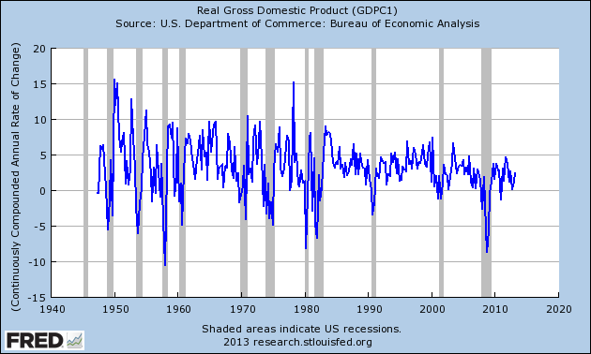
US (real) GDP growth
Source: FRED

Slide 45
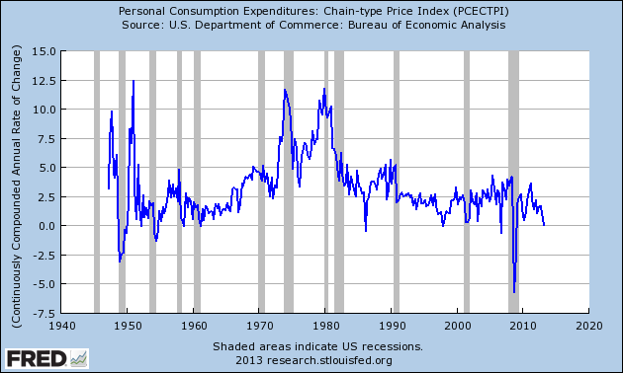
US inflation
Source: FRED

Slide 46
GDP per capita (USD, PPP adj)
Source: World Bank, World Development Indicators

Slide 47
Growth in GDP per capita (20-year avg)
Source: Penn World Tables.

Slide 48
Growth in GDP per capita (2013 est)
Source: OECD.

Slide 49
Roadmap
GDP: Gross Domestic Product
Expenditures and financial flows (“identities”)
Prices and quantities
Second thoughts

Slide 50
GDP

Slide 51
GDP
GDP = Gross Domestic Product – and Income
Total value of production in a geographic area
Sum value added across all production units
By convention we don’t subtract depreciation (“gross”)
Three approaches to the same answer
Value added
Income (value added is income for someone)
Final sales (the end of the value chain)

Slide 52
Final sales
Common way to report data
Who buys the good at the end of the value chain?
Two approaches
Include all producers

Slide 53
GDP: example 1
Example
Farmer produces wheat, sells it for 100
Miller buys the wheat, produces flour, sells it for 175
Baker buys the flour, makes bread, sells it for 300
What is value-added for each producer?
What is GDP?
What is total income for the economy?
Who eats the bread?

Slide 54
GDP: example 1
Producer | Farmer | Miller | Baker | GDP
Value-added
Final sales

Slide 55
GDP: example 1
Producer | Farmer | Miller | Baker | GDP
Value-added | 100 | 75 | 125 | 300
Final sales | 0 | 0 | 300 | 300

Slide 56
GDP: example 2
Barley farmer
Sales = 10
Rent = 3
Farmer’s profit = 7
Brewer
Sales = 110
Rent = 30
Wages = 70
Barley input = 10 (COGS)

Slide 57
GDP: example 2
Producer | Farmer | Brewer | Total
Value-added
Income
Final sales

Slide 58
GDP: example 2
Producer | Farmer | Brewer | Total
Value-added | 10 | 100 | 110
Income | 10 | 100 | 110
Final sales | 0 | 110 | 110

Slide 59
GDP: investment & government
Investment not an input cost
Like corporate financial statements
Except: we never do subtract depreciation
Government purchases valued at cost
If the government produces goods and services, we value the output at whatever the input cost is

Slide 60
GDP: example 3
Computer maker
Sales = 100
Wages = 65
Materials = 10
Owners’ income = 25
New building = 15
What is value added?
What is income?
What is final sales?
Concept | Total
Value-added
Income
Final sales

Slide 61
GDP: example 3
Computer maker
Sales = 100
Wages = 65
Materials = 10
Owners’ income = 25
New building = 15
What is value added?
What is income?
What is final sales?
Concept | Total
Value-added | 90
Income | 90
Final sales | 100*
* Includes 10 from materials producer

Slide 62
GDP: example 4
Government
Wages = 75
Rent = 25
What is value added?
What is income?
What is final sales?
Concept | Total
Value-added
Income
Final sales

Slide 63
GDP: example 4
Government
Wages = 75
Rent = 25
What is value added?
What is income?
What is final sales?
Concept | Total
Value-added | 100
Income | 100
Final sales | 100

Slide 64
GDP: imports & exports
The issue
GDP is what we make
Final sales is what we buy
How do we reconcile the former with the latter?
Solution: add exports, subtract imports
Exports are things we make but don’t buy
Imports are things we buy but don’t make

Slide 65
GDP: example 2 revisited
Barley farmer in Canada
Sales = 10
Rent = 3
Farmer’s profit = 7
Brewer in the US
Sales = 110
Rent = 30
Wages = 70
Barley input = 10 (COGS)

Slide 66
GDP: example 2 revisited
Canada
US
Producer | Farmer | Brewer | US Total
Value-added
Income
Final sales

Slide 67
GDP: example 2 revisited
Canada
US
Producer | Farmer | Brewer | US Total
Value-added | 10 | 100 | 100
Income | 10 | 100 | 100
Final sales | 10 | 110 – 10* | 100
* Remember: subtract imports

Slide 68
GDP: example 5
Import-export firm
Sales = 140
Of which: 120 local, 20 abroad
Material inputs = 25 from abroad, 10 local
What is value added?
Income?
Final sales?
Concept | Total
Value-added
Income
Final sales

Slide 69
GDP: example 5
Import-export firm
Sales = 140
Of which: 120 local, 20 abroad
Material inputs = 25 from abroad, 10 local
What is value added?
Income?
Final sales?
Concept | Total
Value-added | 105
Income | 105
Final sales | 140* – 25** = 115
* Remember: add exports
** And: subtract imports

Slide 70
GDP as value added by industry
mfg
FIRE
bus. services
agriculture
Source: BEA
Notes:
Agriculture, Manufacturing, FIRE, Business Services

Slide 71
GDP as income by type
labor comp.
rental income
corp. profits
interest
Source: BEA

Slide 72
Expenditures & financial flows

Slide 73
Expenditure flows
Allocate GDP among purchasers of final goods:
Y = C + I + G + NX
Y = GDP
C = sales to households (“consumption”)
I = sales of capital goods to firms (“investment” = “capex”)
G = purchases of goods and services by government
NX = net exports (exports minus imports)

Slide 74
GDP as final sales by expenditure
personal consumption
govt consumption
investment
net exports

Slide 75
Saving flows 1
Allocate flows of assets
Y – C – G = I + NX
S = I + NX
S = gross domestic saving (purchases of assets)
NX = net purchases of foreign assets

Slide 76
Saving flows 2
Separate household and government
(Y – C – T) + (T – G) = I + NX
S_{p} + S_{g} = I + NX
T = taxes net of transfers paid by households to govt
Warning: many measures of saving, all different
Call me is this ever comes up

Slide 77
Saving flows 3
Do Americans save too little?

Slide 78
US saving and investment
investment
saving
net exports

Slide 79
Household net worth
Source: Flow of Funds Accounts
Notes:
Table L.10

Slide 80
Prices & quantities

Slide 81
Prices in US data ??
Graph prices of different goods, show they’re not the same….

Slide 82
Prices and quantities
What we’ve seen so far is “nominal GDP”
GDP measured at current prices, in local currency units
If nominal GDP goes up
How much is more stuff? (more “real GDP”)
And how much higher prices? (“inflation”)
[We could ask the same of a firm’s sales]
Problem
There’s no clear answer
Or rather: several answers, equally sensible but different

Slide 83
Prices and quantities
Our problem: find P and Q so that
NY = PQ = p₁q₁ + p₂q₂ + etc
NY = Nominal GDP = GDP at current prices (a “value”)
p,q = price and quantity of a specific product
P,Q = “average” price (“price level”) and quantity (“real GDP”)
Growth rates
Of Q: real GDP growth
Of P: inflation
How do we compute P and Q?

Slide 84
Prices and quantities
Method 1 (“fixed price method”)
Find average quantity Q using “base-year” prices
Find “average” price from P = NY/Q (“deflator”)
Method 2 (“fixed quantity method”)
Find average price P using “base-year” quantities
Find “average” quantity from Q = NY/P
Problems
Both make sense, but answers are different
Choice of base year matters too
We don’t need to know the details

Slide 85
Prices in Argentina
Former president instituted “new methodology”
Only certain products are in the official price index
Prices of those products subject to “persuasion”
Inflation lower with new method
What happened next
Official products cheap, but not available (why?)
Unofficial estimates of inflation more than double official rate
Economists arrested for producing private inflation estimates
[Search: “inflation Argentina”]

Slide 86
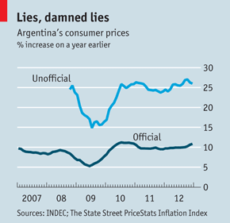
Prices in Argentina
“The IMF and Argentina,” The Economist, Feb 9, 2013:

Slide 87
Second thoughts

Slide 88
Do we care about GDP?
Bill Gates
“You can’t eat GDP.”
Bill Easterly
“Mr Gates apparently missed the economics lecture that listed the components of GDP, such as food.”
WSJ, March 2007

Slide 89

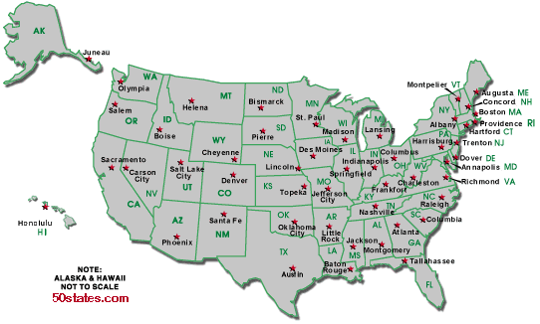
Do we care about GDP?
Per capita GDP: $47k
Per capita GDP: $34k
Avg weekly hours: 35
Avg weekly hours: 29

Slide 90
Do we care about GDP?
The obvious
GDP per person reflects income and standard of living
The less obvious
Correlated with many other things we care about: life expectancy, child mortality, poverty
Recall Gapminder
But it’s one number, not the answer to all questions

Slide 91
Do we care about GDP?
Jones and Klenow, “Beyond GDP”
Compute economic welfare by combining measures of consumption
Result: correlation with GDP per person is 0.95

Slide 92
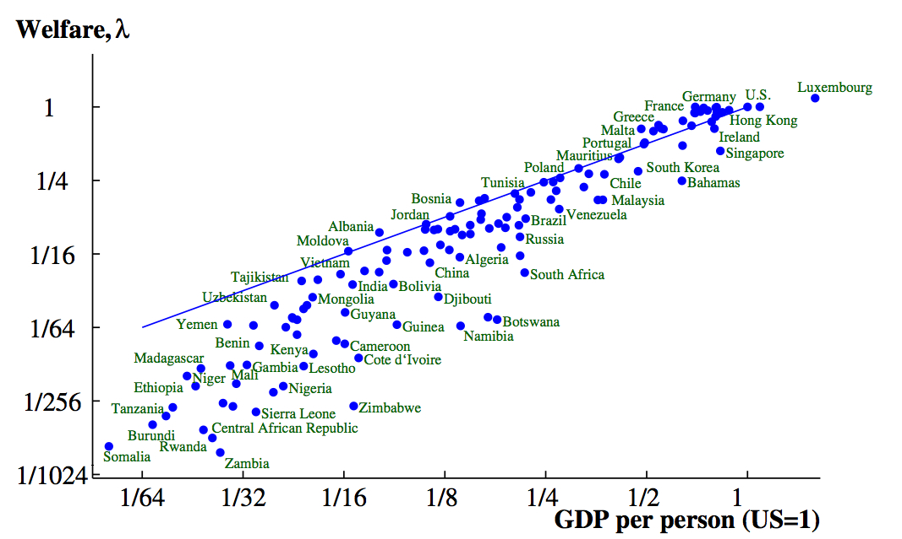
Do we care about GDP? (2000)
Source: Jones and Klenow, “Beyond GDP”

Slide 93
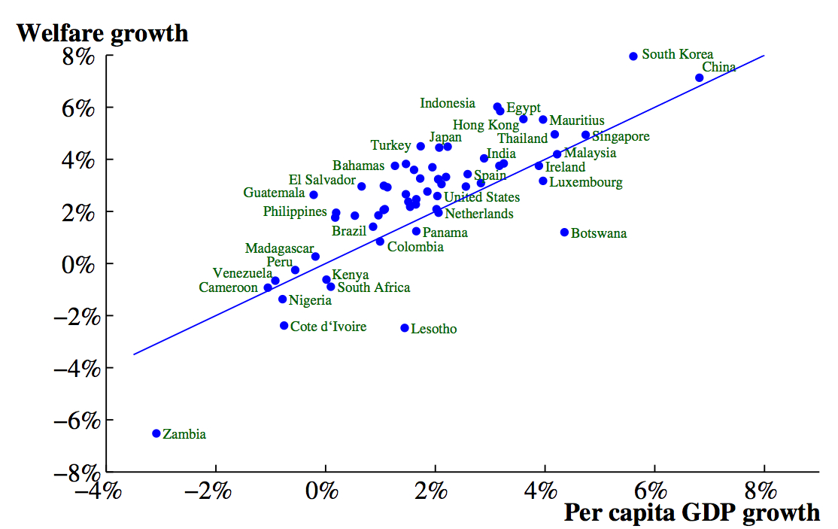
Do we care about GDP? (growth, 1980-2000)
Source: Jones and Klenow, “Beyond GDP”

Slide 94
Fine points
Home production not counted in GDP
Black market transactions not counted either
Some “income” not in GDP
Capital gains (houses, equity)
Interest on government debt
Returns on foreign assets
Call me if you ever have to deal with this

Slide 95
Macroeconomic data
Caption for old New Yorker cartoon:
“Final, revised government figures for the fourth quarter of 1981 now indicate that the Yankees, not the Dodgers, won the World Series.”

Slide 96
What have we learned?
GDP measures output , income, and expenditure
Per capita GDP is wildly different across countries
Labor gets about 2/3, “capital” 1/3
Expenditures: Y = C + I + G + NX
Real GDP measures the quantity of output
Inflation measures the change in average prices
Macroeconomic data are like sausages

Slide 97
Problem Set #0
Due at start of next class
Should look professional
Start now!

Slide 98
Something for the ride home
Should we save more?
As individuals or as countries?
Why? Or why not?
Examples?
Add your thoughts on the discussion page

Slide 99
Something for the ride home
Are natural resources critical to economic growth?
Why? Or why not?
Examples?
Add your thoughts on the discussion page

