Slide 1

The Global Economy The Production Function
Notes:
Short class, encourage discussion
Open website, Gapminder
Also growth spreadsheet (pf + solow)
Manhood video
Doing Business
Basic issue: what makes a country an attractive place to do business? Arg and Greece messed up, but can we make that precise?

Slide 2
Saving and investment
How important for economic performance?
Examples?
Why?

Slide 3
Roadmap
Saving ✓
Reminders
Economic history of the world
Theory: the production function
Inputs: capital and labor
Productivity

Slide 4
Reminders

Slide 5
Reminder: real and nominal GDP
Real GDP (“quantity”)
GDP at 2010 prices
GDP in 2005 USD
GDP in USD, PPP adjusted
GDP chain-weighted in 2010 USD
Nominal GDP (“value = price times quantity”)
GDP at current prices
GDP in LCUs
Both come from “NIPA”:
National Income and Product Accounts

Slide 6
Reminder: GDP per capita (USD, PPP adj)
Source: World Bank, World Development Indicators

Slide 7
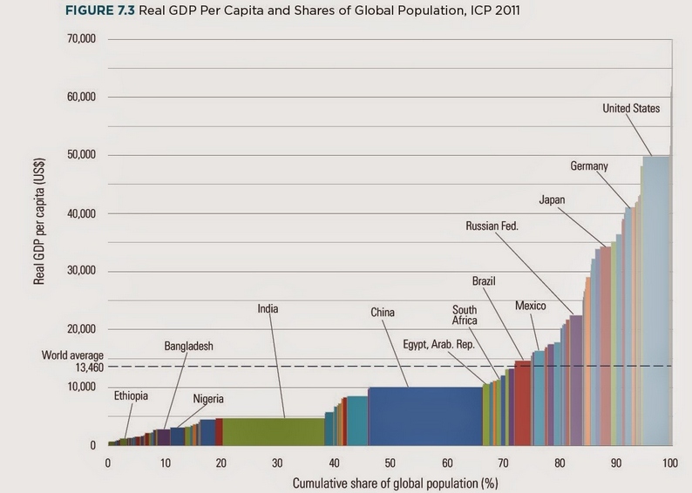
Reminder: GDP
Source: World Bank, International Comparisons Project, report.
Notes:
http://www.vox.com/xpress/2014/8/10/5988295/real-gdp-per-capita-chart
Bill Lewis, McKinsey

Slide 8
Reminder: where are we headed?
Module 1: long-term economic performance
Why are some countries rich, and others poor?
Where are the economic and business opportunities?
Suggested answer (developed over several weeks)
Business opportunities and economic performance generally reflect effective markets backed by institutions that keep them honest
Effective markets, not “free” markets

Slide 9
Reminder: where are we headed?
Where would you open a new Nike factory?
What factors are important to you?
How do Indonesia, Kazakhstan, Viet Nam compare? Others?
Where should Four Seasons expand?
What factors are important to you?
How do Baku, Dublin, Guangzhou compare? Others?
Where should Genpact open a new BPO operation?
What factors are important to you?
How do Ghana, India, Jamaica compare? Others?

Slide 10
Economic history of the world

Slide 11
Economic history of the world
Until recently, life was “poor, nasty, brutish, and short”
Thomas Hobbes, “Leviathan,” 1651
[In the natural state of Man] there is no place for industry . … [There is] continual fear and danger of violent death, and the life of man [is] solitary, poor, nasty, brutish, and short.“

Slide 12
Economic history of the world
Nasty and short on Gapminder
http://www.gapminder.org/world/

Slide 13
Economic history of the world
Statistic | Year
 | 1 | 1000 | 1820 | 2008
Population (millions) | 225 | 267 | 1,042 | 6,694
GDP Per Capita (1990 USD) | 467 | 425 | 666 | 7,614
Life expectancy (years) | 24 | 24 | 26 | 66
Source: Angus Maddison, Millenial Perspective.

Slide 14
GDP per capita (1990 international USD)
Region | Year
 | 0 | 1000 | 1820 | 2008
Western Europe | 599 | 425 | 1,218 | 21,672
Western “offshoots” | 400 | 400 | 1,202 | 30,152
Japan | 400 | 425 | 669 | 22,816
Latin America | 400 | 400 | 691 | 6,973
Former USSR | 400 | 400 | 688 | 7,904
China | 450 | 466 | 600 | 6,725
Africa | 472 | 425 | 420 | 1,760
World Average | 467 | 453 | 666 | 7,614
Source: Angus Maddison, website.

Slide 15
Some examples
Notes:
2^8=256, 2^9=512, 2^10=1024, 2^11=2048,2^12=4096, 2^13=8192, 2^14=16384, 2^15=32768
Log2 scale: each number represents a doubling, Arg<13, Ger>14, Germany GDP/capita (19,144) almost double Argentina(7,666)
Germany, US, most of Western Europe: 2% growth over last 100 years
Argentina: used to be as rich as Germany

Slide 16
Growth
Source: World Bank, World Development Indicators.

Slide 17
Summary
Several centuries ago, we were all poor – and died young
Now there’s enormous variation across countries
Also variation in growth rates
Modest variation among rich countries
Greater variation among poor countries
Questions
Why?
What will the future bring?
Where are the opportunities?

Slide 18
Open questions
Why did Western Europe do so well?
Why not the Greeks and Romans?
Why not China?
Why not India?
Why not the Islamic world?

Slide 19
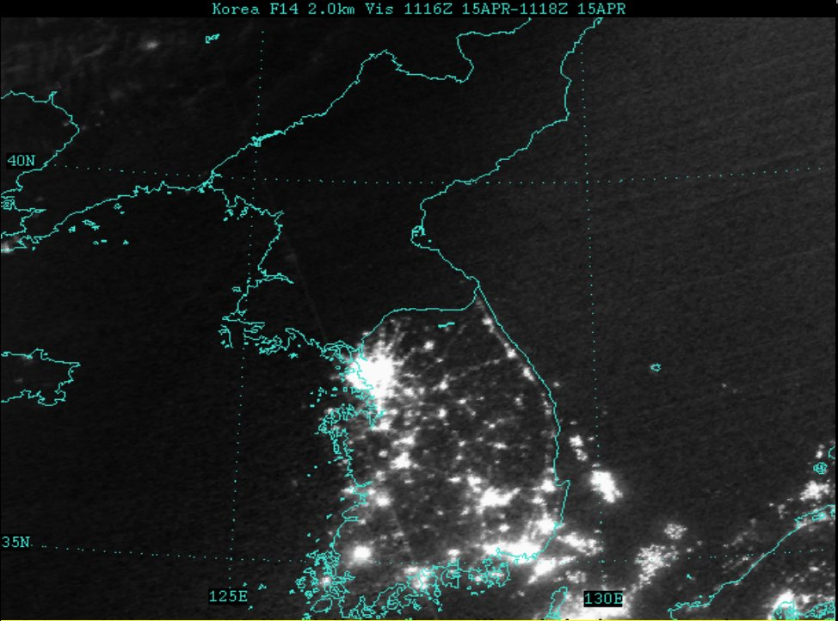
A controlled experiment

Slide 20
Theory: The Production Function

Slide 21
Why theory?
A tool to help us organize our thoughts
What factors facilitate good performance?
What factors offer attractive business opportunities?

Slide 22
What kind of theory?
Albert Einstein
“Make things as simple as possible – but not simpler.”
Georgia O’Keefe
“Nothing is less real than realism. Details are confusing. It is only by selection, by elimination, by emphasis that we get to the real meaning of things.”
Me
“Let’s keep things simple.”

Slide 23
Theory: the picture
GDP
Capital & Labor
Productivity
Political Process
“Institutions”

Slide 24
Theory: the math
The idea: relate output to inputs
Mathematical version (“production function”):
Y = A F(K,L) = A K^{α} L^{1-α}
A formula we can compute in a spreadsheet
Definitions:
K = quantity of physical capital used in production (plant and equipment)
L = quantity of labor used in production
A = total factor productivity (everything else)
α = a parameter we set equal to 1/3 (more soon)

Slide 25
Production function properties
More inputs lead to more output
Positive marginal products of capital and labor
Diminishing marginal products
If we increase one input at a time, each increase leads to less additional output
Marginal product = partial derivative of production function
Constant returns to scale
If we double **both** inputs, we double output (no inherent advantage or disadvantage to size)

Slide 26
Production function properties

Slide 27
Where does α come from?
Capital’s share of value-added
If you know calculus, this is how we show it
Profit is
Profit = pY – rK – wL = pAK^{α}L^{1-α} – rK – wL
Maximize profit by setting derivative wrt K equal to zero
dProfit/dK = αpAK^{α-1}L^{1-α} – r = 0
Multiply by K
α pAK^{α}L^{1-α} = rK
α = rK / pAK^{α}L^{1-α}
Evidence (last week): about 1/3

Slide 28
Capital (K)
What we mean: plant and equipment, physical capital
Why does it change?
Depreciation/destruction
New investment (“capex”)
Mathematical version:
K_{t+1} = K_{t} – δ_{t}K_{t} + I_{t}
= (1 – δ_{t}) K_{t} + I_{t}
Adjustments for quality?

Slide 29
Measuring capital
Option #1: direct surveys of plant and equipment
Option #2: perpetual inventory method
Pick an initial value K₀
Pick a depreciation rate (or measure depreciation directly)
Measure K like this:
K_{t+1} = (1 – δ_{t})K_{t} + I_{t}
In practice, #2 is the norm:
Get I from “NIPA” [“real” investment]
Set δ = 0.06 [ballpark number]
Example: K₂₀₁₀ = 100, δ = 0.06, I = 13 → K₂₀₁₁ = ??

Slide 30
Labor (L)
What we mean: units of work effort
Why does it change?
Population growth
Fraction of population employed (extensive margin)
Hours worked per worker (intensive margin)
Our starting point: number of people working

Slide 31
Measuring labor
Our starting point
L = number of people working
Adjustments for hours worked
Replace L with hL (h = hours per worker)
Adjustments for skill, education
Replace L with HL (H = “human capital”)
H commonly connected to years of school

Slide 32
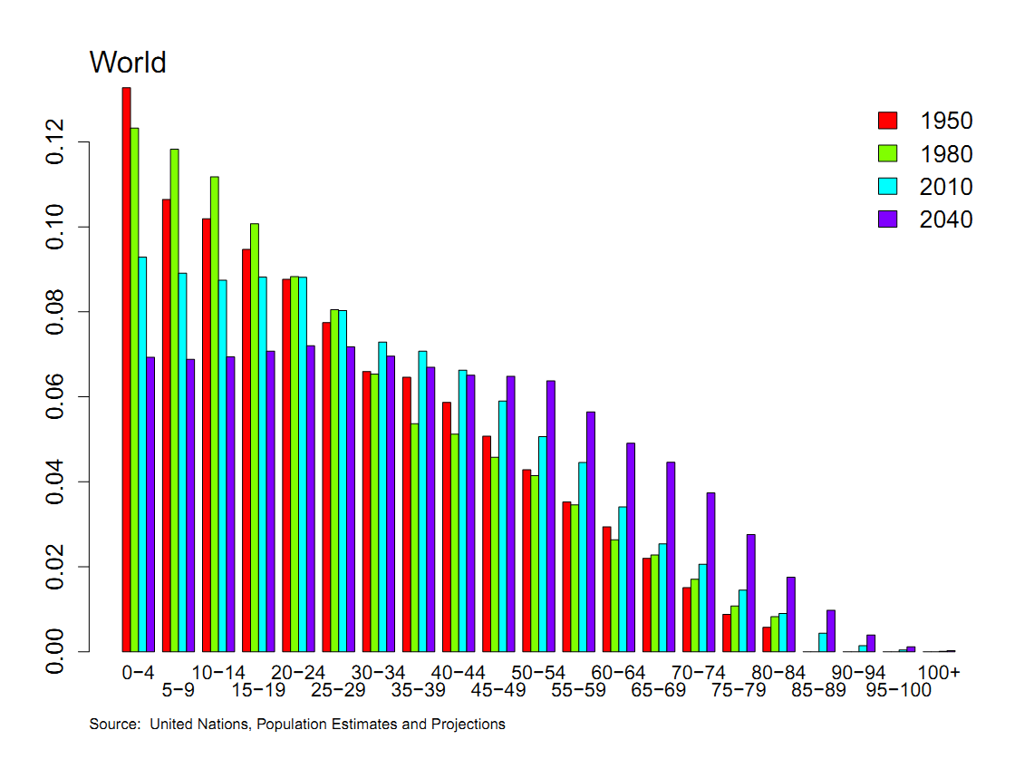
Population by age

Slide 33
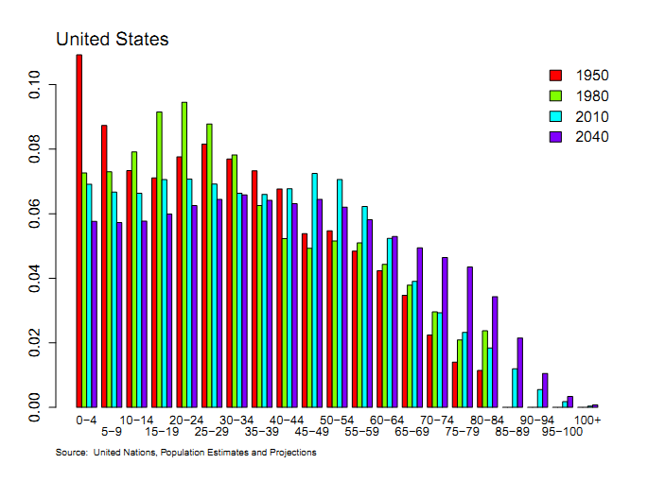
Population by age

Slide 34
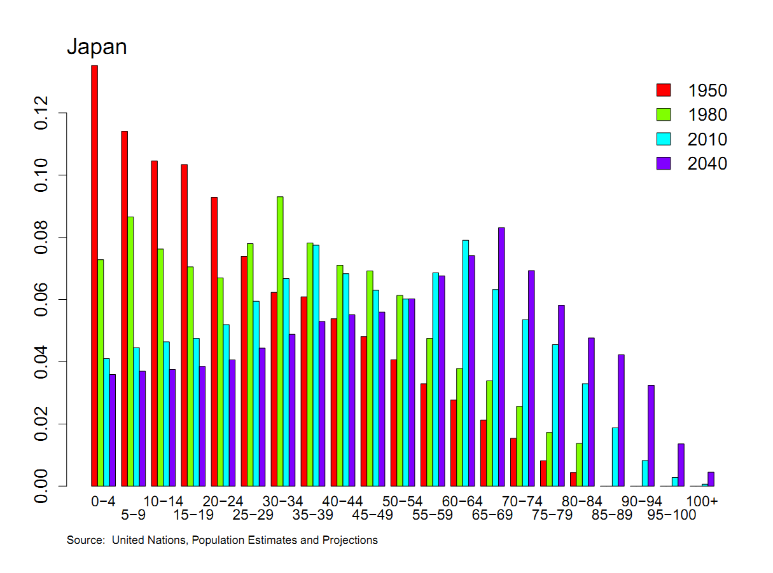
Population by age

Slide 35
Population by age
Business Week, Nov 2012:
Last year, for the first time, sales of adult diapers in Japan exceeded those for babies.
Target markets in Japan? US?

Slide 36
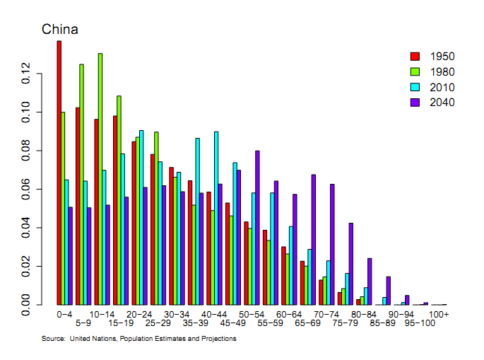
Population by age

Slide 37
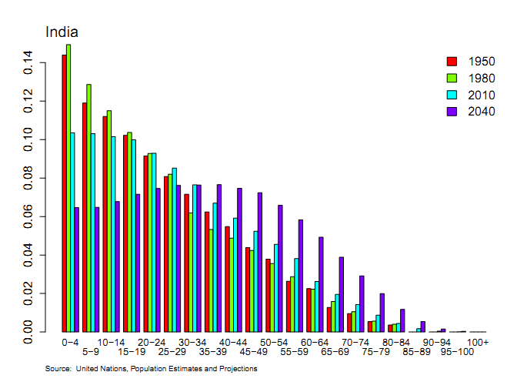
Population by age

Slide 38
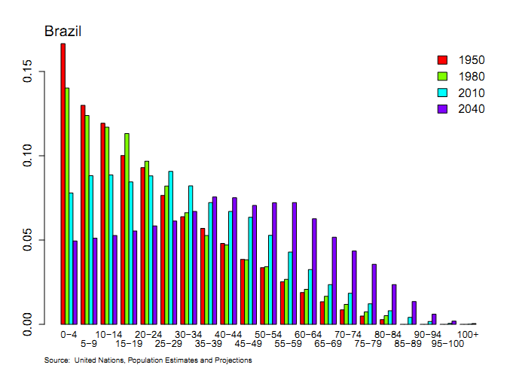
Population by age

Slide 39
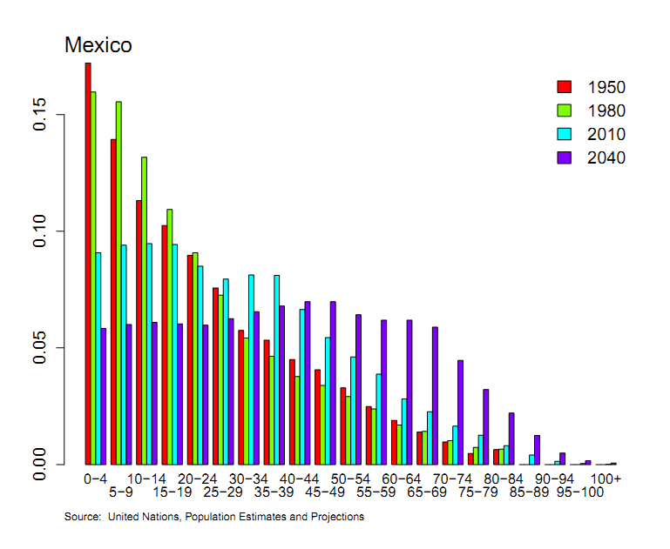
Population by age

Slide 40
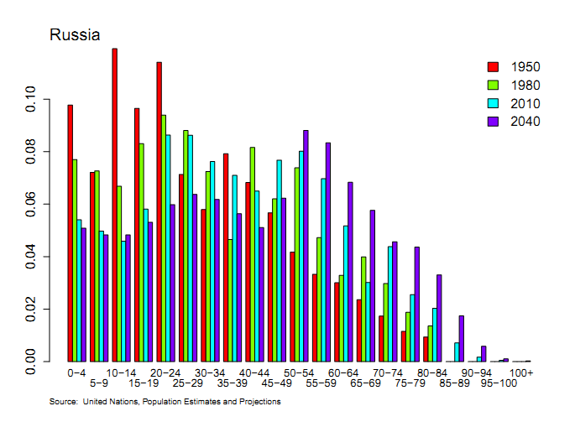
Population by age

Slide 41
Productivity (A)
Standard number
Average product of labor: Y/L
How do we measure it?
Measure output and labor input, take the ratio
Our number
Total Factor Productivity (TFP): A = Y/F(K,L)
How do we measure it?
Same idea, but “input” combines capital and labor (“total”)

Slide 42
Productivity
Solve the production function for A
Y = A K^{α} L^{1-α}
A = Y/[K^{α} L^{1-α}] = (Y/L)/(K/L)^{α}
Example: Y/L = 33, K/L = 65,
A = 33/65^{1/3} = 8.21
Note: units meaningless, but the same across time or countries

Slide 43
Production function review
Remember: Y = A F(K,L)
What changes in this equation if
A firm builds a new factory?
Fewer people retire at 65
Spanish banks channel funds to unproductive firms
Workers shift from agriculture to industry in Viet Nam?
Competition drives inefficient firms out of business?
Venture capital fund identifies good unfunded projects?
Alaska builds a bridge to nowhere?
China invests in massive infrastructure projects?

Slide 44
What have we learned?
The production function links output to inputs and productivity:
Y = A K^{α} L^{1-α}
Capital input (K)
Plant and equipment, a consequence of investment (I)
Labor input (L)
Population growth, age distribution, participation, hours (h), skill (H)
TFP (A) can be inferred from data on output and inputs

Slide 45
“Guard your manhood”
What is this ad doing?
Is it effective?
Notes:
http://youtu.be/ZSHNq79o-gM

Slide 46
The Global Economy Solow’s Growth Model

Slide 47
Problem Set #0
Answers will be posted
Question 3 makes two points that will come up later
C and I move up and down with GDP (correlations)
I moves a lot more than the others (standard deviations)

Slide 48
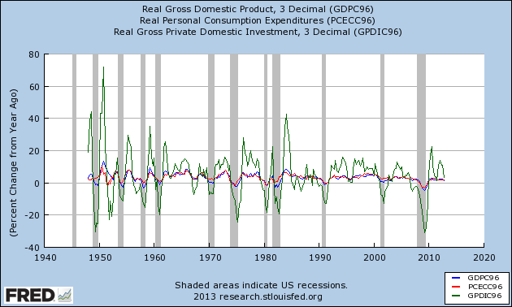
Problem Set #0

Slide 49
Problem Set #0
Question 4
How do the periods 1950-84, 1985-2007, and 2008-present compare?

Slide 50
Problem Set #1
Due in two weeks
Do in groups, learn from each other

Slide 51
What’s happening?
What’s going on in Greece?
Who’s right?
Why is this so complicated?

Slide 52
What’s happening?
Liz Alderman, “Greek bureaucracy,” NYT, today
Businesses are still stymied by labor rules and tax policies. Firms and start-ups face high administrative costs and bureaucratic inefficiency that Greek business associations say jeopardize jobs and leach about €14 billion a year from the economy. Corruption remains widespread, and vested interests have fought against opening swaths of the economy to competition.
What’s going on here? Why?

Slide 53
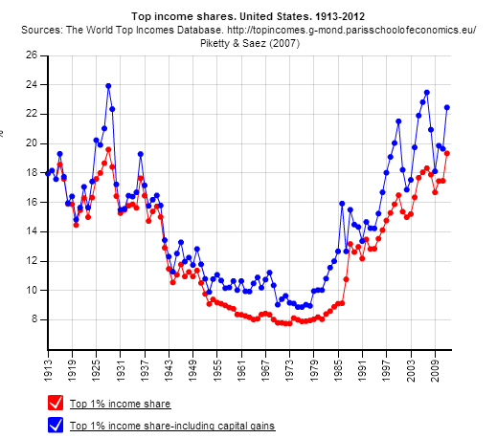
What’s happening?
Source: World Top Incomes.
Notes:
http://topincomes.parisschoolofeconomics.eu/#Graphic:

Slide 54
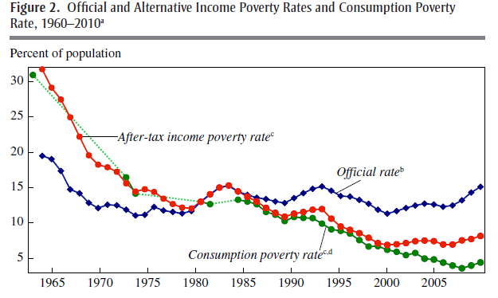
What’s happening?
Source: Meyer and Sullivan, Brookings.
Notes:
http://www.brookings.edu/~/media/Projects/BPEA/Fall%202012/2012b_Meyer.pdf
http://conversableeconomist.blogspot.com/2013/09/the-poverty-rate-income-and-consumption.html

Slide 55
Roadmap
Problem Set #0 ✓
What’s happening? ✓
Saving and growth
Solow’s model
Does India need more saving?
China less?

Slide 56
Saving and growth
JFK in 1960, height of Cold War
Rapid growth in USSR, also high saving and investment rates
Cause and effect?
US analysts in 1985
Rapid growth in Asian “tigers,” lots of saving
Cause and effect?
China in 2010
Rapid growth, saving close to 50% of GDP
Does India need to do the same?

Slide 57
Saving and growth
How does saving generate growth?
Critical to long-run performance?

Slide 58
Saving and growth
GDP
Capital & Labor
Productivity
Political Process
“Institutions”

Slide 59
Solow’s Model

Slide 60
Solow model
How it works
Saving finances capital accumulation
More capital leads to greater output
Impact eventually tails off: diminishing marginal product of capital

Slide 61
Solow model: equations
Production function:
Y = A K^{α} L^{1-α}
Flow identity:
S = I
Saving:
S = sY
Capital stock:
K_{t+1} – K_{t} = ΔK = I – δK

Slide 62
Solow model: analysis
“Analysis” here means we substitute like crazy
ΔK = sY – δK
= sAK^{α} L^{1-α} – δK
For the time being, A, L don’t change
Two competing forces on K
Depreciation drives K down
Saving drives K up
Which is stronger?
Where does diminishing returns show up?

Slide 63
Solow model: dynamics
output
saving
depreciation

Slide 64
Solow model: convergence
Eventually the two forces balance
Capital stock eventually stops changing
Output does, too
Solow’s answer to JFK
USSR won’t catch up through saving alone
Eventually the effects of higher saving/investment peter out

Slide 65
India

Slide 66
India
Saving and investment rates well below China’s
How important is this to India’s future?

Slide 67
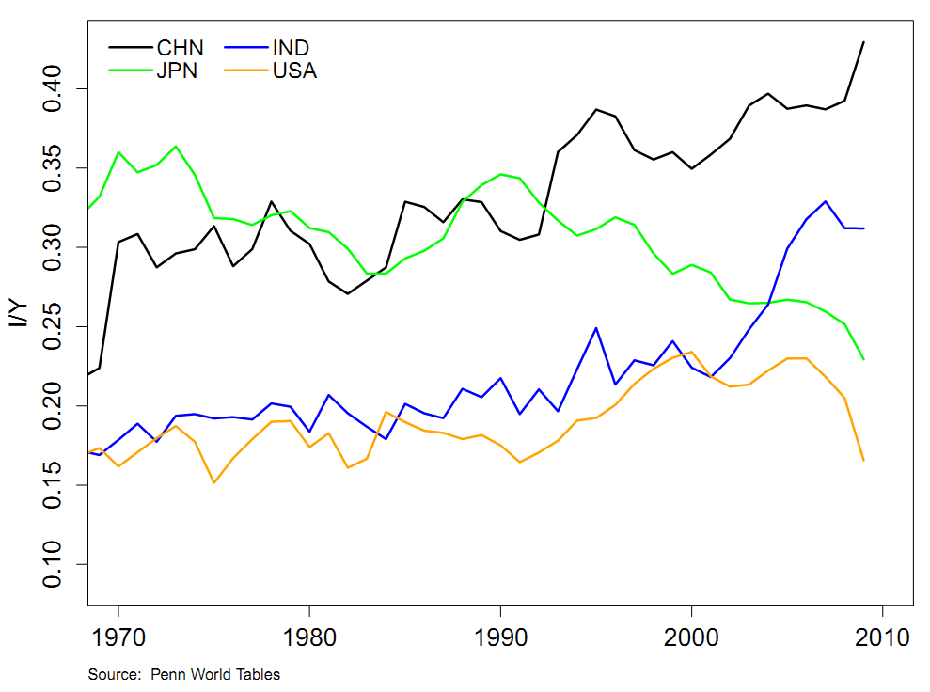
Investment rates

Slide 68
India
Experiments with Solow model
Benchmark: start model in 2010 and see what happens
Raise saving rate
Introduce productivity growth
What has the biggest impact?

Slide 69
India
Solow model inputs (estimates for 2010)
Output Y=GDP: 4.08 trillion USD
Capital K: 8.23 trillion USD
Labor L: 0.452 billion people
Source: Penn World Table
Productivity A: how do we compute this?
Saving/investment rate s: 0.25
Depreciation rate δ: 0.06
Experiments
Raise saving rate
Add productivity growth

Slide 70
India
Solow model experiments
Raise saving rate
Add labor force growth
Add productivity growth
Increase productivity growth

Slide 71
India
Scenario | GDP
2010 | 4.08
2050: no-growth benchmark
2050: higher saving (+5%)
2050: population growth (1%)
2050: TFP growth (2%)
2050: TFP growth (+1%)

Slide 72
India
Scenario | GDP
2010 | 4.08
2050: no-growth benchmark | 5.56
2050: higher saving (+5%) | 6.03
2050: population growth (1%) | 7.01
2050: TFP growth (2%) | 15.49
2050: TFP growth (+1%) | 25.94

Slide 73
China

Slide 74
China
Saving and investment are 40-50% of GDP?
Is that too much?

Slide 75
Investment rates (I/Y)

Slide 76
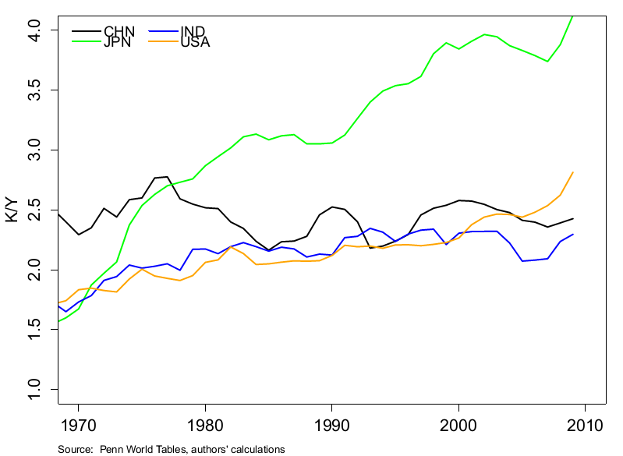
Capital intensity (K/Y)

Slide 77
China summary
Quantity of capital not unusual
K/Y not much different from US
How can that be?
When you growth this fast, you need a lot of investment
“Quality” of capital raises some questions
Has public infrastructure been overdone?
Are productive firms starved for resources?
Is the financial system a hindrance to future growth?

Slide 78
Almost done

Slide 79
What have we learned?
Solow model
Saving and capital accumulation generate growth
But diminishing returns kills this off quickly
Conclusion: saving and capital formation can’t be the keys to prosperity (in the US, in China, in India, etc)
Solow model still a useful forecasting tool
If not capital, what?
Productivity growth

Slide 80
Something for the ride home
Are natural resources critical to economic growth?
Do countries that have a lot of them tend to do well?
Examples?
Why? Or why not?
Add your thoughts on the discussion page

