Slide 1

The Global Economy Monetary Policy & Interest Rates
Notes:
Open Cleveland Fed animation
Tax spreadsheet

Slide 2
What’s happening?
“Japan slips into recession,” NBC News, from May Choy
Japan, the world's third largest economy, slipped into recession after the nation's gross domestic product fell for the second consecutive quarter this year. Official government figures released Monday showed a 1.6 percent annualized contraction, due to continued sluggish consumer consumption triggered by a 3 percent sales tax hike — the first phase of a 5% increase implemented back in April.
What’s going on here?
Notes:
http://www.nbcnews.com/news/world/japan-slips-recession-defies-forecast-growth-n249816

Slide 3
What’s happening?
“Live blog,” WSJ, from Logan Winston
Japanese Prime Minister Shinzo Abe announced the postponing of a tax increase and the holding of early elections at a news conference Tuesday.
Lawmakers from the Mr. Abe’s ruling party are positioning the general election in December as a de facto referendum on the so-called Abenomics economic policy of easy money, public spending and deregulation that Japan’s government has pursued to boost growth and escape from deflation.
What’s going on here?
Notes:
http://blogs.wsj.com/japanrealtime/2014/11/18/shinzo-abe-speaks-to-nation-live-blog/?mod=WSJBlog&mod=japanblog

Slide 4
Ride home revisited
Should the US tie its money to gold?
What does that mean?
Why or why not?

Slide 5
Ride home revisited
Ron Paul
Paul maintains that a return to using gold and silver as legal tender — in addition to the dollar – would make the dollar more stable while also keeping prices down and defending against government interference in markets.
“All I want to do is legalize [the use of silver and gold as money], and if nobody cares, if nobody likes gold and silver, they can keep investing in paper assets and put their savings accounts in paper money.”
Do you agree? Why or why not?
Notes:
http://www.opensecrets.org/news/2010/12/rand-paul-ron-paul-gold-and-silver/

Slide 6
The idea
Interest rates reflect many things, but the short-term focus of bond traders in most countries is on the central bank

Slide 7
Keep it simple
Lots of stories and institutional detail along the way
Focus on central bank balance sheet and Taylor rule

Slide 8
Big picture for bond investors
Bond investors
Bond prices fall when interest rates rise (definition)
More so for long bonds
If you expect rates to rise, hold short bonds
Look to Fed for guidance [more coming]

Slide 9
Big picture for policy analysts
Are you worried about inflation or growth right now?
What should the Fed do?
Would we be better off with gold as our currency?

Slide 10
Big picture for philosophers
What is money?
Why does it matter?
Is gold money? Paper? Bitcoins?

Slide 11
Big picture for economists
Donald Knuth
Science is what we understand well enough to explain to a computer. Art is everything else.
Evidently monetary policy is art
Notes:
http://www.math.upenn.edu/~wilf/foreword.pdf

Slide 12
Courses related to this topic
Monetary policy, banks, and central banks (ECON-GB.2333)
Tobias Adrian, NY Fed, Head of Capital Markets Group
Financial crisis and policy response (ECON-GB.2343)
Kim Schoenholtz, Professor of Management Practice, Ex-Salomon and Citi, former Chief US Economist at Citi, central bank expert
Not offered next term, but probably next year

Slide 13
Roadmap
Short history of money
What should central banks do?
Money supply mechanics
Interest rate mechanics
Taylor’s interest rate rule
Unconventional monetary policy

Slide 14
Short history of money

Slide 15
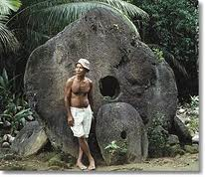
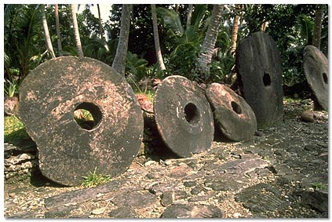
Stone money
Milton Friedman, “Stone money,” in Money Mischief
On the island of Yap in the Western Pacific …
What’s the point?

Slide 16
Commodity money
Gold standard
Money tied to gold (eg, 1 oz = $35)
In principle, people can take their money to the central bank and exchange it for gold
This guarantees money has value
Questions
Does it deliver stable prices?
Is it a waste of gold?
An improvement on our current system?

Slide 17
Commodity money
David Ricardo, Proposals for a Secure Currency, 1816
The introduction of precious metals [as money] may with truth be considered one of the most important steps toward the improvement of commerce. But it is no less true that … it would be another improvement to banish them altogether [in favor of paper money].
What is he saying? Do you agree?

Slide 18
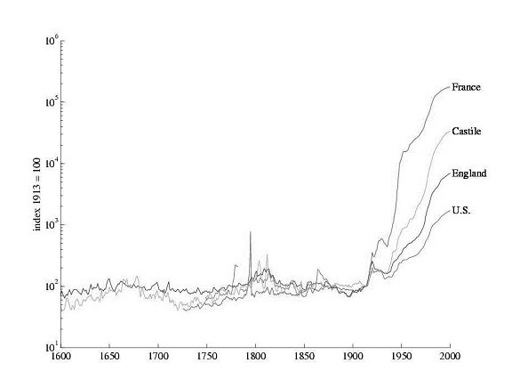
Prices with commodity & paper monies

Slide 19
Open question
How do we deliver stable prices?
Commodity money?
Central bank policy?
Something else?

Slide 20
What should central banks do?

Slide 21
Federal Reserve System
Founded by Federal Reserve Act of 1913
The Federal Reserve System and the Federal Open Market Committee should seek “to promote effectively the goals of maximum employment, stable prices, and moderate long-term interest rates.”
So what’s the goal?
And what about motherhood and apple pie?

Slide 22
ECB
ECB = European Central Bank
Treaty of Maastricht (1992)
The primary objective of [monetary policy] shall be to maintain price stability.
Without prejudice to the objective of price stability, the ECB shall support the general economic policies in the Community with a view to contributing to the achievement of … a high level of employment and sustainable and non-inflationary growth.
How does this differ from Fed? Good idea or bad?

Slide 23
Banco Central de Argentina
BCRA Act of 2003
The Argentine Central Bank is a self-governed institution whose primary and fundamental mission is to preserve the value of the currency.
Good idea? Did it work?

Slide 24
Federal Reserve revisited
Fed policy statement, October 29, 2014:
Information received since we met in September suggests that economic activity is expanding at a moderate pace. Labor market conditions improved somewhat further, with solid job gains and a lower unemployment rate. Inflation has continued to run below the Committee's longer-run objective.
The Committee today reaffirmed its view that the current 0 to 1/4 percent target range for the federal funds rate remains appropriate.
What are they saying? Do you agree?
Notes:
http://www.federalreserve.gov/monetarypolicy/fomccalendars.htm

Slide 25
Money & interest rates

Slide 26
Where do interest rates come from?
We generally think of monetary policy in terms of interest rates
Where do these interest rates come from?
Short-term Treasuries?
Long-term Treasuries?
Fed funds rate?
Inflation-indexed Treasuries (TIPS)?

Slide 27
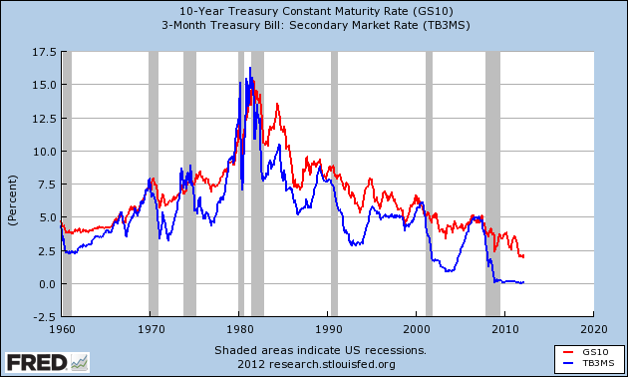
Where do interest rates come from?
Why so high?

Slide 28
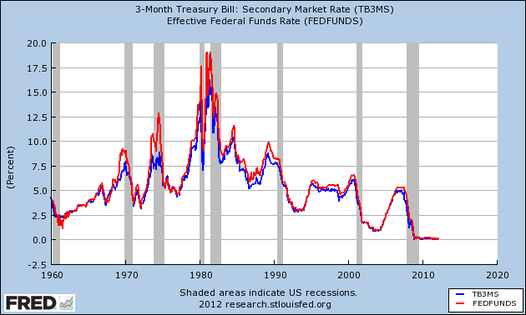
Where do interest rates come from?

Slide 29
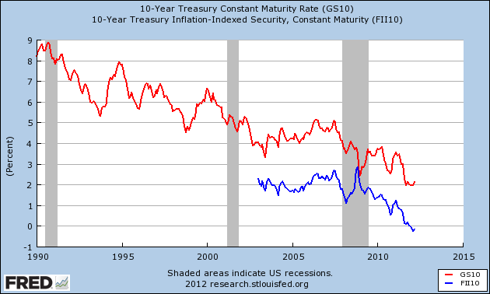
Where do interest rates come from?
Why different?

Slide 30
Where do interest rates come from?
Interest and inflation (“Fisher equation”)
i = r + π
i = “nominal” interest rate (payment in dollars)
r = “real” interest rate (payments in goods)
π = inflation (expected?)

Slide 31
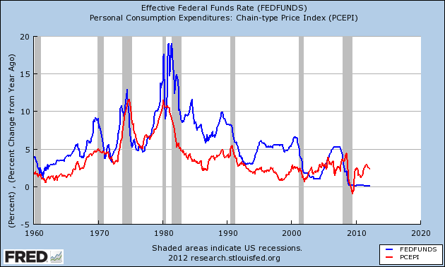
Where do interest rates come from?

Slide 32
Where do interest rates come from?
Summary
Inflation is part of the story
But there’s still a lot of variation left

Slide 33
Money supply mechanics

Slide 34
Reminder: money supply mechanics
Treasury
Assets |  | Liabilities
 |  | Bonds | 200
How does central bank increase money supply?
[Think: asset swap]
Why do households go along?
Central bank
Assets |  | Liabilities
Bonds | 20 | Money | 20
Households and firms
Assets |  | Liabilities
Money | 20
Bonds | 180

Slide 35
Fed policy statement
Federal Open Market Committee (“Fed” or “FOMC”)
Meets eight times a year
Makes public statement immediately following
Search: “FOMC”
Statement includes
Interest rate target
And recently: asset purchases (“quantitative easing”)

Slide 36
Fed policy statement
Statement of October 29, 2014:
The Committee judges that there has been a substantial improvement in the outlook for the labor market since the inception of its current asset purchase program. Moreover, the Committee continues to see sufficient underlying strength in the broader economy to support ongoing progress toward maximum employment in a context of price stability. Accordingly, the Committee decided to conclude its asset purchase program this month.
What are they saying?
Notes:
http://www.federalreserve.gov/monetarypolicy/fomccalendars.htm

Slide 37
Asset market purchases
Central bank usually
Assets |  | Liabilities
Bonds | 20 | Money | 20
What are these “asset market purchases”?
How does the Fed finance them?
Why is it helpful to pay interest on reserves?
What kind of asset swap is this?
Central bank now
Assets |  | Liabilities
Bonds | 120 | Money | 20
Agency | 100 | Reserves | 200

Slide 38
Interest rate mechanics

Slide 39
Overview
Central banks shift AD by changing money supply
But: Fed policy statement focused on interest rate
Translation
Increase in interest rate is same as reduction in money supply
Decrease in interest rate is same as expansion of money supply
More soon, but that’s the point
Focus on US, but [most] other countries are similar

Slide 40
Some institutional detail
In practice, Fed operates in market for “reserves”
Reserves are deposits of banks at Fed (“fed funds”)
The Fed is the bank for banks
Reserves held by banks for transactions or as investments
Banks trade overnight positions in “fed funds”
If they have more than they want, they sell
If they have less than they want, they buy
The rate on these positions is the “fed funds rate”

Slide 41
Hitting the target interest rate
How does the Fed hit its target interest rate?
Demand for money depends on interest rate
Why? Currency pays no interest, so hold less if rate is high
So… choose supply of money to hit target
No different from markets for apples, copper, etc

Slide 42
Hitting the target interest rate
i
MS
target i*
MD
M

Slide 43
What if demand changes?
i
MS
target i*
MD
M

Slide 44
What if demand changes?
Sell bonds, accept money
i
MS
target i*
MD
M

Slide 45
Hitting the target interest rate
Market federal funds rate

Slide 46
Hitting the target interest rate
Summary
Increasing money supply lowers interest rate
Decreasing money supply raises interest rate
We’ll talk as if changing money supply and interest rate are equivalent

Slide 47
Up next
What rate do we choose?
Could go back to AS/AD
But we’ll use a popular rule of thumb instead

Slide 48
The Taylor rule for the fed funds rate

Slide 49
The Taylor rule
A formula for setting fed funds rate
What’s good about a formula? Bad?
What should rate respond to?
Inflation?
GDP and GDP growth?
Condition of financial system?
Exchange rate?
Other things?

Slide 50
The Taylor rule
John Taylor’s rule for setting fed funds rate
i = r* + π + a₁(π ₋ π*) + a₂(g ₋ g*)
i = target fed funds rate
r* = average real interest rate [2%]
π = inflation rate
π* = target inflation rate [2%]
g = GDP growth rate
g* = average GDP growth rate [3%]
(a₁, a₂) = numbers/parameters [1/2, 1/2]
Variations?

Slide 51
The Taylor rule as bond trader’s guide
What happens to interest rate if
GDP growth rises?
Inflation rises?
Employment rises?
Other indicators?

Slide 52
The Taylor rule
What does it suggest on average?
i = r* + π + a₁(π ₋ π*) + a₂(g ₋ g*)

Slide 53
The Taylor rule
What does it suggest now?
i = r* + π + a₁(π ₋ π*) + a₂(g ₋ g*)
Recent numbers
Inflation PCE chain index: YOY Sep = 1.4%
GDP growth: YOY Q3 = 2.3%

Slide 54
The Taylor rule
How much does it respond to inflation? Why?
i = r* + π + a₁(π ₋ π*) + a₂(g ₋ g*)

Slide 55
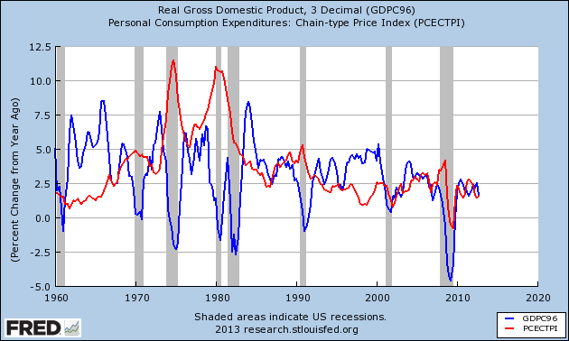
US history: inflation and growth

Slide 56
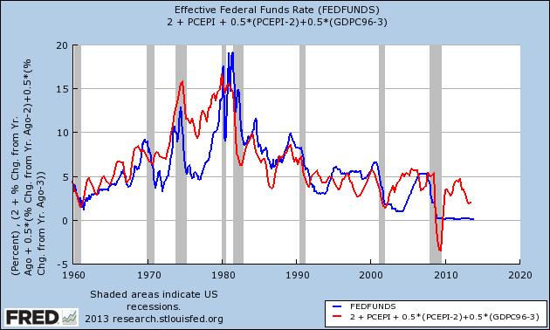
US history: Taylor rule

Slide 57
The Taylor rule
What happened in 1970s?
Rate below Taylor rule, inflation shot up
Same as last week, where we called it too much money
What happened in 2001?
Rate below Taylor rule, justified or mistake?
What happened in 2008?
Taylor rule points to negative rate, can’t be done [more soon]
What should we do now?
Taylor rule above target, rate too low?

Slide 58
Unconventional policy

Slide 59
Unconventional monetary policies
Policy 1: quantitative easing
What do we do when the interest rate hits zero?
Policy 2: credit easing
How can we mitigate impact of financial disruption?

Slide 60
Unconventional policy 1
What happens when interest rate hits zero?
Can’t have negative interest rates, people would hold cash instead
ZLB: zero lower bound
But: you can still increase money supply
QE: quantitative easing
New name for an old idea?

Slide 61
QE at the ZLB
i
MS
What happens when i hits zero?
MD
M

Slide 62
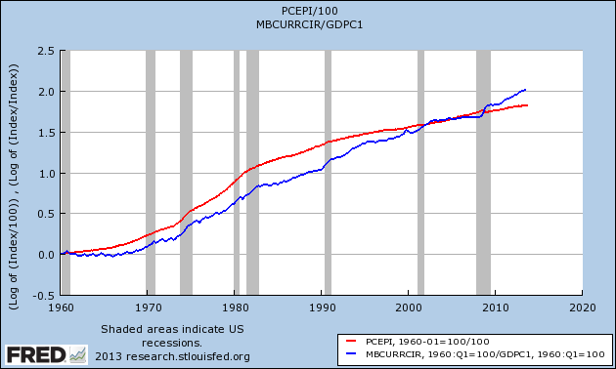
Quantitative easing (currency)
P
M/Y

Slide 63
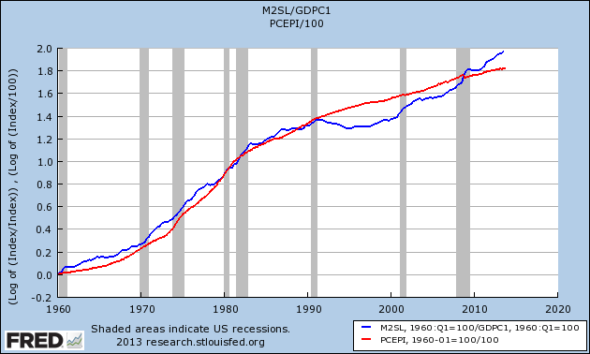
Quantitative easing (M2)
P
M/Y

Slide 64
Unconventional policy 2
Another unconventional policy: buy assets
CE: credit easing (buy private assets)
QE: quantitative easing (buy public assets in large quantities)
See Cleveland Fed animation
http://www.clevelandfed.org/research/Data/Credit_Easing/index.cfm
Why?
Prop up financial system? Twist yield curve?

Slide 65
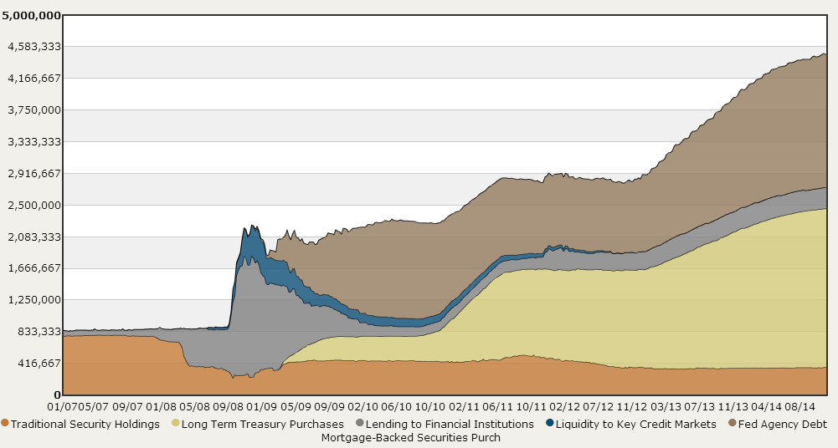
Quantitative and credit easing
Source: Cleveland Fed.

Slide 66
Unconventional policy revisited
Was it
Brilliant strategy that mitigated impact of the financial crisis?
Excessive expansion that will lead to inflation down the road?

Slide 67
What have we learned?
Central banks usually target an interest rate rather than the money supply
Two ways of thinking about the same thing
Taylor rule ties interest rate to inflation and growth
Bond trader’s guide
Raises questions when policy differs [like now?]
When interest rate hits zero, you can still increase the quantity of money

Slide 68
The Global Economy Principles of Tax Policy

Slide 69
Ride home revisited
Should corporations pay more tax?
People?

Slide 70
Roadmap
New module: crises
The ideas
Words and numbers
Principles of spending policy
Principles of tax policy
Low rates, broad base

Slide 71
Starting new module
New module organized roughly around economic crises
First topic: “fiscal policy” = “government finance”
Government spending
Tax revenue
Debt = deferred taxes [next week]

Slide 72
The ideas
Countries differ – a lot – in the magnitude and type of spending, the taxes they collect, and how they manage their debt
Good tax systems
Are transparent and simple to execute
Apply low rates to a broad base
Pay for government spending [next week]
[Lots of detail, don’t lose the thread]

Slide 73
Words and numbers

Slide 74
Words
Old joke:
Opinion polls show that 100% of voters think other people should pay more tax.

Slide 75
Words
The Economist, Survey France:
An employer who pays a worker twice the minimum wage, or €2,400 a month, has to shell out nearly half as much again to the state in social-security contributions; the employee, for his part, has to hand over 22% of his pay in social-security contributions, on top of income tax. A French pay slip typically runs to over 40 itemised lines.
Is this a good system? Why or why not?

Slide 76
Words
Ivan Miklos, Deputy Prime Minister of Slovakia, Financial Times, on corporate taxes:
I am convinced that the reforms of new EU member states could serve as inspiration for the older member states as well. One such reform is the flat tax. … We now have one of the simplest, most transparent tax systems in the world. … And our tax revenues have not decreased at all, partly because the reform eliminated most of the incentives and opportunities for tax avoidance. The new system has been particularly popular with German companies.
Is this a good system? Why or why not?

Slide 77
Words
EIU, Country Commerce Report, India:
Corporate tax rates have come down in recent years to fairly reasonable levels, in keeping with the government’s aim to widen the tax base and ensure greater compliance. But the underground economy, with its untaxed transactions and incomes, remains large.
The system remains complicated, however, and is the subject of frequent litigation.
Is this a good system? Why or why not?

Slide 78
Words
David Leonhardt, “Who will crack the code?” NYT, May 25, 2013:
Many economists and tax experts believe the United States corporate-tax code is terribly flawed. It includes a notoriously high statutory rate that causes companies to devote resources to avoiding taxes. But it has so many loopholes that the effective corporate tax rate in the United States is slightly lower than the average for rich countries.
Is this a good system? Why or why not?
Notes:
http://www.nytimes.com/2013/05/26/opinion/sunday/who-will-crack-the-code.html?_r=0

Slide 79
Words
Eduardo Porter, “A tax code of politics,” NYT, April 10, 2012:
Our byzantine tax code is built upon a longstanding political deal: Democrats wanted a tax scale with higher rates for richer Americans to finance social programs for the poor and middle class. Republicans countered by pushing for tax exceptions, exclusions and deductions that shielded the incomes of the rich from the taxman and reduced government revenue.
This compromise has left us with a loophole-riddled code.
Is this a good system? Why or why not?

Slide 80
Words: summary
What should we tax?
Who should we tax?
How should we tax?
Why?

Slide 81
Words: summary
Check
http://conversableeconomist.blogspot.com/2013/12/distribution-of-us-federal-taxes.html
http://conversableeconomist.blogspot.com/2014/07/double-irish-dutch-sandwich.html
Also http://www.nytimes.com/2013/05/26/opinion/sunday/who-will-crack-the-code.html The soda industry’s success at legally avoiding taxes shows why so many economists and tax experts believe the United States corporate-tax code is terribly flawed. It includes a notoriously high statutory rate that causes companies to devote resources to avoiding taxes. But it has so many loopholes that the effective corporate tax rate in the United States is slightly lower than the average for rich countries.

Slide 82
Government spending (% of GDP)
Source: OECD fiscal database.

Slide 83
US federal government spending
Medicare, Medicaid, Social Security
2010
2020
“Discretionary”
!!

Slide 84
Personal tax rates (%, at average wage)
Source: OECD. Green=direct tax. Blue=total incl soc ins payments.

Slide 85
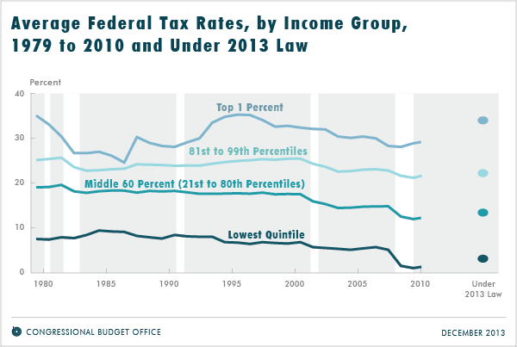
US average tax rates by income (all taxes)
http://www.cbo.gov/publication/44604
Notes:
http://www.cbo.gov/publication/44604

Slide 86
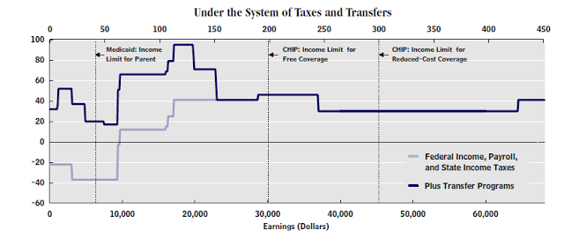
US: marginal tax rates by income
Source: CBO via Cochrane.
Notes:
http://johnhcochrane.blogspot.com/2012/11/taxes-and-cliffs.html

Slide 87
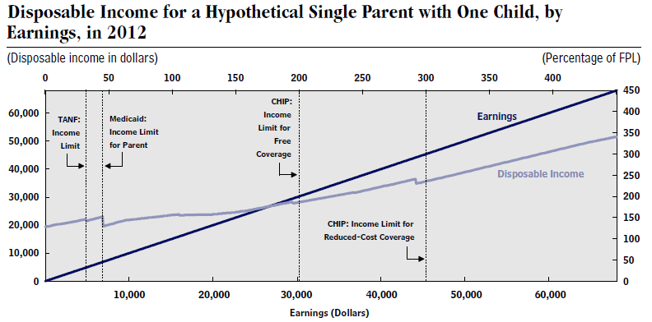
US: post-tax and pre-tax income
Source: CBO via Cochrane.
Notes:
http://johnhcochrane.blogspot.com/2012/11/taxes-and-cliffs.html
http://www.cbo.gov/sites/default/files/cbofiles/attachments/11-15-2012-MarginalTaxRates.pdf

Slide 88
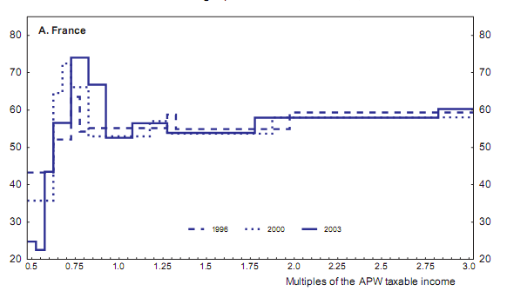
France: marginal tax rates by income
Source: OECD working paper 439, “The French tax system.”

Slide 89
Corporate tax rates
Source: KPMG.

Slide 90
Value-added tax rates
Source: Doing Business.

Slide 91
Principles of government spending

Slide 92
Government spending
Classic argument: provide public goods
Public goods are
Non excludable: hard to keep non-payers from consuming
National security, legal system, fish in the ocean
Non rival: my consumption does not affect your consumption
Fresh air, NY skyline, public safety
Hard for a private firm to capture all the benefits, so market would provide too little

Slide 93
Government spending
Classic argument: provide public goods
http://marginalrevolution.com/marginalrevolution/2015/06/planetary-defense-is-a-public-good.html

Slide 94
Government spending
Many goods partly private, partly public
Individuals and countries differ on
Roads?
Security?
Education?
Mass transit?
Sport stadiums?
Opera?
Health care?
Others?

Slide 95

Government spending
Libertarian Reluctantly Calls Fire Department
April 21, 2004 | Issue 40•16
CHEYENNE, WY—After attempting to contain a living-room blaze started by a cigarette, card-carrying Libertarian Trent Jacobs reluctantly called the Cheyenne Fire Department Monday. “Although the community would do better to rely on an efficient, free-market fire-fighting service, the fact is that expensive, unnecessary public fire departments do exist,” Jacobs said. “Also, my house was burning down.” Jacobs did not offer to pay firefighters for their service.
© Copyright 2006, Onion, Inc. All rights reserved.
The Onion is not intended for readers under 18 years of age.

Slide 96
Government spending, continued
Most government spending not goods, public or otherwise
They’re transfer payments to cover
Pension funds
Disability
Healthcare
Countries differ, but (esp) in rich countries transfers are greater than purchases of goods and services

Slide 97
Principles of tax policy

Slide 98
Tax principles
Societies choose different levels of spending
They have to pay for it, primarily through taxes
Which taxes?
Principles of good tax policy
Transparent and easy to execute
Apply low rates to a broad base
Collect enough revenue to pay for government spending [next week]

Slide 99
Complexity of business taxes (hours)
Source: Doing Business.

Slide 100
Tax complexity: Vodaphone in India
Civitas.in online case [my summary]
Vodafone BV, based in the Netherlands and controlled by Vodafone UK, obtained a controlling interest in CGP Investments Holdings, located in Cayman Island, from Hong Kong-based Hutchinson Telecommunications International Ltd (HTIL)
HTIL had a stake in CGP’s mobile operations in India.
India sent Vodaphone a $2.3b tax bill based on capital gains in its India operations (gains taxed on transfer of control)
The Supreme Court rejected the government’s argument in March, but the government threatened to pass legislation allowing retrospective taxation of business deals.
The saga continues … http://timesofindia.indiatimes.com/business/india-business/Vodafone-wins-Rs-3200cr-tax-case/articleshow/44779467.cms
Notes:
http://timesofindia.indiatimes.com/business/india-business/Vodafone-wins-Rs-3200cr-tax-case/articleshow/44779467.cms

Slide 101
Low rate, broad base

Slide 102
Tax “distortions”
If we start with a good allocation of resources, taxes move us away from it
We say taxes “distort” decisions to buy and sell
Examples
Tax on cigarettes discourages smoking
Tax on labor income discourages work
Tax on saving and investment income discourages both
In each case: good or bad?

Slide 103
Tax “distortions”
The idea is to raise enough revenue to pay for spending with smallest distortions possible
Tax principle #2: Apply a low rate on a broad base

Slide 104
Tax “distortions”
Apply low tax rate to broad tax base
Why?
Taxes “distort” economic decisions
High tax rates distort more
Our thought experiment
Tax two markets equally
Tax one market twice as much
Which is better?

Slide 105
Welfare maximized where S=D
P
consumer surplus
S
P*
producer surplus
D
Q*
Q

Slide 106
Tax destroys surplus
P
Deadweight loss
S'
consumer surplus
P_{c}’
S
t
P*
tax revenue
P_{f}’
producer surplus
D
Q’
Q*
Q

Slide 107
Large tax destroys more surplus
P
S”
S
2t
t
Doubling the tax quadruples the deadweight loss!
D
Q

Slide 108
Tax distortion summary
Summary
Tax at rate t generates loss of one triangle
Tax at rate t on two markets generates loss of two triangles
Tax at rate 2t on one market generates loss of four triangles
Therefore
Better off taxing two markets at rate t
Principle #3: tax broad base (two markets) at low rate (t, not 2t)

Slide 109
Low rate, broad base
Should we
Make food and clothing exempt from tax?
Mortgage interest?
Health insurance?
Internet sales?
Legal services?
Education supplied by nonprofits?

Slide 110
Low rate, broad base
“A dance is a dance,” New York Times, October 2012
The New York State Court of Appeals ruled last week that Nite Moves, a strip club near Albany, must pay sales tax on admissions fees it collects from customers. State law exempts from sales tax “dramatic or musical arts performances,” including “choreographic” performances. The question was whether a private lap dance or a pole dance qualifies as a “dance.”
What’s going on here?

Slide 111
Low rate, broad base: VAT
Why tax value added?
Countries used to tax output at all stages
Example: 5 stages in value chain, tax each stage on total value

Slide 112
Low rate, broad base: taxing interest
Impact of taxing interest income
Without taxes
Price now of one dollar of consumption now: 1
Price now of one dollar of consumption n periods from now:
1/(1+r)^{n}
With taxes
Price now of one dollar of consumption now: 1
Price now of one dollar of consumption n periods from now:
1/[1+(1-t)r]^{n}

Slide 113
Low rate, broad base: taxing interest
Numbers
r = 0.05 [5%]
t = 0.25 [25%]
n = 20 [20 years]
Compare cost of future consumption
1/(1+r)^{n} = 0.38
1/[1+(1-t)r]^{n} = 0.48
This makes future consumption more expensive
What does it distort? What are the consequences?

Slide 114
What have we learned?
Countries differ a lot in government spending and taxes
Taxes change incentives to work, save, etc
Good tax systems
Generate enough revenue to cover spending [next week]
Simple and transparent
Broad base, low rate

Slide 115
Coming up
Problem Set #4: monetary & fiscal policy
Due in two classes (three weeks)
First question doable now

Slide 116
For the ride home
Has the US government issued too much debt?
What’s too much? What are the consequences?
Have a great Thanksgiving!

