Slide 1

The Global Economy Labor Markets
Notes:
http://youtu.be/0aHEKmuGmiM
http://youtu.be/qGJSI48gkFc

Slide 2
Regulation
“Vital part of thriving markets?”
“Flawed and crude? “
Which one? Both? Neither?
Examples?
Notes:
http://www.newyorker.com/magazine/2010/06/14/the-regulation-crisis
http://timharford.com/2014/09/when-regulators-are-all-out-to-dejeuner/

Slide 3
Min wage
Warren Buffett
http://www.wsj.com/articles/better-than-raising-the-minimum-wage-1432249927

Slide 4
Idea for the day
Regulation can be good or bad
Can facilitate productive activity
Can also be an obstacle to it
Needed: balance
Today’s examples
Labor markets (first half)
Financial markets (second half)
Both essential to economic performance

Slide 5
Where we’ve been
Essential tool: production function
Y/L = A (K/L)^{α}
Sources of country performance
Capital per worker K/L
Productivity A
Institutions: sources of productivity
Governance
Rule of law
Property rights
Competitive markets

Slide 6
Where we’re going
GDP
Capital & Labor
Productivity
Political Process
“Institutions”

Slide 7
Roadmap
Regulation ✓
What’s going on in France?
Labor market indicators
Labor market analysis
Labor market “protection” and “flexibility”
Examples (skim at break, discussion by request only)

Slide 8
What’s going on in France?

Slide 9
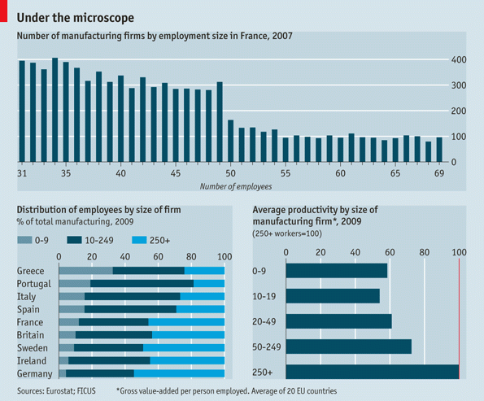
What’s going on in France?
Source: The Economist, March 3, 2012.

Slide 10
What’s going on in France?
Bloomberg Business Week, May 3, 2012
Once a company has at least 50 employees, management must create three worker councils, introduce profit sharing, and submit restructuring plans to the councils if the company decides to fire workers for economic reasons.
What’s going on here? Who wins? Who loses?

Slide 11
What’s going on in France?
Christopher Caldwell, Financial Times, Feb 05:
In early 2000, when the French unemployment rate was 9.6%, Martine Aubry, the Socialist labour minister, shepherded into law a bill that capped the work-week of most employees at 35 hours. She called it “a necessity for job creation.” Today French labour participation is rock-bottom among developed countries.
What’s going on here? Who wins? Who loses?

Slide 12
What’s going on in France?
Liz Alderman, NYT, February 20, 2013
“How stupid do you think we are?” wrote Titan CEO Maurice Taylor, an American. “The French work force gets paid high wages but works only three hours. They have one hour for their breaks and lunch, talk for three and work for three.” He was roundly condemned in France for his “predatory” American corporate culture.
What’s going on here? Who wins? Who loses?

Slide 13
What’s going on in France?
Jacqui Cheng, “Sacre bleu!” Ars Technica, March 13, 2013
It's a rule of retail life that you often have to work long past closing time while you clean up or do inventory for the following day. But Apple Store employees in France won't have to do this anymore. Apple has been ordered to stop asking its retail employees to work past 9pm and must now pay €10,000 in damages. French labor laws forbid requiring employees to work between 9pm and 6am (as well as Sundays, all day).
What’s going on here? Who wins? Who loses?

Slide 14
What’s going on in France?
Jean Tirole, press conference, October 2014
Hours after he won the economics Nobel Prize, Tirole said he felt “sad” the French economy was experiencing difficulties despite having “a lot of assets”.
“We haven’t succeeded in France to undertake the labour market reforms that are similar to those in Germany, Scandinavia and so on,” he said in telephone interview.
He was attacked in France for his “neoliberal” views.
What is he saying? Do you agree?
Notes:
http://marginalrevolution.com/marginalrevolution/2014/10/the-french-disease-is-not-just-hypochondria.html
http://www.france24.com/en/20141013-economics-nobel-prize-tirole-downsize-state-france-economy-unemployment/

Slide 15
What’s going on in France?
How do France and the US compare?
Unemployment?
Employment?
Hours worked?
GDP per capita?

Slide 16
Unemployment rate
France
US
Source: OECD.

Slide 17
Employment rate
US
France
Source: OECD.

Slide 18
Hours worked
US
France
Source: OECD.

Slide 19
What’s going on in France?
GDP per capita and GDP per hour worked
 | Y/POP | Y/L | Y/hL
US | 34,875 | 67,865 | 37.58
France | 25,664 | 56,909 | 37.12
Ratio | 1.36 | 1.19 | 1.012
Source: OECD and Penn World Tables.

Slide 20
What’s going on in France?
How would you summarize the evidence?
Explain it?

Slide 21
Labor Market Indicators

Slide 22
Labor market indicators
What the numbers mean
Why experts prefer employment to unemployment

Slide 23
Employment “status” in the US
Non-institutional, civilian population, 16 and over
Source: BLS, Jan 2012.

Slide 24
Standard indicators
Employment rate = employed/working-age population
Labor force = employed + unemployed
Unemployment rate = unemployed/labor force
Participation rate = labor force/working-age population
Inactivity rate = out of labor force/working-age population
Hours worked = average hours worked of employed people

Slide 25
Employment status in the US
Population 16+:
Labor force :
Employment rate:
Unemployment rate:
Participation rate:
Source: BLS, Jan 2012.

Slide 26
Employment status in the US
Population 16+: 242.268
Labor force : 154.395
Employment rate: 58.5%
Unemployment rate: 8.3%
Participation rate: 63.7%
Source: BLS, Jan 2012.

Slide 27
Ways to reduce unemployment
Unemployed get jobs
Raises employment rate
Unemployed leave labor force
Employment rate doesn’t change
Unemployment rate falls
Which is more informative
Employment or unemployment?

Slide 28
Unemployment rates
Source: OECD.

Slide 29
Employment rates
Source: OECD.

Slide 30
Hours worked
Source: OECD.

Slide 31
Paid holidays and vacation
Source: OECD.

Slide 32
Labor Market Analysis

Slide 33
Why unemployment?
Are jobs like donuts? hotel rooms? something else?
Evidence is overwhelming that the number of jobs isn’t fixed, it responds to circumstances

Slide 34
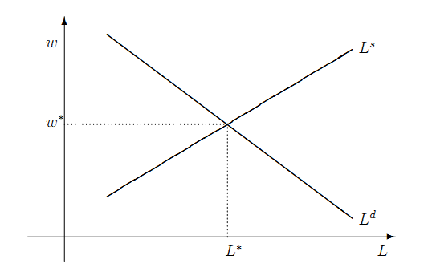
Frictionless labor market model
Where’s the unemployment?

Slide 35
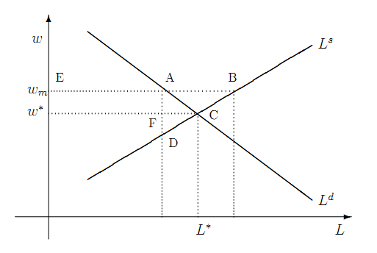
Institution: minimum wage
Where’s the unemployment?

Slide 36
Institution: minimum wage
What happens to unemployment? Why?
Is this a big effect or a small one?
Who wins in the model? Who loses? Which is bigger?
Who wins in the real world? Who loses? Which is bigger?

Slide 37
Institution: minimum wage
If we doubled pay at McDonald’s, what would happen?

Slide 38
Institution: minimum wage
Who gets the minimum wage in the US?
2.5% of US workers (3.3m)
Young: half are 16-24
White: 77%
Part-time: 64%
What will happen if minimum wage goes up?
Best guess, hotly debated: increase of 1% in min wage reduces employment by 0.1 to 0.2% for adults, 0.3% for teens
If so, increase from 7.25 to 10.10 would reduce employment by ~0.3m [CBO estimates higher]
Notes:
http://www.pewresearch.org/fact-tank/2014/09/08/who-makes-minimum-wage/
http://www.bls.gov/cps/minwage2013.pdf
http://www.cbo.gov/publication/44995

Slide 39
Minimum wage (fraction of median)
Source: OECD.

Slide 40
Institution: minimum wage
Milton Friedman
The minimum wage is discrimination against people with low skills, because it forces firms to pay a wage greater than their skill supports. As a result, many of them are unemployed, rather than working and developing skills that would improve their prospects.
Do you agree or disagree? Why?

Slide 41
Institution: minimum wage
Gary Becker, Becker-Posner blog:
Generous minimum wages and other rigidities of the French labor market caused unemployment rates that have remained stubbornly high. Immigrants, youths, and other new entrants into the labor market have been hurt the most.
Do you agree or disagree? Why?

Slide 42
Labor Market Institutions

Slide 43
“Protection” v “flexibility”
What you’ll be dealing with in other countries
Doing Business
Least flexible labor market = Portugal
Most flexible labor market = New Zealand
Examples of “euro” and “anglo” models
Employment protection law (EPL) governs
Fixed term contracts
Overtime compensation
Dismissal
Collective bargaining

Slide 44
“Protection” v “flexibility”
Fixed-term contracts
PRT Fixed term contracts allowed only in special situations (such as seasonal activity)
NZL Fixed term contracts are unrestricted, with no maximum duration period
Source: Botero, Djankov, La Porta, Lopez-de-Silanes, Shleifer, Regulation of Labor.

Slide 45
“Protection” v “flexibility”
Overtime
PRT Mandatory premium for overtime ranges from 50% to 75%, additional restrictions on night work, and there are 24 days of paid leave per year.
NZL No required premium for overtime, no restrictions on night work, and the minimum paid leave is 15 days per year.
Source: Botero, Djankov, La Porta, Lopez-de-Silanes, Shleifer, Regulation of Labor.

Slide 46
Rigidity of hours (index)
Source: World Bank, Doing Business.
Notes:
46

Slide 47
“Protection” v “flexibility”
Dismissal
PRT List of fair grounds for terminations and stringent procedures for dismissals, such as mandatory notification of the government and priority rules for re-employment of redundant workers.
NZL Allows “contracts at will,” which can be terminated without notice without cause.
Source: Botero, Djankov, La Porta, Lopez-de-Silanes, Shleifer, Regulation of Labor.

Slide 48
Firing costs (weeks of wages)
Source: World Bank, Doing Business.
Notes:
48

Slide 49
“Protection” v “flexibility”
Collective bargaining
PRT Employers have a legal duty to bargain with unions, collective agreements are extended to third parties by law, workers councils are mandatory, and employer lockouts are prohibited.
NZL Employers have no legal obligation to bargain with unions, collective agreements are not extended, labor participation in management is not required, and employer lockouts are allowed.
Source: Botero, Djankov, La Porta, Lopez-de-Silanes, Shleifer, Regulation of Labor.

Slide 50
Union rights (index)
Source: Botero, Djankov, La Porta, Lopez-de-Silanes, Shleifer, Regulation of Labor.

Slide 51
Overall employment protection (index)
Source: OECD.
Notes:
http://www.oecd.org/employment/emp/onlineoecdemploymentdatabase.htm#epl

Slide 52
France revisited
What happened?
Would you build a plant there? Locate a bank?

Slide 53
Time for a break

Slide 54
Examples

Slide 55
Examples
Countries where you’ve had experience?

Slide 56
India
Shankar Acharya, “Ten myths about India,” FT Forum, Feb 1, 2010
Myth 4. Our labor laws protect labor. Quite the opposite. Present laws overprotect a tiny minority at the expense of the mast majority of workers. By making it extremely difficult to fire workers, our laws massively discourage the employment of new workers. They lead to huge under-utilization of our most abundant resource, low-skill labor.
What’s going on here? Who wins? Who loses?

Slide 57
India
Sean Dougherty, Veronica Frisancho, and Kala Krishna, “Job protection in India,” Vox EU:
We estimate the productivity effects of deregulation in state-level labor market policies. We find that even modest deregulation has improved total factor productivity substantially.
What’s going on here? Who wins? Who loses?
Notes:
http://www.voxeu.org/article/job-protection-reform-india

Slide 58
Brazil
EIU, Country Commerce Report
The 1988 federal constitution contains several important labour provisions: it legalises unions, collective bargaining negotiations, and the right to strike in both the public and private sectors. The constitution also sets overtime rates, provides a monthly minimum wage and regulates working hours. It lists a variety of labour entitlements, including the following: maternity leave, annual leave, workers’ compensation, social services, medical assistance and unemployment benefits.
What’s going on here? Who wins? Who loses?

Slide 59
Italy
“Employment, Italian style,” WSJ, June 25, 2012
Once you hire employee 11, you must submit an annual self-assessment to the national authorities outlining every possible health and safety hazard to which your employees might be subject.
Once you hire your 16th employee, national unions can set up shop.
Hire No. 16 also means that your next recruit must qualify as disabled. By the time your firm hires its 51st worker, 7% of the payroll must be handicapped in some way.
What’s going on here? Who wins? Who loses?
Notes:
http://johnhcochrane.blogspot.com/2012/06/sand-in-gears.html

Slide 60
Japan
EIU, Country Commerce Report
Japan’s labour system traditionally featured lifetime employment, elaborate fringe benefits, and wages based on length of service rather than performance. Most Japanese companies are finding this system increasingly difficult to sustain. But changing the social contract of lifetime employment has been difficult. The result is a massive number of unneeded workers in virtually every industry. The rigidity of the job market is partly offset by the growing presence of non-regular and part-time workers willing to work for less pay with no job security at all.
What’s going on here? Who wins? Who loses?

Slide 61
Spain
EIU, Country Commerce Report
High rates of unemployment have hindered Spain’s economy for years, partly because of rigid labour laws that are among the strictest in the EU. Significant reforms that increase labour-market flexibility have been difficult to enact.
What’s going on here? Who wins? Who loses?

Slide 62
Germany
The Hartz reforms of 2002-05
Reduced benefits for long-term unemployment
Enhanced education and training
Facilitated private job sites
Results
Employment and productivity up
Schroeder lost the next election
What’s going on here? Who wins? Who loses?

Slide 63
US
Econbrowser, November 2012
The recent health care legislation requires that that large companies either provide health insurance for full-time workers or pay a fee. But the Wall Street Journal reports that some are taking a third route-- shifting to more part-time workers.
What’s going on here? Who wins? Who loses?
To be clear: this is speculative. We don’t know yet what the effects of healthcare laws will be.
Notes:
http://www.econbrowser.com/archives/2012/11/links_for_20121.html

Slide 64
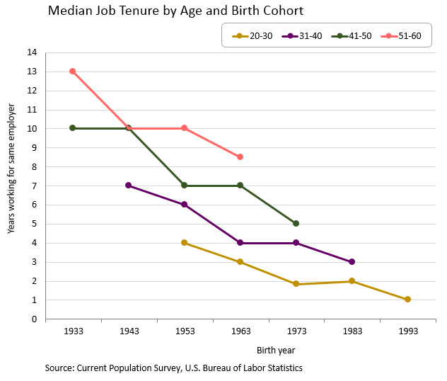
US *** ??
Notes:
http://macroblog.typepad.com/macroblog/2015/06/falling-job-tenure-its-not-just-about-millennials.html

Slide 65
US
Caroline Baum, Bloomberg, September 4, 2013:
A higher wage is great for the workers who keep their jobs; it isn’t so great for those who wouldn’t get hired. With a higher minimum wage, the cost of automating certain tasks suddenly becomes more affordable.
What’s going on here? Who wins? Who loses?
Notes:
http://www.bloomberg.com/news/2013-09-04/can-we-pay-a-minimum-wage-that-makes-everyone-rich-.html

Slide 66
What have we learned?
Wide variation in labor market institutions/regulations
Something to keep in mind when you’re operating in another country
Also variation in “outcomes”
Employment, unemployment, hours …
In flexible labor markets
Easier to lose a job
Easier to find one
Who wins? Who loses?

Slide 67
Two weeks off in August
http://youtu.be/qGJSI48gkFc

Slide 68
Red tape in Spain
http://youtu.be/0aHEKmuGmiM

Slide 69
Red tape in Spain
Spain ranks 136 (of 185) in ease of starting a business
Below Peru (60), Uzbekistan (90), and Nigeria (119)
Above Chad (181) and Haiti (183)
Source: Doing Business

Slide 70
Ghana mini-case
What features do you need in this business?
How does Ghana stack up?
Good idea – or not?

Slide 71
The Global Economy Volatility & Financial Markets

Slide 72
Roadmap
Two weeks off, Ghana mini-case ✓
What’s happening?
Volatility
Financial markets “game”
Financial market institutions
Crisis management

Slide 73
What’s happening?
Mike Arroyo (Sat) asks:
Could weaker rule of law work to China's advantage? If it ignores hackers, could it benefit from theft of trade secrets?
What do you think?

Slide 74
What’s happening?
UK to issue RMB bonds
UK Treasury announced its intention to issue the first Western renminbi bonds.
What’s going on here?
Notes:
http://online.wsj.com/articles/u-k-treasury-to-sell-debut-renminbi-bond-1412844729

Slide 75
What’s happening?
AIG’s lawsuit
In 2008, the Feds invested 184b in AIG in return for 80% of the equity.
USA Today: Former AIG CEO Maurice Greenberg is suing the federal government, arguing it illegally took a controlling interest in AIG without adequately compensating shareholders.
Should the Feds have bailed out AIG? Were they too aggressive? Not aggressive enough?
Notes:
http://www.economicprincipals.com/issues/2014.10.12/1657.html
http://www.bloombergview.com/articles/2014-10-10/aig-shareholders-still-want-a-nicer-bailout

Slide 76
Volatility

Slide 77
Equilibrium
Call me when we get there

Slide 78
The idea
Good economic performance requires effective labor and financial markets
Especially in a volatile economic environment
Volatility calls for “reallocation:” moving labor and capital around to new products and industries
Financial markets are hard to get right
They require lots of “infrastructure”
They sometimes freeze up

Slide 79
Volatility
Marx and Engels, Communist Manifesto, 1848
Everlasting uncertainty and agitation distinguish the bourgeois epoch from all earlier ones. All fixed, fast frozen relations … are swept away, all new-formed ones become antiquated before they can ossify. All that is solid melts into air, all that is holy is profaned, and man is at last compelled to face with sober senses his real condition of life. … All old-established national industries have been destroyed or are daily being destroyed. They are dislodged by new industries, whose introduction becomes a life and death question for all civilized nations.
Does this sound right to you?

Slide 80
Volatility
Joseph Schumpeter, Capitalism, Socialism & Democracy
The process of Creative Destruction is the essential fact about capitalism. In capitalist reality, competition … strikes not at the margins of the profits and the outputs of the existing firms but at their foundations and their very lives.
Does this sound right to you?

Slide 81
Volatility
Reihan Salam, “Amazon,” Slate, Oct 15, 2014
If Amazon weren’t a relentless competitor, consumers would endure the same high prices and mediocre service. Amazon is the living embodiment of the “invisible foot” of capitalism.
We've all heard of Adam Smith's “invisible hand” that guides the free market. The invisible foot is the invisible hand's brutish older brother. It is the force that sees to it that capital gets reallocated from firms that aren’t doing their jobs to firms that are by putting the former out of business.
Does this sound right to you?
Notes:
http://www.slate.com/articles/business/moneybox/2014/10/amazon_isn_t_the_problem_with_capitalism_it_s_the_solution_to_our_economic.single.html

Slide 82
Volatility
Adam Davidson, Planet Money, March 2013
In January, 4.2 million were hired. And 4.1 million quit or were fired. In other words, every 1.6 seconds, someone got a job and someone else left a job. Even in good economic times, new jobs are constantly being created and old jobs are constantly being destroyed.
There's a little-known jobs report that shows all this creation and destruction. It's called the Job Openings and Labor Turnover Survey, though it typically goes by the catchy acronym JOLTS.
What’s going on here?

Slide 83
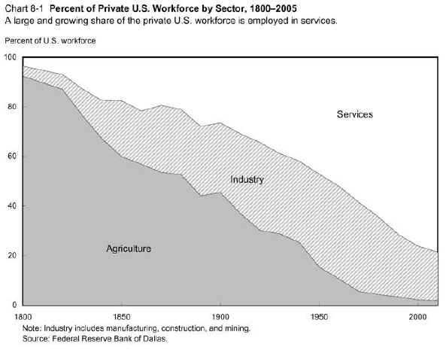
Volatility

Slide 84
Volatility
Millions of farm jobs lost
Millions of industrial jobs lost
Where did they go?

Slide 85
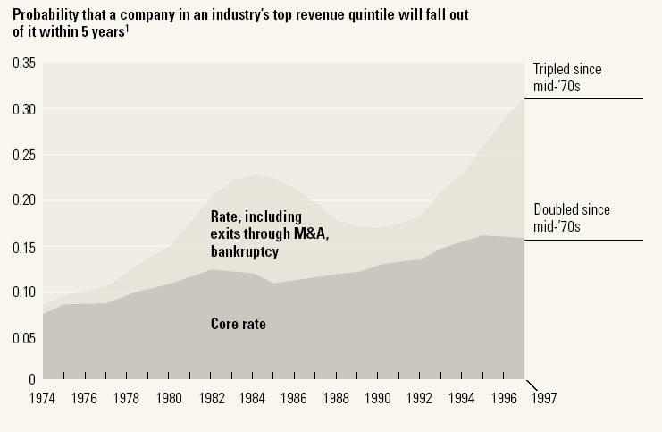
Volatility
Source: McKinsey Quarterly, “Extreme competition,” 2005.

Slide 86
Volatility
Products come and go
Firms come and go
Industries come and go
Good or bad?
What does this mean for labor and capital markets?

Slide 87
Volatility
In a volatile world, do you want
“Fixed, fast relations”?
“Creative destruction”?
Why?

Slide 88
France again
Viscusi and Deen, “Why France…,” Bloomberg Business Week, May 2012:
Pierrick Haan, CEO of a medical supply company, notes: “The cost of labor isn’t the main problem, it’s the rigidities. If you make a mistake in your hiring plans, you can’t correct it.” He plans to expand production in Tunisia, Bulgaria, or Romania.
Worker groups say the labor code itself isn’t the issue. “If the code is complicated, it’s because our society is complicated. Cars are much more complicated today than they were 40 years ago. Why shouldn’t the labor code be?”
What’s going on here?
Notes:
http://www.businessweek.com/articles/2012-05-03/why-france-has-so-many-49-employee-companies

Slide 89
Financial markets

Slide 90
Financial markets overview
Obvious
Enforce property rights
Less obvious: manage crises
Financial markets sometimes freeze up
Should we bail out banks? Why? Why not?

Slide 91
Lending game

Slide 92
Lending game
A bit of game theory…
Parameters:
Borrower has project that generates 100 + 15
Lender offers 100 to borrower for one year
Lender’s cost of funds is 5%, charges 10%
In default, borrower uses up 50, keeps the rest [Hmmm…]
Where’s the value in this game?
Who gets it?

Slide 93
Lending game
Don’t lend
Payoffs = (0,0)
L
(+5,+5)
Repay
Lend
B
Default
(–105,+65)
What’s the outcome? What can we do about it?
Notes:
93
Note: economic activity creates value

Slide 94
Lending game
Don’t lend
Payoffs = (0,0)
L
(+5,+5)
Repay
Lend
B
0
X
Default
(–105,+65)
What’s the outcome? What can we do about it?
Notes:
94

Slide 95
Lending game
Note: creditor rights are good for borrowers
If default is attractive, lenders won’t lend
Result: projects not funded, TFP lower than it could be
Evidence
States/countries with stronger creditor rights have more lending, lower rates
Also higher GDP per capita

Slide 96
Financial market institutions

Slide 97
Financial market institutions
Obvious: enforce property rights
Protect creditors
Governance of firms by owners
Disclosure of information to investors

Slide 98
Days to enforce contracts
Source: World Bank, Doing Business.

Slide 99
Cost of enforcing contracts
Source: World Bank, Doing Business.

Slide 100
Investor protection (index)
Source: World Bank, Doing Business.

Slide 101
Financial markets in action
Indicator | US | France | Ratio
GDP | 6,297b | 1,296b | 5:1
Biomedical researchers | 77,000 | 12,000 | 6:1
Public research funding | 15.8b | 1.8b | 9:1
Industry research funding | 18.6b | 2.8b | 7:1
Biotech patents | 13,982 | 1051 | 13:1
Biotech startups | 1,100 | 40 | 27:1
Publicly-traded biotechs | 315 | 5 | 63:1
Recombinant proteins | 97 | 0 | ∞:1
Source: Michelle Gittelman.

Slide 102
Managing crises

Slide 103
Financial market institutions
Less obvious: manage financial crises
Why not let failures happen?
Meltzer: “Capitalism without failure is like religion without sin”
But: they cause collateral damage
How do we balance these things?

Slide 104
Financial crises happen
Common in emerging markets
Mexico: 1982, 1994
Asian crisis: 1997
US: 1891, 1907, …
Developed countries too
Japan: 1990s
Scandinavia (Norway, Sweden, Finland): 1990s
All over: 2008-09

Slide 105
Financial crises
Matt Levine, Bloomberg View , Oct 10, 2014
Banks invest in risky assets and hand out risk-free claims to their savers. This bit of magic works most of the time, but sometimes people realize their risk-free claims are backed by risky assets, and they panic. The solution has been known for about 140 years. It's for the central bank to lend the banks money until the crisis passes.
Many people dislike this, and it is sort of unseemly, but it really is a well-known set of facts. You can reduce the risk of banking crises happening, but not to zero.
What is he saying? Do you agree? Disagree?
Notes:
http://www.bloombergview.com/articles/2014-10-10/aig-shareholders-still-want-a-nicer-bailout

Slide 106
Managing financial crises
Matt Levine, Bloomberg View , Oct 10, 2014
You want banks to
not do anything that could make them need a bailout
but take a bailout as soon as they need one.
Striking this balance is hard.
What is he saying? Do you agree? Disagree?
Notes:
http://www.bloombergview.com/articles/2014-10-10/aig-shareholders-still-want-a-nicer-bailout

Slide 107
Managing financial crises
Frozen financial system cause collateral damage
So: protect banks through regulation
Deposit insurance
Limits on risk
Capital requirements to cover risks that go bad
Look closely at large banks (“systemic”)
Central bank lending when needed
Just banks or also money market funds, hedge funds?
[The details are mind-numbing]

Slide 108
Managing financial crises: open issues
Are governments capable of doing this well?
Complex rules invite influence, arbitrage
Should failure be an option?
Let failures fail, deal with consequences
Challenges
Just banks? Commercial paper? Money market funds? AIG?
Choluteca bridge problem
Dodd-Frank problem [aka Rube Goldberg]

Slide 109
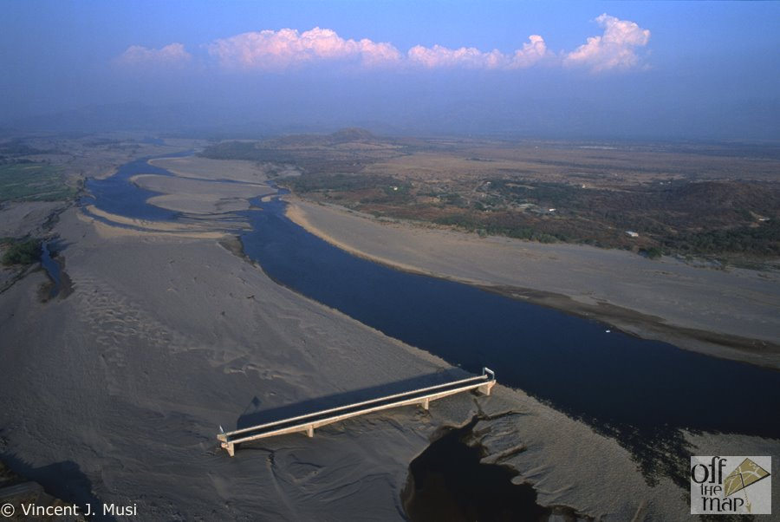
Choluteca Bridge

Slide 110
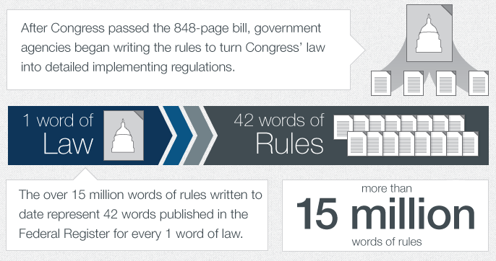
Dodd-Frank
Source: Davis-Polk.
Notes:
http://www.davispolkportal.com/infographic/july2013infographic.html

Slide 111
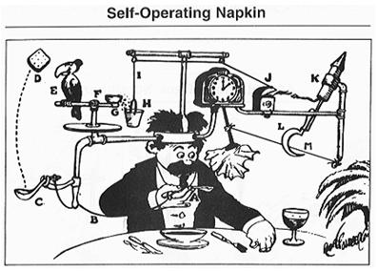
Rube Goldberg

Slide 112
What have we learned?
The world’s a volatile place
Products, companies, and industries come and go
Financial markets facilitate the reallocation of capital
With good institutions, they work better
But they’re prone to crises
A fact of life or something we can manage?

Slide 113
For the ride home
Are markets “moral”?
Would you use them to
Set wages and salaries?
Buy and sell goods from other countries?
Solve gas shortages after natural disasters?
Allocate kidneys for transplants?
Why or why not?
Read mini-case on course website
Come to class prepared to discuss

Slide 114
Extra Slides

Slide 115
What’s going on in Denmark?

Slide 116
Denmark’s “flexicurity” model
Flexible labor markets
Flexible hours, easy to fire people
Strong support for unemployed
Training programs
Subsidies to employers
Results
Flexible labor market
Security for unemployed
Cost is 4-5% of GDP [OECD average 0.5%]

Slide 117
Denmark’s “flexicurity” model
World Economic Forum
Denmark continues to distinguish itself as having one of the most efficient labor markets internationally, with more flexibility in setting wages, firing, and therefore hiring workers than in the other Nordics and in most countries more generally.
Who wins? Who loses?

Slide 118
What’s happening?
Joe Nocera , “Putin shows his hand,” NYT, Oct 10, 2014
The Russian economy has been in a downturn since Putin returned to power in 2012. The ruble is in free fall. More than $100 billion of capital is expected to flee the country this year [capital outflow!].
After the sanctions, things got worse. Vladimir Yevtushenkov, a Russian billionaire, had his shares in Bashneft seized by the government. It is widely believed that Bashneft’s assets will find their way to Rosneft, which is run by Putin’s friends and in desperate need of capital.
What’s going on here? What does it tell you about the Russian economy?
Notes:
http://www.nytimes.com/2014/10/11/opinion/joe-nocera-putin-shows-his-hand.html

