Slide 1

The Global Economy Trade Theory
Notes:
Samuelson story…

Slide 2
Work this in somehow ??
Adam Posen
We have increasing evidence in recent years that the real gains from trade are from putting pressure on individual businesses to be more productive. If you ask Chinese businessmen and officials what was behind their growth, they’ll tell you a lot of it was being exposed to foreign competition and international markets. The competition, the pressure for efficiency, is a really big deal here.
http://www.vox.com/2015/5/14/8606853/adam-posen-tpp

Slide 3
Work this in somehow ??
http://www.washingtonpost.com/opinions/rescuing-the-free-trade-deals/2015/06/14/f10d82c2-1119-11e5-9726-49d6fa26a8c6_story.html

Slide 4
Work this in somehow ??
Stan’s suggestion: no one gives up interpersonal trade, lives in the woods. Why?

Slide 5
Are markets “moral”?
Examples of markets working well? Not so well?
Should we have more or less market activity in
International trade in goods?
International trade in assets?
Shortages after natural disasters?
Addictive drugs?
Human organs?
Do markets contribute to prosperity?
Are markets moral?

Slide 6
The idea
International trade theory
International trade, and markets in general, are win-win: both sides of a trade benefit, or (presumably) they wouldn’t do it. This is simple and compelling logic, not opinion.
International trade reality
A fact of life in international business is that locals use their political connections against foreign competitors.

Slide 7
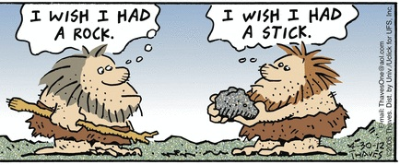
The idea (cave man version)
Source: Frank and Ernest.

Slide 8
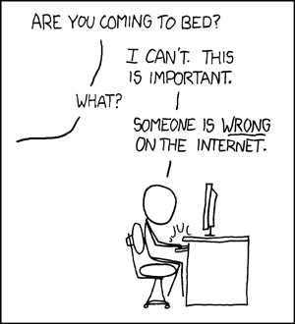
The idea (my wife’s version)
Source: xkcd.com

Slide 9
Roadmap
Are markets moral?
Trade facts
The logic of markets
Ricardo’s model of trade
Thinking about trade

Slide 10
Trade facts

Slide 11
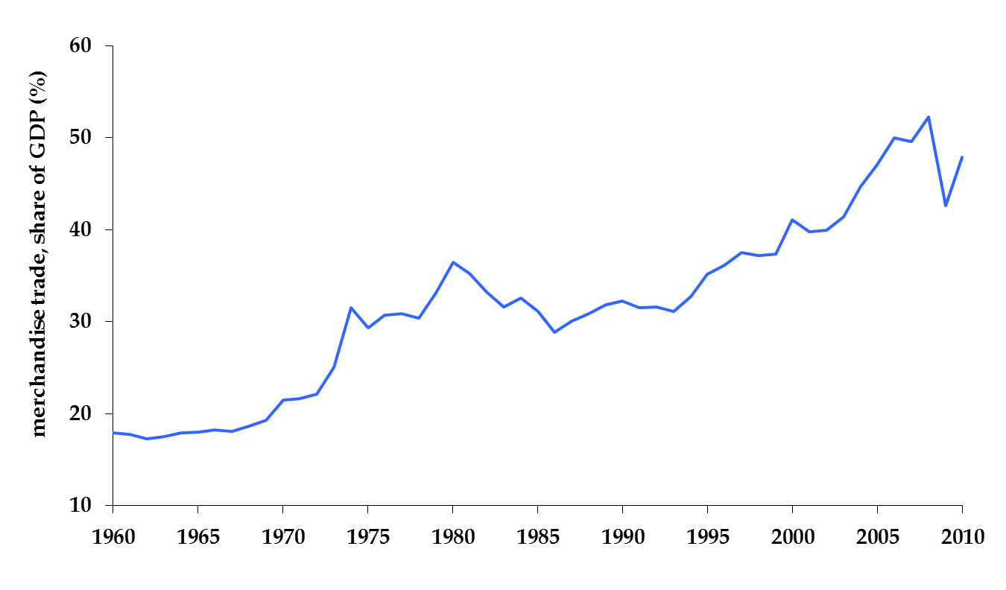
Trade has expanded
World trade / World GDP
Source: WTO

Slide 12
… but hasn’t always
US Tariffs
US Imports
Source: WTO

Slide 13
Average tariffs
non-agriculture
Source: WTO

Slide 14
Average tariffs
agriculture
non-agriculture
Source: WTO

Slide 15
More than tariffs
Subsidies to producers
Especially agriculture in rich countries
Health and safety regulations
Voluntary export restraints
Anti-dumping duties

Slide 16
Trade facts: summary
Trade is growing faster than GDP
Not a sure thing, we’ve seen reversals before
Many ways to stifle trade
Tariffs, regulations, paperwork
Barriers on manufactured goods generally low
Barriers on agriculture much higher

Slide 17
The logic of markets

Slide 18
The logic of markets
Adam Smith, Wealth of Nations, 1776
By pursuing his own interest, [an individual] is led by an invisible hand to promote the interest of the society more effectively than when he really intends to promote it. I have never known much good done by those who affected to trade for the public good. (paraphrase)
Logic
If two people or countries voluntarily exchange products, it suggests that both find it in their interest. It’s “win-win.” Economic activity is a positive sum game.
Circle this, TWICE, it’s fundamental

Slide 19
The logic of markets
First theorem of welfare economics
Under certain conditions, competitive markets produce a good allocation of resources.
What conditions?
Clearly defined property rights, full information
What do we mean by a “good allocation”?
No one can be made better off without someone else being made worse off. (“Pareto optimal”)
Notes:
Property rights includes (??) externalities?

Slide 20
The logic of markets
Voluntary exchange is “win-win”
Suppose two people value an asset or product differently
Trade can benefit both
What price?
Who gains? Who loses?

Slide 21
The logic of markets
Airlines, October 2001
Too many planes, too little cash
General Electric
Lots of cash, major player in plane leasing business
Solution: trade!
What price?
Who gains? Who loses?

Slide 22
The logic of markets
Goldman Sachs, September 2008
Liquidity tight, wanted cash
Berkshire Hathaway
Lots of cash on hand, earning low returns
Solution: trade!
What price?
Who gains? Who loses?

Slide 23
The logic of markets
What examples come to mind?

Slide 24
Ricardo’s model of trade

Slide 25
How most people think about trade
Mexicans
We can’t compete with the US, they’re more productive
Americans
We can’t compete with Mexico, their wages are too low
Trade is “lose-lose”
Sound familiar?

Slide 26
Ricardo’s model of trade
Why a model?
Simpler than the real world, a good way to check our logic
Ricardo, 1817
Two countries, two goods
With free trade, each country produces one good
Key concept: comparative advantage
Each country produces the good at which it is comparatively most productive
Details in the notes

Slide 27
Ricardo: setup
Two countries: US, Mexico
Two goods: apples, bananas
One input: labor
Production function: Y = AL (no K)
Productivities A (output from one unit of labor):
 | Apples/hr | Bananas/hr | Labor (hrs)
US | 20 | 10 | 100
Mexico | 5 | 5 | 100

Slide 28
Production possibilities in Mexico
b
bananas and apples trade one for one
500
what if they could trade one banana for more than one apple?
500
a

Slide 29
Production possibilities in US
b
one banana is worth two apples
[apples cheap, bananas expensive compared to Mexico]
1000
what if they could trade a banana for less than two apples?
2000
a

Slide 30
The logic of markets
Mexico
Relative to US: bananas cheap, apples expensive
United States
Relative to Mexico: apples cheap, bananas expensive
Solution: trade!
What price?
Who gains? Who loses?

Slide 31
Consumption possibilities in Mexico
b
500
Consumption possibilities with trade and p_{a}/p_{b} < 1
Consumption possibilities without trade
500
a

Slide 32
Consumption possibilities in US
b
Consumption possibilities with trade and p_{a}/p_{b} > 1/2
1000
Consumption possibilities without trade
2000
a

Slide 33
Comparative advantage
US trades apples for bananas
Mexico trades bananas for apples
Both trade on better terms than local production allows
Consumption opportunities expand
Everyone wins! Voila!

Slide 34
Trade and autarky
 | Autarky | Trade
US
Consumption of apples | 1500 | 1500
Consumption of bananas | 250 | 375
GDP at world prices | 91.7 | 100
Mexico
Consumption of apples | 375 | 500
Consumption of bananas | 125 | 125
GDP at world prices | 27.1 | 33.3

Slide 35
Thinking about trade

Slide 36
How people think about trade, cont’d
How does Mexico compete against high US productivity?
How does US compete against low Mexican wages?
Who gains? Who loses?
Why?
What happens to overall productivity?

Slide 37
How we think about trade
Production done by most efficient producer
Stop producing in the inefficient sector
Shift resources to the efficient sector
This raises real wages
Consumers buy from cheapest vendor
Allows them to consume more
No change in number of jobs
Trade is about what jobs, not how many
Same thing inside countries

Slide 38
Trade and technology
Is trade like new technology?
Both change production possibilities frontier
Both disrupt production and employment
Both generate complaints

Slide 39
Winners and losers
In our model, everyone wins
In more complex models
Some people win
Some people lose
But winners gain more than losers lose
Examples?

Slide 40
Automobile productivity
New technology for making cars
Technology breakthrough reduces labor requirement
Thousands thrown out of work
Who gains? Who loses?
Is this good for the economy as a whole?

Slide 41
Automobile productivity
New technology for making cars
Grow soybeans in Iowa
Ship them to Japan, get cars in return
Thousands thrown out of work
Who gains? Who loses?
Is this good for the economy as a whole?
Source: Steve Landsburg

Slide 42
What have we learned?
Globalization is a fact of life
Clear logic for (competitive) markets and trade
Production more efficient (“comparative advantage”)
Consumers get lower prices
Win-win: “comparative advantage”
Like new technology?
More shortly

Slide 43

The Global Economy Trade Reality

Slide 44
What’s happening?
“Driving in France,” NYT, Aug 23 14, via Micah
Alexandre Chartier and Benjamin Gaignault work off Apple computers and have no intention of ever using the DVD player tucked in the corner. But French regulations demand that all driving schools have one, so they got one. Mr. Chartier and his partner are trying to break into the driving school business here, using computer technology to match teachers and students across France and to offer cut rates. But they are not having an easy time.
What’s going on here? What does it mean?
Notes:
http://www.nytimes.com/2014/08/24/world/europe/a-driving-school-in-france-hits-a-wall-of-regulations.html

Slide 45
What’s happening?
“Kazakhstan issues bonds,” Bloomberg, Oct 6 14
Kazakhstan sold $1.5 billion of 10-year dollar bonds and $1 billion of 30-year debt. It comes to the market after a change in sovereign bond contracts designed to prevent a repeat of the wrangling that has marred restructuring of Argentina’s debt. The changes allow a majority of bondholders to agree to modifications that bind on all bondholders.
What’s going on here? What does it mean?

Slide 46
Roadmap
What’s coming up?
Problem Set #2
Trade fallacies
If trade is so great…
Offshoring
Trade restrictions

Slide 47
What’s coming up?
We’re finishing “long-term economic performance”
Midterm next class
Bring calculator that does logs and exponents
Also one page, both sides, with anything you wish
Practice exams posted
Also answers to practice problems
Special office hours Tue & Fri (other times by request)

Slide 48
Problem Set #2
Answers will be posted Saturday

Slide 49
Problem Set #2
Question 2: What’s going on in Italy?
GDP growth? Productivity? Institutions?

Slide 50
Problem Set #2
Question 3: Would you locate a plant in Brazil, the Czech Republic, or Taiwan? Why?

Slide 51
Trade fallacies

Slide 52
The fallacy game
Think about how this works in Ricardo’s model
Add anything you think is missing

Slide 53
Fallacy #1
Trade costs us jobs
Why a fallacy?
Trade is about what jobs, not how many
What they’re really saying: “I lost my job, and I’m mad”
In most countries, trade is a small factor in job creation and destruction [in US, replace “small” with “tiny”]

Slide 54
Fallacy #2
Our tariffs are good for us – they protect our industry
Why a fallacy?
Inefficient production
Higher prices for consumers
Note: still a fallacy if other countries have tariffs [they can make their own mistakes]

Slide 55
Fallacy #3
We should subsidize local producers to help them compete
Why a fallacy?
Costs us money
Encourages inefficient production

Slide 56
Fallacy #4
High-wage countries can’t compete
Why a fallacy?
Competitiveness depends on relation between wages and productivity
If wages reflect productivity, high wages are a sign of strength, not weakness

Slide 57
Fallacy #5
Free trade creates trade deficits
Why a fallacy?
My deficit is someone else’s surplus
Trade deficits are really about capital flows

Slide 58
If trade is so great…

Slide 59
… why are so many people against it?
Lou Dobbs
The shipment of American jobs to cheap foreign labor markets threatens not only millions of workers and their families, but also the American way of life. Corporate America isn’t doing all this alone: Big business and Washington are in cahoots, trading our nation’s livelihood for short-term gain.
Do you agree? Disagree?

Slide 60
… why are so many people against it?
AFL-CIO
America’s policies do little or nothing to safeguard the rights of workers and the environment here and around the world. They fuel a race to the bottom in living standards. That needs to change. We need policies that support good jobs at home and sustainable development abroad. We need to blatant abuses by countries that stack the decks against US workers.
Do you agree? Disagree?

Slide 61
… why are so many people against it?
Pew Research Center via Marginal Revolution
Out of 44 countries surveyed, only one – Israel – tends to believe that increased trade will foster competition and deliver lower prices for consumers.
On whether trade with other countries is a good thing, 68% of Americans agree and 76% of people worldwide.
What you’d expect? Why or why not?
Notes:
http://marginalrevolution.com/marginalrevolution/2014/09/why-dont-we-have-more-free-trade.html

Slide 62
… why are so many people against it?
Dave Barry
Q: You are a large US car maker. You have been losing sales to Japanese producers, whose cars tend to be extremely well made. You should:
Have Congress restrict Japanese imports
Have Congress give you money
Have Congress allow you to kidnap consumers’ children unless they buy your cars.
Remind everyone about Pearl Harbor.
A: These are all pretty good.
Source: Dave Barry, “Claw your way to the top”

Slide 63
… why are so many people against it?
Political process
Democratic leaders often protect their supporters
Dictators often protect their friends
Trade adds
Protect us from foreign competitors who don’t vote
Gains outweigh losses, but
Losses clear and concentrated (5k people lose 100k jobs)
Gains fuzzy and dispersed (300m people gain $10 each)

Slide 64
Offshoring

Slide 65
Offshoring
Terminology
Outsourcing: buy something you previously produced yourself
Offshoring: usually means imports of services [eg, business process outsourcing]
Technology makes this much easier than before
Internet connections, Skype, etc
Communication virtually free to anywhere
Feels more threatening to many of us

Slide 66
Krugman’s example
You work for Deutsche Bank, make $100k/year
They fire you, pay 20k to Indian producer, save 80k
Who gains? Who loses?

Slide 67
Krugman’s example, cont’d
You work for Deutsche Bank, make $100k/year
You pay 20k to Indian producer, pocket 80k
Who gains? Who loses?
Someone did this (search: “outsource your own job”)
Notes:
http://www.theglobeandmail.com/technology/how-a-model-employee-got-away-with-outsourcing-his-software-job-to-china/article7409256

Slide 68
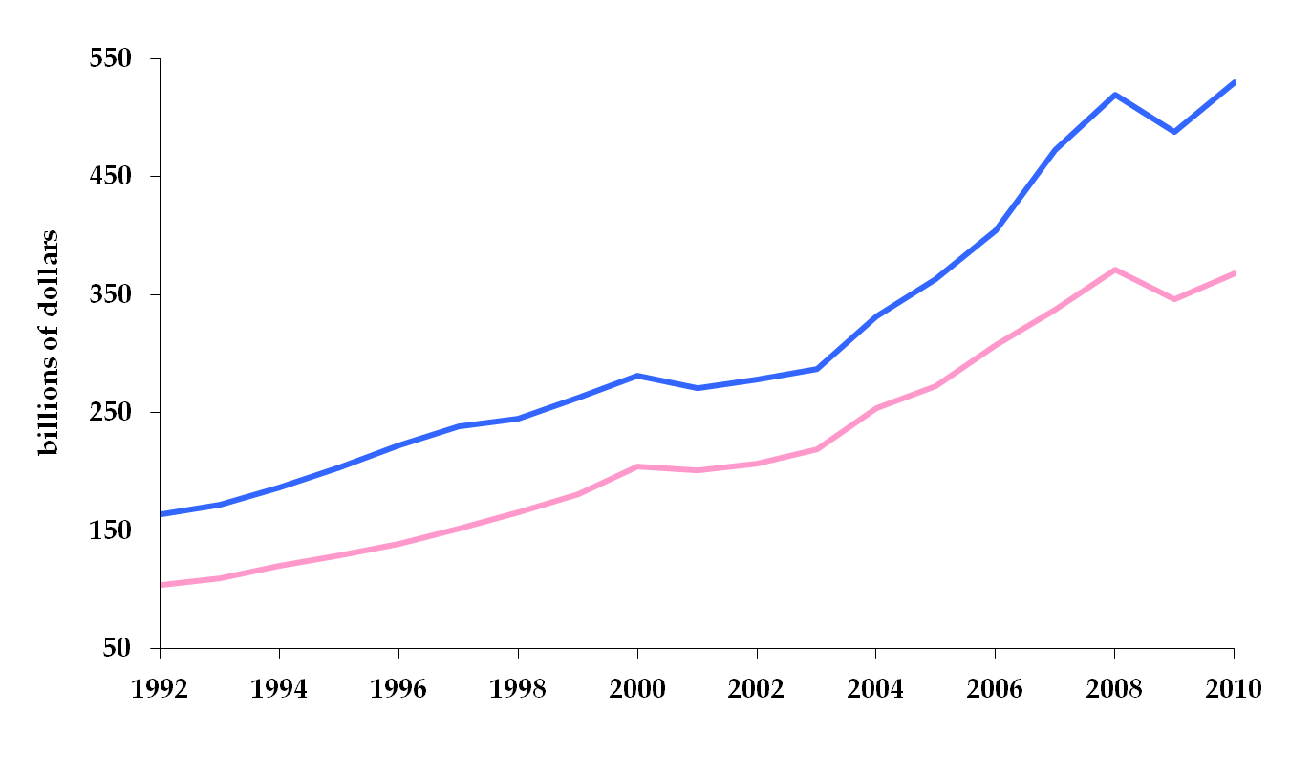
US trade in services
Insourcing: exports of services
Outsourcing: imports of services
Source: BEA, International data, table 3a.

Slide 69
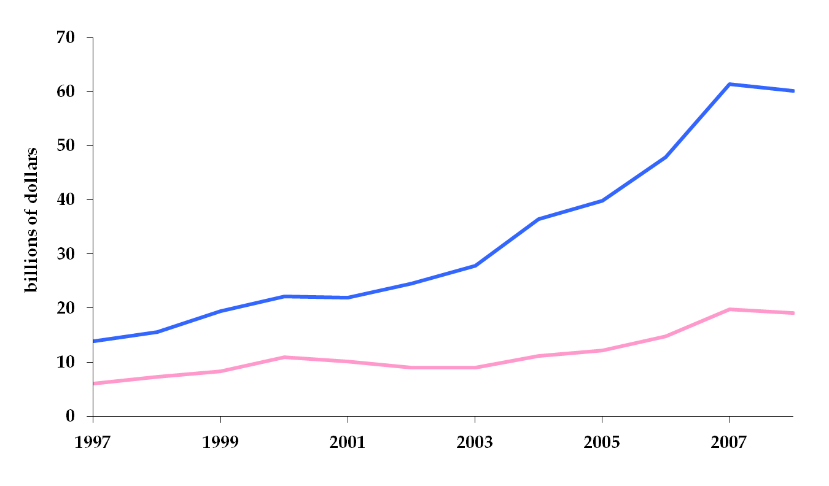
US trade in services
Insourcing of financial services
Outsourcing of financial services
Source: BEA, International data, table 3a.

Slide 70
US trade in services
Insourcing of film and television
Outsourcing film and television
Source: BEA, International data, table 3a.

Slide 71
Trade restrictions

Slide 72
Managing markets
There are times markets don’t work well
But hard-earned experience makes us modest about chances of doing better
See for yourself…

Slide 73
Ways to restrict trade
Tariffs limited by treaty, so use
Subsidies to local producers
Health and safety regulations
Quotas
Antidumping suits

Slide 74
Subsidies to sugar producers
US policy
Guaranteed prices for sugar (18-22 cents per lb.)
World price for sugar around 9 cents per lb.
Estimated cost: $2.15b over 10 years
Who gains?
5,980 sugar and sugar beet farms in 2002 census (600k per!)
Who loses?
Consumers: they pay $1.9b over world price
Taxpayers: they pay for price supports
Who’s the pirate?

Slide 75
Subsidies to sugar producers, cont’d
Why does this work?
Accidental byproducts
High-fructose corn syrup
Ethanol
Notes:
http://www.igmchicago.org/igm-economic-experts-panel/poll-results?SurveyID=SV_09vbSl37UGl6oCh

Slide 76
Subsidies to cotton producers
US policy
Agreed to $1.6b cap in 1995
Current subsidy: >$2b
Brazil argued they violate trade rules
WTO agreed in 2004
Resolution: we subsidize Brazilian producers, too
Who gains? Who loses? Who’s the pirate?
Planet Money podcast (search: “cotton wars”)

Slide 77
Norway
Smuggling milk and butter into Norway

Slide 78
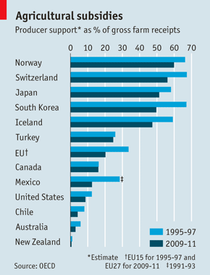
Agricultural subsidies
Source: OECD numbers, reported in The Economist.

Slide 79
Health and safety
EU bans hormone-treated meat
US bans unpasteurized cheese
Cheese must be made with pasteurized milk or aged for 60 days
Many countries ban genetically-modified rice
Only approved for consumption in US, Canada
China bans US GMO corn (they were mad at us)

Slide 80
Health and safety
UPS enters Mexico in 1992 for post-NAFTA boom
Mexicans protect locals (big trucks “unsafe” – for UPS)
NAFTA arbitration panel sides with UPS – 3+ times
UPS asks Clinton for help
Clinton drags feet when Teamsters protest Mexican truckers entering US (“unsafe”!)
Mexico drags its feet in return
20 years later little has changed

Slide 81
Quotas
Limit quantity of a good that can be imported
Voluntary export restraints: quotas imposed by the exporting country (“voluntarily”!)

Slide 82
Voluntary export restraints
In 1980s, US “persuaded” Japan to limit car exports
Similar to a tariff, but
“Voluntary”
US collected no revenue (where did it go?)
Limits on numbers benefited Japanese producers
Eliminated competition among them, prices rose
Instigated increase in quality
What were we thinking?

Slide 83
Dumping
Dumping
When foreign firms use “predatory” pricing
Predatory means price below domestic price or estimated cost
Domestic firms may file for protection
Must show foreign firms pricing “unfairly” and “injury to domestic firms”
Unfair = price below domestic market or production cost
If so, compensating tariff imposed
Who wins? Who loses? Who’s the pirate?
How can we tell dumping from competition?
What does “unfair” mean?

Slide 84
Chinese furniture dumping
Stickley builds huge plant in Vietnam
Files dumping suit against Chinese producers
US producers divided
Retailers against suit, producers in favor
Production leaves US anyway
Chinese firms hire US lawyers, settle
China passes dumping law, files suits against Americans
Who gains? Who loses? Who’s the pirate?

Slide 85
Solar panels
Ongoing saga, similar to furniture

Slide 86
Save US wire hangers!!
One remaining US-based hanger producer…
… files petition against Chinese producers
US’s International Trade Commission investigates
Finds: hangers sold below “fair market value”
Duties assessed range from 33% to 165%
Hanger prices double in US market
Who wins? Who loses? Who’s the pirate?

Slide 87
Save hangers, cont’d
Who wins?
Domestic hanger producers
Wisconsin hanger plant reopens
Who loses?
Dry cleaners
People who use dry cleaners
Unintended consequence
Hanger recycling

Slide 88
World Trade Organization
1947 General Agreement on Trade and Tariffs
23 original signers
Major cornerstone: nondiscrimination
1995 GATT becomes the World Trade Organization
Enforcement mechanism: none
Exemptions: health and safety arguments
Current issues
Tariffs on non-agriculture very low
General Agreement on Trade in Services (in the works)
Trade Related Aspects of Intellectual Property Rights (in the works)

Slide 89
WTO principles
Tariff “binding”
A negotiated tariff is bound: it cannot be increased in the future
Nondiscrimination
Member grant each other most favored nation status … now called normal trade relations (NTR)
Tariff rates the same for all
Exception: regional trade agreements (eg, NAFTA)
Exception: “escape clauses” (China and tires)

Slide 90
What have we learned?
Strong arguments for trade
And open competitive markets in general
But political opposition is a fact of life
Many ways to protect friends and locals
Tariffs, quotas, dumping, health and safety, …
International business remains a challenge

Slide 91
For the ride home
How is the US economy doing?
What does that mean for your business?

Slide 92
Extra slides

Slide 93
The logic of markets
Adam Smith, Wealth of Nations, 1776
It is the maxim of every prudent master of a family, never to attempt to make at home what it will cost him more to make than to buy. What is prudence in the conduct of every private family, can scarce be folly in that of a great kingdom.
Who wins from protection? Who loses?

Slide 94
Comparative advantage
Without trade
Relative price reflects only relative productivities
With trade
Produce good with highest relative productivity
Comparative advantage!
Relative productivity of apples
US: 20/10 = 2
Mexico: 5/5 = 1
Relative productivity of bananas
US: 10/20 = 1/2
Mexico: 5/5 = 1
Who has the comparative advantage?

Slide 95
No trade: “autarky”
With no trade
Production = consumption
Production possibility set = consumption possibility set
Relative price of apples in US
p_{a}/p_{b} = 1/2
Relative price of apples in Mexico
p_{a}/p_{b} = 1
Note: apples cheap in US, bananas cheap in Mexico

Slide 96
What if?
What if the US could trade apples for bananas with
p_{a}/p_{b} > 1/2?
What if Mexico could trade bananas for apples with
p_{a}/p_{b} < 1?
What should each country do?
Who gains? Who loses?

Slide 97
Subsidies to sugar producers, cont’d
Links
http://www.npr.org/2013/03/28/175569499/farm-bills-sugar-subsidy-more-taxing-than-sweet-critics-say http://www.motherjones.com/kevin-drum/2013/06/sugar-industry-getting-sweet-deal-uncle-sugar
http://www.mysanantonio.com/opinion/commentary/article/Sweet-deal-for-U-S-sugar-growers-4923616.php
Notes:
http://www.igmchicago.org/igm-economic-experts-panel/poll-results?SurveyID=SV_09vbSl37UGl6oCh

