Slide 1

The Global Economy Monetary Policy & Interest Rates
Notes:
Open Cleveland Fed animation
Tax spreadsheet

Slide 2
Ride home revisited
Should Fed continue aggressive expansion of money supply (“quantitative easing”)?
Why or why not?

Slide 3
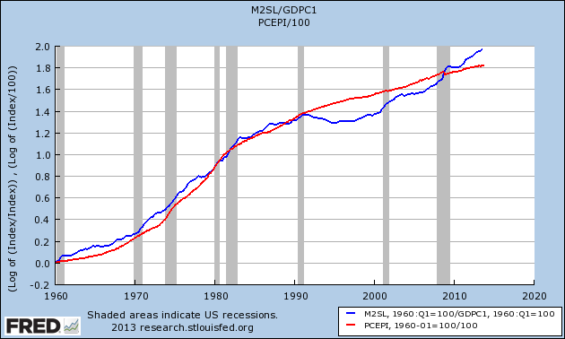
Ride home revisited
P
M/Y

Slide 4
The idea
Interest rates reflect many things, but the short-term focus of bond traders in most countries is on the central bank

Slide 5
Keep it simple
Lots of stories and institutional detail along the way
Focus on central bank balance sheet and Taylor rule

Slide 6
Big picture for bond investors
Bond investors
Bond prices fall when interest rates rise (definition)
More so for long bonds
If you expect rates to rise, hold short bonds
Look to Fed for guidance [more coming]

Slide 7
Big picture for policy analysts
Are you worried about inflation or growth right now?
What should the Fed do?
Would we be better off with gold as our currency?

Slide 8
Big picture for philosophers
What is money?
Why does it matter?
Is gold money? Paper? Bitcoins?

Slide 9
Big picture for economists
Donald Knuth
Science is what we understand well enough to explain to a computer. Art is everything else.
Evidently monetary policy is art
Notes:
http://www.math.upenn.edu/~wilf/foreword.pdf

Slide 10
Courses related to this topic
Monetary policy, banks, and central banks (ECON-GB.2333)
Tobias Adrian, NY Fed, Head of Capital Markets Group
Financial crisis and policy response (ECON-GB.2343)
Kim Schoenholtz, Professor of Management Practice, Ex-Salomon and Citi, former Chief US Economist at Citi, central bank expert
Not offered next term, but probably next year

Slide 11
Roadmap
Short history of money
What should central banks do?
Money supply mechanics
Interest rate mechanics
Taylor’s interest rate rule
Unconventional monetary policy

Slide 12
Short history of money

Slide 13
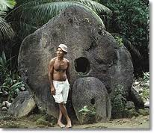
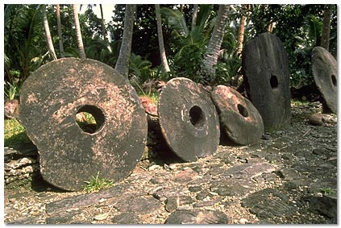
Stone money
Milton Friedman, “Stone money,” in Money Mischief
On the island of Yap in the Western Pacific …
What’s the point?

Slide 14
Commodity money
Gold standard
Money tied to gold (eg, 1 oz = $35)
In principle, people can take their money to the central bank and exchange it for gold
This guarantees money has value
Questions
Does it deliver stable prices?
Is it a waste of gold?
An improvement on our current system?

Slide 15
Commodity money
David Ricardo, Proposals for a Secure Currency, 1816
The introduction of precious metals [as money] may with truth be considered one of the most important steps toward the improvement of commerce. But it is no less true that … it would be another improvement to banish them altogether [in favor of paper money].
What is he saying? Do you agree?

Slide 16
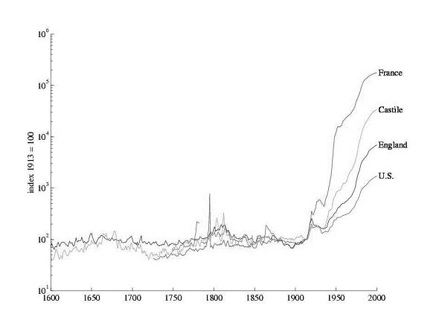
Prices with commodity & paper monies

Slide 17
Open question
How do we deliver stable prices?
Commodity money?
Central bank policy?
Something else?

Slide 18
What should central banks do?

Slide 19
Federal Reserve System
Founded by Federal Reserve Act of 1913
The Federal Reserve System and the Federal Open Market Committee should seek “to promote effectively the goals of maximum employment, stable prices, and moderate long-term interest rates.”
So what’s the goal?
And what about motherhood and apple pie?

Slide 20
ECB
ECB = European Central Bank
Treaty of Maastricht (1992)
The primary objective of [monetary policy] shall be to maintain price stability.
Without prejudice to the objective of price stability, the ECB shall support the general economic policies in the Community with a view to contributing to the achievement of … a high level of employment and sustainable and non-inflationary growth.
How does this differ from Fed? Good idea or bad?

Slide 21
Banco Central de Argentina
BCRA Act of 2003
The Argentine Central Bank is a self-governed institution whose primary and fundamental mission is to preserve the value of the currency.
Good idea? Did it work?

Slide 22
Federal Reserve revisited
Fed policy statement, October 30, 2013:
Information received since the September meeting generally suggests that economic activity has continued to expand at a moderate pace. Consistent with its statutory mandate, the Committee seeks to foster maximum employment and price stability.
What are they saying? Do you agree?
Notes:
http://www.federalreserve.gov/monetarypolicy/fomccalendars.htm

Slide 23
Federal Reserve revisited
Janet Yellen, testimony, November 2013
The past six years have been challenging and difficult. We have made good progress, but unemployment is still too high. At the same time, inflation has been running below the Federal Reserve's goal of 2 percent. For these reasons, the Federal Reserve is using its monetary policy tools to promote a more robust recovery.
What is she saying? Do you agree?
Notes:
http://www.federalreserve.gov/newsevents/testimony/yellen20131114a.htm

Slide 24
Federal Reserve revisited
Charles Plosser, President, Philly Fed, speech, November 2013
The active pursuit of employment objectives continues to be problematic for the Fed. Most economists are dubious of the ability of monetary policy to predictably and precisely control employment in the short run, and there is a strong consensus that, in the long run, monetary policy cannot determine employment.
What is he saying? Do you agree?
Notes:
http://johnhcochrane.blogspot.com/2013/11/a-limited-central-bank.html http://www.philadelphiafed.org/publications/speeches/plosser/2013/11-13-13_cato-institute.cfm

Slide 25
Money & interest rates

Slide 26
Where do interest rates come from?
We generally think of monetary policy in terms of interest rates
Where do these interest rates come from?
Short-term Treasuries?
Long-term Treasuries?
Fed funds rate?
Inflation-indexed Treasuries (TIPS)?

Slide 27
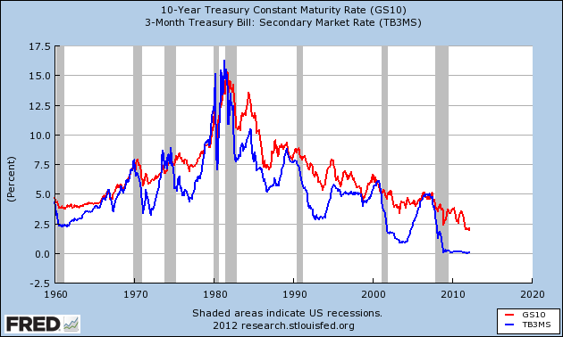
Where do interest rates come from?
Why so high?

Slide 28
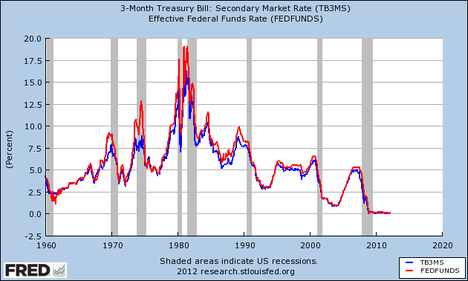
Where do interest rates come from?

Slide 29
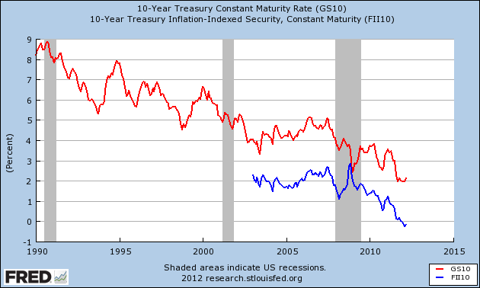
Where do interest rates come from?
Why different?

Slide 30
Where do interest rates come from?
Interest and inflation (“Fisher equation”)
i = r + π
i = “nominal” interest rate (payment in dollars)
r = “real” interest rate (payments in goods)
π = inflation (expected?)

Slide 31
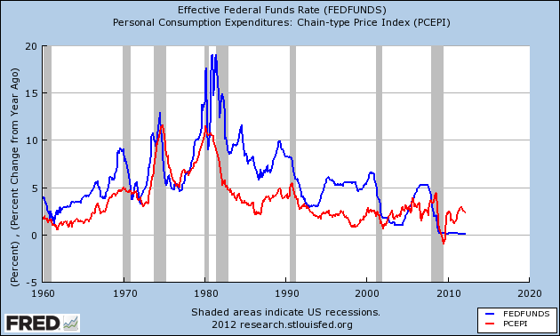
Where do interest rates come from?

Slide 32
Where do interest rates come from?
Summary
Inflation is part of the story
But there’s still a lot of variation left

Slide 33
Money supply mechanics

Slide 34
Reminder: money supply mechanics
Treasury
Assets |  | Liabilities
 |  | Bonds | 200
How does central bank increase money supply?
[Think: asset swap]
Why do households go along?
Central bank
Assets |  | Liabilities
Bonds | 20 | Money | 20
Households and firms
Assets |  | Liabilities
Money | 20
Bonds | 180

Slide 35
Fed policy statement
Federal Open Market Committee (“Fed” or “FOMC”)
Meets eight times a year
Makes public statement immediately following
Search: “FOMC”
Statement includes
Interest rate target
And recently: asset purchases (“quantitative easing”)

Slide 36
Fed policy statement
Statement of October 30, 2013:
The Committee sees the improvement in economic activity since it began its asset purchase program as consistent with growing underlying strength in the economy. However, the Committee decided to continue purchasing agency mortgage-backed securities at a pace of $40 billion per month and longer-term Treasury securities at a pace of $45 billion per month.
The Committee decided to keep the target range for the federal funds rate at 0 to 1/4 percent and currently anticipates that this exceptionally low range will be appropriate for some time.
What are they saying?
Notes:
http://www.federalreserve.gov/monetarypolicy/fomccalendars.htm

Slide 37
Asset market purchases
Central bank usually
Assets |  | Liabilities
Bonds | 20 | Money | 20
What are these “asset market purchases”?
How does the Fed finance them?
Why is it helpful to pay interest on reserves?
What kind of asset swap is this?
Central bank now
Assets |  | Liabilities
Bonds | 120 | Money | 20
Agency | 100 | Reserves | 200

Slide 38
Interest rate mechanics

Slide 39
Overview
Central banks shift AD by changing money supply
But: Fed policy statement focused on interest rate
Translation
Increase in interest rate is same as reduction in money supply
Decrease in interest rate is same as expansion of money supply
More soon, but that’s the point
Focus on US, but [most] other countries are similar

Slide 40
Some institutional detail
In practice, Fed operates in market for “reserves”
Reserves are deposits of banks at Fed (“fed funds”)
The Fed is the bank for banks
Reserves held by banks for transactions or as investments
Banks trade overnight positions in “fed funds”
If they have more than they want, they sell
If they have less than they want, they buy
The rate on these positions is the “fed funds rate”

Slide 41
Hitting the target interest rate
How does the Fed hit its target interest rate?
Demand for money depends on interest rate
Why? Currency pays no interest, so hold less if rate is high
So… choose supply of money to hit target
No different from markets for apples, copper, etc

Slide 42
Hitting the target interest rate
i
MS
target i*
MD
M

Slide 43
What if demand changes?
i
MS
target i*
MD
M

Slide 44
What if demand changes?
Sell bonds, accept money
i
MS
target i*
MD
M

Slide 45
Hitting the target interest rate
Market federal funds rate

Slide 46
Hitting the target interest rate
Summary
Increasing money supply lowers interest rate
Decreasing money supply raises interest rate
We’ll talk as if changing money supply and interest rate are equivalent

Slide 47
Up next
What rate do we choose?
Could go back to AS/AD
But we’ll use a popular rule of thumb instead

Slide 48
The Taylor rule for the fed funds rate

Slide 49
The Taylor rule
A formula for setting fed funds rate
What’s good about a formula? Bad?
What should rate respond to?
Inflation?
GDP and GDP growth?
Condition of financial system?
Exchange rate?
Other things?

Slide 50
The Taylor rule
John Taylor’s rule for setting fed funds rate
i = r* + π + a₁(π ₋ π*) + a₂(g ₋ g*)
i = target fed funds rate
r* = average real interest rate [2%]
π = inflation rate
π* = target inflation rate [2%]
g = GDP growth rate
g* = average GDP growth rate [3%]
(a₁, a₂) = numbers/parameters [1/2, 1/2]
Variations?

Slide 51
The Taylor rule as bond trader’s guide
What happens to interest rate if
GDP growth rises?
Inflation rises?
Employment rises?
Other indicators?

Slide 52
The Taylor rule
What does it suggest on average?
i = r* + π + a₁(π ₋ π*) + a₂(g ₋ g*)

Slide 53
The Taylor rule
What does it suggest now?
i = r* + π + a₁(π ₋ π*) + a₂(g ₋ g*)
Recent numbers
Inflation PCE chain index: YOY Sep = 0.9%
Inflation CPI urban consumers: YOY Sep = 1.2%
GDP growth: 2013Q3 = 2.8%. YOY = 1.6%

Slide 54
The Taylor rule
How much does it respond to inflation? Why?
i = r* + π + a₁(π ₋ π*) + a₂(g ₋ g*)

Slide 55
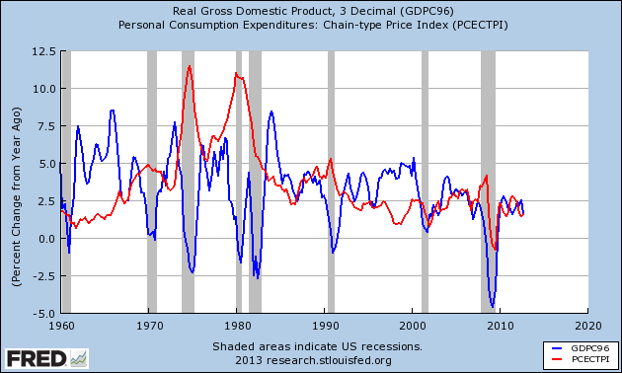
US history: inflation and growth

Slide 56
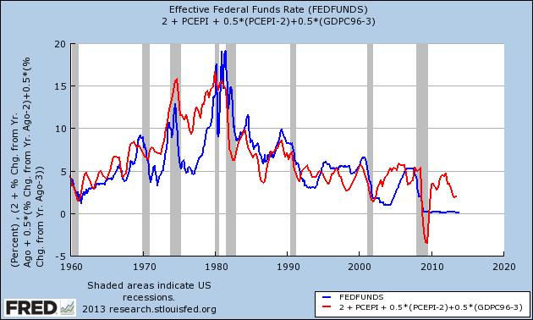
US history: Taylor rule

Slide 57
The Taylor rule
What happened in 1970s?
Rate below Taylor rule, inflation shot up
Same as last week, where we called it too much money
What happened in 2001?
Rate below Taylor rule, justified or mistake?
What happened in 2008?
Taylor rule points to negative rate, can’t be done [more soon]
What should we do now?
Taylor rule above target, rate too low?

Slide 58
Unconventional policy

Slide 59
Unconventional monetary policies
Policy 1: quantitative easing
What do we do when the interest rate hits zero?
Policy 2: credit easing
How can we mitigate impact of financial disruption?

Slide 60
Unconventional policy 1
What happens when interest rate hits zero?
Can’t have negative interest rates, people would hold cash instead
ZLB: zero lower bound
But: you can still increase money supply
QE: quantitative easing
New name for an old idea?

Slide 61
QE at the ZLB
i
MS
What happens when i hits zero?
MD
M

Slide 62
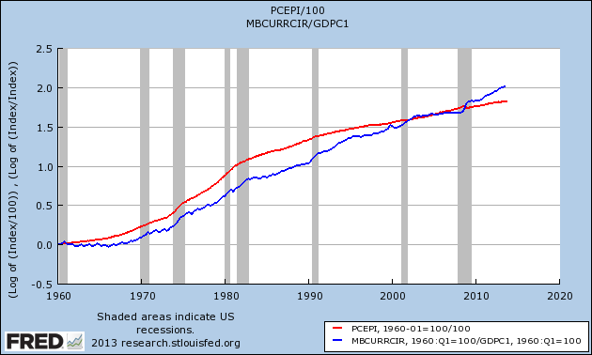
Quantitative easing (currency)
P
M/Y

Slide 63
Quantitative easing (M2)
P
M/Y

Slide 64
Unconventional policy 2
Another unconventional policy: buy assets
CE: credit easing (buy private assets)
QE: quantitative easing (buy public assets in large quantities)
See Cleveland Fed animation
http://www.clevelandfed.org/research/Data/Credit_Easing/index.cfm
Why?
Prop up financial system? Twist yield curve?

Slide 65
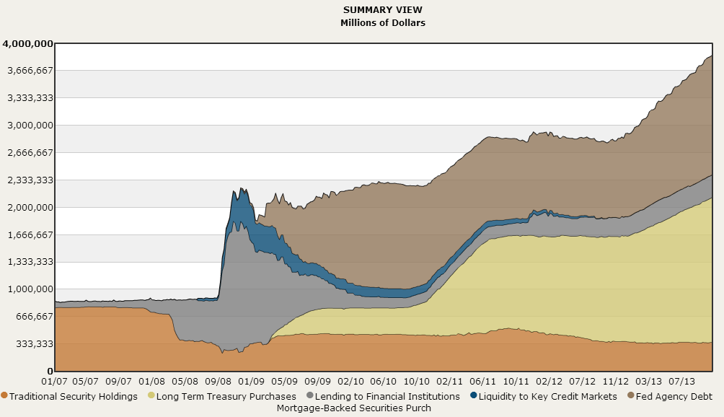
Quantitative and credit easing
Source: Cleveland Fed.

Slide 66
Unconventional policy revisited
Which was it?
Brilliant strategy that mitigated impact of the financial crisis
Excessive expansion that will lead to inflation down the road

Slide 67
Unconventional policy revisited
??? Data from options
http://ashokarao.com/2014/10/14/expectation-variation-and-the-inflation-debate/

Slide 68
What have we learned?
Central banks usually target an interest rate rather than the money supply
Two ways of thinking about the same thing
Taylor rule ties interest rate to inflation and growth
Bond trader’s guide
Raises questions when policy differs [like now?]
When interest rate hits zero, you can still increase the quantity of money

Slide 69

The Global Economy Principles of Tax Policy

Slide 70
Roadmap
New module: crises
The ideas
Words and numbers
Principles of spending policy
Principles of tax policy
Low rates, broad base

Slide 71
Starting new module
New module organized roughly around economic crises
First topic: “fiscal policy” = “government finance”
Government spending
Tax revenue
Debt = deferred taxes [next week]

Slide 72
The ideas
Countries differ – a lot – in the magnitude and type of spending, the taxes they collect, and how they manage their debt
Good tax systems
Pay for government spending [next week]
Are transparent and simple to execute
Apply low rates to a broad base

Slide 73
Words and numbers

Slide 74
Words
An old joke:
Opinion polls show that 100% of voters think other people should pay more tax.

Slide 75
Words
The Economist, Survey France, Oct 26 06:
An employer who pays a worker twice the minimum wage, or €2,400 a month, has to shell out nearly half as much again to the state in social-security contributions; the employee, for his part, has to hand over 22% of his pay in social-security contributions, on top of income tax. A French pay slip typically runs to over 40 itemised lines.
What’s going on here?

Slide 76
Words
Ivan Miklos, Deputy Prime Minister of Slovakia, Financial Times, on corporate taxes:
I am convinced that the reforms of new EU member states could serve as inspiration for the older member states as well. One such reform is the flat tax. … We now have one of the simplest, most transparent tax systems in the world. … And our tax revenues have not decreased at all, partly because the reform eliminated most of the incentives and opportunities for tax avoidance. The new system has been particularly popular with German companies.
What’s going on here?

Slide 77
Words
EIU, Country Commerce Report, India:
Corporate tax rates have come down in recent years to fairly reasonable levels, in keeping with the government’s aim to widen the tax base and ensure greater compliance. But the underground economy, with its untaxed transactions and incomes, remains large.
The system remains complicated, however, and is the subject of frequent litigation.
What’s going on here?

Slide 78
Words
Jesse Drucker, Bloomberg, May 2013
Even amid growing public outrage in Europe against austerity policies, the gulf between rhetoric and reality on taxation means individuals rather than businesses are often bearing the brunt of higher taxes.
What’s going on here?
Notes:
http://www.bloomberg.com/news/2013-05-13/europe-eases-corporate-tax-dodge-as-worker-burdens-rise.html

Slide 79
Words
Tom Friedman, NYT, Mar 2 10:
Intel’s CEO Paul Otellini: “The things that are not conducive to investments here are [corporate] taxes and capital equipment credits. A new semiconductor factory at world scale built from scratch is about $4.5 billion — in the United States. If I build that factory in almost any other country in the world, where they have significant incentive programs, I could save $1 billion. [We built our new plant in China] and it wasn’t because the labor costs are lower. Yeah, the construction costs were a little bit lower, but the cost of operating after tax was substantially lower.”
What’s going on here?

Slide 80
Words
Eduardo Porter, “A tax code of politics,” NYT, April 10, 2012:
Our byzantine tax code is built upon a longstanding political deal: Democrats wanted a tax scale with higher rates for richer Americans to finance social programs for the poor and middle class. Republicans countered by pushing for tax exceptions, exclusions and deductions that shielded the incomes of the rich from the taxman and reduced government revenue.
This compromise has left us with a loophole-riddled code.
What’s going on here?

Slide 81
Words
Eduardo Porter, “A tax code of politics,” NYT, April 10, 2012 (continued):
The richest 1 percent of Americans, who make $1.5 million on average, pay 28 percent of their income in federal taxes. That’s way below the top rate of 35 percent. The rest of us also pay little. The bottom 85 percent of taxpayers have an average federal tax rate of 12 percent. The poorest 25 percent pay less than 1 percent of their income
What’s going on here?

Slide 82
Words: summary
What should we tax?
Who should we tax?
Why?

Slide 83
Words: summary
Check
http://conversableeconomist.blogspot.com/2013/12/distribution-of-us-federal-taxes.html
http://conversableeconomist.blogspot.com/2014/07/double-irish-dutch-sandwich.html
Also http://www.nytimes.com/2013/05/26/opinion/sunday/who-will-crack-the-code.html The soda industry’s success at legally avoiding taxes shows why so many economists and tax experts believe the United States corporate-tax code is terribly flawed. It includes a notoriously high statutory rate that causes companies to devote resources to avoiding taxes. But it has so many loopholes that the effective corporate tax rate in the United States is slightly lower than the average for rich countries.

Slide 84
Government spending (% of GDP)
Source: OECD fiscal database.

Slide 85
US federal government spending
Medicare, Medicaid, Social Security
2010
2020
“Discretionary”
Where the sequester lives
!!

Slide 86
Personal tax rates (%, at average wage)
Source: OECD. Green=direct tax. Blue=total incl soc ins payments.

Slide 87
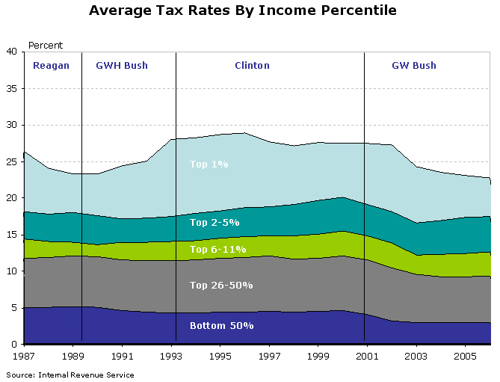
US average tax rates by income (all taxes)

Slide 88
US average tax rates by income (all taxes)
http://www.cbo.gov/publication/44604

Slide 89
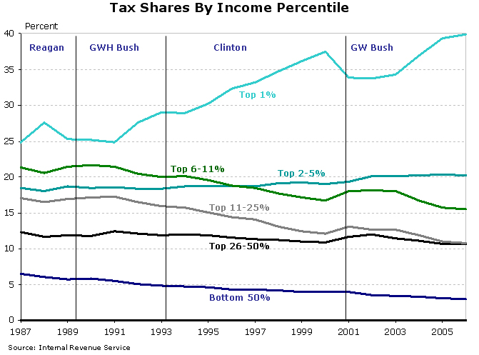
US tax shares by income (all taxes)

Slide 90
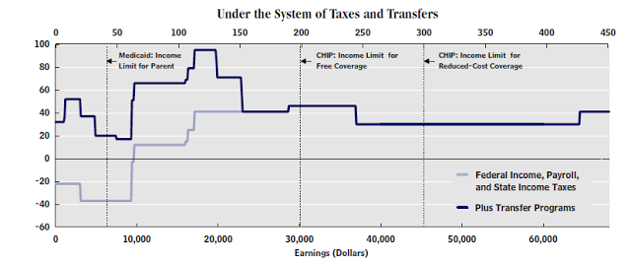
US: marginal tax rates by income
Source: CBO via Cochrane.
Notes:
http://johnhcochrane.blogspot.com/2012/11/taxes-and-cliffs.html

Slide 91
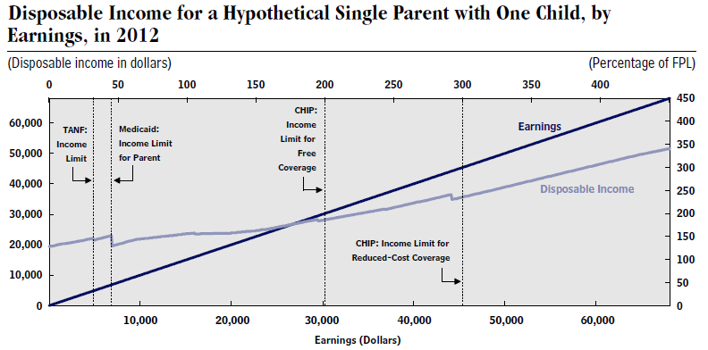
US: post-tax and pre-tax income
Source: CBO via Cochrane.
Notes:
http://johnhcochrane.blogspot.com/2012/11/taxes-and-cliffs.html
http://www.cbo.gov/sites/default/files/cbofiles/attachments/11-15-2012-MarginalTaxRates.pdf

Slide 92
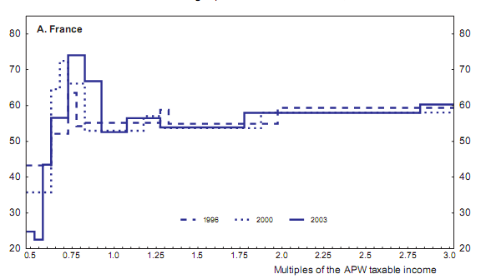
France: marginal tax rates by income
Source: OECD working paper 439, “The French tax system.”

Slide 93
Corporate tax rates
Source: KPMG.

Slide 94
Value-added tax rates
Source: Doing Business.

Slide 95
Principles of government spending

Slide 96
Government spending
Classic argument: provide public goods
Public goods are
Non excludable: hard to keep non-payers from consuming
National security, legal system, fish in the ocean
Non rival: my consumption does not affect your consumption
Fresh air, NY skyline, public safety
Hard for a private firm to capture all the benefits, so market would provide too little

Slide 97
Government spending
Many goods partly private, partly public
Individuals and countries differ on
Roads?
Security?
Education?
Mass transit?
Sport stadiums?
Opera?
Health care?
Others?

Slide 98

Government spending
Libertarian Reluctantly Calls Fire Department
April 21, 2004 | Issue 40•16
CHEYENNE, WY—After attempting to contain a living-room blaze started by a cigarette, card-carrying Libertarian Trent Jacobs reluctantly called the Cheyenne Fire Department Monday. “Although the community would do better to rely on an efficient, free-market fire-fighting service, the fact is that expensive, unnecessary public fire departments do exist,” Jacobs said. “Also, my house was burning down.” Jacobs did not offer to pay firefighters for their service.
© Copyright 2006, Onion, Inc. All rights reserved.
The Onion is not intended for readers under 18 years of age.

Slide 99
Government spending, continued
Most government spending not goods, public or otherwise
Transfer payments to cover
Pension funds
Disability
Healthcare
Countries differ, but (esp) in rich countries transfers are greater than purchases of goods and services

Slide 100
Principles of tax policy

Slide 101
Tax principles
Societies choose different levels of spending
They have to pay for it, primarily through taxes
Which taxes?
Principles of good tax policy
Collect enough revenue to pay for government spending [next week]
Transparent and easy to execute
Apply low rates to a broad base

Slide 102
Complexity of business taxes (hours)
Source: Doing Business.

Slide 103
Tax complexity: Vodaphone in India
Civitas.in online case [my summary]
Vodafone BV, based in the Netherlands and controlled by Vodafone UK, obtained a controlling interest in CGP Investments Holdings, located in Cayman Island, from Hong Kong-based Hutchinson Telecommunications International Ltd (HTIL)
HTIL had a stake in CGP’s mobile operations in India.
India sent Vodaphone a $2.3b tax bill based on capital gains in its India operations (gains taxed on transfer of control)
The Supreme Court rejected the government’s argument in March, but the government threatened to pass legislation allowing retrospective taxation of business deals.
The saga continues …

Slide 104
Low rate, broad base

Slide 105
Tax “distortions”
If we start with a good allocation of resources, taxes move us away from it
We say taxes “distort” decisions to buy and sell
Examples
Tax on cigarettes discourages smoking
Tax on labor income discourages work
Tax on saving and investment income discourages both
In each case: good or bad?

Slide 106
Tax “distortions”
The idea is to raise enough revenue to pay for spending with smallest distortions possible
Tax principle #3: Apply a low rate on a broad base

Slide 107
Tax “distortions”
Apply low tax rate to broad tax base
Why?
Taxes “distort” economic decisions
High tax rates distort more
Our thought experiment
Tax two markets equally
Tax one market twice as much
Which is better?

Slide 108
Welfare maximized where S=D
P
consumer surplus
S
P*
producer surplus
D
Q*
Q

Slide 109
Tax destroys surplus
P
Deadweight loss
S'
consumer surplus
P_{c}’
S
t
P*
tax revenue
P_{f}’
producer surplus
D
Q’
Q*
Q

Slide 110
Large tax destroys more surplus
P
S”
S
2t
t
Doubling the tax quadruples the deadweight loss!
D
Q

Slide 111
Tax distortion summary
Summary
Tax at rate t generates loss of one triangle
Tax at rate t on two markets generates loss of two triangles
Tax at rate 2t on one market generates loss of four triangles
Therefore
Better off taxing two markets at rate t
Principle #3: tax broad base (two markets) at low rate (t, not 2t)

Slide 112
Low rate, broad base
Should we
Make food and clothing exempt from tax?
Mortgage interest?
Health insurance?
Internet sales?
Legal services?
Education supplied by nonprofits?

Slide 113
Low rate, broad base
“A dance is a dance,” New York Times, October 2012
The New York State Court of Appeals ruled last week that Nite Moves, a strip club near Albany, must pay sales tax on admissions fees it collects from customers. State law exempts from sales tax “dramatic or musical arts performances,” including “choreographic” performances. The question was whether a private lap dance or a pole dance qualifies as a “dance.”
What’s going on here?

Slide 114
Low rate, broad base: VAT
Why tax value added?
Countries used to tax output at all stages
Example: 5 stages in value chain, tax each stage on total value

Slide 115
Low rate, broad base: taxing interest
Impact of taxing interest income
Without taxes
Price now of one dollar of consumption now: 1
Price now of one dollar of consumption n periods from now:
1/(1+r)^{n}
With taxes
Price now of one dollar of consumption now: 1
Price now of one dollar of consumption n periods from now:
1/[1+(1-t)r]^{n}

Slide 116
Low rate, broad base: taxing interest
Numbers
r = 0.05 [5%]
t = 0.25 [25%]
n = 20 [20 years]
Compare cost of future consumption
1/(1+r)^{n} = 0.38
1/[1+(1-t)r]^{n} = 0.48
This makes future consumption more expensive
What does it distort? What are the consequences?

Slide 117
What have we learned?
Countries differ a lot in government spending and taxes
Taxes change incentives to work, save, etc
Good tax systems
Generate enough revenue to cover spending [next week]
Simple and transparent
Broad base, low rate

Slide 118
Coming up
Problem Set #4: monetary & fiscal policy
Due in two classes (three weeks)
First question doable now

Slide 119
For the ride home
Has the US government issued too much debt?
What’s too much? What are the consequences?
Have a great Thanksgiving!

