Slide 1

The Global Economy Government Debt & Deficits
Notes:
Open deficit spreadsheet
Open Big Mac index

Slide 2
Ride home revisited
Has the US government issued too much debt?
What’s too much? How would we know? What are the consequences?

Slide 3
The idea
Governments issue debt when spending exceeds revenue. When they issue too much debt, investors bail out, possibly triggering a crisis.
Open question: how much is “too much”?

Slide 4
Roadmap
Macroeconomic crises
Words and pictures
Debt arithmetic
Debt dynamics
What’s missing?
Is the US in trouble?

Slide 5
Macroeconomic crises

Slide 6
Macroeconomic crises
New module
The classic crisis triggers
Sovereign debt (“debt crisis”)
Financial fragility (“financial crisis”)
Fixed exchange rates (“exchange rate crisis”)
What was/is the trigger in
Japan in the 1990s?
Mexico in 1994?
The US in 2008?
Europe today? (Greece, Ireland, Portugal, Spain, Italy…)

Slide 7
Words & pictures

Slide 8
Words
Alexander Hamilton, Second Report on Public Credit, 1795
Every system of Public Credit must assume as a fundamental principle the ability to pay the debt which it contracts. With the creation of debt should be incorporated the means of extinguishment.
What is he saying? Do you agree?

Slide 9
Words
“Krugman declares bankruptcy,” Daily Currant, March 2013
Economist and columnist Paul Krugman declared personal bankruptcy today following a failed attempt to spend his way out of debt. … Rather than tighten his belt, the economist decided to "stimulate" his way to a personal recovery by investing in expenses he hoped would one day boost his income.
What are they saying? Do you agree?

Slide 10
Words
Thomas Sargent, October 2011
Here’s a phrase that you hear. You hear that US fiscal policy is unsustainable. You hear it from both parties. What they mean is that certain promises people have made – taxes, entitlements, medicare, medicaid – those are incredible, they don’t fit together. So US fiscal policy is very uncertain. It’s uncertain because it’s not clear which of these promises is going to be broken first.
What is he saying? Do you agree?

Slide 11
Words
Walter Wriston, 1987
Countries don't go out of business. ... The infrastructure doesn't go away, the productivity of the people doesn't go away, the natural resources don’t go away. And so their assets always exceed their liabilities, which is the technical reason for bankruptcy. That's very different from a company.
What is he saying? Do you agree?

Slide 12

Words
October 2012
The ARA Libertad, a training ship owned by the Argentine navy, was detained in Ghana at the request of Elliott Capital Management, a hedge fund run by Paul Singer.
What’s going on here?

Slide 13
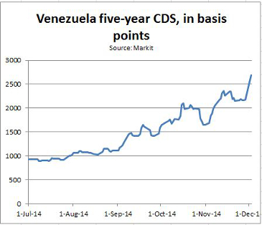
Venezuela
Notes:
http://blogs.wsj.com/moneybeat/2014/12/04/how-the-swaps-market-is-preparing-for-a-venezuelan-default/

Slide 14
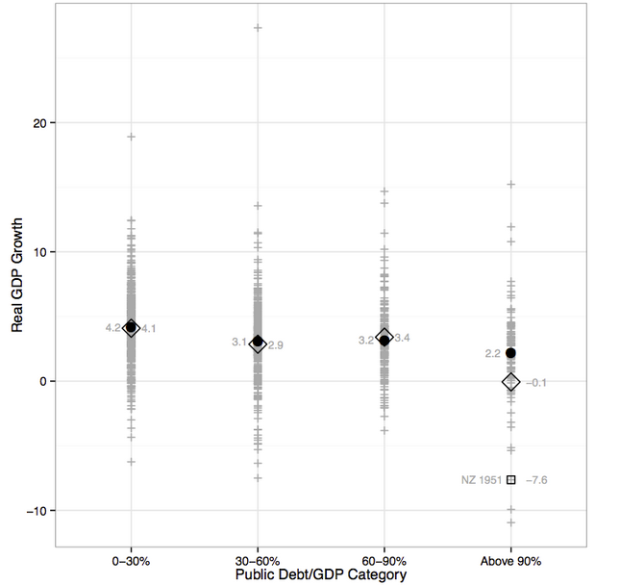
Reinhart-Rogoff data
Notes:
http://simplystatistics.org/2013/04/16/i-wish-economists-made-better-plots/

Slide 15
Government deficits (% of GDP, 2013)
Source: EIU CountryData.

Slide 16
Government debt (% of GDP)
Source: EIU CountryData.

Slide 17
Debt arithmetic

Slide 18
Government budget: Principle #1
Principle #1 of fiscal policy
Government spending must be financed with tax revenue, either now or in the future

Slide 19
Government budget: ingredients
Government spending in year t
G_{t} + V_{t} + i_{t}B_{t-1}
G = government purchases of goods and services
V = government spending on transfers
i = interest rate on debt B
Government tax revenue in year t: T_{t}
Government debt at end of year t-1, start of year t: B_{t-1}

Slide 20
Government budget: US, $b, 2012
Revenue |  | 4,259
 | Tax revenue | 3,041
 | Social insurance contributions | 955
Expenses |  | 5,621
 | Goods, services, and employee comp | 2,548
 | Transfer payments | 2,385
 | Interest on debt | 632
Surplus |  | −1,362
For reference: GDP = 16,245
Source: BEA, Table 3.1, consolidated government; numbers may not sum to totals.

Slide 21
Government budget
Budget (cash flow out = cash flow in)
G_{t} + V_{t} + i_{t}B_{t-1} = T_{t} + B_{t} − B_{t-1}
Spending = Tax Revenue + Change in Debt
Government deficit
(G_{t} + V_{t} + i_{t} B_{t-1}) − T_{t}
Primary deficit (excl interest)
D_{t} = G_{t} + V_{t} − T_{t}
(replace three symbols with one)

Slide 22
Government budget arithmetic
Primary deficit (excl interest)
D_{t} = (G_{t} + V_{t}) − T_{t}
Budget becomes
G_{t} + V_{t} + i_{t}B_{t-1} − T_{t} = B_{t} − B_{t-1}
D_{t} + i_{t}B_{t-1} = B_{t} − B_{t-1}
The point: this is how debt is connected to deficits
Past debt incurs interest expense
Current deficits lead to increases in debt

Slide 23
Government budget arithmetic
Looking back in time
Where does debt come from?
D_{t} + i_{t}B_{t-1} = B_{t} − B_{t-1}
B_{t} = D_{t} + (1+i_{t})B_{t-1}
= D_{t} + (1+i_{t}) D_{t-1} + (1+i_{t})(1+i_{t-1})D_{t-2} …
Answer: debt = past primary deficits plus interest
?? Downplay math, the point is what matters

Slide 24
Government budget arithmetic
Looking forward in time
Where does debt lead? [kill t on i_{t} for simplicity]
D_{t} + iB_{t-1} = B_{t} − B_{t-1}
B_{t-1} = − D_{t}/(1+i) + B_{t-1}/(1+i)
= − D_{t}/(1+i) − D_{t+1}/(1+i)² − D_{t+2} /(1+i)³ …
Answer: debt = present value of future primary surpluses
Debt today is a promise to run (primary) surpluses in the future

Slide 25
Government budget: Principle #1
Principle #1 of fiscal policy
Government spending must be financed with tax revenue, either now or in the future.
That’s what the arithmetic says

Slide 26
Debt dynamics

Slide 27
Debt dynamics
Focus: ratio of debt to GDP, B/Y
By convention, both are nominal
What makes B/Y change over time?
Two ways to reduce B/Y
Decrease debt
Increase output
Here’s how that works …

Slide 28
Debt dynamics
We usually look at debt and deficits as ratios to GDP
How do they change over time?
Growth of (nominal) debt
[1] B_{t} = (1+i_{t})B_{t-1} + D_{t}
Growth of (nominal) GDP
[2] Y_{t} = (1+g_{t}+π_{t}) Y_{t-1}
g_{t}= real GDP growth, π_{t} = inflation
Both numerator and denominator of B/Y change

Slide 29
Debt dynamics
Reminder:
[1] B_{t} = (1+i_{t})B_{t-1} + D_{t}
[2] Y_{t} = (1+g_{t}+π_{t})Y_{t-1}
Divide [1] by [2]:
B_{t}/Y_{t} = [(1+i_{t})/(1+g_{t}+π_{t})] B_{t-1}/Y_{t-1} + D_{t}/Y_{t}
≈ [1+i_{t}−(g_{t}+π_{t})] B_{t-1}/Y_{t-1} + D_{t}/Y_{t}
≈ B_{t-1}/Y_{t-1} + (i_{t}−π_{t})B_{t-1}/Y_{t-1} − g_{t}B_{t-1}/Y_{t-1} + D_{t}/Y_{t}
Δ(B_{t}/Y_{t}) = (i_{t}−π_{t})B_{t-1}/Y_{t-1} − g_{t}B_{t-1}/Y_{t-1} + D_{t}/Y_{t}

Slide 30
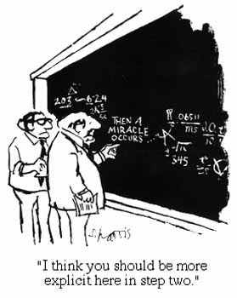
Debt dynamics
More on that last step

Slide 31
Debt dynamics
Ok, what are we left with?
Δ(B_{t}/Y_{t}) = (i_{t}−π_{t})B_{t-1}/Y_{t-1} − g_{t}B_{t-1}/Y_{t-1} + D_{t}/Y_{t}
(A) (B) (C)
(A): interest on debt at (real) interest rate r = i−π
(B): real GDP growth at rate g
(C): (primary) deficit D

Slide 32
Debt dynamics
In case you forgot
Δ(B_{t}/Y_{t}) = (i_{t}−π_{t})B_{t-1}/Y_{t-1} − g_{t}B_{t-1}/Y_{t-1} + D_{t}/Y_{t}
Dealing with percentages
We need to convert (i, π, g) to numbers: 0.05, not 5
But it’s convenient to keep (B/Y) and (D/Y) as percentages: 50, not 0.50 (your choice, but that’s what we’ll do)

Slide 33
Debt dynamics in Greece
Total deficit (% GDP) | 2.4
Primary deficit (% GDP) | 0.2
Interest rate paid on debt (%) (!) | 1.34
Inflation rate (%) | −0.5
Real GDP growth rate (%) | −4.0
Public debt (% GDP, previous year end) | 156.9
Is B/Y going up or down? Why?
Source: EIU, Country Risk Report.

Slide 34
Debt dynamics in Greece
Δ(B_{t}/Y_{t}) = (i_{t}−π_{t})B_{t-1}/Y_{t-1} − g_{t}B_{t-1}/Y_{t-1} + D_{t}/Y_{t}
(A) (B) (C)
Calculations
(A):
(B):
(C):
Total:
What if we use the 10-year government bond rate (8.31)?

Slide 35
Debt dynamics in Greece
Δ(B_{t}/Y_{t}) = (i_{t}−π_{t})B_{t-1}/Y_{t-1} − g_{t}B_{t-1}/Y_{t-1} + D_{t}/Y_{t}
(A) (B) (C)
Calculations
(A): (0.0134+0.005)*156.9 = +2.89
(B): +0.040*156.9 = +6.28
(C): +0.20
Total: +9.36 (B/Y rises to 166.3)
What if we use the 10-year government bond rate (8.31)?

Slide 36
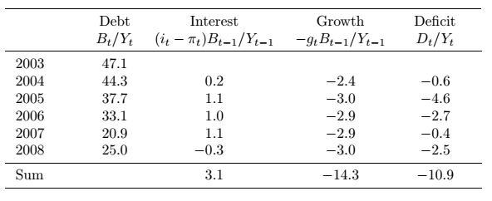
What happened to Peru’s debt?
Debt-to-GDP fell from 47.1% to 25.0% [total change in B/Y = −22.1%]
Why?
Source: Global Economy book.

Slide 37
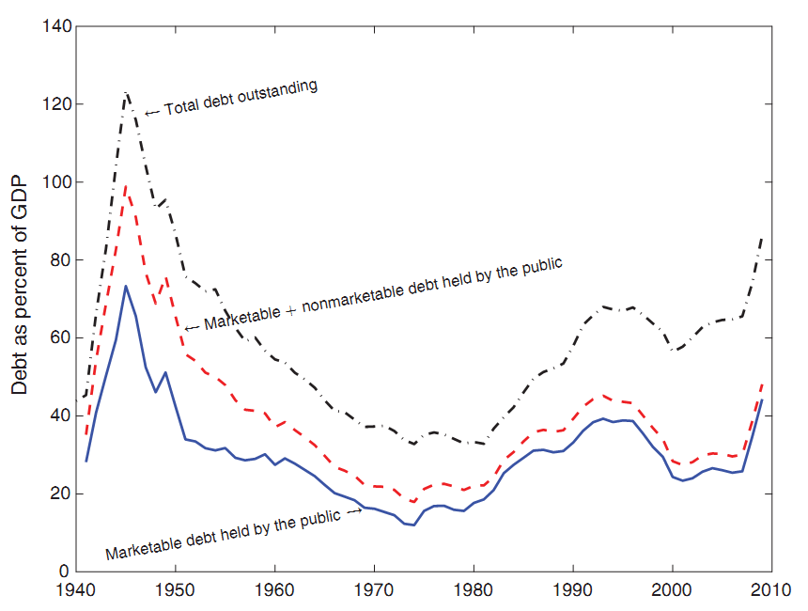
What happened to US WW II debt?
Source: Hall and Sargent.

Slide 38
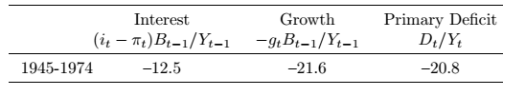
What happened to US WW II debt?
Debt-to-GDP fell from 66% in 1945 to 11% in 1974 [a change of –55%]
Why?
Source: Hall and Sargent.

Slide 39
What’s missing?

Slide 40
What’s missing?
Hidden liabilities
Like what?
Financial bailouts
Unfunded pensions
Other entitlements
Implicit guarantees of businesses or regional governments
Examples?

Slide 41
What’s missing?
The impact of growth on tax revenue
GDP growth
Affects B/Y directly
Also raises tax revenue, reduces primary deficit
Overall: the best cure for debt problems (also the converse)
Examples?

Slide 42
What’s missing?
The impact of debt on the interest rate
Interest rate can rise sharply if investors become concerned with repayment
Direct impact on changes in debt through r = i – π
When does it happen?
Examples?

Slide 43
What’s missing?
Maturity of debt
Short debt needs to be rolled over
Interest rate could rise quickly
Or you could be shut out of markets altogether
Examples?

Slide 44
Is the US in trouble?

Slide 45
Is the US in trouble?
What’s the problem?
Large current deficits
Growing debt
Significant increases in future spending in pipeline
Blinder (D) and Hubbard (R), WaPo, Sept 19, 2011
The (total) deficit is forecast by the CBO to reach 15.5% of GDP by 2035. By then, the national debt would be 187% of GDP. The main culprit is increased health care spending, which CBO projects to rise from 5.6% of GDP now to 10.4% by 2035.
Comment: little of this stems from ACA/Obamacare

Slide 46
Is the US in trouble?
See link to CBO report on course outline
Notes:
http://www.cbo.gov/sites/default/files/45471-Long-TermBudgetOutlook_7-29.pdf

Slide 47
US government debt
Source: CBO.

Slide 48
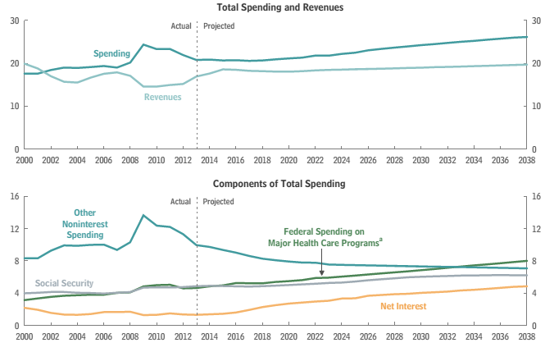
US government expenses & revenues
Source: CBO.

Slide 49
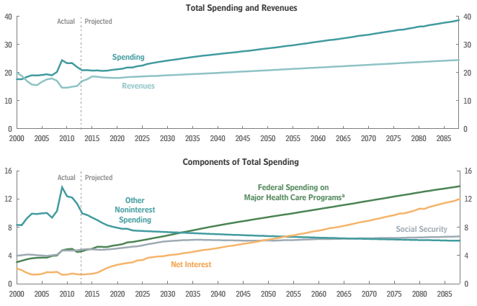
US government expenses & revenues
Source: CBO.

Slide 50
Social security spending
Source: CBO.

Slide 51
Demography
Source: CBO.

Slide 52
Social Security “fixes”
Solutions
Increase the payroll tax – or other taxes
Reduce benefits
Raise retirement age
Reduce cost-of-living adjustments
Congressional Budget Office analysis
http://www.cbo.gov/doc.cfm?index=11580

Slide 53
Medicare and Medicaid
Medicare: age 65 and older
Parts A&B cover hospital and physician care
Part D (2006) covers drugs
Funded by payroll tax and general revenues
Medicaid: poor (joint state-federal program)
Federal government share >50%
States set rules subject to federal approval

Slide 54
Federal healthcare spending
Source: CBO.

Slide 55
Medicare and Medicaid “fixes”
Health care system as a whole is a mess
What can be done for Medicare and Medicaid?
Spending needs to be paid for
Either raise tax revenue: by a lot!
Or reduce benefits: but how?
The central budget issue of our time

Slide 56
What have we learned?
Government budgets: deficits are financed by
By issuing debt today
And promising to run (primary) surpluses in the future
Standard tool
Debt dynamics equation (look for red box)
Signs of trouble
Too much debt
Continuing and/or rising deficits
Weak political system
US faces questions about future healthcare spending

Slide 57
The Global Economy Foreign Exchange

Slide 58
Announcement
Special class meeting
Right after final exam
Malt House, 206 Thompson, just north of Bleecker
My treat

Slide 59
The ideas
Exchange rates are …
Relative prices of currencies [dollar price of one euro]
Source of variation in costs, revenues, etc
Where sensible theories come to die

Slide 60
The question
How can I predict the euro over the next six months?
Answer: you can’t, it’s hard to beat a prediction of no change

Slide 61
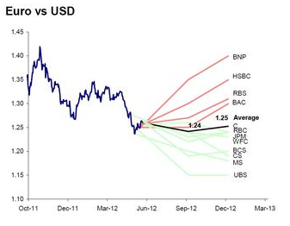
Dollars per euro
Source: Ticker sense.

Slide 62
Roadmap
Heineken USA
Words and pictures
Exchange rates and prices (“PPP anchor”)
Exchange rates and interest rates (“carry trade”)

Slide 63
Heineken USA
What’s your margin (price minus cost per unit) at the current exchange rate?
How likely is a rise in the euro of 12%? A fall?
What happens to your margin if the euro rises 12%?
What strategies would you recommend to deal with this currency risk?

Slide 64
Heineken USA
Margin
Cost per unit: 1.35*2.50 + 2.00 = 5.38
Margin in dollars = 1.62, margin in euros = 1.20
How likely is a rise in the euro of 12%?
Roughly a one standard deviation move
Cost per unit: 1.12*1.35*2.50 + 2.00 = 5.78
Margin in dollars = 1.22, margin in euros = 0.81
What strategies would you recommend to deal with currency risk?
Notes:
http://www.ny.frb.org/markets/impliedvolatility.html

Slide 65
Words & pictures

Slide 66
Words
Alan Greenspan, “The euro as an international currency,” November 2001
Having endeavored to forecast exchange rates for more than half a century, I have developed significant humility about my ability in this area, a sentiment I suspect many in this room share.
What is he saying? Does it make sense?

Slide 67
Words
Warren Buffett, Letter to Shareholders, 2005
Berkshire owned about $21.4 billion of foreign exchange contracts at yearend, spread among 12 currencies. Holding of this kind are a change for us. But the evidence grows that our trade [deficit] will put unremitting pressure on the dollar for many years to come.
Positions closed 2 years later at a loss.

Slide 68
Words
Jean-Paul Villain, head of strategy, ADIA, 2010
We came to a very firm conclusion: we simply don’t know how to trade currencies.
What is he saying? Does it make sense?

Slide 69
Words
Anonymous hedge fund trader, n+1, 2008:
From time to time, the dollar’s been very weak; from time to time it’s strong. … Over the very long term, currency prices tend to be fairly stable and mean reverting. So the dollar’s weak today, but that’s no reason to believe it’s going to be weak forever. It’s amazing how many brilliant investors have gotten egg on their faces trading G-7 crosses.
What is he saying? Does it make sense?

Slide 70
Words
Michael Feroli, Chief US Economist, JP Morgan Chase
No framework works very well. Currency prices remain somewhat of a mystery.
What is he saying? Does it make sense?

Slide 71
Yen per dollar
Source: Fed via FRED.

Slide 72
Dollars per euro
Source: Fed via FRED.

Slide 73
Pesos per dollar
Source: Fed via FRED.

Slide 74
Yuan per dollar
Source: Fed via FRED.

Slide 75
Exchange rates & prices

Slide 76
Exchange rates
Exchange rate terminology
e = exchange rate : dollar price of one unit of euro
If e rises, we say the dollar has depreciated (declined in value)
If e falls, we say the dollar has appreciated (increased in value)
The reverse, of course, for the euro
The facts
e’s for many currencies move around a lot
Annual std dev of stock market ~18%, dollar/euro ~12%
Why?

Slide 77
Exchange rates and prices
The theory
Exchange rates reflect differences in prices of goods
Prices look high in Paris, but if we convert them to dollars using the exchange rate, they should be about the same as New York
We call this “purchasing power parity” (PPP)
The reality
Crude approximation, but useful as long-term anchor
What we say
If prices are high in Paris, we say the euro is overvalued [it’s all relative: we also say dollar is undervalued]

Slide 78
Exchange rates and prices
Define
P = domestic price (measured in dollars)
P* = foreign price (measured in euros)
e = exchange rate (dollar price of one euro)
Compare P with eP*
P ?=? e P*
e ?=? P/P*
RER = e P*/P ?=? 1

Slide 79
Exchange rates and prices
Region | USD Price of Big Mac (Jul 2013)
US | 4.56
Euro area | 4.66
Japan | 3.20
China | 2.61
India | 1.50
Brazil | 5.28
Mexico | 2.86
Source: The Economist.

Slide 80
Exchange rates and prices
Big Macs
Why are prices so low in China? India? Mexico?
Why so high in Brazil?
How would you expect exchange rates to change?
How fast?
Are Big Macs typical?

Slide 81
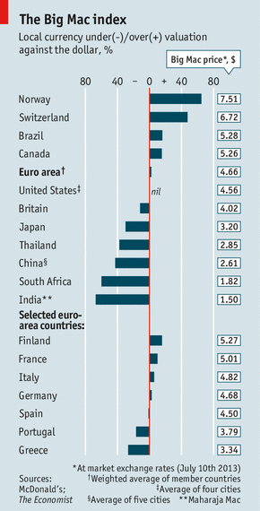
Exchange rates and prices
http://www.economist.com/content/big-mac-index
Which currencies are “overvalued”?
Which currencies are “undervalued”?
Why?
Source: The Economist.

Slide 82
Exchange rates and prices
Suppose we used price indexes instead of Big Macs
Do we see e = P/P*?

Slide 83
Exchange rates and prices
Let’s check
Convention: home = country exchange rate is quoted in
Dollars per pound: home=US, foreign=UK
Yen per dollar: home=Japan, foreign=US

Slide 84
Pesos per dollar
Source: Fed via FRED.

Slide 85
Yuan per dollar
Source: Fed via FRED.

Slide 86
Yen per dollar
Source: Fed via FRED.

Slide 87
Dollars per euro
Source: Fed via FRED.

Slide 88
Exchange rates and prices
Summary
Dollar v peso
Large movements in P/P* reflected in e
Still lots of variation in RER
Dollar v euro
Lots of variation in e
Little variation in P/P*
Therefore: movements in RER = eP*/P mirror those in e
PPP fails miserably

Slide 89
Exchange rates and prices
One last try
PPP says
e = P/P*
Rate of Change of e = Rate of Change of P/P*
Let’s look at this over different time intervals

Slide 90
Exchange rates and prices
Source: Deutsche Bank FX Guide.

Slide 91
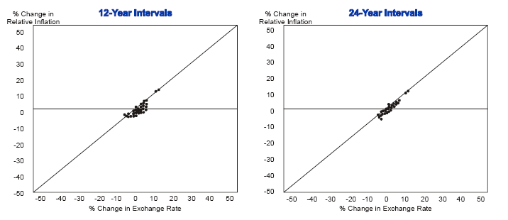
Exchange rates and prices

Slide 92
Exchange rates and prices
Summary of PPP
An approximation that works best
When there are large differences in inflation rates
And over long periods of time
Otherwise variations in exchange rates mirror variations of relative prices and costs (think Heineken)

Slide 93
Exchange rates & interest rates

Slide 94
Exchange rates and interest rates
If two countries have different interest rates, the one with the higher rate will tend to appreciate
R² small (<0.05) but that’s enough to make money
More coming …

Slide 95
Exchange rates and interest rates
Region | Money market rate (local currency)
US | 0.24
Euro area | 0.74
Japan | 0.44
China | 3.40
India | 8.14
Brazil | 12.00
Mexico | 5.75
Source: The Economist.

Slide 96
Exchange rates and interest rates
Why do interest rates differ across countries/currencies?
Do global capital markets equate expected returns?

Slide 97
Exchange rates and interest rates
The “carry trade”
Long position in high interest rate currency
Short position in low interest rate currency
Carry: collect difference in interest rates
Risk: the low-rate currency rises
Does it work?
Most of the time, yes
Why?

Slide 98
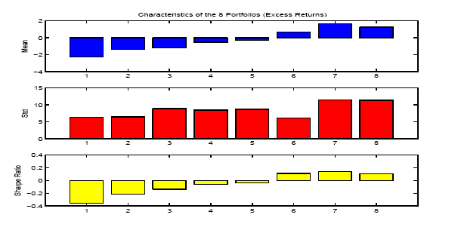
Exchange rates and interest rates
Source: Lustig and Verdelhan.

Slide 99
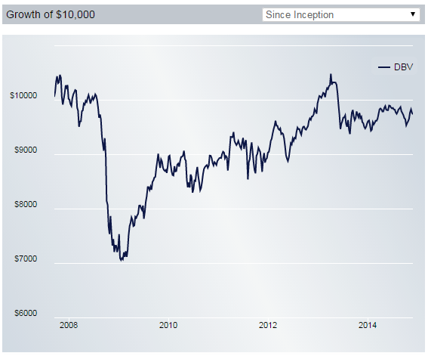
Exchange rates and interest rates
Source: Deutsche Bank G10 Currency Harvest Fund.
Notes:
https://etfus.deutscheawm.com/powershares-db-g10-currency-harvest-fund/performance

Slide 100
Exchange rates & anything else?

Slide 101
Exchange rates and …
Trade balance?
GDP growth?
Stock market?

Slide 102
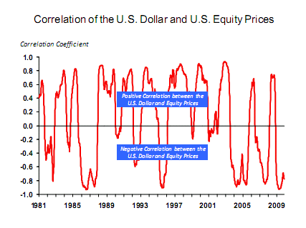
Exchange rates and stock prices
Source: Michael Rosenberg, Bloomberg.

Slide 103
What have we learned?
Exchange rates are variable, affect costs, revenues, etc, in international transactions
In the short run, most of this variation is unpredictable, even inexplicable
In the long run, exchange rates roughly mirror ratios of prices (PPP)

Slide 104
For the ride home
Is China’s currency “too cheap”?
What does that mean?
What evidence would tell us one way or the other?

Slide 105
Reminders
Problem Set #4 due next week
Last one!
Post questions on discussion board – or email me
Final exam the week after
Similar to midterm
Practice exams are posted
Post questions on discussion board – or email me

Slide 106
Debt dynamics in Brazil, 2014 est
Total deficit (% GDP) | 3.3
Primary deficit (% GDP) | −1.5
Interest rate (money market, %) | 9.9
Inflation rate (%) | 5.7
Real GDP growth rate (%) | 2.6
Public debt (% GDP, previous year end) | 59.2
Is B/Y going up or down? Why?
Source: EIU, Country Risk Report.

Slide 107
Debt dynamics in Brazil
Δ(B_{t}/Y_{t}) = (i_{t}−π_{t})B_{t-1}/Y_{t-1} − g_{t}B_{t-1}/Y_{t-1} + D_{t}/Y_{t}
(A) (B) (C)

Slide 108
Debt dynamics in Brazil
Δ(B_{t}/Y_{t}) = (i_{t}−π_{t})B_{t-1}/Y_{t-1} − g_{t}B_{t-1}/Y_{t-1} + D_{t}/Y_{t}
(A) (B) (C)
Calculations
(A): (0.099-0.057)*59.2 = +2.49
(B): −0.026*59.2 = −1.54
(C): −1.50
Total: −0.55 (B/Y falls from 59.2 percent of GDP to 58.65)

Slide 109
Debt dynamics in Brazil
Updated numbers and more in Problem Set #4

Slide 110
Debt dynamics in Italy!!!???
Δ(B_{t}/Y_{t}) = (i_{t}−π_{t})B_{t-1}/Y_{t-1} − g_{t}B_{t-1}/Y_{t-1} + D_{t}/Y_{t}
(A) (B) (C)

Slide 111
Debt dynamics in Italy
http://blogs.wsj.com/economics/2014/09/18/italys-growing-debt-looms-over-european-and-global-economies/
From the EIU report
Debt above median of Euro Area (90% of GDP) and Developed Countries (83%)
Greece was granted debt relief by private creditors in early 2012 and by official creditors (via longer maturities on bail-out loans and lower interest rates) in late 2012. Further debt relief by official creditors may be needed to stop the upward trend in sovereign debt.
Average maturity now 16 years
Market rate on debt probably 10% or higher , well above what they’re paying

