Slide 1

The Global Economy The Production Function
Notes:
Open website, Gapminder
Also growth spreadsheet (pf + solow)

Slide 2
Saving and investment
How important for economic performance?
Examples?
Why?

Slide 3
Natural resources
Good or bad for economic performance?
Examples?
Why?

Slide 4
Natural resources
Matt Manfre: “impactful in economic growth”
ldt250: “At an early stage in economic development, natural resources are critical”
Vimal Dwivedi: “important for economic growth”

Slide 5
Natural resources
What we know
Countries with lots of resources do worse – on average
“resource curse,” “Dutch disease”
Suggestions why
Primary: corruption
Secondary: exchange rate, government programs

Slide 6
Stress
Ignore what you think you know ****

Slide 7
Roadmap
Natural resources ✓
Reminders
Economic history of the world
Theory: the production function
Inputs: capital and labor
Productivity

Slide 8
Reminders

Slide 9
Reminder/clarification: imports/exports
The issue
GDP is what we make
Final sales is what we buy
How do we reconcile them?
Solution: add exports, subtract imports
Exports are things we make but don’t buy
Imports are things we buy but don’t make

Slide 10
Example 2 revisited
Barley farmer in Canada
Sales = 10
Rent = 3
Farmer’s profit = 7
Brewer in the US
Sales = 110
Rent = 30
Wages = 70
Barley input = 10 (COGS)

Slide 11
Example 2 revisited
Canada
US
Producer | Farmer | Brewer | US Total
Value-added | 10 | 100 | 100
Income | 10 | 100 | 100
Final sales | 10 | 110 – 10* | 100
* Remember: subtract imports

Slide 12
Example 5
Import-export firm
Sales = 140
Of which: 120 local, 20 abroad
Material inputs = 25 from abroad, 10 local
What is value added?
Income?
Final sales?
Concept | Total
Value-added | 105
Income | 105
Final sales | 140* – 25** = 115
* Remember: add exports
** And: subtract imports

Slide 13
Reminder: real and nominal GDP
Real GDP (“quantity”)
GDP in constant dollars
GDP in 2005 USD
GDP in USD, PPP adjusted
GDP chain-weighted in 2010 USD
Nominal GDP (“value = price times quantity”)
GDP at current prices
GDP in LCUs
Both come from “NIPA”:
National Income and Product Accounts

Slide 14
Reminder: GDP per capita (USD, PPP adj)
Source: World Bank, World Development Indicators

Slide 15
Reminder: GDP
http://www.vox.com/xpress/2014/8/10/5988295/real-gdp-per-capita-chart

Slide 16
Reminder: where are we headed?
Module 1: long-term economic performance
Why are some countries rich, and others poor?
Where are the economic and business opportunities?
Suggested answer (developed over several weeks)
Business opportunities and economic performance generally reflect effective markets backed by institutions that keep them honest
Effective markets, not “free” markets

Slide 17
Reminder: where are we headed?
Where would you open a new Nike factory?
What factors are important to you?
How do Indonesia, Kazakhstan, Viet Nam compare? Others?
Where should Four Seasons expand?
What factors are important to you?
How do Baku, Dublin, Guangzhou compare? Others?
Where should Genpact open a new BPO operation?
What factors are important to you?
How do Ghana, India, Jamaica compare? Others?

Slide 18
Economic history of the world

Slide 19
Economic history of the world
Until recently, life was “poor, nasty, brutish, and short”
Hobbes, “Leviathan,” 1651
[In the natural state of Man] there is no place for industry . … [There is] continual fear and danger of violent death, and the life of man [is] solitary, poor, nasty, brutish, and short.“

Slide 20
Economic history of the world
Statistic | Year
 | 1 | 1000 | 1820 | 2008
Population (millions) | 225 | 267 | 1,042 | 6,694
GDP Per Capita (1990 USD) | 467 | 425 | 666 | 7,614
Life expectancy (years) | 24 | 24 | 26 | 66
Source: Angus Maddison, Millenial Perspective.

Slide 21
GDP per capita (1990 international USD)
Region | Year
 | 0 | 1000 | 1820 | 2008
Western Europe | 599 | 425 | 1,218 | 21,672
Western “offshoots” | 400 | 400 | 1,202 | 30,152
Japan | 400 | 425 | 669 | 22,816
Latin America | 400 | 400 | 691 | 6,973
Former USSR | 400 | 400 | 688 | 7,904
China | 450 | 466 | 600 | 6,725
Africa | 472 | 425 | 420 | 1,760
World Average | 467 | 453 | 666 | 7,614
Source: Angus Maddison, website.

Slide 22
Economic history of the world
Gapminder again
http://www.gapminder.org/world/

Slide 23
Some examples
Notes:
2^8=256, 2^9=512, 2^10=1024, 2^11=2048,2^12=4096, 2^13=8192, 2^14=16384, 2^15=32768
Log2 scale: each number represents a doubling, Arg<13, Ger>14, Germany GDP/capita (19,144) almost double Argentina(7,666)
Germany, US, most of Western Europe: 2% growth over last 100 years
Argentina: used to be as rich as Germany

Slide 24
Growth
Source: World Bank, World Development Indicators.

Slide 25
Summary
Several centuries ago, we were all poor – and died young
Now there’s enormous variation across countries
Also variation in growth rates
Modest variation among rich countries
Greater variation among poor countries
Questions
Why?
What will the future bring?
Where are the opportunities?

Slide 26
Open questions
Why did Western Europe do so well?
Why not the Greeks and Romans?
Why not China?
Why not India?
Why not the Islamic world?

Slide 27
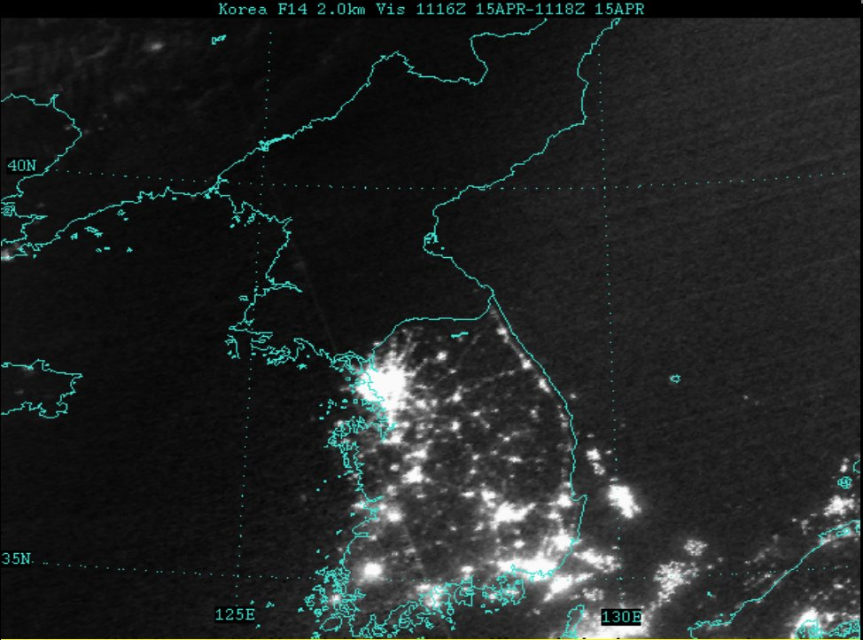
A controlled experiment
What separates the successes from the others?
What roleAlso variation in growth rates
Modest variation among rich countries
More variation among poor countries

Slide 28
Theory: The Production Function

Slide 29
Why theory?
A tool to help us organize our thoughts
What factors facilitate good performance?
What factors offer attractive business opportunities?

Slide 30
What theory?
Our goal
Keep it simple
Georgia O’Keefe: ??

Slide 31
Theory: the picture
GDP
Capital & Labor
Productivity
Political Process
“Institutions”

Slide 32
Theory: the math
The idea: relate output to inputs
Mathematical version (“production function”):
Y = A F(K,L) = A K^{α} L^{1-α}
A formula we can compute in a spreadsheet
Definitions:
K = quantity of physical capital used in production (plant and equipment)
L = quantity of labor used in production
A = total factor productivity (everything else)
α = a parameter we set equal to 1/3 (more soon)

Slide 33
Production function properties
More inputs lead to more output
Positive marginal products of capital and labor
Diminishing marginal products
If we increase one input at a time, each increase leads to less additional output
Marginal product = partial derivative of production function
Constant returns to scale
If we double **both** inputs, we double output (no inherent advantage or disadvantage to size)

Slide 34
Production function properties

Slide 35
Where does α come from?
Capital’s share of value-added
If you know calculus, this is how we show it
Profit is
Profit = pY – rK – wL = pAK^{α}L^{1-α} – rK – wL
Maximize profit by setting derivative wrt K equal to zero
dProfit/dK = αpAK^{α-1}L^{1-α} – r = 0
Multiply by K
α pAK^{α}L^{1-α} = rK
α = rK / pAK^{α}L^{1-α}
Evidence (last week): about 1/3

Slide 36
Capital (K)
What we mean: plant and equipment, physical capital
Why does it change?
Depreciation/destruction
New investment (“capex”)
Mathematical version:
K_{t+1} = K_{t} – δ_{t}K_{t} + I_{t}
= (1 – δ_{t}) K_{t} + I_{t}
Adjustments for quality?

Slide 37
Measuring capital
Option #1: direct surveys of plant and equipment
Option #2: perpetual inventory method
Pick an initial value K₀
Pick a depreciation rate (or measure depreciation directly)
Measure K like this:
K_{t+1} = (1 – δ_{t})K_{t} + I_{t}
In practice, #2 is the norm:
Get I from “NIPA” [“real” investment]
Set δ = 0.06 [ballpark number]
Example: K₂₀₁₀ = 100, δ = 0.06, I = 13 → K₂₀₁₁ = ??

Slide 38
Labor (L)
What we mean: units of work effort
Why does it change?
Population growth
Fraction of population employed (extensive margin)
Hours worked per worker (intensive margin)
Our starting point: number of people working

Slide 39
Measuring labor
Our starting point
L = number of people working
Adjustments for hours worked
Replace L with hL (h = hours per worker)
Adjustments for skill, education
Replace L with HL (H = “human capital”)
H commonly connected to years of school

Slide 40
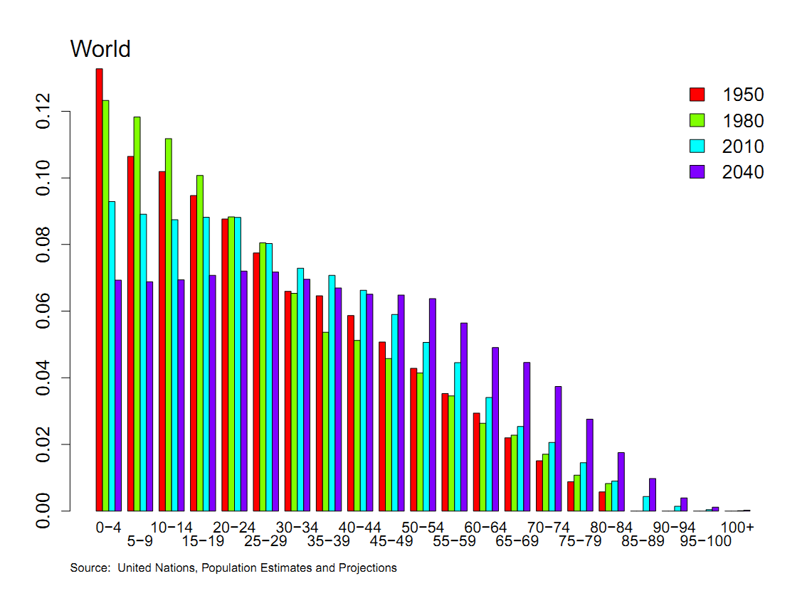
Population by age

Slide 41
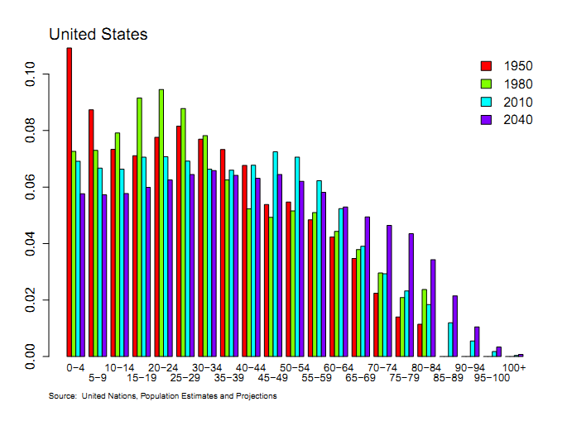
Population by age

Slide 42
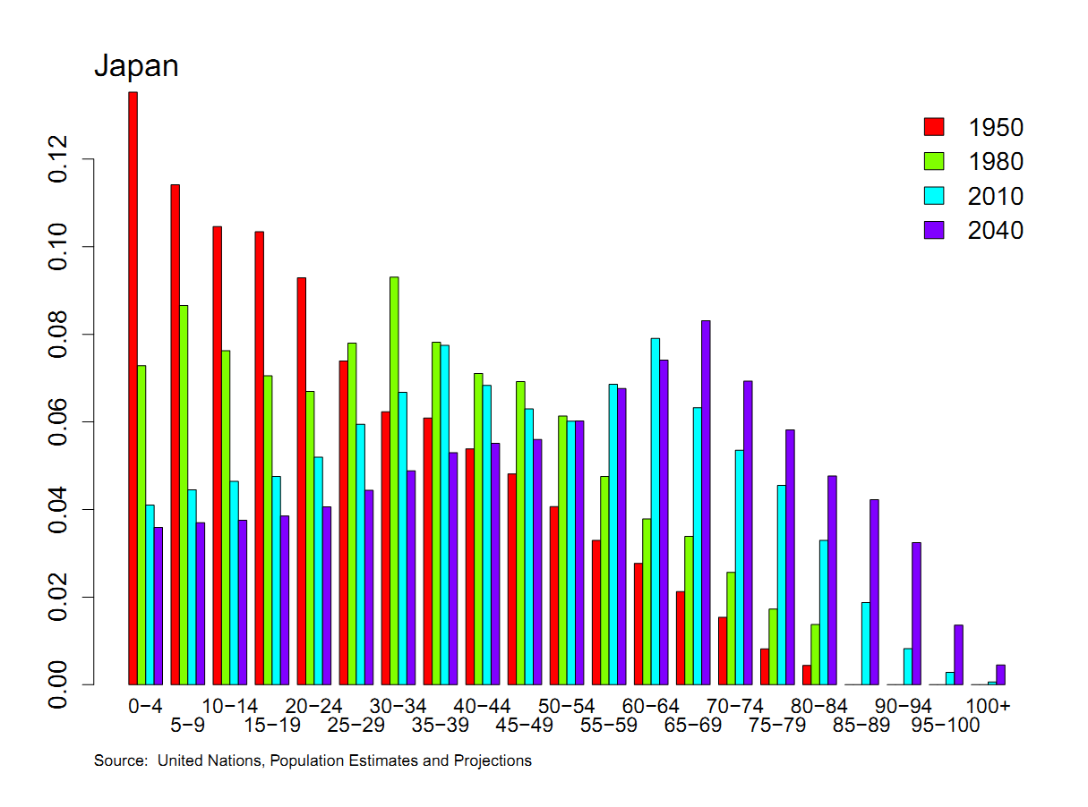
Population by age

Slide 43
Population by age
Business Week, Nov 2012:
Last year, for the first time, sales of adult diapers in Japan exceeded those for babies.
Target markets in Japan? US?

Slide 44
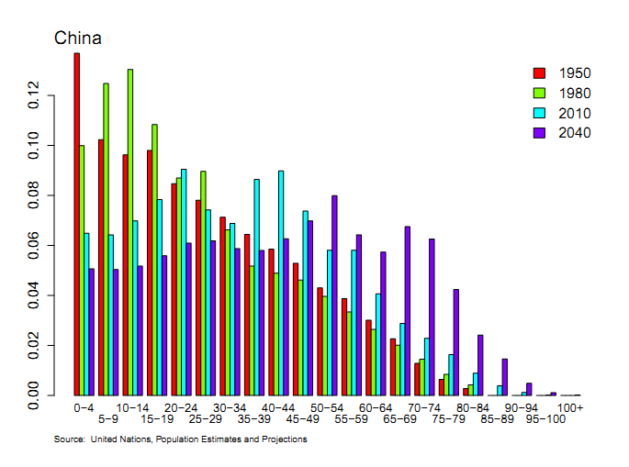
Population by age

Slide 45
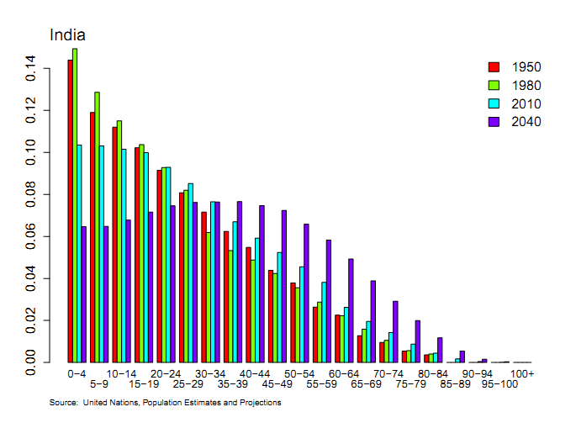
Population by age

Slide 46
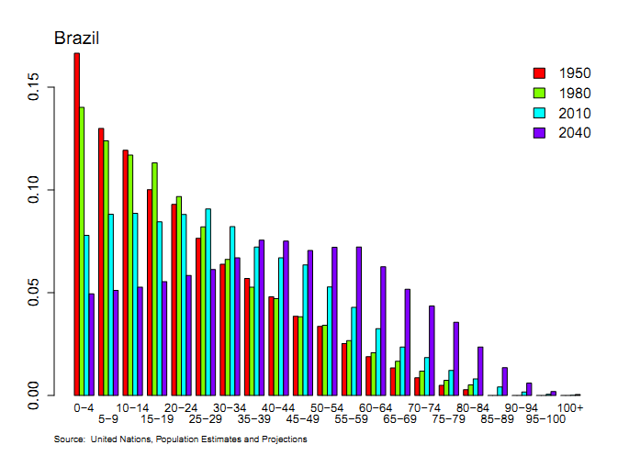
Population by age

Slide 47
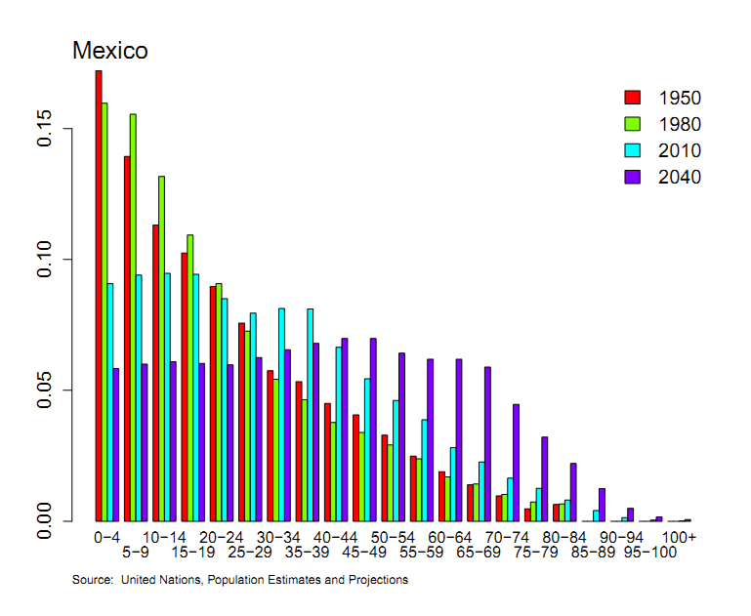
Population by age

Slide 48
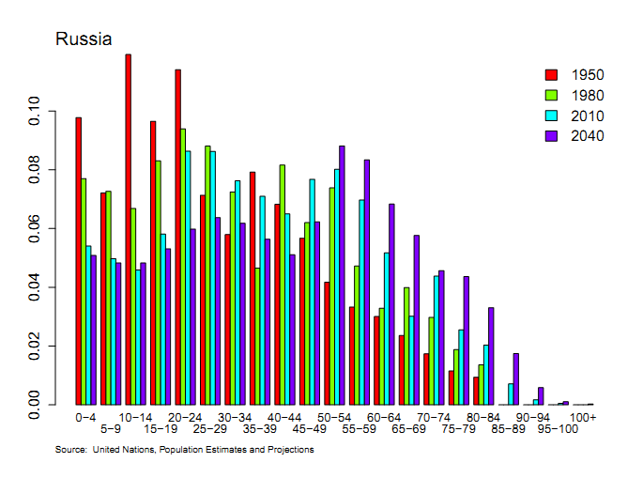
Population by age

Slide 49
Productivity (A)
Standard number
Average product of labor: Y/L
How do we measure it?
Measure output and input, take the ratio
Our number
Total Factor Productivity (TFP): A = Y/F(K,L)
How do we measure it?
Same idea, but “input” combines capital and labor (“total”)

Slide 50
Productivity
Solve the production function for A
Y = A K^{α} L^{1-α}
A = Y/[K^{α} L^{1-α}] = (Y/L)/(K/L)^{α}
Example: Y/L = 33, K/L = 65,
A = 33/65^{1/3} = 8.21
Note: units meaningless, but the same across time or countries

Slide 51
Production function review
Remember: Y = A F(K,L)
What changes in this equation if
A firm builds a new factory?
Fewer people retire at 65
Spanish banks channel funds to unproductive firms
Workers shift from agriculture to industry in Viet Nam?
Competition drives inefficient firms out of business?
Venture capital fund identifies good unfunded projects?
Alaska builds a bridge to nowhere?
China invests in massive infrastructure projects?

Slide 52
What have we learned?
The production function links output to inputs and productivity:
Y = A K^{α} L^{1-α}
Capital input (K)
Plant and equipment, a consequence of investment (I)
Labor input (L)
Population growth, age distribution, participation, hours (h), skill (H)
TFP (A) can be inferred from data on output and inputs

Slide 53
The Global Economy Solow’s Growth Model

Slide 54
Problem Set #0
Answers will be posted after Saturday class
Question 3 makes two points that will come up later
GDP, C, and I move up and down together (correlations)
I moves a lot more than the others (standard deviations)

Slide 55
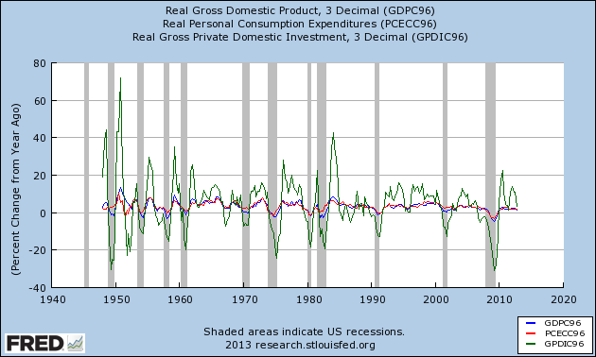
Problem Set #0

Slide 56
Problem Set #1
Due at start of next class
Do in groups, learn from each other
Post questions on Discussion & Announcements (or email me and I’ll do it)
Note data link for Question 3 (also embedded in pdf)
Anyone need group members?

Slide 57
What’s happening?
“Warranting attention,” The Economist, via Kerri McCarthy:
WHY lie if telling the truth could save you billions of dollars? The question has baffled Argentine pundits since INDEC, the county's statistical office, announced that it expects output to rise by 5.1% in 2013, nearly double private-sector estimates. What makes INDEC's wheeze truly bizarre is that it could trigger arcane financial instruments called GDP-indexed warrants [and cost the government $3.5b].
What’s going on here?
Notes:
http://www.economist.com/blogs/americasview/2013/09/argentinas-official-statistics

Slide 58
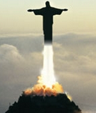

What’s happening?
The Economist on Brazil
2009
Now

Slide 59
What’s happening?
“Has Brazil blown it?” The Economist, this week:
Brazil has done far too little to reform its government in the boom years. Companies face the world’s most burdensome tax code, payroll taxes add 58% to salaries and the government has got its spending priorities upside down. Pensions are absurdly generous. The average Brazilian can look forward to a pension of 70% of final pay at 54. By contrast, its stock of infrastructure is rotten.
Fortunately, Brazil also has great strengths. …
What’s going on here?
Notes:
http://www.economist.com/blogs/americasview/2013/09/argentinas-official-statistics

Slide 60
Roadmap
Problem Set #0 ✓
What’s happening? ✓
Saving and growth
Solow’s model
Does India need more saving?
China less?

Slide 61
Saving and growth
Saving seems virtuous
Should we do more of it? If so, how much?
Why? Or why not?

Slide 62
Saving and growth
JFK in 1960, height of Cold War
Rapid growth in USSR, also high saving and investment rates
Cause and effect?
US analysts in 1985
Rapid growth in Asian “tigers,” lots of saving
Cause and effect?
China in 2010
Rapid growth, saving close to 50% of GDP
Does India need to do the same?

Slide 63
Saving and growth
How does saving generate growth?
Critical to long-run performance?

Slide 64
Saving and growth
GDP
Capital & Labor
Productivity
Political Process
“Institutions”

Slide 65
Solow’s Model

Slide 66
Solow model
How it works
Saving finances capital accumulation
More capital leads to greater output
Impact eventually tails off: diminishing marginal product of capital

Slide 67
Solow model: equations
Production function:
Y = A K^{α} L^{1-α}
Flow identity:
S = I
Saving:
S = sY
Capital stock:
K_{t+1} – K_{t} = ΔK = I – δK

Slide 68
Solow model: analysis
“Analysis” here means we substitute like crazy
ΔK = sY – δK
= sAK^{α} L^{1-α} – δK
For the time being, A, L don’t change
Two competing forces on K
Depreciation drives K down
Saving drives K up
Which is stronger?
Where does diminishing returns show up?

Slide 69
Solow model: dynamics
output
saving
depreciation

Slide 70
Solow model: convergence
Eventually the two forces balance
Capital stock eventually stops changing
Output does, too
Solow’s answer to JFK
USSR won’t catch up through saving alone
Eventually the effects of higher saving/investment peter out

Slide 71
India

Slide 72
India
Saving and investment rates well below China’s
How important is this to India’s future?

Slide 73
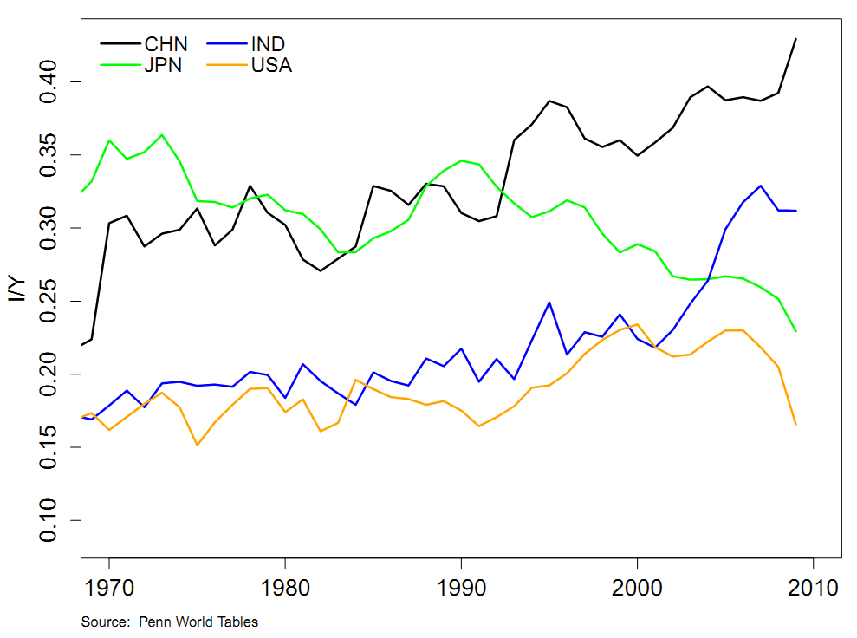
Investment rates

Slide 74
India
Experiments with Solow model
Benchmark: start model in 2010 and see what happens
Raise saving rate
Introduce productivity growth
What has the biggest impact?

Slide 75
India
Solow model inputs (estimates for 2010)
Output Y=GDP: 4.08 trillion USD
Capital K: 8.23 trillion USD
Labor L: 0.452 billion people
Source: Penn World Table
Productivity A: how do we compute this?
Saving/investment rate s: 0.25
Depreciation rate δ: 0.06
Experiments
Raise saving rate
Add productivity growth

Slide 76
India
Solow model experiments
Raise saving rate
Add labor force growth
Add productivity growth
Increase productivity growth

Slide 77
India
Scenario | GDP
2010 | 4.08
2050: no-growth benchmark
2050: higher saving (+5%)
2050: population growth (1%)
2050: TFP growth (2%)
2050: TFP growth (+1%)

Slide 78
India
Scenario | GDP
2010 | 4.08
2050: no-growth benchmark | 5.56
2050: higher saving (+5%) | 6.03
2050: population growth (1%) | 7.01
2050: TFP growth (2%) | 15.49
2050: TFP growth (+1%) | 25.94

Slide 79
China

Slide 80
Investment rates

Slide 81
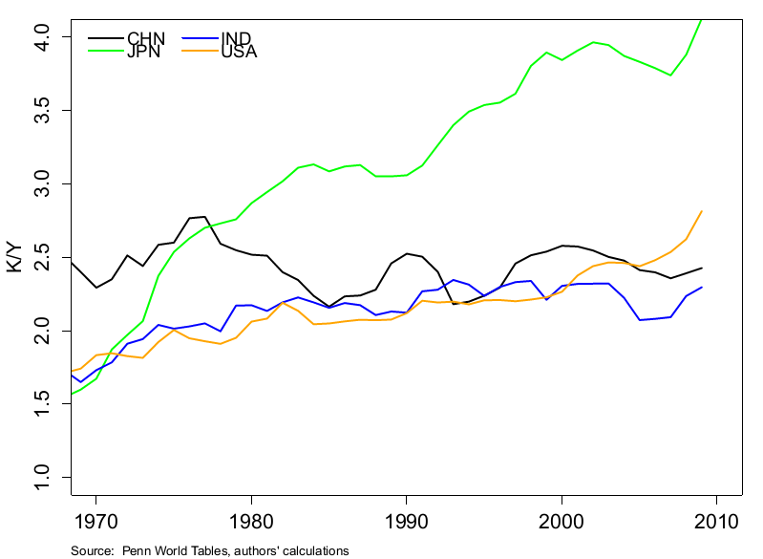
Capital intensity

Slide 82
China summary
Quantity of capital not unusual
K/Y not much different from US
How can that be?
When you growth this fast, you need a lot of investment
“Quality” of capital raises some questions
Has public infrastructure been overdone?
Are productive firms starved for resources?
Is the financial system a hindrance to future growth?

Slide 83
Almost done

Slide 84
What have we learned?
Solow model
Saving and capital accumulation generate growth
But diminishing returns kills this off quickly
Conclusion: saving and capital formation can’t be the keys to prosperity (in the US, in China, in India, etc)
Solow model still a useful forecasting tool
If not capital, what?
TFP growth

Slide 85
Something for the ride home
Are natural resources critical to economic growth?
Why? Or why not?
Examples?
Add your thoughts on the discussion page

Slide 86
For the ride home
http://mungowitzend.blogspot.com/2014/08/the-state-is-not-unicornand-munger-test.html
From the WSJ, last week:
In the derivatives market, the cost to insure against a default by the US government has risen sixfold in the past week.… If history is any guide, markets may become more tumultuous as the debt-ceiling deadline nears.
Could the debt ceiling standoff damage the US economy? Why or why not?

