Slide 1

The Global Economy Sources of Economic Growth
Notes:
Open spreadsheet
http://www.theatlantic.com/infocus/2013/08/26-years-of-growth-shanghai-then-and-now/100569

Slide 2
Natural resources
Good or bad for economic performance?
Examples?
Why?

Slide 3
Natural resources
From Ethan Mandelup (edited)
My first thought is oil and the Middle East, where you see great wealth and also great disparity. But Iceland has abundant thermal energy and a stable economy.
Does this sound right? Other thoughts?

Slide 4
Natural resources
What we know
Countries with lots of resources do worse – on average
“Dutch disease,” “resource curse”
Abundant resources: Nigeria, Liberia, Middle East, Venezuala
Scarce resources: Japan, Switzerland
Suggestions why
Primary: corruption
Secondary: government programs, exchange rate

Slide 5
Wages
Would you like to work in a high- or low-wage country?
Why? Why not?
Would you open an office or factory in a high- or low-wage country?
Why? Why not?

Slide 6
Roadmap
Resources, wages ✓
What’s happening?
Reminders
GDP per capita & GDP per worker
Level comparisons
Growth rates and growth accounting

Slide 7
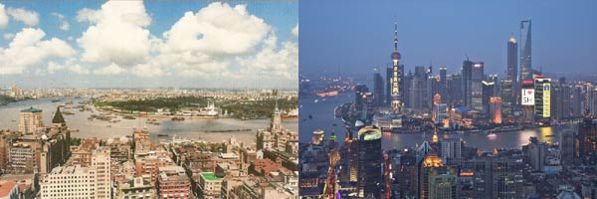
What’s happening?
From Stacy Xie, Shanghai in 1990 and 2010
Search “shanghai then now pictures”
Notes:
http://www.theatlantic.com/infocus/2013/08/26-years-of-growth-shanghai-then-and-now/100569/

Slide 8
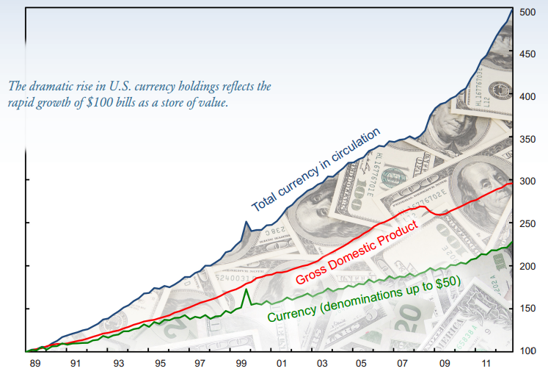
What’s happening?
From Lillian Pontius-Goldblatt
Source: SF Fed.
Notes:
http://www.frbsf.org/files/2012_Annual_Report_Essay.pdf

Slide 9
What’s happening?
“The worst-managed economy?” The Economist, this week:
A big oil producer unable to pay its bills in an oil boom is a rare beast. Thanks to colossal mismanagement, that is exactly what Venezuela has become.
Unpaid bills and an over-valued exchange rate have produced shortages of food, medicine, and other basic supplies. Printing bolivares to pay bills has driven inflation over 60%. Even measuring inflation has become more difficult, as an estimated one-third of goods are not available.
What’s going on here? Why?

Slide 10
Reminders

Slide 11
Reminder: our perspective
Last week
Output comes from inputs and productivity
Capital can’t be the primary factor driving performance
Today and next week
How is Country X doing? Why?
What’s it like running a business there?

Slide 12
Reminder: GDP per capita (USD, PPP adj)
Source: World Bank, World Development Indicators

Slide 13
Reminder: our plan
GDP
Capital & Labor
Productivity
Political Process
“Institutions”

Slide 14
Reminder: production function
Production function
Y = A K^{α} L^{1– α}
[a formula in a spreadsheet]
All together now: what is α?
Ingredients
Y: real GDP (output)
K: quantity of physical capital (plant and equipment)
L: quantity of labor (number of workers)
A: total factor productivity (TFP) (“productivity” for short)

Slide 15
Level comparisons

Slide 16
GDP and GDP per worker
Production function in per worker form
Y = A K^{α} L^{1– α}
Y/L = A (K/L)^{α}
Productivity (TFP) in per worker form
A = (Y/L)/(K/L)^{α}

Slide 17
GDP per capita and GDP per worker
GDP per worker
Y = A K^{α} L^{1– α}
Y/L = A (K/L)^{α}
GDP per capita
Y/POP = (Y/L) (L/POP)
= A (K/L)^{α} (L/POP)
We’ll focus on Y/L now, add L/POP next week
Where do differences in Y/L come from?

Slide 18
Data
Penn World Table provides
Y: real GDP (2009 USD)
L: employment
K: capital stock
POP: population
Comparable across countries, 1950-present
Linked on course page

Slide 19
Comparing output per worker
Why do countries have different output per worker?
GDP per worker
Y/L = A (K/L)^{α}
Comparison of countries 1 and 2
(Y/L)₁/(Y/L)₂ = (A₁/A₂) [(K/L)₁/(K/L)₂]^{α}
Bottom line: a clue to economic performance

Slide 20
Level comparison: US & Mexico
Why is Y/L larger in the US than Mexico (2010)?
 | Y/L | K/L | A
Mexico | 27.62 | 73.47
US | 82.36 | 220.89
Ratio
“Contribution”
Numbers in bold are data, the others are computed
“Contribution” means the K/L term has an exponent of 1/3
Mention “thousands”

Slide 21
Level comparison: US & Mexico
Why is Y/L larger in the US than Mexico (2010)?
 | Y/L | K/L | A
Mexico | 27.62 | 73.47 | 6.59
US | 82.36 | 220.89 | 13.62
Ratio | 0.34 | 0.33 | 0.48
“Contribution” | 0.34 | 0.69 | 0.48
Numbers in bold are data, the others are computed
“Contribution” means the K/L term has an exponent of 1/3

Slide 22
Level comparison: China & India
How do China and India compare (2010)?
 | Y/L | K/L | A
China | 11.93 | 28.61 | 3.90
India | 9.01 | 18.18 | 3.43
Ratio | 1.32 | 1.57 | 1.14
“Contribution” | 1.32 | 1.16 | 1.14
Numbers in bold are data, the others are computed
“Contribution” means the K/L term has an exponent of 1/3

Slide 23
Growth rates & growth accounting

Slide 24
Growth rate review
Traditional growth rate g
(1+g)^{n} = x_{t+n}/x_{t}
Continuously-compounded growth rate γ
e^{nγ} = x_{t+n}/x_{t}
How to compute it (with “natural log” LN)
γ = [ln(x_{t+n}) – ln(x_{t})]/n = ln(x_{t+n}/x_{t})/n
See
“Math review”

Slide 25

Natural logarithms
Source: John Cook’s blog.

Slide 26
Growth rate review
Why are we inflicting this on you?
Builds character
Makes the calculations easier
Continuous compounding eliminates the dreaded cross terms we get with interest rates and growth rates: (1+g)^2 vs exp(2g)
Do I really need to do this?
Yes
Really

Slide 27
Growth accounting
Why differences in growth in output per worker?
Production function
Y/L = A (K/L)^{α}
Additive in growth rates
γ_{Y/L} = γ_{A} + α γ_{K/L}
[γ_{x} means “growth rate of X”]
γ_{K/L} is growth rate of K/L
α γ_{K/L} is “contribution” to growth
Bottom line: a clue to economic performance

Slide 28
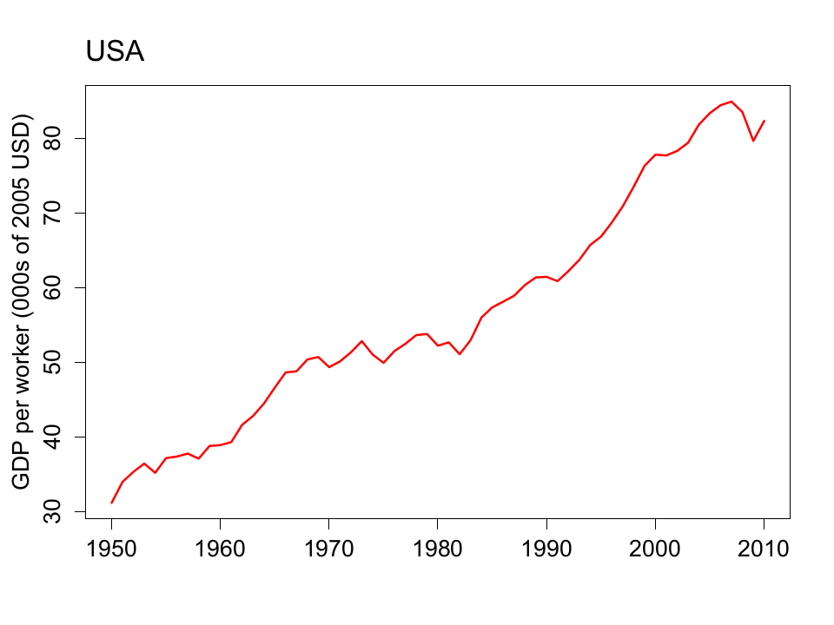
What happened in the US?

Slide 29
What happened in the US?
γ_{Y/L} = γ_{A} + α γ_{K/L}
 | Y/L | K/L | A
1950 | 31.18 | 57.75
2010 | 82.36 | 220.89
Growth rate (annual %)
Contribution to growth
Numbers in bold are data, the rest are computed
“Contribution” means we multiply γ_{K/L} by 1/3

Slide 30
What happened in the US?
γ_{Y/L} = γ_{A} + α γ_{K/L}
 | Y/L | K/L | A
1950 | 31.18 | 57.75 | 8.07
2010 | 82.36 | 220.89 | 13.62
Growth rate (annual %) | 1.62 | 2.24 | 0.87
Contribution to growth | 1.62 | 0.75 | 0.87
Numbers in bold are data, the rest are computed
“Contribution” means we multiply γ_{K/L} by 1/3

Slide 31
What happened in the US?
World Economic Forum
While many structural features continue to make its economy extremely productive, a number of escalating weaknesses have lowered the US ranking. Compared to last year, policymaking is less transparent (ranked 50th of 141 countries) and regulation more burdensome (58th). Lack of macroeconomic stability continues to be the greatest area of weakness (90th), particularly repeated fiscal deficits and burgeoning levels of public debt.
Does this sound right to you?

Slide 32
What happened in Kenya?

Slide 33
What happened in Kenya?
γ_{Y/L} = γ_{A} + α γ_{K/L}
 | Y/L | K/L | A
1990 | 2.38 | 5.02 | 1.39
2010 | 3.27 | 4.98 | 1.91
Growth rate (annual %) | 0.53 | (0.02) | 0.54
Contribution to growth | 0.53 | (0.01) | 0.54
Numbers in bold are data, the rest are computed
“Contribution” means we multiply γ_{K/L} by 1/3

Slide 34
What happened in Kenya?
World Economic Forum
Kenya moves up six places to 90th, including improvement in market efficiency. Its economy is supported by financial markets that are well developed (up by seven places to 24th position), an efficient labor market (25th), and an increasingly efficient goods market (62nd).
With a new constitution in 2010, Kenya has registered improvements in “institutions” and is now 78th, up from 123rd five years ago. This is largely more efficient government and reduced corruption. The country’s education system gets relatively good marks.
Does this sound right to you?

Slide 35
What happened in Russia?

Slide 36
What happened in Russia?
World Economic Forum
The Russian economy continues to face challenges. Russia’s weak and inefficient institutional framework (97th) remains its Achilles heel and will require a major overhaul in order to eradicate corruption and favoritism (92nd) and re-establish trust in the independence of the judiciary (109th). Strengths include an educated population.
Does this sound right to you?

Slide 37
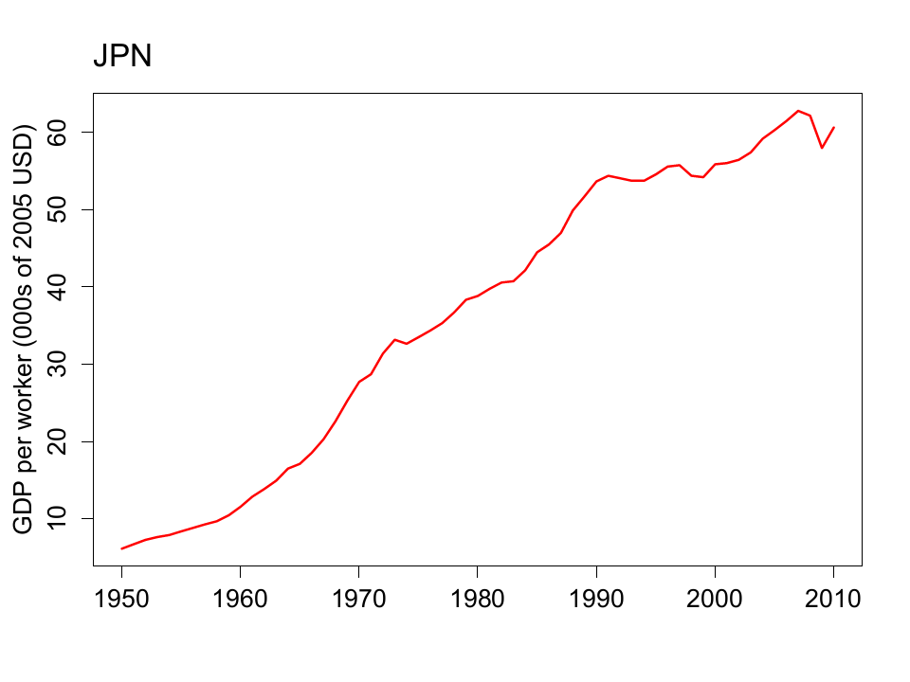
What happened in Japan?

Slide 38
What happened in Japan?
 | Y/L | K/L | A
1950 | 6.14 | 8.11 | 3.06
1990 | 53.67 | 152.84 | 10.04
2010 | 60.64 | 244.34 | 9.70
Contribution, 1950-1990 | 5.42 | 2.45 | 2.97
Contribution, 1990-2010 | 0.61 | 0.78 | (0.17)
Numbers in bold are data, the rest are computed

Slide 39
What happened in Japan?
Huge success story
Capital played larger role than in US
1990s malaise
Widespread financial crisis
Many banks insolvent but allowed to linger (“Zombies”)
Massive stimulus program to little evident effect
Challenging demographics
Lessons?

Slide 40
What happened in Japan?
World Economic Forum
Japan continues to enjoy a major competitive edge in business sophistication and innovation. Overall competitive performance, however, continues to be dragged down by severe macroeconomic weaknesses, with high budget deficits and the highest public debt levels in the entire sample.
Does this sound right to you?

Slide 41
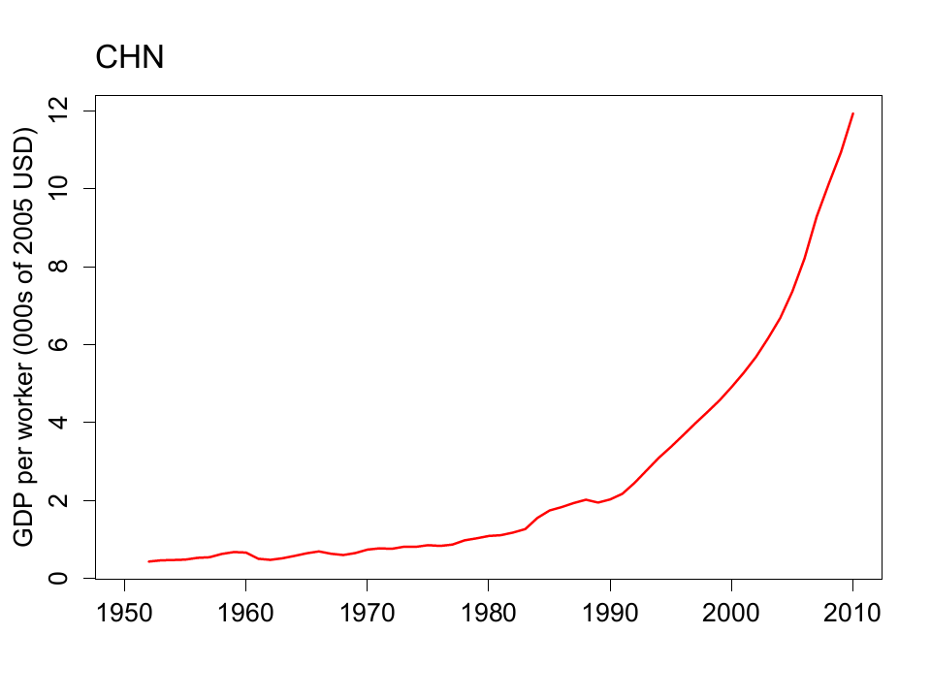
What happened in China?

Slide 42
What happened in China?
 | Y/L | K/L | A
1952 | 0.44 | 1.64 | 0.37
1978 | 0.98 | 3.04 | 0.68
2010 | 11.93 | 28.61 | 3.90
Contribution, 1952-1978 | 3.08 | 0.79 | 2.29
Contribution, 1978-2010 | 7.79 | 2.34 | 5.45
Numbers in bold are data, the rest are computed

Slide 43
What happened in China?
Modest reforms in late 1970s led to huge gains
Ongoing development of market economy
Economic structure remains unusual
“Socialism with Chinese characteristics”
Central role for Communist Party
Do banks lend to Party friends or good business?

Slide 44
What happened in China?
World Economic Forum
China continues to lead the BRICs by a wide margin. The ecosystem for entrepreneurship and innovation has improved, led by higher education and training.
The financial sector is fragile. Access to loans remains very difficult for a large number of firms. Barriers to entry, along with investment rules, greatly limit competition.
Corruption and low levels of accountability and transparency continue to weaken the institutional framework.
Does this sound right to you?

Slide 45
What happened in China?
EIU Country Finance Report:
China’s financial sector is large but immature, with significant structural weaknesses. Risk-management techniques and the quality of bank lending have improved. However, the dominance of state-owned banks (the five large banks dominate the sector) suggests that savings are not used efficiently. Pressure from local governments means that lending decisions are still occasionally driven by political factors.
Does this sound right to you?

Slide 46
What have we learned?
Production function is a clue about performance
Why output per worker differs across countries
Why countries grow
[Also a good source of exam questions]
Productivity invariably central to good performance
Up next: the foundations of high productivity

Slide 47
After the break
 | Y/L | K/L | A
1950 | 1.44 | 2.00
1980 | 2.76 | 5.13
2010 | 9.01 | 18.18
Contribution, 1950-1980
Contribution, 1980-2010
Fill in the blanks for India

Slide 48
The Global Economy Institutions

Slide 49
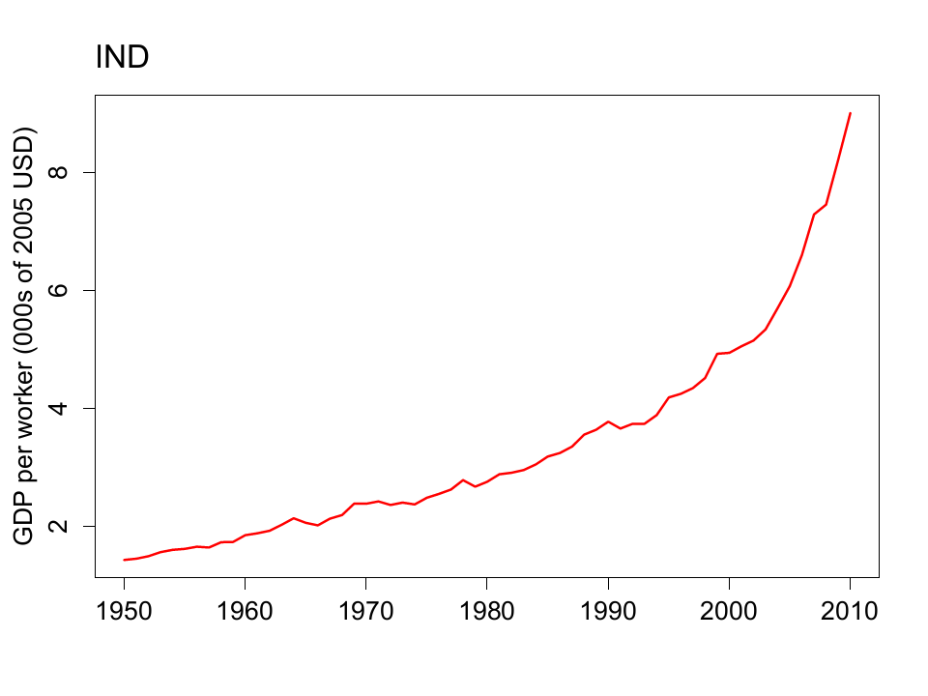
What happened in India?

Slide 50
What happened in India?
 | Y/L | K/L | A
1950 | 1.44 | 2.00 | 1.14
1980 | 2.76 | 5.13 | 1.60
2010 | 9.01 | 18.18
Contribution, 1950-1980 | 2.18 | 1.05 | 1.13
Contribution, 1980-2010
Why did India grow? Fill in the blanks.

Slide 51
What happened in India?
 | Y/L | K/L | A
1950 | 1.44 | 2.00 | 1.14
1980 | 2.76 | 5.13 | 1.60
2010 | 9.01 | 18.18 | 3.43
Contribution, 1950-1980 | 2.18 | 1.05 | 1.13
Contribution, 1980-2010 | 3.94 | 1.41 | 2.53
Numbers in bold are data, the rest are computed

Slide 52
What happened in India?
British colony, independent 1947
Slow growth before and after independence
Active democracy
British and successors built bureaucratic planned economy
Modest liberalization under Rajiv Gandhi in 1980s
More liberalization during 1990 crisis
Dramatic improvement in economic performance

Slide 53
What happened in India?
World Economic Forum
The country’s supply of infrastructure remains largely insufficient. In health and education, quality remains a concern. Discontent in the business community about the inability of the government to provide a more conducive environment for business has been growing. Corruption (99th) and burdensome regulation (96th) fuel this discontent. Despite these considerable challenges, India has a well-developed and sophisticated financial market.
Does this sound right to you?

Slide 54
What happened in India?
EIU, Country Finance Report:
India is a difficult operating environment for foreign companies. Most economic activities are girded with restrictions, public services and infrastructure are poor, and the government continues to impede the free flow of capital across its borders. Tax rates are high and the tax system is complicated.
Does this sound right to you?

Slide 55
Roadmap
What happened in India? ✓
Problem Set #1
Nineteenth-century ocean shipping
Institutions
Measuring institutional quality
What is this?

Slide 56
Problem Set #1
Answers will be posted after Saturday’s class
When you look at the figure for Question 3
Which way is “capital” flowing – in or out of China?
What does this mean?

Slide 57
Problem Set #1

Slide 58
Nineteenth-century ocean shipping

Slide 59
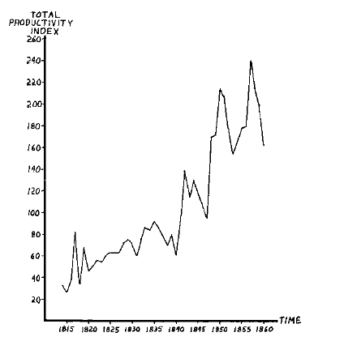
Ocean shipping
Source: Douglas North, Journal of Political Economy, 1968.

Slide 60
Ocean shipping
Massive improvements in productivity
Why?

Slide 61
Ocean shipping
What’s the takeaway?
Productivity is in the environment, not the individual
Steve Jobs?
Immigration?
Who are the pirates today? In the US? In Mexico? In India? Elsewhere?

Slide 62
Institutions

Slide 63
What are “institutions”?
Social mechanisms that facilitate economic performance
Good institutions favor production over piracy
Like what?
What’s important in your business or industry?

Slide 64
Institutions: categories
Governance
Rule of law
Clearly defined property rights
Open, honest, competitive markets
Overall: consistency over time

Slide 65
Institutions
Governance
Governments should be strong enough to deliver security and enforce rules
But not so strong that they rob their own citizens
They should facilitate economic performance, not hinder it [corruption and red tape are the opposite of this]

Slide 66
Institutions
James Madison, Federalist Papers 51 (1788):
If men were angels, no government would be necessary. If angels were to govern men, … controls on government would [not] be necessary. In framing a government which is to be administered by men over men, the great difficulty lies in this: you must first enable the government to control the governed; and in the next place oblige it to control itself.

Slide 67
Institutions
Old Soviet joke:
Here’s how things work under Communism. We pretend to work, and they pretend to pay us.

Slide 68
Institutions
Old Czech joke (circa 1968):
The difference between capitalism and socialism? Under capitalism, Man oppresses Man. Under socialism it’s exactly the opposite.

Slide 69
Institutions
Rule of law
Legal system must enforce the law
Honest police and judiciary

Slide 70
Institutions
Property rights
Should be clearly defined
And enforced

Slide 71
Institutions
Kenneth Arrow, “Gifts and exchange”
[A market] system must involve the concept of property. [But] property systems are not self-enforcing. The judges and police may indeed be paid, but the system itself would disappear if they were to sell their services and decisions. Thus the definition of property rights depends precisely on the lack of universality of private property.
My take: without rule of law, property rights are meaningless

Slide 72
Institutions
Open, honest, competitive markets
Not “free” markets
Competitive, not monopolies
Free entry

Slide 73
What is this?

Slide 74
Two questions
Here’s how the game works
For each example, ask yourself
What institution is this?
Who are the pirates?
Categories
Governance
Rule of law
Property rights
Competitive markets

Slide 75
What is this?
Sandeep Kohli, “Long live license Raj,” WSJ, Feb 13 09:
When I set up restaurants in Dehli, I found the License Raj was alive and well. First, you need a "No Objection" certificate from the Fire Department. Then a Health license from the Municipal Corporation of Delhi. Then three different police clearances – one from the police station in the area where the restaurant is located, the next from the police station in the area where the restaurant manager lives, and then another one from the police licensing department. Next, you apply for Tourism & Excise licenses. Inspectors check out the premises and paste a notice at the restaurant inviting objections from the neighborhood regarding the sale of alcohol.

Slide 76
What is this?
From a student working for a NYC hospital:
All building projects must get the approval of three city agencies.
Almost everyone hires an expediter, typically someone who used to work for the city and now helps you navigate the system.
The Buildings Department, in particular, has long history of corruption.
This adds an estimated 30-40% to construction costs from the permitting process alone, more if you count the extra time, effort, and delay to go through all this.

Slide 77
What is this?
Andrew Kramer, New York Times, May 16, 2006:
Mike Matthews, a sound-effects designer and one-time promoter of Jimi Hendrix, bought a moribund Russian factory and converted it to making vacuum tubes for high-end guitar amplifiers. Now he’s facing a hostile takeover. A company called Russian Business Estates offered $400k for his firm, which has a monthly turnover of $600k. When Mr Matthews refused, the electricity went off. Then he was accused of “security violations.”
Notes:
http://www.nytimes.com/2006/05/16/business/worldbusiness/16cheat.html?sq=russia%20vacuum%20tubes%20amplifier%20guitar&st=cse&scp=1&pagewanted=all

Slide 78
What is this?
Argentina in 2008 (WSJ, Oct 28 08)
Argentina’s government pressed forward with its controversial plan to nationalize private pension plans. President Fernandez de Kirchner said her move is designed to protect private pension funds from mismanagement amid the global financial crisis.

Slide 79
What is this?
Hernando de Soto, The Other Path
Researchers tried to set up a factory in Lima – legally
Steps required: 11
Time: 289 days
Bribes requested: 10 (2 paid)
Cost: $1,231 (32 times the monthly min wage)

Slide 80
What is this?
Tesla Motors
Tesla Motors sells high-end electric cars direct to the consumer. But North Carolina’s car dealers have proposed a law prohibiting sales except through car dealers. Robert Glaser, president of the N.C. Automobile Dealers Association, comments: “The whole point of the system is to protect the consumer.”

Slide 81
What is this?
Uber
Surge pricing outlawed in New York State
Uber outlawed in Germany, now working with taxis.

Slide 82
What is this?
Car loans in Brazil
In 2000, the car loan market was dead: bad loans couldn’t be enforced, courts wouldn’t give lender title, so lenders simply didn’t lend
Then: Brazil allowed lenders to give loans in exchange for title
Car loans boomed
Delinquencies, too

Slide 83
What is this?
Bill Lewis, McKinsey, The Power of Productivity
The Japan we see the small farmer, the small shopkeeper, and the small milk plant. But small isn’t beautiful, it’s inefficient and unproductive. A string of land restrictions, tax policies, loan subsidies, and regulations prop up the small while stifling the enterprising and efficient. As a result, Japan is 40% more productive than the US in autos but 50% less productive in retail.

Slide 84
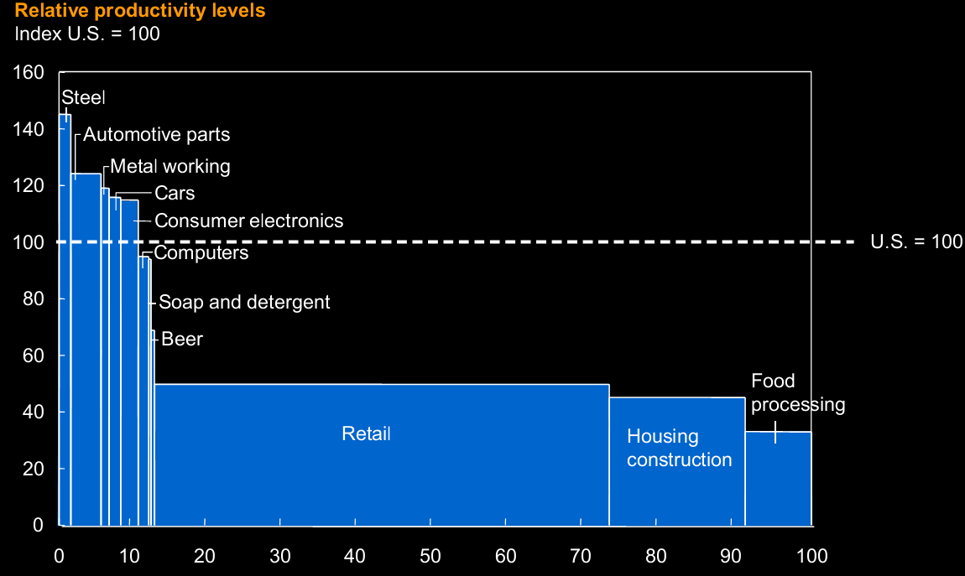
What happened in Japan?

Slide 85
What is this?
World Economic Forum on Mexico
There is a lack of competition in some key strategic sectors, which spills over into most sectors of the economy.

Slide 86
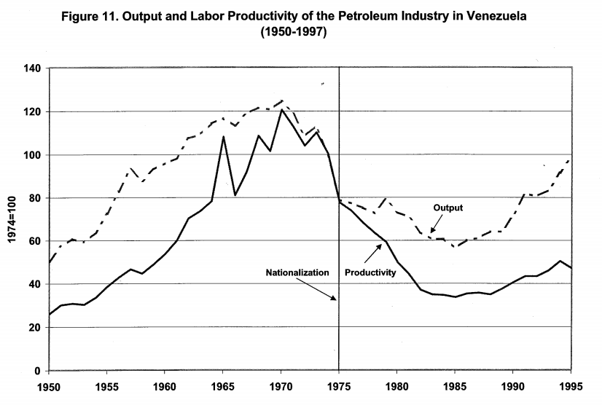
What is this?
Source: Cole, Ohanian, Riascos, and Schmitz, “Latin America in the rearview mirror.”

Slide 87
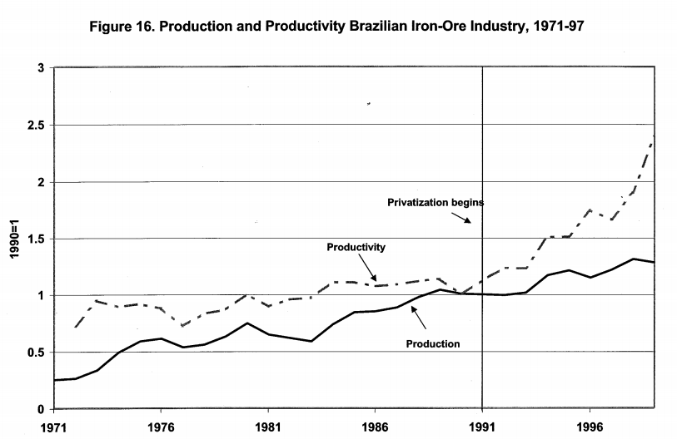
What is this?
Source: Cole, Ohanian, Riascos, and Schmitz, “Latin America in the rearview mirror.”

Slide 88
What is this?
What examples come to mind?
Any specifically relevant to your business?

Slide 89
Measuring institutional quality

Slide 90
Measuring institutional quality
Bill Gates
I have been struck by how important measurement is to improving the human condition. You can achieve incredible progress if you set a clear goal and find a measure that will drive progress toward that goal.
Lots of measures now available
Attempts to quantify institutional features of the economic and business environment
See links on resource page

Slide 91
Measures of institutional quality
Good sources
World Bank, World Governance Indicators
World Bank, Doing Business
Transparency International, corruption indexes
Useful aggregators
Economist Intelligence Unit, various reports
World Economic Forum, Global Competitiveness Report
Links to these and more on the “resources” page

Slide 92
Government effectiveness
Source: World Bank, Governance Indicators.

Slide 93
Regulatory quality
Source: World Bank, Governance Indicators.

Slide 94
Rule of law
Source: World Bank, Governance Indicators.

Slide 95
Control of corruption
Source: World Bank, Governance Indicators.

Slide 96
Days to enforce a contract
Source: World Bank, Doing Business.

Slide 97
Cost of enforcing a contract
Source: World Bank, Doing Business.

Slide 98
Procedures required to start a business
Source: World Bank, Doing Business.

Slide 99
Cost of starting a business
Source: World Bank, Doing Business.

Slide 100
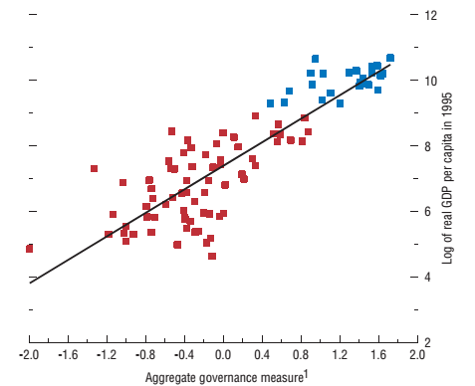
Institutions and performance
Source: IMF, WEO, 2003.
Notes:
http://www.imf.org/external/pubs/ft/weo/2003/01/pdf/chapter3.pdf

Slide 101
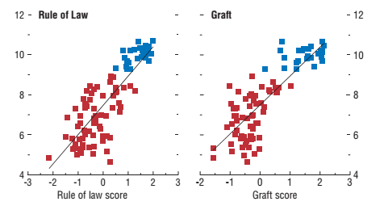
Institutions and performance
Source: IMF, WEO, 2003.
Notes:
http://www.imf.org/external/pubs/ft/weo/2003/01/pdf/chapter3.pdf

Slide 102
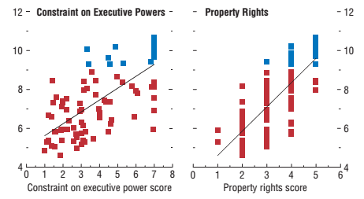
Institutions and performance
Source: IMF, WEO, 2003.
Notes:
http://www.imf.org/external/pubs/ft/weo/2003/01/pdf/chapter3.pdf

Slide 103
Summing up
Why is China growing so rapidly?
India? Mexico? Others?
Answer so far
Productivity
Good institutions
Translation
Bad institutions raise cost of doing business, lower productivity

Slide 104
Summary
GDP
Capital & Labor
Productivity
Political Process
“Institutions”

Slide 105
What have we learned?
Good institutions support productivity and economic performance
A short list includes
Governance
Rule of law
Property rights
Competitive markets
We have measures of most of these things
Macroeconomic policies matter, too [later]

Slide 106
Problems
Problem Set A
Will not be collected, but good practice
Problem Set #2
Due in two weeks, mostly doable now

Slide 107
For the ride home
James Surowiecki, New Yorker, June 10, 2010
Regulation isn’t an obstacle to thriving markets, it’s a vital part of them.
Tim Harford, Undercover Economist, September 2014
Just because a problem exists does not mean a new regulation will solve it. Policymaking is flawed and crude while the world is subtle and unpredictable. That is why regulations have a tendency to backfire.
Do you agree or disagree? Which one? Bring examples to class
Notes:
http://www.newyorker.com/magazine/2010/06/14/the-regulation-crisis
http://timharford.com/2014/09/when-regulators-are-all-out-to-dejeuner/

Slide 108
Extra slides

Slide 109
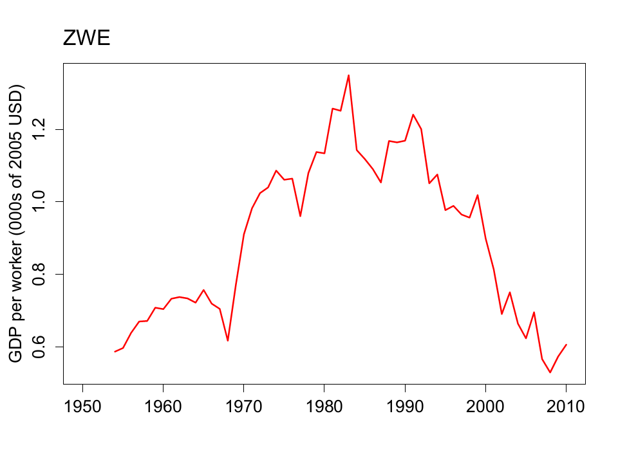
What happened in Zimbabwe?

Slide 110
What happened in Zimbabwe?
γ_{Y/L} = γ_{A} + α γ_{K/L}
 | Y/L | K/L | A
1990 | 11.69 | 37.80 | 3.48
2010 | 6.06 | 37.78 | 1.81
Growth rate (annual %) | (3.28) | (0.00) | (3.28)
Contribution to growth | (3.28) | (0.00) | (3.28)
Numbers in bold are data, the rest are computed
“Contribution” means we multiply γ_{K/L} by 1/3

Slide 111
What happened in Zimbabwe?
Fertile farm land, abundant natural resources
History
European immigration/colonization in late 19th century
British colony 1888-1965
Independent from 1980
Led by Robert Mugabe since then
1997 “land reform” led to sharp drop in agricultural output, loss of tax revenue, hyperinflation, economic chaos
Now an opportunity?

Slide 112
What happened in Zimbabwe?
World Economic Forum
Zimbabwe tentatively reverses its adverse trend. The assessment of public institutions, while still weak, has improved measurably, increasing from 125th two years ago to 107th. Specific areas of improvement are ethics and corruption and government inefficiency, although significant room for improvement remains. On the other hand, major concerns linger with regard to the protection of property rights, where Zimbabwe is second-to-last.
Does this sound right to you?

Slide 113
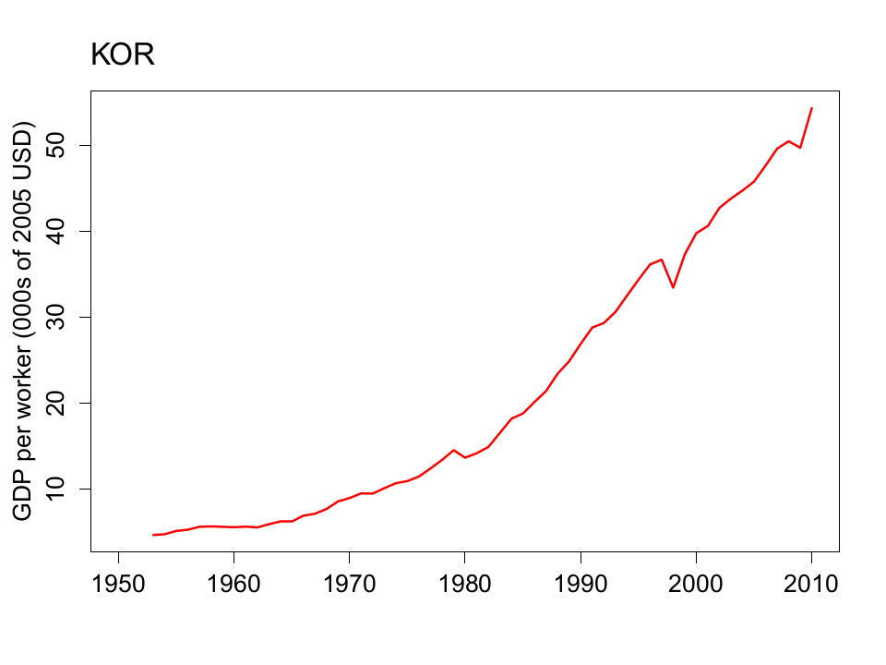
What happened in Korea?

Slide 114
What happened in Korea?
γ_{Y/L} = γ_{A} + α γ_{K/L}
 | Y/L | K/L | A
1953 | 4.70 | 4.84 | 2.78
2010 | 54.32 | 189.64 | 9.45
Growth rate (annual %) | 4.29 | 6.44 | 2.15
Contribution to growth | 4.29 | 2.15 | 2.15
Numbers in bold are data, the rest are computed
“Contribution” means we multiply γ_{K/L} by 1/3

Slide 115
What happened in Korea?
Huge economic success
Characteristics
Less advanced than the North prior to the Korean conflict
Massive investments from US
Strong government role in the economy early on
Encouraged large conglomerates (“chaebols”)
Greater role for investment than we see in US
Which of these matters?

Slide 116
What happened in Korea?
World Economic Forum
Korea’s performance is very uneven. The country’s outstanding infrastructure (9th) and stable macroeconomic environment (6th) are among its key competitive strengths. Education is accessible and of high quality. On the other hand, considerable room for improvement remains with respect to the quality of its institutions (65th) and its rigid labor market (76th), as well as its largely inefficient financial market (80th).
Does this sound right to you?

Slide 117
Institutions
Another old Soviet joke:
One can’t help but be reminded of the old Soviet joke about the collective farm director and his chickens. … One day, the expert comes back, and the director announces, “All the chickens are dead.” “What a shame,” the expert says. “I had so many more great ideas.”
Notes:
http://conversableeconomist.blogspot.com/2014/08/the-enigma-of-russias-economy.html

Slide 118
What is this?
Car loans in Brazil
In 2000, the car loan market was dead: bad loans couldn’t be enforced, courts wouldn’t give lender title, so lenders simply didn’t lend
Then: Brazil allowed lenders to give loans in exchange for title
Car loans boomed
Delinquencies, too

Slide 119
What is this?
David Leonhardt, NY Times, Nov 8 09:
When Intermountain standardized lung care for premature babies, it not only cut the number who went on a ventilator by more than 75 percent; it also reduced costs by hundreds of thousands of dollars a year. Perversely, Intermountain’s revenues were reduced by even more. Thanks to the fee-for-service system, the hospital had been making money off substandard care. By improving care it lost money.

Slide 120
What is this?
Mireya Navarro, NY Times, Oct 20, 2013:
After her husband died, Mary Veronica Santiago fell behind on her bills and decide to file for bankruptcy. Mrs. Santiago has lived for 50 years in a two-bedroom rent-controlled apartment near Tompkins Square Park, in a neighborhood where unregulated apartments rent for thousands more a month than Mrs. Santiago’s rent of $703. As her case was nearing conclusion, her landlord offered to buy her rent-stabilized lease and pay off her debt.

Slide 121
What is this?
“Africa’s Singapore?” The Economist, Feb 25 2012:
Rwanda is best known for the genocide of 1994. It has been peaceful since then, but lacks nearly all of Singapore’s advantages. Yet Rwanda has one huge advantage: the rule of law. No African country has done more to curb corruption. Transparency International reckons Rwanda is less graft-ridden than Greece or Italy. The country is blessedly free of red tape, too. Property rights are strengthening, as well—the government is giving peasants formal title to their land.

Slide 122
What is this?
Joe Nocera, NY Times, Aug 22 11:
In April, the National Labor Relations Board filed a complaint against Boeing, accusing it of opening its new non-union South Carolina plant to retaliate against the union, which has a history of striking at contract time. The NLRB’s proposed solution is to move all its Dreamliner production back to Puget Sound.

Slide 123
What is this?
The Economist, Nov 9 2012:
Michael Woodford was sacked as president of Japan’s Olympus after he revealed a $1.7b accounting cover-up. The company’s board lied about the mystery. When the truth came out, the board kept their jobs and the boss lost his. Over the summer, a government advisory committee quietly squelched proposed reforms to corporate governance.

Slide 124
What’s this?
“Fiscal footnote,” NYT, Jan 19, 2013:
Amgen scored a largely unnoticed coup: Lawmakers inserted a paragraph into the “fiscal cliff” bill that strongly favored one of its drugs. The language delays a set of Medicare price restraints on a class of drugs that includes [Amgen drug] Sensipar. It is projected to cost Medicare up to $500 million.
Amgen has a small army of 74 lobbyists in the capital.

