Slide 1

The Global Economy Fixed Exchange Rates
Notes:
Lifetime technical support
http://www.economist.com/content/big-mac-index

Slide 2
Is China’s currency “undervalued”?

Slide 3
The renminbi
Terminology
Currency: renminbi (RMB)
Units: yuan
Is the RMB “undervalued”?
What do we mean by that?
How would we make the case – either way?

Slide 4
The renminbi
New York Senator Charles Schumer
It's time to put some muscle into our trade relationship with China. For too long, the Chinese government has been playing games with the value of its currency in order to get a competitive edge.
What is he saying? Do you agree?

Slide 5
The renminbi
Paul Krugman
Here's how it works: Unlike the dollar, the euro or the yen, whose values fluctuate freely, China's currency is pegged to the dollar by official policy. At this exchange rate, Chinese manufacturing has a large cost advantage over its rivals. [As a byproduct], China's government buys up dollars, adding to a $2 trillion-plus hoard of foreign exchange reserves.
What is he saying? Do you agree?

Slide 6
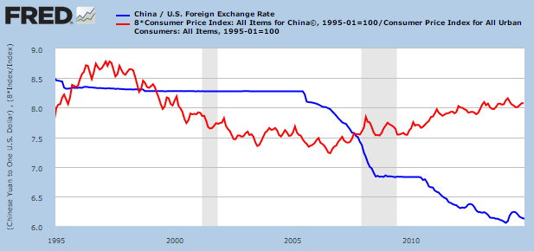


Yuan per dollar
Source: Fed via FRED.

Slide 7
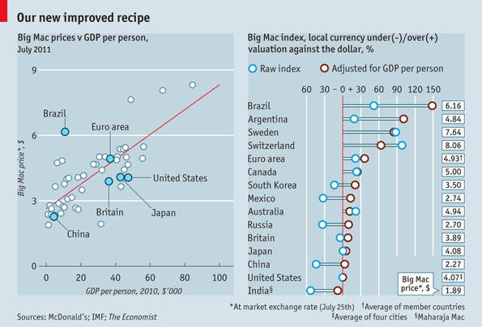
Big Mac prices
Source: The Economist.
Notes:
http://www.economist.com/content/big-mac-index

Slide 8
The renminbi
Is the RMB “undervalued”?
What do we mean by that?
How would we make the case – either way?

Slide 9
The renminbi
My summary
Chinese goods cheap, but not especially so [remember: PPP doesn’t work that well – for anyone] [also: prices generally lower in poor countries]
Not mentioned: Chinese price indexes of poor quality, makes PPP calculations noisy
Fixed exchange rate and massive accumulation of dollar reserves is unusual, attracts attention
Something to think about: latent demand for dollars limited by capital controls [more shortly on what this means]

Slide 10
Fixed Exchange Rates

Slide 11
The idea
In a fixed exchange rate system, the central bank buys and sells foreign currency as needed to maintain the exchange rate
Can fail spectacularly if the central bank runs out of foreign currency

Slide 12
The idea
Stan Fischer, First Deputy Managing Director, IMF
Each of the major crises since 1994 – Mexico in 1994, Thailand, Indonesia and Korea in 1997, Russia and Brazil in 1998, and Argentina and Turkey in 2000 – has involved a fixed or pegged exchange rate. And countries that did not have pegged rates – among them South Africa, Israel in 1998, Mexico in 1998, and Turkey in 1998 – avoided crises of this type.
What is he saying? Does it make sense to you?

Slide 13
Roadmap
Is China’s currency “undervalued”?
Exchange rate systems
Fixed exchange rates
The trilemma

Slide 14
Exchange rate systems

Slide 15
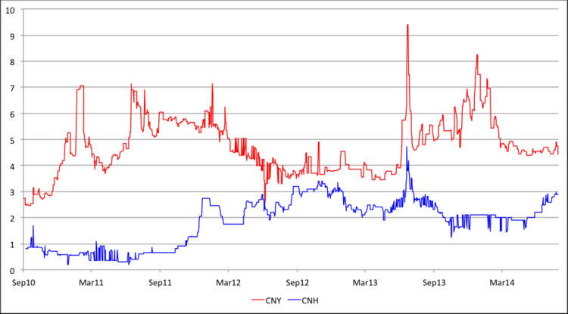
RMB rates in Shanghai and HK
What’s going on here?
Notes:
http://www.moneyandbanking.com/commentary/2014/8/28/chinas-capital-controls-and-the-exchange-rate-regime

Slide 16
The renminbi
EIU, Country Finance Report, China
Although the government maintains relatively strict exchange controls, the general trend over the past decade has been towards gradual liberalisation of China’s foreign-exchange market. The country reached its most significant milestone in December 1996 when it officially made the renminbi convertible on the current account. Convertibility on the capital account is not expected in the near future.
What are they saying? Do you agree?

Slide 17
Exchange rate systems
Convertibility
A currency is convertible if you can trade it freely for foreign currency -- and vice versa
Exchange controls
Limits on convertibility for some purposes
Fixed and flexible exchange rate systems
An exchange rate is flexible [floating] if the market price is determined with little or no direct government participation
An exchange rate is fixed [pegged] if the central bank supports an official rate by buying and selling foreign currency

Slide 18
Exchange rate systems
China, EIU, Country Finance Report
The State Administration of Foreign Exchange (SAFE) administers the complex set of regulations that China uses to keep its currency open for trade purposes but closed for most types of investment).

Slide 19
Exchange rate systems
Mexico, EIU, Country Finance Report
No restrictions apply to export proceeds and import payments. Export revenues may be held indefinitely in Mexican pesos or in foreign currency.
No restrictions apply to Mexican individuals or companies borrowing from abroad, nor are restrictions imposed on nonresident companies and individuals borrowing domestically.

Slide 20
Exchange rate systems
China, EIU, Country Finance Report
In 2010 China announced that the renminbi's fixed peg to the US dollar would be replaced by a more flexible currency regime. China’s decision to abandon the renminbi’s peg spurred the development of a new range of foreign-exchange-related services, even though the exchange rate is still tightly controlled by Chinese authorities.

Slide 21
The renminbi
IMF, Article IV Consultation, 2011
IMF staff: Reforms should seek to secure a more modern framework for monetary management … and open the capital account. In all of this, a stronger renminbi will be an important complement.
[Chinese] authorities disagreed with the staff. They underlined the progress that has been made in continuing to improve the mechanism for setting the exchange rate.
What are they saying? Do you agree?

Slide 22
Exchange rate systems
Mexico, EIU, Country Finance Report
The value of the peso is determined by market forces through a floating exchange-rate regime that has been in place since the December 1994 peso devaluation. Under this framework, the Banco de Mexico (the central bank) makes no commitment to the level of the peso exchange rate and does intervene in foreign-exchange markets to ensure currency stability.

Slide 23
Exchange rate systems
Common currency (Euro Zone, Panama)
Currency board (HK, Argentina < 00)
Fixed exchange rate (US < 71)
Crawling peg (Mexico < 95, China > 05)
Managed exchange rate (Saudi Arabia?)
Floating exchange rate (US, Mexico)
Increasing flexibility

Slide 24
Fixed exchange rates

Slide 25
Fixed exchange rates
How does the central bank “fix” the rate? [Ask yourself: how would you set any price?]
Foreign exchange reserves
Foreign-denominated assets on the central bank’s balance sheet

Slide 26
Reminder: money supply mechanics
Central bank
Assets |  | Liabilities
Bonds | 20 | Money | 20
How does central bank increase money supply?
Households and firms
Assets |  | Liabilities
Money | 20
Bonds | 180

Slide 27
Fixed exchange rate mechanics
Central bank
Assets |  | Liabilities
Bonds FX reserves | 10 10 | Money | 20
What are foreign- exchange reserves?
How does bank maintain fixed exchange rate? (“intervention”)
What happens if people want to sell FX? Buy?
Households and firms
Assets |  | Liabilities
Money FX | 20 50
Bonds | 190

Slide 28
Fixed exchange rate mechanics
Central bank
Assets |  | Liabilities
Bonds FX reserves | 10 10 | Money | 20
What happens to money if people want to sell FX?
How can we offset this? (“sterilization”)
Households and firms
Assets |  | Liabilities
Money FX | 20 50
Bonds | 190

Slide 29
Pesos per dollar
What happened here?
Source: Fed via FRED.

Slide 30
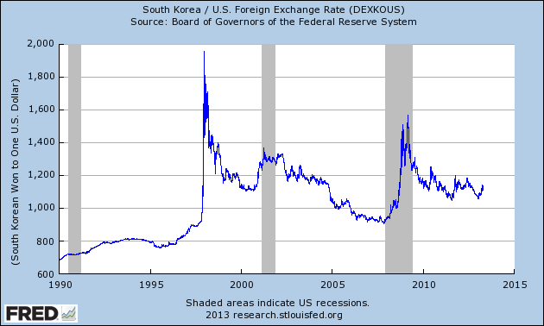
Won per dollar
What happened here?
Source: Fed via FRED.

Slide 31
Fixed exchange rate mechanics
Central bank
Assets |  | Liabilities
Bonds FX reserves | 10 10 | Money | 20
What happened in Mexico in Dec 1994?
Households and firms
Assets |  | Liabilities
Money FX | 20 50
Bonds | 190

Slide 32
Fixed exchange rate mechanics
Central bank
Assets |  | Liabilities
Bonds FX reserves | 10 0! | Money | 10
What happened in Mexico in Dec 1994?
Households and firms
Assets |  | Liabilities
Money FX | 10 60
Bonds | 190

Slide 33
Fixed exchange rate mechanics
Central bank
Assets |  | Liabilities
Bonds FX reserves | 10 10 | Money | 20
How did China get trillions of reserves?
Could China run out?
Households and firms
Assets |  | Liabilities
Money FX | 20 50
Bonds | 190

Slide 34
Fixed exchange rates: currency boards
The idea
If reserves > local currency, you can never run out
[think about this…]
Has worked well in Hong Kong
Failed in 2001 in Argentina – why?
Weak political system
Banks had dollar liabilities, not matched with dollar assets

Slide 35
Fixed exchange rates: summary
Fixed rate maintained through central bank sales and sales/purchases of foreign currency (“intervention”)
Sales limited by quantity of reserves
Typically changes the money supply, but you can offset that with conventional monetary policy (trade money for bonds): “sterilization”
Often fail in spectacular fashion
A suggestion that large adjustments are called for?

Slide 36
The trilemma

Slide 37
The trilemma
What’s a trilemma?
Three choices, but you only get two
The politician’s trilemma
Honest, smart, electable
MBA student’s trilemma
Job, school, social life

Slide 38
The trilemma
The trilemma of international finance
Fixed exchange rate
Free flow of capital (no “controls”)
Independent monetary policy

Slide 39
The trilemma
What are the US’s trilemma choices?
Fixed exchange rate
Free flow of capital
Independent monetary policy

Slide 40
The trilemma
What are China’s trilemma choices?
Fixed exchange rate
Free flow of capital
Independent monetary policy

Slide 41
The trilemma: UK, 1992
Quasi-fixed rate with European currencies (DM)
Trading band of 2.25%
Free flow of capital
High interest rates in Germany forced UK to follow
Why?
Weak UK economy made lower interest rate attractive
What are your choices?

Slide 42
The trilemma: UK, 1992
George Soros wonders which one will go first
Fixed exchange rate?
Free flow of capital?
Independent monetary policy?
Bets the farm on the first one, makes ~$1b
Bank of England lets pound float

Slide 43
Deutschemark-Pound exchange rates
Growth rate of reserve assets (right axis)
Exchange rate (left axis)

Slide 44
The trilemma: UK, 1992
Who lost?
UK Treasury estimates
₤800m in trading trading losses (buying into a down market)
₤2.4b in capital gains it would have made if it kept reserves
Search for “Black Wednesday”
September 16, 1992

Slide 45
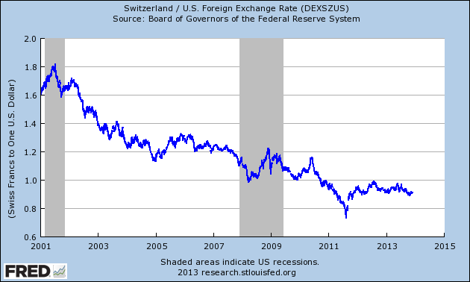
Swiss francs per dollar
What happened here?

Slide 46
The trilemma: Switzerland, 2011-
Sharp appreciation in 2011
Big Mac index suggested 98% overvaluation
Exporters suffering, companies threatened to leave
September 2011
Swiss National Bank announced massive intervention
Established a floor of 1.2 per euro
Which did we give up?
Fixed exchange rate?
Free flow of capital?
Independent monetary policy?

Slide 47
What have we learned?
Fixed exchange rates require government support
Buy and sell FX at official rate
Or restrict convertibility
Common transactions
Intervention: sales and purchases of foreign currency
Sterilization: undo impact on money supply
Trilemma: you only get two of
Fixed exchange rate
Free (international) flow of capital
Independent monetary policy

Slide 48
The Global Economy Macroeconomic Crises

Slide 49
Final exam
Material since midterm only
Bring calculator (logs and exponents not needed)
Also one page with anything on it you wish
Practice exams posted
Also answers to problem sets and practice problems
Exam lasts 2 hours, followed by Malt House (my treat)
Special office hours: Sat 4-5, Tue 3-5:30, Fri 3-5
Or email me

Slide 50
PS #4 Q1: ECB policy
How does it compare to the Taylor rule?
How would you assess it?

Slide 51
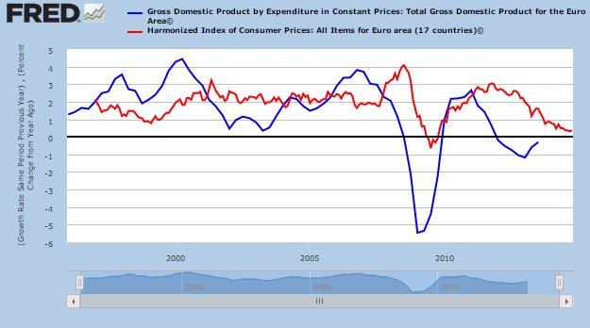
PS #4 Q1: inflation and growth

Slide 52
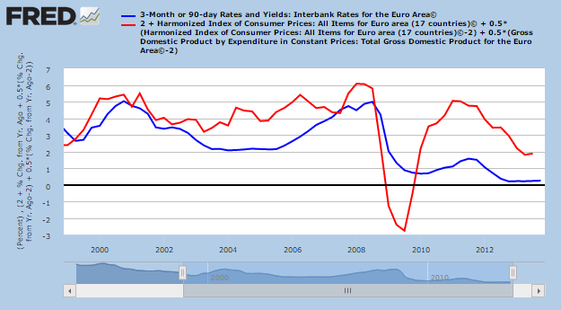
PS #4 Q1: Taylor rule

Slide 53
PS #4 Q2: Brazil’s budget
How does it look to you?
What would you add to the numbers?

Slide 54
Brazil
From a Brazilian student
The state owned banks are absurd. Brasil uses its development bank to offer subsidized interest rates to friends of the government. The bank is a major owner of companies as well. And the cost does not go in the budget.
Revenues from the deep-water oil are complicated. Right now, the more Petrobras produces, the more money they lose. They are instructed by the government not to raise prices, so there has been a misalignment with market prices. Petrobras has lost half its market value over the last year or so because of that interference.

Slide 55
Problem Set #4
Answers will be posted Saturday afternoon

Slide 56
Macroeconomic Crises

Slide 57
Crises
What countries are in trouble now?
How would you be able to tell?

Slide 58
The idea s
Macroeconomic crises: stuff happens, fact of life
Sometimes source of opportunities
Hard to predict, but there are often signs of trouble

Slide 59
Roadmap
What’s happening?
Crises
Signs of trouble [aka “the checklist”]
Crisis responses
Examples: Mexico, Korea, Europe

Slide 60
What’s happening?
“Meet Putin’s neighbors,” Bloomberg, via Rafael Roman
Just how much has President Vladimir Putin’s Ukraine incursion eroded investor confidence in Russia?
Consider the names that the country is now surrounded by in CDS market: Lebanon, El Salvador and war-torn Iraq. With investors charging 389 basis points a year to insure against a halt in Russian debt payments, those three countries -- all of which either have junk ratings or none at all -- are quoted at the closest levels to Putin’s government.
What’s going on? Do you agree?

Slide 61
Crises

Slide 62
Crises
Crises =
Unusually large recessions
Typically different in type as well as magnitude
A regular feature of the world throughout history
Significant business risk, also opportunity

Slide 63
Crises
Australia, 1891-1893 (“Barings crisis”)
GDP fell 18%
United States, 1907-1908
GDP fell 10%
Mexico, 1994-1995
GDP fell 9%, peso fell almost 50%
Korea, 1997-98
GDP fell 9%, won fell 30%
Argentina, 1999-2002
GDP fell 20%, peso fell 65%

Slide 64
Crisis triggers
The classic crisis triggers
Sovereign debt (“debt crisis”)
Financial system weakness (“financial crisis”)
Fixed exchange rates (“exchange rate crisis”)

Slide 65
Signs of trouble

Slide 66
Signs of trouble
Can we see them coming?
What would we look at?

Slide 67
Signs of trouble
Crisis checklist
Government debt and deficits
Financial system
Exchange rate and reserves
Politics and institutions

Slide 68
Signs of trouble
Sovereign debt indicators
Lots of debt (ratio of public debt to GDP)
Large and continuing deficits
Underlying long-term problems: pensions, banks, guarantees…
Secondary indicators
Signs of investor concern (CDS spreads)
Political instability, hints that default might be attractive
Debt short term
Debt denominated in foreign currency

Slide 69
Government deficits (% of GDP, 2013)
Signs of trouble?
Source: IMF, WEO.

Slide 70
Government debt (net, % of GDP)
Signs of trouble?
Source: IMF, WEO.

Slide 71
Signs of trouble
Financial system indicators
[for completeness, not part of this course]
Low capital ratios at banks and related institutions
Increasing loan losses, nonperforming loans
Secondary indicators
Rapid growth in real estate prices
Currency mismatches, borrowing in foreign currency
Rapid growth of “near banks”

Slide 72
Signs of trouble
Exchange rate indicators
Fixed or “managed” exchange rate system
Overvaluation either by PPP or relative to last five years
Low foreign exchange reserves
Secondary indicators
Nature of any “fix,” esp convertibility
Governance of monetary authority

Slide 73
Big Mac prices (USD)
Signs of trouble?
Source: The Economist.

Slide 74
Foreign exchange reserves (USD billions)
Signs of trouble?
Source: The Economist.

Slide 75
Signs of trouble
Walter Wriston, CEO of Citibank, 1980 or so
Countries don’t go out of business. The infrastructure doesn’t go away, the productivity of the people doesn’t go away, the natural resources don’t go away. Generally their assets exceed their liabilities, which is the technical reason for private bankruptcy. Which makes this very different from a company.
What is he saying? Do you agree?

Slide 76
Signs of trouble
Indicators of politics and institutions
Weak institutions overall
Political uncertainty – elections, for example
Remember Wriston
Governments choose to default

Slide 77
Crisis responses

Slide 78
Crisis responses
Response to government budget problems
Reduce spending, raise taxes (duh!)
IMF loans can smooth transition, come with “conditionality”
If default happens, resolve it quickly

Slide 79
Crisis responses
Response to financial sector problems
If system is sound but illiquid, lend aggressively against normally good collateral [classic role of central bank: lender of last resort]
If system is insolvent, get through bankruptcy and recapitalize as quickly as possible [this is fiscal policy: costs money, at least up front]

Slide 80
Crisis responses
Response to exchange rate problems
Let the currency float
More controversial: impose capital controls

Slide 81
Crisis responses
Response to political problems
Hmmmm….

Slide 82
Mexico

Slide 83
Mexico, 1994-1995
High growth in early 1990s
Economic liberalization, NAFTA
Modest government debt [27%] and deficit [1%]
Exchange rate “managed”
Higher inflation than US led to “real appreciation”
Political turmoil during 1994 presidential election [Chiapas, Colosio, …]
What went wrong? What was the trigger?

Slide 84
Mexico: government surpluses (% of GDP)
Source: EIU, CountryData

Slide 85
Mexico: government debt (% of GDP)
Source: EIU, CountryData

Slide 86
Mexico: real exchange rate
Source: EIU, CountryData

Slide 87
Mexico: foreign exchange reserves
Source: EIU, CountryData

Slide 88
Pesos per dollar
Source: Fed via FRED.

Slide 89
Mexico: what went wrong?
Debt modest, budget surpluses
But …
High degree of political uncertainty
Borrowing both short-term and (partly) in dollars
Low reserves, managed exchange rate not defensible
Mid-December 1994: investors refused to roll over government debt – boom!

Slide 90
Mexico: what was the response?
January 31, 1995:
Mexico borrows $20b from US collateralized by oil
Other governments and agencies arrange $30b lines of credit
Mexico cuts spending, raises taxes in 1995, budget balanced throughout crisis
The result
GDP falls sharply in 1995, rebounds in 1996
Loans repaid in full in 1997

Slide 91
Mexico: GDP growth
Source: EIU, CountryData

Slide 92
Mexico: crisis checklist
Where did we go wrong?
Government debt and deficits
Financial system
Exchange rate and reserves
Politics and institutions

Slide 93
Korea

Slide 94
Korea
Great success story from mid-1950s on
Continued rapid growth 1990-96
Currency pegged
What went wrong? What was the trigger?

Slide 95
Korea: government surpluses (% of GDP)
Source: EIU, CountryData

Slide 96
Korea: foreign exchange reserves
Source: EIU, CountryData

Slide 97
Won per dollar
Source: Fed via FRED.

Slide 98
Korea: what went wrong?
Strong growth
Government ran surpluses, but …
Banks lent aggressively to corporates (Chaebols)
Much of it financed by short-term foreign borrowing
Kia Motors collapsed in July
US interest rates rose, dollar appreciated
Reserves fell
December 1997: currency collapsed – boom!

Slide 99
Korea: what was the response?
The response
IMF contributes 21b to 58.4b bailout (USD)
Government shuts down insolvent banks
Bankrupt firms sold or merged
FX reserves increased
Crisis rebranded locally as “IMF crisis”
The result
Wages fell sharply
GDP rebounded in 1999

Slide 100
Korea: GDP growth
Source: EIU, CountryData

Slide 101
Korea: crisis checklist
Where did we go wrong?
Government debt and deficits
Financial system
Exchange rate and reserves
Politics and institutions

Slide 102
Europe

Slide 103
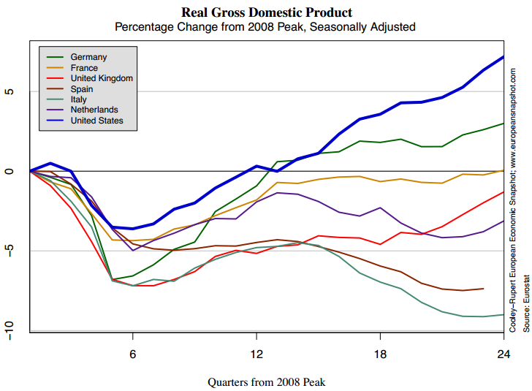
Europe
Source: Cooley and Rupert, European Economic Snapshot.

Slide 104
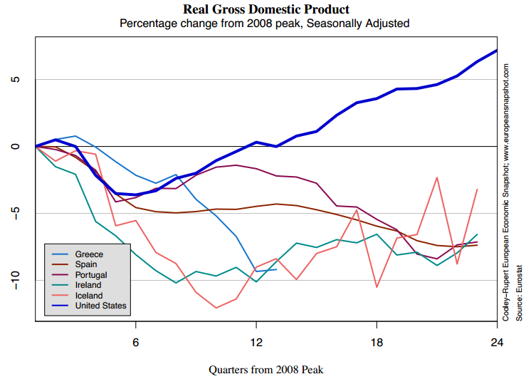
Europe
Source: Cooley and Rupert, European Economic Snapshot.

Slide 105
Europe
What’s going on over there?
Why no rebound as in Mexico and Korea?
Our goal: make this as simple as possible
What’s the trigger?
My take
Sovereign debt problems
“Enabled” by Euro Zone
Exacerbated by common currency [how?]
No coordinated policy response

Slide 106
Europe
Edward Hugh, Fistful of Euros blog, May 2013:
The euro bares an uncanny resemblance to Dr Strangelove’s doomsday machine, designed so that one day it would almost inevitably blow up the global financial system, but constructed so that any attempt to dismantle it would produce the same outcome.

Slide 107
Europe
The plan is to stop here
The rest of these slides are just in case there are questions
But Europe is way too complicated to put on an exam

Slide 108
What have we learned?
Crises happen
Hard to predict, but signs of trouble include
Government debt and deficits
Financial sector weakness
Fixed, overvalued exchange rate
Weak political leadership, unstable politics
[aka “the checklist”]
Europe’s a complicated mess

Slide 109
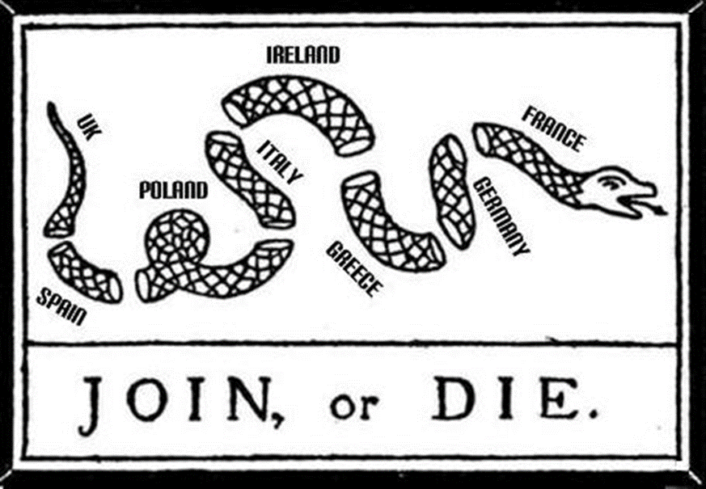
Europe
From former student Aaron Martin

Slide 110
Government debt (% of GDP)
Source: EIU, CountryData.

Slide 111
Long-term government interest rates
Source: ECB, statistical data warehouse.

Slide 112
Long-term government interest rates
Source: ECB, statistical data warehouse.

Slide 113
GDP growth
Source: ECB, statistical data warehouse.

Slide 114
The Articles of Confederation
From Wikipedia
Under the Articles of Confederation, the central government's power was limited. The Congress — the only federal institution — was denied powers of taxation: it could only request money from the states. Most decisions, including modifications to the Articles, required unanimous approval of all thirteen state legislatures.
Good structure or bad? Why?

Slide 115
Europe
European Union emerged from wreckage of WW II
Closer economic ties to connect countries, maintain peace
Short history
Paris Treaty (1951): coal and steel community
Treaty of Rome (1957): more extensive free trade zone
Continued integration and expansion
Maastricht Treaty (1993) set up single currency and ECB

Slide 116
Two currency unions
Common? | US | EU
Currency | Yes | Yes
Deposit insurance | Yes | No
Bank regulation | Yes | No
Fiscal policy | Yes | No
Political authority | Yes | No
Language | Yes | No
Olympic team | Yes | No
Army | Yes | No

Slide 117
Europe
Monetary Union came with conditions
Limits on debt and deficits
A “no-bailout” clause
Why?
Attempt to reconcile centralized monetary policy and decentralized fiscal policy
No exit plan

Slide 118
Euro Zone as enabler
Why could countries borrow at German rates?
Euro Zone as “enabler”
Treaty limits on debt and deficits not enforced
National bank regulators accepted all sovereign debt as riskless
Payments system (TARGET2) leaves central banks of strong countries with claims on those of weak countries [implicit loans from Bundesbank to Greece, etc]
Free capital mobility plus national deposit insurance is an invitation to a bank run
No exit plan

Slide 119
Euro Zone leadership vacuum
Federal structure unworkable
Political power lies with the countries – also fiscal authority
Unanimous consent needed for everything
That’s what killed the “Articles of Confederation”

Slide 120
Euro Zone future
Where from here?
More centralized “federal” system?
Or the reverse?
Slow response makes years of low growth more likely
Also rigid labor markets and other market restrictions

Slide 121
Greece
What’s happening in Greece?

Slide 122
Greece: government debt (% of GDP)
Source: EIU, CountryData

Slide 123
Greece: government surpluses (% of GDP)
Source: EIU, CountryData

Slide 124
Greece: GDP growth
Source: IMF, WEO.

Slide 125
Greece
What’s happening in Greece?
Large government debt, suspect financial statements
Continuing deficits (high spending, poor tax collection)
Current debt likely insupportable without help
Questions
Why were they able to sell debt at such low rates?
Why is this taking so long?
Would devaluation have helped?
Should they leave the Euro Area?

Slide 126
Greece: crisis checklist
Where did we go wrong?
Government debt and deficits
Financial system
Exchange rate and reserves
Politics and institutions

Slide 127
Spain
What’s happening in Spain?

Slide 128
Spain: government debt (% of GDP)
Source: EIU, CountryData

Slide 129
Spain: government surpluses (% of GDP)
Source: EIU, CountryData

Slide 130
Spain: GDP growth
Source: IMF, WEO.

Slide 131
Spain
What’s happening in Spain?
Modest debt and deficits prior to crisis
Larger housing boom and bust than most
Downturn hit revenue hard, led to large deficits
Rigid labor markets likely slowing recovery
Questions
How big are hidden liabilities of regional governments and “cajas”? [like Korea?]

Slide 132
Spain: crisis checklist
Where did we go wrong?
Government debt and deficits
Financial system
Exchange rate and reserves
Politics and institutions

Slide 133
Italy
What’s happening in Italy?

Slide 134
Italy: government debt (% of GDP)
Source: EIU, CountryData

Slide 135
Italy: government surpluses (% of GDP)
Source: EIU, CountryData

Slide 136
Italy: GDP growth
Source: IMF, WEO.

Slide 137
Italy
What’s happening in Italy?
Large debt prior to crisis, but deficits modest and primary balance is in surplus
Sharp increase in interest rate raised burden of debt
Problem is productivity and growth – there isn’t any
Political system gridlocked?
Questions
What will it take to restart economic growth?

Slide 138
Italy: crisis checklist
Where did we go wrong?
Government debt and deficits
Financial system
Exchange rate and reserves
Politics and institutions

