Slide 1

The Global Economy Aggregate Supply & Demand
Notes:
Many slides, but they go quickly.
Unifying framework, analyst standard
Talk about demand AND supply
People say spend and that’s good for the economy. But what if we’re at capacity?
Cartoon: crawling across desert, one pictures bottle of cold water. Demand AND supply.

Slide 2
Problem Set #3
Answers will be posted after class

Slide 3
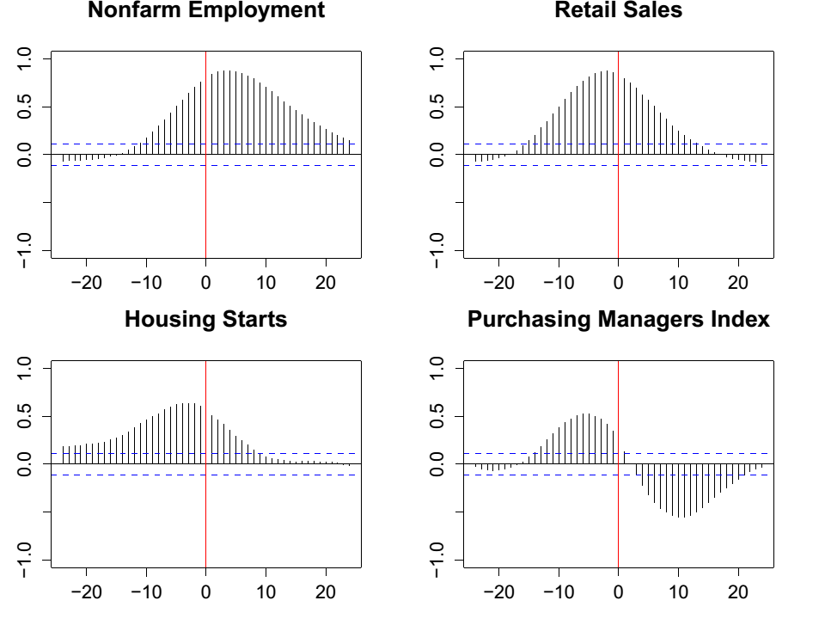
Problem Set #3: Question 2

Slide 4
Problem Set #3: Question 3
What indicators do you recommend?
How is the economy doing?

Slide 5
Demand – AND supply
Unifying framework
First half
AS/AD model: the industry standard
Second half:
What changed, supply or demand?
What should we do about it?

Slide 6
Roadmap
Where we’ve been…
Aggregate supply
Aggregate demand
Aggregate supply AND demand
Applications

Slide 7
Where we’ve been…
Where we’ve been: business cycle data
Properties: some things are more cyclical than others
Indicators: procyclical and countercyclical, leading and lagging
Where we’re headed: business cycle theory
Adapt supply/demand diagram to whole economy
Why does the economy fluctuate?
What should we do about it?

Slide 8
Aggregate supply & demand

Slide 9
Two perspectives (“Field of dreams” version)
Supply is what matters
If you build it, people will buy it
All we had prior to 1930
Demand is what matters
If there’s demand, someone will build it
Response to Depression (John Maynard Keynes and others)
Paul Krugman?
What we do
Supply AND demand

Slide 10
Aggregate supply and demand
Adapt supply/demand diagram to whole economy
Axes
P is price level
Y is real GDP
Usually interpreted as inflation and GDP growth
Curves
Supply is about production of goods
Demand is about purchases of goods

Slide 11
Aggregate supply and demand
P
AS
AD
Y

Slide 12
Aggregate supply

Slide 13
Aggregate supply I
Supply is about production
Classical version [“long run”]
Production function
Y = A K^{α} L^{1-α}
At any point in time
A is given [but may change over time]
K is given [but may change over time]
L reflects “equilibrium” in labor market
Y must therefore be “given” [and AS* vertical]

Slide 14
Aggregate supply I
P
AS*
Y*
Y

Slide 15
Aggregate supply I
Reminder:
Y = A K^{α} L^{1-α}
Over time, what happens when these change?
A?
K?
L?
How do we represent this in the diagram?

Slide 16
Aggregate supply I
P
AS*
Y*
Y

Slide 17
Aggregate supply I
Oil prices
An increase is like a drop in TFP
Why?
Think about total payments to capital, labor, and oil producers
If more goes to oil producers, there’s less for capital and labor
Our measure of output is payments to capital and labor, so it’s gone down
If oil producers are local the lost revenue would show up there, but if they’re abroad, local output falls
That’s just like a fall in productivity: AS shifts left

Slide 18
Aggregate supply II
Keynesian version [“short run”]
Production function
Y = A K^{α} L^{1-α}
At any point in time
A, K given
Simple version: nominal wage “sticky”
Increase in P reduces real wage, firms hire more workers
More L implies more Y ⇨ AS curve slopes upward
Wage eventually adjusts, bringing us back to AS*

Slide 19
Aggregate supply II
P
AS*
AS
Y*
Y

Slide 20
Aggregate supply: shifts
What happens to aggregate supply if we
Change A or K?
Change price of oil?
Note: both AS and AS* shift – and by same amount [the last part is a short cut, you can thank me later]

Slide 21
Aggregate supply II
P
AS*
AS
Y*
Y

Slide 22
Aggregate supply: shifts
P
AS*
AS
Y*
Y

Slide 23
Aggregate supply: shifts
P
AS*
AS
Y*
Y

Slide 24
Aggregate demand

Slide 25
Review: quantity theory
Recall our production function for transactions
M V = P Y
M = stock of money in circulation (quantity of currency)
V = velocity (how often a unit of currency is used in a year)
P = price level (the GDP deflator or other price index)
Y = real GDP

Slide 26
Aggregate demand
Basic version
Quantity theory generates inverse relation between P and Y
M V = P Y
P = M V / Y
Given (M,V), high Y associated with low P
What happens if M rises?

Slide 27
Aggregate demand
P
AD
Y

Slide 28
Aggregate demand: shifts
P
AD
Y

Slide 29
Aggregate demand
Sophisticated version (more than we need)
Increase in money supply drives down interest rate
At lower interest rate, demand rises for interest-sensitive products: cars, houses, plant and equipment
More on the interest rate next week
Other demand increase also shift AD to the right (government spending, optimism of firms and consumers)

Slide 30
Aggregate demand
P
AD
Y

Slide 31
Aggregate demand: shifts
What happens to aggregate demand if we
Increase M?
Increase G?
Increase something that changes consumption or investment demand (“confidence”? “animal spirits”?)

Slide 32
Aggregate demand: shifts
P
AD
Y

Slide 33
Aggregate demand: shifts
P
AD
Y

Slide 34
Aggregate demand: shifts
P
AD
Y

Slide 35
Aggregate supply & demand

Slide 36
Equilibrium
Equilibrium: where supply and demand cross
Which ones?
Short-run equilibrium
Where AS and AD cross
Long-run equilibrium
Where AS* and AD cross
Question for later: how do you get from one to the other?

Slide 37
Equilibrium
P
AS*
AS
AD
Y*
Y

Slide 38
Equilibrium ?
P
AS*
AS
A
B
AD
Y*
Y

Slide 39
Equilibrium
Start at A
At A, real wage is too high [How do we know that? Y is below Y*]
End at B – but how do we get there?
Wage too high, so let’s say it falls
That moves AS to the right until it crosses AS* at B
Wages “sticky,” not stuck forever
At lower wage, firms hire more workers, output rises

Slide 40
Equilibrium: summary
Short-run equilibrium
Where AS and AD cross
Long-run equilibrium
Where AS* and AD cross

Slide 41
Applications of the AS/AD model

Slide 42
Applications
Increase money supply M
Increase government purchases G
Increase productivity A
Increase price of oil

Slide 43
Applications
Action plan
Start somewhere: curves (AS*, AS, AD)
Where are the short-run and long-run equilibria?
Suggest an application – which curve shifts?
What are the new short-run and long-run equilibria?
What happens to Y and P?

Slide 44
Application: more money
Increase supply of money
Which curve shifts? Which way?
What happens to Y and P?

Slide 45
Application: more money
P
AS*
AS
A
AD
Y*
Y

Slide 46
Application: more money
P
AS*
AS
C
B
A
AD
Y*
Y

Slide 47
Application: more money
Start at A: short run and long run equilibrium
More money: AD shifts right
New short-run equilibrium at B
Higher prices, higher output
New long-run equilibrium at C
Higher prices, output unchanged (!)
Why? Does this make sense to you?

Slide 48
Application: more money
How does this compare to our analysis of hyperinflations?
Hyperinflation
More money generates higher prices
AS/AD
Short run: higher prices AND higher output
Long run: only higher prices

Slide 49
Application: more money
Mervyn King on monetary stimulus:
Monetary policy supports demand and output by encouraging households and businesses to switch demand from tomorrow to today. But when tomorrow becomes today, an even larger stimulus is required to bring forward more spending from the future. Since the paradox of policy has been evident for almost four years, tomorrow has become not just today but yesterday. When the factors leading to a downturn are long-lasting, only continual injections of stimulus will suffice to sustain the level of real activity. Obviously, this cannot continue indefinitely. Policy can only smooth, not prevent, the ultimate adjustment. At some point the paradox of policy must be resolved.

Slide 50
Application: fiscal stimulus
Increase government purchases
Which curve shifts? Which way?
What happens to Y and P?

Slide 51
Application: fiscal stimulus
P
AS*
AS
A
AD
Y*
Y

Slide 52
Application: fiscal stimulus
P
AS*
AS
C
B
A
AD
Y*
Y

Slide 53
Application: fiscal stimulus
Analysis same as previous one
AD shifts right
Short run impact: Y and P both rise
Long run impact: only P rises

Slide 54
Application: fiscal stimulus
Do we need more of it?
Krugman: we should have more stimulus
What’s the argument?

Slide 55
Application: fiscal stimulus
P
AS*
AS
A
AD
Y*
Y

Slide 56
Application: fiscal stimulus
P
AS*
AS
B
A
AD
Y*
Y

Slide 57
Application: fiscal stimulus
How powerful is fiscal stimulus?
The “multiplier” m: if G goes up $1, Y goes up $m
Estimates range from 0 to 2
Best guess: multiplier around one, maybe a little less
Takes 1-2 years to implement
What about tax cuts?
Estimate 70-75% of temporary tax cuts are saved
Hence: not much of an increase in demand
Where does this leave Krugman?

Slide 58
Application: fiscal stimulus
Should we hire people to do nothing?
Pro argument: generates value through multiplier
Con argument: it’s a waste of resources

Slide 59
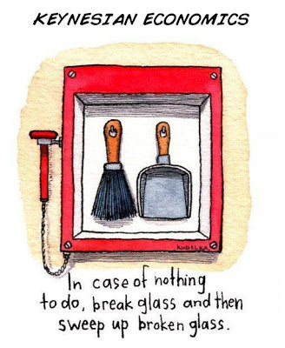
Application: fiscal stimulus
Via Greg Mankiw

Slide 60
Application: fiscal stimulus
David Cameron @ NYU, March 16, 2012
Q: Is Keynesianism dead?
A: I don’t think there’s a huge difference between our approaches [stimulus in the US, austerity in the UK]. We both want growth. We both want to deal with our deficits.
As for Keynes: Of course government can stimulate economic activity. But when you’re borrowing around 10% of your GDP, as we were in 2010, when the markets are beginning to ask, are you going to pay your debts? In that case, stimulus could raise interest rates and slow the economy. So I think you need to be practical.

Slide 61
Application: productivity
Increase productivity A
Which curve shifts? Which way?
What happens to Y and P?

Slide 62
Application: more productivity
P
AS*
AS
A
AD
Y*
Y

Slide 63
Application: more productivity
P
AS*
AS
A
B
C
AD
Y*
Y

Slide 64
Application: more productivity
Start at A: short-run and long-run equilibrium
More productivity: AS and AS* shift right
New short-run equilibrium at B
Lower prices, higher output
New long-run equilibrium at C
Even lower prices, higher output
Why? Does this make sense to you?

Slide 65
Application: higher oil prices
Increase oil prices
Which curve shifts? Which way?
What happens to Y and P?

Slide 66
Application: higher oil prices
P
AS*
AS
A
AD
Y*
Y

Slide 67
Aggregate supply: higher oil prices
P
AS*
AS
C
B
A
AD
Y*
Y

Slide 68
Application: higher oil prices
Start at A: short run and long run equilibrium
Higher oil prices: AS and AS* shift left
New short-run equilibrium at B
Higher prices, lower output
New long-run equilibrium at C
Even higher prices, lower output
Why? Does this make sense to you?

Slide 69
What have we learned?
Aggregate supply and demand is the analyst standard
Supply refers to production, affected by productivity, oil prices, etc
Demand refers to purchases, affected by money supply, government purchases, etc
Summary
In the long run, output is determined by the production function (the first half of the course)
In the short run, things like the money supply and government purchases also matter (this part of the course)

Slide 70

The Global Economy Policy in the AS/AD Model

Slide 71
Midterm
110 points total
Mean: 85
Approximate A range (35%): 92 to 103
Solid B: 70 and above
Don’t panic, but could use improvement: below 70

Slide 72
The idea
Most countercyclical policies affect demand
If the problem is with supply, we’re out of luck [although lots of things increase productivity over time]

Slide 73
Roadmap
AS/AD review
Crisis of confidence
Where do business cycles come from?
Policy goals and responses
What happened?

Slide 74
AS/AD review

Slide 75
AS/AD review
Aggregate supply and demand
Supply concerns the production of goods
Demand concerns purchases of goods
How to use them
Short-run equilibrium: where AS and AD cross
Long-run equilibrium: where AS* and AD cross
What shifts them
AD: money supply, government purchases, “optimism”
AS & AS*: productivity, capital stock, oil prices
Rule of thumb: AS and AS* shift left/right by the same amount

Slide 76
AS/AD review
P
AS*
AS
Where is the short-run equilibrium?
Long-run equilibrium?
A
AD
Y*
Y

Slide 77
AS/AD review
P
AS*
AS
Where is the short-run equilibrium?
Long-run equilibrium?
A
B
AD
Y*
Y

Slide 78
Crisis of confidence
Replace with Abenomics?
http://www.economist.com/news/asia/21605929-shinzo-abes-fight-reshape-japans-economy-and-society-entering-new-phase-battle-japan

Slide 79
Crisis of confidence
Where are we now?
Do Feroli’s channels affect supply or demand?
If demand, which way does AD shift? What is the impact on growth and inflation?
What would you add – or do differently?

Slide 80
Crisis of confidence
P
AS*
AS
AD
Y*
Y

Slide 81
Where do business cycles come from?

Slide 82
Inflation and growth
Reminder: interpret axes as inflation and (GDP) growth
Why do inflation and growth change?
Shifts in AS and AD?
Which one? How can you tell?

Slide 83
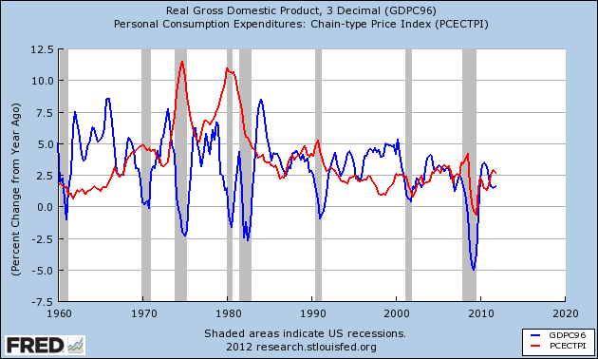
Inflation and growth

Slide 84
Inflation and growth
Would you expect to see high growth associated with high or low inflation? Why?
How would inflation and growth be related if
Most shifts were in aggregate demand?
Most shifts were in aggregate supply?
Where do you see demand “shocks”?
Where do you see supply “shocks”?

Slide 85
Inflation and growth
P
AS*
AS
AD
Y*
Y

Slide 86
Inflation and growth

Slide 87
Inflation and growth
Do we see mostly supply or demand shocks?

Slide 88
Inflation and growth

Slide 89
Policy goals and responses

Slide 90
Policy goals and responses
The idea
Monetary policy should respond differently to changes in output that result from supply and demand shifts
Accommodate one, offset the other
Intuitive only when you understand it – not before!

Slide 91
Policy goals and responses
What are our policy goals?
Low inflation or stable prices [why?]
Output at or near Y* [invisible hand again]
How would we reach them?
Typically monetary policy, which shifts AD
Could use fiscal policy, too, but it takes longer to implement

Slide 92
Policy goals and responses
P
AS*
AS
Is this good or bad?
A
AD
Y*
Y

Slide 93
Policy goals and responses
What happens if demand shifts right?
What might do this?
Are things better or worse?

Slide 94
Policy goals and responses
P
AS*
AS
B
Is this good or bad?
A
AD
Y*
Y

Slide 95
Policy goals and responses
What happens if demand shifts left?
What might do this?
Are things better or worse?

Slide 96
Policy goals and responses
P
AS*
AS
Is this good or bad?
A
B
AD
Y*
Y

Slide 97
Policy goals and responses
How should we respond to a demand shift?
What should we do?
How would we do it?

Slide 98
Policy goals and responses
P
AS*
AS
What should policy do?
A
B
AD
Y*
Y

Slide 99
Policy goals and responses
How should we respond to a demand shift?
Reverse it: use (say) monetary policy to shift demand back to A
Does this make sense to you?

Slide 100
Policy goals and responses
Now do the same thing with supply shifts
Same logic, but keep your eyes open for something new
What happens if supply shifts right?
What might do this?
Are things better or worse?

Slide 101
Policy goals and responses
P
AS*
AS
Is this good or bad?
A
B
AD
Y*
Y

Slide 102
Policy goals and responses
What happens if supply shifts left?
What might do this?
Are things better or worse?

Slide 103
Policy goals and responses
P
AS*
AS
B
Is this good or bad?
A
AD
Y*
Y

Slide 104
Policy goals and responses
How should we respond to a supply shift?
What should we do?
How should we do it?
Reminder: policy goals are
Stable prices
Output at or near Y*

Slide 105
Policy goals and responses
P
AS*
AS
What should policy do?
A
B
AD
Y*
Y

Slide 106
Policy goals and responses
P
AS*
AS
Why is C good?
A
C
B
AD
Y*
Y

Slide 107
Policy goals and responses
How should we respond to a supply shift?
Reinforce or “accommodate” it: shift AD in same direction as AS
Does this make sense?

Slide 108
Policy goals and responses
P
AS*
AS
B
What should policy do?
A
AD
Y*
Y

Slide 109
Policy goals and responses
P
AS*
AS
B
Why is C good?
C
A
AD
Y*
Y

Slide 110
Policy goals and responses
How should we respond to a supply shift?
Reinforce or “accommodate” it: shift AD in same direction as AS
Does it make sense to lower output further?

Slide 111
What happened?

Slide 112
What happened?
Our mission
Identify source of shock: supply or demand?
Recommend the appropriate policy

Slide 113
What happened?
In the mid 1970s?
GDP growth low, inflation jumped up
In the early 1980s
Double-dip recession, inflation fell sharply
In the late 1990s?
GDP growth high, inflation remained low
In the early 2000s?
Fear of deflation, aggressive monetary expansion

Slide 114
What happened?

Slide 115
What happened in the mid-1970s?

Slide 116
What happened in the mid-1970s?
In the mid 1970s?
GDP growth low, inflation jumped up
Order of events
OPEC raised oil prices from $15 to $30
Output fell
Inflation soared – and stayed up
How did this work? Shift in supply or demand?

Slide 117
What happened in mid-1970s?
P
AS*
AS
B
What should Fed do?
C
A
AD
Y*
Y

Slide 118
What happened in mid-1970s?
P
AS*
AS
C
B
What happens if Fed shifts AD the other way?
A
AD
Y*
Y

Slide 119
What happened in the mid-1970s?
Standard interpretation of 1970s inflation
OPEC was a shift left in AS/AS*
Fed should therefore accommodate, shift AD left
If so, we would have seen a drop in Y but stable prices
But the Fed shifted AD right, raising inflation sharply
Long-run output response the same in both cases

Slide 120
What happened in the early 1980s?

Slide 121
What happened in the early 1980s?
In the early 1980s?
Double dip recession, inflation dropped sharply
Order of events
Volcker appointed head of Fed, charged with killing inflation
Reduced money growth, interest rates rose sharply
After a year or two, inflation dropped
How did this work? Shift in supply or demand?

Slide 122
What happened in the early 1980s?
P
AS*
AS
Short-run impact? Long run?
A
B
C
AD
Y*
Y

Slide 123
What happened in the early 1980s?
Standard interpretation
Fed shifted AD back sharply
Short run impact: recession, lower inflation (A to B)
Long-run impact: much lower inflation (B to C)
Why do some find prospect of inflation so painful?

Slide 124
What happened in the late 1990s?

Slide 125
What happened in the late 1990s?
In the late 1990s
The economy is booming
Is it “overheating”?
What should the Fed do?
Recall:
If high demand, Fed should reverse it
If high supply, Fed should accommodate
Which was it? How can you tell?

Slide 126
What happened in the early 2000s?

Slide 127
What happened in the early 2000s?
In the early 2000s
The economy recovered nicely from “dot-com crash”
Inflation low – deflation on the horizon?
Fed expanded money supply aggressively
Questions
Avoided deflation, inflation jumped up
Low interest rates facilitated cheap leverage
Good idea or bad?

Slide 128
Deflation summary
Deflation = negative inflation (falling prices)
Evidence
Deflation associated with bad economic performance: US in 1930s in the US, Japan in 1990s
Also with good performance: US in 1880s, many others
Theoretical mechanism
Unexpected deflation benefits lenders, hurts borrowers
Therefore bad?

Slide 129
What have we learned?
Shifts to supply and demand move GDP growth and inflation around
AS/AD model suggests we should
“Offset” demand shifts
“Accommodate” supply shifts
How can we tell them apart?
Ask yourself whether inflation and GDP growth are moving in the same direction or not

Slide 130
For the ride home
Should Fed continue aggressive expansion of money supply (“quantitative easing”)?
Or slow down?
Why or why not?
***??? Should corporations pay more tax?

Slide 131
For the ride home
Should corporations pay more tax?
Should we outlaw “inversions” that give firms a foreign headquarters? ??
President Obama on Thursday called for Congress to strip away tax advantages that have encouraged a rush of mergers and acquisitions that give companies an overseas base while they maintain their presence in the United States.
“I don’t care if it’s legal — it’s wrong.”
Notes:
http://www.nytimes.com/2014/07/25/us/obama-to-urge-end-to-loophole-letting-firms-shield-profits-abroad-.html

