Slide 1

The Global Economy Business Cycle Properties
Notes:
Open FRED, Bloomberg Calendar

Slide 2
Where we’re headed
New module: short-term economic performance

Slide 3
The idea
Economic growth is volatile
We’re not sure why, but we did come up with a name: business cycles

Slide 4
Roadmap
What’s happening?
Business cycles
Volatility
Mercedes-Benz USA
Business cycle properties (some things are more “cyclical” than others)
What’s more cyclical?

Slide 5
What’s happening?
Leo Mirani, Quartz, October 2014
Facebook’s corporation tax in the United Kingdom for 2013 came to a grand total of £3,169 ($4,005). The company also received £185,196 in credits from previous years, leaving it with a credit balance of £182,027. The income tax paid by an inner London school teacher comes to just over £3,500.
What’s going on here? What do you think?
Notes:
http://qz.com/285380/a-london-school-teacher-pays-more-uk-tax-than-facebook/

Slide 6
What’s happening?
From the Bloomberg Economic Calendar
Wednesday: FOMC announcement, ADP employment
Thursday: GDP, jobless claims
Friday: Consumer Sentiment, PMI
Next Wednesday: ADP employment report
Next Friday: BLS employment report
More next class
Bloomberg -> Markets -> Economic Calendar
Source: Bloomberg, Economic Calendar.

Slide 7
Business cycles

Slide 8
Business cycles: what are they?
Burns and Mitchell
“Business cycles” are fluctuations in aggregate economic activity. Expansions occur in many economic activities, followed by similarly general recessions, which merge into the next “cycle.”
That is: short-term fluctuations in growth rates

Slide 9
Business cycles: terminology
peak
trough
expansion
recession/ contraction
11 months
59 months

Slide 10
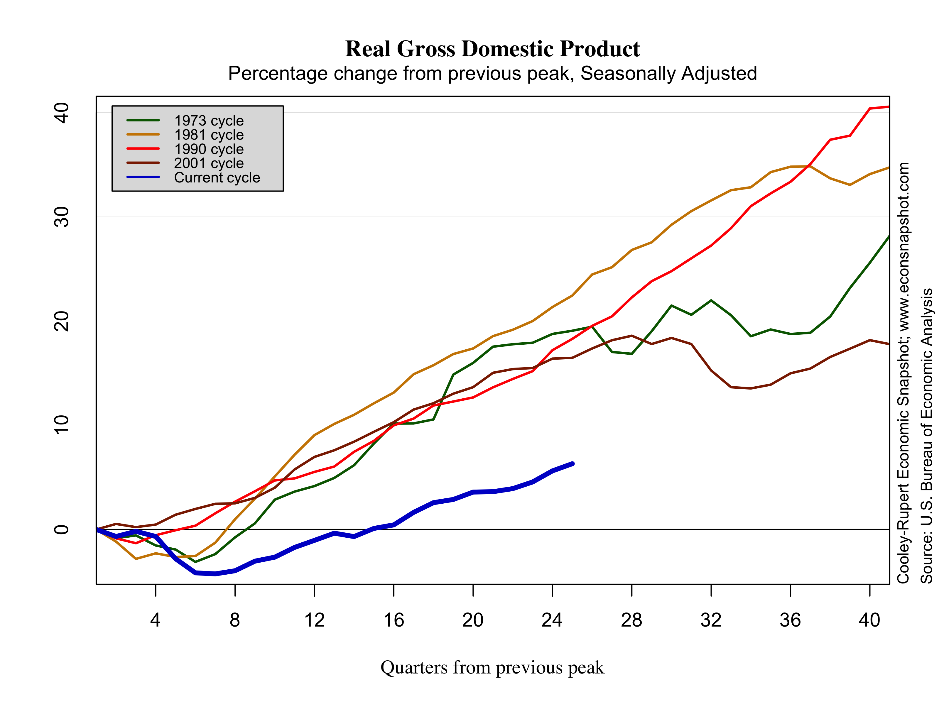
Business cycles: recent history

Slide 11
Business cycles: who cares?
Finance
Fixed income
Currencies
Asset management
Equities, esp emerging markets
Media and marketing
Not a focus, but they’re unusually cyclical businesses
Everyone else
Fact of life you’ll have to deal with

Slide 12
Volatility

Slide 13
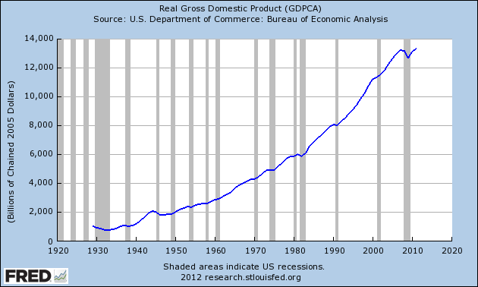
US GDP (annual)

Slide 14
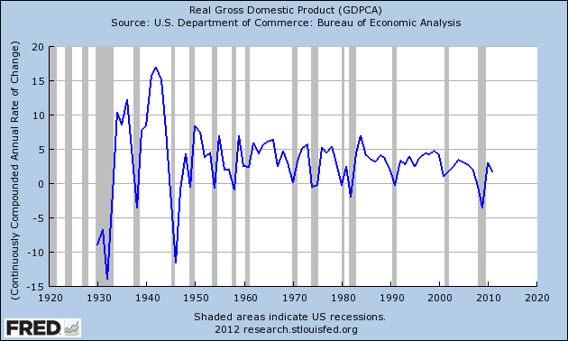
US GDP (annual, growth rate)

Slide 15
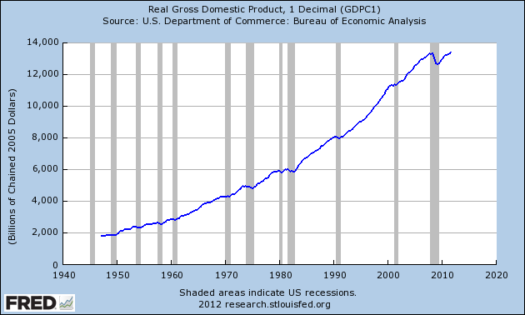
US GDP (quarterly)

Slide 16
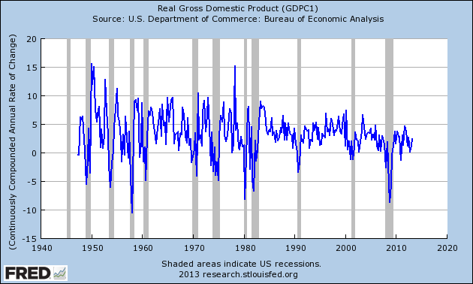
US GDP (quarterly, growth rate)

Slide 17
Mean annual GDP growth, 1980-2011
Source: EIU CountryData

Slide 18
Std dev annual GDP growth, 1980-2011
Source: EIU CountryData

Slide 19
Mercedes-Benz USA

Slide 20
Mercedes-Benz USA
How cyclical is their business?
Why?
What should they do to deal with it?

Slide 21
Business cycle properties

Slide 22
Business cycle properties
Some things are more cyclical than others
Which ones?

Slide 23
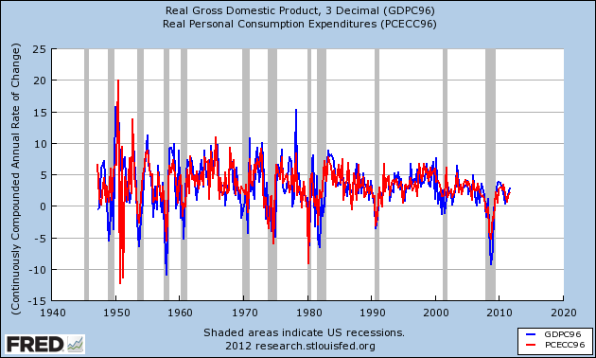
Consumption

Slide 24
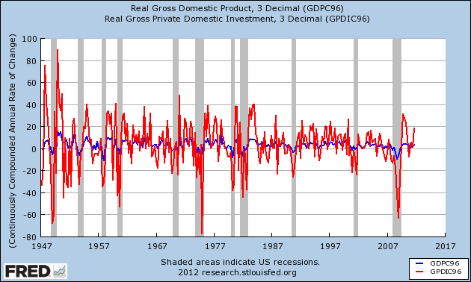
Private investment

Slide 25
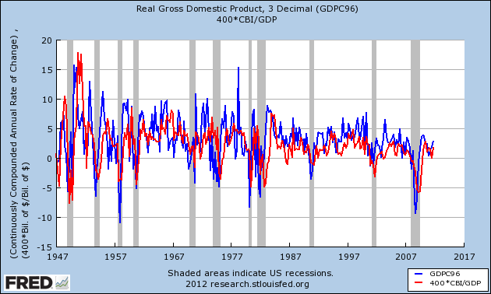
Change in inventories

Slide 26
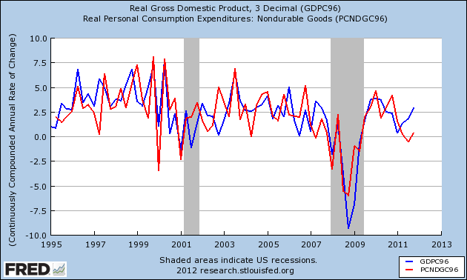
Consumption: nondurable goods

Slide 27
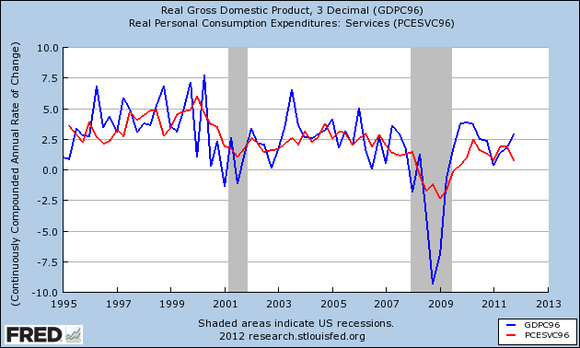
Consumption: services

Slide 28
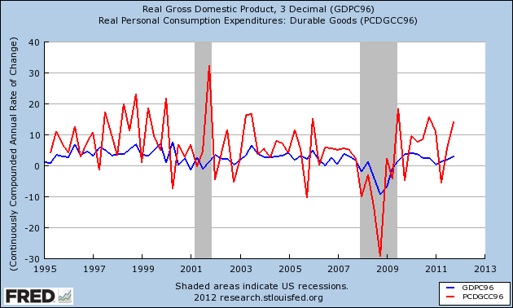
Consumption: durable goods

Slide 29
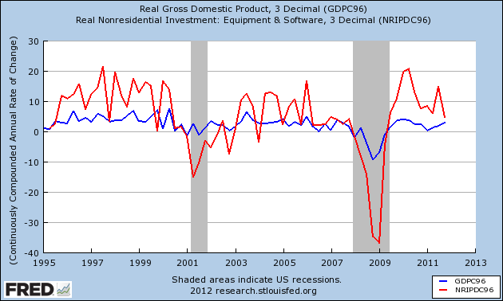
Investment: equipment & software

Slide 30
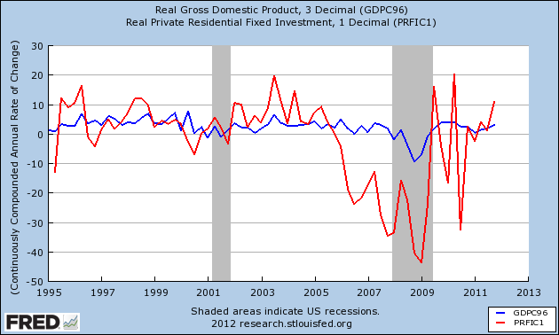
Investment: housing

Slide 31
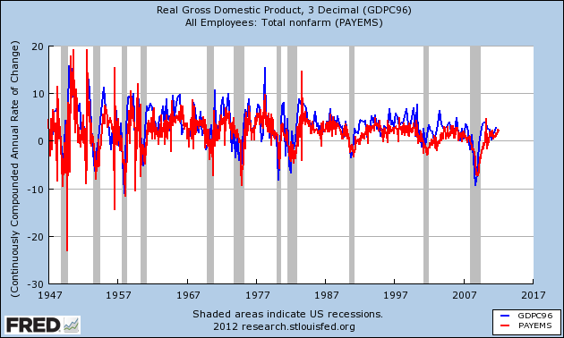
Employment

Slide 32
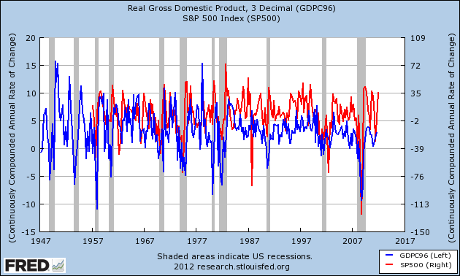
S&P 500

Slide 33
What’s more cyclical?

Slide 34
What’s more cyclical?
General Motors
Pfizer
Proctor & Gamble
Johnson & Johnson

Slide 35
What’s more cyclical?
Walmart
Richemont
New York Times
Google
American Airlines
McKinsey

Slide 36
What have we learned?
Economic growth is volatile
Lots of things move up and down together
[Like what?]
Some of them move more than others
[Which ones?]

Slide 37
For the ride home
The economy
How does it look to you?
How would you get a clearer picture?
What indicators do you think would be helpful?

