Slide 1

The Global Economy Business Cycle Indicators
Notes:
Open FRED, graph employment
Open Bloomberg calendar
Open Outline
Short? Esp second half?

Slide 2
Where we’re headed
Short-term economic performance
A series of topics
On today’s agenda
Indicators
Big inflations

Slide 3
The question
How does the US economy look to you right now?
How can you tell?

Slide 4
The idea
Lots of indicators of economic activity
We use their past patterns to assess
Current economic conditions
Near-term future economic conditions
If (say) an increase in housing starts has been associated with good economic performance in the past …
What if this time is different?

Slide 5
Joke of the day
Why do economists add a digit after the decimal point to their forecasts?
To show they have a sense of humor

Slide 6
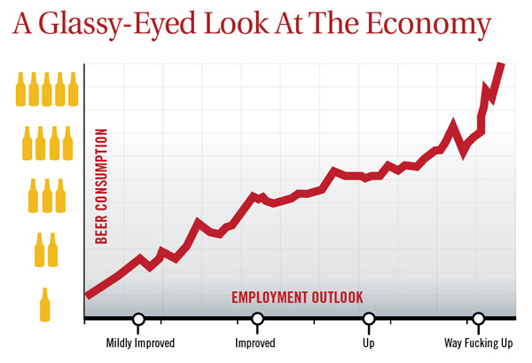
Bonus joke of the day
“Nation's Unemployment Outlook Improves Drastically After Fifth Beer,” The Onion.
Notes:
6
http://www.theonion.com/articles/nations-unemployment-outlook-improves-drastically,2792/

Slide 7
Forecasting
Tim Harford
Economists have allowed themselves to walk into a trap where we say we can forecast, but no serious economist thinks we can. [True, that, but what does he mean by “we”?]
John Maynard Keynes
You don't expect dentists to be able to forecast how many teeth you'll have when you're 80. You expect them to give good advice and fix problems.

Slide 8
Courses related to this topic
Real-world analysis of economic data (ECON-GB.2347)
Professor Peter D’Antonio, Citi, Director and Head of US Economic Forecasting, does this for a living
Forecasting time series data (STAT-GB.0018)
Professor Cliff Hurvich, expert and pianist
Or Professor Rohit Deo, also an expert

Slide 9
What’s happening?
Employment report comes out Friday at 8:30am
Consensus: up 240k in October
September: up 248k
Unemployment rate: consensus 5.9 (same as Sep)
More on Bloomberg calendar, FRED
What do we learn from this?
How will markets respond?

Slide 10
Roadmap
Indicators
The cross-correlation function
The business cycle scorecard

Slide 11
Indicators

Slide 12
Indicators of economic activity
Hundreds of them, more all the time
See Bloomberg calendar (ditto WSJ, others)

Slide 13
Indicators: terminology
A variable is procyclical if it moves up and down with the economy, countercyclical if it moves in the opposite direction
A variable leads the economy if its ups and downs come before, lags if its movements come after, coincident if they happen at the same time
“The economy” = GDP growth

Slide 14
Indicators: plan
Look at monthly data (mostly yoy growth rates)
Shift from GDP to industrial production
For each one
Is it procyclical? Countercyclical?
Does it lead? Lag?
What does it suggest about current and future conditions?

Slide 15
Indicators: FRED
Plot and download data

Slide 16
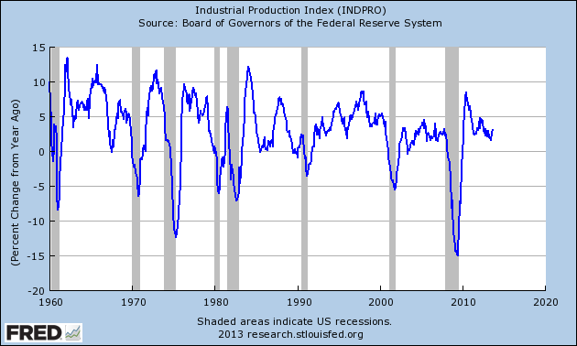
Industrial production (yoy growth)

Slide 17
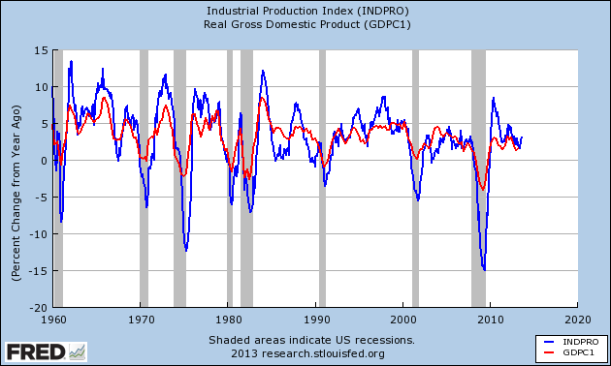
Industrial production and GDP (yoy)

Slide 18
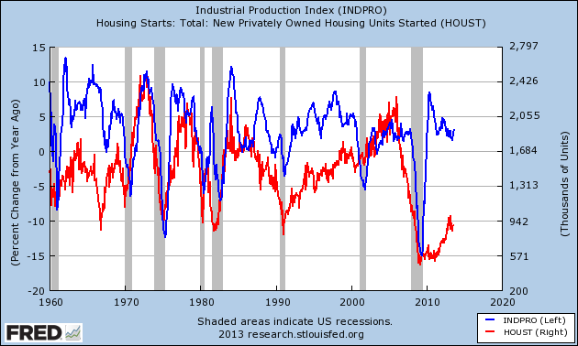
Housing starts (units, thousands)

Slide 19
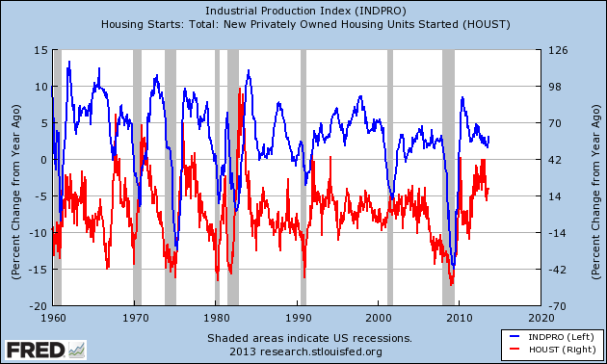
Housing starts (yoy growth)

Slide 20
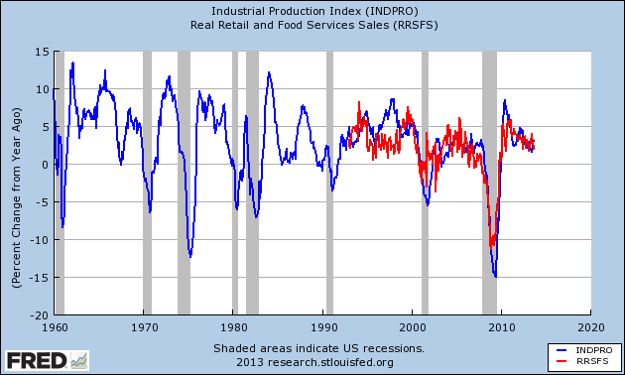
Retail sales (yoy growth)

Slide 21
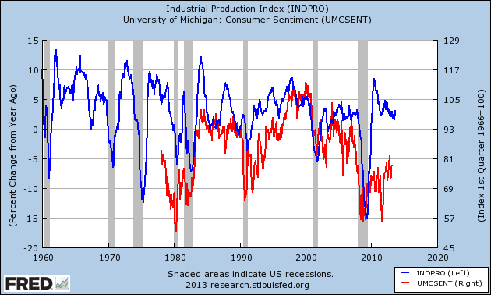
Consumer sentiment (index)

Slide 22
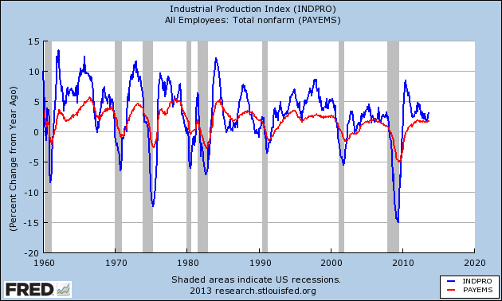
Employment (yoy growth)

Slide 23
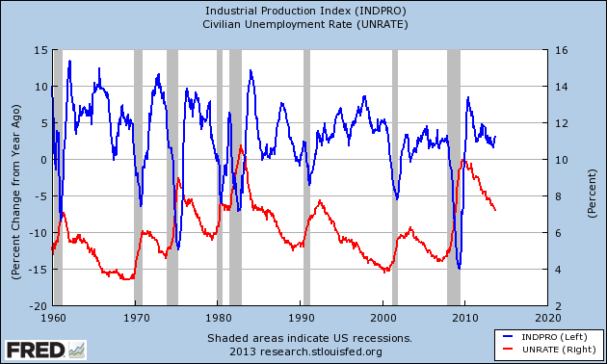
Unemployment rate

Slide 24
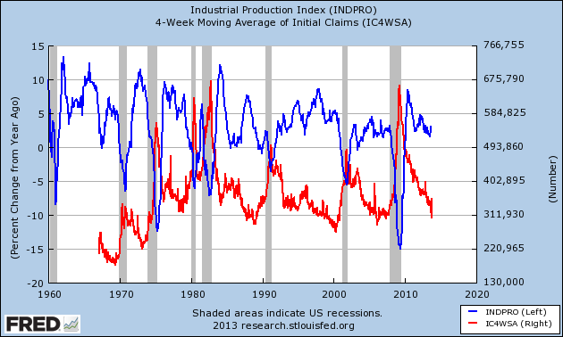
Initial claims for UI

Slide 25
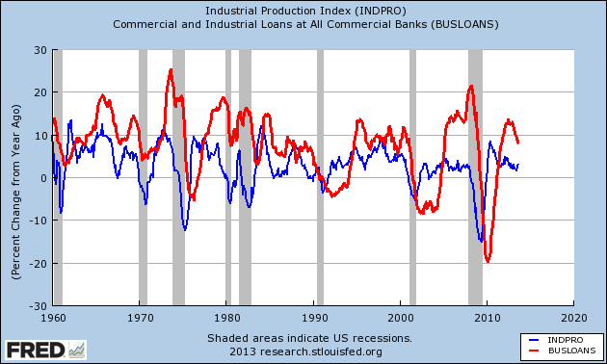
Commercial & industrial loans (yoy growth)

Slide 26
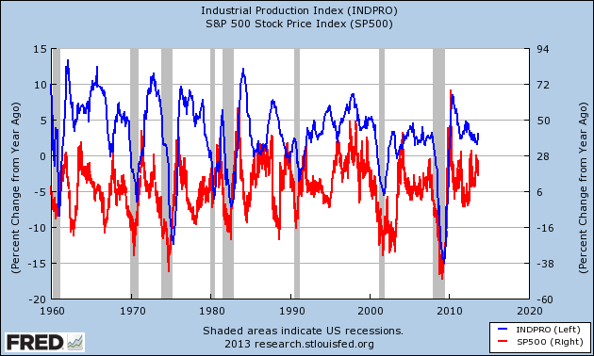
S&P 500 (yoy growth)

Slide 27
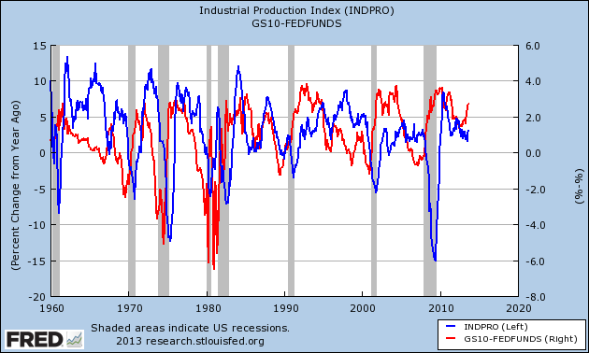
Term spread (10y – fed funds)

Slide 28
Indicator summary
Think about which indicators are
Procyclical
Countercyclical
Leading
Lagging
Coincident
Which ones do you like best?

Slide 29
Cross-correlations

Slide 30
Review: correlations
Correlations: a measure of (linear) association between two variables
Conveniently scaled between –1 and +1
The farther from zero, the stronger the association
Link to nontechnical guide on Course Outline

Slide 31
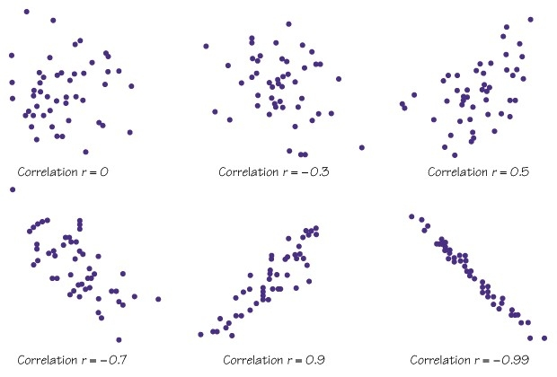
Review: correlations

Slide 32
The cross-correlation function
Look at the correlation between x and y
Think of x as the indicator
Plus: shift y back and forth in time (to see leads and lags)
Formally
ccf(k) = corr[x(t),y(t-k)]
If k<0: x leads y [or y lags x]
If k>0: x lags y [or y leads x]
Why? Makes a great picture

Slide 33
Contemporaneous correlation
Date | x(t) | y(t)
1 | 2.43 | 8.47
2 | 1.19 | 2.29
3 | 0.13 | 7.36
4 | 0.56 | 6.39
5 | 0.38 | 6.02
6 | 0.96 | 0.22
7 | 1.87 | 3.60
Reminder:
ccf(k) = corr[x(t),y(t-k)]
For k = 0:
ccf(0) = corr[x(t),y(t)]
Use data marked
Red for x
Blue for y

Slide 34
Lagging correlation
Date | x(t) | y(t-1)
1 | 2.43 | 8.47
2 | 1.19 | 2.29
3 | 0.13 | 7.36
4 | 0.56 | 6.39
5 | 0.38 | 6.02
6 | 0.96 | 0.22
7 | 1.87 | 3.60
Reminder:
ccf(k) = corr[x(t),y(t-k)]
For k = +1:
ccf(1) = corr[x(t),y(t-1)]
Means: x lags y
Use data marked
Red for x
Blue for y
Note lost observation

Slide 35
Leading correlation
Date | x(t) | y(t+1)
1 | 2.43 | 8.47
2 | 1.19 | 2.29
3 | 0.13 | 7.36
4 | 0.56 | 6.39
5 | 0.38 | 6.02
6 | 0.96 | 0.22
7 | 1.87 | 3.60
Reminder:
ccf(k) = corr[x(t),y(t-k)]
For k = -1:
ccf(1) = corr[x(t),y(t+1)]
Means: x leads y
Use data marked
Red for x
Blue for y
Note lost observation

Slide 36
Cross correlation graphs
Pictures: plot ccf(k) against k
y = IP growth
x = indicator
Sample period: 1960 to present [why?]
Most variables are yoy growth rates [why?]
Does indicator lead or lag IP growth?

Slide 37
Does employment lead or lag?

Slide 38
How to tell
Find the largest correlation
Procyclical or countercyclical?
If positive, procyclical
If negative, countercyclical
Leading or lagging
If to the left, leading
If to the right, lagging

Slide 39
Initial (“new”) claims for UI (yoy growth)

Slide 40
Housing starts (yoy growth)

Slide 41
Consumer sentiment (yoy growth)

Slide 42
S&P 500 (yoy growth)

Slide 43
Yield spread

Slide 44
Good indicators
Which ones have high correlations?
Which ones lead?
Which ones do you like best?
Warning: even the best indicators forecast the future imperfectly [poorly?]

Slide 45
Computing cross-correlations
How do we compute them?
Method 1: use Excel to calculate each point [see link]
Method 2: use some kind of statistical software [R? Python?]

Slide 46
Business cycle scorecard

Slide 47
Business cycle scorecard
Useful summary of lots of indicators
For each one:
Graph indicator over time
Add lines for mean, +/- one std deviation
Rate indicator as strong positive, positive, negative, strong negative

Slide 48
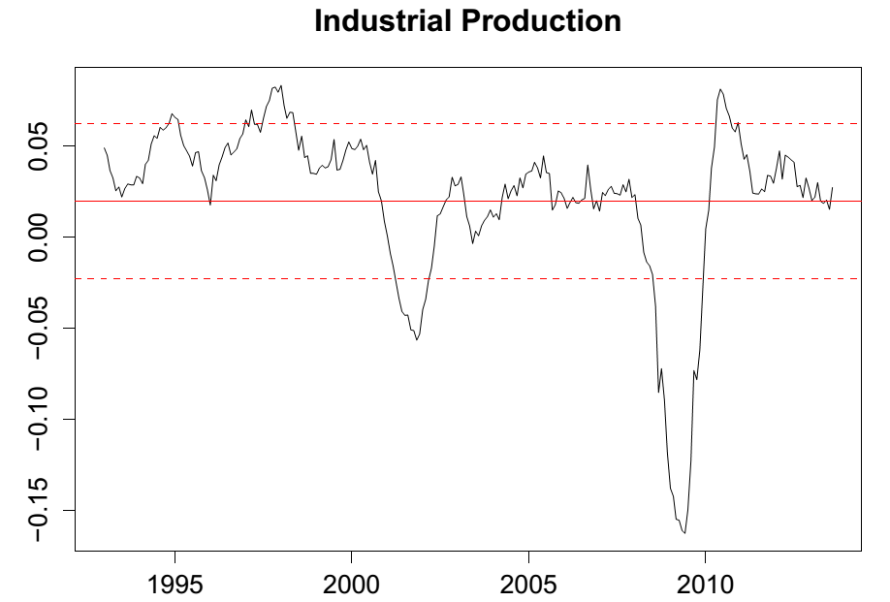
Business cycle scorecard

Slide 49
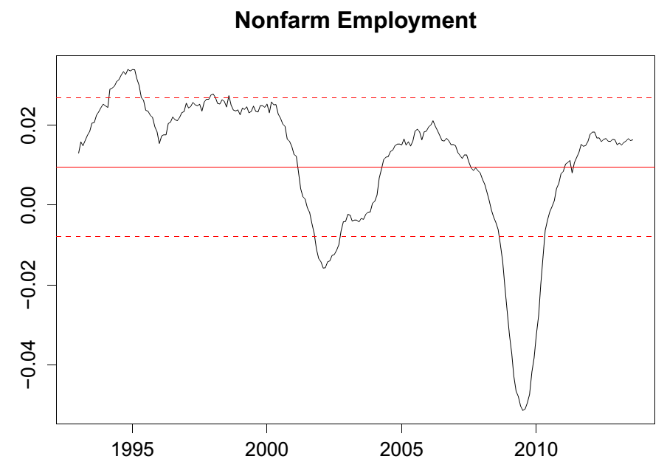
Business cycle scorecard

Slide 50
Business cycle scorecard
Indicator | Strong Negative | Negative | Positive | Strong Positive
Ind. Prod.
Total

Slide 51
Business cycle scorecard
Coming up: Problem Set #3 due next week
Download indicators from FRED
Compute cross-correlation functions
Construct business cycle scorecard
Start soon!

Slide 52
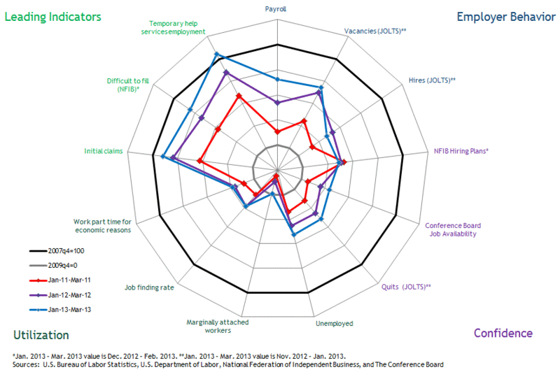
Scorecard: my goal
Source: Macroblog, April 2013.

Slide 53
What have we learned?
Lots of things move up and down with the economy
We can use these patterns to assess current and near-term future conditions
Useful tools
Cross-correlation function
Business cycle scorecard
Where can I learn more?
Indicators course: ECON-GB.2347, D’Antonio
Forecasting course: STAT-GB.0018, Deo and Hurvich

Slide 54
Midterm
Answers posted
Grade distribution
Maximum: 110 (out of 110)
80th percentile: 106
65th: 101
50th: 98
25th : 92

Slide 55

The Global Economy Hyperinflation

Slide 56
The Global Economy Inflation and Monetary Policy
Notes:
This is like studying fevers starting with ebola.

Slide 57
Terminology
The price level is a measure of average prices
We label it P
Measured in units of currency (how many dollars to buy…)
Inflation is the rate of growth of the price level
Buying goods takes more currency
Or: a unit of currency buys less (same thing, of course)
We call it deflation if growth rate is negative
Hyperinflation is inflation > 100% per year
Notes:
Has anyone here lived through a hyperinflation?

Slide 58
The idea
Study inflation by looking at extreme cases
[Like studying the flu via ebola?]

Slide 59
The idea
Tom Sargent, interview
The way to start a hyperinflation is run sustained government deficits and then have the monetary authority print money to pay for it. That always works. How do you stop a hyperinflation? You stop doing it. This isn’t high economic theory.
What is he saying? Does it make sense to you?

Slide 60
The idea
La Nacion, via Google translate, March 25, 2012
[Argentina's] Central Bank president, Mercedes Marco del Pont, said it “is totally false to say that the issue [of money] generates inflation.” She continued: ”only in Argentina does the idea remain that the expansion of the money [supply] generates inflation.”
What is she saying? Does it make sense to you?

Slide 61
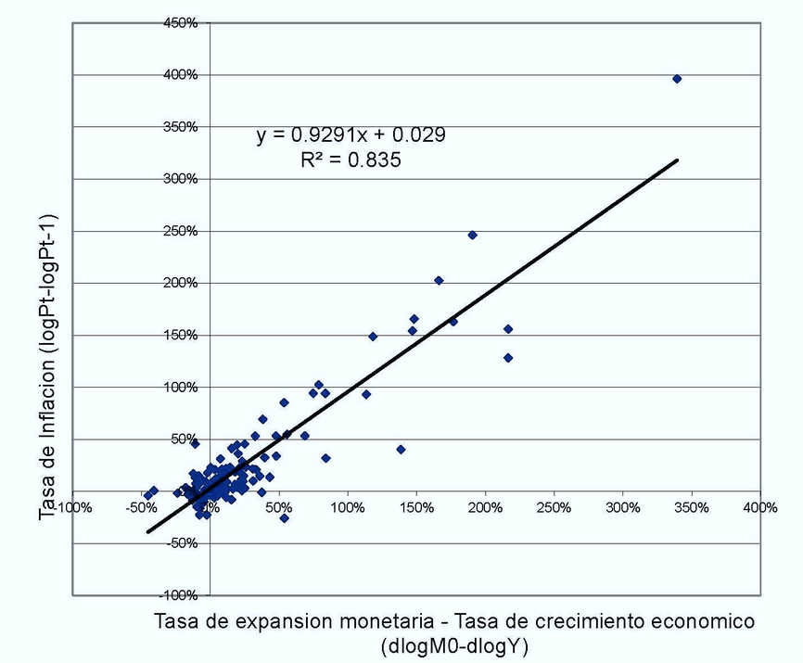
The idea: Argentine data
Source: Foco Economico, March 2012.

Slide 62
Roadmap
Terminology
Hyperinflation show and tell
Money and inflation: the quantity theory
Money supply mechanics
How deficits enter the picture

Slide 63
Hyperinflation show and tell

Slide 64
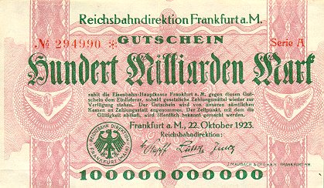
German currency
October 1923: 20 USD = 1 billion RM
Notes:
http://www.zum.de/whkmla/region/germany/turm2023.html

Slide 65
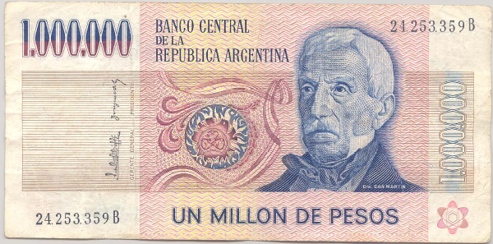
Argentine currency
This note dates from 1980s. What’s it worth now?

Slide 66
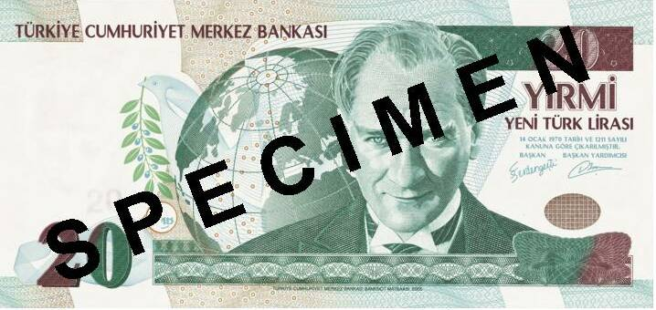
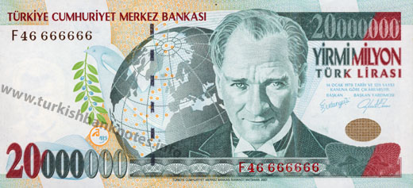
Turkish currencies
After 2008
Before 2008

Slide 67
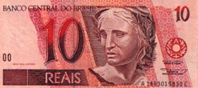
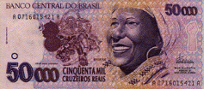
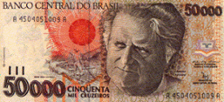
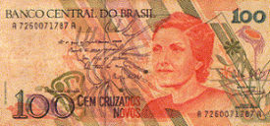
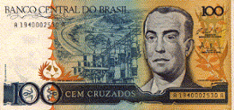
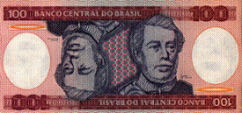
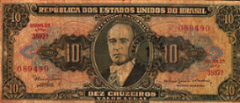
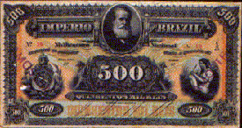
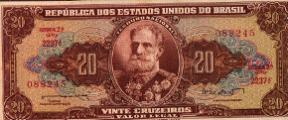
Brazilian currencies
REAL, Jun 1994 – present
CRUZEIRO REAL, Aug 1993 - Jun 1994
CRUZEIRO, Mar 1990 – Aug 1993
CRUZADO, Feb 1986 – Jan 1989
CRUZADO NOVO, Jan 1989 – Mar 1990
CRUZEIRO, May 1970 – Feb 1986
CRUZEIRO NOVO, Feb 1967 – May 1970
MIL-RÉIS, Oct 1833 – Oct 1942
CRUZEIRO, Oct 1942 – Feb 1967

Slide 68
Highest inflation rates ever
Example | Highest Daily Inflation
Hungary, Jul 1946 | 207%
Zimbabwe, Nov 2008 | 98%
Yugoslavia, Jan 1994 | 65%
Germany, Oct 1923 | 21%
Notes:
68
Have you lived through a big inflation? What was it like?

Slide 69
Inflation in Argentina (annual %)
Source: EIU database.

Slide 70
Inflation in Brazil (annual %)
Source: EIU database.

Slide 71
Inflation in Russia (annual %)
Source: EIU database.

Slide 72
Inflation in Turkey (annual %)
Source: EIU database.

Slide 73
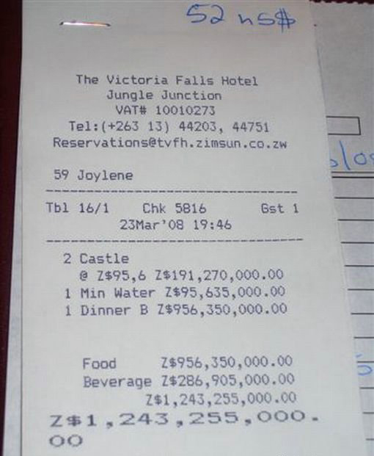
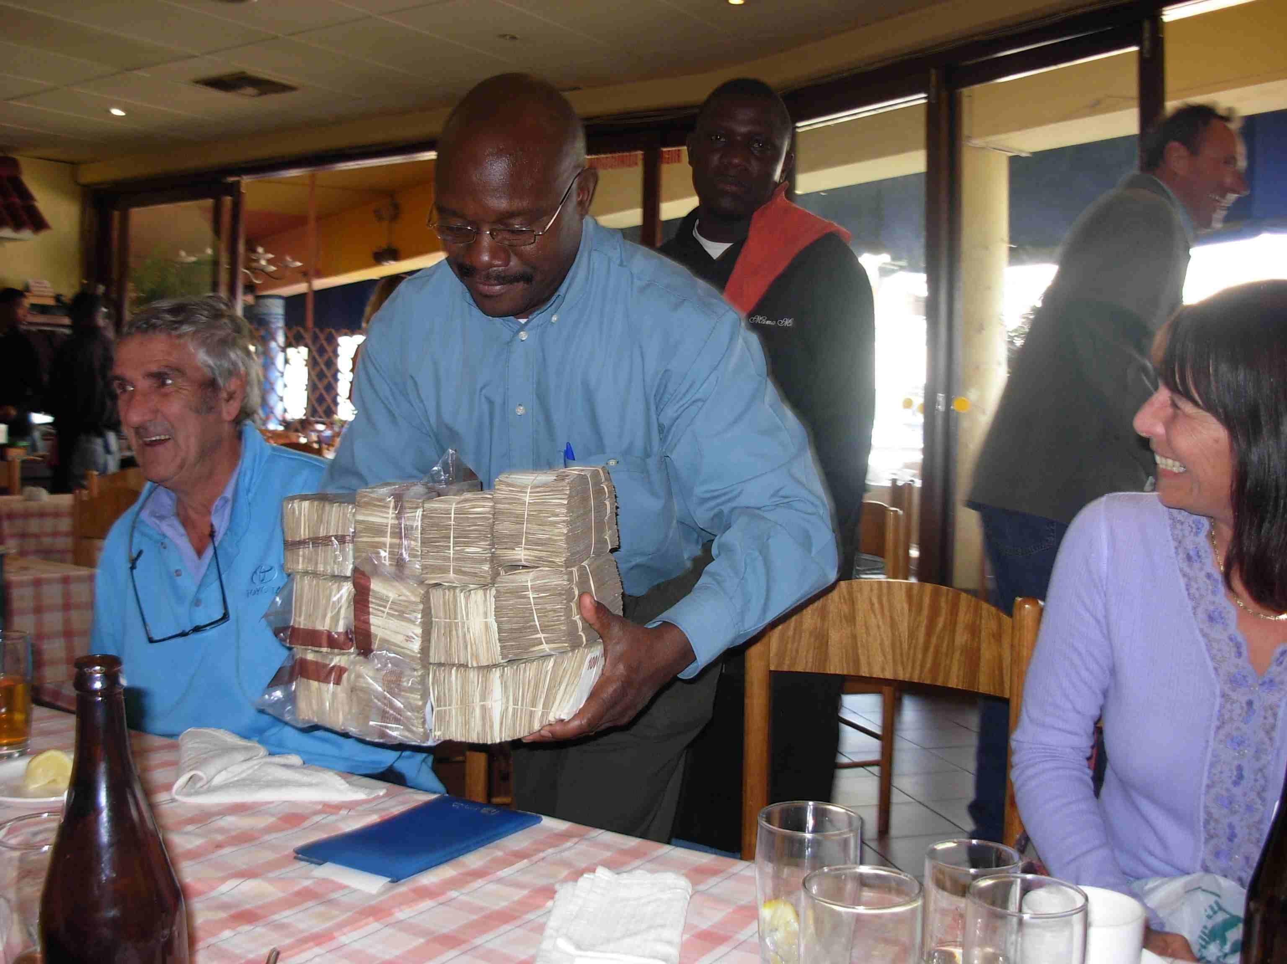
Buying lunch in Zimbabwe

Slide 74
Zimbabwe timeline
December 2006: inflation over 1000%
February 2007: inflation ruled illegal
October 2008: inflation over 200 million percent!
January 2009:
Transactions permitted in foreign currency
Soldiers and teachers to be paid in USD
February 2009: 12 zeros knocked off
April 2009: government abandons currency, people use USD (also South African rand – ZAR)

Slide 75
Inflation in Israel (annual %)
Source: EIU database.
Notes:
75

Slide 76
Israel in the 1980s
American Rabbi visiting Israel:
During Israel’s hyperinflation, I had a mortgage at a 5% fixed annual interest rate. As inflation increased, fixed rate mortgage payments became laughably easy to make, because salaries more or less kept pace with inflation. Finally, I received a notice canceling my mortgage, because the cost of record-keeping had become more than the monthly payment.

Slide 77
Iran
Graeme Wood, “Hyperinflation vacation,” The Atlantic, April 2013:
The Iranian rial was hovering under 40,000 to one U.S. dollar, weaker by nearly half compared with six months earlier. Authorities tried to ban currency trading for a few weeks in October, when the inflation rate peaked.
Wood’s First Rule of Budget Travel: where there is runaway inflation, there are great deals for travelers with hard cash. So in January, I boarded a flight from Dubai to Kish, an Iranian holiday resort in the Persian Gulf.

Slide 78
Other examples
Personal experiences with hyperinflation?

Slide 79
The quantity theory of money

Slide 80
Quantity theory: picture
Money
Growth
Inflation

Slide 81
Quantity theory: words
The more currency (money) in circulation, the less each unit is worth

Slide 82
Quantity theory: math
One equation (a production function for transactions)
M V = P Y
M = stock of money in circulation (amount of currency)
V = velocity (how often a unit of currency is used in a year)
P = price level (the GDP deflator or other price index)
Y = real GDP

Slide 83
Quantity theory: math
One equation (technology for transactions)
M V = P Y
In growth rates
γ_{M} + γ_{V} = γ_{P} + γ_{Y}
γ_{M} = growth of money supply (think: currency)
γ_{V} = growth of velocity
γ_{P} = growth of price level (the inflation rate)
γ_{Y} = growth of real GDP

Slide 84
Quantity theory
Two hypotheses
V is constant (γ_{V} = 0)
Y not affected by changes in M [Or: changes in Y small relative to changes in M]
One conclusion
Money growth causes inflation
γ_{P} = γ_{M} – γ_{Y}
Notes:
84

Slide 85
Quantity theory: long-run evidence

Slide 86
Quantity theory: short-run evidence

Slide 87
Quantity theory: small inflations
Lots of other things relevant in small inflations
Link between money and prices not as tight
More on this next week

Slide 88
Money supply mechanics

Slide 89
Money supply mechanics
How the central bank manages the money supply
Money = currency for our purposes
Supply changed by buying/selling bonds in market
Works through balance sheets for
Treasury
Central bank
Private agents (households and firms)

Slide 90
Money supply mechanics
Treasury
Assets |  | Liabilities
 |  | Bonds | 200
Where does treasury debt come from?
Where does money supply come from?
Central bank
Assets |  | Liabilities
Bonds | 0 | Money | 0
Households and firms
Assets |  | Liabilities
Money | 0
Bonds | 200

Slide 91
Money supply mechanics
Treasury
Assets |  | Liabilities
 |  | Bonds | 200
How does central bank increase money supply?
Why do households go along?
Central bank
Assets |  | Liabilities
Bonds | 20 | Money | 20
Households and firms
Assets |  | Liabilities
Money | 20
Bonds | 180

Slide 92
Money supply mechanics
Treasury
Assets |  | Liabilities
 |  | Bonds | 200
Where do deficits come in?
Does there need to be a connection with money growth?
Why so in hyperinflations?
Central bank
Assets |  | Liabilities
Bonds | 20 | Money | 20
Households and firms
Assets |  | Liabilities
Money | 20
Bonds | 180

Slide 93
Quantity theory: revised picture
Government
Deficit
Money
Growth
Inflation

Slide 94
Hyperinflation recap
Hyperinflations – always! – stem from
Lack of fiscal discipline [= government deficit]
Accommodation by central bank [= printing money]
How to end them: “stop doing it”
Balance government budget
Make central bank independent, prohibit it from buying debt directly from Treasury

Slide 95
Fiscal dominance in the US and EU
Fiscal dominance means
Government debt and deficit are so large that the only alternative to explicit default is printing money
US/Fed view of the world
Need aggressive monetary policy to recover from crisis
EU/ECB view of the world
Need to resist inflation with tight monetary policy
US guilty of “soft fiscal dominance”

Slide 96
What have we learned?
Hyperinflation comes from
Large increases in money supply
Triggered by government deficits
Solution: Stop doing it.
Essential tools
Quantity theory
Central bank balance sheet

Slide 97
For the ride home
Question 1
Would Argentina be better off using USD?
Would the US be better off with gold?
Question 2
Unexpected inflation hurts creditors [why? why unexpected?]
Does this violate property rights?

Slide 98
Problem Set #3
Due in a week
Post questions on the Google Group

