Slide 1

The Global Economy
International Capital Flows
© NYU Stern School of Business

Slide 2
Today’s plan of attack
Current economic and business issues
Group Presentations
Current account deficits
Balance of international payments
Net foreign asset position
Is the US in trouble?

Slide 3
Current issues
Notes:
Sources
Roubini blog http://www.rgemonitor.com/blog/roubini/183467

Slide 4
Current issues
The Economist, Mar 15 07, via Joao Auler:
  For years, the longest shadow of all was cast by America's imposing current-account deficit. But in these fretful times, no one seems to be fretting much about the country's heavy reliance on foreign funding. New figures on released March 14th showed that Americans spent some $857 billion more than they produced in 2006, the equivalent of 6.5% of GDP, and a new record. … None of this had much effect on the dollar.
Notes:
Sources
Roubini blog http://www.rgemonitor.com/blog/roubini/183467

Slide 5
Group Presentations

Slide 6
Current account deficits
What are they?
Where do they come from?
What do they tell us?

Slide 7
Capital flows
Industries
  Industry A (software): growing fast
  Industry B (steel): not growing
  Where will capital markets direct funds?
  Is that a good thing?

Slide 8
Capital flows
Individuals
  You have low income now (in school)
  Expect to have higher income later
  Would like to consume more than income now?
  How do you accomplish that?
  Would capital markets support this?
  Is that a good thing?

Slide 9
Capital flows
Governments
  Chooses to spend more than current tax revenue
  Would capital markets support this?
  Is that a good thing?

Slide 10
Capital flows
Countries
  When might capital flow from one country to another?
  Would capital markets support this?
  Is that a good thing?

Slide 11
Largest deficits (2006 est, USD billions)
United States | –805
Spain | –80
United Kingdom | –40
Australia | –35
France | –31
Italy | –24
Turkey | –20
India | –16
Portugal | –13
Hungary | –9
Source: IMF, WEO; current account.

Slide 12
Largest surpluses (2006 est, USD billions)
Japan | 140
Saudi Arabia | 130
Germany | 122
China | 121
Russia | 120
Norway | 67
Switzerland | 40
Kuwait | 39
United Arab Emirates | 38
Netherlands | 33
Source: IMF, WEO, current account.

Slide 13
Balance of payments
Summary of “current flows”
  Merchandise trade
  Net exports: add trade in services
  Current account: add interest, taxes, and transfers

Slide 14
Balance of payments
How is a current account deficit financed?
  “Inflow” of capital from abroad
  Equivalently: sell assets to rest-of-world
  We say the current account is mirrored by an equal and opposite “capital and financial account”
  Form varies: equity, FDI, bonds, government debt
What does a deficit finance?
S = I + NX

Slide 15
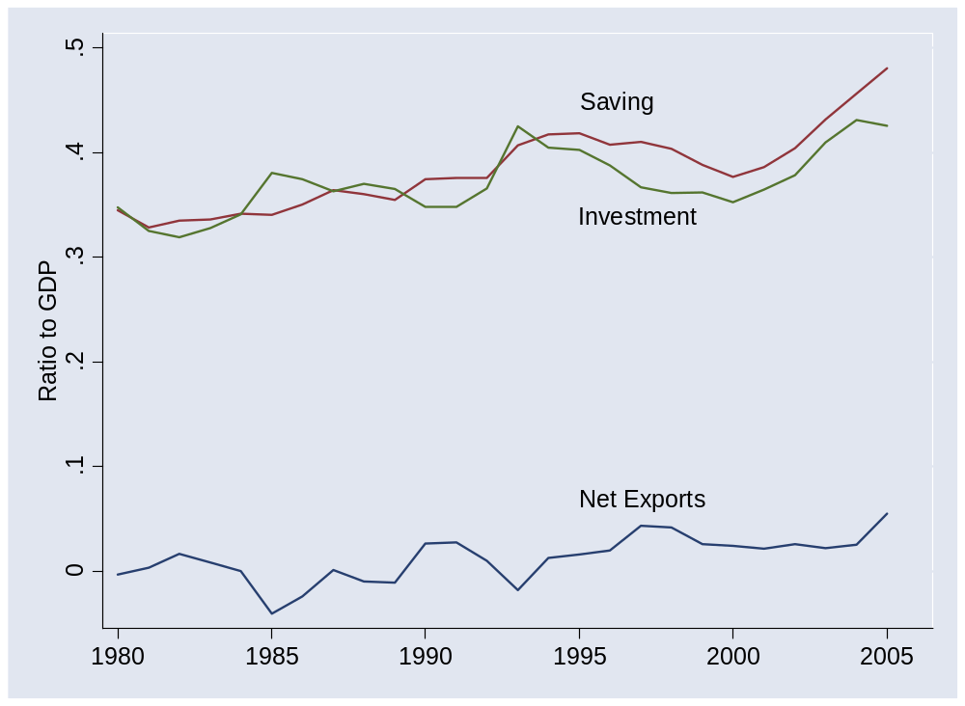
Balance of payments in China
Notes:
Foreshadows this class

Slide 16
Balance of payments
BOP = CA + Capital/Financial Inflows = 0
Goods etc
Country 1
Country 2
“Capital”
If Country 1 runs a current account surplus:
There is a capital “outflow” for Country 1, “inflow” for Country 2.
[Warning: the bottom arrow may seem backwards]
Notes:
Say: NX = CA
Plus: focus on goods

Slide 17
Net foreign assets
International capital markets
  (People in) countries own claims on each other
  Net position (Net Foreign Assets or NFA):
  NFA = Claims on Foreign Countries – Foreign Claims on Us
Changes in NFA:
NFA_{t+1} = NFA_{t} + CA_{t} + Net Asset Revaluations
≈ (1+i)NFA_{t} + NX_{t} + Net Asset Revaluations
Comments
  NX is like the primary deficit from fiscal policy
  Not quite, because CA includes some other things besides interest

Slide 18
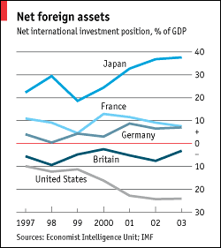
Net foreign assets
Source: Economist, January 2005.
Notes:
table across countries

Slide 19
Is the US in trouble?
Stephen Roach, Morgan Stanley:
  Lacking in domestic saving, America must import foreign saving ... to keep growing at acceptable rates. And so America must then run massive and ever-widening current account deficits to attract that foreign capital. ... America now requires an average of $2.9 billion of capital inflows each and every business day to keep the magic going.

Slide 20
Is the US in trouble?
Warren Buffet:
  As time passes, and as claims against us grow, we own less and less of what we produce. ... Should we continue to run current account deficits comparable to those now prevailing, ... our US ‘family’ will be delivering [a substantial fraction of] its annual output to the rest of the world simply as tribute for the overindulgences of the past.

Slide 21
Is the US in trouble?
Nouriel Roubini and Brad Setzer:
  [We examine] ... US external deficits and the international monetary system that is integral to their financing – a system whose stability hinges on the willingness of Asian central banks to both hold enormous amounts of US Treasuries. ... The system is fragile. Our analysis suggests that the US is on an unsustainable and dangerous path.

Slide 22
Is the US in trouble?
Choose one:
  This US is in trouble
  The US is fine
  Both of the above

Slide 23
Is the US in trouble?
Pessimistic view
  Deficits are financing consumption and government deficits
  Debt is accumulating – and so is interest
  We’ll have to pay it off some day
Optimistic view
  Capital inflow shows US is an attractive place to invest
  Net worth position remains strong despite low saving

Slide 24
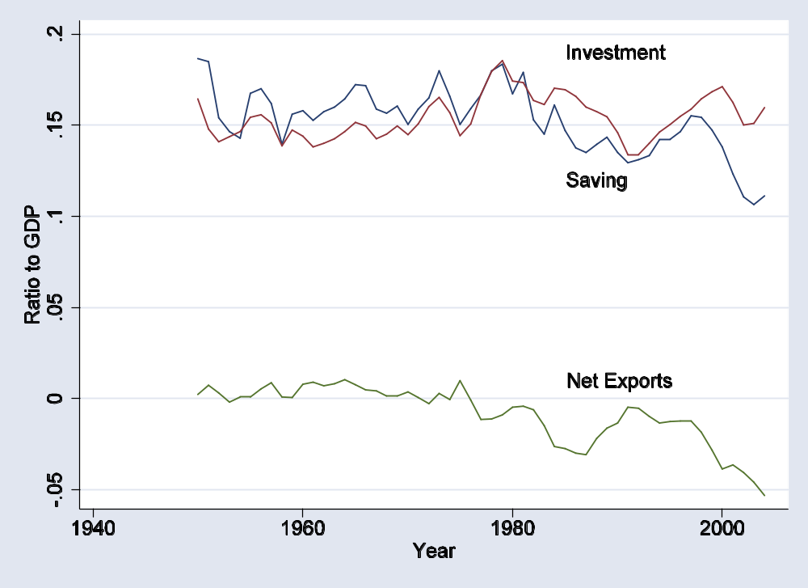
US flows 1

Slide 25
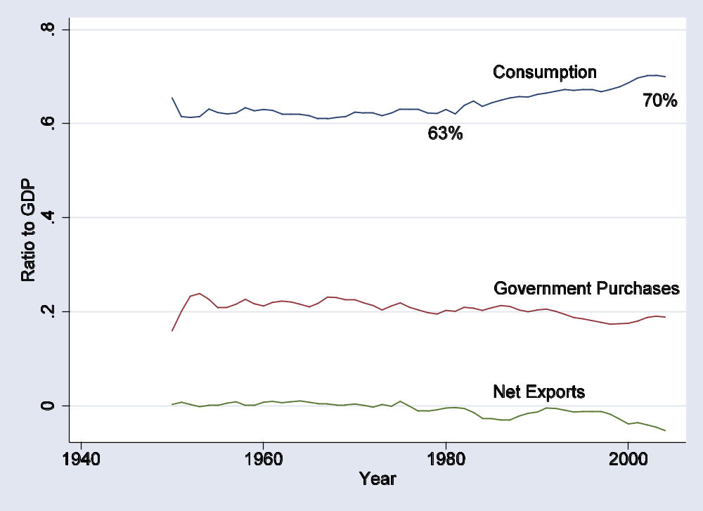
US flows 2

Slide 26
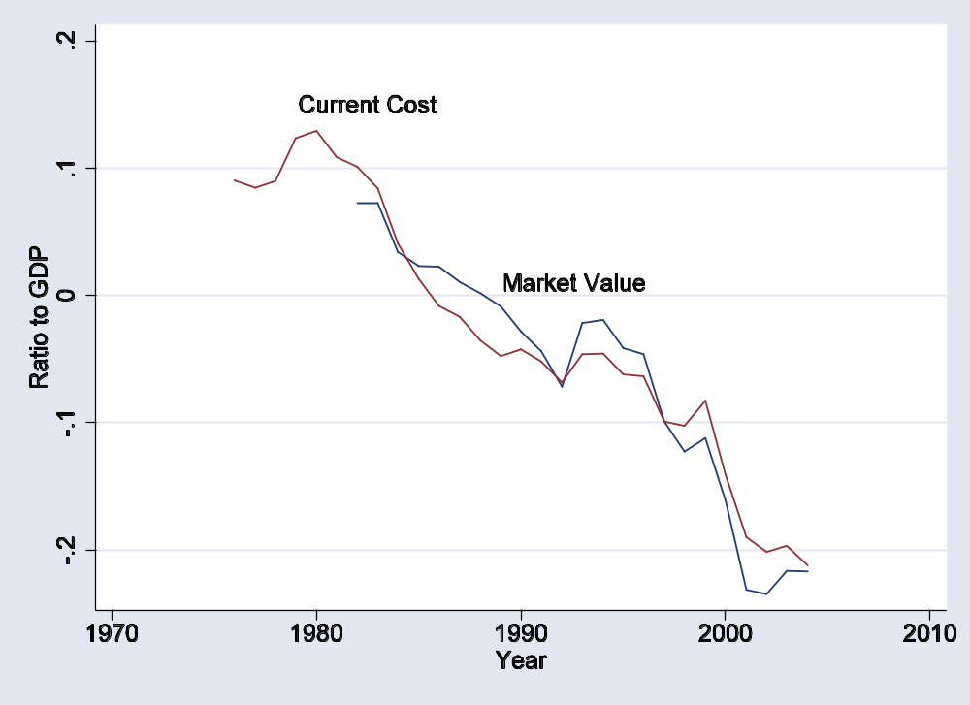
US net foreign assets

Slide 27
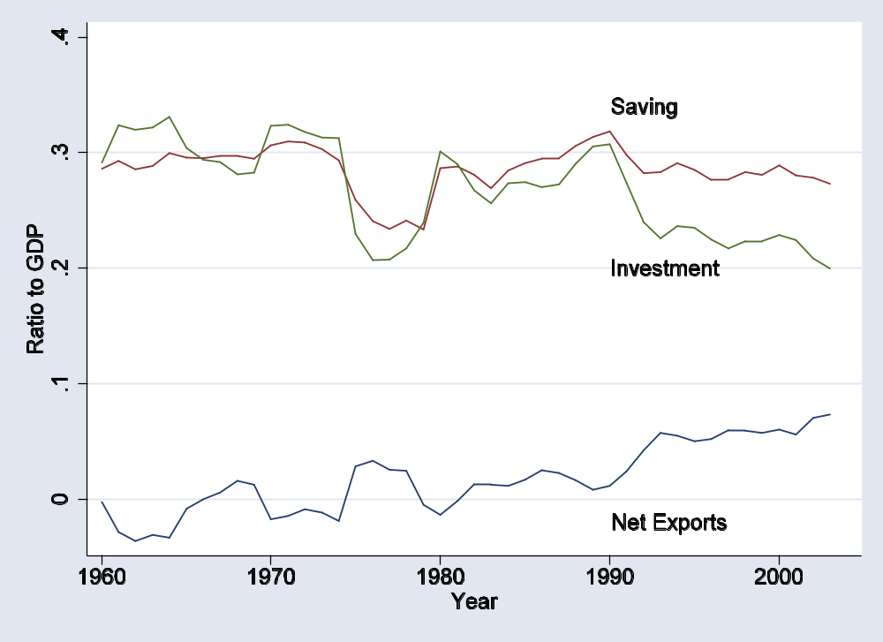
Swiss flows

Slide 28
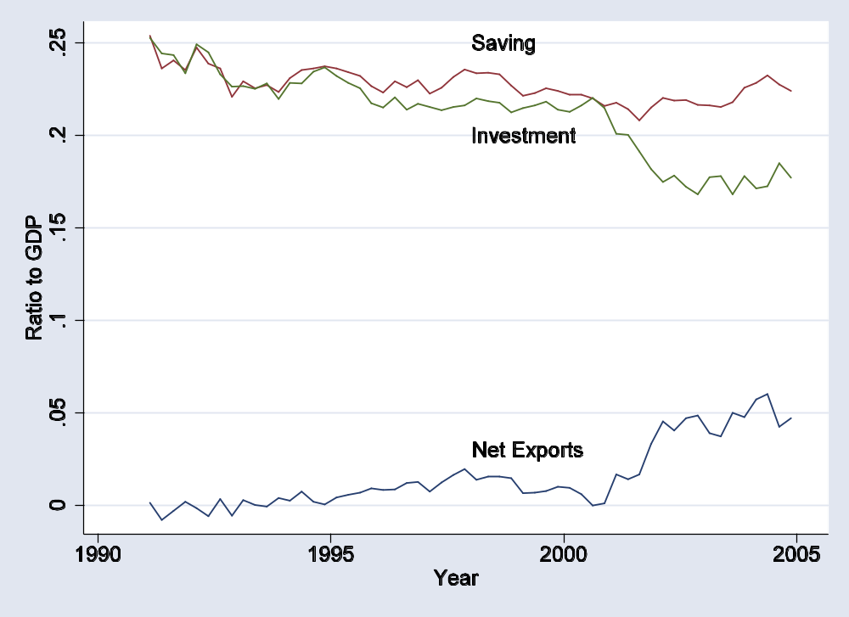
German flows

Slide 29
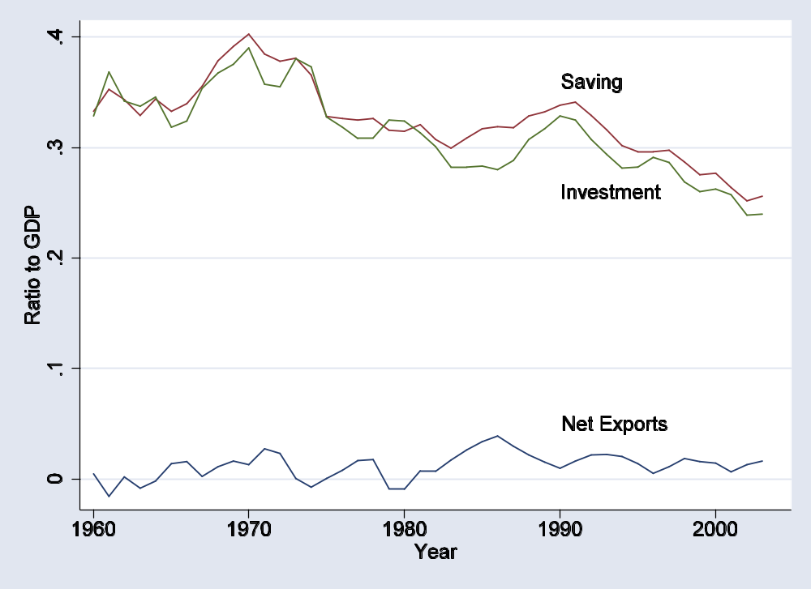
Japanese flows

Slide 30
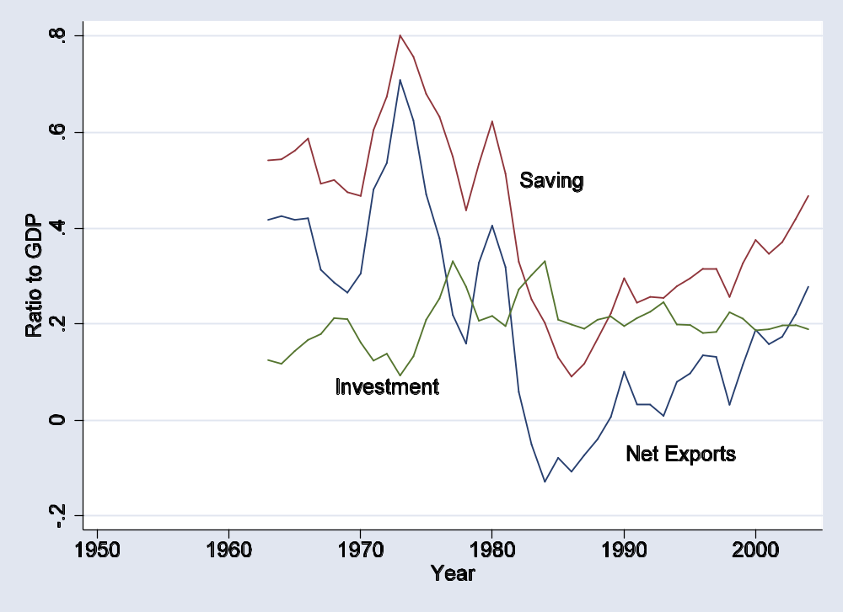
Saudi flows

Slide 31
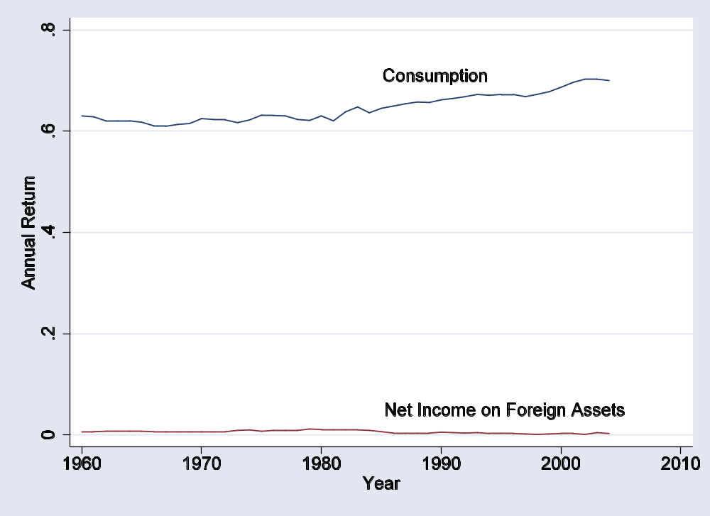
US foreign interest burden

Slide 32
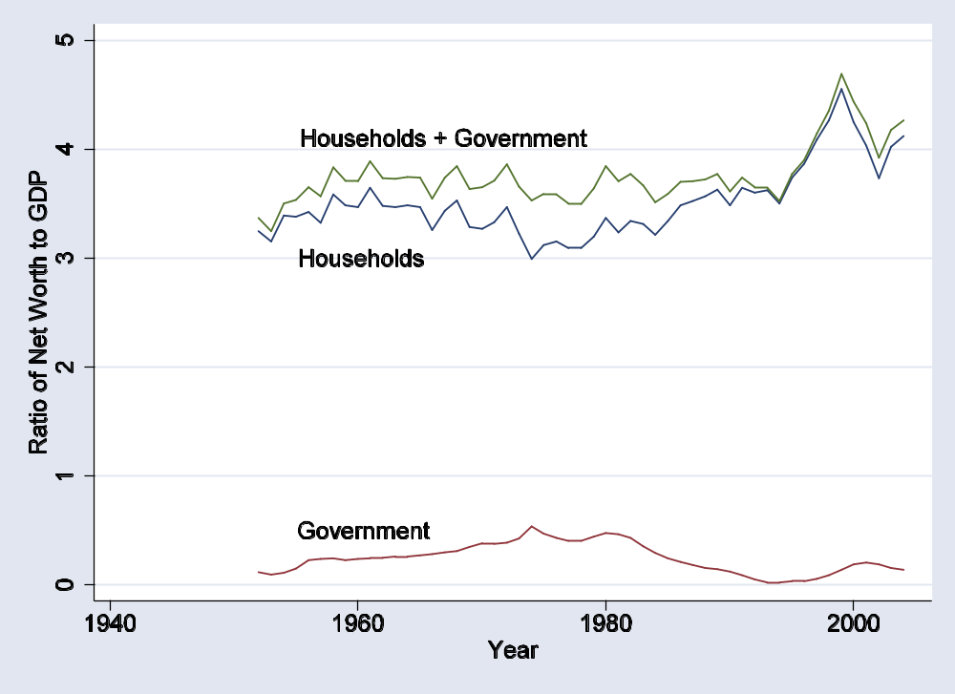
US net worth 1

Slide 33
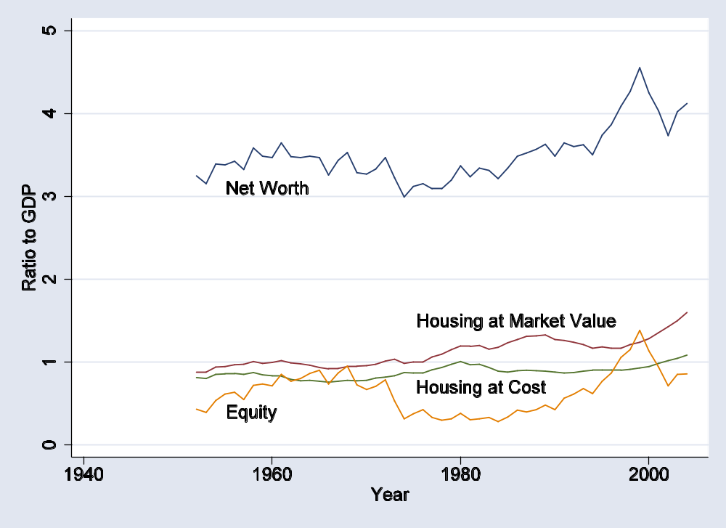
US net worth 2

Slide 34
Is the US in trouble?
Interest burden
  Roubini-Setzer estimate in 10 years: 3% of GDP
Compare to: fall in GDP growth of 0.3% a year

Slide 35
Is the US in trouble?
Choose one:
  We’re in trouble
  We’re fine
  Both of the above

Slide 36
Labor flows
What direction does labor flow internationally?
  What countries is labor trying to get into?
  What countries is labor trying to get out of?
  Why?
  What should we do about it?

Slide 37
SWFs
Note that surpluses mean there are large pots of money in (eg) oil exporters ???
Get data
http://en.wikipedia.org/wiki/Sovereign_wealth_funds [check MS link at the bottom]

Slide 38
Takeaways
Flows of goods are mirrored by financial flows
  Current account deficit ↔ financial/capital inflows
Current account deficits can reflect either high investment or low saving
  May affect ability to repay
Whether deficits are good or bad depends on the use of funds

