Slide 1

The Global Economy
Business Cycles and Their Properties
© NYU Stern School of Business

Slide 2
Today’s plan of attack
Midterm
Group Presentation
Where we’re headed
Pictures
Business cycles
Questions
More pictures

Slide 3
Mercedes USA
..

Slide 4
Midterm
Good overall performance
Grades from 70 to 100
Answers posted

Slide 5
Group Presentation
Now is a good time to think about topics
Due dates:
  Proposal: April 5
  Draft slides: April 12

Slide 6
Where we’re headed
Long-Run Performance
Saving and Investment, Productivity, Institutions, Labor Markets, International Trade, Taxes
First half:
Short-Run Performance
Inflation, Interest Rates, Exchange Rates, Indicators, Monetary Policy, Govt Deficits, Capital Flows, Emerging Market Crises
Second half:

Slide 7
Where we’re headed
Today
  Properties of business cycles
  Business cycle indicators
Thursday
  Making sense of business cycles
  Aggregate supply and demand
Next Tuesday
  Current economic conditions
  Starring (9am): Ish McLaughlin and Brian Jones, Citigroup
  Starring (3pm): Richard Berner, Morgan Stanley

Slide 8
Current issues
Citigroup, Bond Market Monthly, Mar 12, 2007
  We've lowered our 2007 U.S. growth outlook to about 3.0% (from 3.3%), recognizing that the inventory correction in the housing and motor vehicle areas may stretch out just a bit.
  We still think a "token" easing is possible during the second half, but expect to see very little change in monetary policy over the course of the year.

Slide 9
Current issues
Lehman Brothers, US Daily Economic Comment, Mar 19, 2007:
  March 20: We look for February housing starts to rise 5% to a 1.475 million annualized rate after plunging 14.3% in January. The risk is that tightening lending standards in the subprime sector undercuts the incipient recovery in sales.
  March 21: The market is pricing in no chance of a Fed rate cut or hike at the March FOMC meeting, and we agree. Chairman Bernanke hinted at the Fed’s wait and see attitude in a recent testimony. With no expectation of a rate move, the focus will once again be on the statement and the inflation bias in particular.

Slide 10
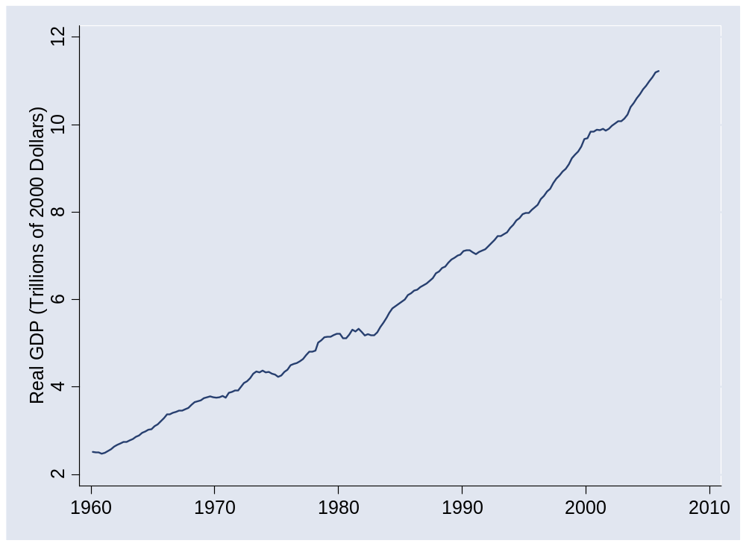
US GDP

Slide 11
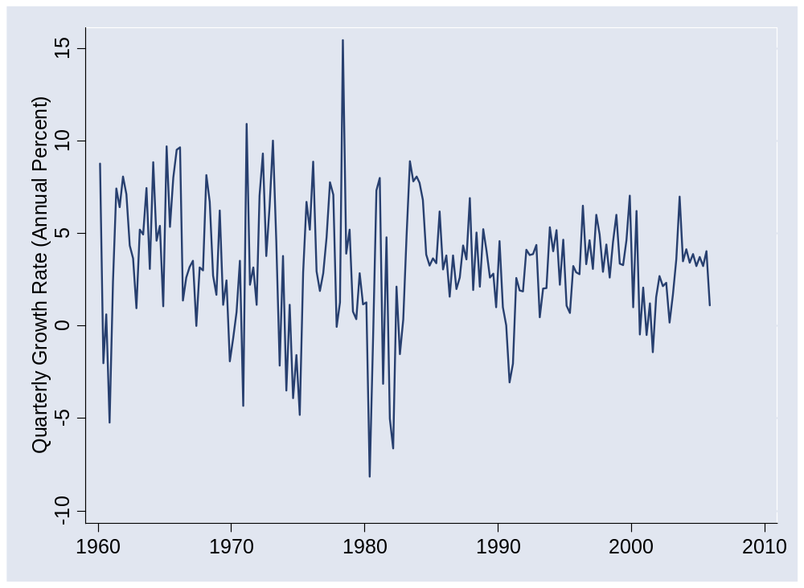
US GDP growth (quarterly, annual rate)

Slide 12
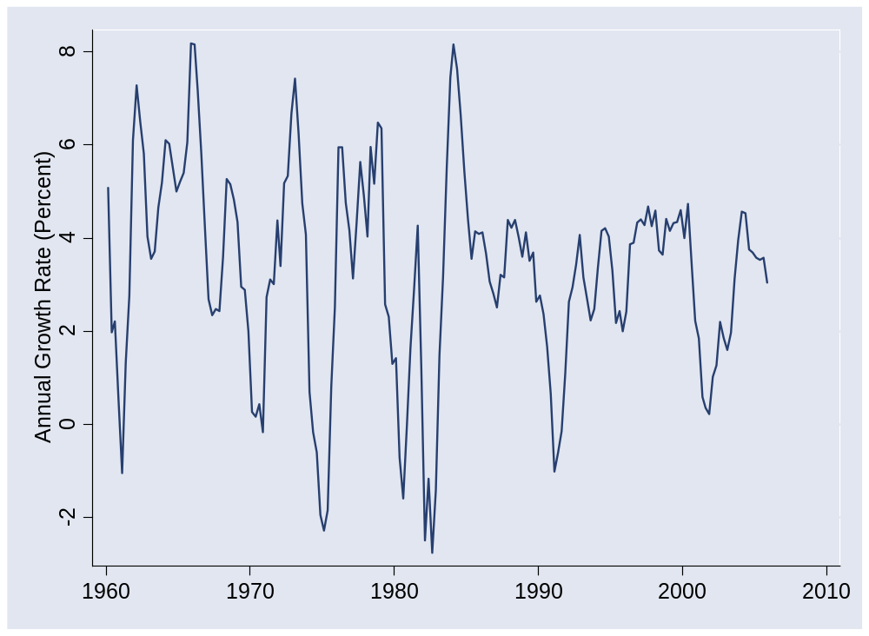
US GDP growth (yoy)

Slide 13
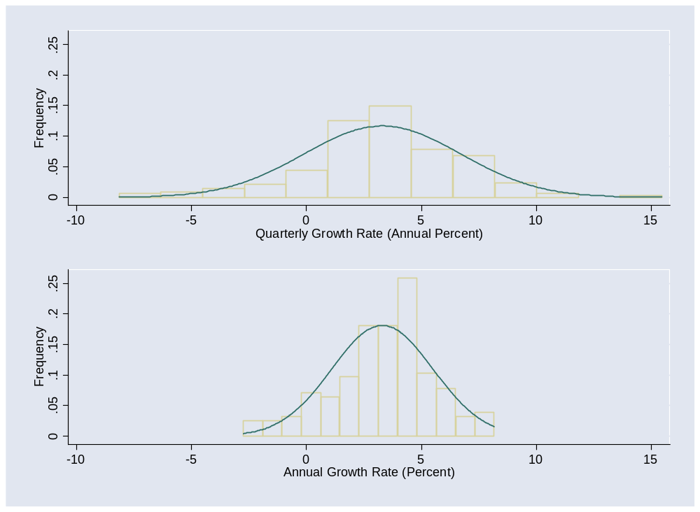
US GDP growth
Notes:
g = 3.5 +/- 7!

Slide 14
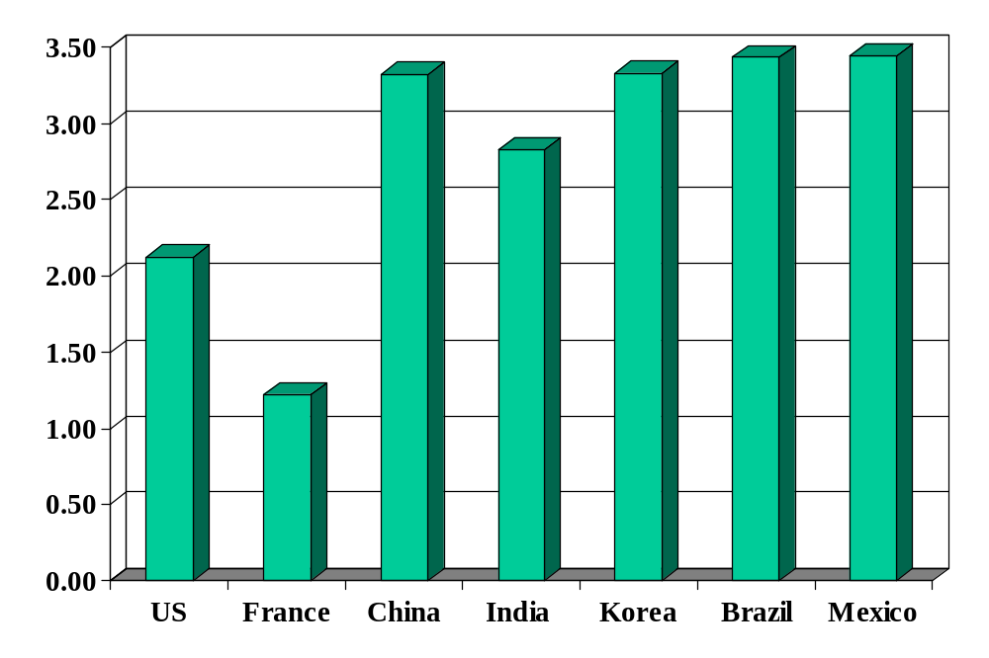
Volatility (std dev of annual growth rate %)
Source: World Bank, World Development Indicators, GDP per capita, 1975-2005.

Slide 15
More on other countries??
Source: World Bank, World Development Indicators, GDP per capita, 1975-2005.

Slide 16
Business cycles
Definitions
  Short-term economic fluctuations (“high frequency”)
  Arthur Burns and Wesley Mitchell: “Business cycles are a type of fluctuation found in the aggregate economic activity of nations.... A cycle consists of expansions occurring at about the same time in many economic activities, followed by similarly general recessions, contractions and revivals which merge into the expansion phases of the next cycle.”

Slide 17
Questions
What are business cycles?
  Short-term fluctuations in output
What do we need to know about them?
  What businesses are most sensitive to fluctuations?
  Can we see a downturn coming? How?
What if I’m in finance?
  Interest rates are a macroeconomic phenomenon
  So are equity markets as a whole
  Even more so for emerging markets
What if I’m not?
  Fluctuations will still affect your business and career

Slide 18
Which is more cyclical?
Toyota
Unilever
Pfizer
Intel
New York Times
Google
American Airlines
McKinsey

Slide 19
Terminology
An indicator is procyclical if it moves up and down with GDP, countercyclical if it moves in the opposite direction
An indicator leads GDP if its ups and downs precede those in GDP, lags if its movements come after

Slide 20
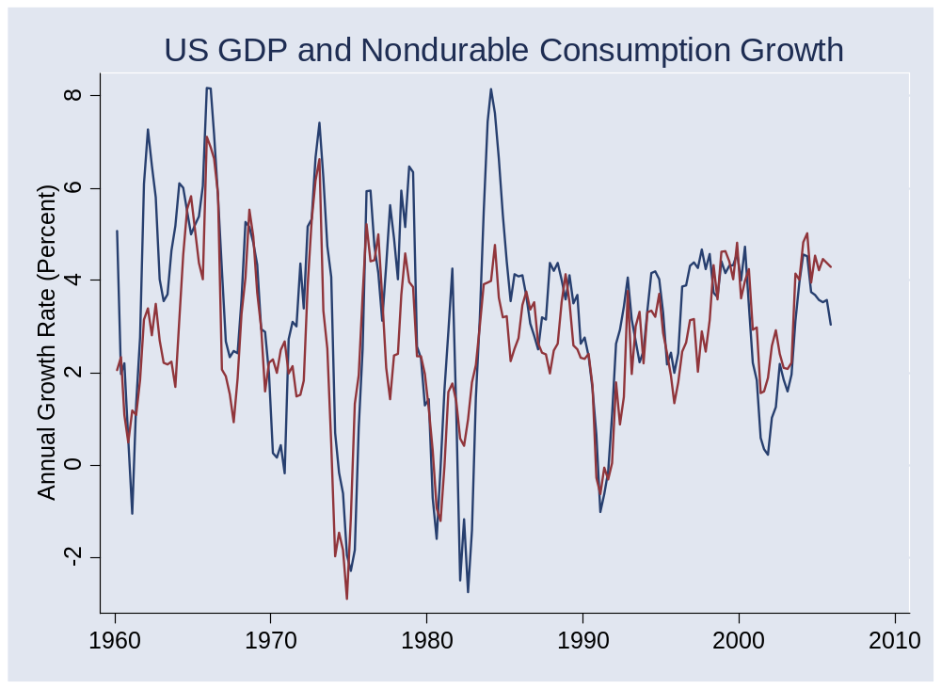
Consumption of nondurables

Slide 21
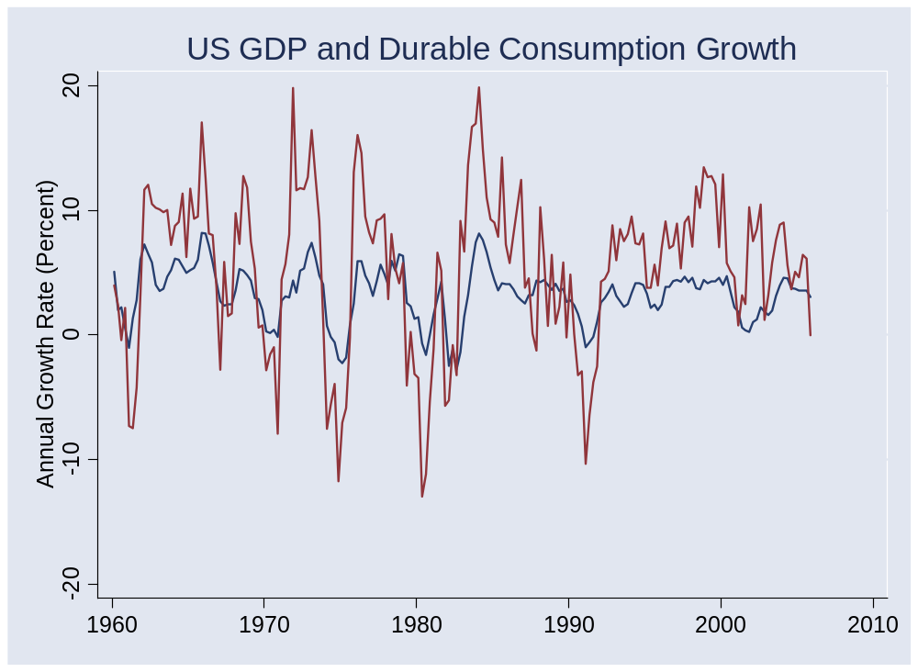
Consumption of durables

Slide 22
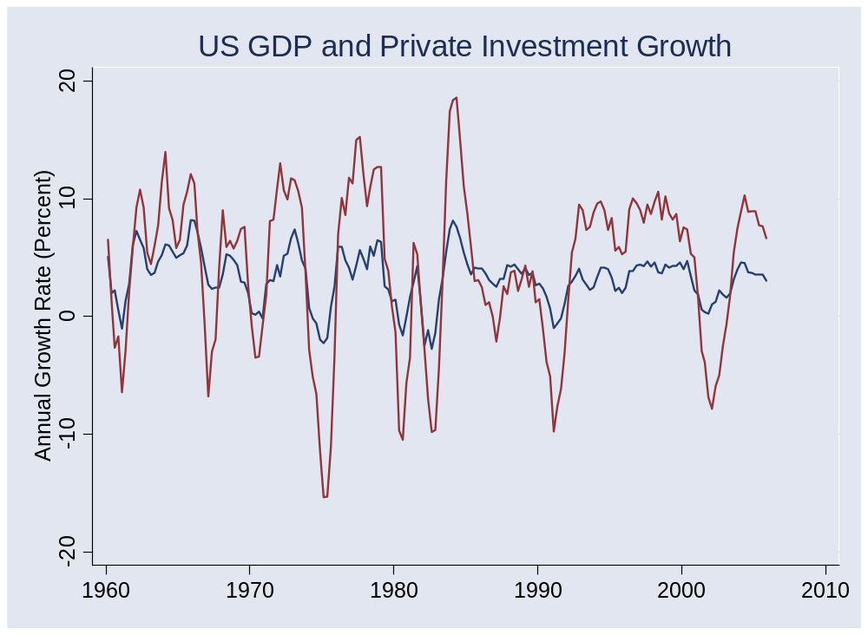
Investment (“producer durables”)

Slide 23
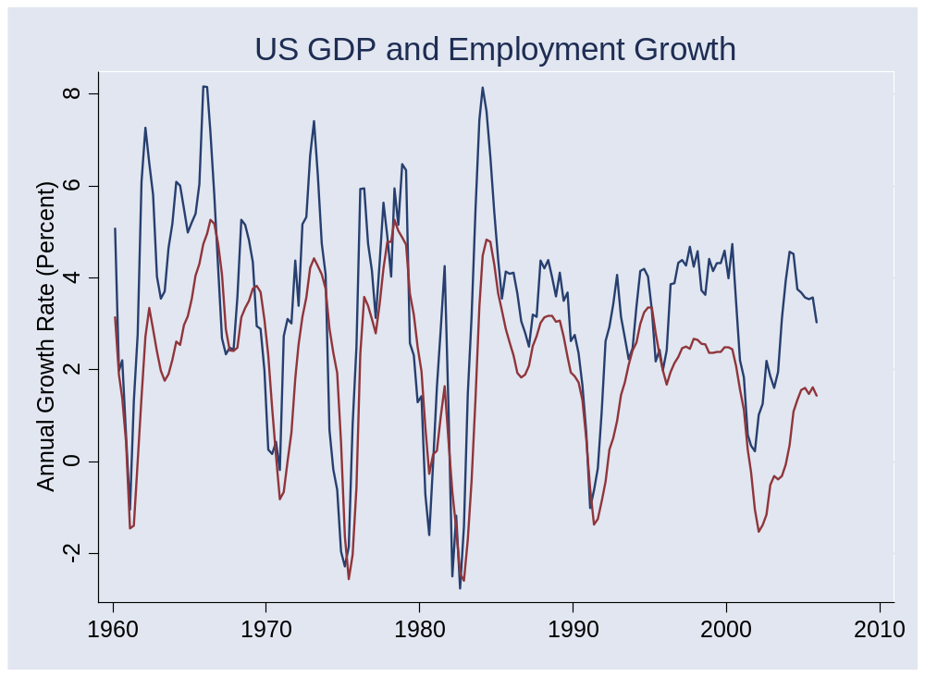
Employment

Slide 24
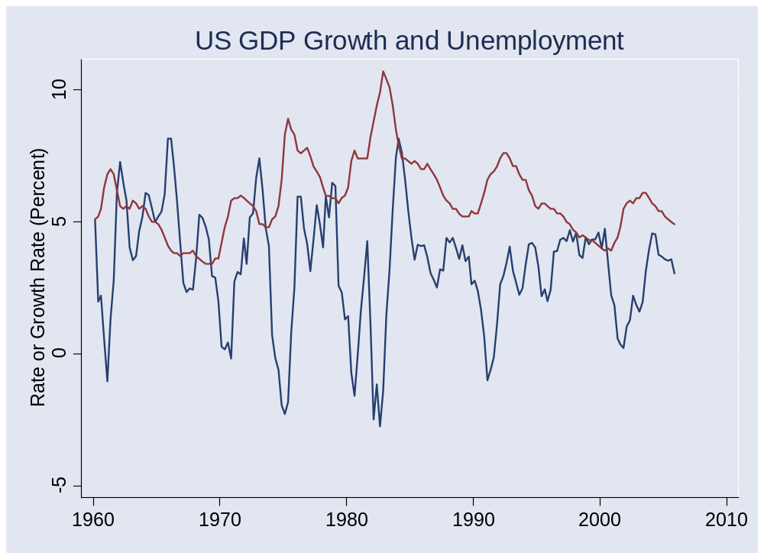
Unemployment

Slide 25
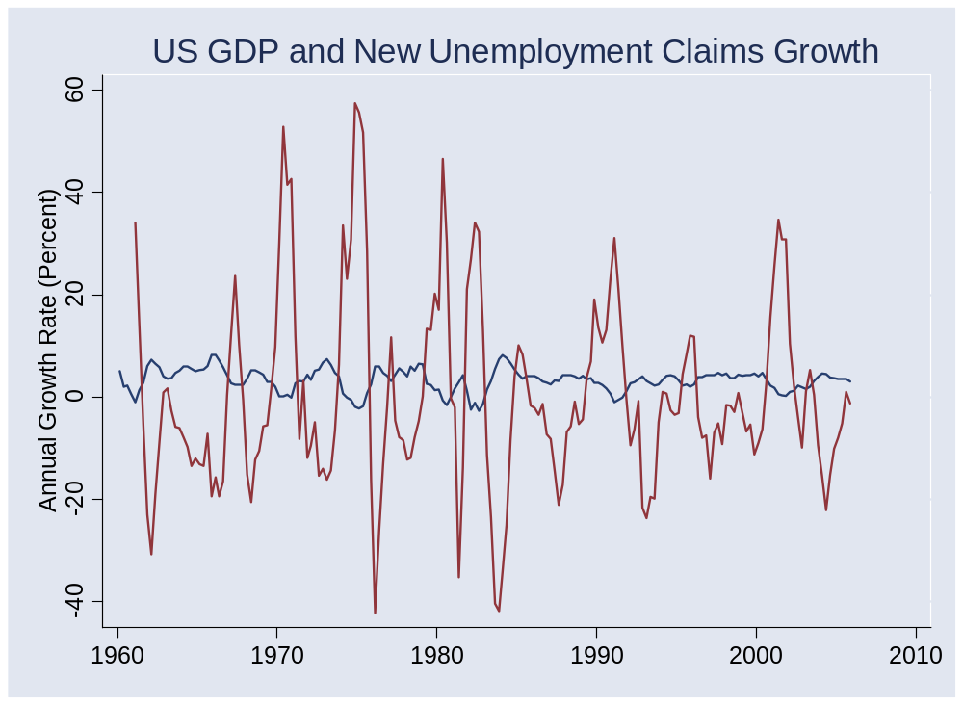
New unemployment claims

Slide 26
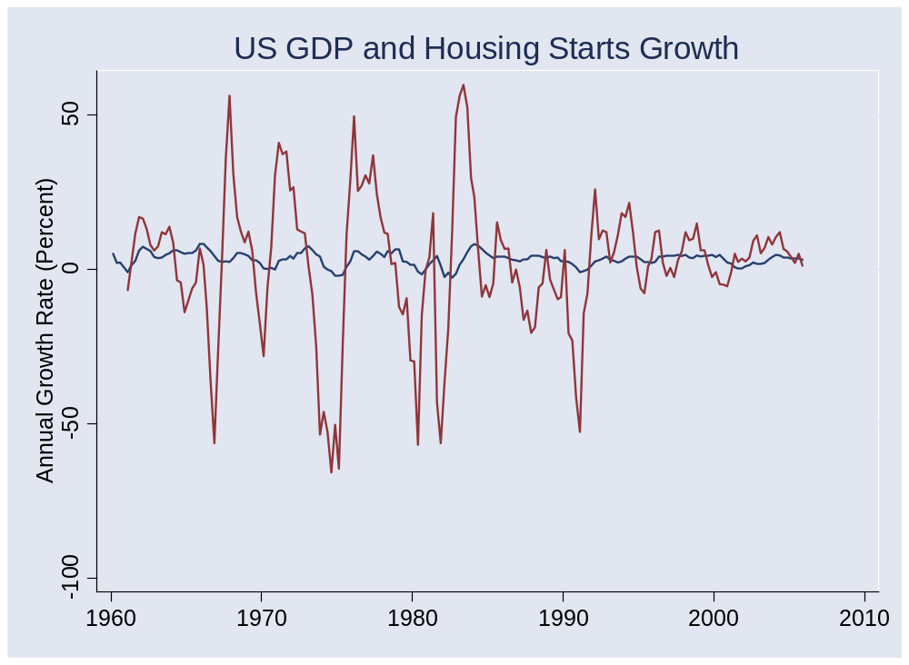
Housing starts

Slide 27
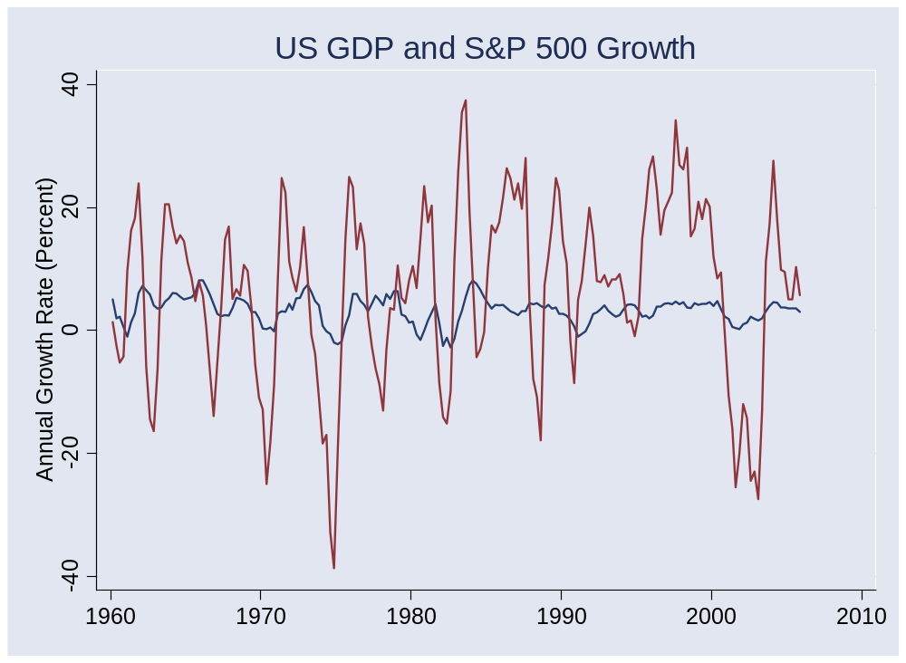
S&P 500

Slide 28
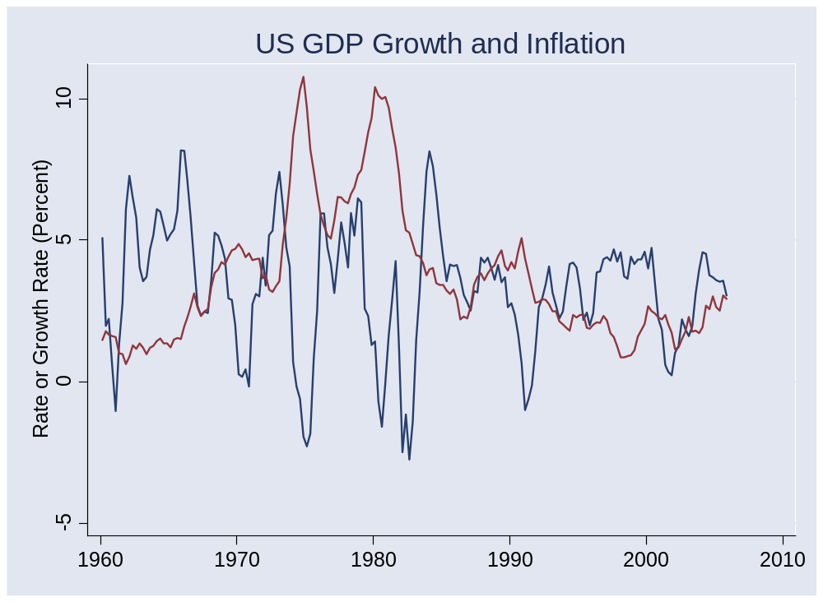
Inflation

Slide 29
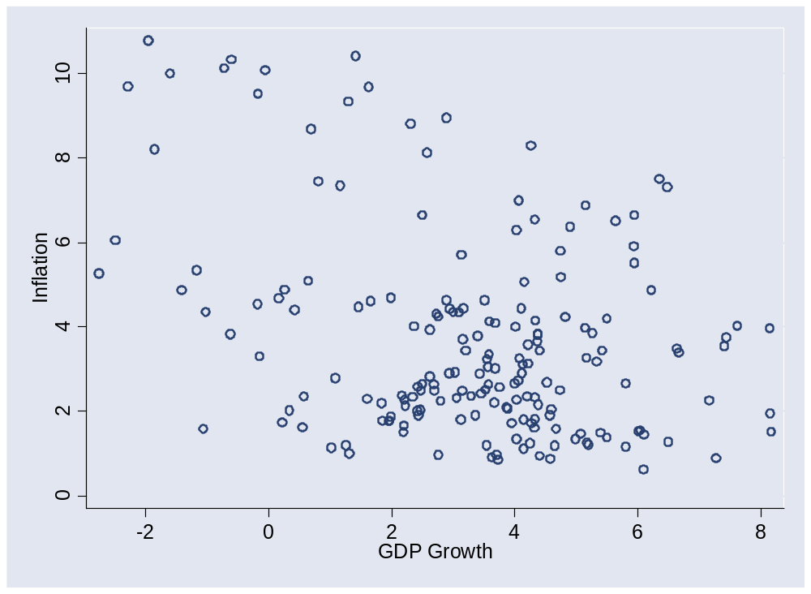
Inflation

Slide 30
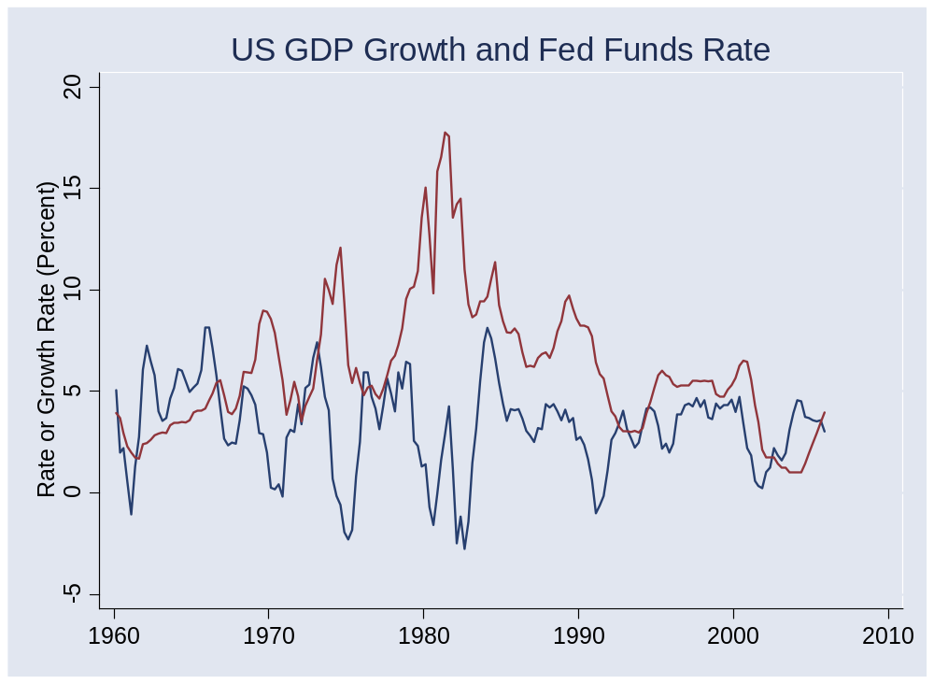
Fed funds rate

Slide 31
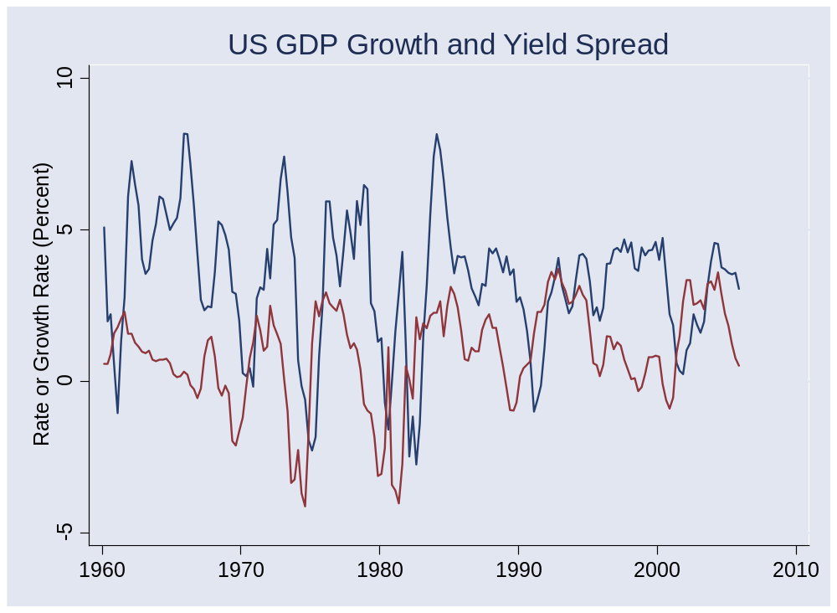
Yield spread

Slide 32
Takeaways
GDP growth is volatile
Lots of things move up and down with GDP
Durable goods production is more volatile than nondurable goods
More coming…

Slide 33
Citigroup Global Markets
Brian M Jones
  Stern MBA 1989
  Previously: Lloyds Bank, Salomon Brothers
  Currently: Director, Citigroup Global Markets
    Briefs traders, investment bankers, and customers on domestic economic developments and their impact on markets
Ish McLaughlin
  Stern MBA 1995
  Previously: Salomon Brothers
  Currently: Managing Director, Citigroup Global Markets
    Investment grade syndicate desk

Slide 34
Questions
How did you get to your current position? What advice would you give us?
How do economic fluctuations affect your business?
How do you see the US economy over the next 3-12 months? Are there any trouble spots on the horizon?
What indicators do you find to be most reliable?
What indicators do you see as positive right now? Negative?
Do you have a theoretical perspective on the current situation?

