Slide 1

The Global Economy
Business Cycle Properties
© NYU Stern School of Business

Slide 2
Today’s plan of attack
Midterm
Group Presentation
Where we’re headed
Current issues
Business cycles
Indicators and forecasting
Aggregation

Slide 3
Midterm
Good overall performance
Grades from 70 to 100
Answers posted

Slide 4
Group Presentation
Now is a good time to think about topics
Talk to me any time
Due dates:
  Proposal: April 5
  Draft slides: April 12
Read the instructions!

Slide 5
Where we’re headed
Long-Run Performance
Saving and Investment, Productivity, Institutions, Labor Markets, International Trade, Taxes
First half:
Short-Run Performance
Inflation, Interest Rates, Exchange Rates, Indicators, Monetary Policy, Govt Deficits, Capital Flows, Emerging Market Crises
Second half:

Slide 6
Where we’re headed
Today
  Properties of business cycles
  Business cycle indicators
Thursday
  Making sense of business cycles
  Aggregate supply and demand
Next Tuesday
  Current economic conditions
  Starring (9am): Ish McLaughlin and Brian Jones, Citigroup
  Starring (3pm): Richard Berner, Morgan Stanley

Slide 7
Current issues
Citigroup, Bond Market Monthly, Mar 12, 2007:
  We've lowered our 2007 U.S. growth outlook to about 3.0% (from 3.3%), recognizing that the inventory correction in the housing and motor vehicle areas may stretch out just a bit.

Slide 8
Current issues
Lehman Brothers, US Daily Economic Comment, Mar 19, 2007:
  March 20: We look for February housing starts to rise 5% to a 1.475 million annualized rate after plunging 14.3% in January. The risk is that tightening lending standards in the subprime sector undercuts the incipient recovery in sales.
  March 21: The market is pricing in no chance of a Fed rate cut or hike at the March FOMC meeting, and we agree. Chairman Bernanke hinted at the Fed’s wait and see attitude in a recent testimony. With no expectation of a rate move, the focus will once again be on the statement and the inflation bias in particular.

Slide 9
Business cycles
Definitions
  Short-term economic fluctuations (“high frequency”)
  Arthur Burns and Wesley Mitchell: “Business cycles are a type of fluctuation found in the aggregate economic activity of nations.... A cycle consists of expansions occurring at about the same time in many economic activities, followed by similarly general recessions, contractions and revivals which merge into the expansion phases of the next cycle.”

Slide 10
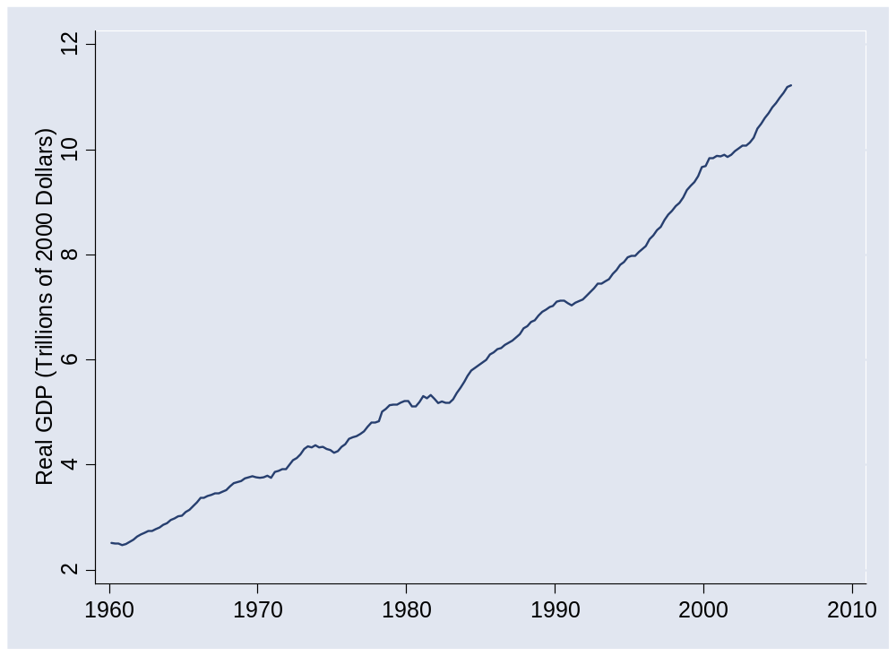
US GDP

Slide 11
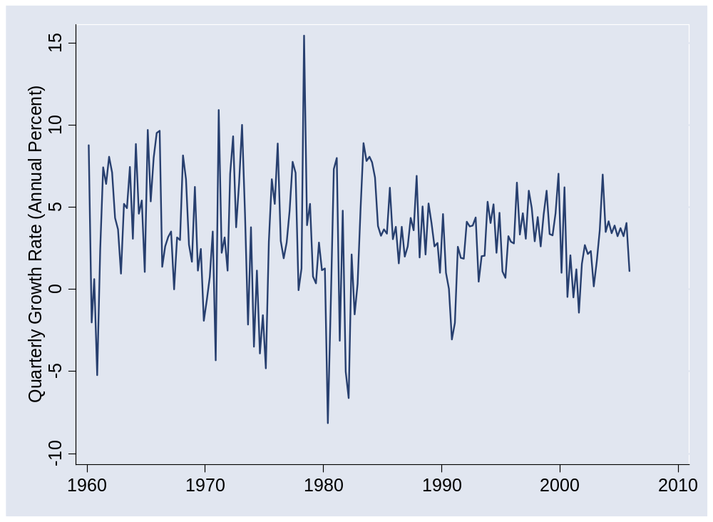
US GDP growth (quarterly, annual rate)

Slide 12
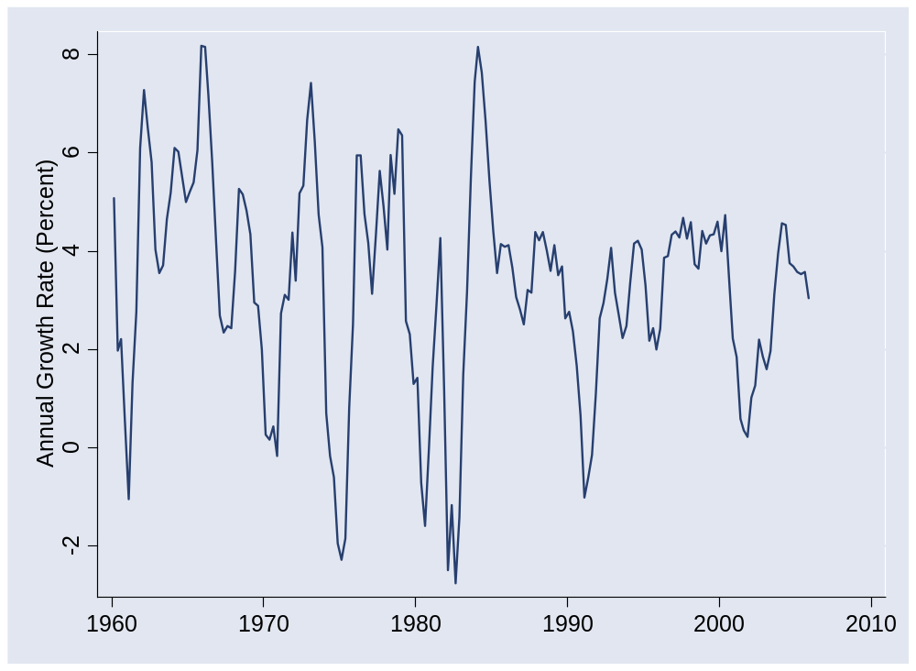
US GDP growth (yoy)

Slide 13
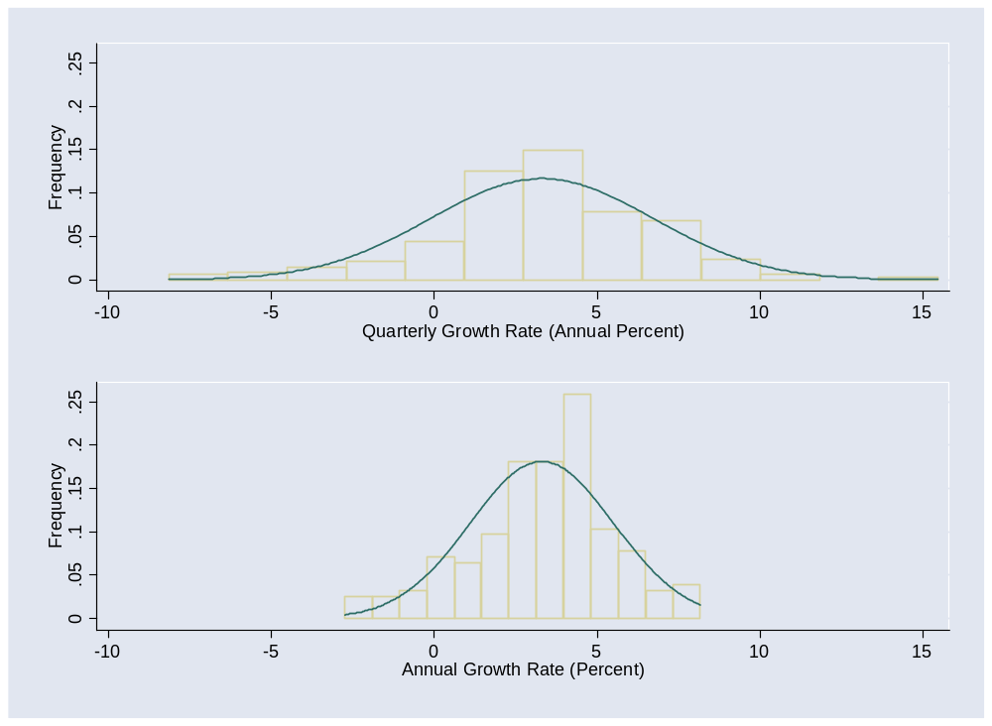
US GDP growth
Notes:
g = 3.5 +/- 7!

Slide 14
Terminology
An indicator is procyclical if it moves up and down with GDP, countercyclical if it moves in the opposite direction
An indicator leads GDP if its ups and downs precede those in GDP, lags if its movements come after

Slide 15
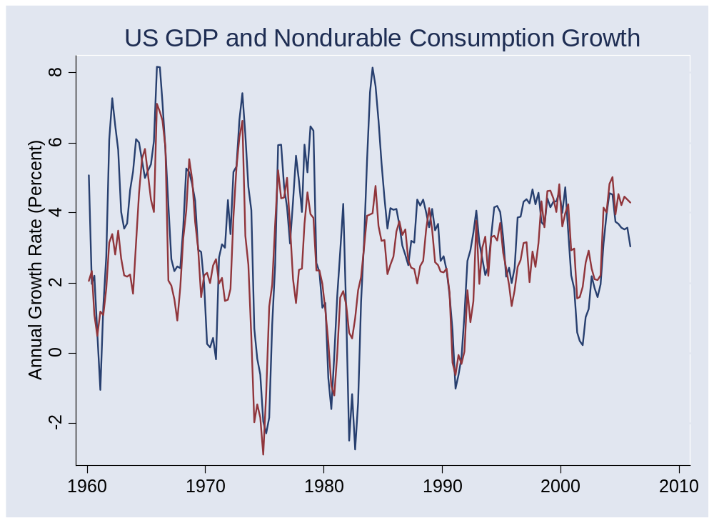
Consumption of nondurables

Slide 16
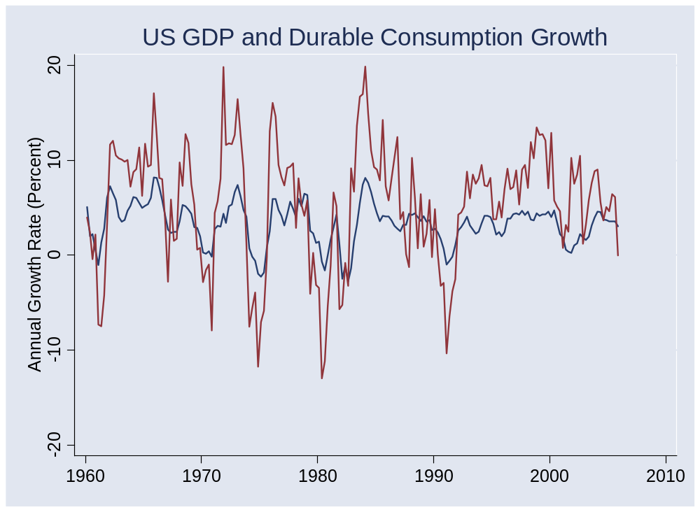
Consumption of durables

Slide 17
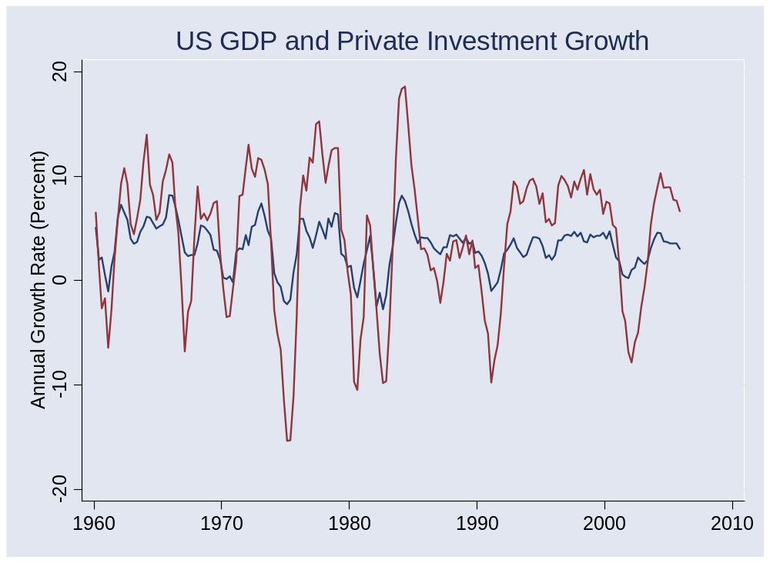
Investment (“producer durables”)

Slide 18
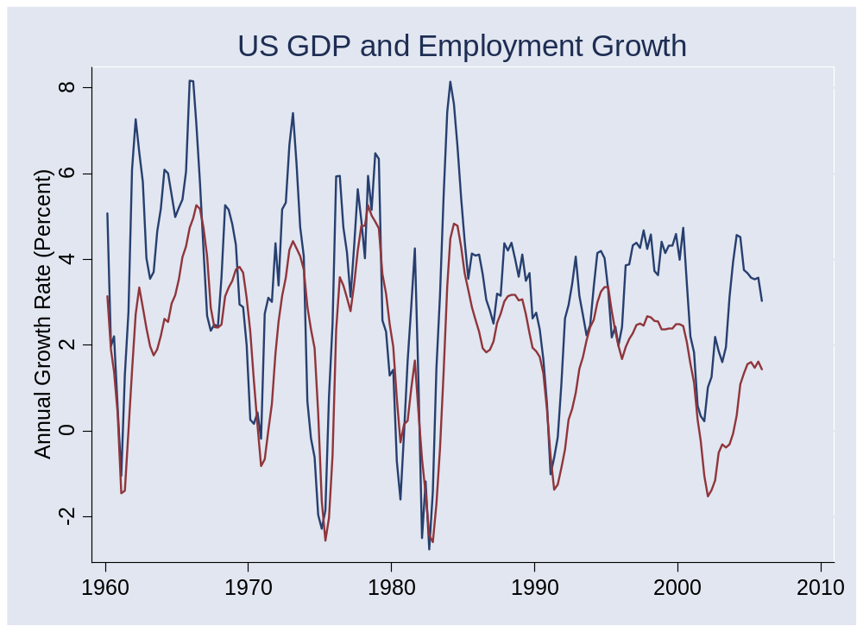
Employment

Slide 19
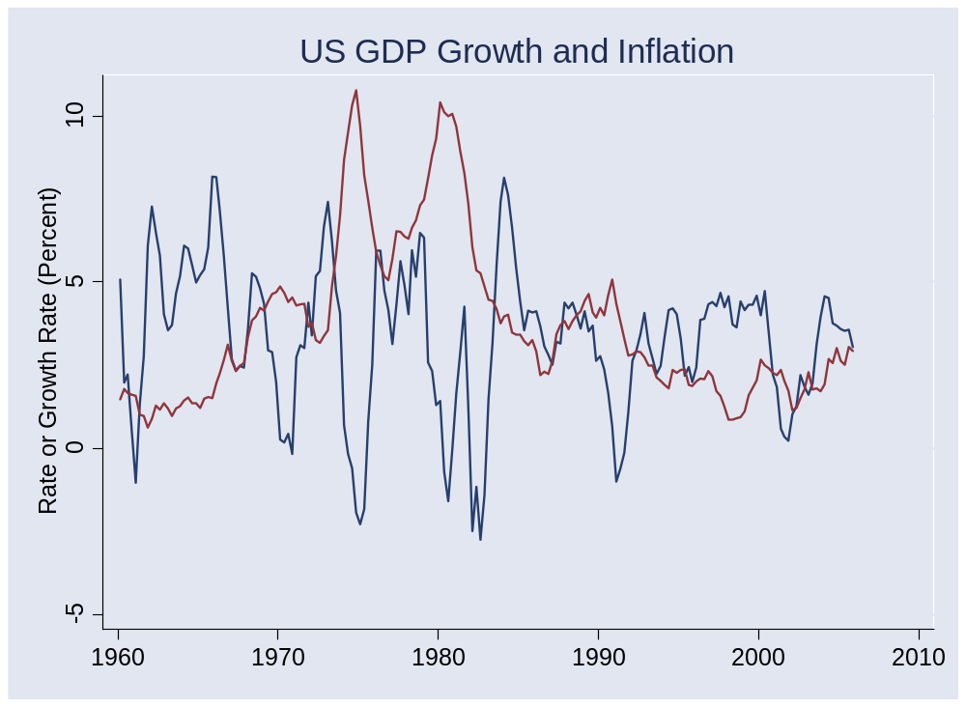
Inflation

Slide 20
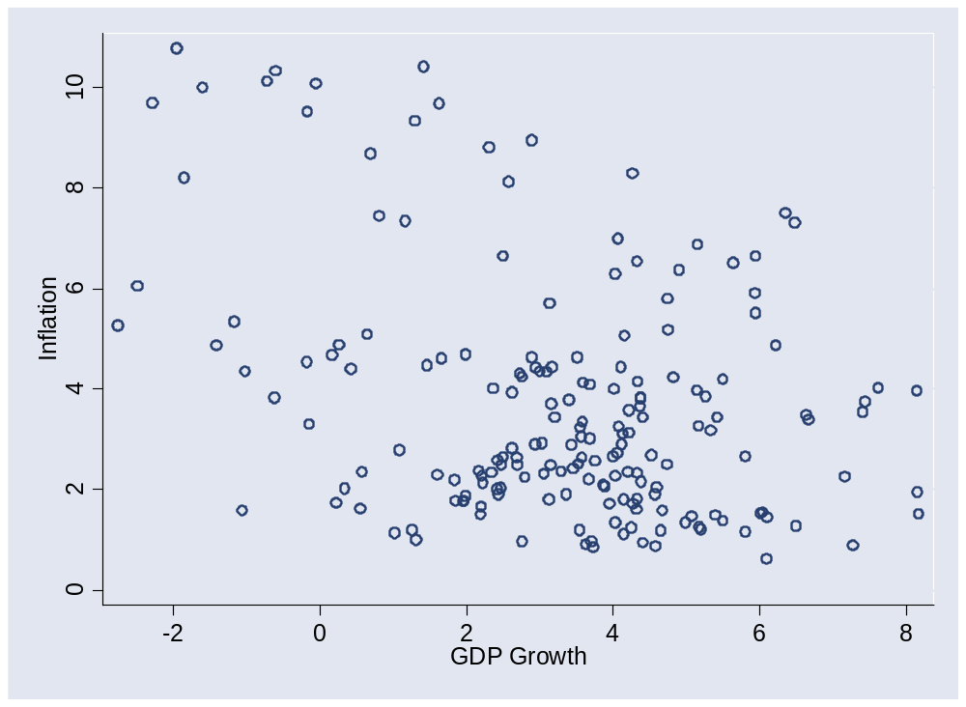
Inflation

Slide 21
Takeaways
GDP growth is volatile
Lots of things move up and down with GDP
Durable goods production is more volatile than nondurable goods
More coming…

Slide 22
The Global Economy
Business Cycle Indicators
© NYU Stern School of Business

Slide 23
What’s a good indicator?
First we need to decide: Indicator of what?
Correlated with variable we’re interested in
Leads variable
Timely: available quickly
Stable: not subject to significant revision that would make in-sample assessment unrealistic

Slide 24
A problem that requires indicators
Forecast economy over next 12 months
Focus on growth rate of industrial production (“IP”)
γ_{t,t+k} = k-period growth rate in IP (set k=12)
Our plan
  Identify good indicators
  Use a regression to relate them to IP growth
  Use the regression to form a forecast

Slide 25
Identifying good indicators
Suggestions?
For each one:
  Why might it work?

Slide 26
Identifying good indicators
Autocorrelation function
  Correlations of an indicator with its own past values (“auto” = “own”)
acf(k) = Corr(x_{t},x_{t-k})
Cross-correlation function
  Correlations between two variables at different times
ccf(k) = Corr(x_{t},y_{t-k})
  If k>0: x lags y [or y leads x]
  If k<0: x leads y [or y lags x]

Slide 27
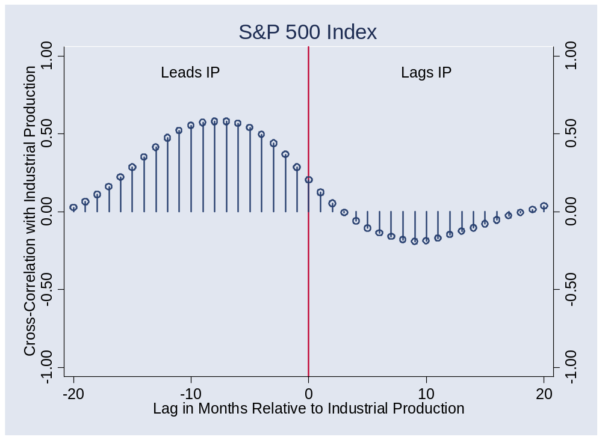
Stock market?

Slide 28
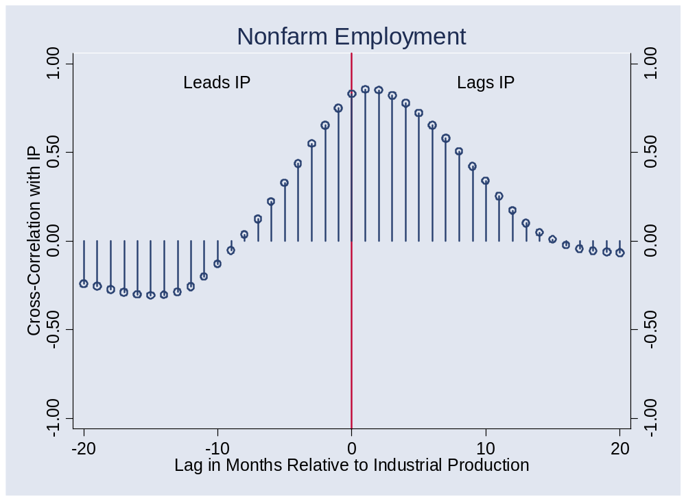
Employment?

Slide 29
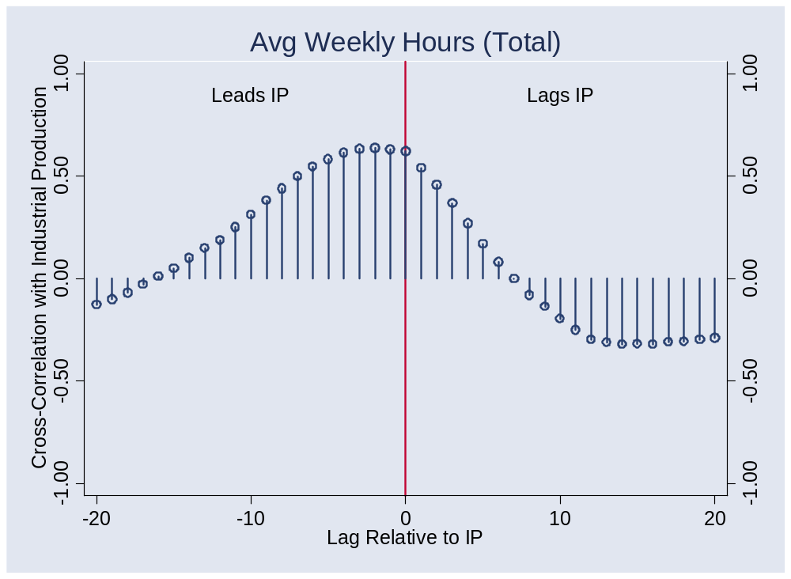
Average weekly hours?

Slide 30
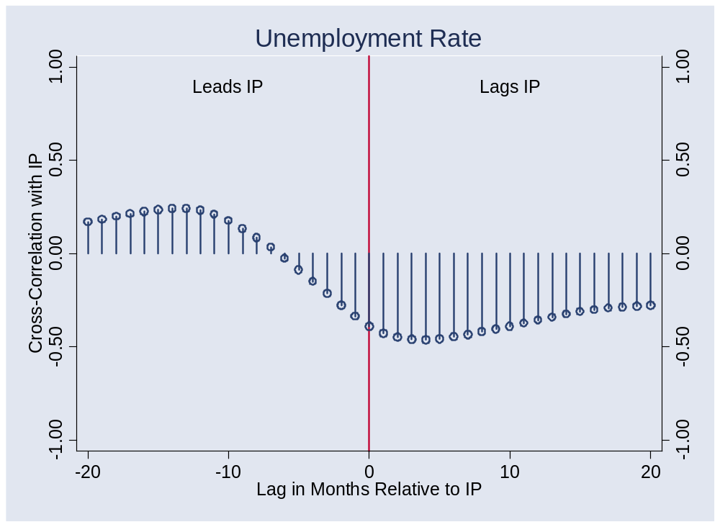
Unemployment?

Slide 31
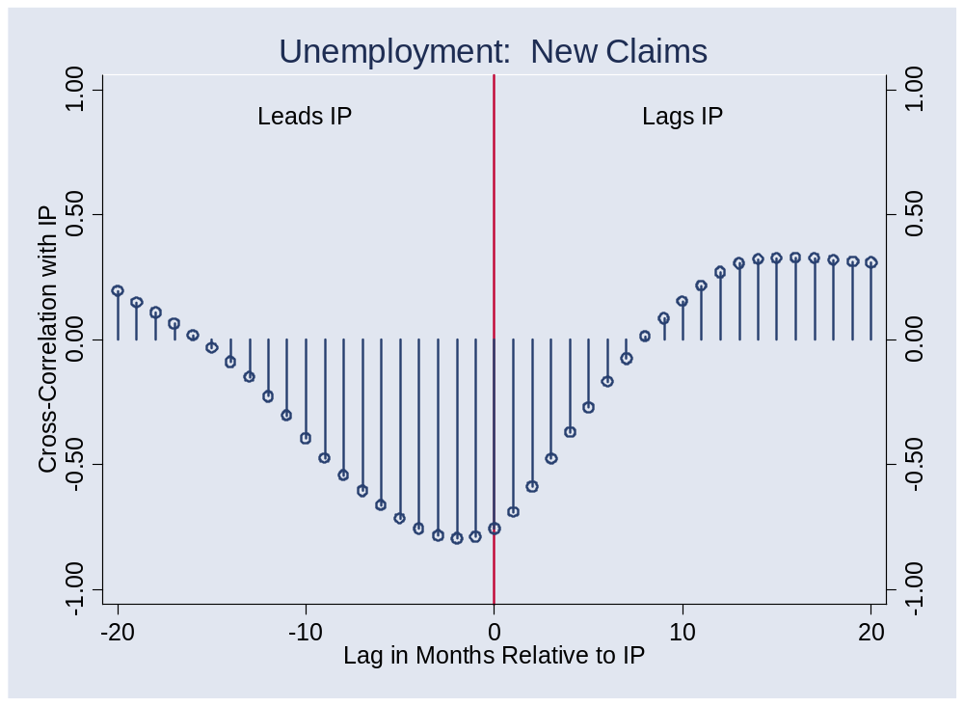
New claims?

Slide 32
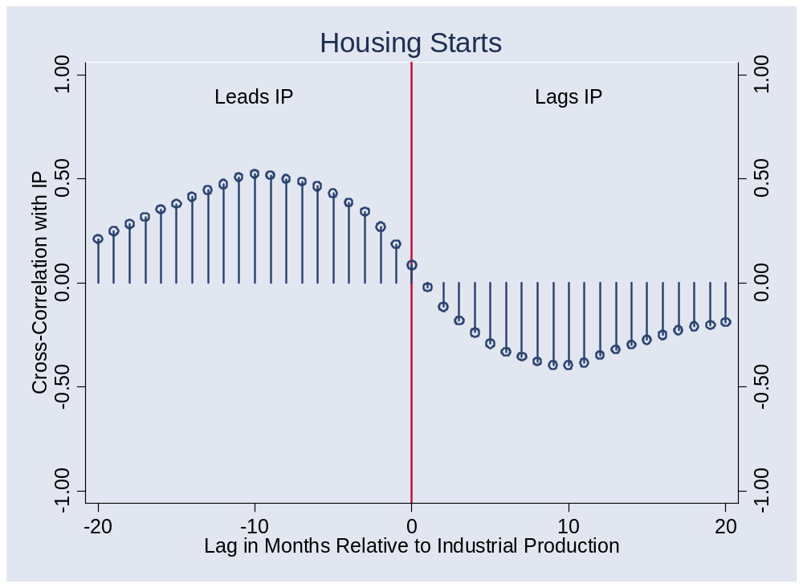
Housing starts?

Slide 33
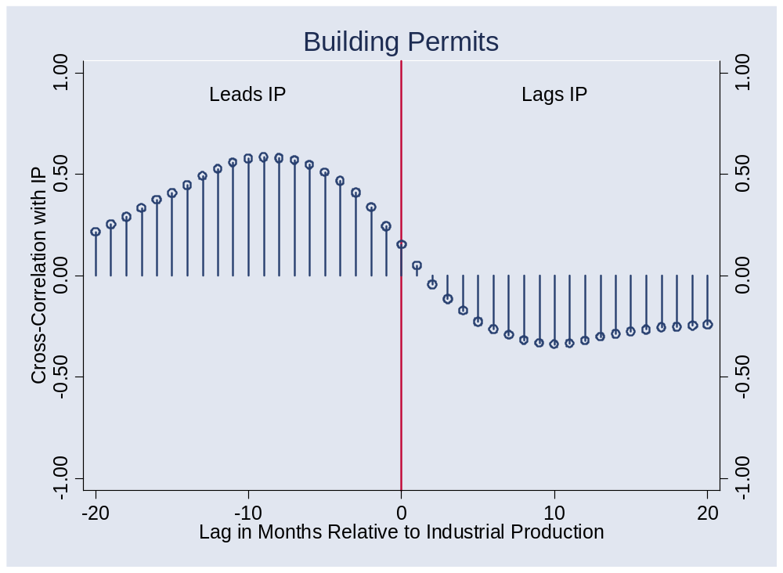
Building permits?

Slide 34
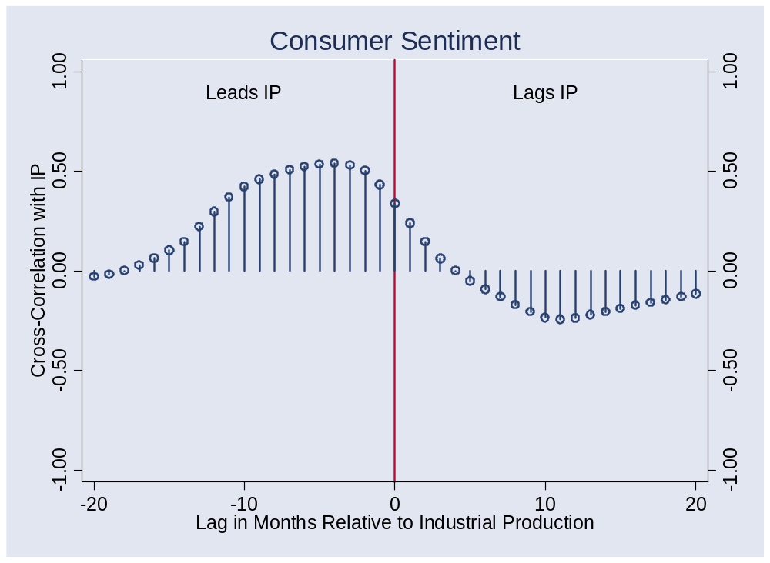
Consumer sentiment?

Slide 35
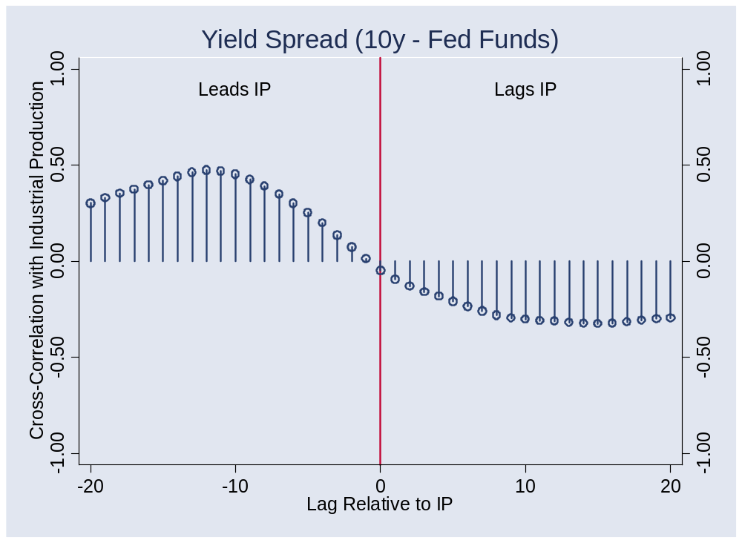
Yield spread?

Slide 36
Forecasting
Recall: we’re forecasting
γ_{t,t+k} = k-period growth rate in IP
Estimate the regression
γ_{t,t+k} = a + b x_{t} + residual
x_{t} is an “indicator” of your choice
Note timing!!
Variations
  Add lags of x
  Add lags of γ
  Use more than one x

Slide 37
Forecasting
Use estimated regression line
Plug in current indicator x
Calculate predicted future growth rate
γ_{t,t+k} = a + b x_{t}
Note timing!!

Slide 38
Forecasting
Sources of forecast error?
How well can we do?
  R² = 0.25 is reasonably good [what does this mean?]

Slide 39
Aggregation
What if we have multiple forecasts?
  Combine them
  Invariably does better
Could we do this ourselves?
  Of course!
Can we use markets?
  Of course!
  They’re natural information “aggregators”
  Risk adjustment?

Slide 40
Prediction markets
Intrade.com
Futures contract pays 100 if statement is true
Contract | Price
Libby pardoned by end of Bush’s term | 63
Giuliani GOP candidate | 42
XM/Sirius merger closes by Jun 08 | 55
Dow > 14,000 at end of 2007 | 13
Fed funds target > 5% at end of 2007 | 51

Slide 41
Macroeconomic markets
Consider futures price of x
Futures price = Market forecast of x + Risk Premium
Do we need the risk premium?
  Generally yes
Examples
  Fed funds, CPI, yield curve, …

Slide 42
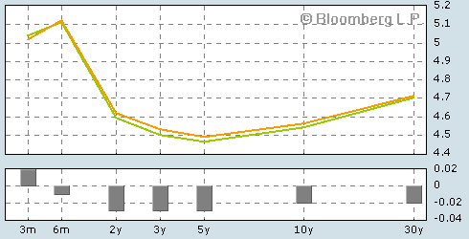
Current yield curve
Source: Bloomberg.com. Green line is current, orange line yesterday.

Slide 43
Takeaways
Good indicators: available, lead variable of interest
Some of the best indicators
  Tied to durable goods (greater sensitivity to cycle)
  Linked to future production
Best forecasts far from perfect
Aggregation is helpful
  Markets do this automatically

