Slide 1

The Global Economy
Business Cycle Theory
© NYU Stern School of Business
Notes:
On the class:
I noticed some glazed eyes. All of the tools in this course are common in consulting and investment banking.
Except today. Today is more about worldview. You won’t be held to the details.

Slide 2
Worldviews
Old, static perspective
  Things settle down (“equilibrium”)
  Example: supply and demand diagram
New, dynamic perspective
  World is “stochastic,” never settles down
  Examples: Black-Scholes model, today’s class, industry dynamics, weather, etc

Slide 3
Agenda
Properties of business cycles (quick review)
Old and new perspectives
New perspective on business cycles
Policy
The dynamic “worldview”

Slide 4
Properties of business cycles
Lots of things move up and down together
  Output, consumption, investment, employment, interest rate
Some things are more volatile than others
  Investment more volatile than output (in percentage terms)
  Consumption is less volatile

Slide 5
Two perspectives
Nobel prize committee, October 2004:
  Finn Kydland and Edward Prescott transformed the theory of business cycles. In their model, realistic fluctuations in TFP brought about behavior in GDP, consumption, investment, and hours worked close to that observed in actual data. … The Laureates laid the groundwork for more robust models by regarding business cycles as the collective outcome of forward-looking decisions made by individual households and firms.
Professor Robert Gordon, Northwestern:
  I am not alone in thinking that their work represents a significant step backwards.

Slide 6
Old perspective
r
LM
IS
Y

Slide 7
Old perspective
Approach to business cycles
  One or both curves wiggle around
Approach to policy
  Wiggle the other one to counter cycles
Strength
  Easy to understand – just like supply and demand
Weakness
  Static: What are long-term interest rates? How do households and firms respond now to changes in future policy, such as changes in future social security benefits?
  One consequence: failed badly when faced with the turbulent environment of the 1970s (inflation AND unemployment?)

Slide 8
New perspective
Thomas Sargent, Stern professor and central figure in the development of modern macroeconomics:
  Households and firms in our models make decisions with as much knowledge of the economic environment as the people making economic policy. … This forces us to think about business cycles and policy in substantially different ways than were standard in the 1960s.

Slide 9
New perspective
Household preferences:
Σ_{t} β^{t} U(C_{t},1–L_{t})
Firms’ technology:
Y = AK^{α}L^{1-α}
Y = C + I
K_{t+1} = (1–δ)K_{t} + I_{t}
“A” random, but “process” known
Yikes!

Slide 10
New perspective
Approach to business cycles
  Random fluctuations in TFP – and maybe other things, too
Approach to policy
  Leave things alone? Cycles could be natural market response to movements in TFP
Strength
  Explicit dynamic behavior
Weakness
  Harder to understand and explain

Slide 11
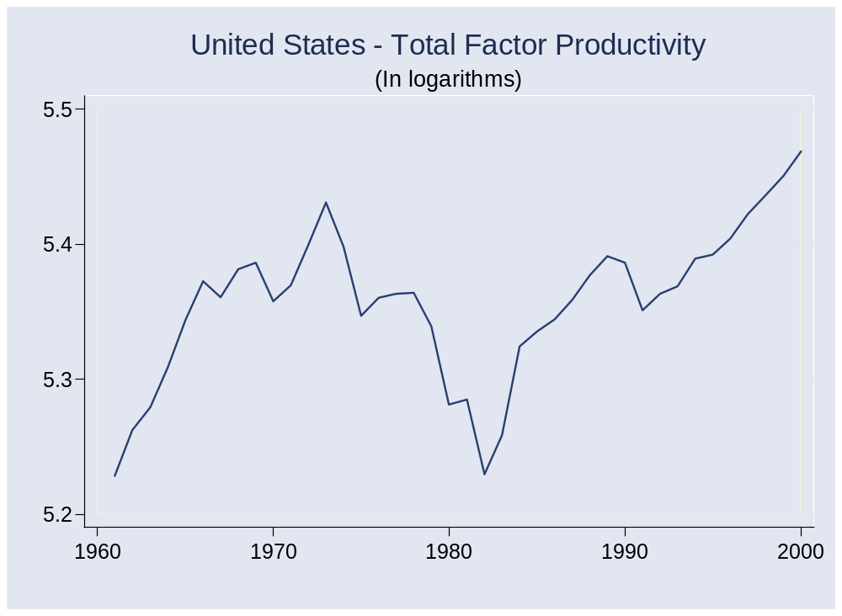
TFP in the US

Slide 12
TFP
Why so volatile? Why sometimes down?
  Increases in oil prices reduce value-added
  Technological progress need not be smooth (internet?)
  Are these good enough answers?

Slide 13
New perspective: overview
1% increase in TFP leads to 1% increase in output with same inputs (production function)
Expenditure identity: Y = C + I
Could C and I both increase by 1%?
  No, because a 1% increase in K requires (roughly) a 10% increase in I (K is roughly 10 times as large as I)
  If I rises more than 1%, C must rise less, which we accomplish by increasing the interest rate
Labor market
  higher wage productivity raises labor demand
  higher wage and interest rate raise labor supply => wage and employment both rise

Slide 14
New perspective
Households:
  Given wage w and return r, choose how much to consume/save and work
Firms:
  Given wage w and return r, choose how much to labor to hire and capital to add
Markets:
  Goods, assets (r), labor (w)

Slide 15
Firms: investment
Dynamic decision
  Invest based on expectation of future profitability
What if TFP rises 1%?
  Guess: you want ~1% more capital [??]
  How much investment is that?
K/Y ≈ 2
I/Y ≈ 0.2
=> K/I ≈ 2/0.2 = 10
Conclusion: I rises more than 1%
Question: why must the shock be persistent?

Slide 16
Firms: labor demand
Maximize profit
Profit = pAK^{α}L^{1–α} – wL
Solution (should look familiar):
∂Profit/∂L = (1–α)pA(K/L)^{α} – w = 0
=> L = [(1–α)pA/w]^{1/α} K
Note: increase in A increases demand for labor

Slide 17
Households: consumption
Dynamic decision
  Consume now, or save and consume later?
  Do two-period problem to see how this works
Budget constraint
S = Y₁ – C₁
C₂ = Y₂ + (1+r)S
=> C₁ + C₂/(1+r) = Y₁ + Y₂/(1+r) = V
=> C₂ = (1+r)(V – C₁)
Real interest rate r
1/(1+r) is price in C₁ units of one unit of C₂

Slide 18
Households: consumption
Utility (ignore leisure/work)
U(C₁,C₂) = [(C₁)^{ρ} + β(C₂)^{ρ}]/ρ
(“ρ” = sensitivity parameter < 1)
Substitute for C₂
U(C₁,C₂) = {(C₁)^{ρ} + β[(1+r)V–C₁]^{ρ}}/ρ
Result:
(C₂/C₁) = [β(1+r)]^{1/(1–ρ)}
1/(1–ρ) > 0 is an elasticity

Slide 19
Households: consumption
Summary
  Level of consumption depends on V
  Timing depends on r
  Contrast to IS/LM: current income isn’t enough to determine C
Income
  Increase in V raises C in both periods
  Timing doesn’t matter, only V
Interest rate
  Consumption path depends on r: high r, steep path
  Or: high r “forecasts” high consumption growth (ditto low) [which is the egg here?]
Notes:
Draw profiles: change V, change r

Slide 20
Consumption smoothing?
Consumption and income
  Introspection: How does consumption respond to retirement? Going back to school?
  Evidence: yes! (coming)
  Note for presentations: a picture is worth…

Slide 21
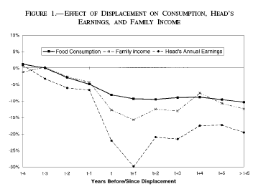
Consumption smoothing?
Stephens, REStat, 2001.

Slide 22
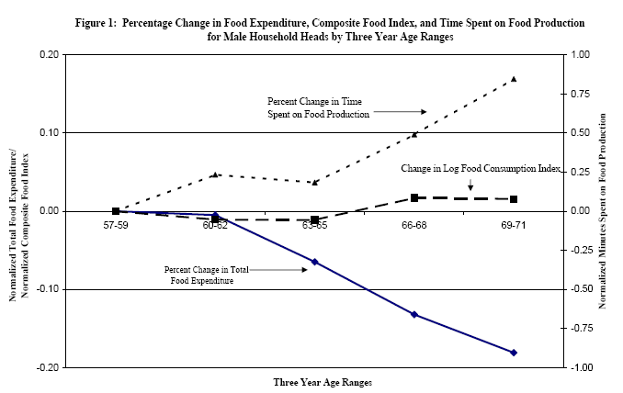
Consumption smoothing?
Aguiar and Hurst.

Slide 23
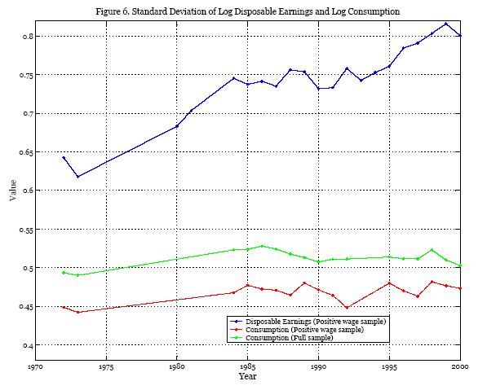
Consumption smoothing?
Krueger and Perri, NBER Macro Annual, 2003.

Slide 24
Market: goods
Effects of (persistent) increase in A
  Output rises
  Households want to consume more (PV of income up)
  Firms want to invest more (a lot!)
  Increase in interest rate reduces consumption, frees up resources for investment
  Bottom line: I rises more than C

Slide 25
Market: labor
Effects of (persistent) increase in A
  Firms want to hire more
  Households may want to work less! (income effect)
Price response
  Increase in wage (and interest rate) induces households to work more

Slide 26
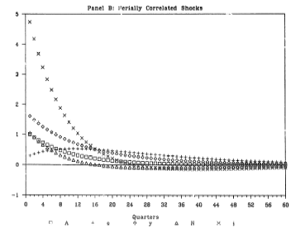
New perspective: picture
□ = A
◊ = Y
+ = C
x = I
∆ = L
King, Plosser, and Rebelo, JME, 1988.

Slide 27
New perspective: summary
Effects of (persistent) increase in A
  Investment rises – a lot
  Consumption rises – a little
  Labor increases
  Output increases
  Wage increases
  Interest rate increases
Comment
  As Nobel committee reported, patterns are similar to what we observe in the real world

Slide 28
New perspective: policy
Are cycles bad?
  Drops in TFP are bad, but they’re simply bad luck [like weather?]
Should policy try to moderate the cycle?
  Not in this model! Market response is best (the usual argument)
  Answer could change if we added sticky prices or wages, impact of policy on TFP, etc
Related policy issue
  What’s the impact on consumption of a cut in current taxes balanced by an increase in future taxes of equal present value? On the interest rate?

Slide 29
Worldview revisited
Is the world “stochastic”?
  Yes, but there are regular patterns
Why do interest rates fluctuate?
  What about the Fed?
Do expectations of future events affect current decisions?
  Of course!

Slide 30
Takeaways
Source of business cycles: TFP?
Are business cycles bad?
  Or are they an efficient response to changes in TFP?
The dynamic worldview
Is this progress or “a significant step backwards”?

