Slide 1

The Global Economy
Principles of Tax Policy
© NYU Stern School of Business
Notes:
Fiscal indicators: deficits, debt, interest payments

Slide 2
Today’s plan of attack
Group Project #7
Current economic and business issues
Where we’re headed
What should governments do?
Pictures
Principles of tax policy
Germany and Brazil

Slide 3
Group Project #7
Projects intended to be best 6 of 7
Notes:
http://online.wsj.com/article/SB117500805386350446-email.html?

Slide 4
Current issues
Notes:
http://online.wsj.com/article/SB117500805386350446-email.html?

Slide 5
Current issues
“Pain from free trade,” WSJ, Mar 28 2007, via Laura Kane:
  For decades, Alan S. Blinder – Princeton University economist, former Federal Reserve Board vice chairman and perennial adviser to Democratic presidential candidates – argued, along with most economists, that free trade enriches the US and its trading partners, despite the harm it does to some workers. … But he says the harm done when some lose jobs and others get them will be far more painful and disruptive than trade advocates acknowledge. He wants government to do far more for displaced workers.
Notes:
http://online.wsj.com/article/SB117500805386350446-email.html?

Slide 6
Current issues
The Economist, Survey France, Oct 26 06:
  An employer who pays a worker twice the minimum wage, or €2,400 a month, has to shell out nearly half as much again to the state in social-security contributions; the employee, for his part, has to hand over 22% of his pay in social-security contributions, on top of income tax. A French pay slip typically runs to over 40 itemised lines. Deductions from the employee's gross pay include 6.65% to the pension fund; 2.4% to the unemployment fund; and 5.1% to the social-security fund. The employer gets stung for contributions of 1.25% to the work-accident fund; 0.4% to the work medicine fund; 2.6% to the transport fund; and so on.
Notes:
http://online.wsj.com/article/SB117500805386350446-email.html?

Slide 7
Where we’re headed
Long-Run Performance
Saving and Investment, Productivity, Institutions, Labor Markets, International Trade, Taxes
First half:
Short-Run Performance
Inflation, Interest Rates, Exchange Rates, Indicators, Monetary Policy, Taxes, Govt Deficits, Capital Flows, Emerging Market Crises
Second half:

Slide 8
What should governments do?
Spending?
Taxes?

Slide 9
What should governments do?
Provide public goods
Public goods are hard for markets to supply
  Non-excludable: hard to keep people from consuming it
    National defense, fresh air, fish in the ocean
  Non-rival: my consumption does not affect your consumption
    National defense, TV (cable and broadcast), NYC skyline
Hard for a private firm to capture all the benefits, so market would provide too little
Examples
  National defense, police, judicial system, fire
  Roads? Sports stadiums? Health-care?

Slide 10
What should governments do?
Many goods have both public and private aspects
Opinions differ on what government should provide

Slide 11

What should governments do?
Libertarian Reluctantly Calls Fire Department
April 21, 2004 | Issue 40•16
CHEYENNE, WY—After attempting to contain a living-room blaze started by a cigarette, card-carrying Libertarian Trent Jacobs reluctantly called the Cheyenne Fire Department Monday. “Although the community would do better to rely on an efficient, free-market fire-fighting service, the fact is that expensive, unnecessary public fire departments do exist,” Jacobs said. “Also, my house was burning down.” Jacobs did not offer to pay firefighters for their service.
© Copyright 2006, Onion, Inc. All rights reserved.
The Onion is not intended for readers under 18 years of age.

Slide 12
What should governments do?
Evidence on long-run impact
  Countries with governments that provide basic services and infrastructure grow faster
  Countries with governments that spend a lot on other things grow more slowly
  But: None of this evidence is definitive
Why?
  Governments supply many of the important “institutions”
  But if they are too large, they may generate adverse incentives

Slide 13
What should governments do?
How should they finance spending?

Slide 14
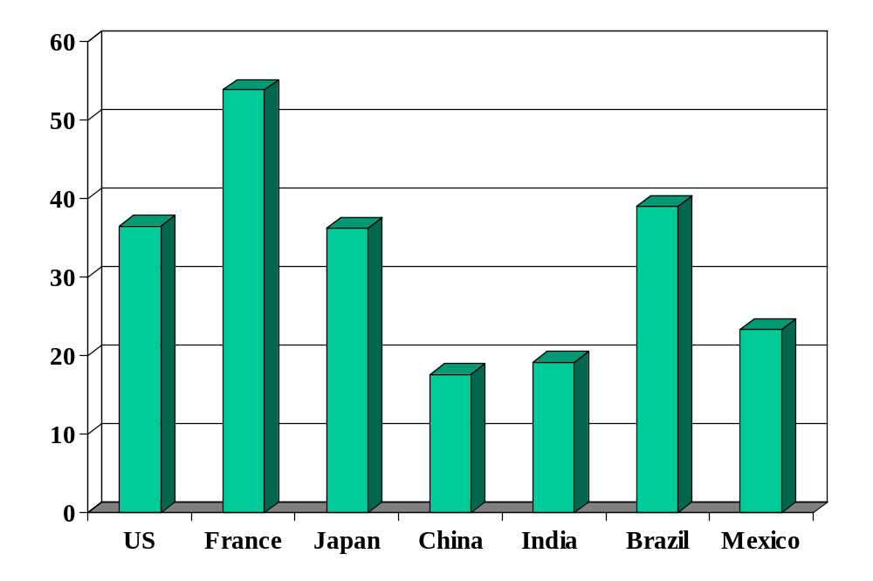
Government spending (% of GDP)
Source: OECD fiscal database, EIU country data.
Notes:
OECD countries: 2006 numbers, Economic Outlook, Annex Table 25.
China, India, Brazil, Mexico: EIU

Slide 15
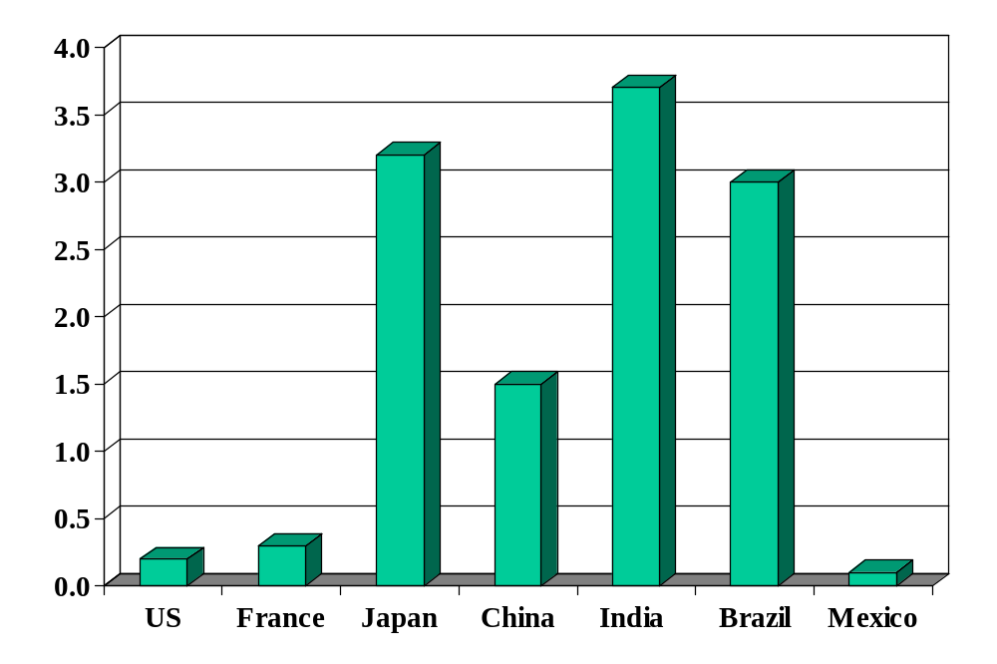
Government deficits (% of GDP)
Source: OECD fiscal database, EIU country data, 2005 (est).

Slide 16
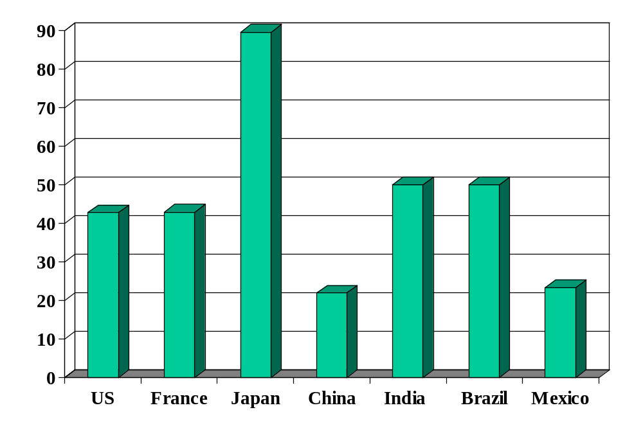
Government debt (% of GDP)
Source: Economist Intelligence Unit Country Data and OECD Economic Outlook.
Notes:
Net debt from OECD

Slide 17
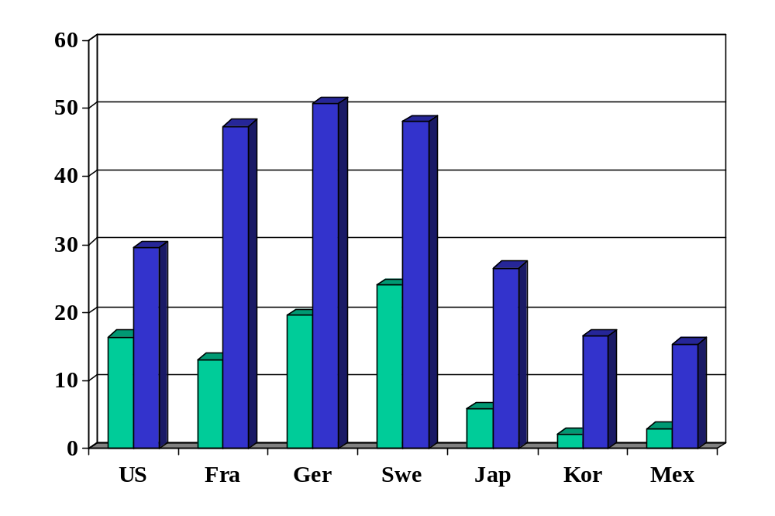
Personal tax rates (%, at average wage)
Source: OECD tax database. Green=direct tax. Blue=total incl soc ins payments by employee/er.
Notes:
For person with average wage

Slide 18
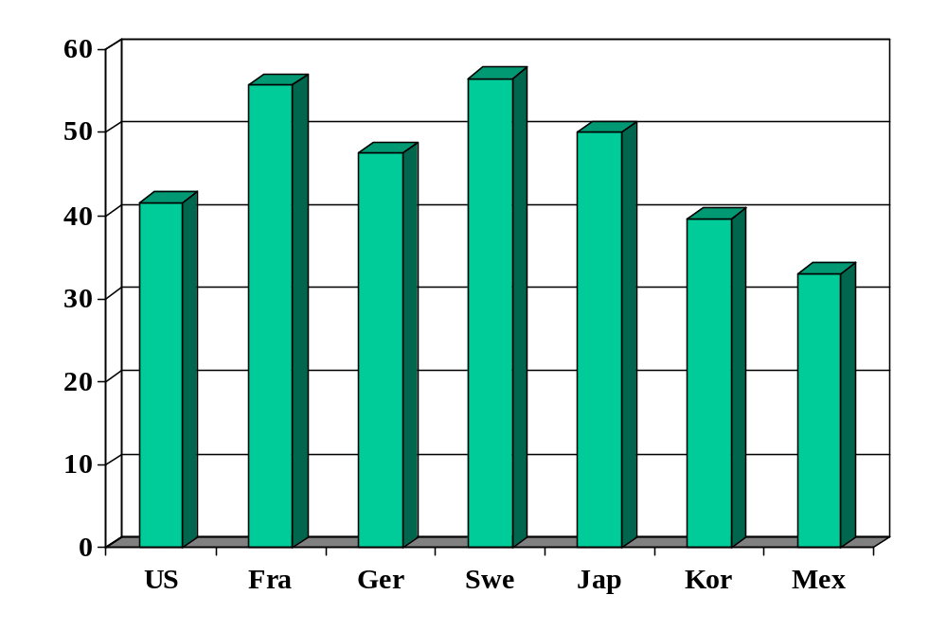
Top personal tax rates (%)
Source: OECD tax database.
Notes:
For person with average wage

Slide 19
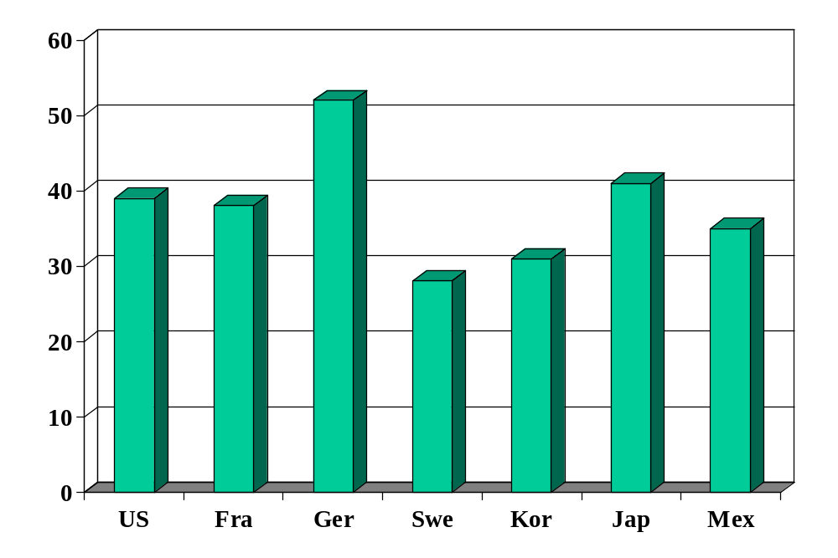
Corporate tax rates (%)
Source: OECD Economic Outlook.

Slide 20
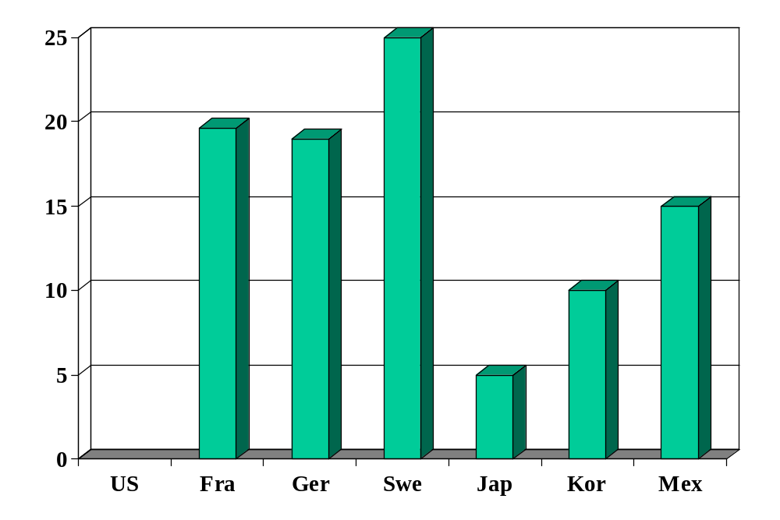
VAT rates (%)
Source: OECD tax database.
Notes:
For person with average wage

Slide 21
Tax principles
Ivan Miklos, Deputy Prime Minister of Slovakia, Financial Times:
  I am convinced that the reforms of new EU member states could serve as inspiration for the older member states as well. One such reform is the flat tax. … We now have one of the simplest, most transparent tax systems in the world. … And our tax revenues have not decreased at all, partly because the reform eliminated most of the incentives and opportunities for tax avoidance. The new system has been particularly popular with German companies.
Notes:
March 23 2005 p 15

Slide 22
Tax principles
Edward Prescott, Wall Street Journal, Dec 20 05:
  Let’s drop the word “cuts” [when we talk about taxes]. The problem with advocating a cut in something is that you are necessarily going to stir up political trouble from someone who will want to increase it again. … And so we got the Reagan tax cuts, the Clinton tax hikes, the Bush temporary tax cuts and . . . who knows what is next? In the meantime, taxpayers are left to wonder and worry what the next tax package will look like, and they are forced to scurry and scheme to take advantage of a current law or to avoid the penalties of the next. Or vice versa. This is no way for a government to treat its citizens.
Notes:
March 23 2005 p 15

Slide 23
Tax principles
What does a good tax system look like?

Slide 24
Tax principles
Taxes must finance spending
  High government spending requires high taxes
  More on this next class
Taxes should apply low rates to a broad base
  Loopholes implicitly raise taxes for others
We should probably avoid taxes on capital
  How?

Slide 25
Taxes and loss of surplus
P
consumer
surplus
S
P*
producer surplus
D
Q*
Q

Slide 26
Taxes and loss of surplus
P
“Deadweight loss”
S'
consumer
surplus
P_{c}
S
t
P*
tax revenue
P_{f}
producer surplus
D
Q'
Q*
Q

Slide 27
Taxes and loss of surplus
P
S''
S'
S
2t
t
D
Q

Slide 28
Tax principles
Where are the largest disincentives of US tax system?
Should we tax food and clothing?
Should internet transactions be tax-free?
Should education be tax-free?

Slide 29
Fiscal policy in Germany (% of GDP)
Revenue |  | 43.4
 | Tax revenue | 22.1
 | Social security revenue | 17.7
Expenses |  | 46.8
 | Goods, services, and employee comp | 11.7
 | Social security | 26.6
 | Interest on debt | 2.8
Surplus |  | -3.3
Sources: EIU Country Profile. Numbers might not add: some small categories have been omitted.

Slide 30
Fiscal policy in Germany
High debt: ~70% of GDP
  Reflects, in part, high cost of reunification
High spending
  Large pension obligations, aging population
High taxes
  Labor: esp high taxes on singles (52%) and two-income families (45%)
  Corporations: highest rate in OECD (39%)
How would this affect you if you were a
  German manufacturer deciding where to locate factory?
  Internationally mobile German worker?
  US investor?
Sources: OECD report.

Slide 31
Fiscal policy in Germany
What would you recommend?
Sources: OECD report.

Slide 32
Fiscal policy in Germany
Financial Times, March 2006:
  Germany will go ahead with the biggest tax rise in decades, the finance minister said, despite mounting warnings that the step is risky and unnecessary. Peer Steinbruck’s defiant comments appeared aimed at preventing a debate from spiraling into a full-blown political controversy. “We have decided on a VAT rise as of January 1, 2007, and we stand by it.” … Alfred Boss, of the IfW institute, said: “The government would be well advised to start thinking about spending cuts instead.”

Slide 33
Fiscal policy in Brazil (% of GDP)
Primary balance (non-interest) | 4.3
Interest on debt | 6.6
Total deficit | –2.3
Public debt | 50.0
Sources: EIU Country Report.

Slide 34
Fiscal policy in Brazil
High debt for a developing country: ~50% of GDP
  Debt service high because interest rate is high
Major spending issues
  High spending for a developing country
  Generous pensions to civil servants (spending ~8% of GDP)
  Similar obligations to private-sector pensions
How would this affect you if you were a
  European food retailer deciding where to expand?
  Brazilian worker about to retire?
  Young Brazilian worker?

Slide 35
Fiscal policy in Brazil
What would you do?

Slide 36
Fiscal policy in Brazil
From the EIU (Dec 06):
  A reform of the pension system for public-sector workers, similar to one that had been proposed by the Cardoso government but had been blocked in Congress, was approved in December 2003. Although the fiscal savings were modest in the short term (at less than 1% of GDP), the reform has been an important milestone in reducing the generous benefits enjoyed by senior civil servants. However, the social security deficit remains a major structural fiscal weakness, having risen from under 1% of GDP in 1997-2000 to 2% of GDP in 2005. Reform of the state-supported pension system for private-sector workers also remains pending.

Slide 37
Fiscal policy in Brazil
Bill Lewis, McKinsey (The Power of Prosperity):
  High government spending for developing country
  Magnified by interest on past debt
  Requires high taxes
  Large underground economy survives by avoiding taxes
  Major impediment to TFP: official businesses more efficient, but higher tax burden limits their growth

Slide 38
Takeaways
Countries differ enormously in government spending and taxation
Taxes change incentives to work and save/invest
Good systems have low rates on large base
Germany and Brazil face difficult choices
  Large government debt and spending requires high tax rates, which have adverse incentives

Slide 39
Extra slides

Slide 40
Ingredients of fiscal policy
Government budget:
G_{t} + V_{t} + i_{t} B_{t} = T_{t} + B_{t+1} – B_{t}
Ingredients:
  G = government purchases of goods and services
  V = transfer payments from government to households
  G + V = government spending
  T = tax revenue
  G + V – T = primary deficit (excl interest)
  B = government debt (“bonds” – includes currency)
  i = (nominal) interest rate paid on debt
  iB = interest payments

