Slide 1

The Global Economy
Government Deficits
© NYU Stern School of Business

Slide 2
Today’s plan of attack
Current economic and business issues
Pictures and quotations
Government budget mechanics
Do we care about deficits? (Should we?)
Sustainability analysis
Is India in trouble?
Is the US in trouble?

Slide 3
Current issues

Slide 4
Current issues
“NJ pension fund endangered,” NYT, April 4, 2007:
  In 2005, New Jersey put either $551 million, $56 million or nothing into its pension fund for teachers. All three figures appeared in various state documents – though the state now says that the actual amount was zero. … New Jersey has been diverting billions of dollars from its pension fund for state and local workers into other government purposes over the last 15 years, using a variety of unorthodox transactions authorized by the Legislature and by governors from both political parties. … [T]he fund could soon be caught in a downward spiral that could devastate the state’s fiscal health. Under its Constitution, New Jersey cannot reduce earned pension benefits.

Slide 5
Central issue
Will the government pay us back?

Slide 6
Current issues
Thomas Friedman, NYT, April 4, 2007:
  Do you remember when you called that 800 number to get details? Do you remember how the voice on the other end of the line helping you had this soft British accent with a slight African lilt? Do you know why? Because you were routed to a call center in Kenya. It's called KenCall. It is located in an abandoned avocado processing plant, and it is the largest of Kenya's blooming outsourcing call centers, with almost 300 employees and annual revenues that have grown to $3.5 million since it opened three years ago. If you're surprised it's here, so are most of its customers. It’s way too early to declare Kenya an economic “African Tiger,” but something is stirring here that bears watching.

Slide 7
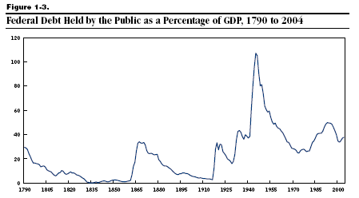
US debt (% of GDP)

Slide 8
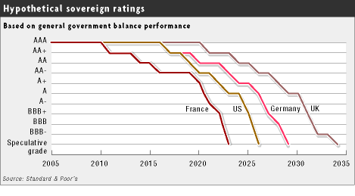
Government debt ratings?
Source: FT, March 21, 2005

Slide 9
Alexander Hamilton
Second Report on Public Credit, 1795:
  Every system of Public Credit must assume as a fundamental principle that it will possess ability to pay the debt which it contracts. … With the creation of debt should be incorporated the means of extinguishment, which means are twofold: the establishing at the time of contracting a fund for the reimbursement of principal, as well as for the payment of interest.

Slide 10
Larry Summers
Remarks to IMF:
  The US government deficit, and the associated low saving rate, are the most serious problem to face the US economy in the last 50 years. [paraphrase]

Slide 11
Government budget: overview
Analogy: credit cards
  Allow you to shift payments in time, not avoid them
  Higher debt leads to higher interest payments, which requires higher cash flow to finance
Government deficits and debt
  Deficits concern timing, not whether we pay for government spending
  Eventually accumulated debt must be repaid [sort of]
  Therefore: not only must deficits not last forever, you must run future (primary) surpluses to balance a deficit today.

Slide 12
Government budget: details
Government budget:
G_{t} + V_{t} + i_{t} B_{t} = T_{t} + B_{t+1} – B_{t}
Ingredients:
  G = government purchases of goods and services
  V = transfer payments from government to households
  G + V = government spending
  T = tax revenue
  D = G + V – T = primary deficit (excl interest)
  B = government debt (“bonds” – ignore money)
  i = (nominal) interest rate on debt
  iB = interest payments

Slide 13
Government budget: variations
Three versions of the same equation
D_{t} + iB_{t} = B_{t+1} – B_{t} (1) finance deficit with debt
B_{t+1} = (1+i)B_{t} + D_{t} (2) debt dynamics (backwards)
B_{t} = B_{t+1}/(1+i) – D_{t}/(1+i) (3) debt dynamics (forwards)
Bottom line
  Deficits must be financed

Slide 14
Government budget: present value
Current debt equals
B_{t} = B_{t+1}/(1+i) – D_{t}/(1+i) [version (3)]
= B_{t+2}/(1+i)² – [D_{t}/(1+i) + D_{t+1}/(1+i)²]
= …
= B_{t+n}/(1+i)^{n} – [D_{t}/(1+i) + D_{t+1}/(1+i)² + … + D_{t+n-1}/(1+i)^{n}]
= present value of future primary surpluses
Comments
  Debt must be financed by future (primary) surpluses
  Assumes: B_{t+n}/(1+i)^{n} → 0 [weaker condition than B_{t+n} → 0]
  Or we could default!

Slide 15
Should we care about deficits?
Deficits concern timing of taxes and revenues
Reasons we don’t care
  Present value doesn’t change [Analogy: Modigliani-Miller on dividends]
Reasons we might care
  Smooth tax rates?
  Redistribution across generations?

Slide 16
Sustainability analysis
Issue:
  Will ratio of debt to GDP settle down if policy doesn’t change?
  If yes: sustainable. If not, unsustainable.
  Both measured at current prices (“nominal”)
Growth of (nominal) debt [budget version (2)]
B_{t+1} = (1+i)B_{t} + D_{t}
Growth of (nominal) GDP
Y_{t+1} = (1+g)Y_{t}
Growth of debt to GDP ratio
B_{t+1}/Y_{t+1} = [(1+i)/(1+g)] (B_{t}/Y_{t}) + (1+g)⁻¹ D_{t}/Y_{t}

Slide 17
Sustainability analysis
“Natural” growth rates
  Debt: (1+i)
  GDP: (1+g)
  Ratio of debt to GDP: (1+i)/(1+g)
Sustainability requires
(1+i)/(1+g) < 1
i < g
Typically i>g
  Therefore something must change – but what?

Slide 18
Sustainability analysis
“Unsustainable” means something must change
  Higher tax revenue
  Lower spending
  Higher growth
  Lower interest rate
  Default on debt

Slide 19
Is India in trouble?
India today
  B/Y = 50%
  D/Y = 0.0% (primary)
  Interest on public debt (iB/Y): 3.7% of GDP
  i = 7.4% [high?]
  g = 13% (8+5)
Is fiscal policy sustainable?
  Compare “natural growth” of B/Y with current surplus

Slide 20
Is India in trouble?
EIU, Country Risk Service, March 2007:
  High levels of domestic public debt remain a concern.
  The government’s ability to implement economic reforms at the federal level will be constrained by the demands of coalition politics.
  The economy is vulnerable to financial shocks owing to overvalued real-estate and stock prices.

Slide 21
Is the US in trouble?
Why or why not?

Slide 22
Is the US in trouble?
US today
  B/Y = 37%
  D/Y = 1.1%
  i = 4.5%
  g = 6% (2.5+3.5)
Is fiscal policy sustainable?
  Compare “natural growth” of B/Y with current surplus

Slide 23
Is the US in trouble?
EIU, Country Risk Service, Nov 2006:
  The public debt/GDP ratio will continue to rise over the medium term but remain modest by comparison with the US’s peers. Foreign holdings of US Treasuries have been rising but all public debt is denominated in US dollars, which means that the government has no exposure to currency risk.

Slide 24
US: debt (% of GDP)
Notes:
http://www.cbo.gov/showdoc.cfm?index=6982&sequence=0

Slide 25
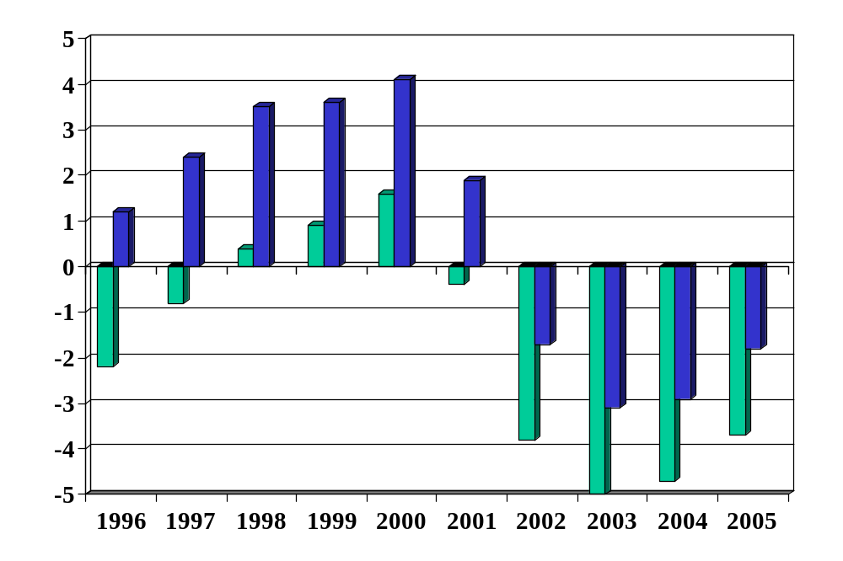
US: budget balance (% of GDP)
Source: OECD Economic Outlook, Annex Tables 27 and 29. Green=total, Blue=primary.

Slide 26
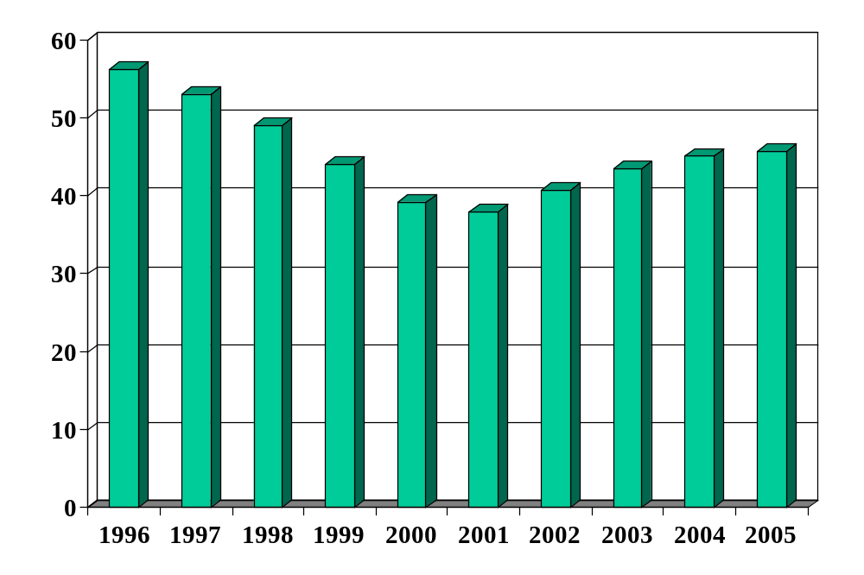
US: debt (% of GDP)
Source: OECD Economic Outlook, Annex Table 33.

Slide 27
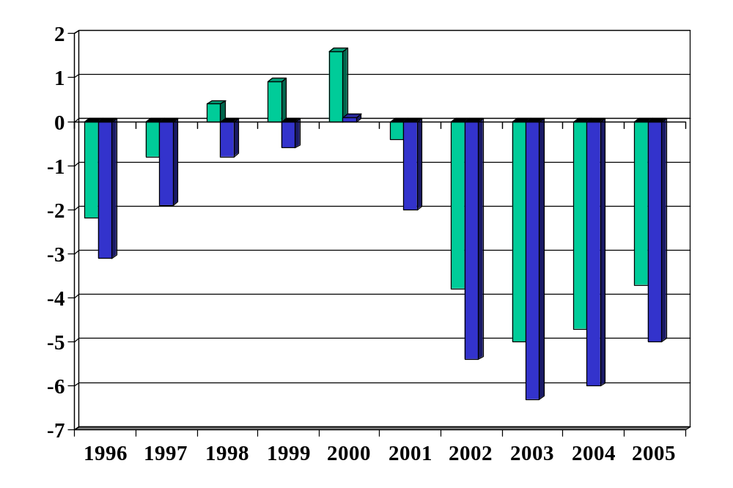
US: impact of soc sec (% of GDP)
Source: OECD Economic Outlook, Annex Tables 27 and 29. Green=total, Blue=excl soc sec.

Slide 28
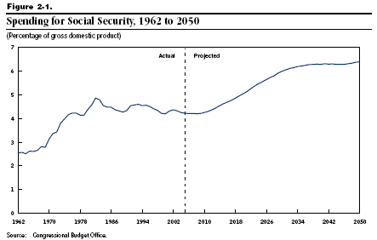
US: social security (% of GDP)

Slide 29
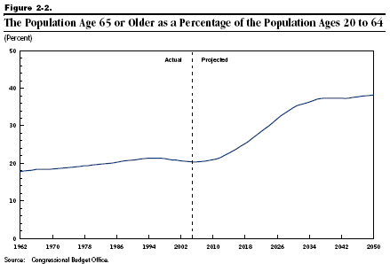
US: age distribution

Slide 30
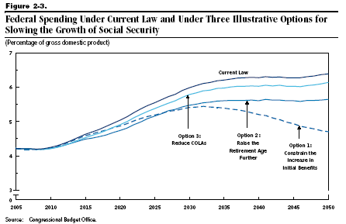
US: social security (% of GDP)

Slide 31
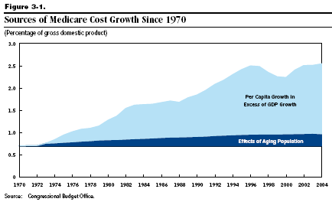
US: medicare (% of GDP)

Slide 32
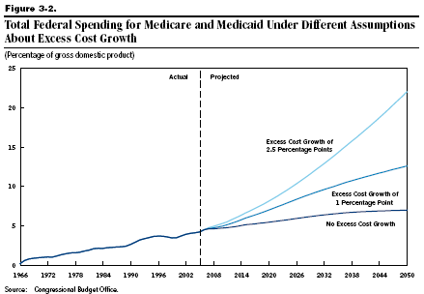
US: medicare/medicaid (% of GDP)
Historical avg: 2.9%

Slide 33
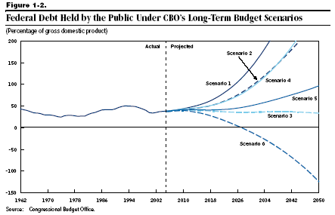
US debt (% of GDP)

Slide 34
Takeaways
Government deficits must be financed
  By issuing debt today
  And by running (primary) surpluses in the future
Sustainability analysis
  Based on dynamics of debt to GDP ratio
Why we might care about deficits
  Uneven tax rates and redistribution
US deficits
  The biggest issues are not the current deficit, but projected future deficits implied by social security and medicare-medicaid payments

Slide 35
Germany: sustainability analysis
Germany today
  B/Y = 70%
  D/Y = 4%
  i = 2%
  g = 4%
Is fiscal policy sustainable?

Slide 36
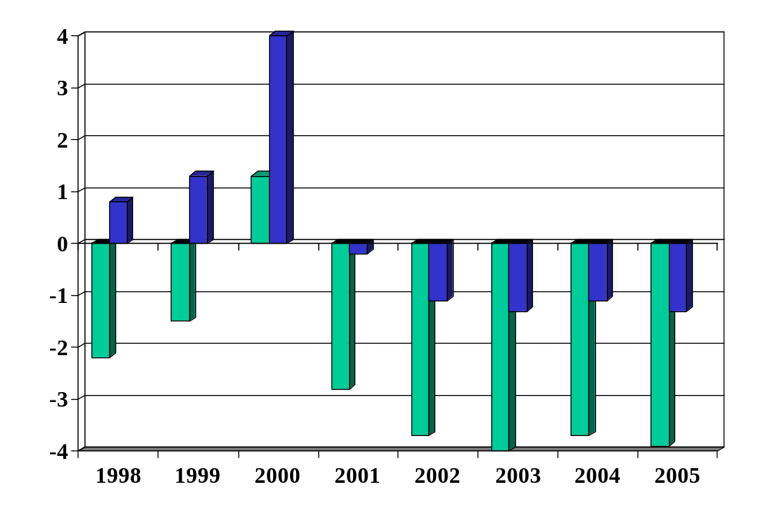
Germany: budget balance (% of GDP)
Source: OECD Economic Outlook, Annex Tables 27 and 29. Green=total, Blue=primary.

Slide 37
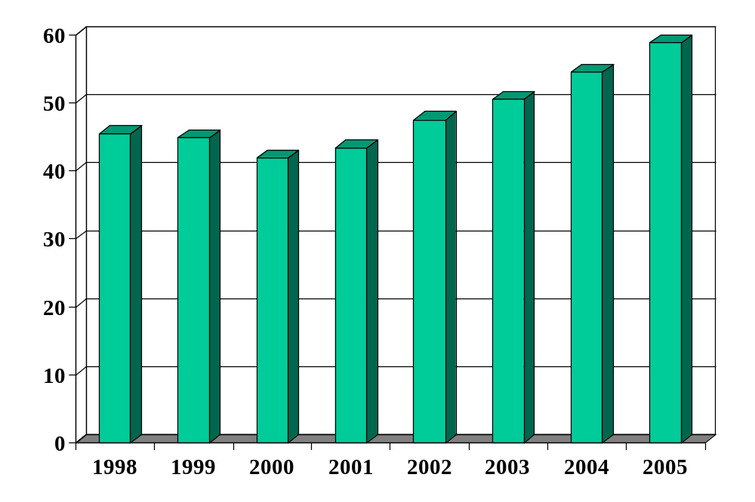
Germany: debt (% of GDP)
Source: OECD Economic Outlook, Annex Table 33.

