Slide 1

The Global Economy
The Production Function
© NYU Stern School of Business
Notes:
Intro
* Start spreadsheet
* Ask students for comments on countries: why successes?

Slide 2
About the TFs
Andrew Verdasca
  From: Toronto, Canada
  Concentrations: finance and accounting
  Career plans: Bear Stearns, investment banking
  Personal interests: sailing, travel, politics
Yuliana Sameroynina
  From: Russia
  Graduate student in economics
  Professional interests: international and development economics
  Personal interests: music, ballet, swimming, ice-skating
Notes:
Questions?

Slide 3
About the Final Exam
Thursday May 3, 9-11am
Notes:
Questions?

Slide 4
Group Project #2
Exercise designed to apply the concepts covered in “Notes on Measurement.”
Notes:
Questions?

Slide 5
Today’s plan of attack
Current economic and business issues
Countries
About the course
History and pictures
Theory: the production function
Capital and labor inputs
Productivity (the infamous “TFP”)

Slide 6
Current issues

Slide 7
Current issues
From The Economist, Jan 27, 2007:
  India has been swept by optimism. A recent article claimed that the growth in India’s total factor productivity (TFP) had accelerated.

Slide 8
Current issues
Paolo Leme, Goldman Sachs (“The ‘B’ in BRICs”):
  Original BRICs analysis: by 2050, BRICs would have greater GDP (not GDP per capita) than G6. [We’ll show how they computed this on Thursday.]
  December 06: Brazil’s growth performance has been disappointing relative to the other BRICs. We are unlikely to see the deep fiscal adjustment needed to raise growth to 5%. … The [Brazilian] government should implement reforms designed to improve institutions, with a view to increasing total factor productivity."

Slide 9
Countries
What factors have affected your country’s performance?
Notes:
Countries: (i) What has your country done well? What could it do better? (ii) Good for growth, bad for growth. <= on board

Slide 10
About the course
Theme: economic performance of countries
First half: long-run performance
  Why is GDP per capita lower in India than France?
  Why are China and India growing so rapidly?
  What are the business opportunities and challenges?
Second half: short-run performance
  How does [country name] look over the next year?
  What are the business opportunities and challenges?

Slide 11
About the course
Long-Run Performance
Saving and Investment, Productivity, Institutions, Labor Markets, International Trade, Taxes
First half:
Short-Run Performance
Inflation, Interest Rates, Indicators, Monetary Policy, Govt Deficits, Exchange Rates, Capital Flows, Emerging Market Crises
Second half:

Slide 12
About today’s class
GDP
Capital & Labor
Productivity
Political Process
“Institutions”

Slide 13
About GDP
GDP: Gross Domestic Production
  Total value of production in a given geographic area
Nominal GDP
  GDP at current prices
  Changes over time from both quantities and prices
Real GDP
  GDP at constant prices (eg, 2000 US dollars)
  Impact of price changes taken out
GDP price deflator
  = Nominal GDP / Real GDP

Slide 14
World history ??
Why Western Europe?
  Total value of production in a given geographic area
Stories
  China
  Arab world
  Math

Slide 15
World history
Statistic | Year 0 | 1000 | 1820 | 1998
Population (millions) | 231 | 268 | 1,041 | 5,908
GDP Per Capita | 444 | 435 | 667 | 5,709
Life expectancy | 24 | 24 | 26 | 66
Source: Maddison, Millennial Perspective, OECD, 2001, Tables 1-2, 1-5a.
Notes:
Prior to 1500 or so: life was “poor, nasty, brutish, and short” (Thomas Hobbes, Leviathan, 1651)
Draw pix on board
Temporary ups and downs from natural disasters, war…

Slide 16
GDP per capita (1990 US$)
Region | Year 0 | 1000 | 1820 | 1998
Western Europe | 450 | 400 | 1,232 | 17,921
Western offshoots | 400 | 400 | 1,201 | 26,146
Japan | 400 | 425 | 669 | 20,413
Latin America | 400 | 400 | 665 | 5,795
E Europe + “USSR” | 400 | 400 | 667 | 4,354
Asia (excl Japan) | 450 | 450 | 575 | 2,936
Africa | 425 | 416 | 418 | 1,368
World Average | 444 | 435 | 667 | 5,709
Source: Maddison, Millennial Perspective, OECD, 2001, Table 1-2.
Notes:
Offshoots = US + Canada + Australia + NZ
Note: Some grew, others didn’t. But it’s not true that growth by some was associated with shrinkage by others.

Slide 17
Share of world GDP (%)
Region | 1000 | 1820 | 1950 | 1998
Western Europe | 8.7 | 23.6 | 26.3 | 20.6
Western offshoots | 0.7 | 1.9 | 30.6 | 25.1
Japan | 2.7 | 3.0 | 3.0 | 7.7
Latin America | 3.9 | 2.0 | 7.9 | 8.7
E Europe + “USSR” | 4.6 | 8.8 | 13.1 | 5.3
Asia (excl Japan) | 67.6 | 56.2 | 15.5 | 29.5
Africa | 11.8 | 4.5 | 3.6 | 3.1
World | 100.0 | 100.0 | 100.0 | 100.0
Source: Maddison, Millennial Perspective, OECD, 2001, Table 3-1c.
Notes:
Offshoots = US + Canada + Australia + NZ

Slide 18
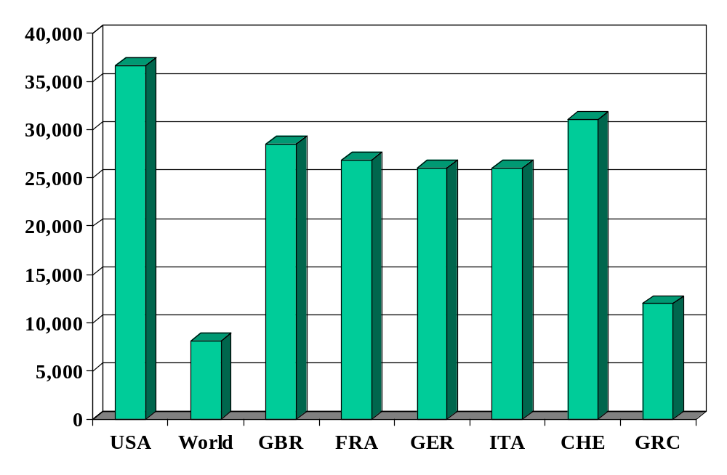
GDP per capita (2000 US$, PPP adj)
Source: World Bank, World Development Indicators, data for 2004, 2000 prices in USD, PPP adjusted.

Slide 19
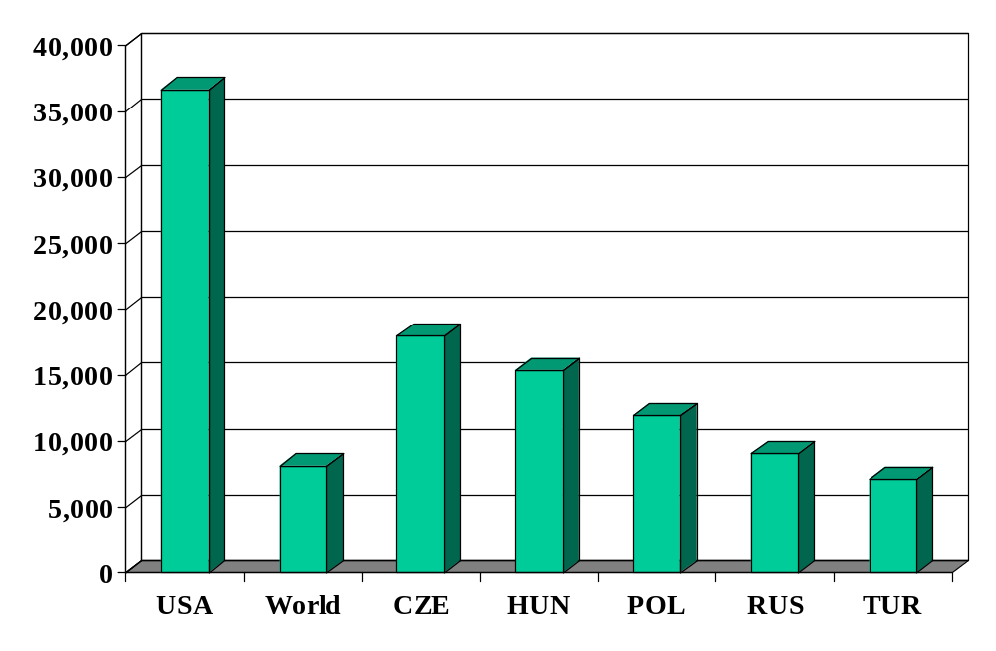
GDP per capita
Source: World Bank, World Development Indicators, data for 2004, 2000 prices in USD, PPP adjusted.

Slide 20
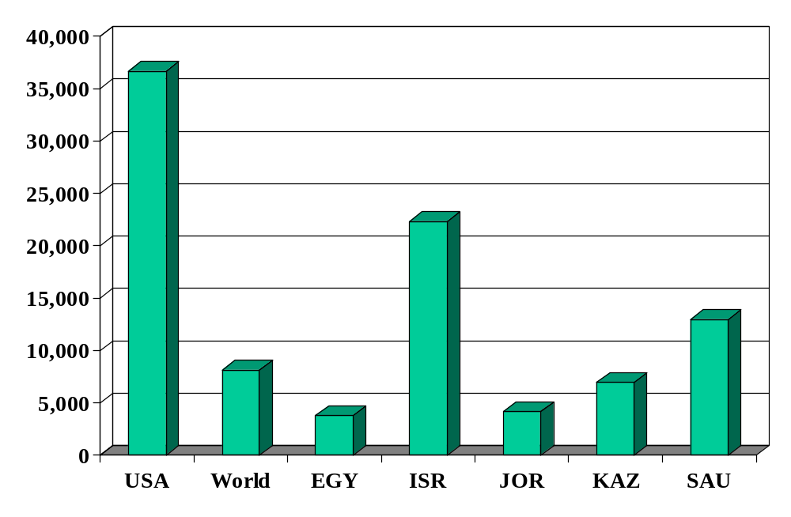
GDP per capita
Source: World Bank, World Development Indicators, data for 2004, 2000 prices in USD, PPP adjusted.

Slide 21
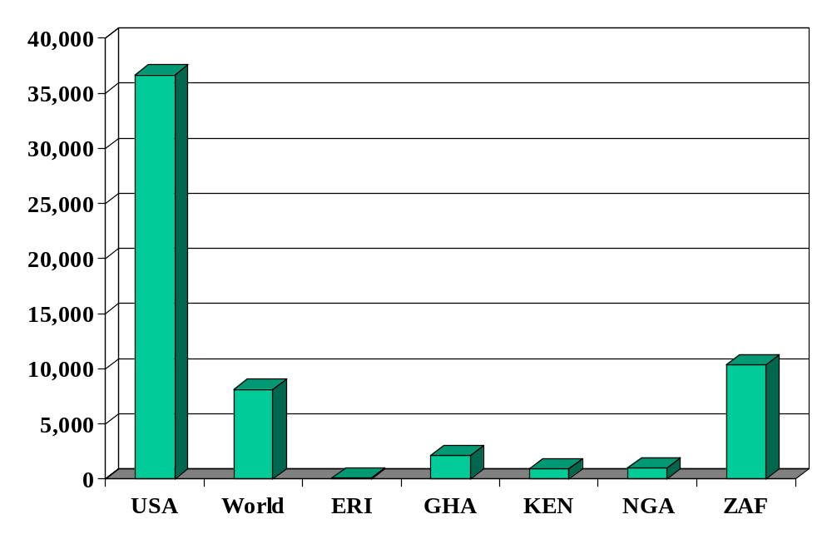
GDP per capita
Source: World Bank, World Development Indicators, data for 2004, 2000 prices in USD, PPP adjusted.

Slide 22
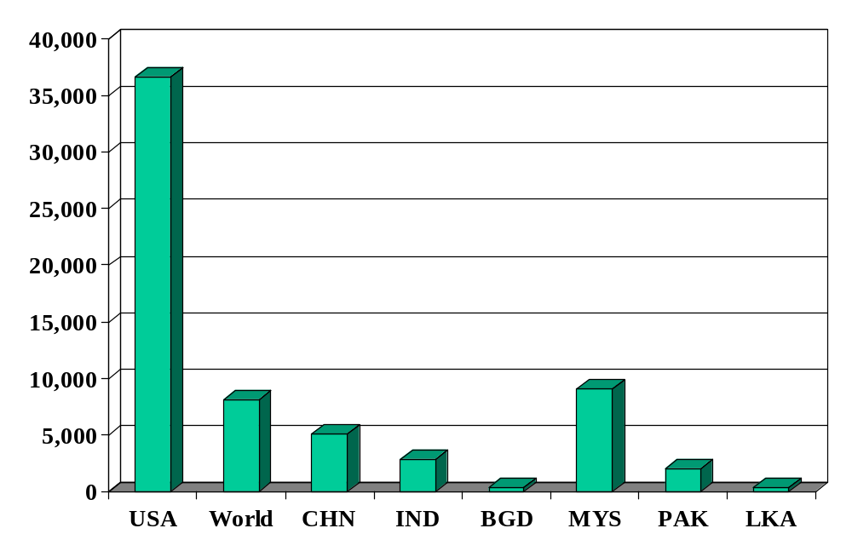
GDP per capita
Source: World Bank, World Development Indicators, data for 2004, 2000 prices in USD, PPP adjusted.

Slide 23
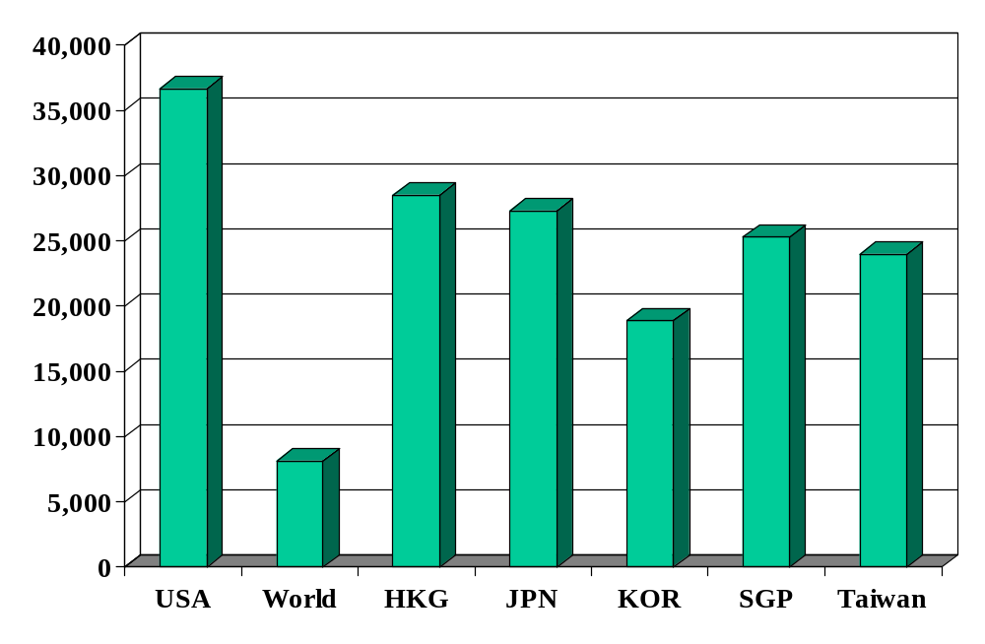
GDP per capita
Source: World Bank, World Development Indicators, data for 2004, 2000 prices in USD, PPP adjusted.

Slide 24
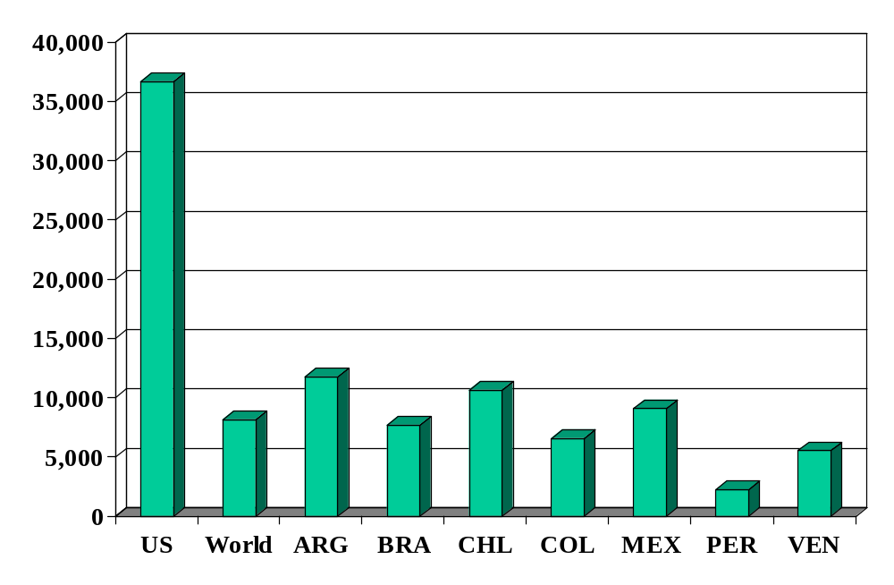
GDP per capita
Source: World Bank, World Development Indicators, data for 2004, 2000 prices in USD, PPP adjusted.

Slide 25
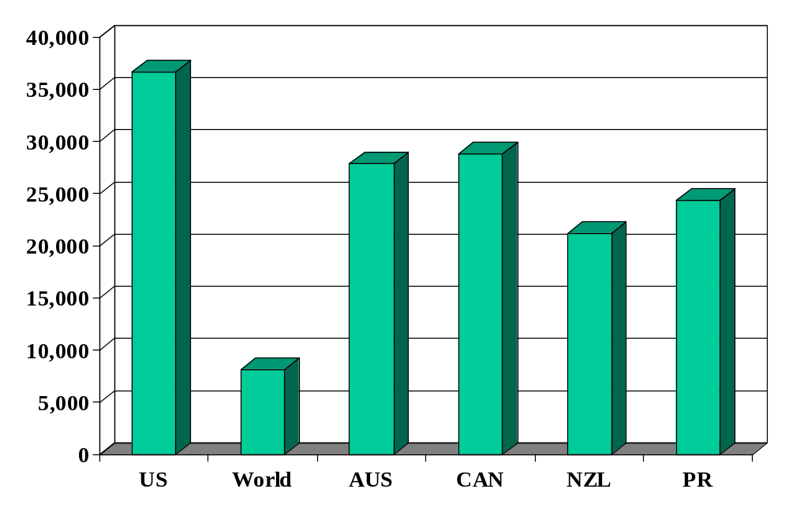
GDP per capita
Source: World Bank, World Development Indicators, data for 2004, 2000 prices in USD, PPP adjusted.

Slide 26
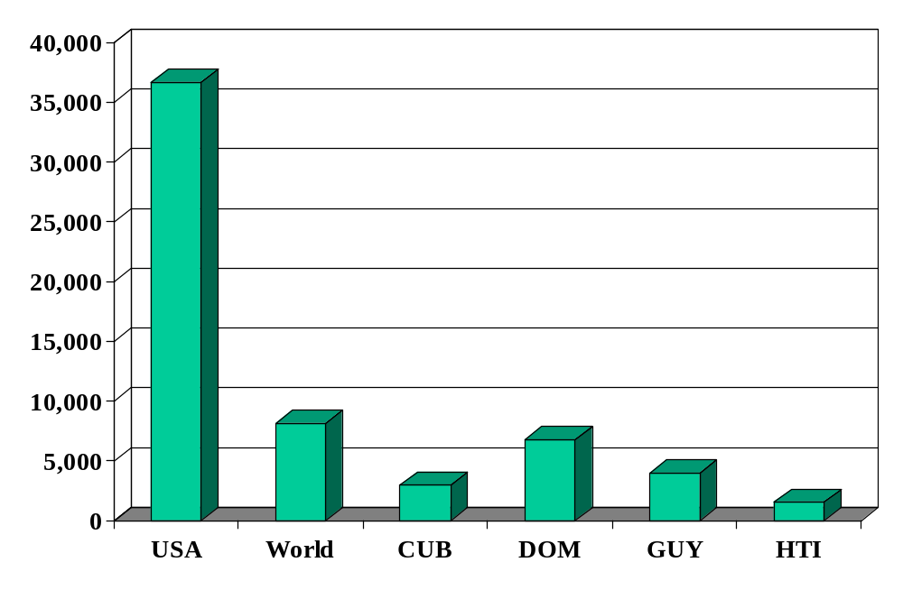
GDP per capita
Source: World Bank, World Development Indicators, data for 2004, 2000 prices in USD, PPP adjusted.

Slide 27
Differences in per capita GDP
Curiosity: Why?
Business: How does business climate vary?
Gates: What should they need to succeed?

Slide 28
Theory
Choose the correct definition:
A belief or conjecture with no connection to reality [“in theory, hummingbirds can’t fly”]
A hypothesis assumed for the sake of argument
Something I’ll never need in my job
A tool that helps me organize my thoughts [think “hammer” or “Excel”]

Slide 29
Production function: picture
GDP
Capital & Labor
Productivity

Slide 30
Production function: math
Idea: relate output to inputs
Mathematical version:
Y = A F(K,L)
= A K^{α} L^{1-α} (“Cobb-Douglas”)
Definitions:
  K = quantity of physical capital used in production (plant and equipment)
  L = quantity of labor used in production
  A = total factor productivity (everything else)
  α = 1/3 (take my word for it)

Slide 31
Production function: properties
More inputs lead to more output
  Positive marginal products of capital and labor
Diminishing marginal products
  If we increase one input, each increase leads to less additional output
Constant returns to scale
  If we double both inputs, we double output

Slide 32
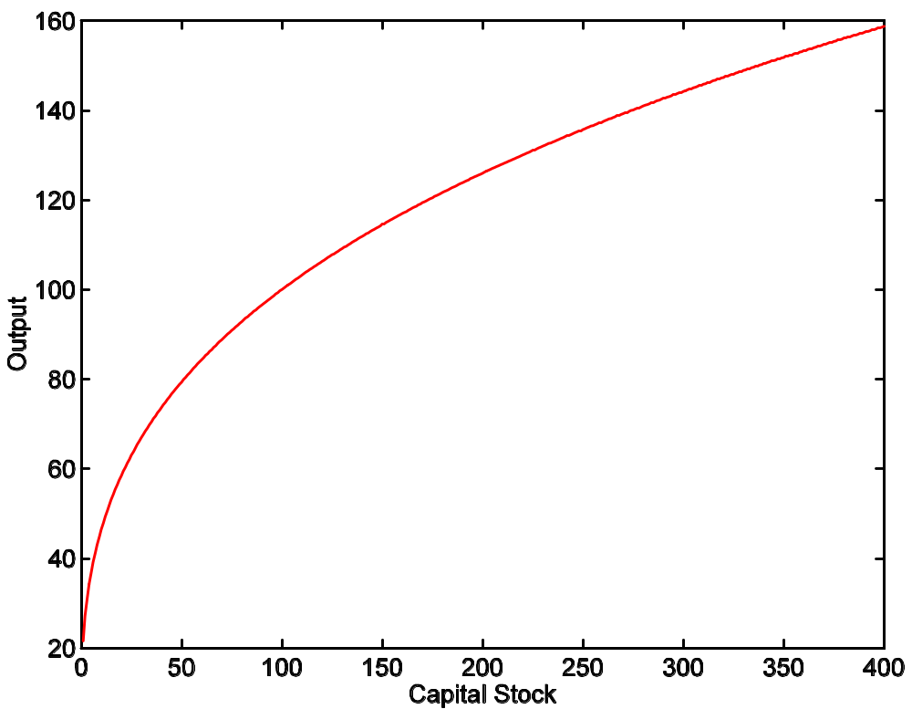
Production function properties
A = 1
L = 100
α = 1/3

Slide 33
Capital
Meaning: physical capital used in production (capital input, plant and equipment)
Why does it change?
  Depreciation/destruction
  New investment (“capex”)
Mathematical version:
K_{t+1} = K_{t} – δ_{t}K_{t} + I_{t}
= (1 – δ_{t})K_{t} + I_{t}
Adjustments for quality?

Slide 34
Capital measurement
Option #1: direct surveys of plant and equipment
Option #2: perpetual inventory method
  Pick an initial value K₀
  Pick a depreciation rate (or measure depreciation directly)
  Measure K like this:
K_{t+1} = (1 – δ_{t})K_{t} + I_{t}
In practice, #2 is the norm:
  Get I from NIPA
  Set δ = 0.06 [ballpark number]
  Example: K₂₀₀₄ = 100, δ = 0.06, I = 12 → K₂₀₀₅ = 106

Slide 35
Labor
Meaning: units of labor used in production (labor input)
Why does it change?
  Population growth
  Fraction of population employed, hours worked, changes in skill
Basic measure: L = number of workers (employment)
Adjustments for quality? Quantity?
  Skill: education? other? [H = “human capital”]
  Hours: often not available [h = hours]
  Leads to an “augmented production function”:
Y = A F(K,hHL) = A K^{α} (hHL)^{1-α}

Slide 36
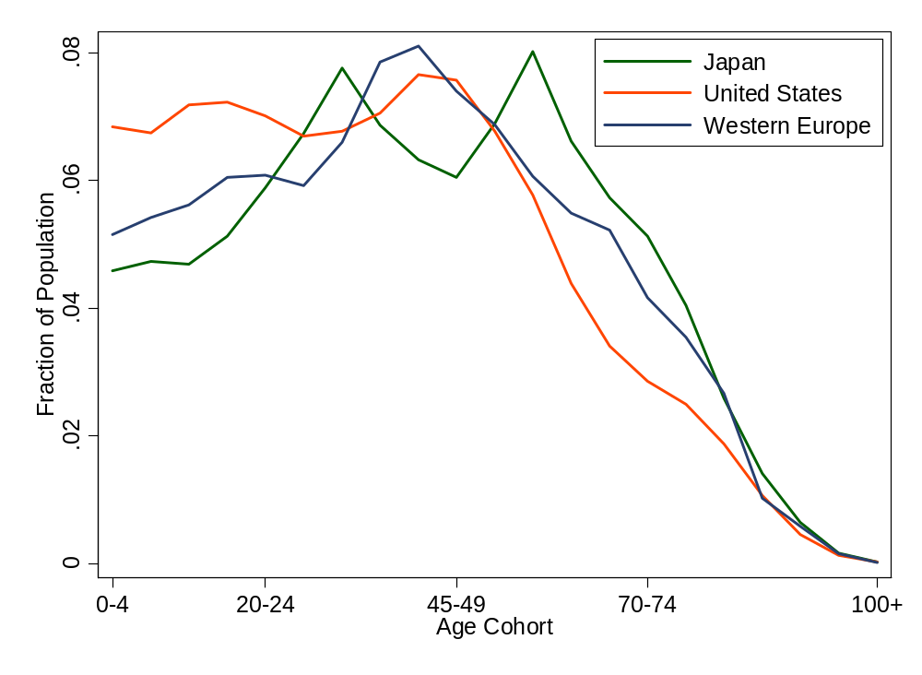
Age distribution

Slide 37
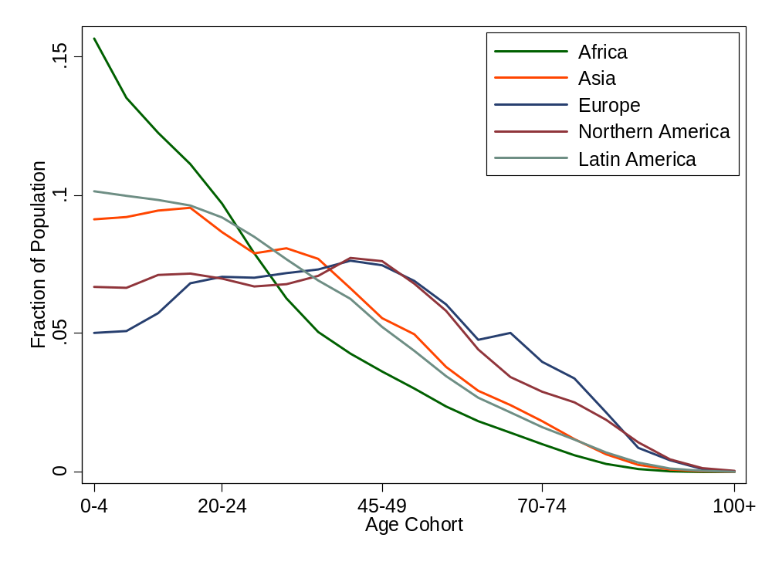
Age distribution

Slide 38
Productivity and “TFP”
Standard number
  Average product of labor: Y/L
Our number:
  Total Factor Productivity: Y/F(K,L) = Y/[K^{α} L^{1-α}]
How do we measure it?
  Solve the production function for A:
  Y = A K^{α} L^{1-α}
  A = Y/[K^{α} L^{1-α}] = (Y/L)/(K/L)^{α}
Example (US): Y/L = 33, K/L = 65:
A = 33/65^{1/3} = 8.21

Slide 39
GDP per capita revisited
Where does GDP per capita come from?
    Y/POP = (L/POP) (Y/L)
    = (L/POP) A (K/L)^{α}
Reasons for high GDP per capita:
  More work: L/POP
  More productivity: A
  More capital: K/L
  Not present but could be added: skill H or hours worked h

Slide 40
Takeaways
The production function links output to inputs and productivity:
Y = A K^{α} L^{1-α}
The capital input (K):
  Plant and equipment, a consequence of investment (I)
The labor input (L):
  Population growth, age distribution, participation
  Could add skill (H) or hours per person (h)
TFP (A) can be inferred from data on output and inputs

