Slide 1

The Global Economy
The Solow Model
© NYU Stern School of Business
Notes:
Start gapminder: growth v GDP per capita
Start spreadsheet (Solow)
Use China and India as the example. Is s a big deal?

Slide 2
About the TFs
Andrew Verdasca
  From: Toronto, Canada
  Concentrations: finance and accounting
  Career plans: Bear Stearns, investment banking
  Personal interests: sailing, travel, politics
Yuliana Sameroynina
  From: Russia
  Graduate student in economics
  Professional interests: international and development economics
  Personal interests: music, ballet, swimming, ice-skating
Notes:
Questions?

Slide 3
Today’s plan of attack
Current economic and business issues
Where we’ve been, where we’re headed
Group Project #2, question 3
The Solow model
  How important are saving and investment?

Slide 4
Executive summary (spoiler alert!)
Saving, investment usually not that important
TFP is the secret ingredient
Next week:
  Quantifying the impact of TFP growth
  Where does TFP come from? (“institutions”)

Slide 5
Current issues

Slide 6
Current issues
GDP update
  Fourth quarter GDP growth (advanced estimate): 3.5% [3.1]
  GDP deflator: 1.5% [1.5]
  Impact on stock market? Bond market?
Lehman’s comment
  GDP grew by 3.5% in the fourth quarter driven by an across-the-board increase in consumption… We continue to see some upside risks to our first quarter growth estimate of 2.5%.

Slide 7
Current issues
FOMC statement (Jan 31 07):
  The Federal Open Market Committee decided today to keep its target for the federal funds rate at 5-1/4 percent.
  Recent indicators have suggested somewhat firmer economic growth, and some tentative signs of stabilization have appeared in the housing market. Overall, the economy seems likely to expand at a moderate pace over coming quarters.
  Readings on core inflation have improved modestly in recent months, and inflation pressures seem likely to moderate over time. However, the high level of resource utilization has the potential to sustain inflation pressures.
  The Committee judges that some inflation risks remain. The extent and timing of any additional firming that may be needed to address these risks will depend on the evolution of the outlook for both inflation and economic growth, as implied by incoming information.

Slide 8
Current issues
Lehman comment on FOMC:
  There were three key changes to the FOMC directive: 1. The FOMC noted “tentative signs of stabilization have appeared in the housing market.” Compared with December’s “substantial cooling” seen in December this represents a shift in the risks the FOMC sees. All else being equal, this is a modestly hawkish statement. 2. Removed “on balance” in the “economy seems likely to expand at a moderate pace in coming quarters.” The removal of these words suggests that the Fed may view the future growth path of the economy as more stable than they had viewed it in December. Again this is more a modestly hawkish statement. 3. The Fed altered the paragraph detailing inflation risks in numerous ways. Taken in conjunction with the inflation bias remaining in place and this is only modestly dovish.

Slide 9
Where we’ve been
GDP: Gross Domestic Production
  Total value of production in a given geographic area
Nominal GDP
  GDP at current prices
  Changes over time from both quantities and prices
Real GDP
  GDP at constant prices (eg, 2000 US dollars)
  Impact of price changes taken out
GDP price deflator
  = Nominal GDP / Real GDP

Slide 10
Where we’ve been
Production function
Y = A K^{α} L^{1-α}
  Y is GDP
  A is “total factor productivity” or TFP
  K is capital (plant and equipment)
  L is number of workers (or perhaps a more refined measure of the “labor input”)
All measurable, either directly (Y,K,L) or indirectly (A)

Slide 11
Where we’ve been
Where do these show up? [choices are Y, K, L, A]
  Government subsidies of less productive sectors (agriculture)
  Tax-sheltered saving program that increases saving
  Training programs that increase skill of workers
  Financial system that finances unproductive investments
  Increase in price of imported oil and gas

Slide 12
Where we’re headed
GDP
Capital & Labor
Productivity
Political Process
“Institutions”

Slide 13
Group Project #2
Notes:
Foreshadows this class

Slide 14
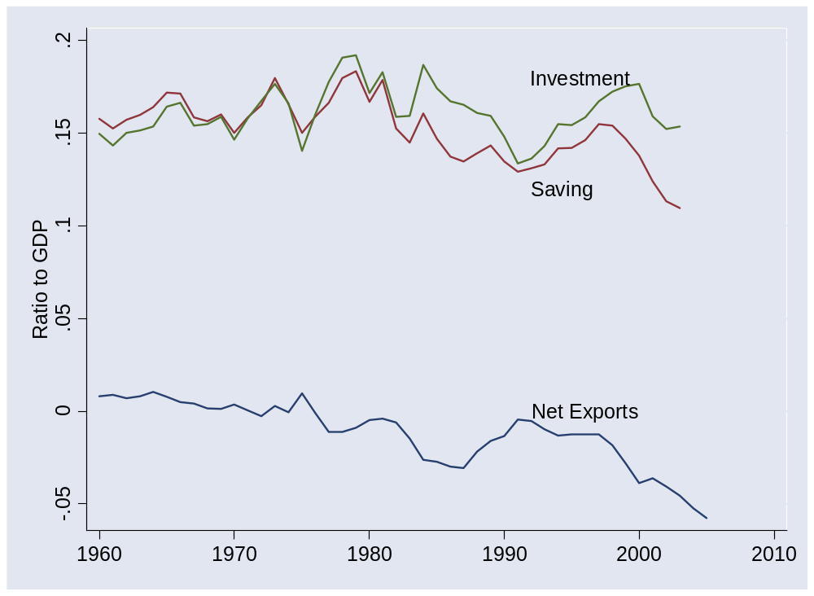
Group Project #2 (US)
Notes:
Foreshadows this class

Slide 15
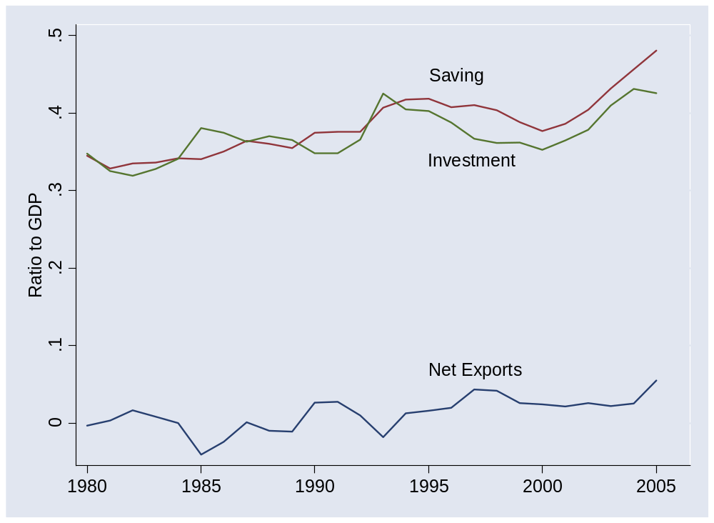
Group Project #2 (China)
Notes:
Foreshadows this class

Slide 16
The question
How important are saving and investment to growth?

Slide 17
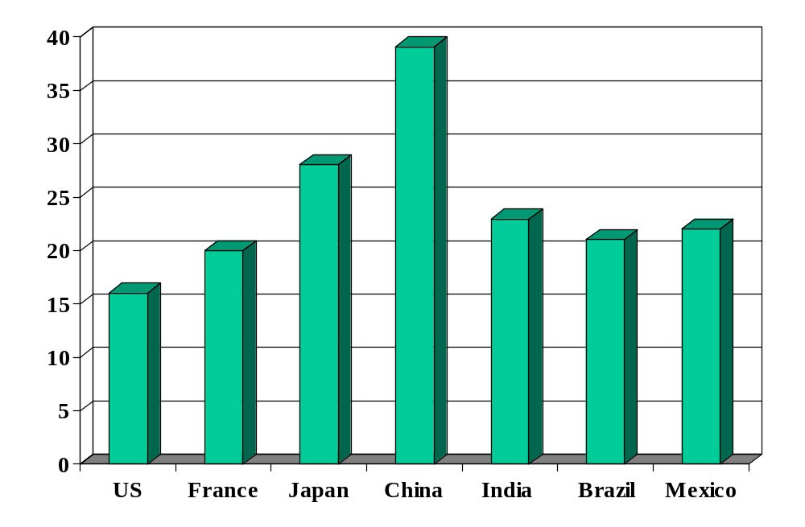
Investment rates (% of GDP)
Source: International Financial Statistics, averages for 1990-present.

Slide 18
Solow model
Quantitative tool for thinking about growth
Used to extrapolate current trends in a sensible way
  How large will China and India be in 2050?
Focus on saving and investment
Conclusion: adding capital can’t produce high growth on its own
  Diminishing returns to capital in production function
Don’t sweat the details

Slide 19
Solow model: overview
Production function:
Y = A K^{α} L^{1-α}
Flow identity:
I = S
Saving:
S = sY
Capital stock:
ΔK = I – δK
Notes:
Write on board, look at spreadsheet

Slide 20
Solow model: India
Inputs:
  GDP in 2003: 3139b (2000 USD)
  Capital: 3683b
  Labor force: 467m
  TFP: compute from above
  Saving and investment rate: 0.20
  Depreciation rate: 0.06
  Labor force growth: 0.00 (for comparison purposes)
  TFP growth: 0.05

Slide 21
Solow model: India
Comparisons
  No labor or TFP growth
  Higher saving/investment rate [how large an impact?]
  Higher TFP growth [how large an impact?]

Slide 22
Solow model: India
Estimated GDP | GDP
2003 | 3,139
2050: no-growth benchmark | 5,030
2050: higher saving (+5%) | 5,591
2050: TFP growth (2%) | 17,188
2050: TFP + 1% | 31,851
Notes:
US in 2050: 27 trillion (ballpark)

Slide 23
Solow model: dynamics
The components lead to:
ΔK = sAK^{α}L^{1-α} – δK
Saving finances investment in new plant and equipment
Depreciation gradually reduces stock of physical capital

Slide 24
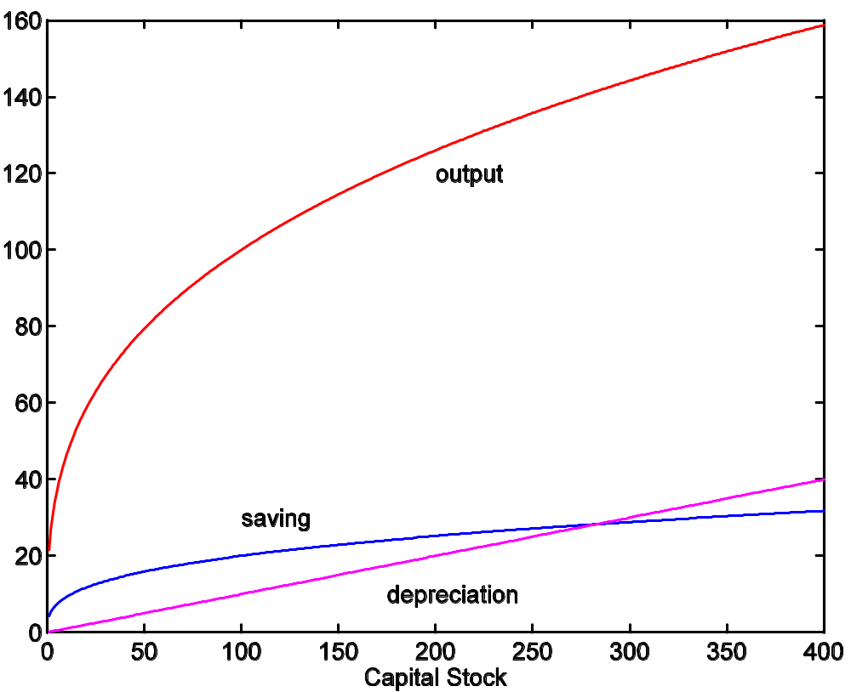
Solow model: dynamics
If we start at K=100, where do we end up?

Slide 25
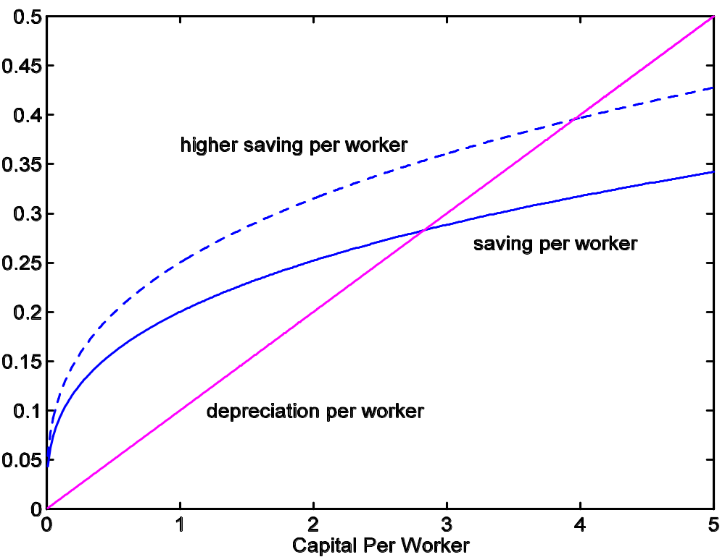
Solow model: saving

Slide 26
Takeaways
Solow model
  Growth comes from saving-financed increases in capital
  Convergence property: growth eventually stops
  Conclusion: capital can’t be the key to growth
  Value: tool for exploring future growth of emerging economies
What are we missing?
  TFP growth

Slide 27
Strong hint
Read notes before next class
  Content is both important and demanding
  You’ll be lost if you don’t

Slide 28
Pictures

Slide 29
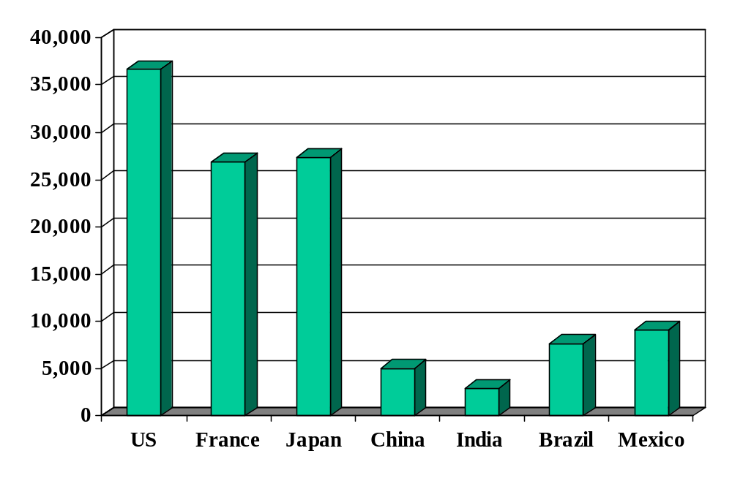
GDP per capita
Source: World Bank, World Development Indicators, data for 2004, 2000 prices in USD, PPP adjusted.

Slide 30
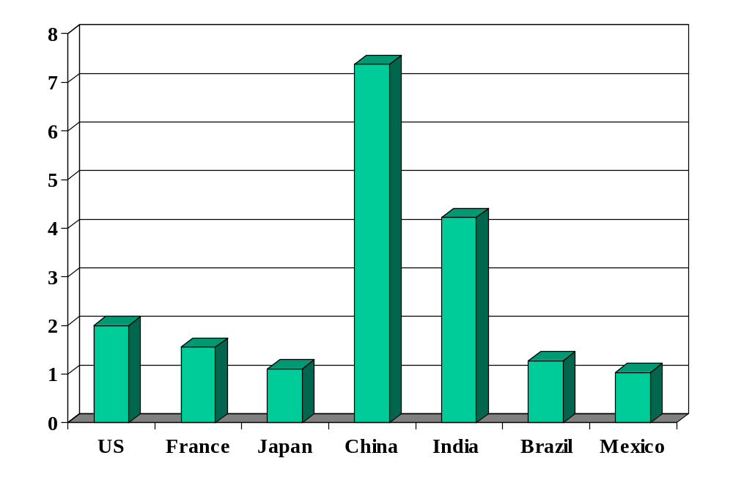
GDP per capita (10-year growth)
Source: World Bank, World Development Indicators, data for 2004, 2000 prices in USD, PPP adjusted.

Slide 31
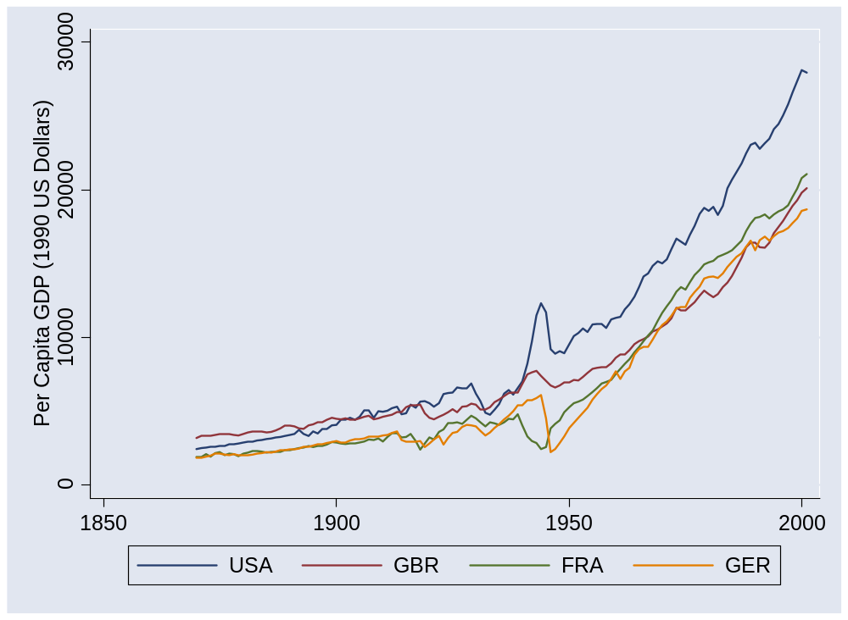
US and Europe
Source: Maddison, Historical Statistics, OECD.

Slide 32
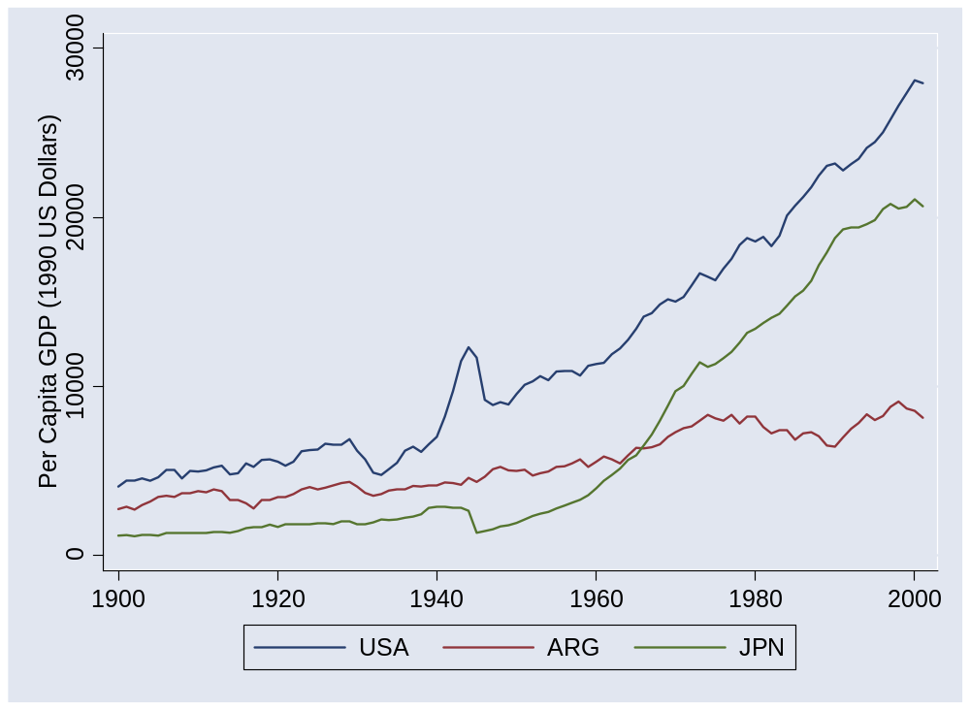
Argentina and Japan
Source: Maddison, Historical Statistics, OECD.

Slide 33
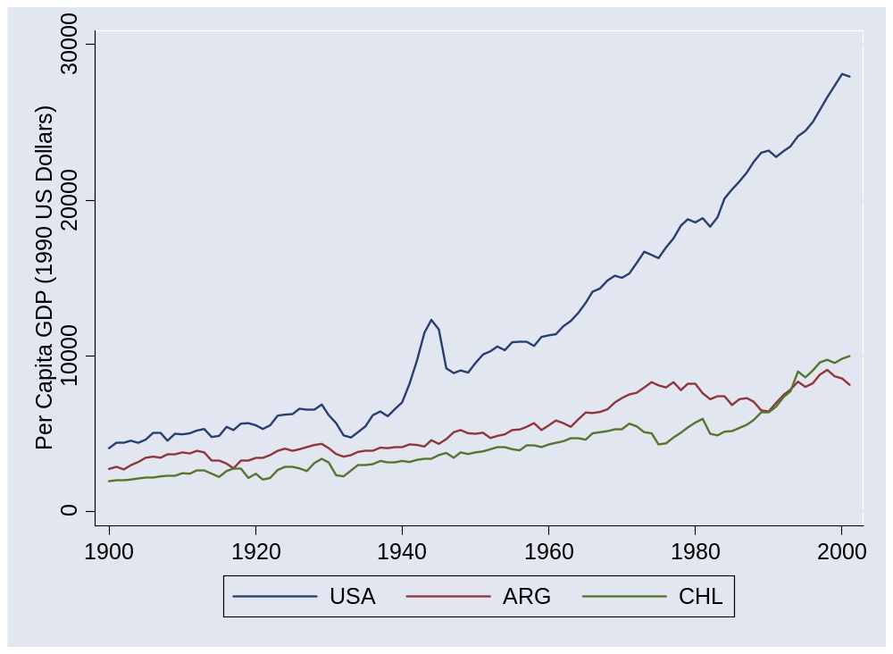
Argentina and Chile
Source: Maddison, Historical Statistics, OECD.

Slide 34
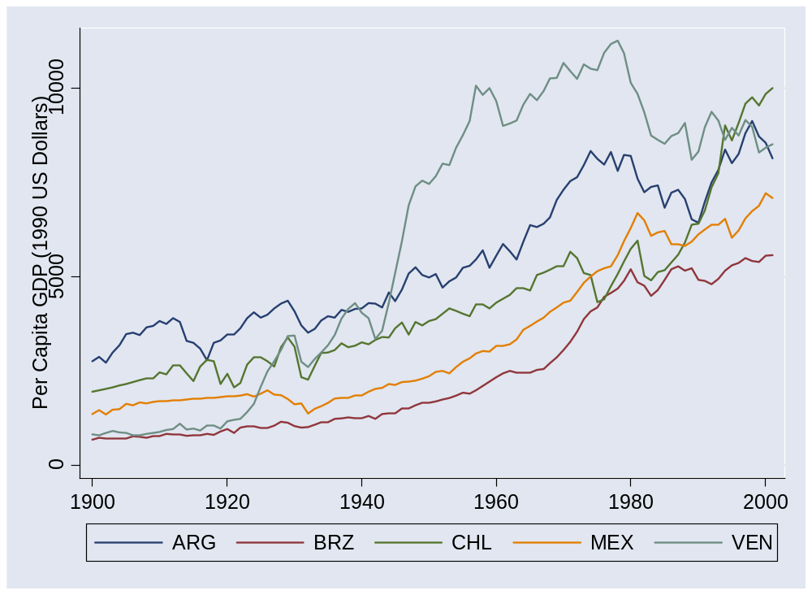
Latin America
Source: Maddison, Historical Statistics, OECD.

Slide 35
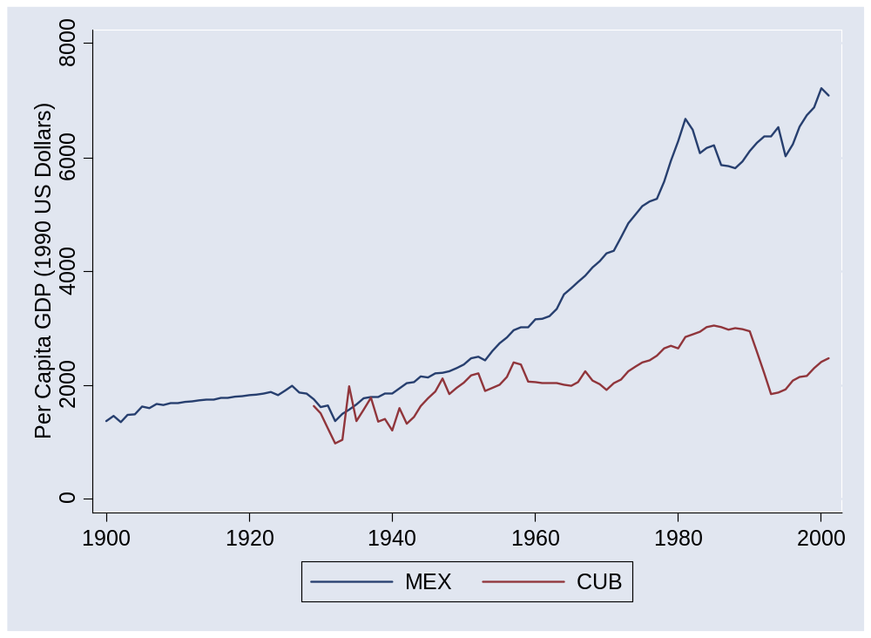
Mexico and Cuba
Source: Maddison, Historical Statistics, OECD.

Slide 36
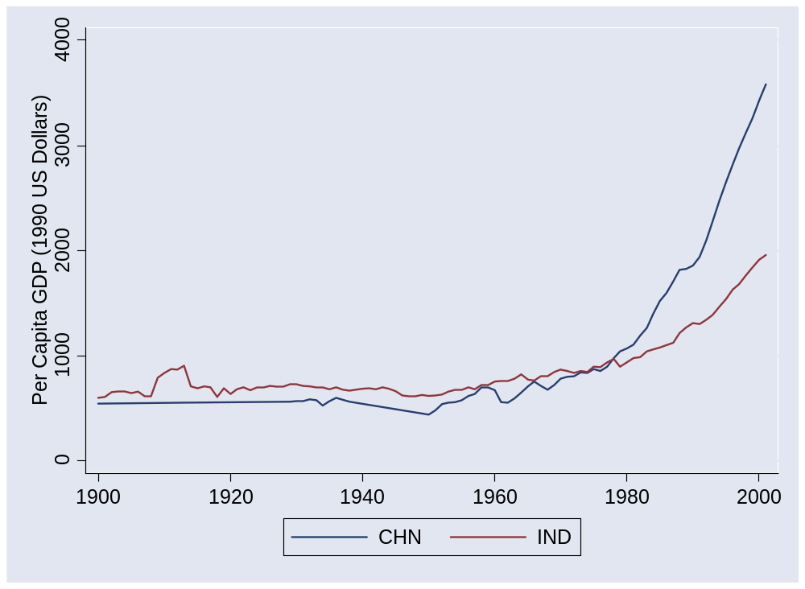
China and India
Source: Maddison, Historical Statistics, OECD.

Slide 37
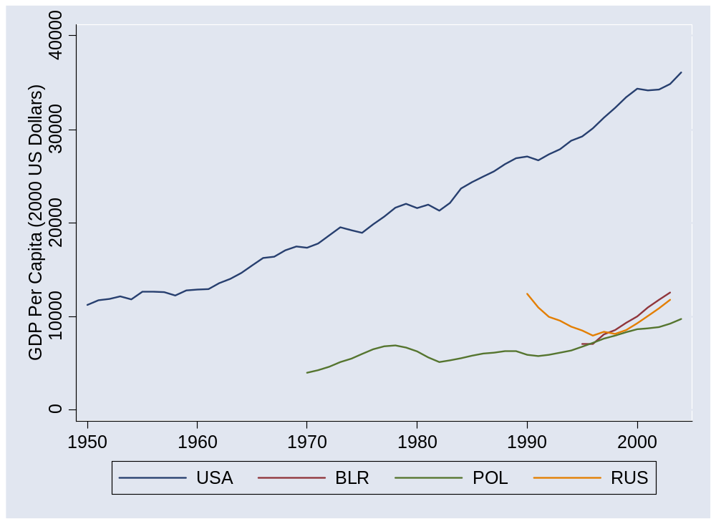
Former Soviet bloc
Source: Penn World Tables, version 6.2.

Slide 38
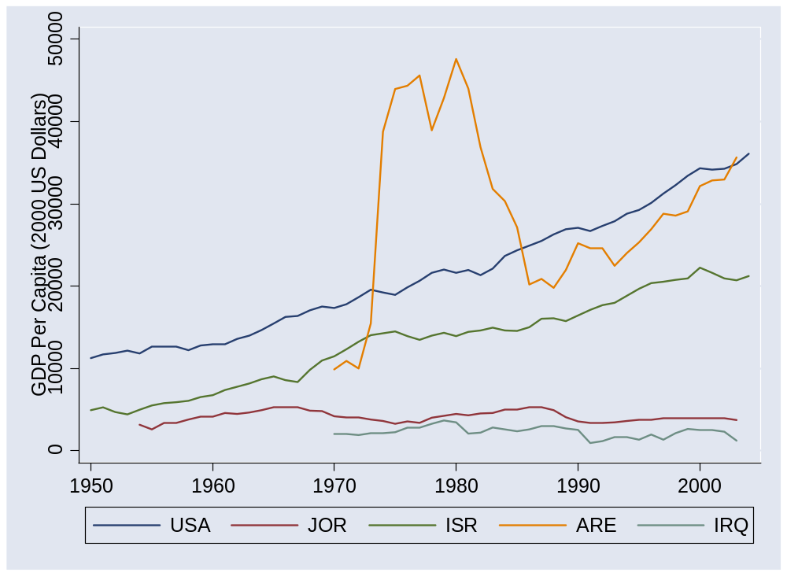
Middle East
Source: Penn World Tables, version 6.2.

Slide 39
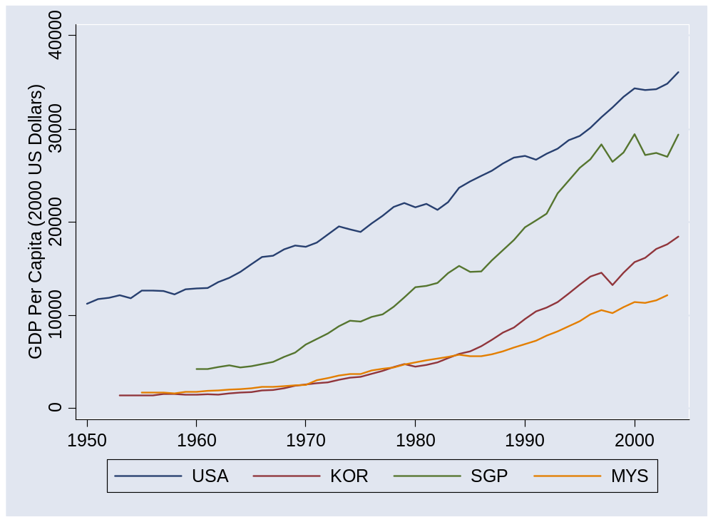
Asia
Source: Penn World Tables, version 6.2.

Slide 40
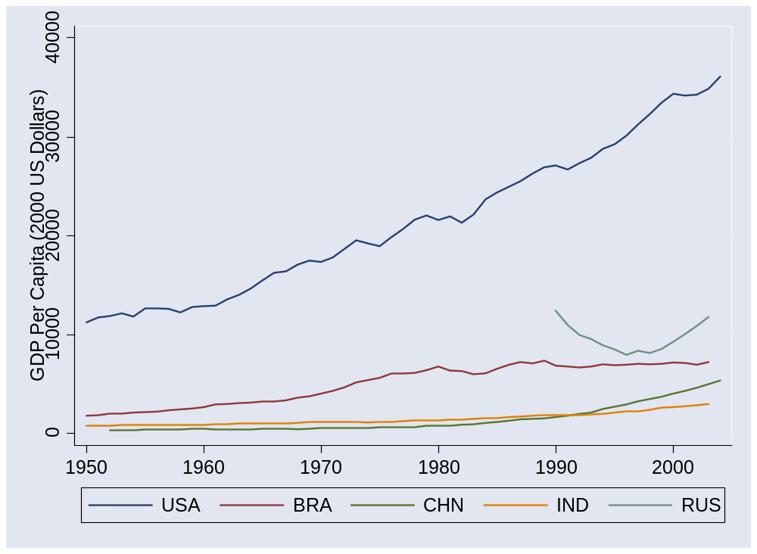
BRICs
Source: Penn World Tables, version 6.2.

Slide 41
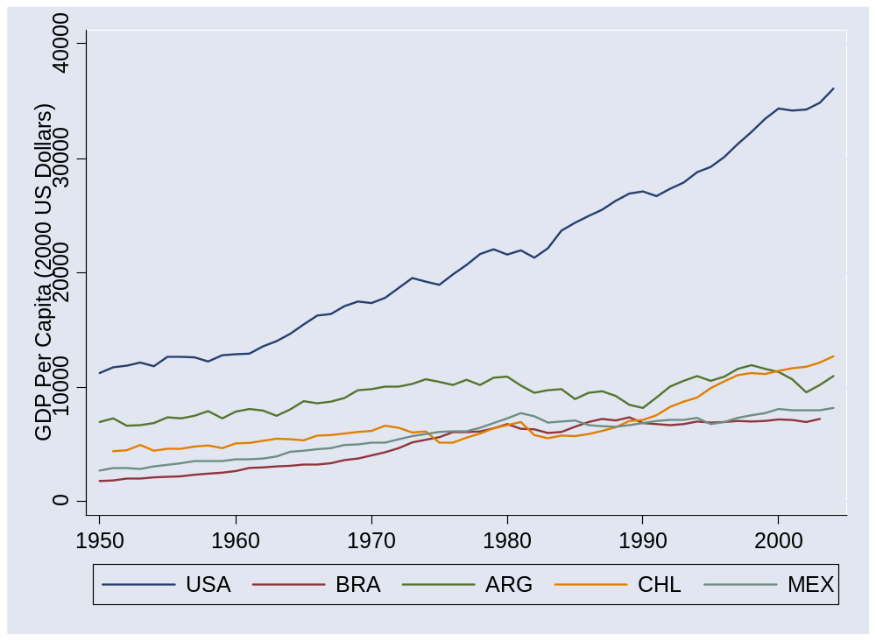
Latin America
Source: Penn World Tables, version 6.2.

Slide 42
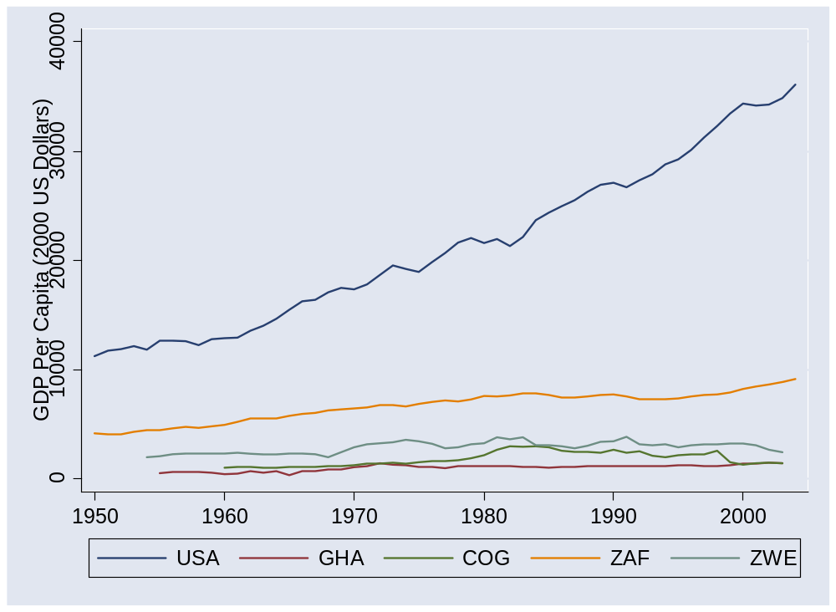
Africa
Source: Penn World Tables, version 6.2.

