Slide 1

The Global Economy
Sources of Growth
© NYU Stern School of Business
Notes:
Open spreadsheet for calculations
Intro: bus people want evidence

Slide 2
Today’s plan of attack
Current economic and business issues
Where we’re headed
Pictures
Growth accounting: where growth comes from
  Including: analyses of several countries
Add?? Singapore/Asia growth story v Krugman?

Slide 3
Current issues

Slide 4
Current issues
India overheating? The Economist, Feb 3 07:
  An alternative is to boost supply by speeding up reforms and attacking the many bottlenecks caused by inadequate infrastructure, dreadful public services, skill shortages, and rigid labor laws. But [these things] not only take time, they take money, and India’s fiscal finances are far from healthy.

Slide 5
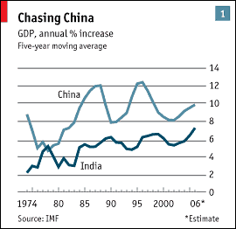
Current issues
Source: The Economist, Feb 3 07.

Slide 6
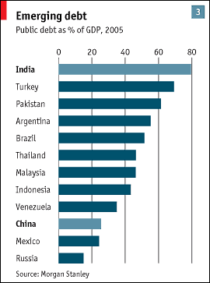
Current issues
Source: The Economist, Feb 3 07.

Slide 7
Current issues
German brain drain, New York Times, Feb 7 07:
  As Dr. Friedrich Boettner, a German orthopedic surgeon in New York, puts it: “I make more money. I’ve got more opportunity. New York was the chance of my lifetime.” German salaries, he said, are not competitive, and the hierarchical structure of some professions in Germany discourages ambitious young people from staying.

Slide 8
Where we’re headed
GDP
Capital & Labor
Productivity
Political Process
“Institutions”

Slide 9
Pictures

Slide 10
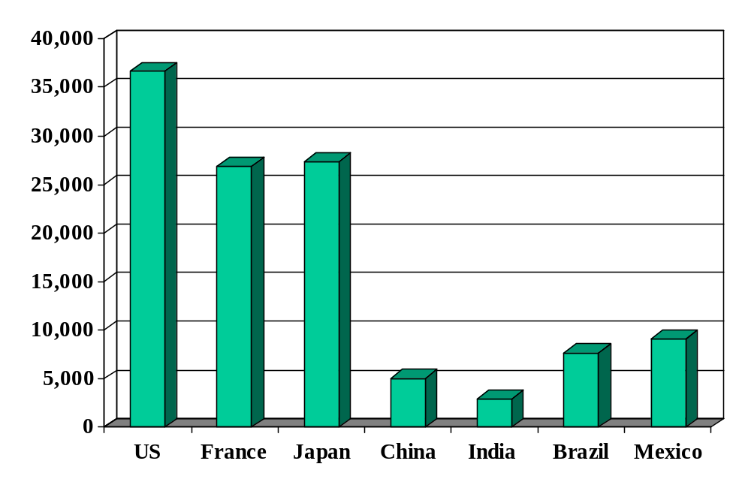
GDP per capita
Source: World Bank, World Development Indicators, data for 2004, 2000 prices in USD, PPP adjusted.

Slide 11
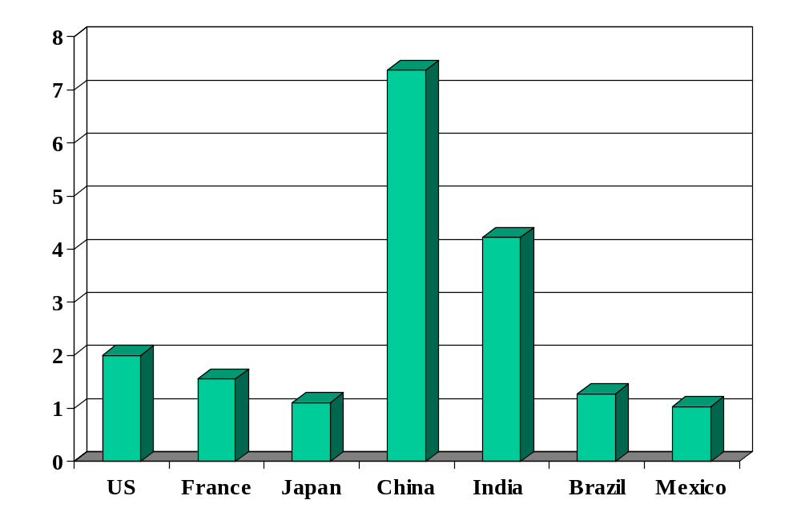
GDP per capita (10-year growth)
Source: World Bank, World Development Indicators, data for 2004, 2000 prices in USD, PPP adjusted.

Slide 12
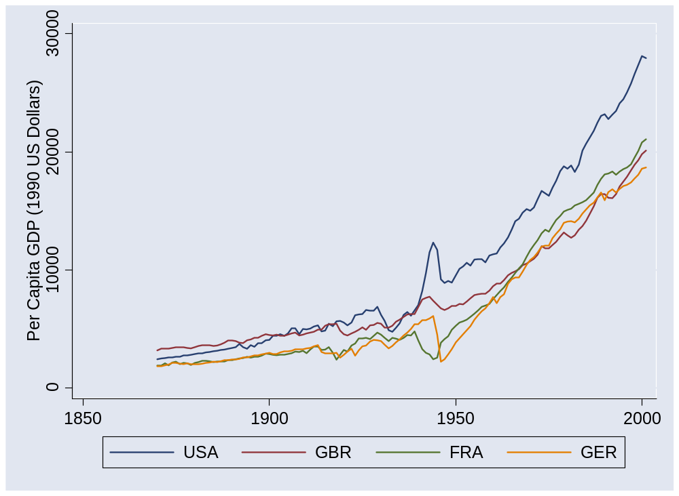
US and Europe
Source: Maddison, Historical Statistics, OECD.

Slide 13
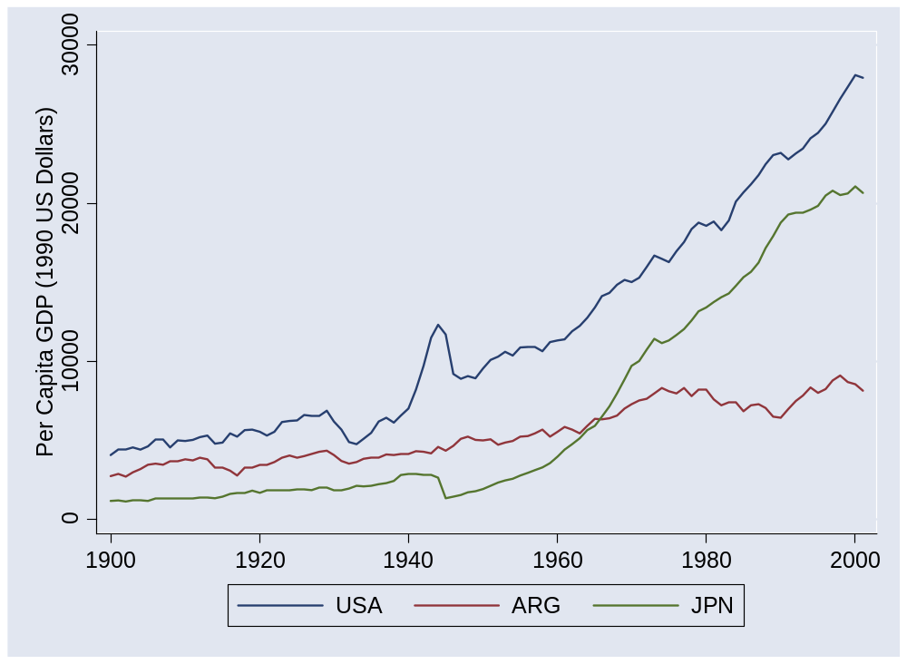
Argentina and Japan
Source: Maddison, Historical Statistics, OECD.

Slide 14
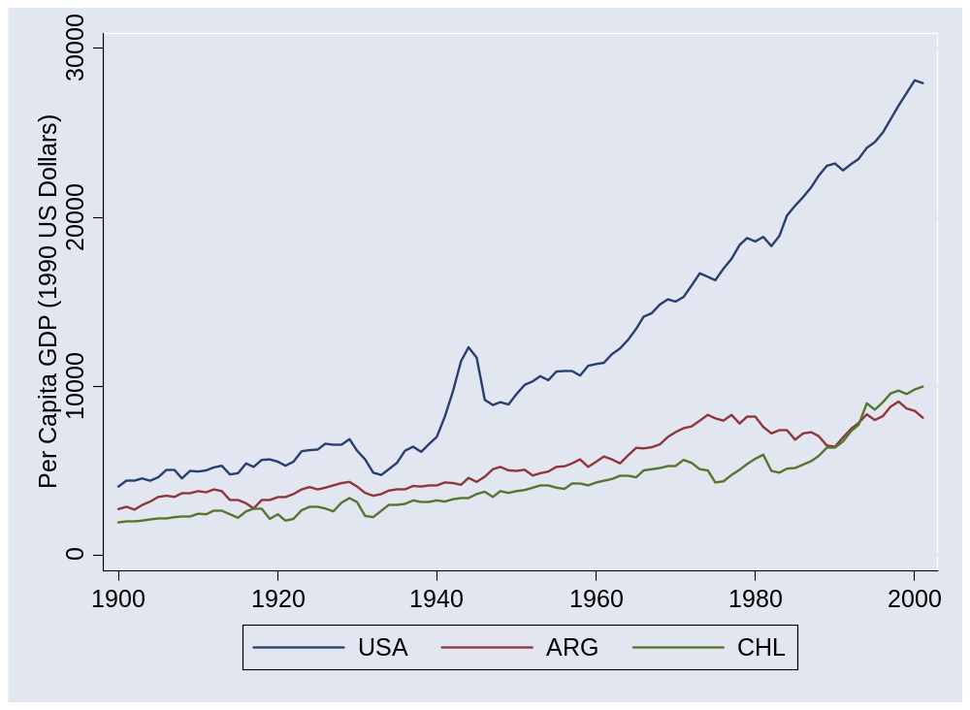
Argentina and Chile
Source: Maddison, Historical Statistics, OECD.

Slide 15
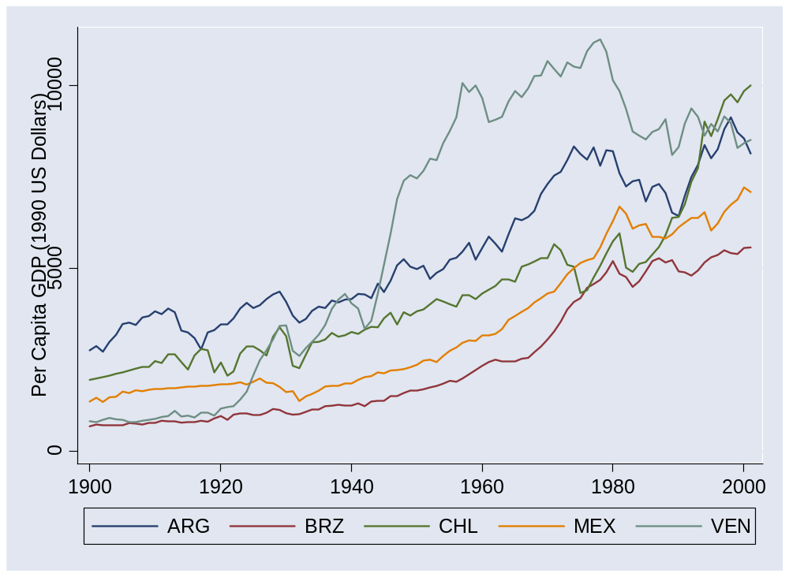
Latin America
Source: Maddison, Historical Statistics, OECD.

Slide 16
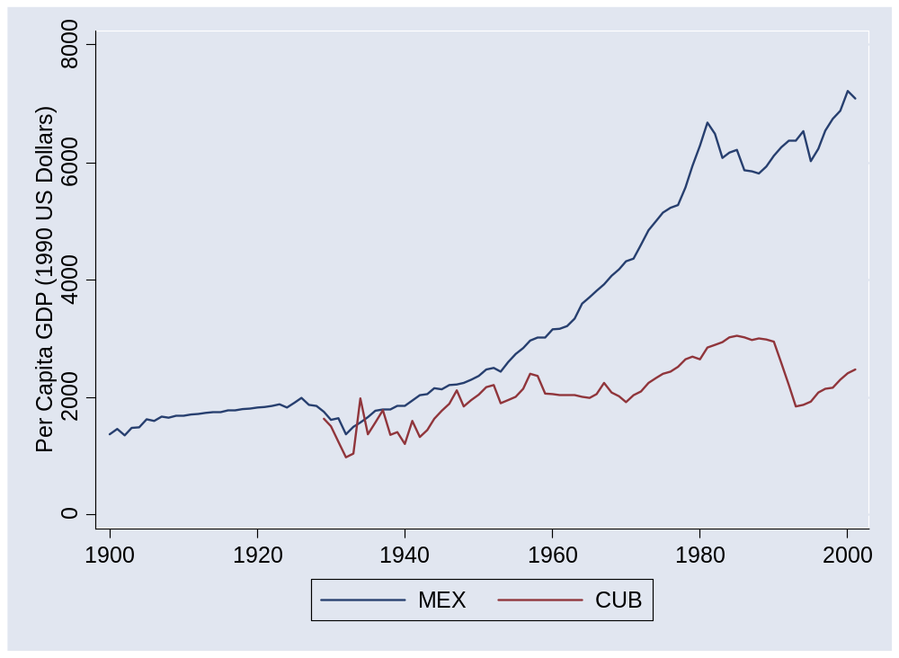
Mexico and Cuba
Source: Maddison, Historical Statistics, OECD.

Slide 17
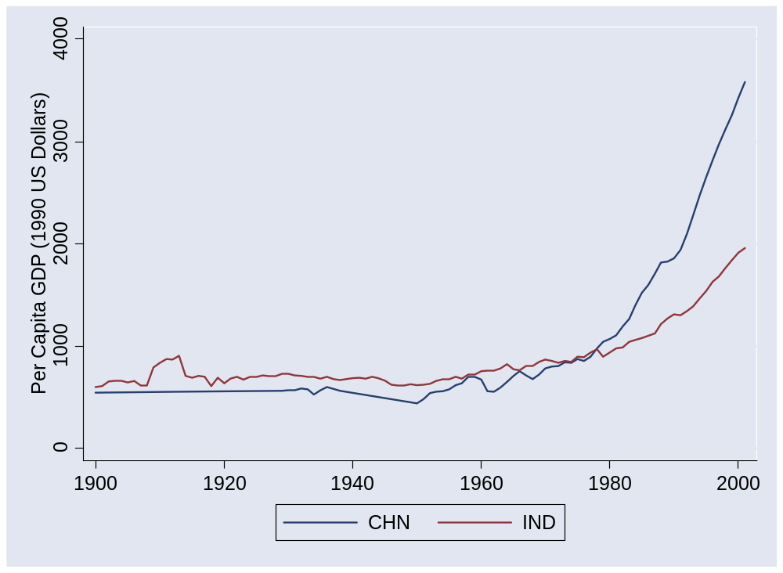
China and India
Source: Maddison, Historical Statistics, OECD.

Slide 18
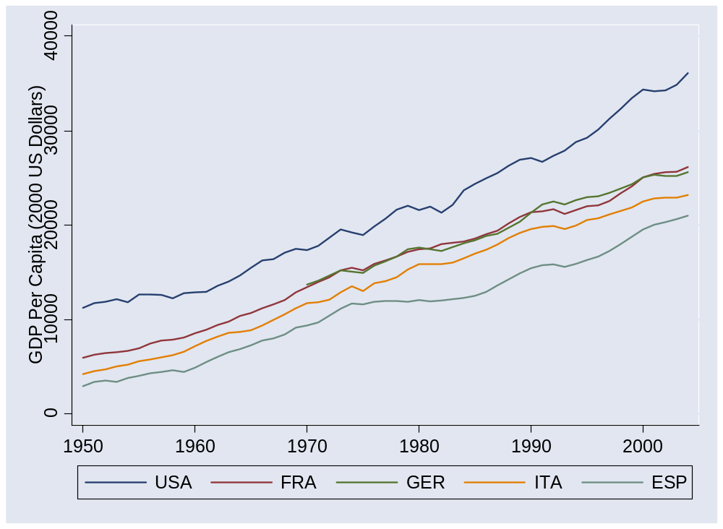
Europe (post 1950)
Source: Penn World Tables, version 6.2.

Slide 19
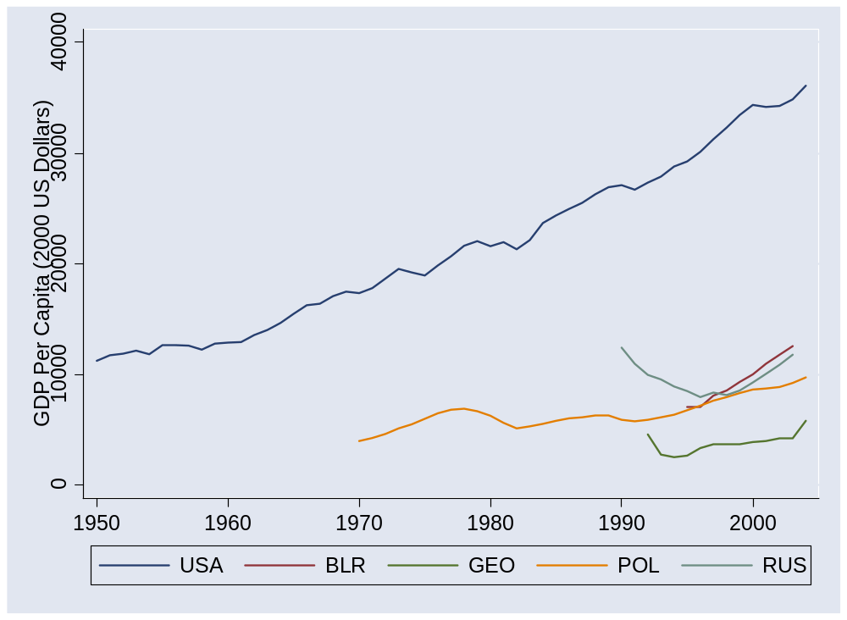
Former Soviet bloc
Source: Penn World Tables, version 6.2.

Slide 20
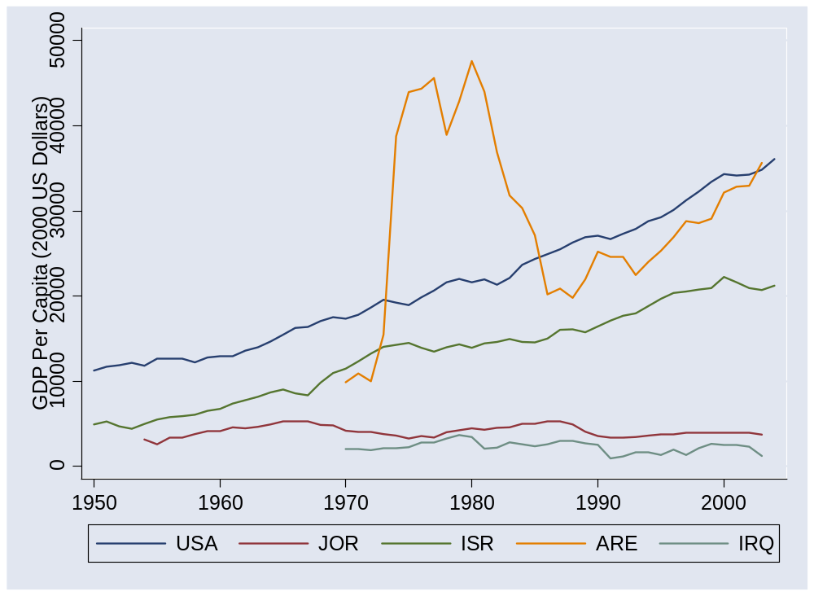
Middle East
Source: Penn World Tables, version 6.2.

Slide 21
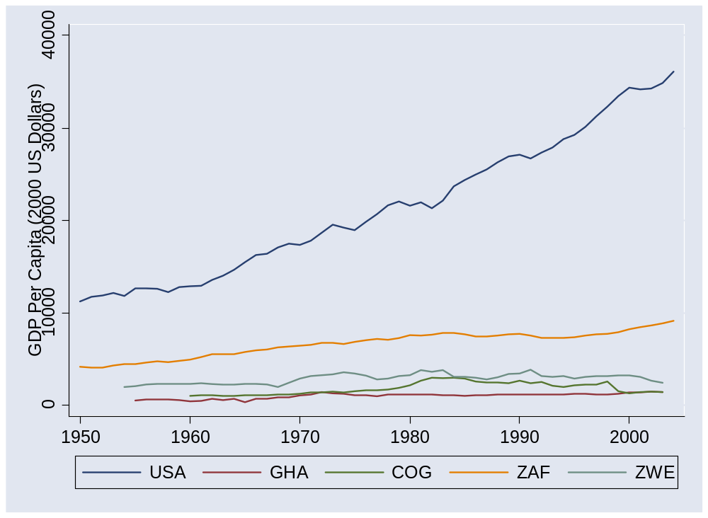
Africa 1
Source: Penn World Tables, version 6.2.

Slide 22
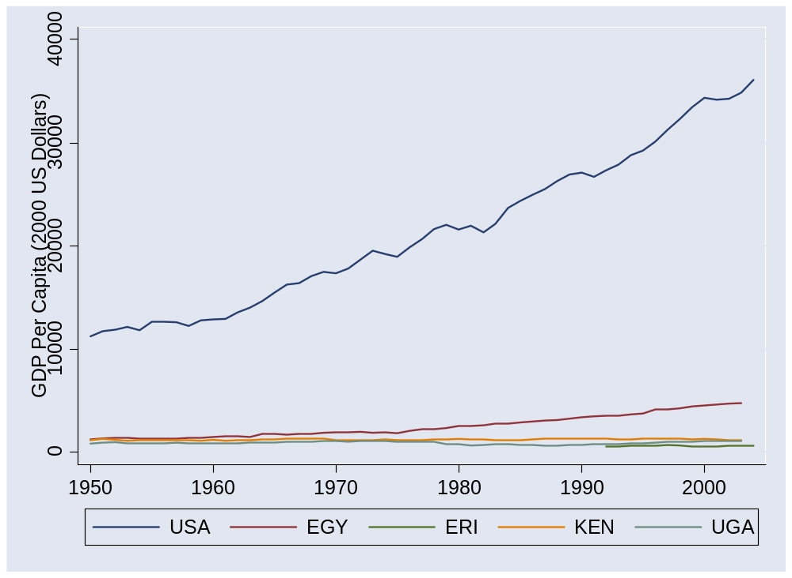
Africa 2
Source: Penn World Tables, version 6.2.

Slide 23
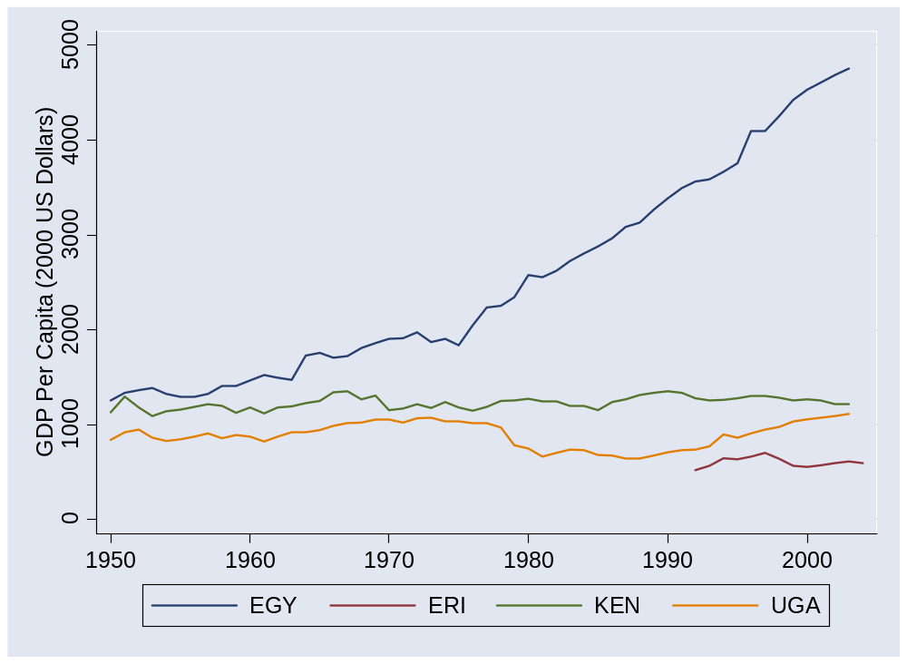
Africa 2 (without USA)
Source: Penn World Tables, version 6.2.

Slide 24
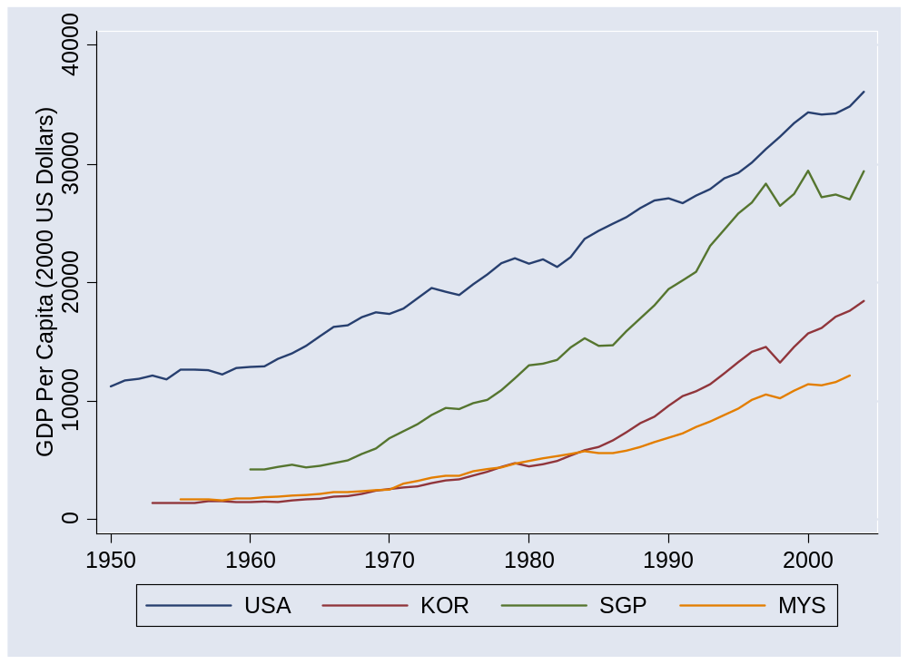
Asia 1
Source: Penn World Tables, version 6.2.

Slide 25
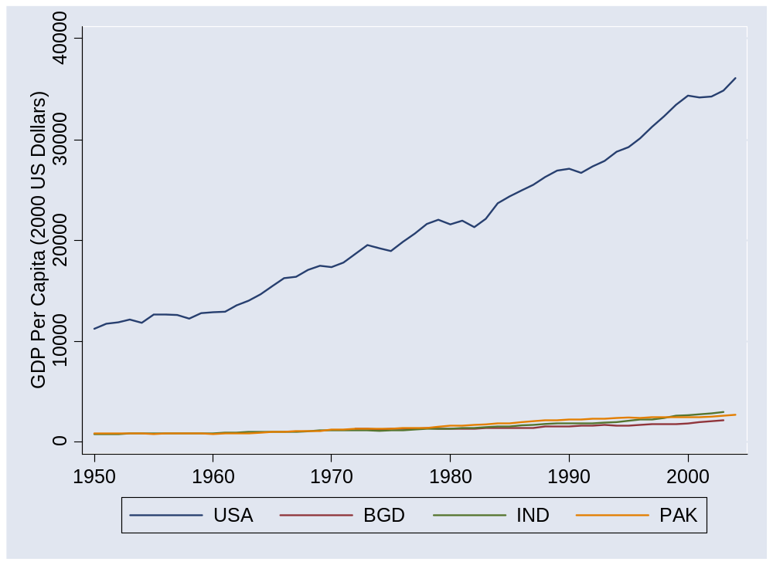
Asia 2
Source: Penn World Tables, version 6.2.

Slide 26
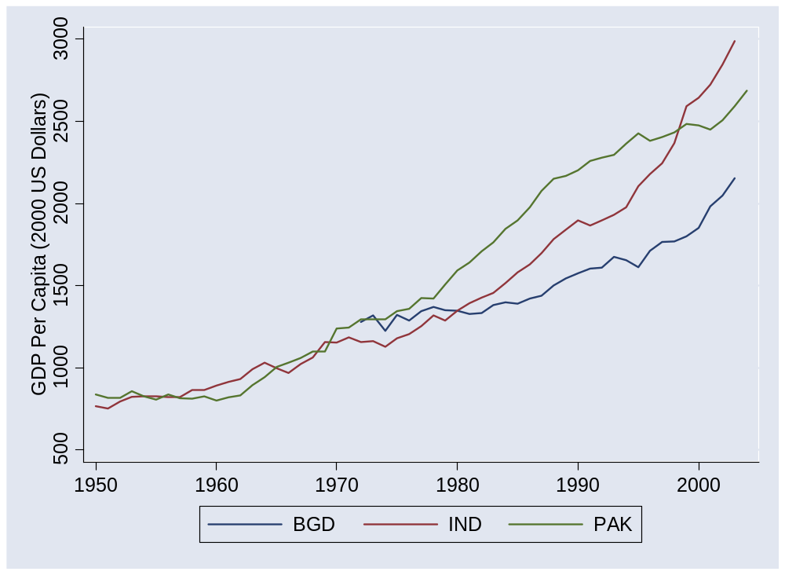
Asia 2 (without USA)
Source: Penn World Tables, version 6.2.

Slide 27
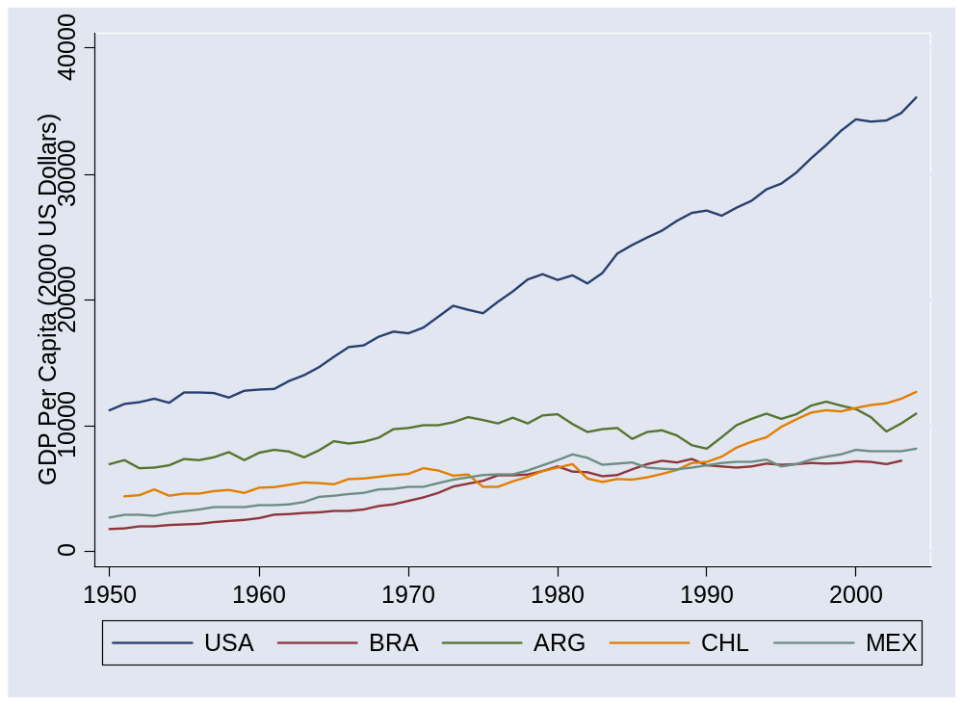
Latin America
Source: Penn World Tables, version 6.2.

Slide 28
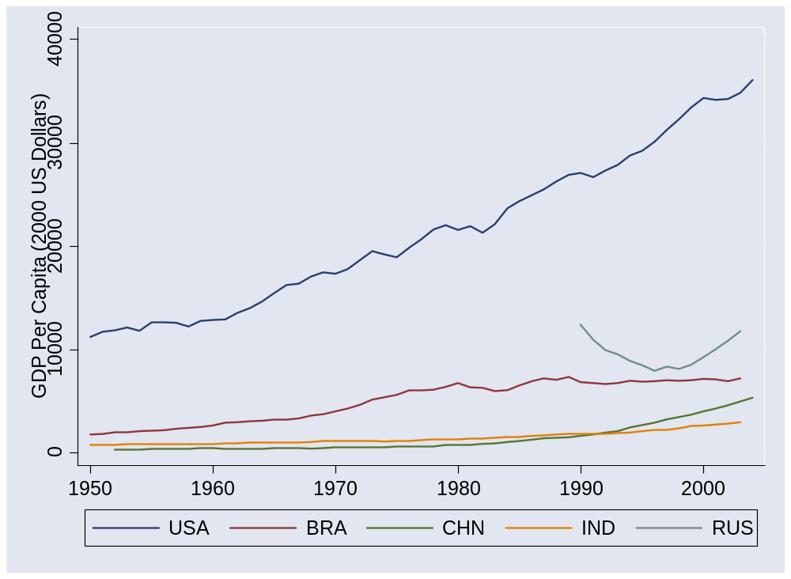
BRICs
Source: Penn World Tables, version 6.2.

Slide 29
The questions
Where do these differences come from?
Where are the opportunities?

Slide 30
GDP per capita and per worker
Separate GDP per capita into two terms
  GDP per worker: Y/L
  Employment rate: L/POP
  Together
  Y/POP = (Y/L) (L/POP)
  We’ll focus on the first term now, the other one later on

Slide 31
Growth rates
How do we compute them?

Slide 32
Level comparisons
Where does output per worker come from?
Production function
Y = A K^{α} L^{1-α}
Y/L = A (K/L)^{α}
Comparison of two countries
(Y/L)₁/(Y/L)₂ = (A₁/A₂) [(K/L)₁/(K/L)₂]^{α}
Bottom line: a clue to economic performance

Slide 33
Growth accounting
Where does growth in output per worker come from?
Production function
Y = A K^{α} L^{1-α}
Y/L = A (K/L)^{α}
log Y/L = log A + α log K/L
Contributions to growth
γ_{Y/L} = γ_{A} + α γ_{K/L}
[γ_{x} means “growth rate of X”]
Bottom line: a clue to where growth comes from

Slide 34
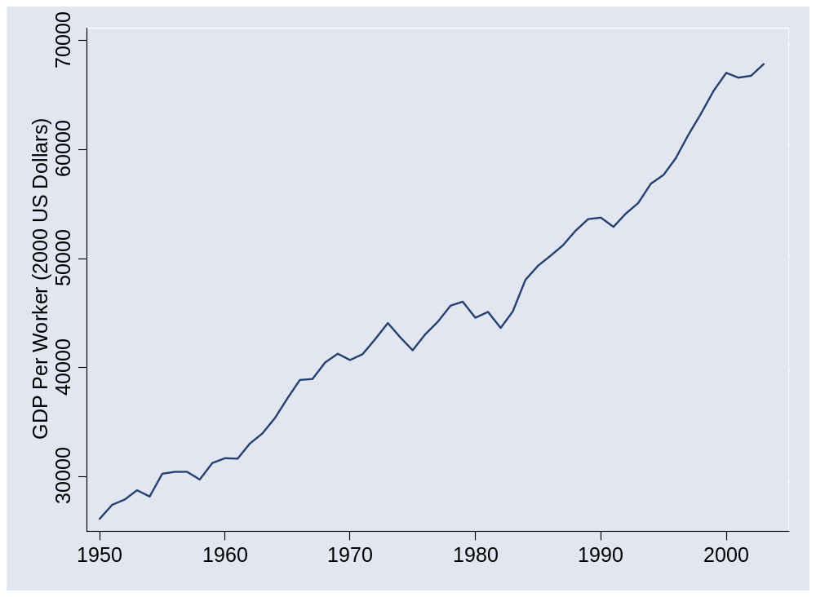
What happened in the US?
Source: Penn World Tables, version 6.2.

Slide 35
What happened in the US?
 | Y/L | K/L | A
1950 | 26,130 | 57,394 | 677
2003 | 67,865 | 177,008 | 1209
Growth rate (annual %) | 1.80 | 2.13 | 1.09
Contribution to growth | 1.80 | 0.71 | 1.09

Slide 36
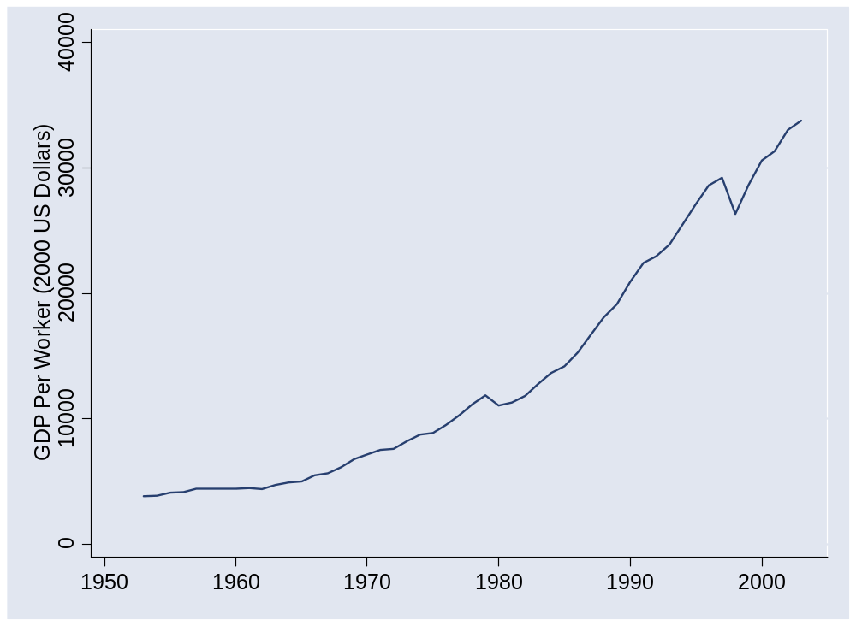
What happened in Korea?
Source: Penn World Tables, version 6.2.

Slide 37
What happened in Korea?
 | Y/L | K/L | A
1953 | 3,817 | 4,289 | 235
2003 | 33,784 | 113,720 | 697
Growth rate (annual %) | 4.36 | 6.56 | 2.18
Contribution to growth | 4.36 | 2.19 | 2.18

Slide 38
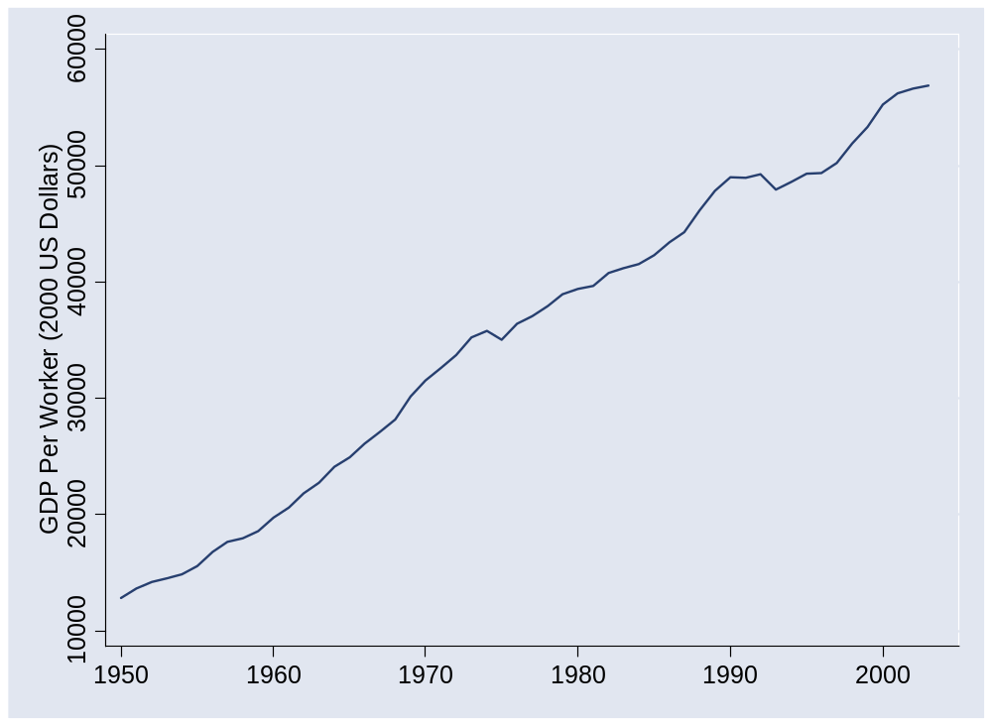
What happened in France?
Source: Penn World Tables, version 6.2.

Slide 39
What happened in France?
 | Y/L | K/L | A
1950 | 12,838 | 24,009 | 445
1973 | 35,236 | 82,298 | 810
2003 | 56,909 | 166,636 | 1,034
Contribution 1950-73 | 4.39 | 1.79 | 2.60
Contribution 1973-2003 | 1.60 | 0.79 | 0.81

Slide 40
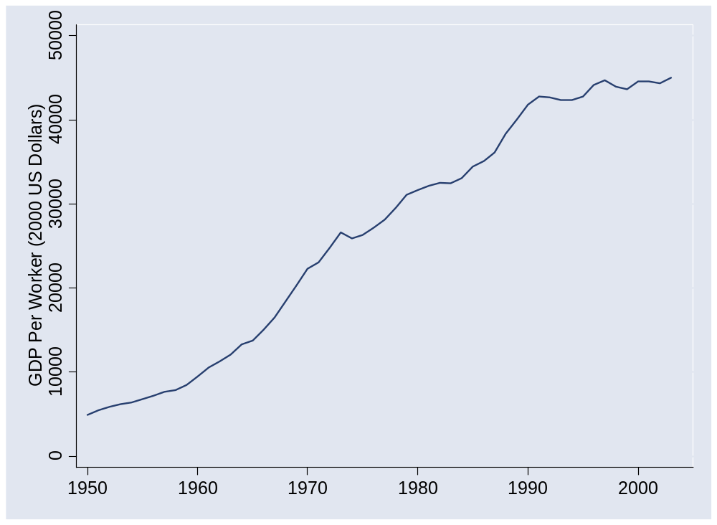
What happened in Japan?
Source: Penn World Tables, version 6.2.

Slide 41
What happened in Japan?
 | Y/L | K/L | A
1950 | 4,936 | 5,104 | 287
1973 | 26,642 | 61,119 | 676
1990 | 41,810 | 133,656 | 818
2003 | 45,030 | 180,284 | 797
Contribution 1950-73 | 7.33 | 3.60 | 3.73
Contribution 1973-90 | 2.65 | 1.53 | 1.12
Contribution 1990-2003 | 0.57 | 0.77 | (0.20)

Slide 42
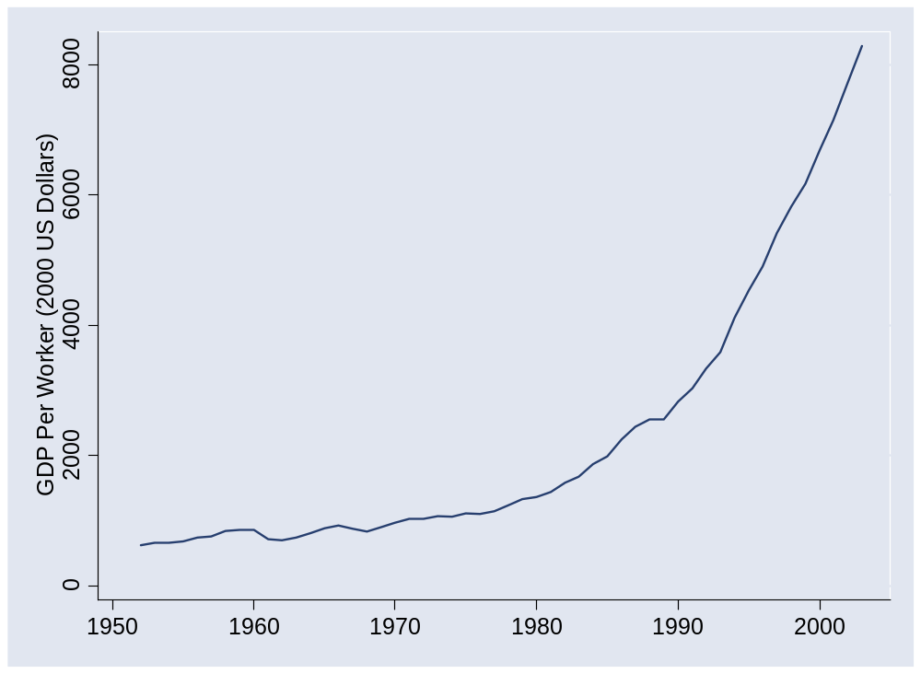
What happened in China?
Source: Penn World Tables, version 6.2.

Slide 43
What happened in China?
 | Y/L | K/L | A
1952 | 620 | 942 | 63
1978 | 1,234 | 3,070 | 85
2003 | 8,284 | 18,015 | 316
Contribution 1952-78 | 2.64 | 1.52 | 1.13
Contribution 1978-2003 | 7.62 | 2.36 | 5.26

Slide 44
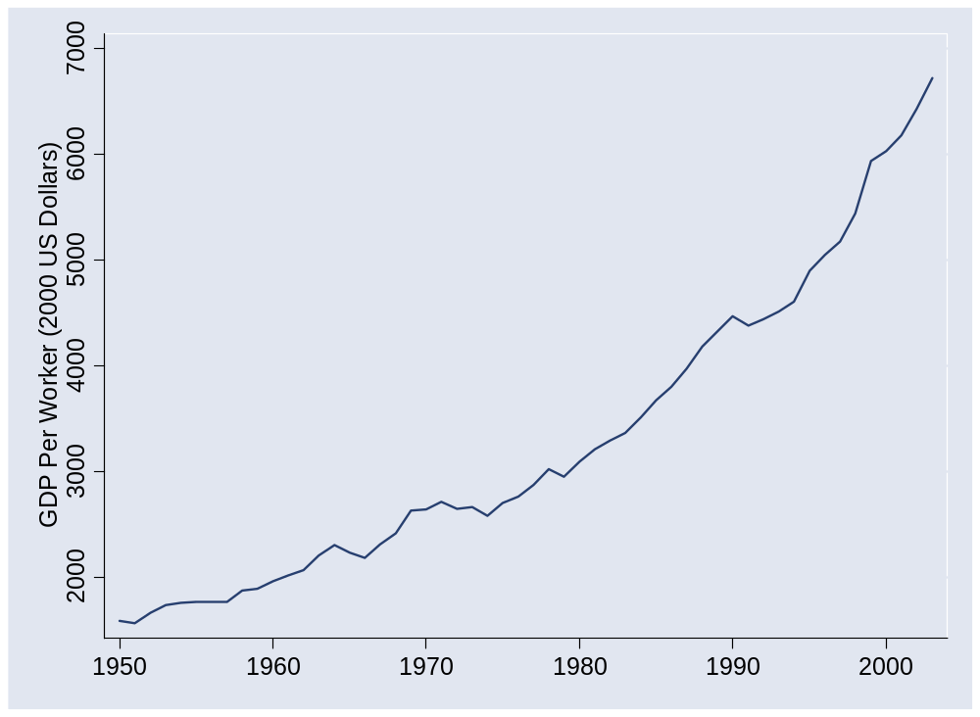
What happened in India?
Source: Penn World Tables, version 6.2.

Slide 45
What happened in India?
 | Y/L | K/L | A
1950 | 1,585 | 990 | 159
1980 | 3,094 | 3,714 | 200
2003 | 6,725 | 7,892 | 338
Contribution 1950-80 | 2.23 | 1.47 | 0.76
Contribution 1980-2003 | 3.38 | 1.09 | 2.28

Slide 46
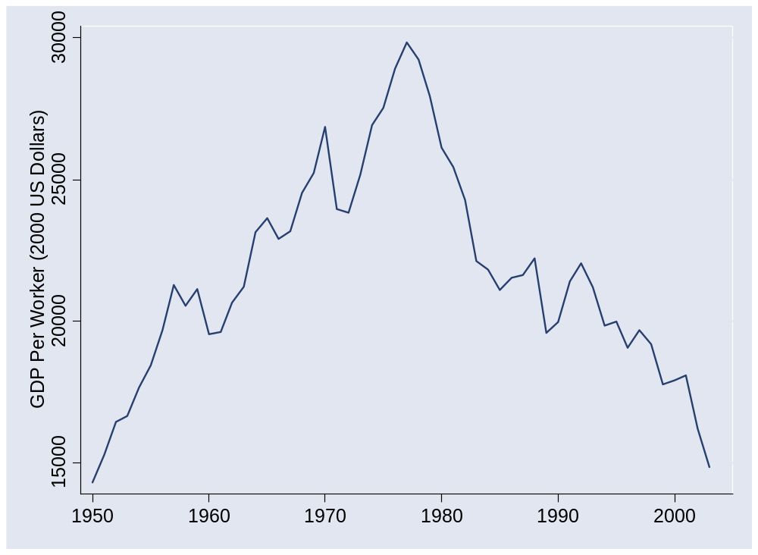
What happened in Venezuela?
Source: Penn World Tables, version 6.2.

Slide 47
What happened in Venezuela?
 | Y/L | K/L | A
1950 | 14,311 | 34,658 | 439
1977 | 29,853 | 81,303 | 689
2003 | 14,848 | 44,990 | 418
Contribution 1950-77 | 2.72 | 1.05 | 1.67
Contribution 1977-2003 | (2.69) | (0.76) | (1.92)

Slide 48
What happened in Country X?
Do your own calculations for any country you like
  Data online (see Blackboard link)

Slide 49
Education??
Do a couple approaches?

Slide 50
Takeaways
Growth accounting tells us the sources of GDP growth
TFP plays an important role in many cases
But… where does TFP come from? [more on this soon]

Slide 51
Group Project #3
Treat as the business problem it claims to be
Make it look professional
Ties in with next class

Slide 52
Otmar Thoemmes (9am Thur)
Deloitte & Touche
  Global Managing Partner of Clients & Markets
  20+ years experience in tax law
  Expert on European business
Education and experience
  Masters in law, University of Munich
  JD, University of Bielefeld
  Managing partner of Wollert-Elmendorff Detsche Industrie-Treuhand GmbH, Munich, now Deloitte & Touche GmbH
  Served European Commission as expert on tax issues

Slide 53
Samuel Villegas (3pm next Tue)
From: Mexico
Stern MBA 1998
Goldman Sachs
  Sales and trading, Latin America
  Credit risk management, Latin America

