Slide 1

The Global Economy
International Capital Flows
© NYU Stern School of Business

Slide 2
Suneet Weling
Stern MBA 1998
Dillon Read and UBS
  Director, Telecom Investment Banking
Merrill Lynch
  Vice President, Media and Telecom Investment Banking

Slide 3
Group Presentations

Slide 4
Agenda
In the news
Are “external” deficits bad?
Sources of external deficits
Balance of payments and net foreign assets
Sustainability analysis
Is the US in trouble?

Slide 5
Are “external” deficits bad?
External deficits:
  trade deficit
  current account deficit
  [ignore difference for now]
Are external deficits bad?

Slide 6
Largest deficits (2006 est, USD billions)
United States | –805
Spain | –80
United Kingdom | –40
Australia | –35
France | –31
Italy | –24
Turkey | –20
India | –16
Portugal | –13
Hungary | –9
Source: IMF, WEO; current account.

Slide 7
Largest surpluses (2006 est, USD billions)
Japan | 140
Saudi Arabia | 130
Germany | 122
China | 121
Russia | 120
Norway | 67
Switzerland | 40
Kuwait | 39
United Arab Emirates | 38
Netherlands | 33
Source: IMF, WEO, current account.

Slide 8
Sources of external deficits
Where do deficits come from?
Recall
S = I + NX

Slide 9
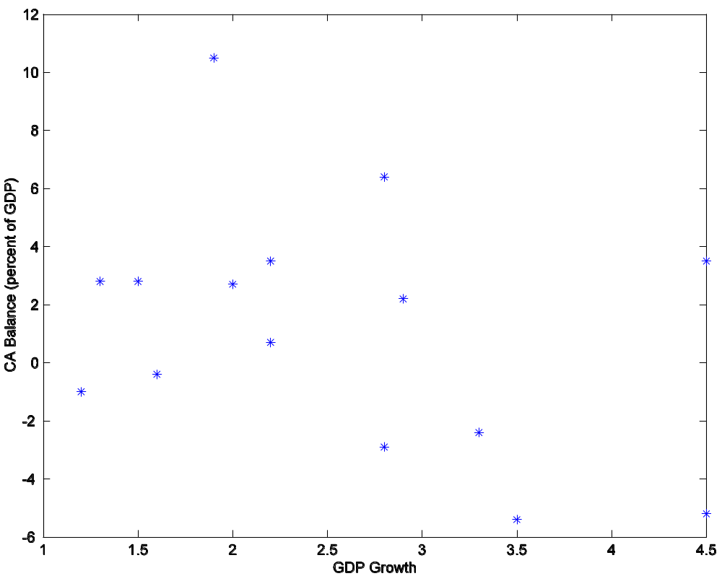
Sources of deficits
CH
SW
Jap
FR
IT
UK
ES
Auz
US
Source: The Economist, 2004-2005.
Notes:
Equity only

Slide 10
Balance of payments
Summary of “current flows”
  Merchandise trade
  Add trade in services: Net exports
  Add interest, taxes, and transfers: Current account

Slide 11
Balance of payments
How is a current account deficit financed?
  “Inflow” of capital from abroad
  Equivalently: sell US assets to rest-of-world
  We say the current account is mirrored by an equal and opposite “capital and financial account”

Slide 12
Balance of payments
BOP = CA + Capital/Financial Inflows = 0
Goods etc
Country 1
Country 2
Capital
If Country 1 runs a current account surplus:
There is a capital “outflow” for Country 1, “inflow” for Country 2.
[Warning: the bottom arrow may seem backwards]
Notes:
Say: NX = CA
Plus: focus on goods

Slide 13
Net foreign assets
Examples of foreign assets

Slide 14
Net foreign assets
International capital markets
  Countries own claims on each other
  Net position (net foreign assets or NFA):
  NFA = Claims on Foreign Countries – Foreign Claims on Us
Changes in NFA:
NFA_{t+1} = NFA_{t} + CA_{t} + Net Asset Revaluations
≈ (1+i)NFA_{t} + NX_{t} + Net Asset Revaluations
Comments
  NX is like the primary deficit from fiscal policy
  Not quite, because CA includes some other things besides interest

Slide 15
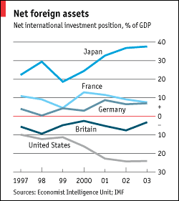
Net foreign assets
Source: Economist, January 2005.
Notes:
table across countries

Slide 16
Sustainability analysis
Are external deficits bad?
  They increase our foreign liabilities
  Which raises our interest burden
  But do they also increase our ability to pay?
Analogy with a firm
  Which firms raise the most money in capital markets?
  How do firms and countries differ?
Sustainability analysis
  Quick look at NFA/Y: how fast is it growing, and why?
  Missing: equity claims, asset revaluations…

Slide 17
Sustainability analysis
Inputs
NFA_{t+1} = (1+i) NFA_{t} + NX_{t}
Y_{t+1} = (1+g) Y_{t}
Change in NFA/Y:
NFA_{t+1}/Y_{t+1} = [(1+i)/(1+g)] (NFA_{t}/Y_{t}) + (1+g)⁻¹ NX_{t}/Y_{t}
Sustainability requires
(1+i)/(1+g) < 1
i < g
Typically i>g
  Therefore something must change – but what?

Slide 18
Sustainability analysis: US
Current numbers
  NFA/Y = –25%
  NX/Y = –6% (deficit)
  i = 5%
  g = 6% (3+3)
Is the current situation sustainable?
  Where are changes in NFA/Y coming from?
  Are you worried?

Slide 19
Is the US in trouble?
Stephen Roach, Morgan Stanley:
  Lacking in domestic saving, America must import foreign saving ... to keep growing at acceptable rates. And so America must then run massive and ever-widening current account deficits to attract that foreign capital. ... America now requires an average of $2.9 billion of capital inflows each and every business day to keep the magic going.

Slide 20
Is the US in trouble?
Warren Buffet:
  As time passes, and as claims against us grow, we own less and less of what we produce. ... Should we continue to run current account deficits comparable to those now prevailing, ... our US ‘family’ will be delivering [a substantial fraction of] its annual output to the rest of the world simply as tribute for the overindulgences of the past.

Slide 21
Is the US in trouble?
Nouriel Roubini and Brad Setzer:
  [We examine] ... US external deficits and the international monetary system that is integral to their financing – a system whose stability hinges on the willingness of Asian central banks to both hold enormous amounts of US Treasuries. ... The system is fragile. Our analysis suggests that the US is on an unsustainable and dangerous path.

Slide 22
Is the US in trouble?
Choose one:
  We’re in trouble
  We’re fine
  Both of the above

Slide 23
Is the US in trouble?
We’re in trouble
  Low saving has led to large deficits, rise in foreign debt
  Debt service will consume a larger part of our budget
  Eventually consumption has to fall, and saving rise
  Adjustment could be precipitous
We’re fine
  Large flow of saving from oil producers and slow-growing countries
  US remains an attractive place to invest
  Net worth position remains strong
  Deficit will probably go away once oil prices fall and/or Japan, Germany, etc start growing again

Slide 24
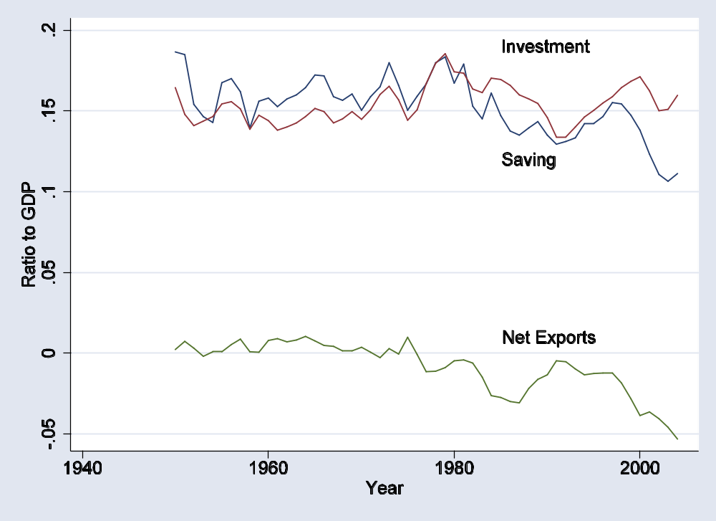
US flows 1

Slide 25
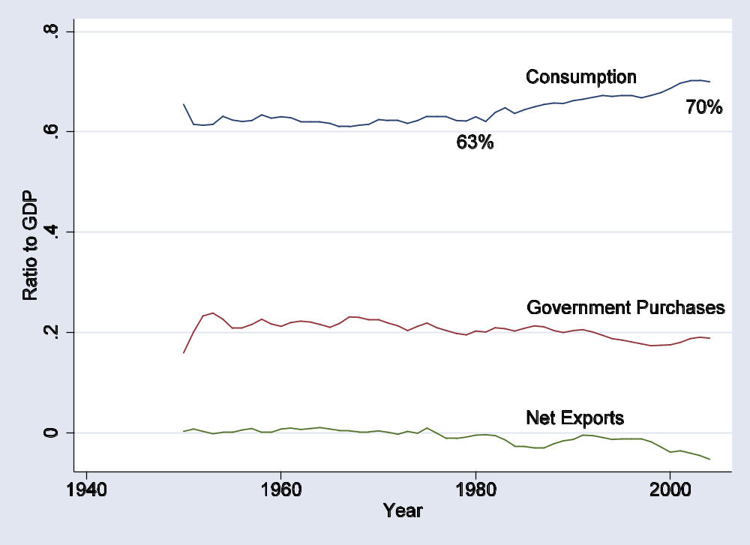
US flows 2

Slide 26
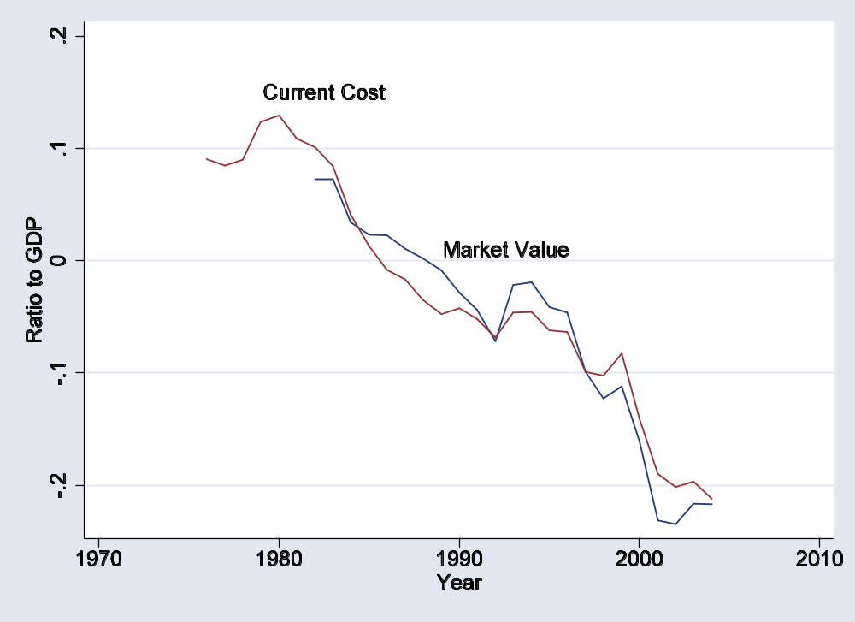
US net foreign assets

Slide 27
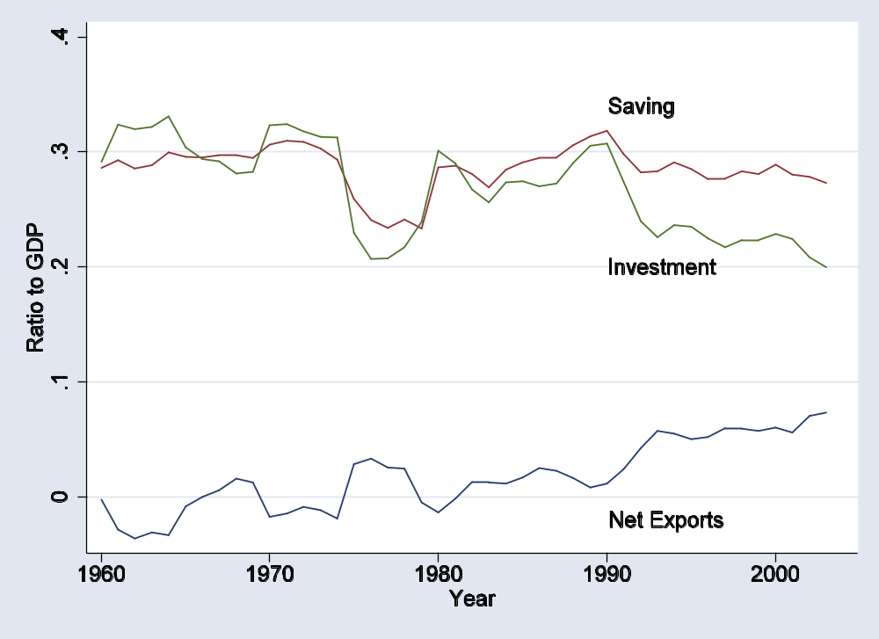
Swiss flows

Slide 28
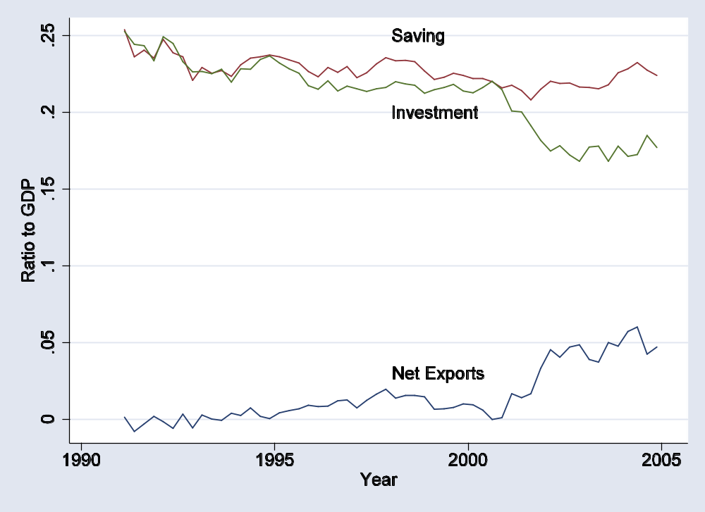
German flows

Slide 29
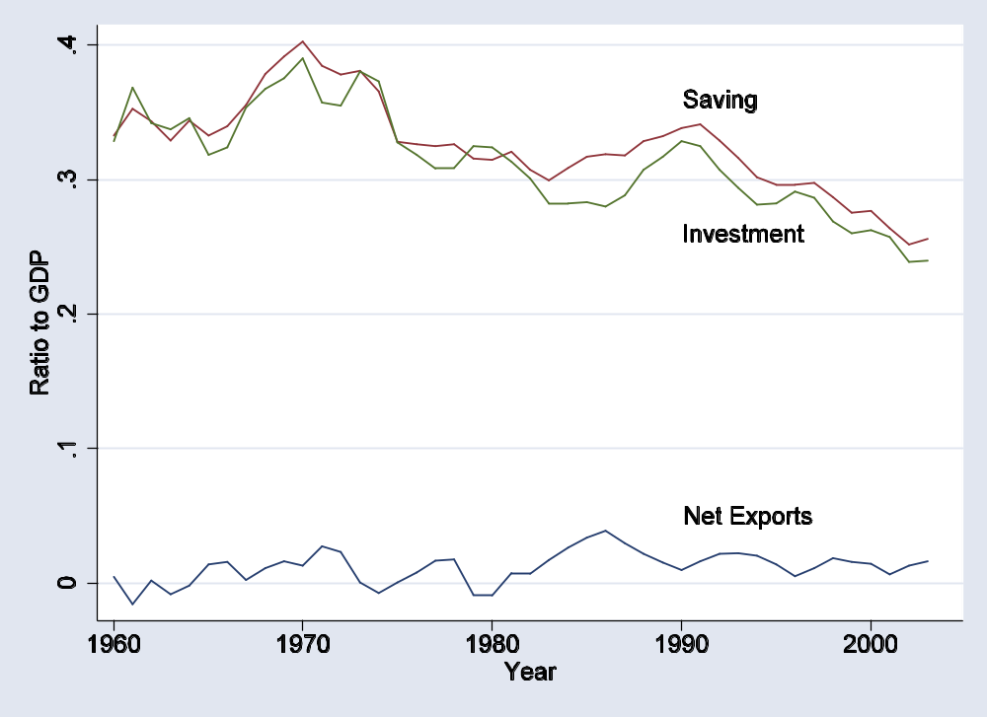
Japanese flows

Slide 30
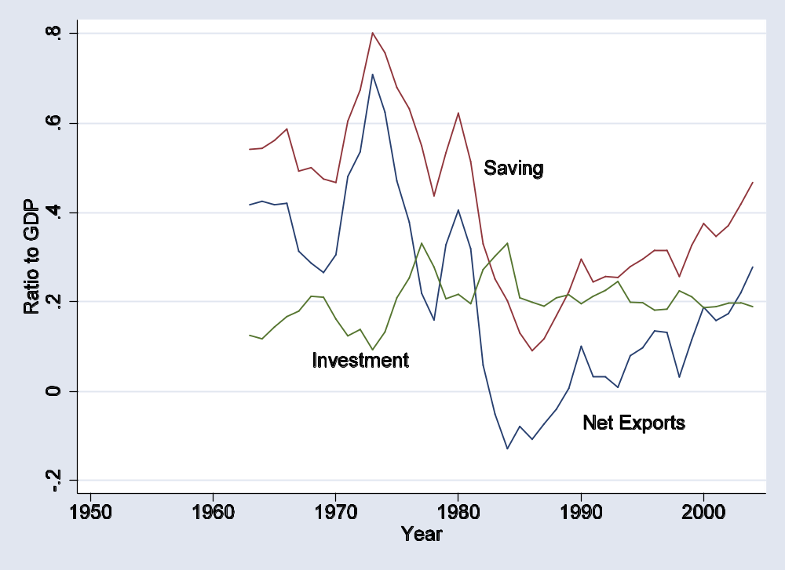
Saudi flows

Slide 31
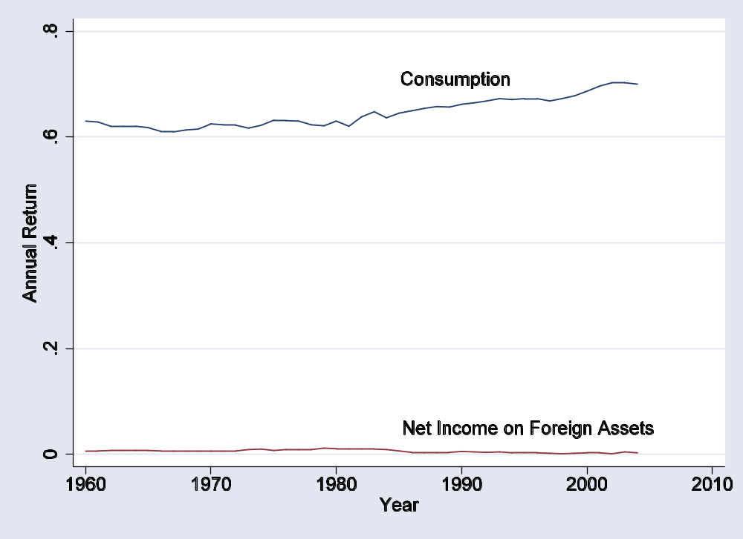
US foreign interest burden

Slide 32
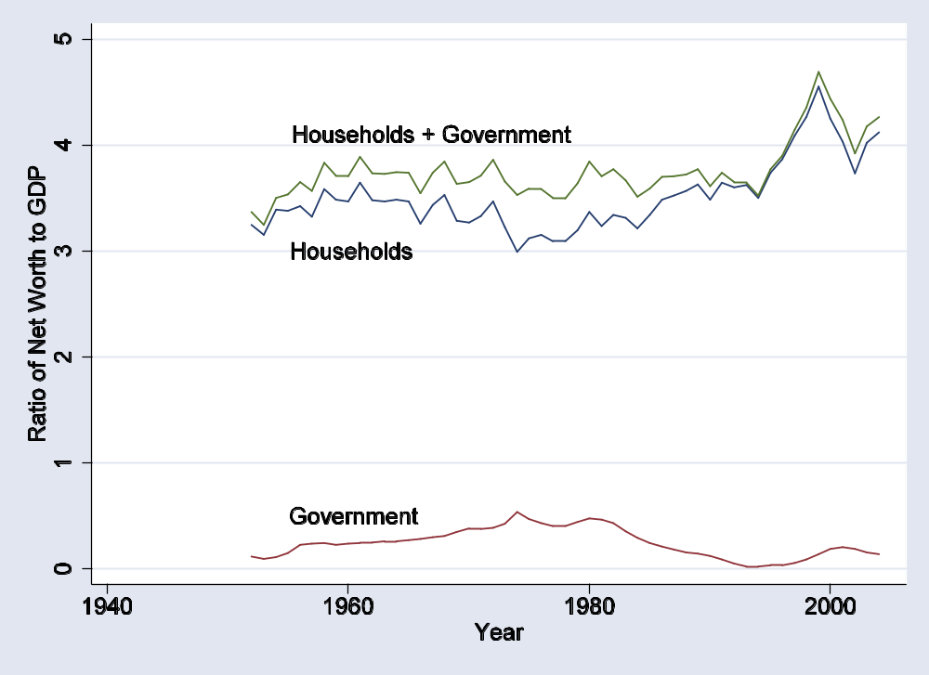
US net worth 1

Slide 33
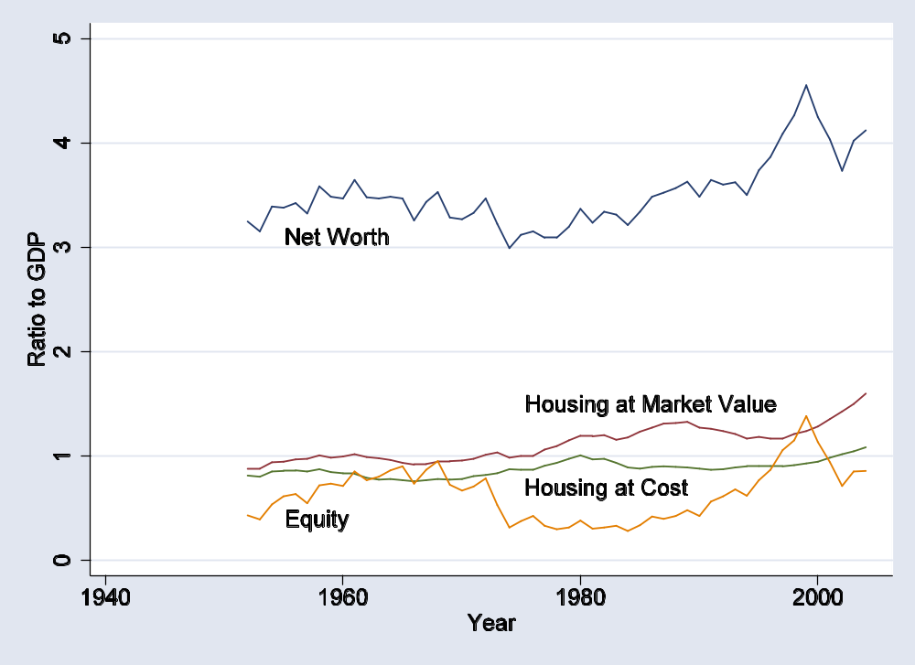
US net worth 2

Slide 34
Is the US in trouble?
Interest burden
  Roubini-Setzer estimate in 10 years: 3% of GDP
Compare to: fall in GDP growth of 0.5% a year

Slide 35
Is the US in trouble?
Choose one:
  We’re in trouble
  We’re fine

Slide 36
Takeaways
Balance of payments: flows of goods are mirrored by financial flows
  Current account deficit = capital inflows
Current account deficits can reflect either high investment or low saving
  May affect ability to repay
Whether deficits are good or bad depends on the use of funds

Slide 37
The Global Economy
Emerging Market Crises
© NYU Stern School of Business

Slide 38
Agenda
In the news
Volatility and crises
Why?
Traditional explanations
Mexico and Korea
Roubini on the Asian crisis
Are the rich different?
China

Slide 39
Iceland
5-6% growth in recent years
Investment boom (hydro, aluminum)
Trade deficit of >10% of GDP
Fiscal deficit of about 3% of GDP
Investors concerned, interest rates up

Slide 40
Iceland
Today’s Financial Times:
  Norway’s state pension fund has emerged as one of the biggest investors to profit from the turmoil in the Icelandic bond markets, according to derivatives traders. Traders estimated that the fund, which invests Norway's large oil revenues abroad and is one of the biggest pension funds in the world, had made a profit of nearly €3m from shorting, or betting on the decline of bonds in Icelandic banks.
Norwegian friend:
  In principle, I’d much rather take advantage of the Swedes.

Slide 41
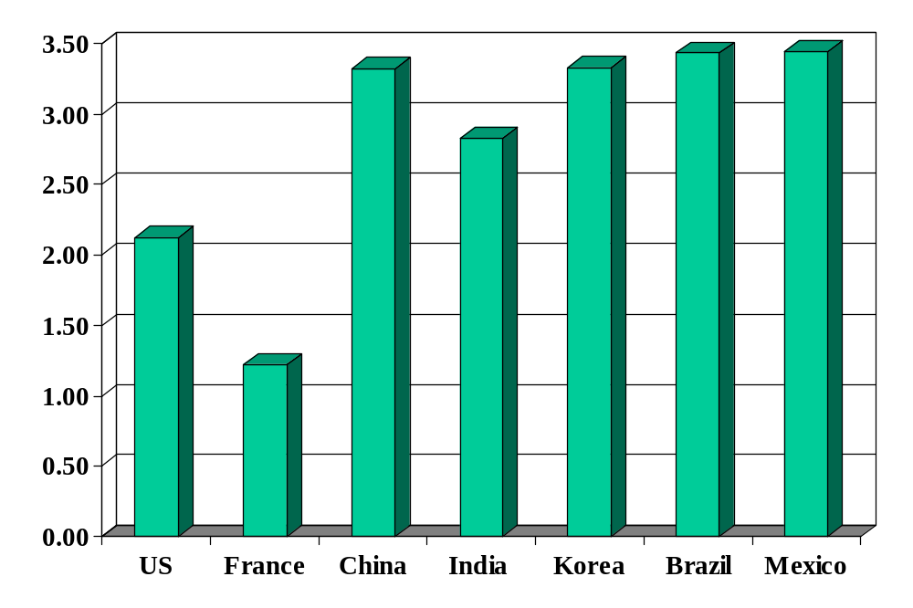
Volatility (std dev of annual growth rate %)
Source: World Bank, World Development Indicators, GDP per capita, 1975-2005.

Slide 42
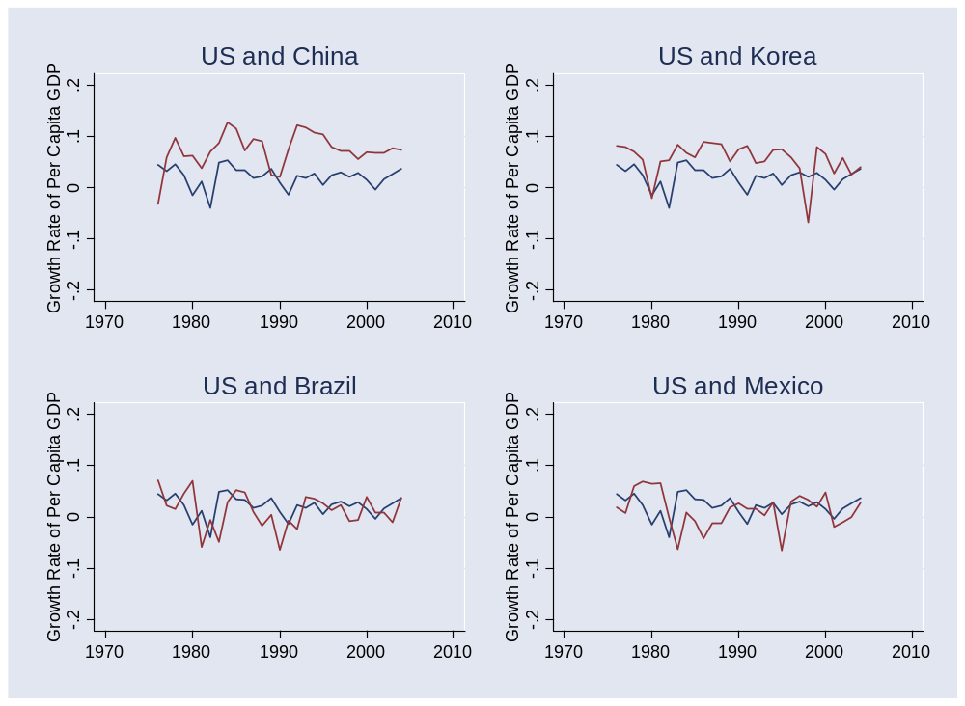
Volatility
Source: World Bank, World Development Indicators, GDP per capita, 1975-2005. Blue=US.

Slide 43
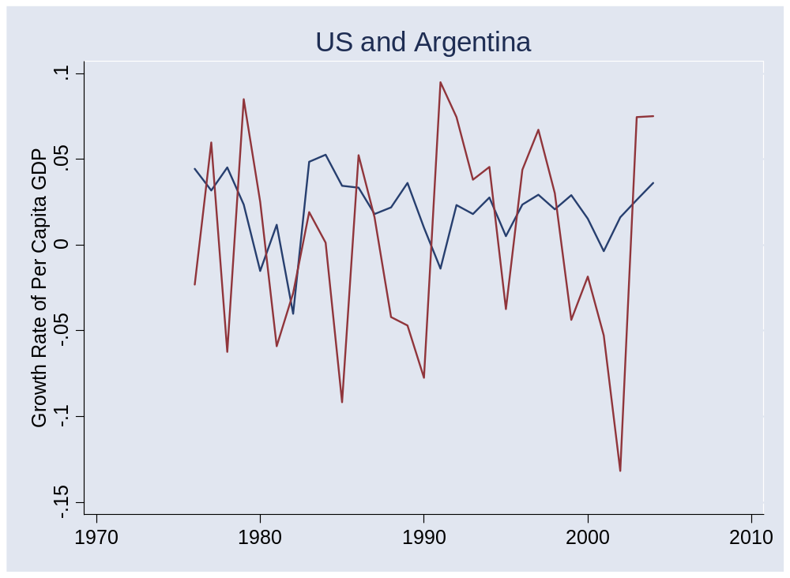
Volatility
Source: World Bank, World Development Indicators, GDP per capita, 1975-2005.

Slide 44
Crises
Australia 1891-93 (“Barings crisis”)
  GDP fell 18%
United States 1907-08
  GDP fell 10%
Mexico 1994-95:
  GDP fell 9%, peso fell almost 50%
Korea 1997-88
  GDP fell 9%, won fell 30%
Argentina 1999-2002
  GDP fell 20%, peso fell 65%

Slide 45
Crises
Why?

Slide 46
Crises
Crises reflect lack of confidence over repayment
  Could be internal or external

Slide 47
Current account review
Current account deficits lead to foreign debt
Viability of debt depends on what underlies it
  Worry if: deficit financed government or personal consumption (saving fell)
  Esp if it’s government debt and the political situation makes repayment politically difficult
  Don’t worry if: deficit financed new plant and equipment (investment rose)
  Unless: the investment isn’t paying off
For later: Why might level of development matter?

Slide 48
Fiscal theory of crises
Fixed exchange rate
Government deficit leads to current account deficit
  Financed in part by issuing foreign debt
Investors question repayment
  When do you hit this point?
Investors stop buying debt (current account reverses!)
Central bank unable to support exchange rate
  FX reserves run out, currency collapses

Slide 49
Exchange rate theory of crises
Fixed exchange rate
Over-valuation leads to current account deficit
Investors question repayment
  When do you hit this point?
Investors stop buying debt (current account reverses!)
Central bank unable to support exchange rate
  FX reserves run out, currency collapses

Slide 50
Mexico
Output fell 9%, peso collapsed
Why?

Slide 51
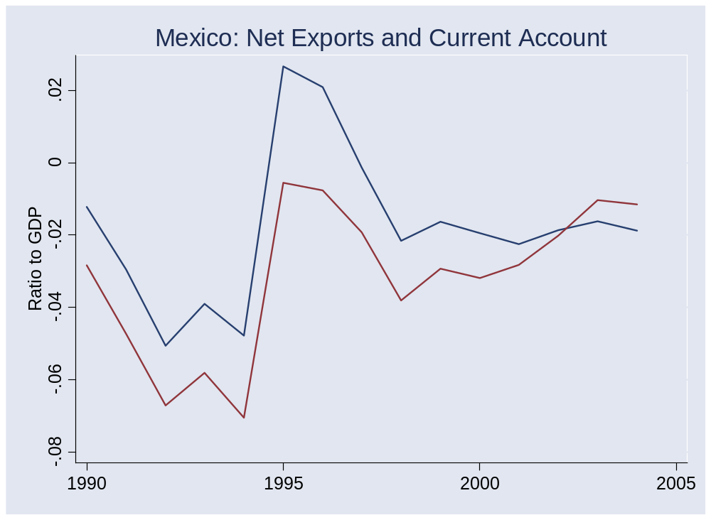
Mexico
Source: IFS. NX=blue, CA=red.

Slide 52
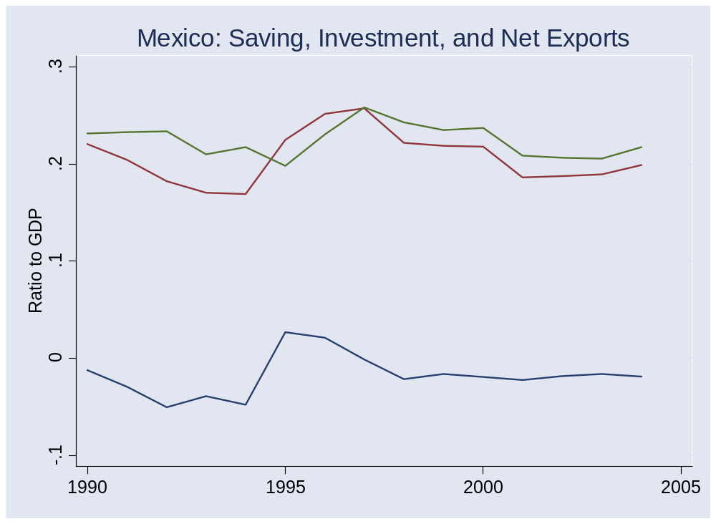
Mexico
Source: IFS. NX=blue, S=red, I=green.

Slide 53
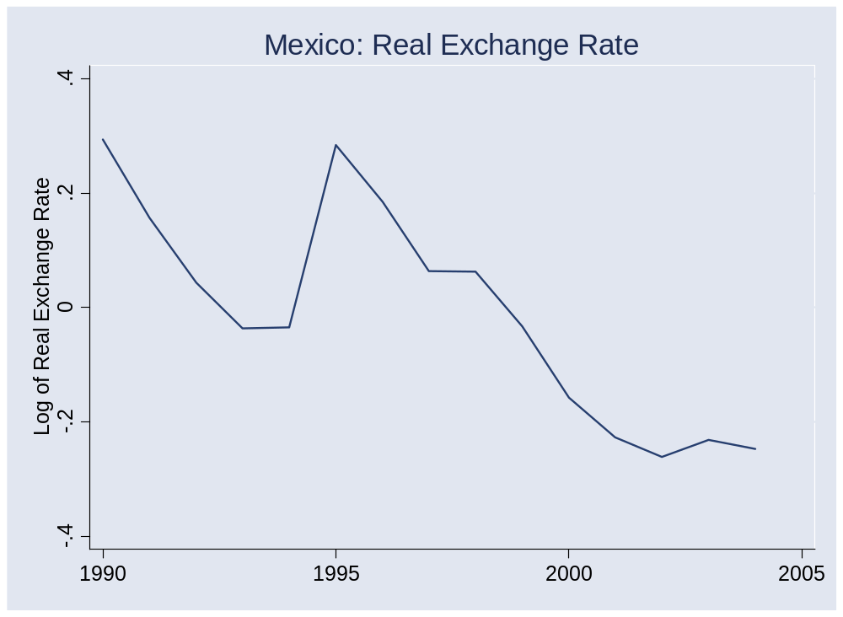
Mexico
Source: IFS.

Slide 54
Mexico
Current account deficits in early 1990s
  Pre-NAFTA investment?
Modest government deficits
Panic followed change of power in December 1994
Large drop in output, peso
Current account reversed
Economy rebounded
Current account deficit resumed

Slide 55
Korea
Output fell 9%, won fell 30%
Why?

Slide 56
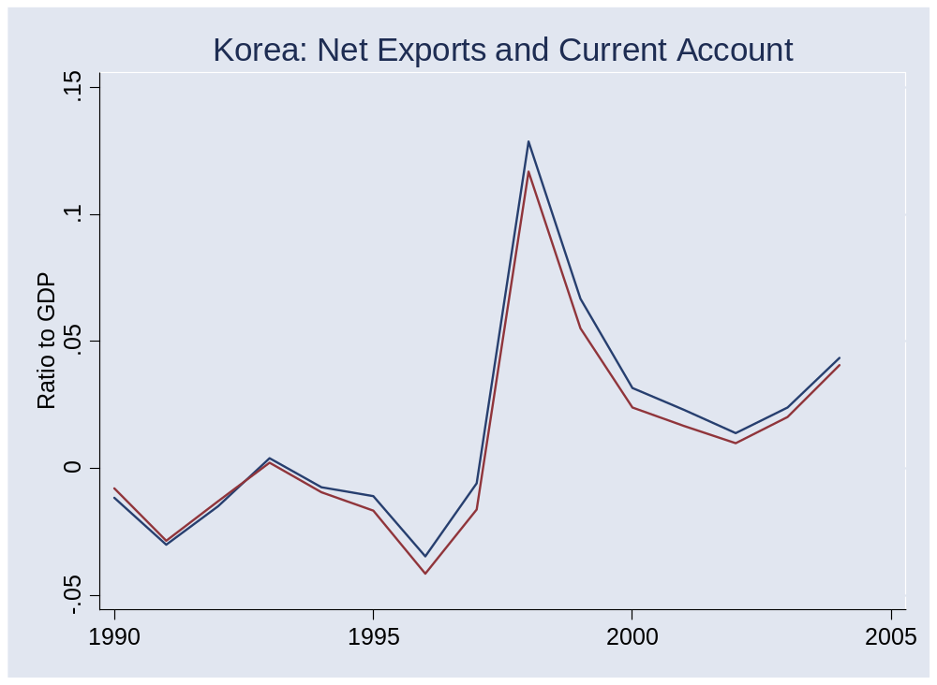
Korea
Source: IFS. NX=blue, CA=red.

Slide 57
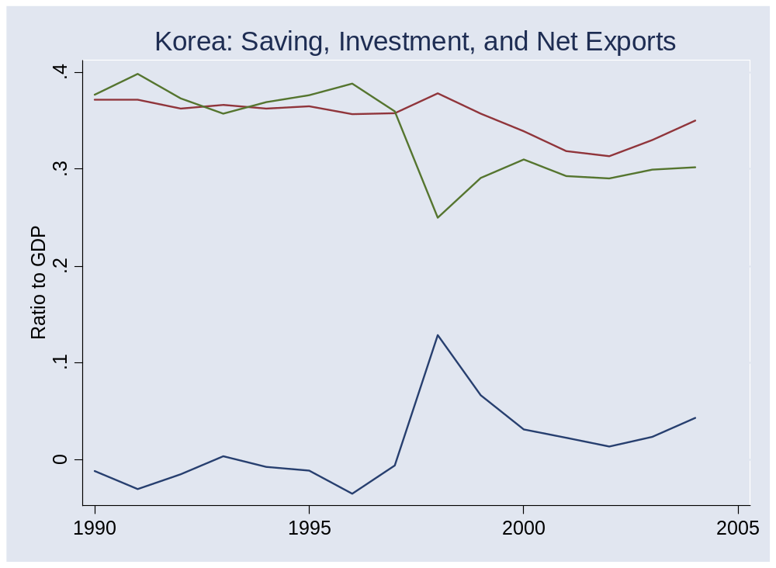
Korea
Source: IFS. NX=blue, S=red, I=green.

Slide 58
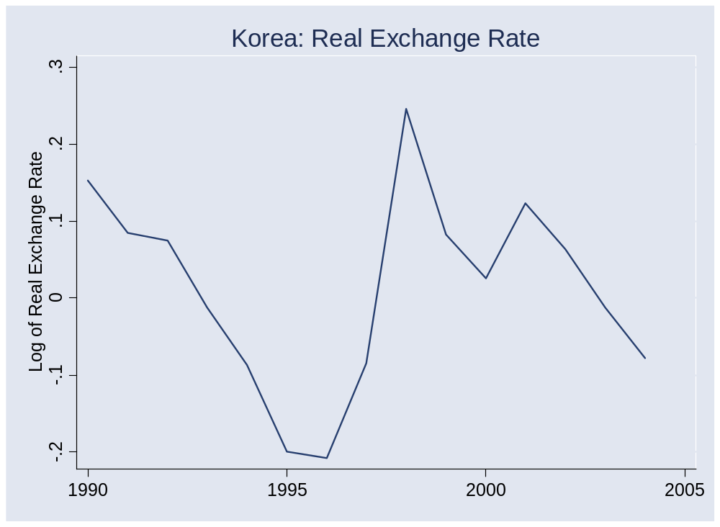
Korea

Slide 59
Korea
Modest current account deficits in mid 1990s
  After years of limited international capital flows
Fiscal surplus!
Financial panic throughout Asia in 1997-98
Current account reversed
Economy rebounded
Current account remains in surplus

Slide 60
Mexico and Korea
How do they fit the theory?

Slide 61
Asian crisis explanation 1
Foreign investors panicked for no reason

Slide 62
Asian crisis explanation 2
Courtesy of Professor Roubini and friends
  Take his course if you want to know more
Financial institutions financed bad private investments
Left them unofficially insolvent
Investors expected governments to bail banks out, which would lead to massive government deficits
Massive expected government deficits led to crisis through the traditional fiscal route

Slide 63
Asian crisis evidence
Every country different, but…
Bad investments?
  Sharp increase in non-performing loans
  Several chaebols insolvent
  Lax bank supervision allowed this to happen [weak institutions]
Capital structure
  Most foreign borrowing took the form of short-term debt
  Not: equity, FDI
  Why? Restrictions on foreign ownership and weak protection of equity creditors

Slide 64
Are the rich different?
Political stability?
Institutional protection of creditors
Sophistication of financial markets
What about Iceland?

Slide 65
Are the rich different?
Are international capital flows (and foreign investors) a bad idea for developing countries?
  Is trade in capital different from trade in goods?

Slide 66
China
Is a crisis possible?
  How would you tell?

Slide 67
Takeaways
Developing countries are volatile
Fundamental factor in crisis
  Investor concern over repayment
Why rich countries are different
  Better protection of investors
  Better capital structure (more equity, less debt)
Why China may be different
  Current account surplus, controls on capital flows
  Foreign claims are equity (FDI)
  Massive reserves
  But banking system is a mess

