Slide 1

The Global Economy
Emerging Market Crises
© NYU Stern School of Business

Slide 2
Agenda
In the news
Volatility and crises
Why?
Traditional explanations
Mexico and Korea
Roubini on the Asian crisis
Are the rich different?
China

Slide 3
Iceland
5-6% growth in recent years
Investment boom (hydro, aluminum)
Trade deficit of >10% of GDP
Fiscal deficit of about 3% of GDP
Investors concerned, interest rates up

Slide 4
Iceland
Today’s Financial Times:
  Norway’s state pension fund has emerged as one of the biggest investors to profit from the turmoil in the Icelandic bond markets, according to derivatives traders. Traders estimated that the fund, which invests Norway's large oil revenues abroad and is one of the biggest pension funds in the world, had made a profit of nearly €3m from shorting, or betting on the decline of bonds in Icelandic banks.
Norwegian friend:
  In principle, I’d much rather take advantage of the Swedes.

Slide 5
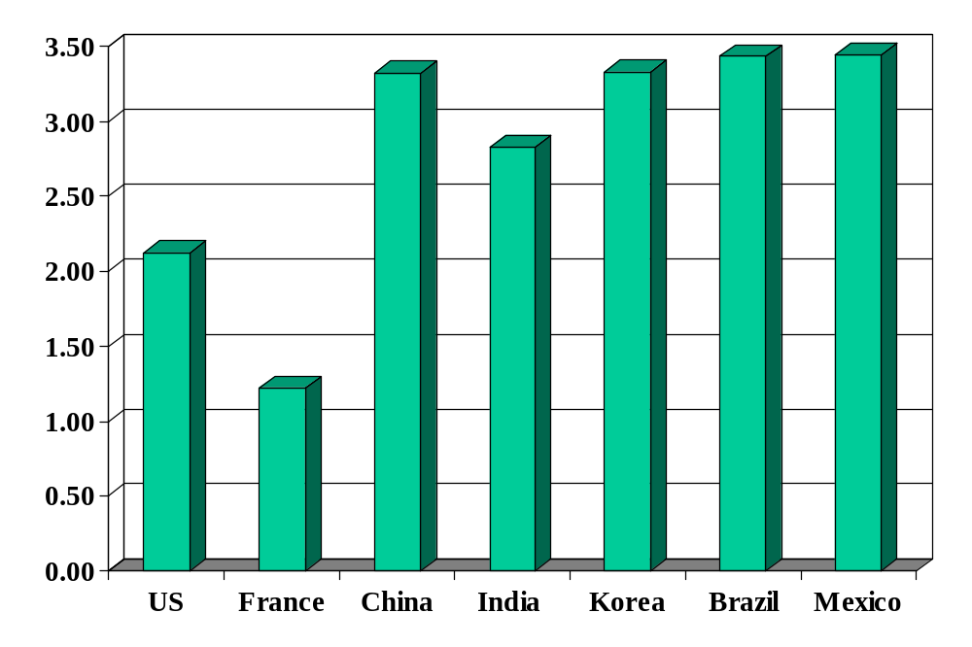
Volatility (std dev of annual growth rate %)
Source: World Bank, World Development Indicators, GDP per capita, 1975-2005.

Slide 6
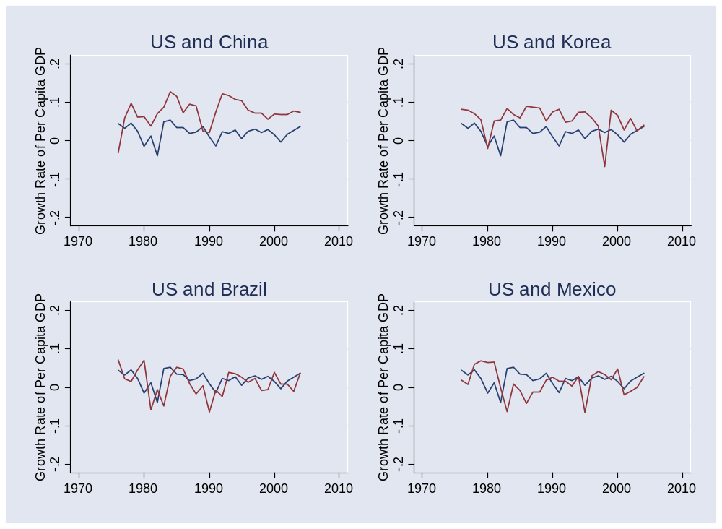
Volatility
Source: World Bank, World Development Indicators, GDP per capita, 1975-2005. Blue=US.

Slide 7
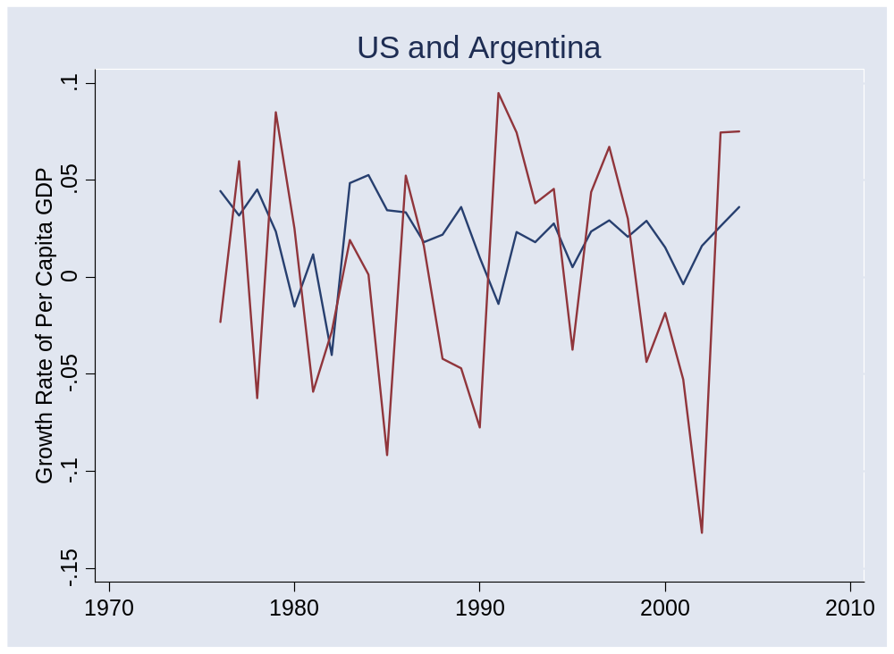
Volatility
Source: World Bank, World Development Indicators, GDP per capita, 1975-2005.

Slide 8
Crises
Australia 1891-93 (“Barings crisis”)
  GDP fell 18%
United States 1907-08
  GDP fell 10%
Mexico 1994-95:
  GDP fell 9%, peso fell almost 50%
Korea 1997-88
  GDP fell 9%, won fell 30%
Argentina 1999-2002
  GDP fell 20%, peso fell 65%

Slide 9
Crises
Why?

Slide 10
Crises
Crises reflect lack of confidence over repayment
  Could be internal or external

Slide 11
Current account review
Current account deficits lead to foreign debt
Viability of debt depends on what underlies it
  Worry if: deficit financed government or personal consumption (saving fell)
  Esp if it’s government debt and the political situation makes repayment politically difficult
  Don’t worry if: deficit financed new plant and equipment (investment rose)
  Unless: the investment isn’t paying off
For later: Why might level of development matter?

Slide 12
Fiscal theory of crises
Fixed exchange rate
Government deficit leads to current account deficit
  Financed in part by issuing foreign debt
Investors question repayment
  When do you hit this point?
Investors stop buying debt (current account reverses!)
Central bank unable to support exchange rate
  FX reserves run out, currency collapses

Slide 13
Exchange rate theory of crises
Fixed exchange rate
Over-valuation leads to current account deficit
Investors question repayment
  When do you hit this point?
Investors stop buying debt (current account reverses!)
Central bank unable to support exchange rate
  FX reserves run out, currency collapses

Slide 14
Mexico
Output fell 9%, peso collapsed
Why?

Slide 15
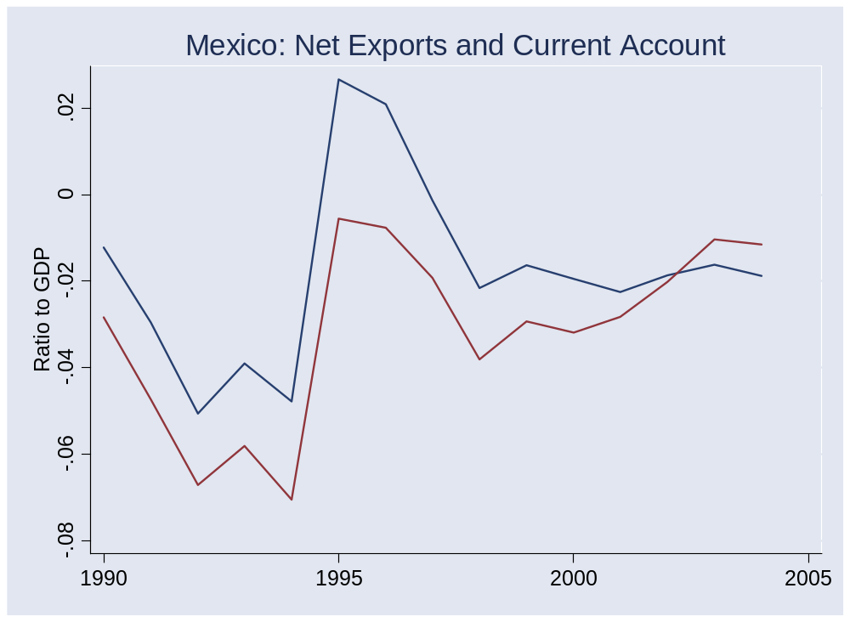
Mexico
Source: IFS. NX=blue, CA=red.

Slide 16
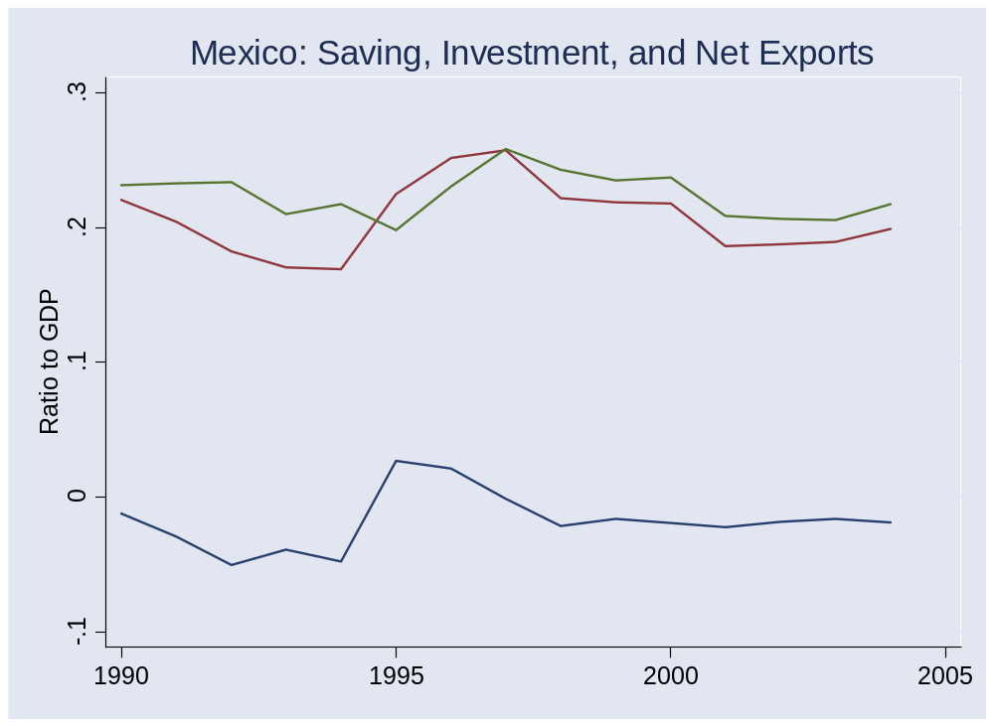
Mexico
Source: IFS. NX=blue, S=red, I=green.

Slide 17
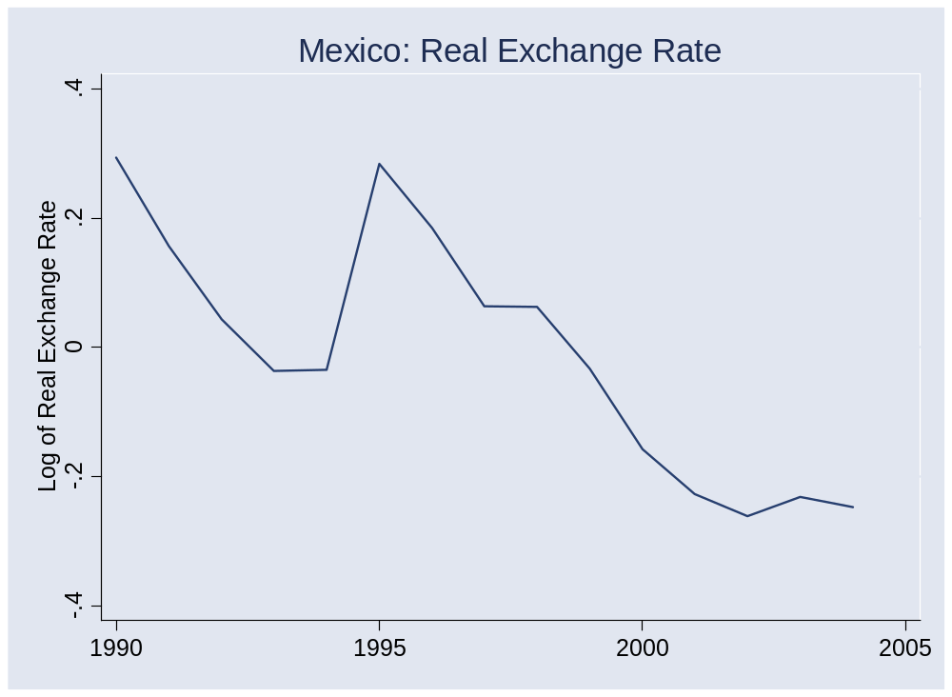
Mexico
Source: IFS.

Slide 18
Mexico
Current account deficits in early 1990s
  Pre-NAFTA investment?
Modest government deficits
Panic followed change of power in December 1994
Large drop in output, peso
Current account reversed
Economy rebounded
Current account deficit resumed

Slide 19
Korea
Output fell 9%, won fell 30%
Why?

Slide 20
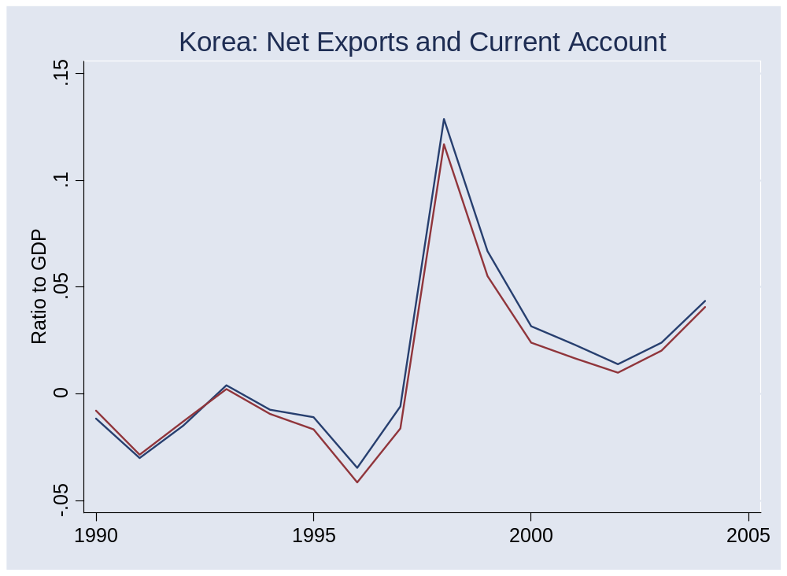
Korea
Source: IFS. NX=blue, CA=red.

Slide 21
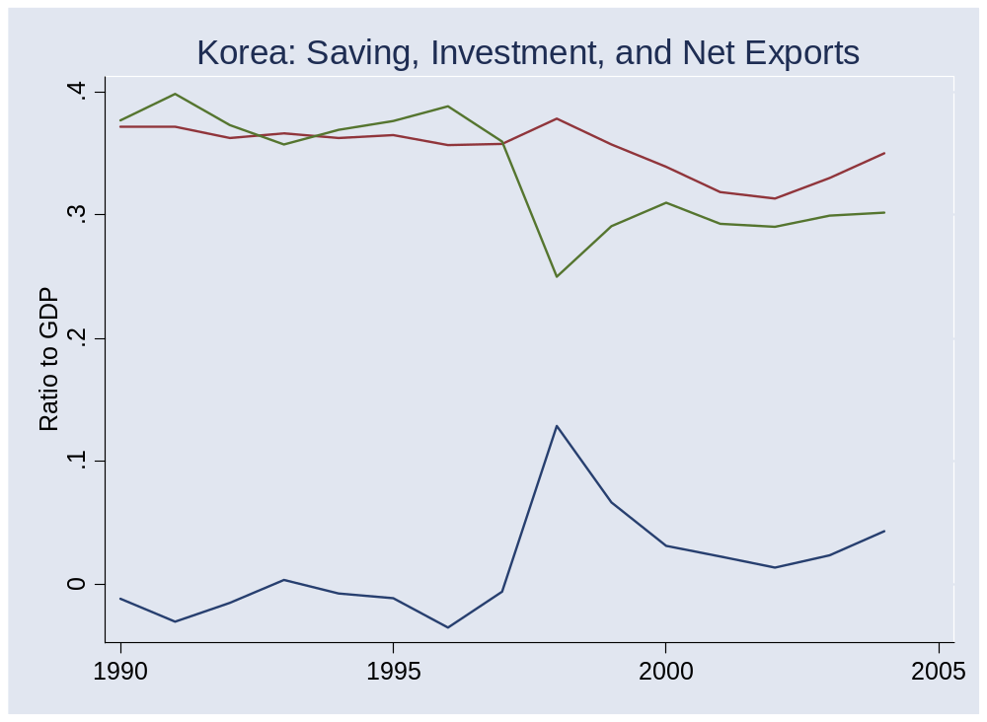
Korea
Source: IFS. NX=blue, S=red, I=green.

Slide 22
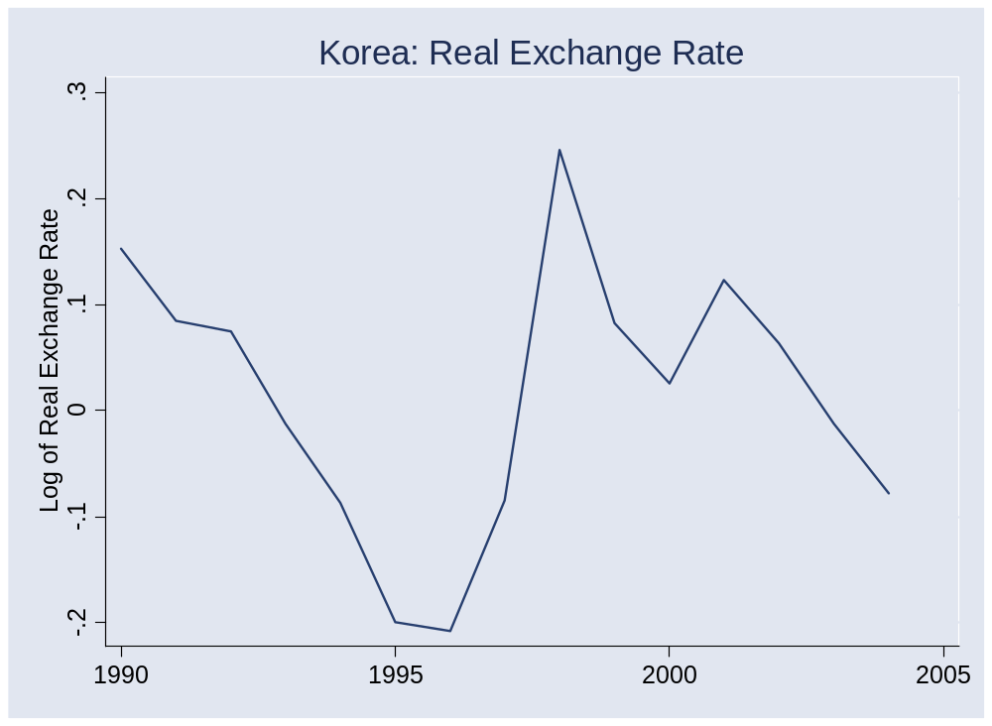
Korea

Slide 23
Korea
Modest current account deficits in mid 1990s
  After years of limited international capital flows
Fiscal surplus!
Financial panic throughout Asia in 1997-98
Current account reversed
Economy rebounded
Current account remains in surplus

Slide 24
Mexico and Korea
How do they fit the theory?

Slide 25
Asian crisis explanation 1
Foreign investors panicked for no reason

Slide 26
Asian crisis explanation 2
Courtesy of Professor Roubini and friends
  Take his course if you want to know more
Financial institutions financed bad private investments
Left them unofficially insolvent
Investors expected governments to bail banks out, which would lead to massive government deficits
Massive expected government deficits led to crisis through the traditional fiscal route

Slide 27
Asian crisis evidence
Every country different, but…
Bad investments?
  Sharp increase in non-performing loans
  Several chaebols insolvent
  Lax bank supervision allowed this to happen [weak institutions]
Capital structure
  Most foreign borrowing took the form of short-term debt
  Not: equity, FDI
  Why? Restrictions on foreign ownership and weak protection of equity creditors

Slide 28
Are the rich different?
Political stability?
Institutional protection of creditors
Sophistication of financial markets
What about Iceland?

Slide 29
Are the rich different?
Are international capital flows (and foreign investors) a bad idea for developing countries?
  Is trade in capital different from trade in goods?

Slide 30
China
Is a crisis possible?
  How would you tell?

Slide 31
Takeaways
Developing countries are volatile
Fundamental factor in crisis
  Investor concern over repayment
Why rich countries are different
  Better protection of investors
  Better capital structure (more equity, less debt)
Why China may be different
  Current account surplus, controls on capital flows
  Foreign claims are equity (FDI)
  Massive reserves
  But banking system is a mess

