Slide 1

The Global Economy
© NYU Stern School of Business
Notes:
Bring to class: Economist
Start Blackboard
GapMinder??
Welcome to Global Economy
Goal: learn about the world, using economics as our tool
World has changed: as of a year ago, emerging markets constitute half of world GDP [why? Two words – China and India]
What would you like to do?

Slide 2
The Global Economy
© NYU Stern School of Business

Slide 3
The Global Economy
© NYU Stern School of Business

Slide 4
Notes…
GapMinder – show growth vs level over time
Economist: growth rates by country
US current situation
  Last 10 quarters
  Bank forecasts
  Indicators: industrial production, employment, housing starts, building permits, VIX, TED, com paper issues (markit.com?), dispersion?
Notes:
Current issues: volunteers?

Slide 5
Today’s plan of attack
Current economic and business issues
  Yours [10 minute max]
  Mine
About the course
Countries
Group Project #1
Notes:
Current issues: volunteers?

Slide 6
The US
What are the prospects for the next 12 months?
Where are the opportunities? The risks?
Notes:
What are the prospects?
What are the big risks?

Slide 7
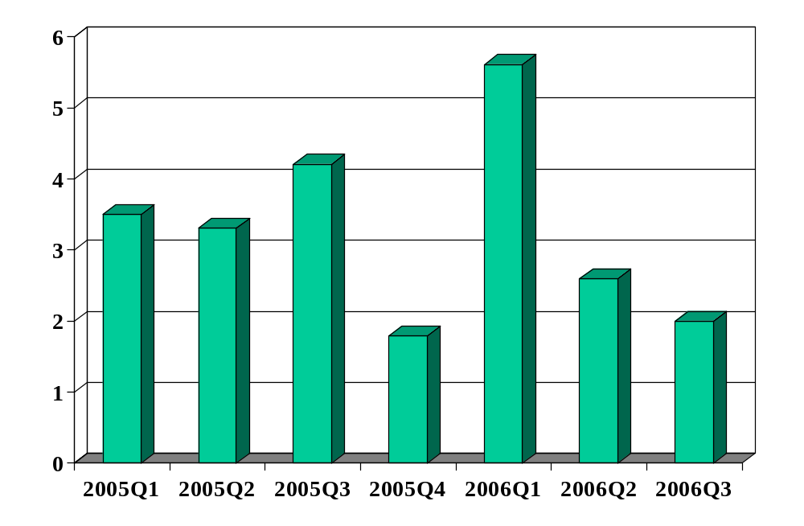
US GDP growth (annual rate, %)
Source: US Bureau of Economic Analysis.

Slide 8
The World
What are the prospects for the next decade?
Where are the opportunities? The risks?
Notes:
What are the prospects?
What are the big risks?

Slide 9
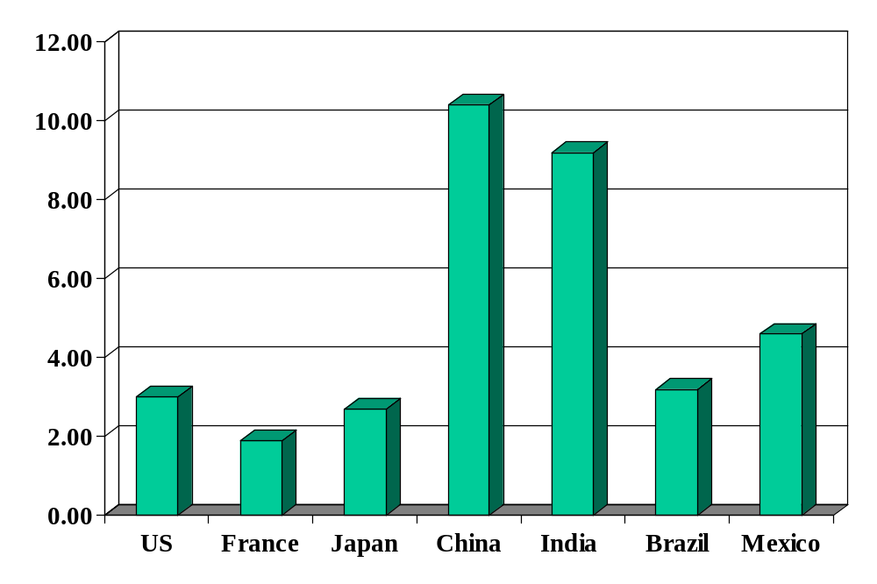
GDP growth (previous year, %)
Source: The Economist.
Notes:
What is this?
Why?
Where are the business opportunities?

Slide 10
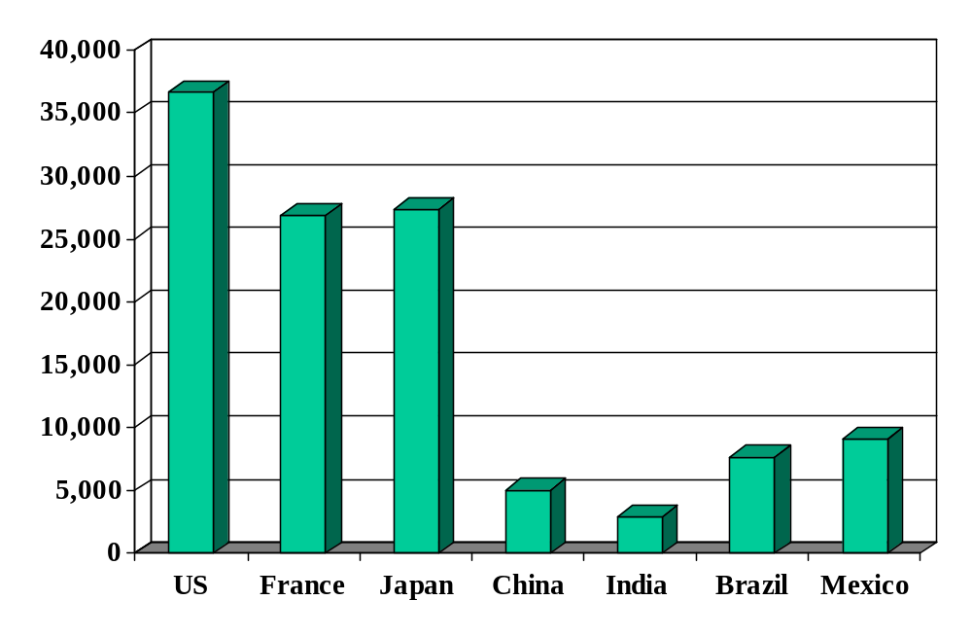
GDP per capita (2000 US dollars)
Source: World Bank, World Development Indicators, data for 2004, 2000 prices in USD, PPP adjusted.

Slide 11
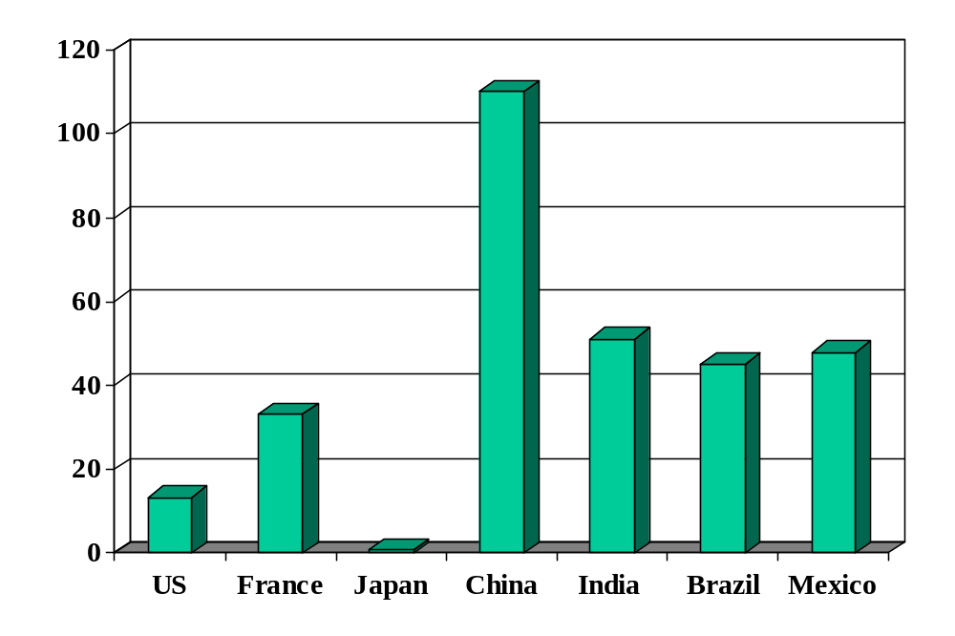
Stock market (previous year, % increase, $)
Source: The Economist.
Notes:
What is this?
Why?
Where are the business opportunities?

Slide 12
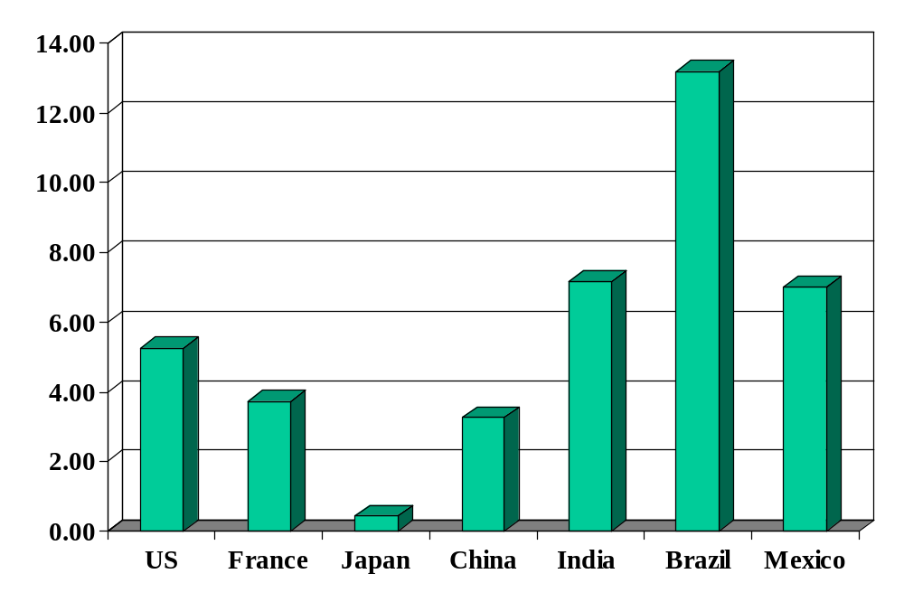
3-month interest rate (annual %, lcu)
Source: The Economist.
Notes:
What is this?
Why?
Where are the business opportunities?

Slide 13
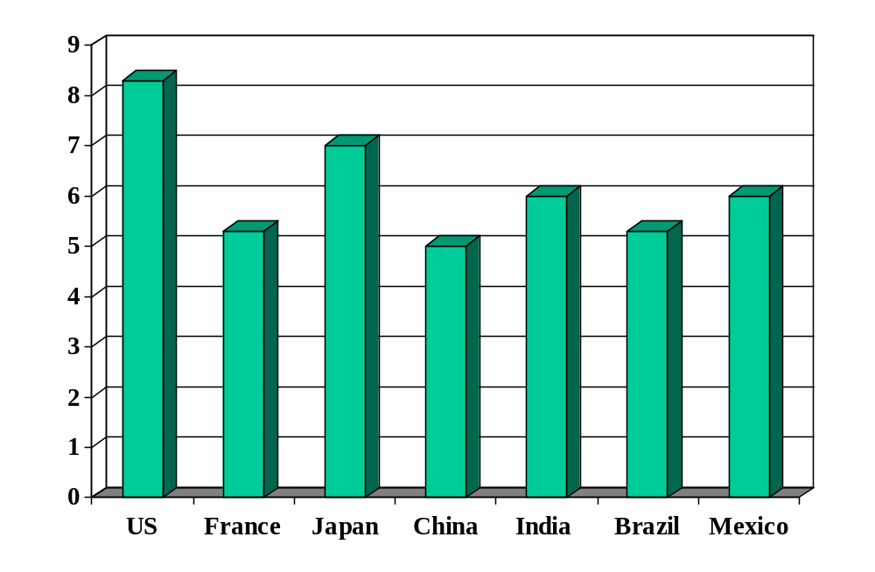
Investor protection (index)
Source: World Bank, Doing Business.

Slide 14
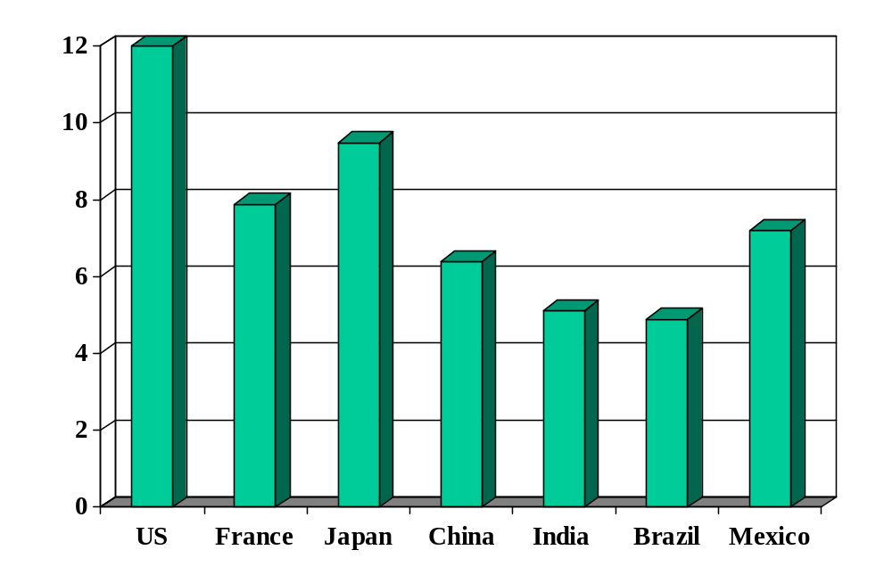
Average schooling of adults (years)
Source: UN data via NationMaster.

Slide 15
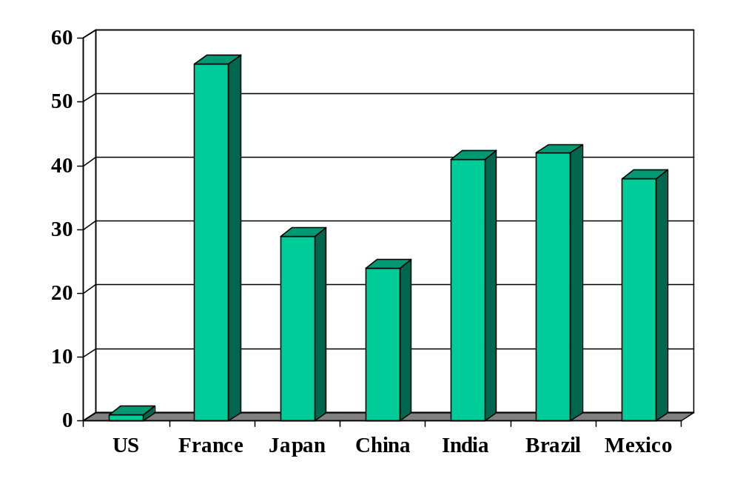
Employment rigidity (index)
Source: World Bank, Doing Business.

Slide 16
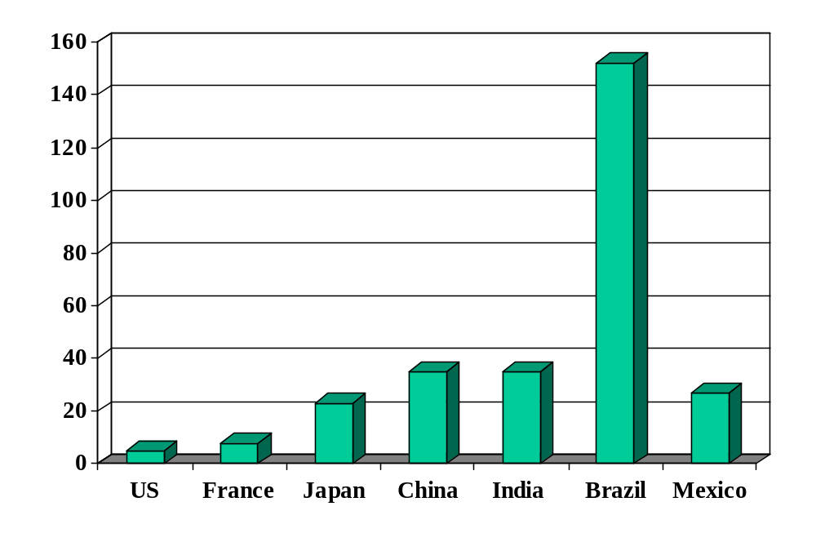
Starting a business (days)
Source: World Bank, Doing Business.

Slide 17
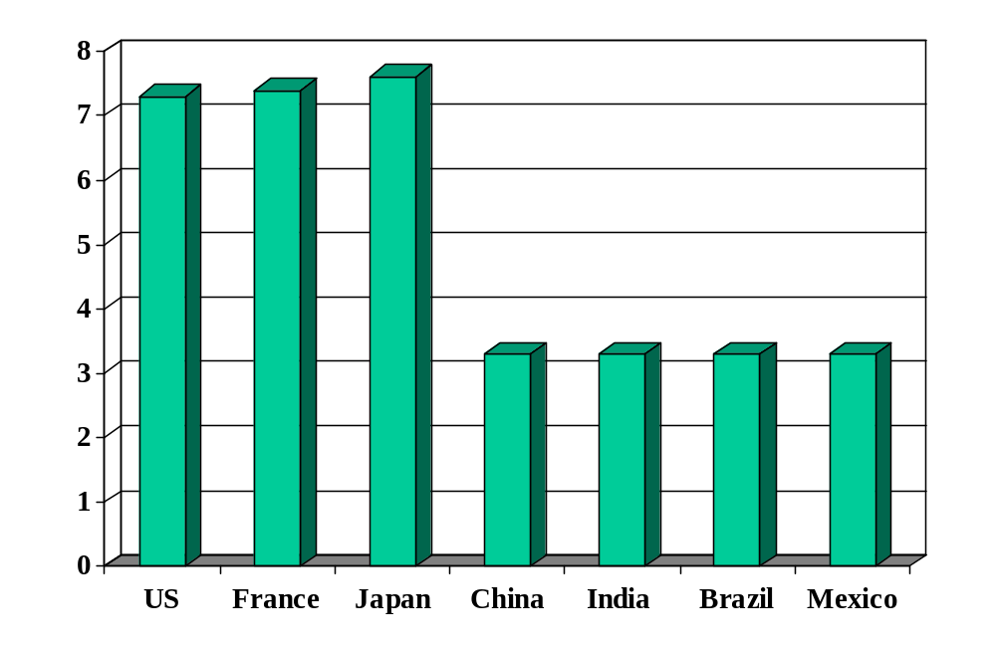
Absence of corruption (index)
Source: Transparency International, Corruption Perceptions Index.

Slide 18
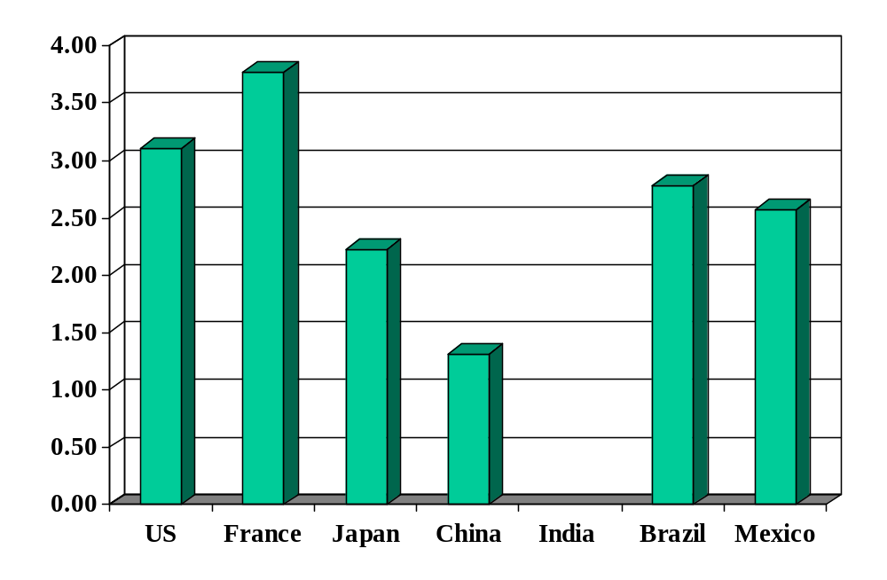
Price of a Big Mac (US$)
Source: The Economist, May 2006.

Slide 19
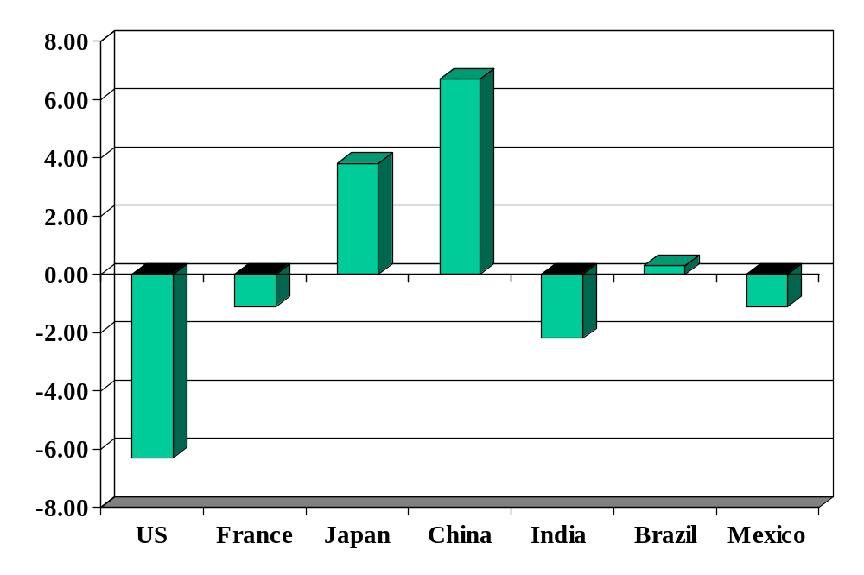
Current account balance (% of GDP)
Source: The Economist.
Notes:
Is a surplus a good sign or a bad one?

Slide 20
Countries
What countries have you lived or worked in?
Notes:
Write down the list

Slide 21
About the course
Read the syllabus – please!

Slide 22
About the course
How to evaluate the performance and business climate of countries
  Risks and opportunities
Useful for
  Marketing: what markets are attractive?
  International consulting: what countries offer the best opportunities for production or sales?
  International finance: what countries offer the best opportunities for investment?

Slide 23
About economics
A tool, not a formula
  Think: hammer
  Some ambiguity inevitable
  All-around good answer: it depends! (But on what?)

Slide 24
About the course
If you find anything in class puzzling, please speak up
Otherwise the experts will take over ??

Slide 25
About the course
What last year’s students said

Slide 26
About the course
Why are you here?

Slide 27
About the course
Theme: economic performance of countries
First half: long-run performance
  Why is GDP per capita lower in India than France?
  Why are China and India growing so rapidly?
  What are the business opportunities and challenges?
Second half: short-run performance
  How does [country name] look over the next year?
  What are the business opportunities and challenges?

Slide 28
About the course
Long-Run Performance
Saving and Investment, Productivity, Institutions, Labor Markets, International Trade, Taxes
First half:
Short-Run Performance
Inflation, Interest Rates, Indicators, Monetary Policy, Govt Deficits, Exchange Rates, Capital Flows, Emerging Market Crises
Second half:

Slide 29
About class notes
Theoretical background to class discussion
More concise than a textbook
Read them – before class
Notes:
Questions?

Slide 30
About the textbook
As usual, a range of opinion
If But if you have little or no background in economics, you might buy
  Pugel, International Economics
  Mankiw, Macroeconomics
Blackboard lists chapters for current edition, but older editions are similar and much cheaper
If you order now, you’ll have them when needed
If you buy and older edition, let me know and I’ll post the appropriate chapters
Notes:
Questions?

Slide 31
About slides
Catalyst for class discussion
Available right after class [??]
Notes:
Questions?

Slide 32
About group projects
Essential part of the class experience
Some of them are demanding… ??
Notes:
Questions?

Slide 33
About groups
Up to 5 members, unlimited marriage and divorce

Slide 34
About participation
Share your thoughts
I’ll share mine
Extra points if you prove me wrong

Slide 35
About participation
If you’re stuck, here are two foolproof comments:
  It depends
  Fact of life

Slide 36
About participation
If you’re an economics aficionado
  Share your insights
  But leave time
If you’re not
  Please ask questions…

Slide 37
About laptops
At the request of other students: last row only

Slide 38
About your grade
Participation | 15%
Group Projects | 30%
Group Presentation | 10%
Midterm | 20%
Final | 25%

Slide 39
About me
Grew up in Pittsburgh
PhD in Economics, Yale, 1981
Research interests:
  International capital markets
  Fixed income and currency derivatives
  Emerging market crises
Other interests:
  Paul (15) and Melanie (12)
  Basketball, biking, books, beer
Notes:
Questions?

Slide 40
About the TFs
Andrew Verdasca
  From: Toronto
  Concentrations: finance and accounting
  Career plans: Bear Stearns, investment banking
  Personal interests: sailing, travel, politics
Fran Su
  From: Guangzhou, China
  Concentrations: marketing and global business
  Career plans: Merck, US human health, marketing
  Personal interests: running, traveling
Notes:
Questions?

Slide 41
About feedback
If you have ideas, comments, questions, whatever:
  Come see me
  Send an email
  Speak to the TF
  Send an anonymous email to me
  … whatever you like

Slide 42
About Blackboard

Slide 43
About Group Project #1
Due Thursday at 9am
Stop by if you have questions
Don’t panic
Get started – now!
Notes:
Questions?

Slide 44
About 9:00 am
Pain for all of us
Suggestion: aim for 8:50, bring coffee and paper
Notes:
Questions?

Slide 45
Takeaways
Read the syllabus
Come to class
Expect to participate
Have some fun
Get to work

