Slide 1

The Global Economy
Labor market dynamics
© NYU Stern School of Business

Slide 2
Today’s plan of attack
Group Project #4
Current economic and business issues
Quotations
Volatility
Labor market “flows”
US and Europe revisited
Innovation

Slide 3
Group Project #4

Slide 4
Current issues

Slide 5
Current issues
Financial Times, Feb 12 07:
  Presidential candidate Segolene Royal laid out her economic vision, which includes: increase the minimum wage, merge state-owned electricity and gas utilities, scrap laws that make it easier for small companies to hire and fire employees; demand that the European Central Bank focus on economic growth.

Slide 6
Current issues
The Economist, Feb 1 07:
  France’s centre-right presidential candidate Nicolas Sarkozy took his campaign to London, calling it “one of the biggest French cities.” London is thought to have at least 300,000 French citizens – and voters – some of whom left “in desperation,” said Sarkozy. He called on them to help revive France’s “blocked society.” Journalists noted that France’s unemployment rate is 8.6%, compared with 5.5% in Britain, and has not dipped below 8% for nearly 25 years.

Slide 7
Current issues
The Economist, Jan 18 07:
  NESTLED among the wooded Blue Ridge mountains in Virginia's far south-west, Galax is a town of bluegrass music, barbecue and hardscrabble living. It is home to an annual fiddlers’ convention and, less happily, a huddle of textile and furniture factories. Over the past few years, globalisation has hit hard. Last year … three big factories closed their doors within months. More than 1,000 people, around one-sixth of the town’s workforce, lost their jobs.
  For some, particularly those in their 50s, the future looks bleak. At 59, Paul Rotan sees little chance of finding another job with health insurance, but he is still six years away from qualifying for Medicare. But other, mainly younger, workers are already better off.

Slide 8
Marx and Engels
Communist Manifesto (1848):
  Everlasting uncertainty and agitation distinguish the bourgeois epoch from all earlier ones. All fixed, fast frozen relations, with their train of ancient and venerable prejudices and opinions, are swept away, all new-formed ones become antiquated before they can ossify. All that is solid melts into air, all that is holy is profaned, and man is at last compelled to face with sober senses his real condition of life and his relations with his kind.
  All old-established national industries have been destroyed or are daily being destroyed. They are dislodged by new industries, whose introduction becomes a life and death question for all civilized nations.
Notes:
http://www.marxist.net/marx/index.html

Slide 9
Joseph Schumpeter
Capitalism, Socialism and Democracy (1942):
  The fundamental impulse that sets and keeps the capitalist engine in motion comes from the new consumers, goods, the new methods of production or transportation, the new markets, the new forms of industrial organization that capitalist enterprise creates. This process of Creative Destruction is the essential fact about capitalism.
  In capitalist reality, competition [comes] from the new commodity, the new technology, the new source of supply, the new type of organization – competition which … strikes not at the margins of the profits and the outputs of the existing firms but at their foundations and their very lives.

Slide 10
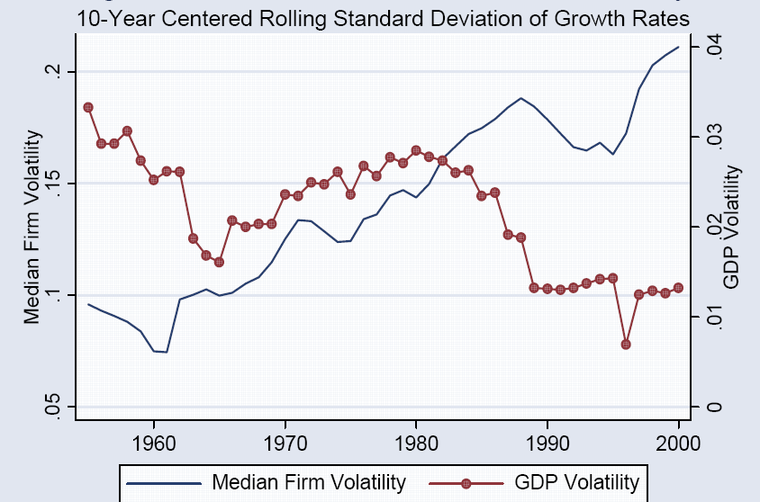
Micro and macro volatility
Source: Comin and Philippon, NBER Macro Annual, 2006.

Slide 11
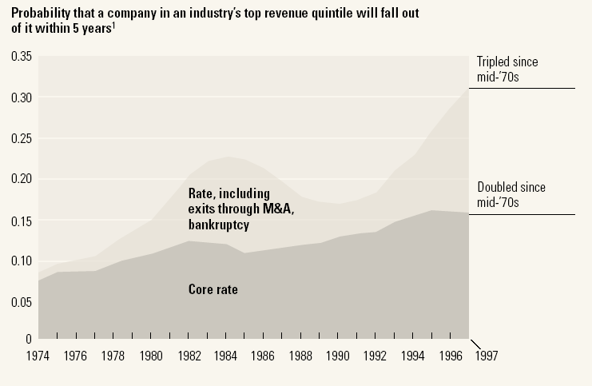
Industry leadership
Source: McKinsey Quarterly, “Extreme competition,” 2005.

Slide 12
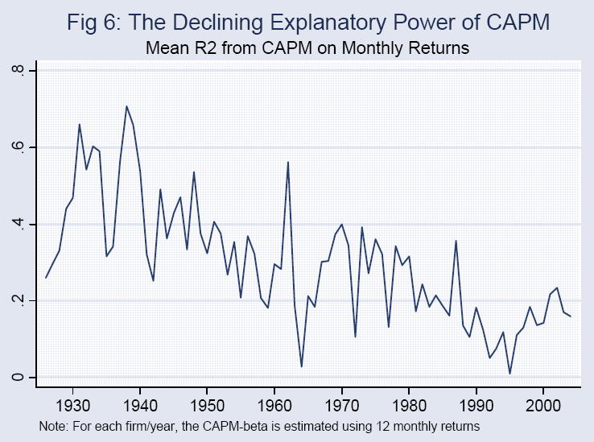
The fall of the CAPM
Source: Comin and Philippon; see also Morck, Yeung, Yu, JFE, 2000.

Slide 13
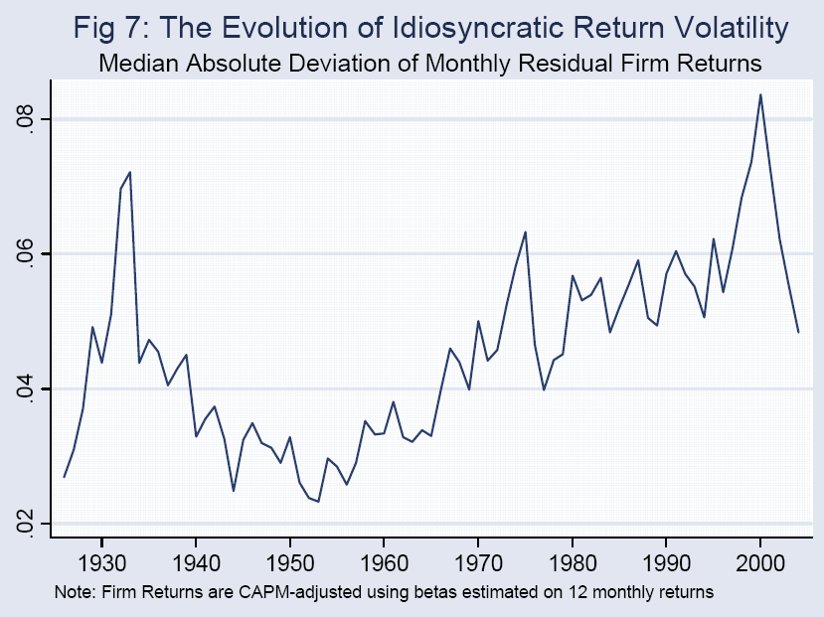
The rise of idiosyncratic risk
Source: Comin and Philippon; see also Morck, Yeung, Yu, JFE, 2000.

Slide 14
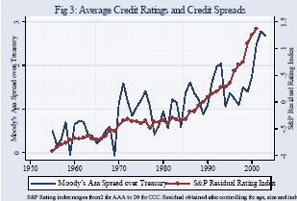
Credit ratings and spreads
Source: Comin and Philippon.

Slide 15
Why?
Why more micro volatility?
Good or bad?

Slide 16
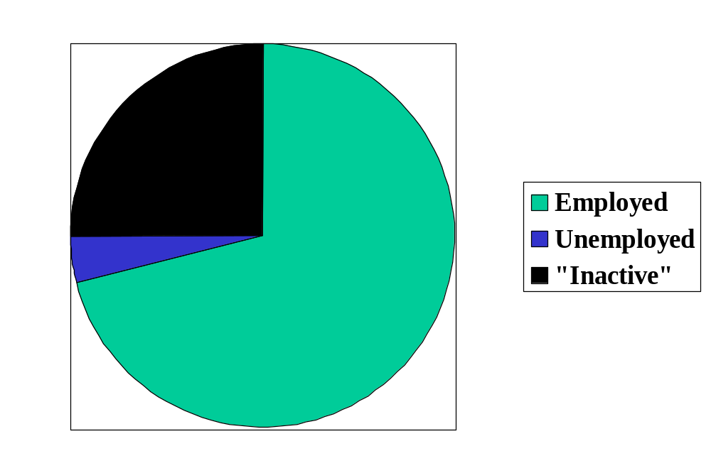
Reminder: labor market status
Source: OECD, Employment Outlook, 2006. Numbers are percentages of the population 15-64.
Notes:
Draw this on board, show what universe and pieces are

Slide 17
Labor market “flows” (“transitions”)
Transitions
  How many people change “status” from month to month?
Aggregate measures of turnover
  Accessions: number of workers taking new jobs, whether their previous status was employed, unemployed, or not in labor force
  Separations: number of workers leaving current jobs, whether they become employed, unemployed, or leave labor force
Bottom line: enormous turnover

Slide 18
Labor market flows (avg, 1993-2005)
Monthly!
2.6% “job-to-job”
Employment
122.0m
1.3%
4.8%
28.3%
2.7%
2.4%
Unemployment
6.2m
Out of labor force
59.3m
23.3%
Source: US data, monthly, reported in Davis, Faberman, and Haltiwanger, “Flow approach,” 2005.

Slide 19
Flows in US and EU
 |  | Workers and Jobs
Country | EPL | Accessions | Separations | Reallocation
Denmark | 1.8 | 29.0 | 29.0 | 58.0
France | 2.8 | 28.9 | 30.7 | 59.6
Germany | 2.5 | 31.6 | 30.4 | 62.0
Italy | 2.5 | 34.5 | 33.6 | 68.1
Sweden | 2.6 | 16.8 | 17.8 | 34.6
UK | 1.2 | 37.2 | 37.6 | 74.8
USA | 0.7 | 45.2 | 46.0 | 91.2
Source: OECD, Employment Report, 1994; numbers are annual percentages of labor force.

Slide 20
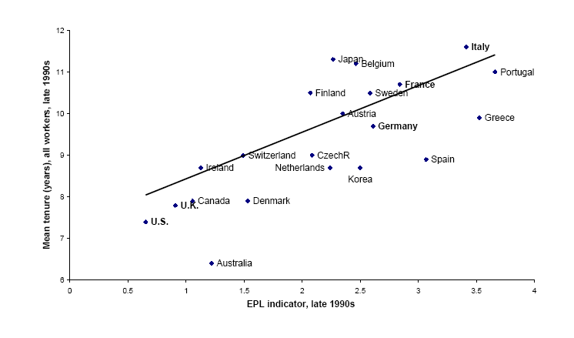
Employment protection and tenure
Source: Bertola, 2001.

Slide 21
US and Europe revisited
Evidence on unemployment
  1960s: unemployment lower in Europe
  Now: unemployment lower in US
Why?
  What changed?
Notes:
Three things: policy, globalization/Berlin Wall, volatility.

Slide 22
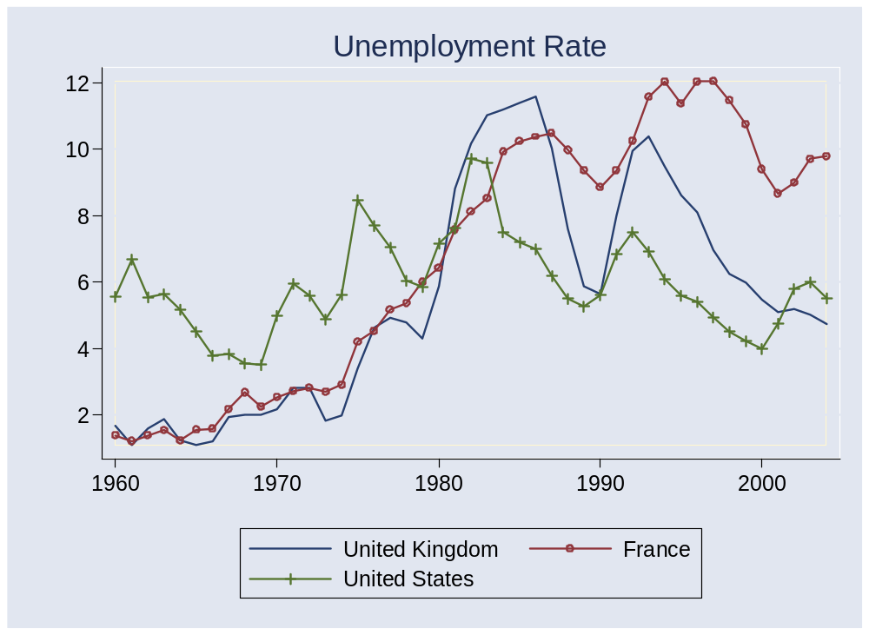
Unemployment rates

Slide 23
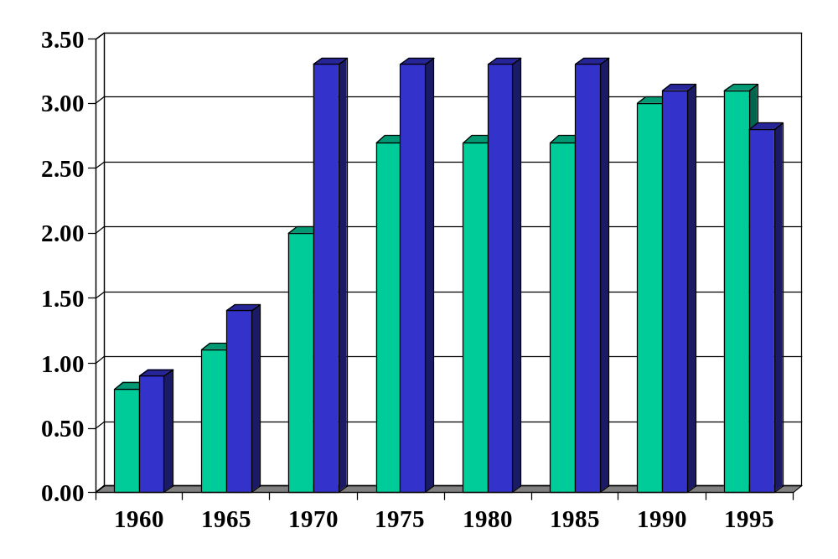
Employment protection in Europe
Green = FRA
Blue = DEU
Source: Blanchard and Wolfers.
Notes:
http://bpp.wharton.upenn.edu/jwolfers/research.shtml

Slide 24
Innovation
A source of prosperity
Also a source of volatility and turbulance
Example:
  Two sectors, agriculture and manufacturing
  Consume equal quantities of each
  Suppose: large increase in TFP in agriculture
  Impact on: employment, GDP, aggregate TFP?
What policies would you recommend?
  What are the costs and benefits of employment protection?
  Were the Luddites right?

Slide 25
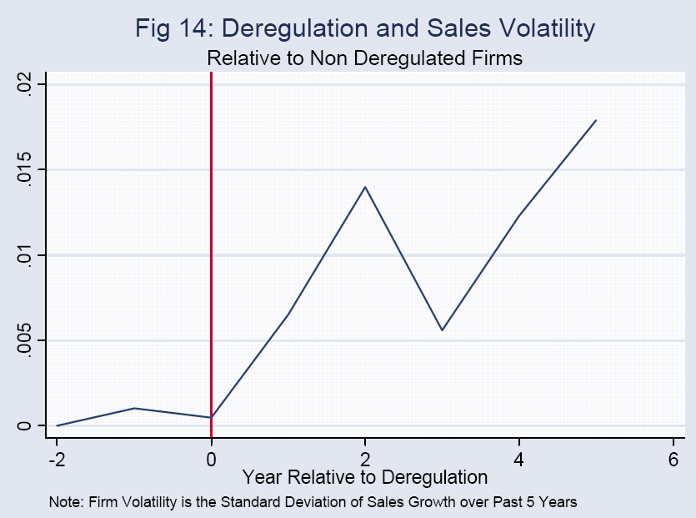
Deregulation in US
Source: Comin and Philippon.

Slide 26
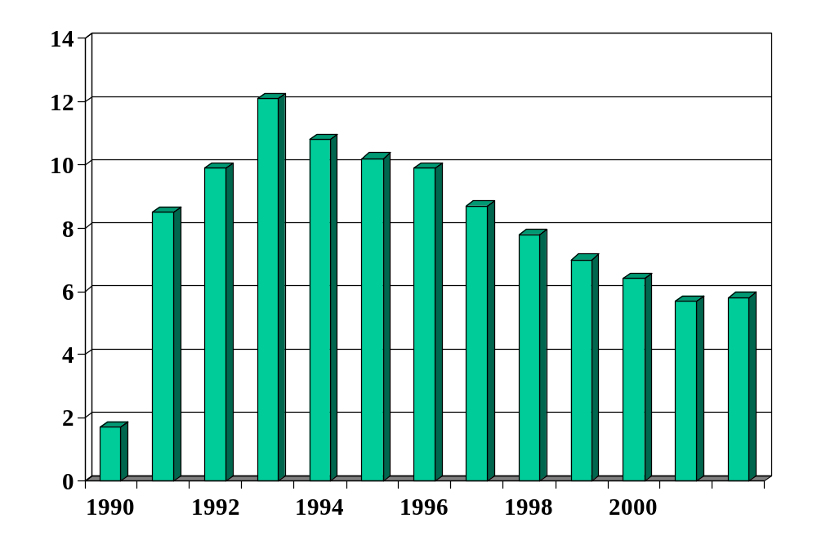
Unemployment in Hungary (%)
Source: World Bank, World Development Indicators.

Slide 27

Ljunqvist and Sargent
Volatile Economy
+
Inflexible Labor Market

Slide 28
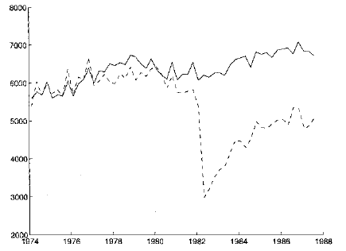
Displaced workers
Average quarterly earnings of “stayers” and “separators”
“stayers”
“separators”
Source: Ljungqvist and Sargent, JPE, 1999; adapted from Jacobson et al, AER, 1993.

Slide 29
Takeaways
Modern economies are volatile
  Affects businesses, employees, investors, etc
  Capital and labor are constantly “reallocated” to growing businesses from shrinking ones
Countries with stronger employment protection
  Have lower turnover
  Harder to lose a job, also harder to get one
  Probably reduces employment, output, and TFP
Competition is good for consumers, stressful for managers and workers
  Investors?

