Slide 1

The Global Economy
Gains from Trade
© NYU Stern School of Business
Notes:
Start quickly – need most of class

Slide 2
Today’s plan of attack
Current economic and business issues
Questions and quotations
The formal argument for free trade
  Smith’s “invisible hand”
  Ricardo’s “comparative advantage”
Trade and TFP
Fallacies
Reminder: feel free to argue

Slide 3
Current issues

Slide 4
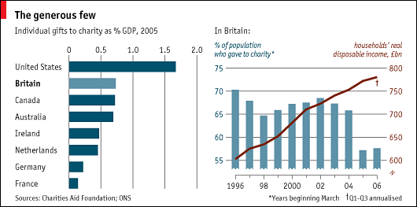
Current issues
From The Economist, Feb 15 07:

Slide 5
Is trade a good thing?
For whom? US? Developing countries? Others?
Notes:
How many believe it?

Slide 6
Adam Smith
Wealth of Nations (1776) on trade restrictions:
  All political writers since the time of Charles II had been prophesying “that in a few years we would be reduced to an absolute state of poverty” [by international trade], but “we find ourselves far richer than before.”
  All commerce that is carried on betwixt any two countries must necessarily be advantageous to both. The very intention of commerce is to exchange your own commodities for others which you think will be more convenient for you. When two men trade between themselves it is undoubtedly for the advantage of both.... The case is exactly the same betwixt any two nations. The goods which the English merchants want to import from France are certainly more valuable to them than what they give for them.
Notes:
http://www.econlib.org/library/Smith/smWN.html

Slide 7
Ernesto Zedillo
Former president of Mexico:
  Half of the world’s population lives on less than $2 a day. I say to you, with all conviction, that a vital part of the solution consists of promoting more globalization. More international trade, more investment flowing across countries, more knowledge diffused internationally among communities and individuals … will do much to defeat the evil of poverty during this new century.

Slide 8
Greg Mankiw
Professor and former Bush economic advisor:
  The movement of US factory jobs and white-collar work to other countries is part of a positive transformation that will enrich the US economy over time, even if it causes short-term pain and dislocation. … Outsourcing is just a new way of doing international trade. More things are tradable than in the past, and that’s a good thing.

Slide 9
Lou Dobbs
Television host and critic of “exporting jobs”:
  The shipment of American jobs to cheap foreign labor markets threatens not only millions of workers and their families, but also the American way of life. Corporate raiders are breaking down our borders in search of the lowest-price labor available anywhere in the world. For the first time in history, corporations are laying off Americans from well-paying jobs and replacing them with low-paid foreign workers. … Corporate America isn’t doing all this alone: Big business and Washington are in cahoots, trading our nation's livelihood for short-term gain.
Notes:
From blurb for his book, Exporting America.

Slide 10
Global Trade Watch
Anti-globalization group on NAFTA:
  The data are in and they clearly show the damage NAFTA has wrought for millions of people in the US, Mexico, and Canada. As we predicted: a race-to-the-bottom in wages, destruction of hundreds of thousands of good US jobs, undermining of democratic control of domestic policy-making, and threats to health, environmental and food safety standards. … Millions of campesinos throughout Mexico have lost a significant source of income and left their small corn farms.

Slide 11
Bill Gross
PIMCO’s Investment Outlook, Nov 04:
  It’s really quite simple you know. Asia has hollowed out our manufacturing base and is now making inroads into services. … We can’t really educate or innovate ourselves out of this. 250 million Americans sitting around thinking up ways for the rest of the world to support us is not my idea of a real world outcome.

Slide 12
Gains from trade?
Virtually all economists believe trade is good
  Consumers buy products from cheapest source, raising their standard of living
  Production moves to most efficient locations, raising aggregate productivity – and wages
  Trade is a positive-sum game: there are more winners than losers, and the winners win more than the losers lose
Virtually no one else really believes it
  Zero-sum mentality?

Slide 13
Ricardo’s model of trade
Why a model?
  Allows us to see exactly what the logic is
Ricardo (1817):
  Productivities fixed
  Comparative advantage: each country should produce the good at which it is comparatively most productive
Notes:
Talk about Ricardo

Slide 14
Ricardo: setup
Two countries (US, Mexico), two goods (apples, bananas), one input (labor)
  Our production function: Y = AL (no K)
Productivities A (output from one unit of labor):
 | Apples | Bananas | Labor
US | 20 | 10 | 100
Mexico | 5 | 5 | 100
Notes:
What would Americans say? Mexicans? Wages and productivity…

Slide 15
Ricardo: consumption possibilities
b
500
Shown for: q = p_{b}/p_{a} > 1
500
a
Notes:
Talk about this in class, show that opportunities expand with trade
For extra work: do the US case…
In a sense, we’re done…

Slide 16
Ricardo: details
We want to compare free trade (no tariffs) with no trade (prohibitive tariffs)
  Extreme, but makes the point
Utility is a composite of the two goods:
u(a,b) = a^{0.75} b^{0.25}
  Translation: consumers spend 75% of income on apples, 25% on bananas
Producers maximize profit
Competitive: no monopolies

Slide 17
Ricardo: numbers
 | Free Trade | No Trade
 | US
Price of apples (p_{a}) | 0.05 | 0.05
Price of bananas (p_{b}) | 0.0667 | 0.10
Wage (w) | 1 | 1 (dollar)
Consumption of apples (a) | 1500 | 1500
Consumption of bananas (b) | 375 | 250
Utility (u) | 1061 | 958
 | Mexico
Price of apples (p_{a}) | 0.05 | 0.2
Price of bananas (p_{b}) | 0.0667 | 0.2
Wage (w) | 0.3333 | 1 (peso)
Consumption of apples (a) | 500 | 375
Consumption of bananas (b) | 125 | 125
Utility (u) | 354 | 285
Notes:
Note change in relative prices:
No trade: US q = 2, Mex q = 1
Free trade: q = 4/3 in both cases (in between)
Pick a number and show where it comes from
Comment on shift in production
Contrast consumption baskets in Mexico (draw on previous diagram)

Slide 18
Ricardo: impact of trade
Aggregate consumption up in both countries
Production changes:
  US shifted to apples
  Mexico shifted to bananas
  No change in labor (“jobs”) by assumption
Shows up as increase in productivity:
  Real GDP = consumption at world prices
  GDP rises in both countries
  Y = AL: rise in Y shows up as rise in A

Slide 19
Ricardo: summary
Mexican consumers are better off
  Consumption possibilities set is strictly larger
Mexican production is more efficient
  Shift production to bananas, at which it is relatively more productive than the US
Similar arguments for the US, too
  Both sides benefit
Is anything missing?

Slide 20
Impact of NAFTA on Mexico
Mexican auto manufacturing is booming
  Many old factories shut down, new ones opened aimed at full North American market
Mexican garment manufacturing booming
  Clothes made with US cloth, shipped back to US
  Rules of origin work against Asian textiles
Mexican corn farmers wiped out
  Corn is US comparative advantage
  Many small farmers displaced

Slide 21
Trade and TFP
Free trade works like an increase in TFP
Are they the same?

Slide 22
Automobile TFP
Consider new technology for making cars:
  Technology breakthrough reduces labor requirement per car
  Thousands thrown out of work
Is this a good thing for the economy as a whole?

Slide 23
Automobile TFP
Consider new technology for making cars:
  We grow soybeans in Iowa
  Ship them to Japan, where they are “transformed” into cars
  Thousands thrown out of work
Is this a good thing for the economy as a whole?

Slide 24
Fallacy #1
Trade costs us jobs
Why a fallacy?
  Trade is about what the jobs are, not how many
  What they’re really saying: “I lost my job, and I’m mad”
  In most countries, trade is a small factor in job creation and destruction [in US, replace “small” with “tiny”]

Slide 25
Fallacy #2
Our tariffs are good for us
Why a fallacy?
  Higher prices for consumers
  Inefficient production
  Note: true even if they have tariffs

Slide 26
Argentina in the 1930s
Export-oriented agriculture
  Wheat
  Beef (refrigerated and canned)
  Major markets: US and UK
During the Depression, both the US and UK raised tariffs on Argentine beef to protect local farmers
Argentina responded with its own protection of manufactures
First step in 60-year decline in performance
Notes:
Argentina: think Canada in the Southern hemisphere
This isn’t all due to trade!

Slide 27
Voluntary export restraints
In 1980s, US “persuaded” Japanese carmakers to limit exports to US
Similar to a tariff, but
  “Voluntary” (hence ok with trade law)
  US got no revenue (Japanese carmakers did)
Limits on numbers benefited Japanese:
  Reduced competition among them in US (profits up)
  Instigated increase in quality
What were we thinking of?

Slide 28
Fallacy #3
We should subsidize local producers to help them compete with foreign producers
Why a fallacy?
  Costs us money
  Encourages inefficient production

Slide 29
Agriculture
Farmers are subsidized in all developed countries:
Country | Subsidy per Farmer
Norway | $33,000
Switzerland | $32,000
Japan | $26,000
US | $21,000
EU | $17,000
And: health and safety regulations keep out imports
Local milk in Norway?
Notes:
Data: The Economist, “From bad to worse,” May 5, 2001

Slide 30
Brazil v US
Brazil filed suit against US cotton subsidies
  US agreed to $1.6b cap on subsidies in 1995
  Current subsidies >$2b
  WTO ruled in 2004 that these subsidies violate trade rules
If Brazil wins:
  Is this good for Brazil?
  Bad for the US?

Slide 31
Fallacy #4
Free trade creates trade deficits
Why a fallacy?
  My deficit is someone else’s surplus: can’t cause deficits for everyone
  Trade deficits are about international financial flows [more later]

Slide 32
Fallacy #5
Outsourcing costs us jobs
Why a fallacy?
  No different from trade in goods: it’s an issue of which jobs, not how many.
  Countries should do jobs at which they have comparative advantage
  Krugman’s example
Notes:
Goldman Sachs: you hire the Indian, or they do.

Slide 33
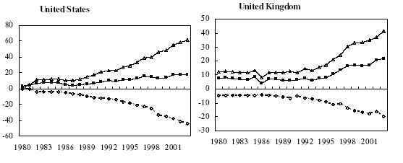
Outsourcing: business services
Billions of dollars: Δ = in, o = out, ■ = net

Slide 34
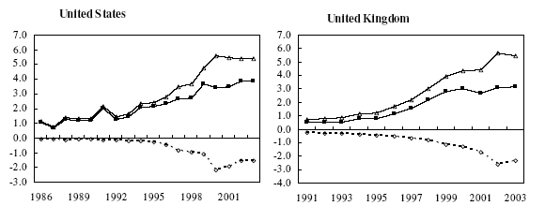
Outsourcing: IT services
Billions of dollars: Δ = in, o = out, ■ = net
Source: Amiti and Wei, NBER 10808.

Slide 35
Fallacy #6
High wages hurt competitiveness
Why a fallacy?
  Wages reflect productivity, a sign of competitive strength

Slide 36
Takeaways
Free trade benefits both countries
  Consumers buy products from cheapest source
  Countries produce those products in which they have a productivity advantage, raising overall productivity
Trade is like TFP
Question for next class
  If trade is such a good idea, why does it generate so much debate?

Slide 37
Mankiw and Swagel
Re their experience on the Council of Economic Advisors (Journal of Monetary Economics, 2006):
  During the presidential campaign of 2004, no economic issue generated more heat or shed less light than the debate over offshore outsourcing.
Notes:
http://www.sciencedirect.com/science/article/B6VBW-4KGPPNN-1/2/3a501e09c90ffe2420b1a0f52c4c9adb

Slide 38
Extra slides

Slide 39
Current issues
Paulo Leme, Goldman Sachs (“The ‘B’ in BRICs”):
  Original BRICs analysis: by 2050, BRICs would have greater GDP (not GDP per capita) than G6. [Application of Solow model.]
  December 06: Brazil’s growth performance has been disappointing relative to the other BRICs. We are unlikely to see the deep fiscal adjustment needed to raise growth to 5%. Brazil remains too closed to international trade.

Slide 40
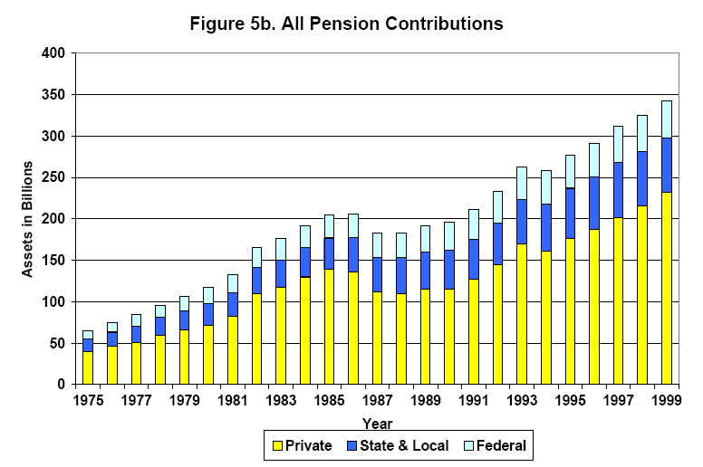
US pension plans
Source: NBER wp 8610.

Slide 41
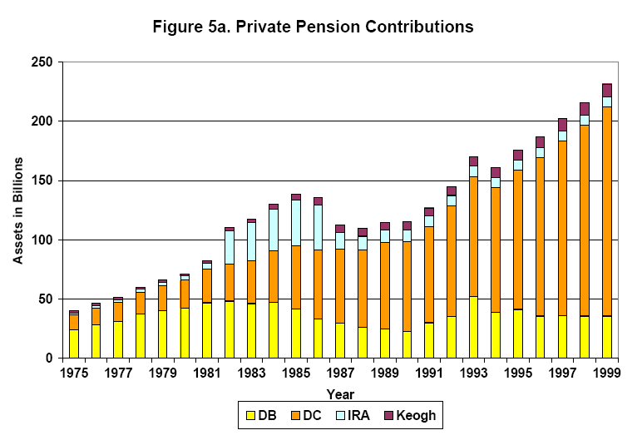
US private pension plans
Source: NBER wp 8610.

Slide 42
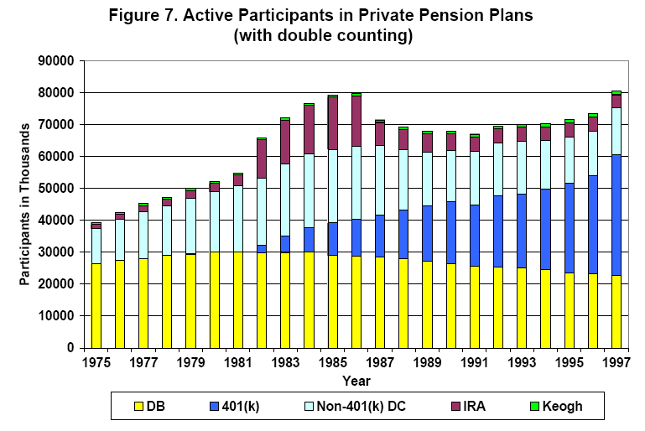
US private pension plans
Source: NBER wp 8610.

