Slide 1
Dashboard Excel Project By David Batista

Slide 2
Introduction
Maven Roasters seeks to enhance operational efficiency and gain insights into customer purchasing behavior. To achieve this, I have collected transactional sales data from January to June 2023.
This project aims to prepare, transform, visualize, and analyze this data, culminating in an interactive dashboard. By examining transaction trends over time and across franchise locations, opportunities can be identified to optimize operations and boost sales.
Excel Project – Slide 2

Slide 3
Methodology & Process Data Preparation and Transformation in Excel
Once the data was collected, I utilized Microsoft Excel to transform and prepare it for analysis. Key tasks included calculating revenue and converting complex date codes into a more readable format using functions like TEXT and basic math operators. A crucial feature for efficiency was the Excel duplicate tool (Ctrl + D), which allowed me to replicate these calculations across thousands of rows seamlessly.
Excel Project – Slide 3

Slide 4
Methodology & Process Creating Pivot Tables to Draw Relationships
I then created pivot tables using the prepared data to highlight key relationships, such as transactions by hour and overall gross revenue by month. For example, the monthly gross revenue pivot table was generated by adding total revenue as a row and isolating the months as columns, utilizing the data I had just transformed in the preparation process that previously had not existed.
Excel Project – Slide 4

Slide 5
Methodology & Process Visualizing Data Relationships
I visualized the data relationships from the pivot tables using appropriate Excel charts for better readability. For instance, I used a line chart to illustrate gross revenue by month and a clustered column chart for gross transactions by month. I optimized these charts using Excel’s formatting options to enhance clarity and presentation.
Excel Project – Slide 5

Slide 6
Methodology & Process Dashboard Organization and Presentation
Lastly these visualizations were neatly organized to form an interactive dashboard utilizing a pivot table slicer so that deep and valuable insights can be made with little effort. For simplicity and viewability, all extra excel UI was disabled, such as gridlines and headers. To make the dashboard cleaner and more presentable
Excel Project – Slide 6

Slide 7
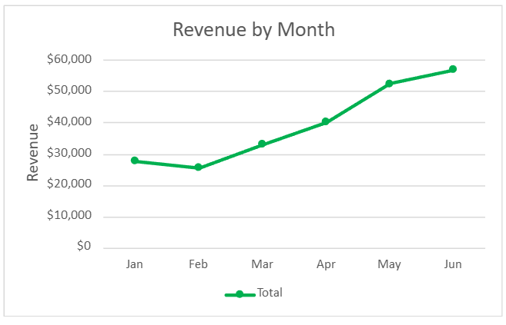
Results - Revenue by Month
Key Finding: Revenue is on a steady increase since February, peaking at the most recent data in the month of June. The franchises can use this to acknowledge that their business is generally doing well.
Excel Project – Slide 7

Slide 8
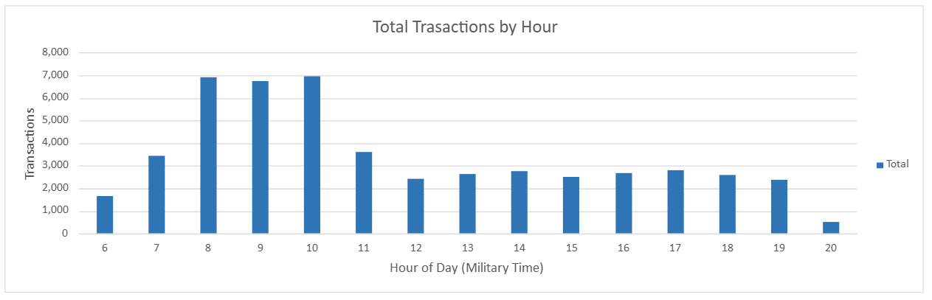
Results - Transactions by Hour
Excel Project – Slide 8
Key Finding: The standout most popular hours for customers is 7-10 am. Whilst, unsurprisingly, almost nobody gets coffee at 8 pm. This will be elaborated further next to optimize business hours.

Slide 9
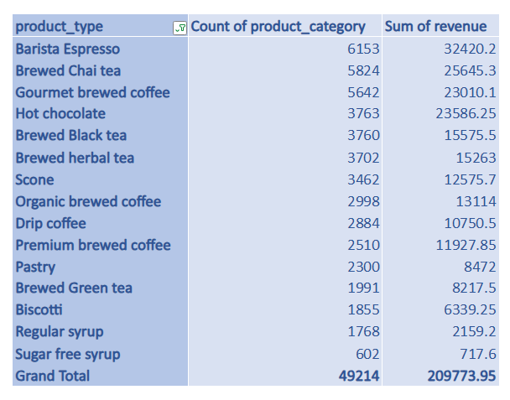
Results - Top 15 Product Categories
Key Finding: Sugar free syrup is the least common product type of the top 15. Barista Espresso takes in more revenue than Gourmet brewed coffee, despite having less transactional sales.
Excel Project – Slide 9

Slide 10
Discussion – Insight and Recommendations
One key insight from the top product types is that scones, premium brewers coffee, and pastries are highly lucrative, even with fewer sales. This highlights the importance of maintaining brand loyalty to support these price-sensitive products and potentially boost their sales. Another crucial insight is the steady revenue growth since February, peaking in June. This consistent trend across all franchises indicates effective overall marketing by the parent company and underscores the importance of this metric in measuring business success.
Excel Project – Slide 10

Slide 11
Discussion – Insight and Recommendations
Another notable observation is that the Astoria Manhattan location has no sales at 8 PM, likely because it closes at 7 PM. This decision may be justified, as the data shows that 8 PM sales are rare, suggesting it could be more economical to close earlier and avoid extra wage costs. Closing before 8 PM could help all franchises save on wage costs just like the Astoria location, strategy will improve profitability by saving on things like wage costs.
Excel Project – Slide 11

Slide 12
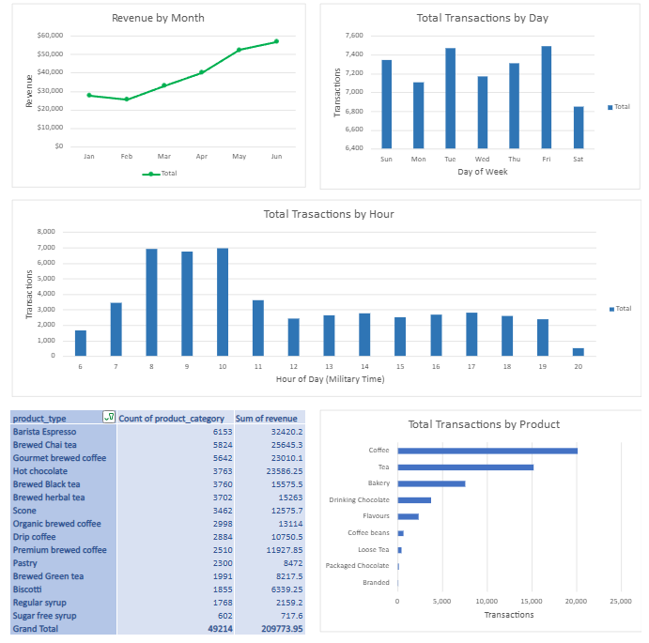
Conclusion
The project successfully utilized the collected data on the Maven Roasters franchises’ sales to create a dashboard of useful insights and analysis based on relationships of relevant data from the set. I recommend closing at 8 PM to cut costs, continuing with the successful marketing strategy, and prioritizing brand loyalty and public relations to sustain or boost sales. The dashboard offers many more insights and recommendations to support these strategies.
Excel Project – Slide 12

Slide 13
Project Q&A
Q: How many transactions data entries were taken?
Q: Where can I access the project dashboard?
Q: What tools were utilized?
A: 149117 transaction entries were taken over the six months
A: You can access the project dashboard in the project repo under the name dashboard.xlsx
A: Microsoft Excel and Google were the tools utilized for this project
Excel Project – Slide 13

Slide 14
Works Cited
Analytics, Maven. “Data Analyst Portfolio Project: Build an Excel Dashboard.” YouTube, YouTube, www.youtube.com/watch?v=OMFlZ6PI6Sk&t=207s. Accessed 16 Oct. 2024.
“How to Apply a Formula to an Entire Column in Excel.” Indeed.com, Indeed Editorial Team, www.indeed.com/career-advice/career-development/apply-formula-to-an-entire-column-in-excel. Accessed 14 Oct. 2024.
Excel Project – Slide 14

